Slide 1


See, Think, Wonder
Vaping

Slide 2
Discuss the following images and answer the following three questions:
What do you see?
What do you think?
What do you wonder?

Slide 3
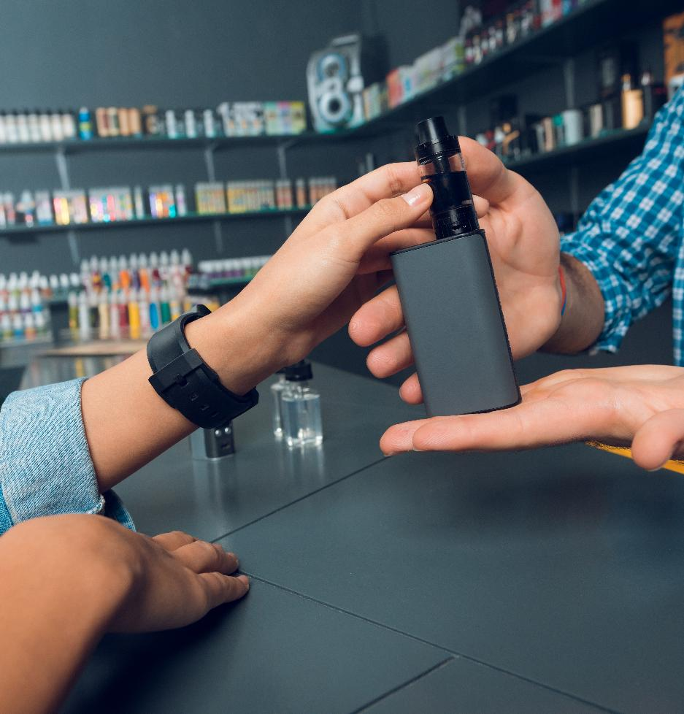

DRAFT
Vaping devices should not be used by children and young people. It is illegal for adults to buy (or try to buy) vaping devices for anyone under 18. This is known as ‘proxy purchase’.
Fines can be issued to retailers and individuals breaking the law.

Slide 4

Switching completely from smoking to vaping significantly reduces health harm for smokers who are unable or unwilling to quit. Unlike cigarettes, there is no combustion (burning) involved in vaping devices, so there is no smoke and no other harmful products of combustion, such as tar and carbon monoxide.
Vapes do not contain the tar, carbon monoxide and other products that cause many smoking-related illnesses, so they are safer than smoking.
However, vapes do contain toxic substances and most vapes also contain nicotine, which can lead to addiction.
This mother may be using a vaping device
to stop smoking.

Slide 5
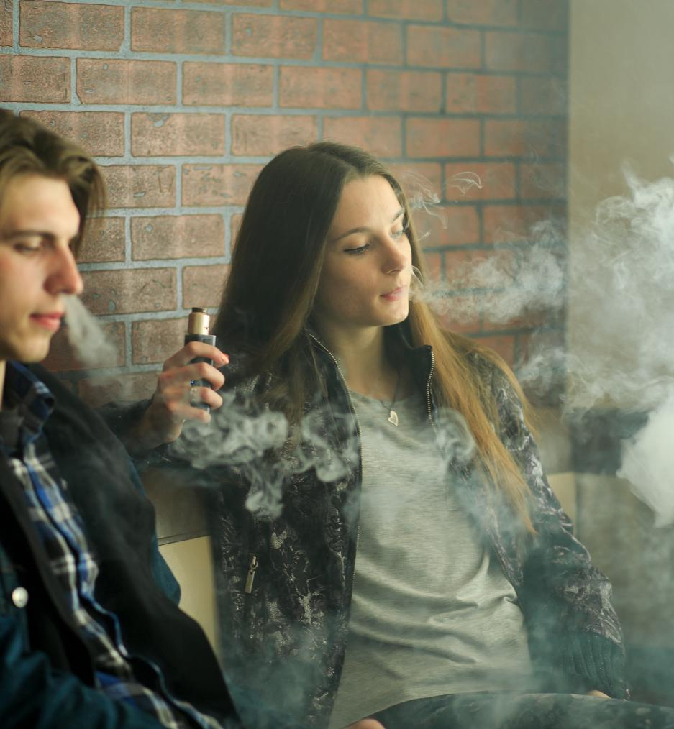
Germs can live almost everywhere. When vapes are used by more than one person germs can spread between them. Multiple viruses such as Flu, the common cold and the herpes virus (which causes cold sores) is present in saliva and so can be passed between people by sharing vapes. It is sensible hygiene advice not to share vapes or to use vapes discarded by others.
It is sensible hygiene advice not to share vapes.

Slide 6
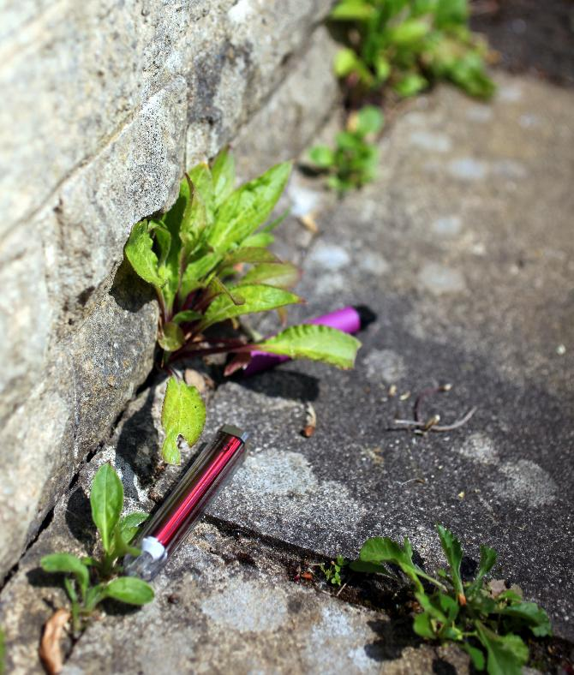
Disposable (single-use) vapes were once widely used by young people and cheaply available.
Since 1 June 2025, the sale and supply of single-use disposable vapes has been banned across the UK, including Wales.
These devices contain plastics, metals and lithium-ion batteries which are difficult to recycle and often end up as waste.
Millions of these devices were discarded each week before the ban — for example nearly 5 million per week in the UK.
Reusable vapes (rechargeable, refillable with replaceable coils) remain legal — and these are now the only legal option for new purchases.
(Sources: ASH 2023; UK Government 2024)

Slide 7
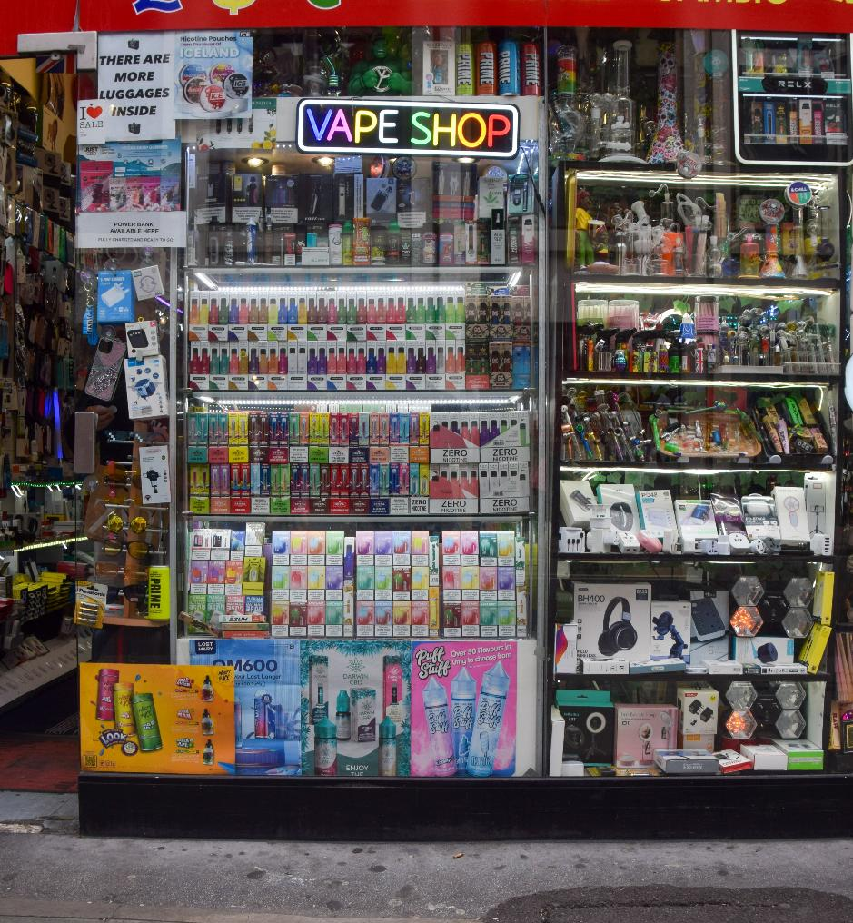
There are concerns about the marketing and promotion of vaping devices and how these may appeal to children and young people. For example, vaping devices may be offered in flavours and colours with packaging and designs (to look like a highlighter pen for example) that can be particularly attractive to young people.
Disposable (single-use) vapes were once cheap and easy to buy, but their sale is now banned across Wales and the wider UK.
However, the fact remains, vaping devices should not be used by children and young people.

