Slide 1
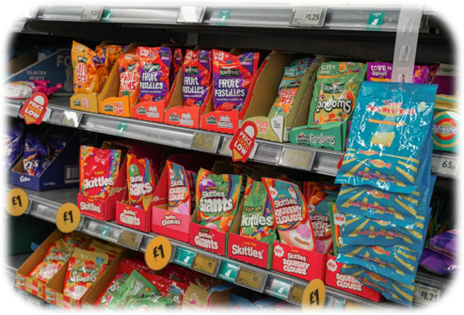
What's in this?
This activity links to the following Knowledge Banks:
What is a healthy, balanced diet?
The law and regulations
Food labels
Where food comes from
This activity explores considered decision making and promotes questioning on the ingredients of pre-packed foods.
Possible Health and Well-being descriptions of learning:
Progression step 1 I am beginning to make connections between my diet and my physical health and well-being. | Progression step 2 I have developed an understanding that I need a balanced diet and I can make informed choices about the food I eat and prepare to support my physical health and well-being. | Progression step 3 I can explain the importance of a balanced diet and nutrition and the impact my choices have on my physical health and well-being. I can plan and prepare basic, nutritious meals. | Progression step 4 I can apply my knowledge and understanding of a balanced diet and nutrition to make choices which will allow me to maintain my physical health and well-being. I can plan and prepare a variety of nutritious meals. | Progression step 5 I can adjust my diet in response to different contexts and apply my knowledge and understanding of a balanced diet and nutrition to support others. I can apply a range of techniques to prepare a variety of nutritious meals.

Slide 2
This information will be helpful when discussing the following slides.
Pre-packed food products must have a list of ingredients with allergens highlighted on the packaging or an attached label.
The ingredients list can also help you work out how healthy or how processed the product is.
Ingredients must be listed in descending order of weight, so the main ingredients in the packaged food always come first.
That means that if the first few ingredients are high-fat ingredients, such as cream, butter or oil, then the food in question is likely to be a high-fat food.
If there are a long list of ingredients it is likely the food is ultra processed.
Check out 'The Law and Regulations' Knowledge Bank for more information on food labels
Check out the 'Where food comes from' Knowledge Bank for more information on food processing
Food labels - NHS (www.nhs.uk)

Slide 3

Questions for Discussion:
Which ingredients do you recognise?
Use these questions when discussing the information and questions on the following slides.
What is the role of each ingredient? Is this clear?
Are there any you've never heard of?​​
How many ingredients are in each product?
What does this indicate?
Food labels - NHS (www.nhs.uk)

Slide 4
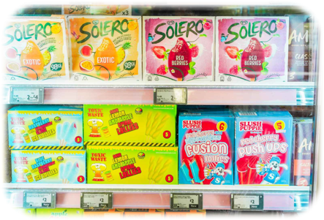
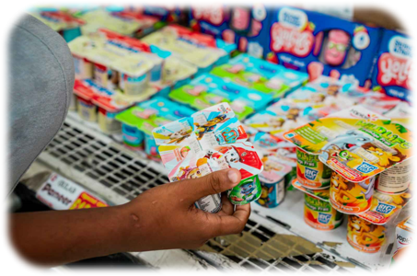
Look at the Following Images
Discuss the ingredients you think are included in these products.

Slide 5
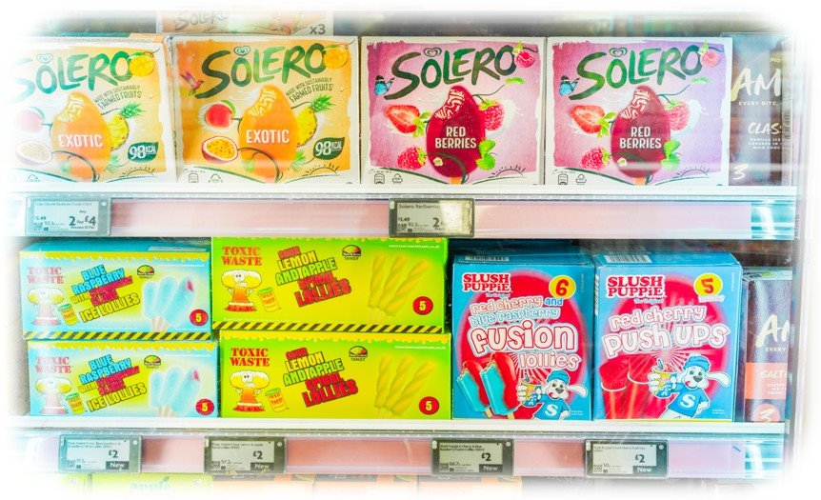
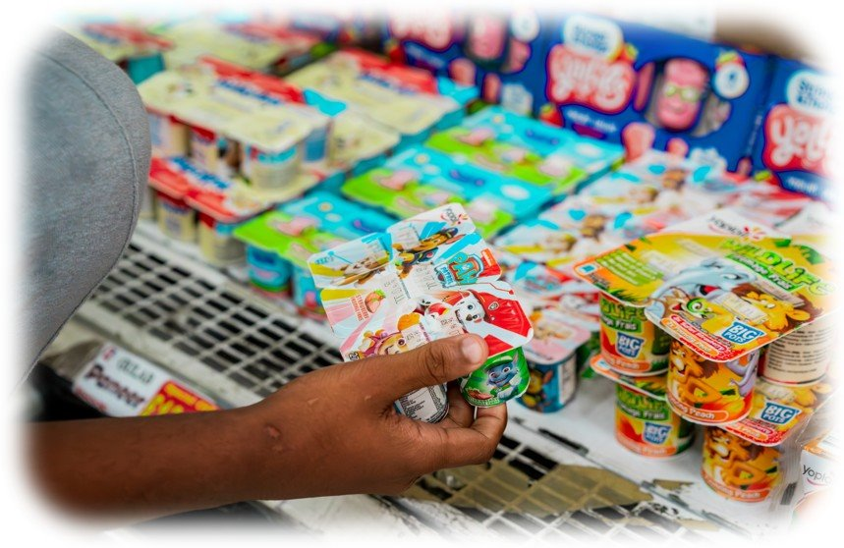
Actual Ingredients:
Solero Exotic Ice Cream 90ml
Reconstituted skimmed MILK, water, pineapple juice from concentrate (8.5%), glucose syrup, fructose, peach puree (6.5%), mango puree (6%), passion fruit juice (6%), sugar, coconut fat, soluble fibre, whey solids (MILK), colour (carotenes), stabilisers (guar gum, locust bean gum, tara gum), emulsifier (mono- and diglycerides of fatty acids), acidity regulator (citric acid), natural vanilla flavouring.
Paw Patrol Strawberry Yogurt Pots 45g
Water, Strawberry Puree from Concentrate 5%, Maize Starch, Vitamin D, Natural Flavourings (Milk), Lemon Juice from Concentrate, Sugar 6.8%, Carrot Juice from Concentrate, Fromage Frais (Pasteurised Semi-Skimmed Milk, Cream (Milk), Lactic Cultures (Milk).

Slide 6
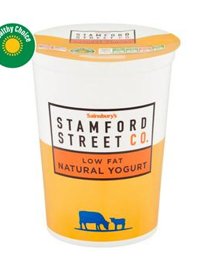
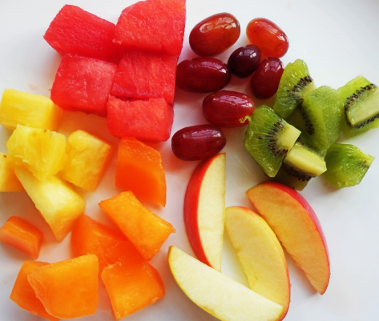
What's in This?
What do you think about these ingredients?
How many of the ingredients do you think give the product a sweet taste?
What is the difference between the two products below?
Solero Exotic Ice Cream 90ml
INGREDIENTS: Reconstituted skimmed MILK, water, pineapple juice from concentrate (8.5%), glucose syrup, fructose, peach puree (6.5%), mango puree (6%), passion fruit juice (6%), sugar, coconut fat, soluble fibre, whey solids (MILK), colour (carotenes), stabilisers (guar gum, locust bean gum, tara gum), emulsifier (mono- and diglycerides of fatty acids), acidity regulator (citric acid), natural vanilla flavouring.
Natural Yoghurt
INGREDIENTS: Low Fat Natural Yogurt (Cows' Milk).
Fruit

Slide 7
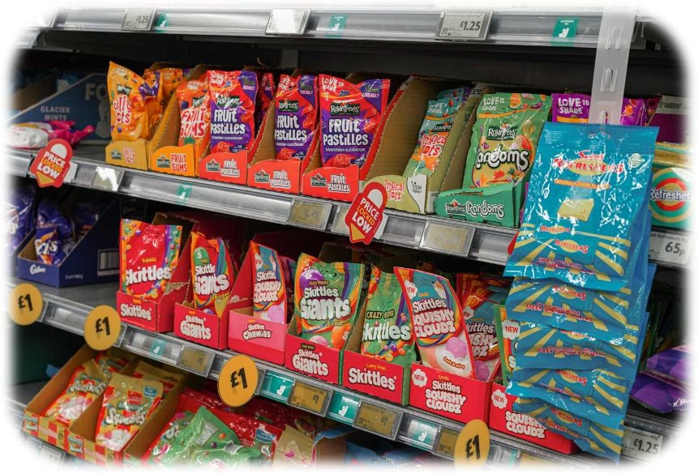
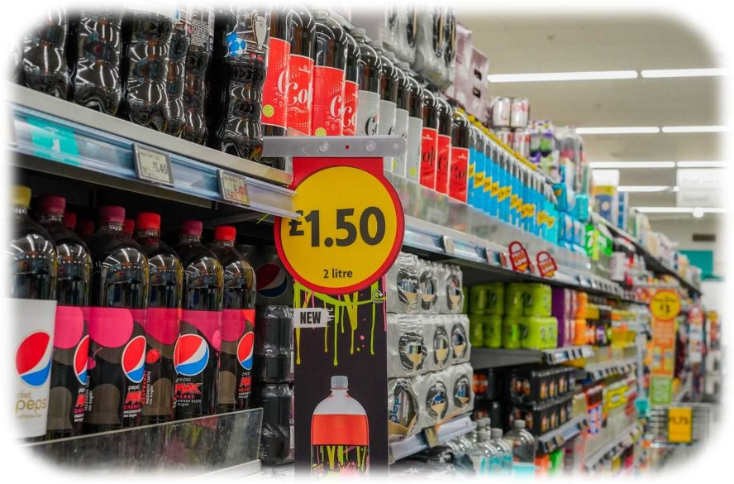
Look at the Following Images
Discuss the ingredients you think are included in these products.

Slide 8
Actual Ingredients:
Fruits Skittle Giants 132g
Sugar, Glucose Syrup, Palm Fat, Acid (Malic Acid), Dextrin, Modified Starch, Flavourings, Maltodextrin, Colours (E162, E163, E160a, E170, E100, E153, E133), Acid (Citric Acid), Acidity Regulator (Trisodium Citrate), Glazing Agent (Carnauba Wax), Emulsifier (Lecithin).
Pepsi Max Cherry No Sugar Cola 2L
Carbonated Water, Colour (E150d), Sweeteners (Aspartame, Acesulfame K), Flavourings (including Caffeine), Acids (Phosphoric Acid, Citric Acid), Preservative (Potassium Sorbate)., Preservative (Potassium Sorbate). Contains a Source of Phenylalanine.

Slide 9
Check out this link to find out more about some of the ingredients: https://www.food.gov.uk/safety-hygiene/food-additives
What's in This?
Take a closer look at some of the ingredients listed below. What do you think about these ingredients?
Do you know what they all are?
What type of ingredients come first on the list?
Do you think the energy you get from these ingredients would last a long time or would we want to keep coming back for more?
Fruits Skittle Giants 132g
Sugar, Glucose Syrup, Palm Fat, Acid (Malic Acid), Dextrin, Modified Starch, Flavourings, Maltodextrin, Colours (E162, E163, E160a, E170, E100, E153, E133), Acid (Citric Acid), Acidity Regulator (Trisodium Citrate), Glazing Agent (Carnauba Wax), Emulsifier (Lecithin).

Slide 10
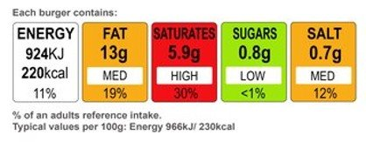
Some front-of-pack nutrition labels use red, amber and green colour coding.
Colour-coded nutritional information tells you at a glance if the food has high, medium or low amounts of fat, saturated fat, sugars and salt:
Red = high
Amber = medium
Green = low
In general, a food or drink that has all or mostly green on the label is a healthier choice.
Any red on the label means the food is high in fat, saturated fat, salt and/or sugars, and you should consume these less often and in small amounts.
This traffic light label is for one burger and is based on the amount of energy an adult needs in a day. What do you think about the way this information is presented?
Food labels - NHS (www.nhs.uk)

Slide 11
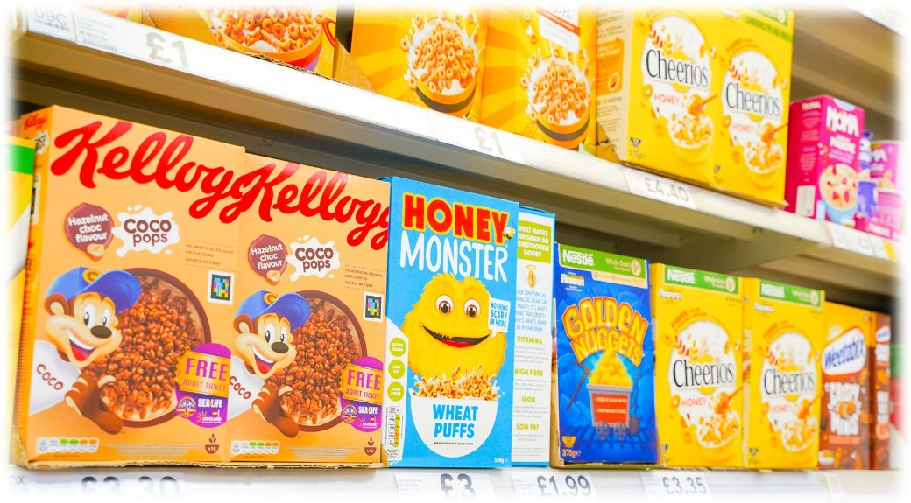
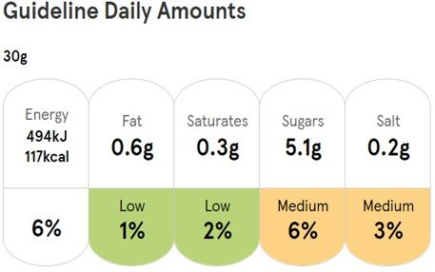
Look at the Following Image
Discuss the ingredients you think are included in these products and the front of pack nutrition label.

Slide 12
Actual Ingredients:
Kellogg's Coco Pops Choc Hazelnut Flavour
Cereal 480g
Rice, Sugar, Glucose Syrup, Fat Reduced Cocoa Powder, Barley Malt Extract, Cocoa Mass, Salt, Natural Flavourings, Niacin, Iron, Vitamin B6, Riboflavin, Thiamin, Folic Acid, Vitamin D, Vitamin B12
Honey Monster Wheat Puffs Cereal 520G
Wheat (60%), Glucose Syrup, Sugar (14%), Honey (3.6%), Soluble Gluco Fibre, Stabiliser (Calcium Carbonate), Caramelised Sugar Syrup, Sunflower Oil, Vitamins and Minerals (Iron, Niacin (B3), Riboflavin (B2), Thiamin (B1), Vitamin D)sorbate). Contains a Source of Phenylalanine.

Slide 13
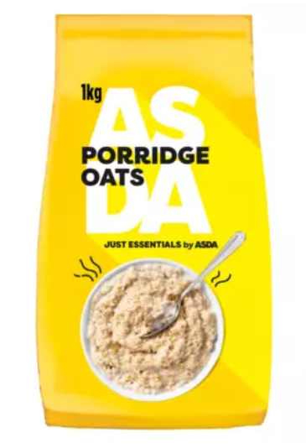
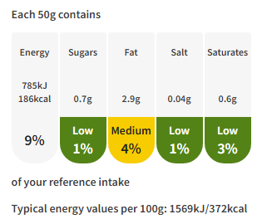
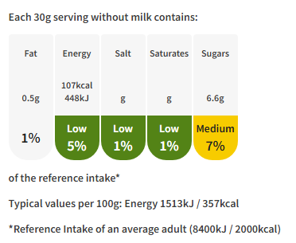
What's in This?
Take a closer look at some of the ingredients listed in the products below.
Why are some ingredients in bold?
Has anything been added to these products to make them seem healthier?
How many different types of sugar can you spot?
Is the front-of-pack nutrition label helpful? How big do you think your servings would be from these cereals?
What are the differences between the two products below?
Honey Monster Wheat Puffs Cereal 520G
INGREDIENTS: Wheat (60%), Glucose Syrup, Sugar (14%), Honey (3.6%), Soluble Gluco Fibre, Stabiliser (Calcium Carbonate), Caramelised Sugar Syrup, Sunflower Oil, Vitamins and Minerals (Iron, Niacin (B3), Riboflavin (B2), Thiamin (B1), Vitamin D)
Porridge oats
INGREDIENTS: Rolled oats

Slide 14
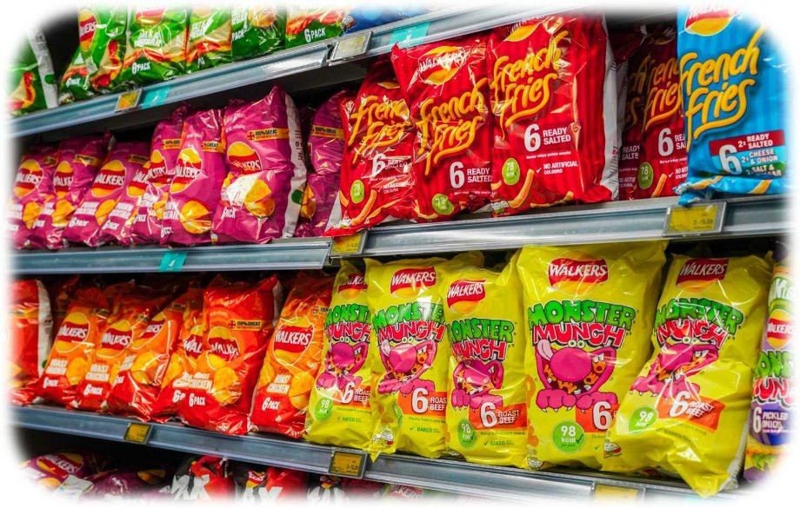
Look at the Following Image
Discuss the ingredients you think are included in these products.

Slide 15
Actual Ingredients:
Walkers Monster Munch
Pickled OnionMaize, Rapeseed Oil, Pickled Onion Seasoning [Flavourings, Whey Permeate (from MILK), Onion Powder, Sugar, Flavour Enhancers (Monosodium Glutamate, Disodium 5-Ribonucleotide), Salt, Potassium Chloride, Garlic Powder, Hydrolysed SOYA Protein, Acid (Citric acid), Spices] [WHEAT Flour (contains Calcium, Iron, Niacin, Thiamin), Hydrolysed SOYA Protein, Whey Permeate (from MILK), Flavourings, Rusk (from WHEAT), Sugar, Flavour Enhancers (Monosodium Glutamate, Disodium 5-Ribonucleotides), Onion Powder, Salt, Garlic Powder, Colour (Ammonia Caramel), Spices]Flamin' HotMaize, Rapeseed Oil, [Flavourings (contains SOYA, MILK), Lactose (from MILK), Hydrolysed SOYA Protein, Fructose, Flavour Enhancers (Monosodium Glutamate, Disodium 5'Ribonucleotide), Sugar, Onion Powder, Potassium Chloride, Salt, Acids (Citric Acid, Malic Acid), Spice, Colours (Sulphite Ammonia Caramel, Paprika Extract, Curcumin), WHEAT Rusk]
Walkers French Fries Ready Salted
Potato Granules, Potato Starch, Sunflower Oil, Salt, Flavour Enhancer
(Monosodium Glutamate), Colour (Annatto Norbixin)

Slide 16
What's in This?
Take a closer look at some of the ingredients listed below.
What vegetable might you expect to see in crisps?
Do you think the ingredients are nutritious?
Would the ingredients help our bodies fight off a cold?
Do you think this combination of ingredients would make a product
tastier?
Walkers Monster Munch
Pickled OnionMaize, Rapeseed Oil, Pickled Onion Seasoning [Flavourings, Whey Permeate (from MILK), Onion Powder, Sugar, Flavour Enhancers (Monosodium Glutamate, Disodium 5-Ribonucleotide), Salt, Potassium Chloride, Garlic Powder, Hydrolysed SOYA Protein, Acid (Citric acid), Spices] [WHEAT Flour (contains Calcium, Iron, Niacin, Thiamin), Hydrolysed SOYA Protein, Whey Permeate (from MILK), Flavourings, Rusk (from WHEAT), Sugar, Flavour Enhancers (Monosodium Glutamate, Disodium 5-Ribonucleotides), Onion Powder, Salt, Garlic Powder, Colour (Ammonia Caramel), Spices]Flamin' HotMaize, Rapeseed Oil, [Flavourings (contains SOYA, MILK), Lactose (from MILK), Hydrolysed SOYA Protein, Fructose, Flavour Enhancers (Monosodium Glutamate, Disodium 5'Ribonucleotide), Sugar, Onion Powder, Potassium Chloride, Salt, Acids (Citric Acid, Malic Acid), Spice, Colours (Sulphite Ammonia Caramel, Paprika Extract, Curcumin), WHEAT Rusk]
Notes:
"Hyper-palatable" refers to foods engineered to have especially strong appeal due to high levels of sugar, fat, salt, and other additives. These foods are designed to be highly desirable and often stimulate the reward centers in the brain more intensely than naturally occurring foods. As a result, they can lead to overeating and contribute to obesity and other health issues. Examples of hyper-palatable foods include fast food, snacks like chips and cookies, sugary beverages, and many processed foods.

Slide 17
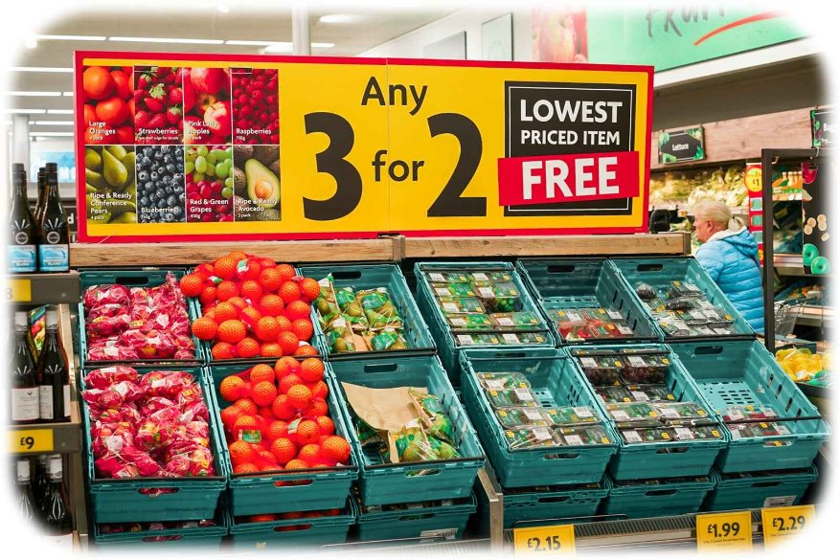
Look at the Following Image
Discuss the ingredients you think are included in these products.

Slide 18
Actual Ingredients:
Apples
Oranges
Pears
Grapes
Avocado
Strawberries
Blueberries

Slide 19
What's in This?
When foods aren't in their original form, we don’t always know what's been added or taken away.
We may not recognise some of the ingredients listed on some food labels which doesn't give us much information about what we're actually eating.
What we do know is that fruit, vegetables, wholegrains and other foods as recommended in the Eatwell Guide support our health and wellbeing.

Slide 20
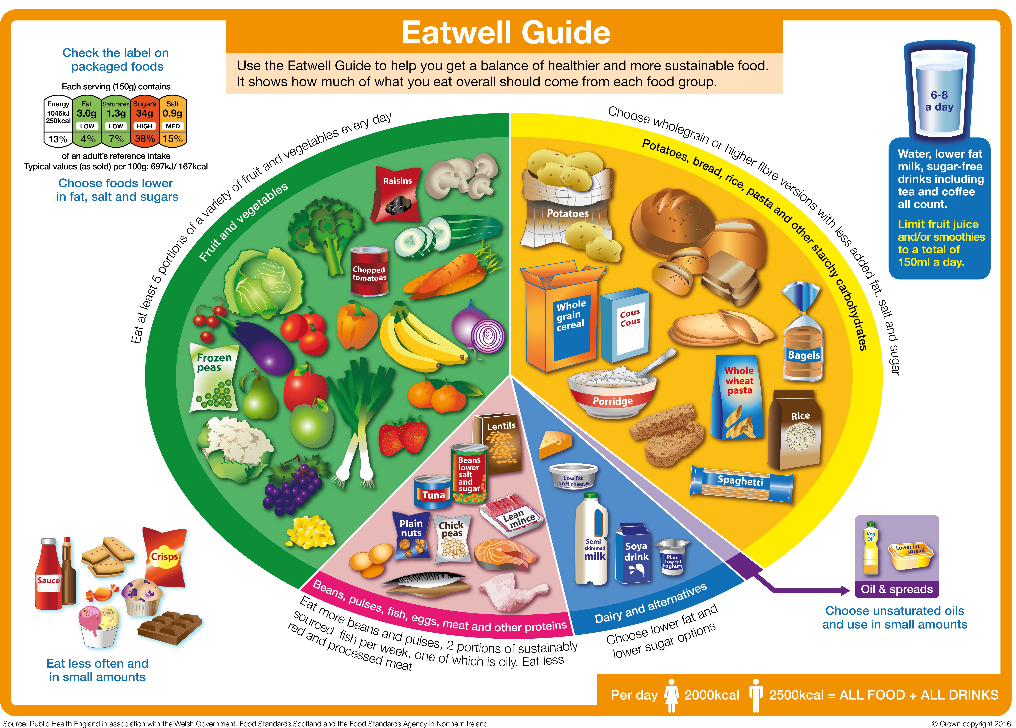
The main thing to remember is that eating too much food (and drinks) with lots of fat, saturated fat, salt and sugar isn't good for us.
It's important to check labels and compare different products. The labels can help us find out how much fat, salt and sugar are in the foods we eat, to help us to make healthier choices.
You may also come across the term ultra-processed foods (UPFs). These foods are typically high in saturated fat, salt and sugar, and low in fibre, vitamins and minerals.
The key is to eat a varied, balanced diet, like the Eatwell Guide suggests to support our health and wellbeing.
Eatwell guide | GOV.WALES

Slide 21
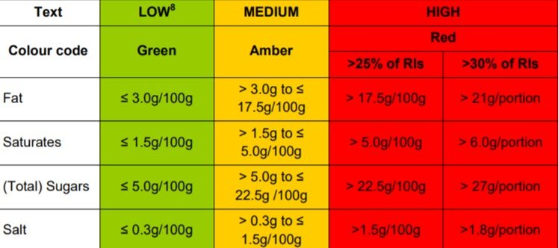
Further possible learning suggestions
Making meals more balanced
Learners to discuss which ingredients go into each section of the Eatwell Guide.
Which ingredients would you add to a meal you enjoy, in order to make the meal more balanced?
For example, could you add more vegetables, fruit, pulses or wholegrains?
Design a front of package label
Find your favourite food item online using a supermarkets website or your favourite recipe.
Using the nutrient information on the back of the packet or recipe, use the table to colour code the product for your traffic light label.
Take a moment to look at the colours on your traffic light, what do they mean? How could we make this better?

