Slide 1

Observe, Wonder, Infer
This activity links to the following Knowledge Banks:
Understanding gaming and gambling
The risks and harms of gaming and gambling
Supporting young people and families with gambling harms
This activity uses images and guided questions to provoke critical thinking about gambling.
Possible Health and Well-being descriptions of learning: Our decision-making impacts on the quality of our lives and the lives of others.
Progression step 1 I have developed an awareness that my decisions can affect me and others. | Progression step 2 I can recognise that my decisions can impact on me and others, both now and in the future. | Progression step 3 I can recognise that some decisions I make will have a long-term impact on my life and the lives of others. | Progression step 4 I can consider relevant factors and implications when making decisions individually and collectively. | Progression step 5 I can critically evaluate factors and implications, including risks, when making decisions individually and collectively.

Slide 2
Gambling industries often use eye‑catching ads, bright colours, exciting language and game‑like designs to draw in young people and make gambling seem fun, easy and harmless. These techniques are carefully chosen to create a sense of excitement and possibility, encouraging young people to see gambling as entertainment rather than something harmful.
We can observe how different forms of gambling rely on bold visuals and targeted messages to grab attention. The bright colourful designs, upbeat sounds and phrases like “Win Big” make the games seem exciting and full of potential rewards. These features make the games look simple and appealing, especially to children and young people who may not notice how rarely people actually win.
As we start to wonder about these images and messages - we begin to see patterns. We might question how the game works, whether people really win often or why the ads focus so much on excitement rather than the risks. These questions help us understand how gambling appeals to emotions like curiosity, hope and thrill, while avoiding any mention of financial loss or addictive behaviour.
By inferring what the creators want us to feel or do, it becomes clear that these ads are designed to make gambling look exciting and full of potential rewards, while hiding the real dangers like financial loss and addictive behaviour. Understanding these techniques helps young people avoid being misled by messages that make winning look easy or guaranteed.

Slide 3
Discuss the following images and answer the following three questions:
What do you observe?
What do you wonder?
What do you infer?

Slide 4
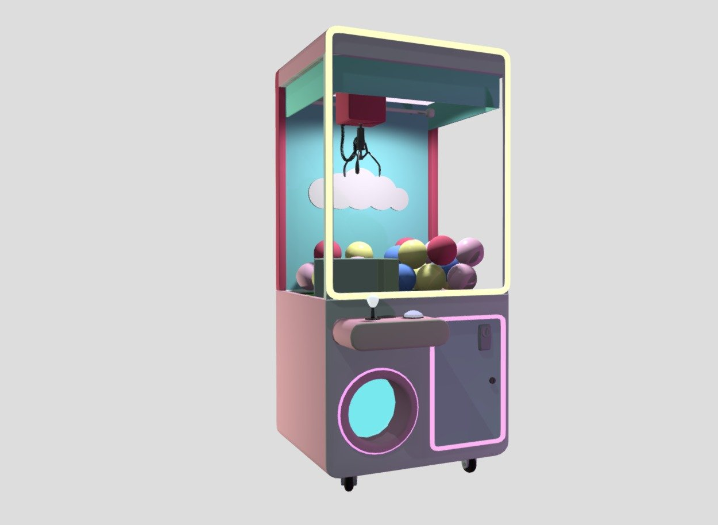
Observe | Wonder | Infer
Flashing lights, upbeat sounds Plush toys or gadgets displayed prominently Claw looks flimsy or weak | How often the machine is programmed to actually grip strongly Whether the prizes are intentionally arranged to look easy to grab How much money people spend before winning | The machine likely uses variable‑strength mechanics to limit wins The environment is designed to create a sense of skill even though the game is all about chance It taps into “just one more try” behaviour similar to gambling reinforcement loops

Slide 5
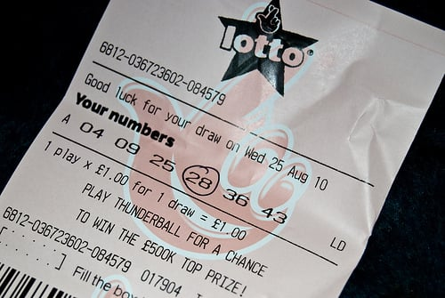
Observe | Wonder | Infer
The National Lottery logo and the draw date A grid of numbers or a Lucky Dip option Words like “WIN BIG TONIGHT” or “£X MILLION JACKPOT” Very small print explaining the odds and rules The ticket looks simple and quick to buy | How many people actually win the jackpot Why the ticket is designed to look exciting and urgent How much money people spend each week How often players choose numbers based on birthdays or patterns How much the lottery earns compared to how much it pays out | The ticket is designed to trigger excitement and “near‑miss” anticipation The odds are likely very low, but the design shifts attention away from that The lottery relies on people overestimating their chances and buying tickets every week

Slide 6
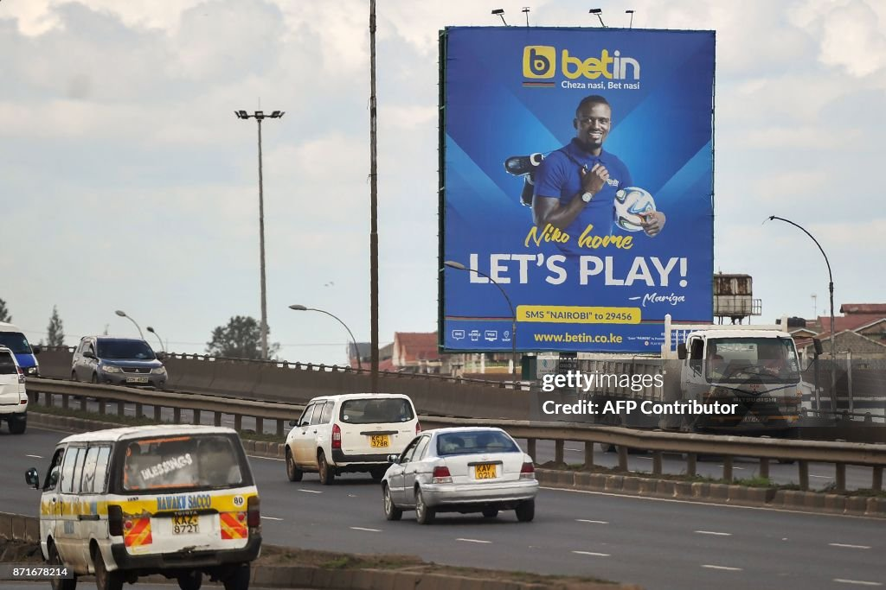
Observe | Wonder | Infer
Images of happy, excited fans Phrases like “Bet Now” or “Boosted Odds” No mention of risks or losses | How many people lose money compared to those who win Why the ad focuses on excitement rather than outcomes Whether the target audience is young adults | The billboard is crafted to associate betting with community, fun and belonging It leaves out the fact that the odds are stacked against the people who bet It normalises gambling as part of sports culture

Slide 7
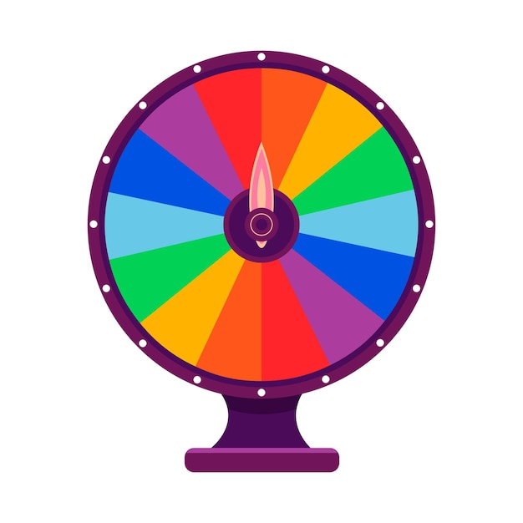
Observe | Wonder | Infer
A colourful wheel with prizes A countdown timer or flashing “FREE SPIN” button Rewards that look valuable but are usually in‑game currency | Whether the spin is actually random Why the game interrupts play to offer this How often players are nudged toward spending money after spinning | It’s designed to copy how slot machines keep people playing It keeps players engaged and increases the chance they’ll make in‑app purchases The “free” spin is a hook to build a habit loop

Slide 8

Observe | Wonder | Infer
Excited fans, winning moments, bright colours Phrases like “Boost your odds”, “Bet now”, “Join today” No mention of losses or risks | How many people actually win compared to those who lose Why the ad focuses on celebration rather than outcomes Whether the ad is targeting young adults or sports fans specifically | The ad is crafted to link betting with belonging, excitement and team loyalty It intentionally avoids discussing the statistical disadvantage to bettors It normalises gambling as part of watching sports

Slide 9
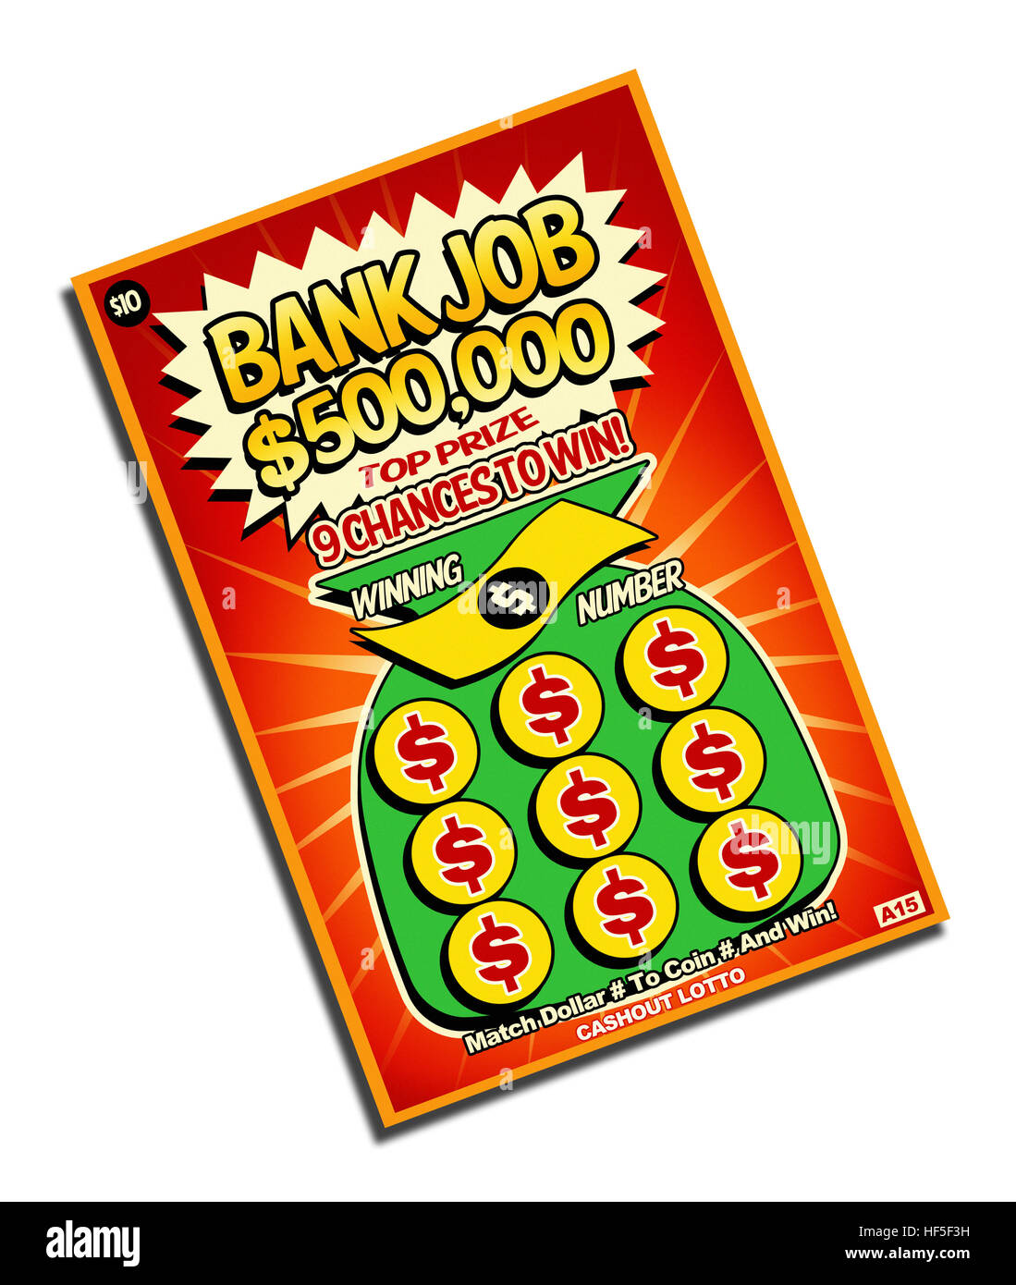
Observe | Wonder | Infer
Shiny foil, bright colours, large prize numbers Small print about odds Cheap price point | How often people win more than they spend Why the design is so visually stimulating Whether the “near‑miss” effect is intentional | The ticket is designed to trigger anticipation and impulse buying The low cost makes it feel harmless even though losses add up The visual design shifts attention away from the low probability of winning

Slide 10
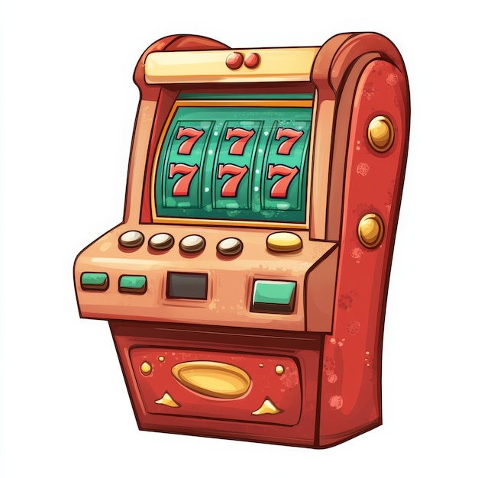
Observe | Wonder | Infer
Flashing lights, spinning reels, upbeat sounds Themes (fruits, adventure, mythology, TV shows) “Big win” animations even for small payouts | Whether the machine is programmed to show near‑wins How often players actually come out ahead Why the environment is so loud and stimulating | Slot machines use variable‑reward schedules to keep players engaged The sensory design (lights, sounds, animations) reinforces continued play The machine is built to make losses feel less noticeable and wins feel huge

Slide 11

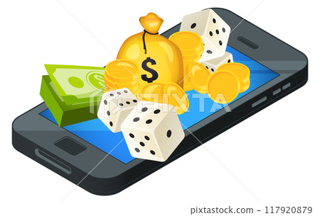
Observe | Wonder | Infer
Bright buttons, quick animations, easy “tap to play” mechanics Daily bonuses, free spins or streak rewards In‑app currency that hides the real cost | Whether the odds are transparent or hidden How the app nudges players toward spending real money Why the app feels so quick and easy to use, like nothing gets in your way | The design mimics casino reinforcement loops but in a more accessible form Virtual currency makes spending feel less real The app is built to maximise engagement and encourage repeated play

Slide 12
One thing I observed today was…
One question I still have is…
One inference I made was…

Slide 13
Further possible learning suggestions
Analyse Emotional Targeting
Understanding how emotional manipulation influences decision‑making.
Learners identify what emotions each product tries to trigger.
Examples:
Excitement
FOMO
Hope
Belonging
Urgency
Explore the Math Behind the Marketing
Seeing the gap between perceived chance and actual probability.
After observing and wondering, learners calculate or estimate:
Odds of winning
Expected value
How small losses add up over time
Investigate “Near‑Miss” Design
Show examples of near‑misses in scratch cards, slots or mobile games.
Learning focus:
Why near‑misses feel like “almost winning”
How this keeps people playing even when losing
How designers intentionally use this effect
Map Out a Player’s Journey
Understanding how gambling harm develops gradually, not suddenly.
Learners create a flowchart of how someone might go from:
curiosity → first try → excitement → repeated play → potential harm

Slide 14
Gambling Support Services in Wales
All Wales Gambling Treatment Service and 24/7 Helpline 0808 281 9265 ​
Referrals are welcome from any individual or professionals to the Treatment Service.​
Email: GamblingService@wales.nhs.uk​
​
GambleAware ​
www.gambleaware.org​
​
NHS National Centre for Gaming Disorders (London) ​
Specialist treatment for gaming disorder for those aged 13 and over. Online access from Wales. ​
www.cnwl.nhs.uk/national-centre-gaming-disorders ​
​
*Please note that the support services listed may be subject to change as commissioning arrangements are updated.

