Slide 1

Always, Sometimes, Never
This activity links to the following Knowledge Banks:
What is a healthy balanced diet?
Industry, Marketing and Advertising
This activity offers thought‑provoking statements that encourage learners to discuss, debate and reflect on food preparation and food choices.
Possible Health and Well-being descriptions of learning:
Progression step 1 I am beginning to make connections between my diet and my physical health and well-being. | Progression step 2 I have developed an understanding that I need a balanced diet and I can make informed choices about the food I eat and prepare to support my physical health and well-being. | Progression step 3 I can explain the importance of a balanced diet and nutrition and the impact my choices have on my physical health and well-being. I can plan and prepare basic, nutritious meals. | Progression step 4 I can apply my knowledge and understanding of a balanced diet and nutrition to make choices which will allow me to maintain my physical health and well-being. I can plan and prepare a variety of nutritious meals. | Progression step 5 I can adjust my diet in response to different contexts and apply my knowledge and understanding of a balanced diet and nutrition to support others. I can apply a range of techniques to prepare a variety of nutritious meals.

Slide 2

Consider and Discuss the Three Statements on Each Slide
Which of these statements do you think you should do:
Always
Sometimes
Never

Slide 3


Which of these statements do you think you should do:
Always
Sometimes
Never
Wash your hands to make sure that they are clean before preparing food or eating.
Wash raw chicken before cooking it to remove any bacteria.
Defrost food before cooking.

Slide 4
Always: Wash your hands to make sure that they are clean before preparing food or eating
Good hygiene means being clean and avoiding harmful germs. Hygiene is important when it comes to cooking and preparing food. If we eat food with germs in it, we might get ill. If you are cooking with raw ingredients, like meat, fish or eggs, you should always wash your hands after touching the raw product.
Sometimes: Defrost food before cooking
Some foods such as vegetables can be cooked straight from frozen, e.g. peas. But when cooking with meat such as mince or chicken, we must make sure it has been fully defrosted before using. It is important to follow the cooking instructions on the packet provided by the manufacturer.
Never: Wash raw chicken before cooking it to remove any bacteria
You shouldn't wash raw chicken because it can spread germs around the kitchen, which can make you sick. Cooking the chicken properly kills the germs. Some food such as fruits and vegetables should be cleaned before eating, especially if these aren't being cooked.

Slide 5
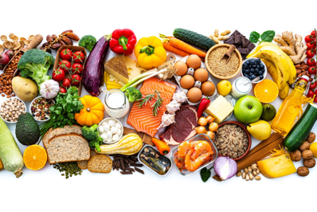
Which of these statements do you think you should do:
Always
Sometimes
Never
Choose foods simply because you like the taste, and you enjoy them.
Eat a variety of different foods from each of the groups to help you get the wide range of nutrients your body needs to stay healthy and work properly.
Restrict or stop eating certain food groups because you saw an influencer talk about it online.

Slide 6
Always: Eat a variety of different foods from each of the groups to help you get the wide range of nutrients your body needs to stay healthy and work properly.
The balance of what we eat is important because food provides our bodies with the nutrients it needs to grow and stay healthy.
Sometimes: Choose foods simply because you like the taste, and you enjoy them.
We all enjoy different foods, and your likes and dislikes are what make you unique! But for the foods that contain higher fats, sugars and salts we need to make sure we eat these less often and in smaller amounts.
Never: Restrict or stop eating certain food groups because you saw an influencer talk about it online.
The type of food (and drink) you eat now is important because it effects healthy growth and development. A healthy balanced diet can fuel the body for daily activities and help you feel at your best.

Slide 7
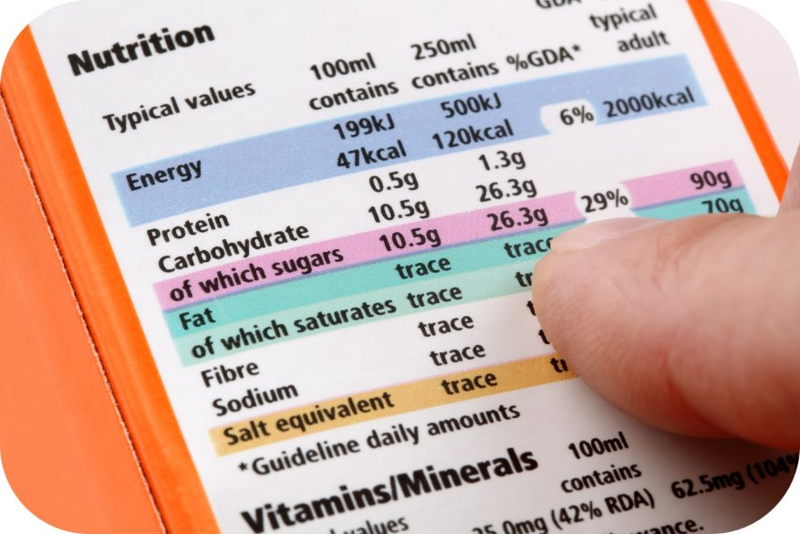
Which of these statements do you think you should do:
Always
Sometimes
Never
Buy food and drinks just because they are endorsed by your favourite influencer online.
Choose to buy branded products because you are worried about what others may think if you buy supermarket own.
Read food and drink labels and packaging before choosing to buy and consume it.

Slide 8
Always: Read food and drink labels and packaging before choosing to buy and consume it.
Knowing what is in the food and drinks you consume can help you make a more informed choice about the foods you're eating. It also tells us about the ingredients, nutrients, allergy information and the portion size.
Sometimes: Choose to buy branded products because you are worried about what others may think if you buy supermarket own.
Sometimes we might prefer the taste of top branded food, but let that be your choice to make. The food available around us and how much it costs can make it harder or easier to maintain a balanced diet because it influences what food and drink we can access and the choices we make. But the supermarket option tastes just as good, and supermarkets often work hard to make their own brands healthier to meet government reformulation targets.
Never: Buy food and drinks just because they are endorsed by your favourite influencer online.
Our food choices are often impacted by food marketing and advertising because the food and drinks industry want to persuade people to buy their products; however heavily marketed food is often high in fat, sugar and salt.

Slide 9
Further possible learning suggestions
Healthy Food Choices and Habits
List several food-related behaviours (e.g., "Eating vegetables every day," "Copying a diet you've seen by an online influencer," "Choosing snacks with added sugar"). Learners are to categorise each behavior as Always, Sometimes, or Never:
Examples:
"Eating vegetables every day":
Always: Vegetables provide essential nutrients and are key to a healthy diet.
Sometimes: For some individuals, dietary restrictions or preferences might limit daily vegetable intake, but alternatives can be considered.
Never: Not eating vegetables every day isn’t ideal and we should try to include fruit, vegetables and other nutrient dense foods daily.
"Skipping meals to lose weight":
Always: Check that the diet is balanced, science led and is right for you.
Sometimes: Some health and wellbeing influencers have great ideas for recipes and daily snacks, so they can provide us with inspiration.
Never: Don't follow a restrictive diet because you think it will make you be or look a certain way or because you want somebody's lifestyle. This could be damaging to your health and well-being and may not be suitable for your daily needs. Skipping meals regularly can lead to nutrient deficiencies and poor metabolism.

