Slide 1
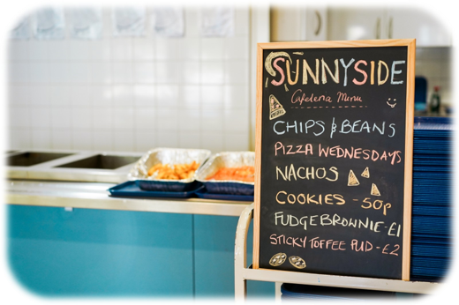
See, Think, Wonder
Food and Nutrition

Slide 2
These activities have been developed for use with both primary and secondary aged learners. They should be used flexibly and can be adapted to meet the identified needs of your learners within the context of your school or setting.
See, Think, Wonder: Industry, Marketing and Advertising Knowledge Bank
These activities provide images to provoke critical thinking and questioning about your food choices.
At the end of the activities are further possible learning suggestions.
Links to Statements of what matters
Health and Wellbeing: Developing physical health has lifelong benefits (health-promoting and health-harming behaviours)
Health and Wellbeing: Our decision-making impacts on the quality of our lives and the lives of others (making informed decisions)
Science and Technology: The world around us is full of living things which depend on each other for survival (an understanding of the factors which affect our health allows us to make informed decisions about our physical health)
Descriptions of learning (possible)
Progression step 1 I have developed an awareness that my decisions can affect me and others. | Progression step 2 I can recognise that my decisions can impact on me and others, both now and in the future. | Progression step 3 I can recognise that some decisions I make will have a long-term impact on my life and the lives of others. | Progression step 4 I can consider relevant factors and implications when making decisions individually and collectively. | Progression step 5 I can critically evaluate factors and implications, including risks, when making decisions individually and collectively.

Slide 3
Discuss the Following Images and Answer the Following Three Questions:
What Do You See?
What Do You Think?
What Do You Wonder?

Slide 4
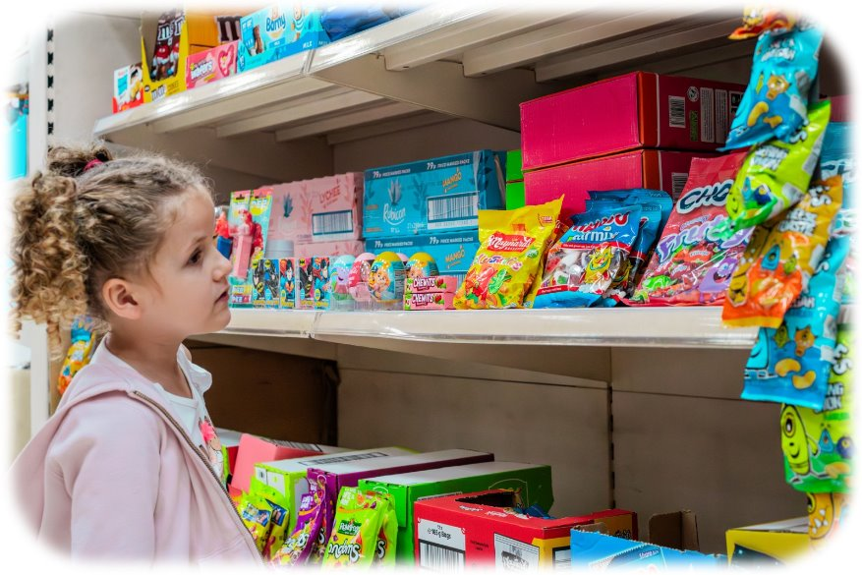

These sweets are displayed in a supermarket at the right height for a child to see them clearly and reach for them.
The packaging is colourful and appealing to children using fun characters and large logos.
Why do supermarkets choose to display products in this way?
Decisions about what people purchase are influenced by where products are placed.

Slide 5
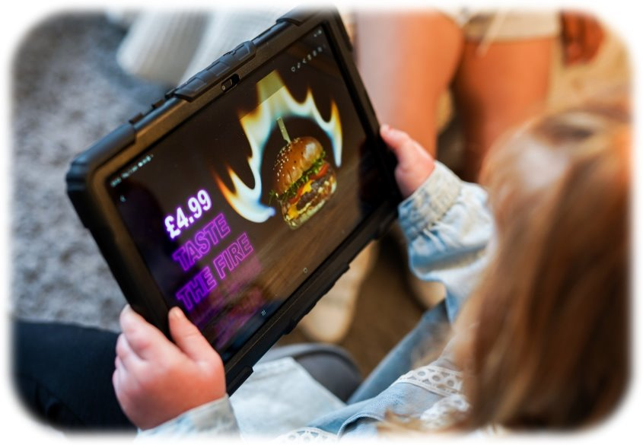
There are food advertising and marketing laws and regulations in place, but do these prevent children and young people from seeing these types of images online?
Advertisements such as this can influence children, young people and adults to choose their products.
Advertisements are designed to persuade people to choose and buy their products.

Slide 6
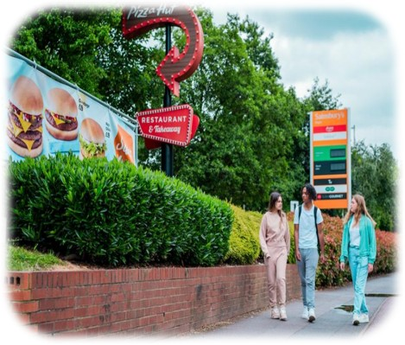
Fast food restaurants and take aways are designed to be low-cost, quick and convenient.
How many fast food places or take aways can you think of in your area?
How do you think this may compare to other areas in Wales?
Do these outlets help you make informed and balanced choices about what you eat?
Fast food is designed to encourage people to make quick and convenient choices about what they eat.

Slide 7
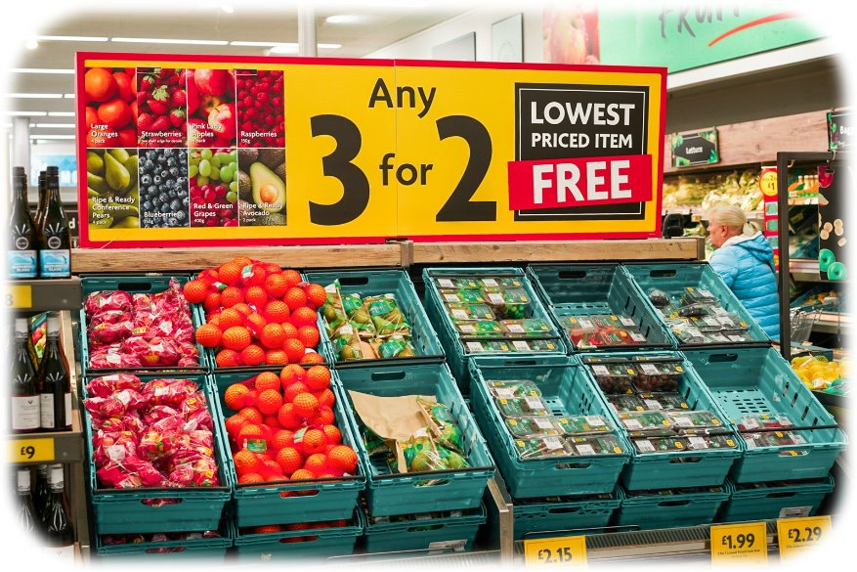
The price of fresh fruit and vegetables can be expensive compared with other food products.
Offers like this are intended to encourage shoppers to purchase these products which contribute to good overall health.
Do all food offers, such as 3 for 2 support you to make good choices that contribute to a healthy balanced diet?
Offers are designed to encourage consumers to buy products. These products can vary.

Slide 8
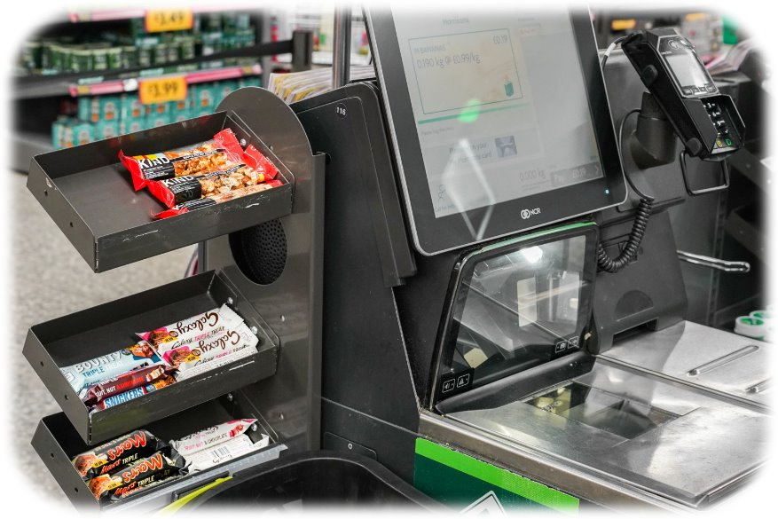
Often, our food choices can be influenced by what we see.
How many times have you picked up something extra when paying at a till in a shop? How much thought goes into this decision?
We can all be influenced by the products we see and how readily available they are.
GSTTF asset library (canto.global)

Slide 9
Further possible learning suggestions
Analysing Food Advertisements
Share a food advertisement (TV commercial, print ad or social media post). Apply the "See, Think, Wonder" framework:
  See: What elements do you notice in the advertisement? (e.g., colours, text, images, celebrities)
  Think: What message or idea is being conveyed? Why do you think the advertisement uses these specific strategies?
  Wonder: What questions or concerns do you have about the ad? Are there any assumptions made or messages that might be misleading?
Exploring Food Packaging
Share a variety of food packaging designs (e.g. healthy v junk food packaging). Apply the "See, Think, Wonder" framework:
See: What colours, logos or images are used? How do these elements differ between healthy and unhealthy food packaging?
Think: How do you think the packaging affects consumer perception of the food product?
Wonder: What questions do you have about the influence of packaging on food choices? Is there a way to make healthier food packaging more appealing?

Slide 10
Thank You For Listening

