Slide 1
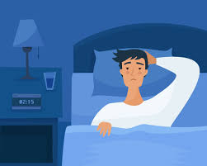
How does Sleep Impact Our Health and Wellbeing?

Slide 2
In this slide set, we’ll explore:
Introduction to Sleep and Wellbeing
The Powerful Link Between Sleep and Health
Sleep and Mental Wellbeing
Emotional Regulation and Mood
Stress, Anxiety and Depression
Cognitive Function and Sleep
Memory and Learning
Attention, Focus and Decision-Making
Reaction Times and Academic Impact
Sleep and Academic Success
Sleep Duration and Performance
Effects of Sleep Deprivation on Learning
Mental Health and Sleep
Depression and Sleep Disturbances
Emotional Resilience
Sleep and Physical Wellbeing
Immune System Support
Weight Management and Metabolism
Fatigue and Energy Regulation
Chronic Health Conditions and Sleep
Sleep and Long-Term Conditions (e.g., pain, respiratory, cardiovascular, neurological)
Strategies for Managing Sleep with Chronic Illness
Children and Sleep Inequality
Impact on Cognitive and Emotional Development
Health Disparities and Social Inequality

Slide 3

The Powerful Link Between Sleep and Health
Sleep is one of our most essential needs — just like food, water and air. Without enough of it, we struggle to learn, focus and feel good.
As we've touched upon before, according to Maslow’s Hierarchy of Needs, rest is a foundation for living a healthy, happy life. Feeling safe, building friendships, doing well in school - all of these depend on being well-rested.
Sleep helps our brain and body recharge, supports memory, learning and emotional well-being. It’s vital for both mental and physical health.

Slide 4
Sleep and our Mental Wellbeing
There is a strong relationship between the amount and quality of our sleep with our mental health and wellbeing. If we don’t get enough good quality sleep, then there is a greater risk of:
Experiencing more negative emotions and fewer positive emotions
Finding it difficult to regulate emotions
Depression and anxiety symptoms
People who aren’t getting enough good quality sleep may feel extremely tired, experience mood changes, stress, anxiety and irritability, have impaired thinking, memory, find it hard to make decisions and be less able to focus.
The following slides will explore how sleep affects our mental wellbeing in more detail.

Slide 5
The Connection Between Emotional Struggles and Poor Quality Sleep
Not enough sleep may result in a state of chronic stress. This can exacerbate how we regulate our emotions and make us more sensitive to stressful stimuli and events. In fact, good sleep appears to be essential to our ability to cope with emotional stress in everyday life.
A lack of sleep can stop us from thinking clearly and keeping our emotions at an even keel. Studies show that excessive sleepiness can:
Bring about mood changes
Cause emotional distress
Make focus and concentrating more difficult
All of which can lead to us experiencing negative emotions, impact work and school performance,
put a strain on relationships and lead to anger and depression.

Slide 6

How Poor Sleep Affects Cognitive Function
Sleep plays a critical role in memory consolidation and not obtaining enough sleep diminishes a wide variety of cognitive functions.
A lack of sleep can:
Slow down our thought processes – making it more difficult to focus and pay attention.
Impair our memory and judgement – causing an inability to concentrate and finish tasks.
Make learning difficult – In children, sleepiness can lead to hyperactivity, also hampering learning. Teens may lose the focus, diligence and memory capacity to perform well in school.
Slow down our reaction times – This can be a particular problem for tasks that need a quick response such as driving.

Slide 7
Sleep, Concentration and Academic Success
Sleep is essential for good concentration and academic success. Getting enough sleep helps with memory, focus, learning and managing emotions - things that are important for doing well in school. On the other hand, not getting enough sleep can make it harder to focus and learn, which can affect academic performance.
Key Connections:
Memory & Learning: Sleep consolidates memories, improving retention of information.
Attention & Focus: Adequate sleep enhances attention span, focus and cognitive control, crucial for academic tasks.
Cognitive Performance: Sleep boosts problem-solving abilities and critical thinking, aiding academic success.
Mood & Motivation: Well-rested learners experience better mood regulation and higher motivation for studies.
Impact of Sleep Deprivation:
Impairs memory, attention and decision-making
Leads to reduced concentration and fragmented thinking
Increases mood disturbances (e.g. anxiety, irritability)
Research Findings:​
Learners with 7-8 hours of sleep perform better academically.​
Sleep deprivation is linked to a decrease in academic performance.

Slide 8
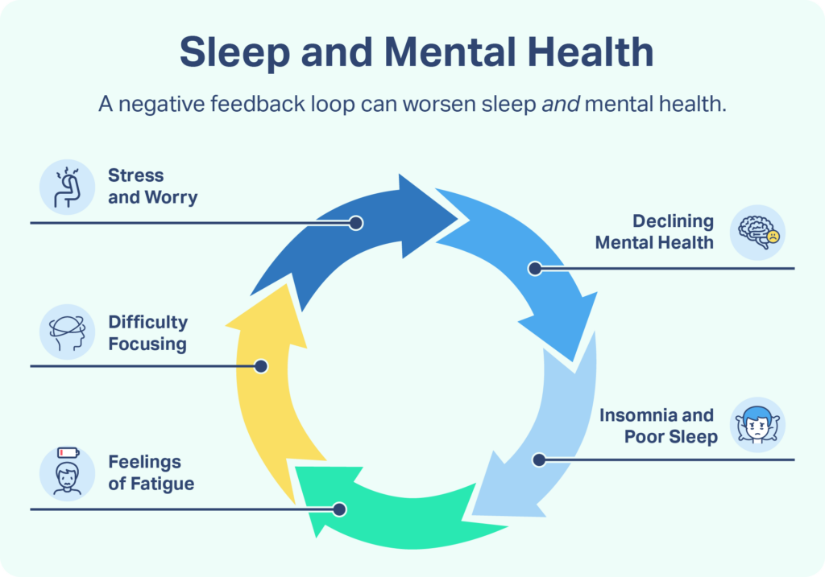
The Relationship Between Sleep and Mental Health
Sleep and depression are strongly connected. Most people with depression have trouble sleeping.
Poor sleep can make it harder to control emotions, which might make us more likely to become depressed later. Depression can also make sleep worse, especially by reducing the amount of deep, restorative sleep we get.
Symptoms of depression may include:
Persistent sadness, low or irritable mood
Feelings of hopelessness, worthlessness or guilt
Loss of interest or pleasure in activities
Decreased energy and fatigue
Difficulty concentrating
Insomnia, waking up too early or oversleeping
Low appetite or overeating
Thoughts of death or suicide
If someone lives with depression, daily stresses could also lead to more nighttime wake-ups and more trouble getting back to sleep than someone without depression would experience.

Slide 9

The Relationship Between Sleep and Physical wellbeing
In addition to affecting our mental wellbeing there is also a relationship between how well we sleep and our physical health and wellbeing.
If we don’t get enough good quality sleep, then there is a greater risk of:
Reduced immunity and risk of infection
Weight gain and obesity
Chronic and long-term health conditions
Fatigue that impacts on the ability to engage in activities
The following slides will explore how sleep affects our physical wellbeing in more detail.

Slide 10

The Impact of Sleep Loss on Immune Function and Infection Risk
We are learning more about how sleep and our health are connected and it’s clear that sleep plays a big role in how our immune system works.
The immune system is important for staying healthy. It helps heal wounds, fight off infections and protect us from serious illnesses.
Sleep and the immune system affect each other.
When the immune system is working hard to fight off an infection, it can make it harder to sleep. On the other hand, getting enough good sleep helps the immune system work better and keep us healthy.
Not getting enough sleep can weaken the immune system. Studies show that lack of sleep can make us more likely to get sick, both in the short term and over time.

Slide 11

The Role of Sleep in Weight Management
Poor sleep is a major risk factor for weight gain and obesity. Research has observed changes in weight when people get fewer than 7 hours of quality sleep a night. Additionally, many sleep disorders, like sleep apnoea, are worsened by weight gain. It’s a vicious cycle. Poor sleep can cause weight gain and weight gain can cause your sleep quality to decrease even further.
A recent clinical trial showed that when people were sleep-deprived:
they ate significantly more calories.
they had a preference for fatty foods.
their energy expenditure did not change.
*The effects of partial sleep deprivation on energy balance: a systematic review and meta-analysis - PubMed

Slide 12
Chronic and long-term health
conditions
Managing Sleep Problems with Chronic (long-term) Health Conditions
If you have a chronic health condition, try these strategies to improve sleep:
Sleep Hygiene: Keep a regular sleep schedule, reduce light and noise and avoid caffeine or alcohol before bed.
CBT-I: A therapy for insomnia, especially helpful for those with depression, anxiety or chronic pain.
Treating Underlying Conditions: Managing health issues (like pain or blood sugar) can improve sleep.
Sleep Apnoea Therapy: CPAP masks can help improve sleep for those with sleep apnoea.
Relaxation Techniques: Practices like mindfulness or breathing exercises can reduce stress and improve sleep.
Sleep is closely linked to many chronic long-term health conditions. Poor sleep can make symptoms worse, and managing these conditions often involves improving sleep. Poor sleep can affect:
Chronic Pain (e.g., Arthritis, Fibromyalgia, Back Pain)
Respiratory Conditions (e.g., Asthma, Sleep Apnoea)
Heart Disease and Hypertension
Mental Health (e.g., Depression, Anxiety, PTSD)
Diabetes (Type 1 and 2)
Neurological Disorders (e.g., Parkinson's, MS)
Obesity

Slide 13
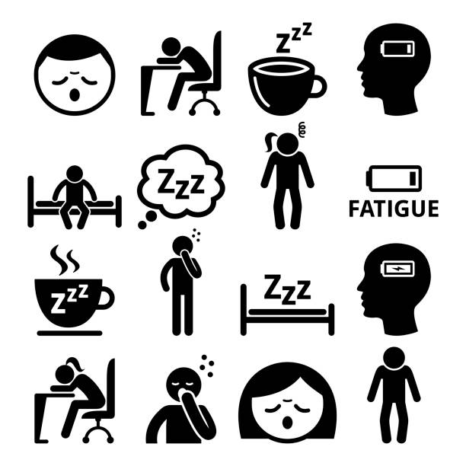
Poor Quality Sleep and Fatigue
Fatigue is an extreme tiredness, it is a feeling of constant exhaustion, burnout or lack of energy. It can be physical, mental or a combination of both. Fatigue can affect anyone.
Lack of sleep or poor-quality sleep can directly lead to fatigue. The more sleep-deprived we are, the more our bodies may feel tired throughout the day, reducing our performance, alertness and emotional well-being. Fatigue can be a signal that our bodies haven't fully recovered, and sleep is the primary way to restore energy levels.
Research shows that fatigue (feeling very tired) usually happens because we don’t get enough sleep, stay awake for too long, or are awake when our body is supposed to be sleeping.

Slide 14
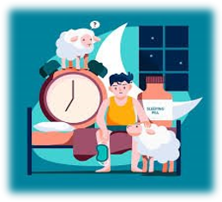
Consequences of Sleep Inequality in Children
Cognitive Development and School Performance Not enough sleep makes it hard for children to focus, remember, and learn, leading to lower test scores and behavior problems.
Physical Health
Lack of sleep can cause weight gain, weaken the immune system and increase the risk of diseases like diabetes and heart problems later in life.
Emotional and Behavioral Problems Children who don’t sleep enough are more likely to experience mood swings, anxiety and, over time, serious mental health issues like depression.
Social Inequality Children from low-income families often get less sleep, which can lead to worse school performance, fewer job opportunities and poor health, creating a cycle of inequality
Children and Sleep inequality
Children and sleep inequality refers to the disparities in sleep quality, duration and access to sleep resources among children from different socioeconomic, racial and environmental backgrounds.
Sleep inequality among children is a significant social issue that affects inequalities in health, academic performance and overall wellbeing.

Slide 15
References
The information provided in this slide set took references from the following:
Sleep Matters: The Impact Of Sleep On Health And Wellbeing | Mental Health Foundation
Emotion, emotion regulation and sleep: An intimate relationship - PMC
Sleep and mental health - Mind
How Can Exercise Affect Sleep? | Sleep Foundation
Physical Activity & Sleep: How Sleep Affects the Body | Sleep Foundation
Sleep and Infectious Disease Risk - PMC
The Link Between Obesity and Sleep
Sleep duration, lifestyles and chronic diseases: a cross-sectional population-based study - PMC
Tiredness and fatigue - NHS
Health Disparities in Pediatric Sleep - PMC
The Bidirectional Relationship between Sleep and Immunity against Infections - PMC

