Slide 1

How we are influenced
This activity links to the following Knowledge Banks:
Understanding gaming and gambling
The risks and harms of gaming and gambling
Supporting young people and families with gambling harms
This activity helps learners understand the techniques used by advertisers to promote gambling products and services. It provides information that will enable teachers to produce their own activities with their learners.
Possible Health and Well-being descriptions of learning: Our decision-making impacts on the quality of our lives and the lives of others.
Progression step 1 I can make decisions based on what I like and dislike. | Progression step 2 I can make decisions based on what I know. | Progression step 3 I can make considered decisions, taking into account available information, including past experiences. | Progression step 4 I can research, examine and evaluate a range of evidence to make considered and informed decisions.

Slide 2
The definition of influence:
'The capacity to have an effect on the character, development, or behaviour of someone or something, or the effect itself'
Just about anything can influence your decision making, behaviour and values but the more we are exposed to something, the more normal it can seem. For example, you may be influenced to wear certain types of clothes, listen to certain music or even to drink certain drinks.
Consider how you are influenced by your friends, family, social media, music, reels and adverts.

Slide 3
The history of gambling adverts
Gambling adverts in the UK have evolved alongside changing laws, technology and social attitudes.
From early horse-race betting to modern online gambling, regulations have tightened through acts like the 1845 Gaming Act, the 1963 Betting, Gaming and Lotteries Act and the 2005 Gambling Act, which created the UK Gambling Commission.
Campaigns like “When the fun stops, stop” and “Take Time To Think” try to encourage safer play, but they mostly focus on telling individuals to be careful. This can make it seem like harm is only about personal choices, when in reality the way gambling companies design their games and ads also plays a big role. That’s why many people are still pushing for stronger rules to protect young people.

Slide 4
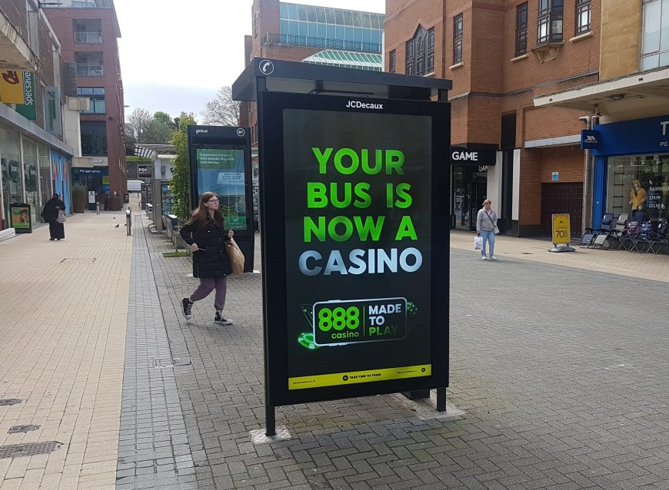
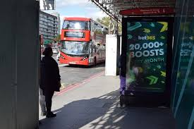
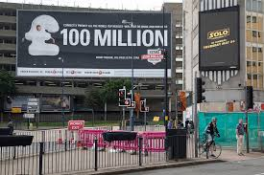
History of gambling advertising
Gambling has historically been advertised as fun, glamorous and risk-free
Gambling marketing often links betting with sport, friendship and success
Gambling adverts often present betting as exciting, social and part of a successful lifestyle
Why ban advertising on billboards?

Slide 5
Marketing and Industry Influence
The gambling industry has a long history of targeting young people.
In the past, marketing linked gambling to excitement, success and social status.
Today, companies use social media, influencer marketing, sponsorships and in-game advertising to appeal to adolescents and young adults.
Marketing exploits peer influence, curiosity and brand loyalty, increasing the likelihood that young people will start gambling or engage in gambling-like activities (e.g. loot boxes, betting apps).
Awareness of these tactics shows that harm is not only a personal choice - commercial interests actively shape behaviour.
Why is it important to be aware of the advertising tactics used by the gambling industry?

Slide 6

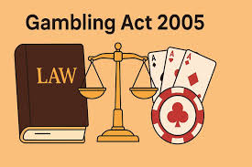
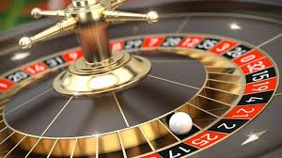


Preventing gambling advertising & Harm
2005
Gambling Act -
Introduced age restrictions (18+)
Advertising permitted but regulated
2019
No gambling adverts aired before 9pm during live sport
2014
Remote Gambling Regulation -
Online operators required UK licence
Consumer protection measures strengthened
2020–2023
Stronger Safeguards & Affordability Checks

Slide 7

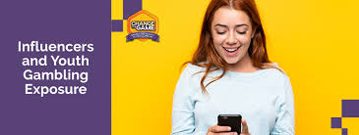
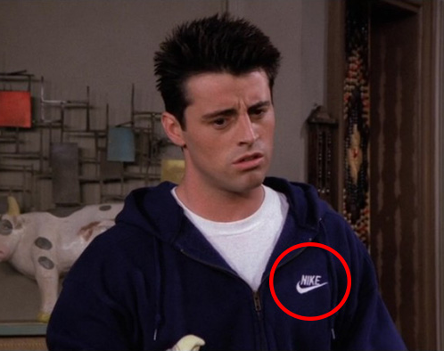
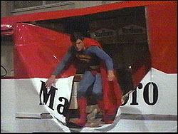
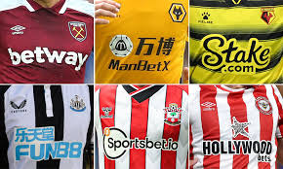

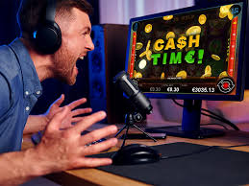


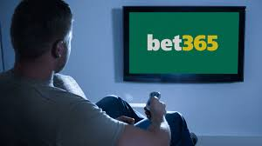
How gambling companies
advertise their products
Gambling marketing is rarely just “an advert” — it’s often embedded into sport, entertainment and digital spaces.
Sport sponsorship (i.e football shirts)
TV & Streaming Advertising
Social Media & Influencers
Integration into Gaming

Slide 8
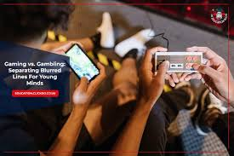
Discuss the following images
What do you notice first when an advert or pop‑up appears?
What do these design features make you want to do?
Why do you think the game wants you to click or spend something?
What options does the screen give you — and which ones stand out most?
What might someone hope will happen if they click on it?
What do you think the game wants players to believe will happen if they click?
How do you decide whether something in a game is worth paying for?
How easy is it to see how much it really costs?
Who could you talk to if something in a game feels confusing or pushy?
When would be a good time to ask for help?

Slide 9

How are gaming and gambling platforms designed?
How are gaming and gambling websites, apps and adverts designed?
Why do you think bright lights, bold colours, animations, sound effects and large text are used?
Why do you think bonuses, rewards, free spins, loot boxes and special offers are heavily advertised?
Are warning messages about addiction and financial harm displayed clearly?

Slide 10
Things to consider:
Be aware of who and what influences you
Think critically about the source of information and their motivations
Ask questions
Build your own understanding by exploring the facts
Make decisions based on your own beliefs and not those of others

Slide 11
Further possible learning suggestions
Advert analysis helps learners think critically about how gambling is marketed across different media, how persuasive techniques are used and what messages these adverts create about gambling and its risks.
Learners examine both TV gambling adverts (video clips) and printed gambling adverts.
As they watch and observe, they make notes on persuasive techniques:
Celebrity or influencer endorsement
“Free bet” or “risk‑free” offers
Bright colours, upbeat music, fast visuals
Showing winners, not losers
Urgent language (“Bet now!”)
Making gambling look normal, fun or glamorous
Learners compare the TV and printed adverts and discuss:
  Who is the target audience
  What persuasive techniques are used
  What message the advert sends about gambling
  What information is missing or hidden
  How a young person might interpret it
Group Discussion:
Which advert felt the most persuasive
Which techniques appeared most often
How adverts made gambling look fun or harmless
Why this might affect young people more than adults
What risks were left out of the adverts
Rewrite the Message
Choose one advert and create a more honest version by:
  Redesigning the poster
  Changing the slogan
  Adding a warning label
  Writing a short “truthful” advert script

Slide 12
Gambling Support Services in Wales
All Wales Gambling Treatment Service and 24/7 Helpline 0808 281 9265 ​
Referrals are welcome from any individual or professionals to the Treatment Service.​
Email: GamblingService@wales.nhs.uk​
​
GambleAware ​
www.gambleaware.org​
​
NHS National Centre for Gaming Disorders (London) ​
Specialist treatment for gaming disorder for those aged 13 and over. Online access from Wales. ​
www.cnwl.nhs.uk/national-centre-gaming-disorders ​
​
*Please note that the support services listed may be subject to change as commissioning arrangements are updated.

