Slide 1

Understanding Sleep:
Why is it Important and What do we mean by good Sleep?

Slide 2
In this slide set, we’ll explore:
Understanding Good Quality Sleep
What makes sleep healthy and restorative
Sleep cycles and sleep stages
Why Do We Need Sleep?
The role of sleep in health, mood, and learning
Sleep in the 24-hour movement cycle
The Circadian Rhythm
How our internal body clock works
What disrupts it and how to protect it
Sleep Quality vs. Sleep Quantity
Differences and why both matter
What impacts continuity and depth of sleep
Barriers to Good Sleep
Causes of sleep difficulties (e.g. insomnia)
Risk factors and who may be affected
Special Considerations
Sleep challenges in neurodiverse children
Cultural differences in sleep practices
Supporting Better Sleep
Healthy routines and environments
When mindfulness helps—and when it doesn’t

Slide 3
What is Good Quality Sleep?
Sleep is essential to every part of our lives, yet it is often one of the first things we compromise when things become busy.
A good and healthy sleep means:
It takes less than 30 minutes to fall asleep
We don’t wake up for more than 30 minutes once we are asleep
We get the amount of sleep needed for our age
Age group | Recommended sleep time in 24 hours
Infants 4 to 12 months | 12 to 16 hours including naps
Children 1 to 2 years | 11 to 14 hours including naps
Children 3 to 5 years | 10 to 13 hours including naps
Children 6 to 12 years | 9 to 12 hours
Teenagers 13 to 18 years | 8 to 10 hours
Adults over 18 years | 7 to 9 hours
*How Much Sleep Do You Need? | Sleep Foundation
Good sleep is essential for physical, mental and emotional well-being. It involves more than just the number of hours we spend in bed—it encompasses sleep quality and how restorative that sleep is for our body and mind.

Slide 4

Why do we need sleep?
Why Sleep Is Important
Sleep is a vital part of our daily lives. It helps our bodies and brains rest, recover and get ready for the next day.
Getting enough good quality sleep helps us:
Think clearly and learn better in school
Feel happier and more in control of our emotions
Stay healthy and full of energy
But sleep doesn’t work alone! To be healthy, we need to think about how we use our whole day – all 24 hours of it. This is called the 24-hour movement cycle, and it includes:
Sleep
Physical activity (like playing, walking or sports)
Time spent sitting or lying down while awake (called sedentary behaviour, like watching TV or gaming)
If we don’t get enough sleep, don’t move enough, or spend too much time sitting still, it can lead to health and well-being problems over time.

Slide 5
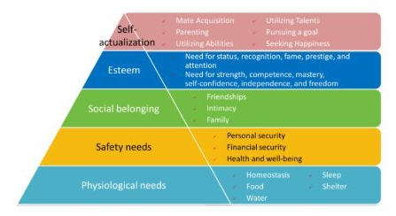
Maslow’s Hierarchy of Needs
What Do We Need to Be Happy and Healthy?
Maslow’s Hierarchy of Needs is a way of understanding what people need to live happy, healthy lives.
It’s often shown as a pyramid with different levels. The idea is that some needs are more important than others, and we must meet the basic ones first before we can focus on the others.
Here’s how it works:
Basic needs – These are aspects like food, water, sleep, and safety. Without these, our bodies can’t work properly.
Next levels – Once our basic needs are met, we can focus on things like:
Feeling loved and connected to others
Feeling good about ourselves
Learning new things and reaching our full potential
Abraham Maslow said that we need to take care of our basic needs (like sleep) before we can do our best in school, feel confident or build good relationships.

Slide 6
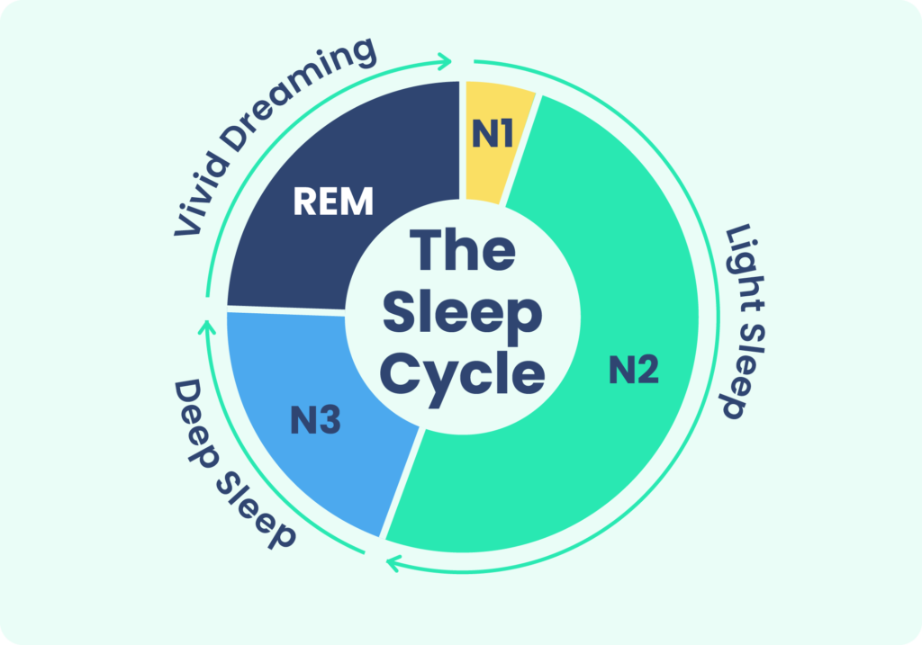
Non-REM sleep
Stage 1 (N1) | This is the period when we first fall asleep. This stage normally lasts just one to seven minutes.
Stage 2 (N2) – Light sleep | Our body enters a more subdued state including a drop in temperature, relaxed muscles, and slowed breathing and heart rate. Collectively, a person typically spends about half their sleep time in N2 sleep.
Stage 3 (N3) – Deep sleep | Stage 3 sleep is also known as N3 or deep sleep, and it is harder to wake someone up from this phase. Muscle tone, pulse, and breathing rate decrease in N3 sleep as the body relaxes even further.
The sleep cycle
We all cycle between different types of sleep during the night and during long naps.
From about 6 months of age, a sleep cycle contains:
rapid eye movement (REM) sleep
non-REM sleep.
Sleep happens in four stages, and each stage has its own pattern of brain activity that scientists can see when they study the brain during sleep.
REM sleep
Stage 4 – REM | During REM sleep, brain activity picks up, nearing levels seen when we are awake. The body experiences atonia, a temporary paralysis of the muscles, with two exceptions: the eyes and the muscles that control breathing. Even though the eyes are closed, they can be seen moving quickly, which is how this stage gets its name. Under normal circumstances, we do not enter a REM sleep stage until we have been asleep for about 90 minutes. In total, REM stages make up around 25% of sleep in adults.

Slide 7
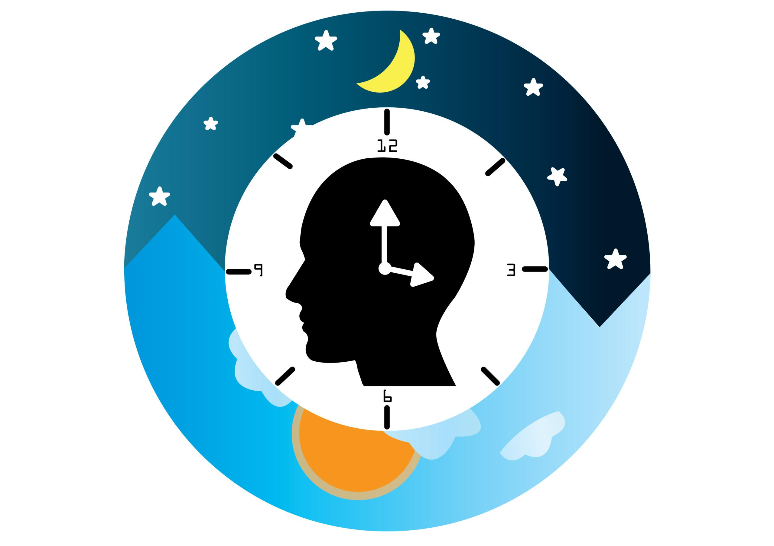
The Circadian Rhythm
Have you ever wondered why taking a nap feels so good in the middle of the afternoon? Or why we feel extra tired when we travel east? Or why your bedtime is different from your family's? The answers to all these questions have to do with something called circadian rhythms.
Our circadian rhythm is our sleep-wake pattern over the course of a 24-hour day — it’s the name given to our body’s internal clock.
Some people may experience disruptions to their circadian rhythm because of external factors or sleep disorders. Maintaining healthy habits can help us respond better to this natural rhythm of our body.

Slide 8
What factors can change our Circadian
Rhythm?
Sometimes our natural circadian rhythm gets disrupted, and our lifestyle needs and internal clock clash. This can occur because of a number of reasons:
Light exposure: Too much light, especially at night, can delay sleep.
Sleep schedule: Irregular sleep times or jet lag can throw off your body clock.
Hormones: Hormonal changes can affect when and how well you sleep.
Age: Our sleep patterns often shift as we get older.
Food habits: Eating late or at odd times can make it harder to sleep.
Exercise: Regular activity helps, but exercising too late can keep you awake.
Environment: Noise, light, and temperature all affect how well we sleep.
Health and medicine: Some conditions and medications can disrupt sleep.
Seasons: Less daylight in winter can shift your body clock.
Screens and devices: Using phones, tablets, or TVs late at night can mess with sleep.

Slide 9
Why a sleep schedule matters?
A consistent sleep schedule (going to bed and getting up at the same time every day) can help us get the amount of sleep we need.
A regular sleep schedule can also help boost the quality of our sleep and ensure that our body’s circadian rhythms aren't disrupted.
Our circadian rhythms also have an important influence on:​
When we feel ready to sleep and wake up​
How our body cycles through the stages of sleep​
Our ability to sleep continuously through the night ​
Both our environment and behaviours affect our circadian rhythms. For example, darkness is a sleep cue that triggers production of the sleep-inducing hormone melatonin that supports healthy sleep and aligns our circadian rhythms with our preferred sleep schedule.​

Slide 10
Sleep Quality vs Sleep Quantity
While sleep quantity is important, the quality of our sleep is also an important factor. Here's how they compare:
Sleep Quantity This means how much sleep we get each night, usually measured in hours.
How Much Sleep Do We Need?
Adults should get 7 to 9 hours of sleep each night to stay healthy.
Children and young people need even more—around 9 or more hours, depending on their age.
What Happens If You Don’t Get Enough Sleep? Not getting enough sleep for a long time can:
Make it harder to think clearly or concentrate
Affect your mood and make us feel more stressed or low
Sleep Quality Sleep quality is about how well you sleep—not just how long. Good sleep is deep, restful, and not interrupted too often.
What Makes Sleep Good?
Sleep Cycles: We go through sleep cycles (about 90 minutes each) that include deep sleep and REM sleep. These help our body and brain recover.
Interruptions: Waking up a lot during the night—because of noise, stress, or health issues—can make sleep less restful.
Feeling Refreshed: If you wake up feeling rested and ready for the day, your sleep quality is likely good.

Slide 11
Sleep Continuity
One sign of quality sleep is being able to sleep through the night without waking up often.
Sometimes sleep gets disrupted — and we might not even remember it. These disruptions can make us feel tired the next day.
Common causes of poor sleep include:
Sleep disorders, such as sleep apnoea and restless legs syndrome
Pain or discomfort
Caregiving responsibilities
Night sweats
A noisy, bright or hot sleep environment
Snoring or movement of a bed partner
Night-time bathroom trips
Sleep continuity is vital to healthy sleep. Without it, we might have trouble waking up in the morning or feeling energised throughout the day, even if we’ve spent plenty of time in bed.

Slide 12
Why might some people find it more difficult to get good quality sleep?
Insomnia is when we aren’t sleeping as we should. That can mean we aren’t sleeping enough, we aren’t sleeping well or we’re having trouble falling or staying asleep. For some people, insomnia is a minor inconvenience. For others, insomnia can be a major disruption.
When we don’t sleep enough, it can cause sleep deprivation, which can keep us from functioning at our best.
There are two main ways that experts use to put insomnia into categories:
Time: Experts classify insomnia as acute (short-term) or chronic (long-term). The chronic form is known as insomnia disorder.
Cause: Primary insomnia means it happens on its own. Secondary insomnia means it’s a symptom of another condition or circumstance.

Slide 13
What Causes sleep difficulties (Insomnia)?
We don’t fully know why insomnia happens, but the current understanding is that this condition can involve many factors. Some of the factors that could cause or contribute include the following:
Family history: Sleep problems like insomnia can run in families.
Brain differences: Some people’s brains are more active or work differently, making sleep harder.
Health issues: Illnesses, injuries or long-term conditions can affect sleep patterns.
Mental health: Anxiety, depression and other conditions often go along with insomnia.
Stressful events: Big life stresses can make it harder to sleep, even if they don’t directly cause insomnia.
Life changes: Things like jet lag, moving house or new routines can disrupt sleep.
Daily habits: Poor sleep habits—like napping too much, using screens late or having caffeine—can lead to insomnia.

Slide 14
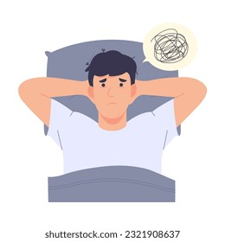
What are the risk factors for sleep difficulties (Insomnia)?
Insomnia is when we regularly experience sleep difficulties. It is more likely to happen in people with the following characteristics or circumstances:
Light sleepers.
People who drink alcohol.
People who don’t feel safe in their homes (such as situations involving repeated violence or abuse).
People with fear or anxiety about sleep, such as those with disruptive sleep issues like nocturnal panic attacks or nightmare disorders.

Slide 15

Sleep difficulties in children with additional needs and Neurodiversity
Children with additional needs (e.g., physical or developmental disabilities) and neurodiversity (the natural diversity of human minds) often experience unique challenges when it comes to sleep.
These challenges can manifest in a variety of ways, impacting both sleep quantity (how much sleep they get) and sleep quality (how restorative their sleep is). Here are the key factors contributing to sleep difficulties in this group:
Sensory Sensitivities
Difficulty with Sleep Routine and Transitions
Overactive Minds or Hyperactivity
Co-occurring Conditions (e.g., Anxiety or Seizure Disorders)
Circadian Rhythm Disruptions
Sleep Disorders
Medications and Treatments
Parent and Family Sleep Struggles

Slide 16

Mindfulness techniques and sleep
Mindfulness techniques are often promoted as a helpful tool to support good sleep. However, a recent review showed that mindfulness may be harmful to some learners, particularly those aged 11 and under, or with a higher risk of mental health problems including anxiety and depression.
Schools should exercise caution in promoting mindfulness universally to all learners. It is important to consider the needs of individual learners and their school population and to identify who may benefit.
There are various resources that can provide more information on mindfulness for sleep including the sleep foundation:
Meditation and Sleep
Every Mind Matters - NHS
Mindfulness in Schools Project (MiSP).pdf

Slide 17
Sleep Practices across Different Cultures
Sleep practices vary widely across cultures, reflecting different social norms, values and environmental factors. Here are some unique sleep customs and traditions from various parts of the world:​
​
Spain and Southern Europe – Siesta: In Spain and many Southern European countries, the concept of the Siesta involves taking a midday nap, typically after lunch, to rest and rejuvenate. ​
Japan – Group Sleeping and Inemuri: In Japan, sleep is sometimes seen as a communal activity, with families or even coworkers napping together in shared spaces.​
Middle East and North Africa – Bedouin Sleeping Customs: Among traditional Bedouin cultures in the Middle East, sleep is often a communal and outdoor experience, especially in rural areas.​
India – Co-Sleeping and Family-Oriented Sleep Practices: In many parts of India, co-sleeping with children and extended family members is a common practice.​
China – Duanxin and Traditional Resting Practices: In China, a long-standing tradition of duanxin, or taking a break to rest during the afternoon, aligns with the concept of maintaining energy for the day. ​
These are just some of the many examples of the many cultural and communal experiences of sleep across the world.

Slide 18
References
The information provided in this slide set took references from the following:
Sleep hygiene in children and young people | Great Ormond Street Hospital (gosh.nhs.uk)
How Much Sleep Do You Need? | Sleep Foundation
MHF-Taking-Sleep-Seriously-Publication-2020.pdf (mentalhealth.org.uk)
Stages of Sleep: What Happens in a Sleep Cycle | Sleep Foundation
Circadian Rhythm Disorders: Symptoms, Treatment & Types
Sleep Quality: How to Determine if You’re Getting Poor Sleep | Sleep Foundation
Insomnia - Symptoms and causes - Mayo Clinic
Sleep for neurodivergent children and young people
Meditation and Sleep

