Slide 1
Vaccination against shingles (Herpes Zoster)
These slides are version controlled and subject to revision
Vaccine Preventable Disease Programme
Public Health Wales
Version 6
Last update: August 2025
Notes:
Material contained in this document may be reproduced without prior permission provided it is done so accurately and is not used in a misleading context.
Acknowledgement to Public Health Wales NHS Trust to be stated.
© 2025 Public Health Wales NHS Trust.
Version 2
Slide 37 and 56: Updated Green book advice on co-administration - update to the COVID-19: the green book, chapter 14a - GOV.UK (www.gov.uk) indicates that COVID-19 vaccines can be given at the same time as other vaccines, including flu vaccines.
Version 3 (1 September 2023)
Completed slide set update: Updated to align with proposed changes to shingles programme from 01 September 2023
Version 4 (11 September 2023)
Slide 45: Slide content and notes section updated to align with recently updated UKHSA Shingles vaccination: guidance for healthcare professionals: https://www.gov.uk/government/publications/shingles-vaccination-guidance-for-healthcare-professionals
Slide 48: Slide content and notes section updated to align with recently updated UKHSA Shingles vaccination: guidance for healthcare professionals: https://www.gov.uk/government/publications/shingles-vaccination-guidance-for-healthcare-professionals
Slide 49 and 50: Added slide “Immunosuppressed individuals who develop a varicella rash following inadvertent vaccination with Zostavax®” to provide further information to healthcare practitioners. Aligned with Green Book Chapter 28a: Shingles (up to 31/08/2023): Shingles (herpes zoster): the green book, chapter 28a - GOV.UK (www.gov.uk) / https://www.gov.uk/government/publications/shingles-herpes-zoster-the-green-book-chapter-28a and UKHSA Shingles vaccination: guidance for healthcare professionals: https://www.gov.uk/government/publications/shingles-vaccination-guidance-for-healthcare-professionals
Slide 57: Slide content and notes section updated to align with recently updated UKHSA Shingles vaccination: guidance for healthcare professionals https://www.gov.uk/government/publications/shingles-vaccination-guidance-for-healthcare-professionals
Slide 64: Slide content and notes section updated to align with recently updated UKHSA Shingles vaccination: guidance for healthcare professionals https://www.gov.uk/government/publications/shingles-vaccination-guidance-for-healthcare-professionals
Slide 65: Slide content and notes section updated to align with recently updated UKHSA Shingles vaccination: guidance for healthcare professionals: https://www.gov.uk/government/publications/shingles-vaccination-guidance-for-healthcare-professionals
Slide 78: Resource information updated
Slide 79: Image of ‘Visual aid for healthcare professionals’ added to slide
Version 5 (17/04/2025)
These slides have been reviewed and changes made in relation to:
*the removal of Zostavax (including transmission of vaccine virus) which has been discontinued
*updated images
*updated epi/surveillance
*reflect embedded programme dates
*reflect the VCAG decision on Shingrix® vaccine eligibility for those who received Zostavax routinely but have since become severely immunosuppressed following
*black triangle status
*updates to Green Book (Chapter 8)
*coadministration
*PGDs
*updated resources
VPDP are aiming to standardize the format of template training slides.
Version 6
Slide set updated to reflect severely immunosuppressed cohort from 50 year and over to 18 years and over.
Slide 2: Notes section updated
Slide 9: Text on slide and in notes section updated
Slide 11: Text updated
Slide 13: Text updated
Slide 15: Text updated
Slide 17: Table and text updated
Slide 24: Text updated
Slide 25: Note section updated
Slide 25: Notes section text removed (in relation to availability of Shingrix from 2021 for severely immunosuppressed individuals)
Slide 26: Added recent WHC/2025/028 to slide and information about the extended programme for severely immunosuppressed individuals in the notes section.
Slide 29: Text updated
Slide 30: Text updated
Slide 31: Text updated
Slide 37: Text updated
Slide 38: Slide content updated (Previously slide 26 vaccine eligibility)
Slide 44: Text and notes section updated
Slide 52: Updated
Slide 54: Updated
Slide 55: Updated

Slide 2
Vaccination against shingles (Herpes Zoster)
The information contained within this slide set is up to date as of August 2025.
​It is important that all immunisers delivering the shingles vaccination programme and/ or those who are providing immunisation advice familiarise themselves with the most up to date clinical evidence and guidance, this can be found in the following key documents:
Shingles (Herpes Zoster): the green book, chapter: https://www.gov.uk/government/publications/shingles-herpes-zoster-the-green-book-chapter-28a.
UKHSA Shingles vaccination: guidance for healthcare professionals: https://www.gov.uk/government/publications/shingles-vaccination-guidance-for-healthcare-professionals.
Shingles vaccination programme website page is available here: Shingles - Information for health professionals - Public Health Wales (nhs.wales).
The content of this training slide set is subject to review. This resource will be version controlled. This is version 6 dated August 2025.
Notes:
Background
In 2010, the Joint Committee on Vaccination and Immunisation (JCVI) was asked by the Secretary of State for Health to review the available evidence relevant to the introduction of a universal vaccination programme to protect against shingles (Herpes Zoster). The JCVI considered a range of issues including disease epidemiology, vaccine efficacy, vaccine safety and the cost effectiveness of introducing a routine shingles vaccination programme in the UK. Based on the findings of the cost-effectiveness analysis, the JCVI recommended a universal routine herpes zoster (shingles) vaccination programme using a single dose of the live Zostavax® shingles vaccine for adults aged 70 with a catch-up programme for those aged 71 to 79 years. Individuals who reached their 80th birthday were not eligible for a shingles vaccination due to the reduced efficacy of Zostavax® vaccine with increased age.
From September 2013, a single dose of Zostavax® shingles vaccine was offered routinely to individuals aged 70 years (born on or after 1 September 1942) with a phased catch up programme based on age as of 1 September that year. From August 2021 Shingrix® vaccine was introduced as an alternative vaccine for immunocompromised individuals.
From September 2023 Shingrix® should be offered to all severely immunosuppressed individuals from 50 years of age and to immunocompetent individuals from 60 years of age over a 10 year phased introduction.
From August 2025 Shingrix® should be offered to all severely immunosuppressed individuals from 18 years of age (with no upper age limit) in accordance with the Welsh Health Circular (WHC/2025/028) Expansion of shingles immunisation for severely immunosuppressed people aged 18 to 49 | GOV.WALES.
This resource is designed to support healthcare practitioners involved in discussing and delivering the routine vaccination against shingles. It is to support healthcare practitioners involved in discussing routine vaccination against shingles. This resource does not cover the actual administration techniques involved in vaccinating against shingles. If staff are required to deliver vaccinations they should refer to their line manager for additional training.
Note: shingles is also known as herpes zoster. Shingles is used throughout this slide set.

Slide 3
Acknowledgements
Vaccine Preventable Disease Programme (VPDP), Public Health Wales Immunisation and Vaccines - Public
UK Health Security Agency (UKHSA) https://www.gov.uk/government/collections/shingles-vaccination-programme
UKHSA Shingles training slide set (2024)* https://www.gov.uk/government/collections/shingles-vaccination-programme
Other references included in slides or footer notes
Notes:
*including UKHSA Training slides: November 2024, August 2023 and August 2021 (Text transferred to UK Health Security Agency (UKHSA) template January 2022) (Available on request)

Slide 4
Contents
Section | Slide number
Aims | 5
Objectives | 6
What is shingles? | 7
Epidemiology and Surveillance | 14
Vaccination against shingles | 23
The shingles vaccination programme | 37
Optimising vaccine uptake | 46
Resources | 51

Slide 5
Aims
To provide information for healthcare practitioners involved in advising on and delivering the shingles vaccination programme
To raise awareness of the current epidemiology of shingles and the impact on older adults
To describe the vaccination programme details including administration of the vaccine, eligibility, recommended dosage and schedule, contraindications, precautions and potential adverse reactions
To raise awareness of the impact of the shingles vaccination programme
To highlight resources that support the shingles vaccination programme

Slide 6
Objectives
After completing this resource immunisers will be able to:
Describe the aetiology and epidemiology of shingles
Understand the rationale and evidence base for the shingles vaccination programme
Discuss the benefits of vaccination against shingles
Gain essential knowledge to administer the vaccine safely
Identify relevant resources and additional information in relation to the shingles vaccination programme

Slide 7
What is shingles?
What is shingles?

Slide 8
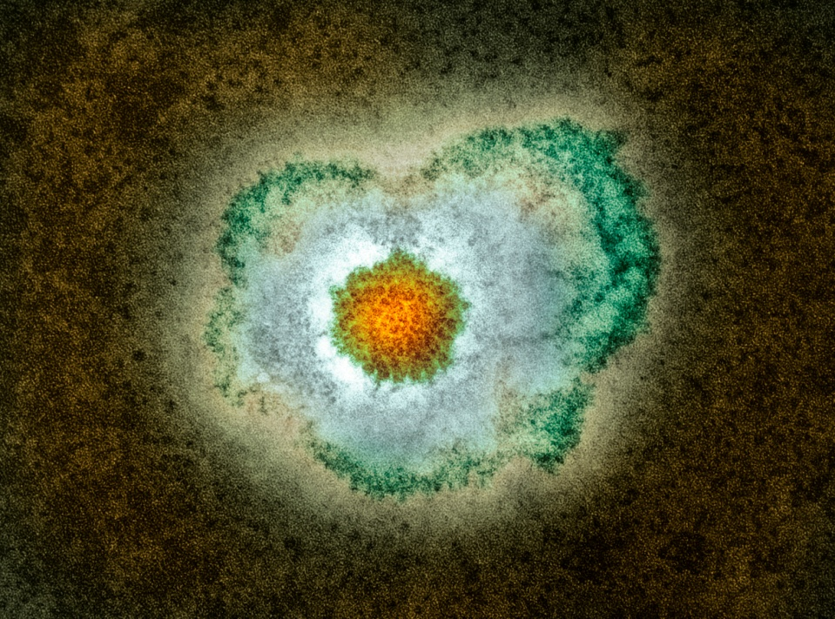
Shingles
A viral infection of the nerve cells and surrounding skin
Caused by the varicella zoster virus (chickenpox)
After a person recovers from chickenpox infection, the virus remains dormant in the nerve cells and can reactivate at a later stage when the immune system is weakened
Reactivation of the dormant virus leads to the clinical manifestation of shingles
Reactivation can be associated with older age, malignancy, immunosuppressant therapy or HIV infection
Notes:
Shingles (herpes zoster) is caused by the reactivation of a latent varicella zoster virus (VZV) infection, generally decades after the primary infection
Following primary VZV infection, the virus enters the sensory nerves and travels along the nerve to the sensory dorsal root ganglia and establishes a permanent latent infection
Reactivation of the latent virus leads to the clinical manifestations of shingles and is associated with immune senescence or suppression of the immune system e.g. immunosuppressive therapy, HIV infection, malignancy . The risk and severity of shingles increases with age.
Although rare, it is possible to have shingles more than once
Shingles is not caused by the same virus that causes genital herpes
Green Book Chapter 1:
Immunity and how vaccines work: the green book, chapter 1 - GOV.UK (www.gov.uk)

Slide 9
Transmission
The varicella virus that causes shingles (herpes zoster) is the same virus that causes chickenpox (varicella zoster).
Shingles itself is not contagious.
A person exposed to shingles will not develop shingles.
Varicella-zoster virus (VZV) can spread to someone who has never had chickenpox or the chickenpox vaccine. In that case, they would develop chickenpox, not shingles.
The virus spreads through direct contact with the fluid from the shingles blisters. Once the blisters crust over, the risk of spreading the virus is very low.
A person exposed to chickenpox will not develop shingles.
Individuals with shingles should try to avoid:
    Pregnant women who have not had chickenpox before.
    People with a weakened immune system - like someone having chemotherapy.
    Babies less than 1 month old.
Shingles (herpes zoster)
Notes:
Infection with varicella zoster (chickenpox) is a pre-requisite for the development of shingles
You do not develop shingles from being in contact with chickenpox
Shingles cannot be transmitted from one person to another, although it can cause chickenpox in individuals who have not previously had the disease and who have direct contact with the fluid from the shingles vesicles
*Individuals with active lesions, particularly if they are immunosuppressed, can transmit VZV to susceptible individuals to cause chickenpox and therefore at - risk individuals who have had a significant exposure to shingles require post exposure management
https://www.gov.uk/government/publications/shingles-herpes-zoster-the-green-book-chapter-28a
https://assets.publishing.service.gov.uk/government/uploads/system/uploads/attachment_data/file/1012943/Green_book_of_immunisation_28a_Shingles.pdf:
Management of at-risk individuals following significant exposure to chickenpox or herpes zoster:
The aim of post-exposure management is to protect individuals at high risk of suffering from severe varicella and those who may transmit infection to those at high risk (e.g. healthcare workers). VZIG prophylaxis is recommended for individuals who fulfil all of the following three criteria:
● significant exposure to chickenpox or herpes zoster
● a clinical condition that increases the risk of severe varicella; this includes immunosuppressed patients, neonates and pregnant women (see below)
● no antibodies to VZ virus Chapter 34 (publishing.service.gov.uk)
https://www.nhs.uk/conditions/shingles/
https://www.who.int/news-room/fact-sheets/detail/shingles-(herpes-zoster)

Slide 10
Clinical presentation of shingles (1)
Prodromal phase – the first signs of shingles may include:
  Abnormal skin sensations and pain in the affected area of skin (dermatone).
  Headache
  Feeling generally unwell
  Photophobia
  Malaise
  Fever (although this is less common)
Notes:
Diagnosis | Diagnosis | Shingles | CKS | NICE
Shingles (herpes zoster): the green book, chapter 28a - GOV.UK (www.gov.uk)
Images of shingles available NHS site: www.nhs.uk/conditions/shingles/

Slide 11
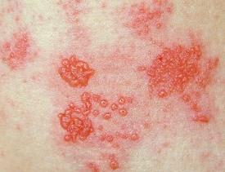
Clinical presentation of shingles (2)
Acute stage
The first signs of shingles begin most commonly with abnormal skin sensations and pain in the affected area of skin (dermatome). Headache, photophobia, malaise and less commonly fever may occur as part of the prodromal phase
Around 20% of people present with systemic symptoms, such as headache, fever, malaise or fatigue.
Within days or weeks a unilateral vesicular rash typically appears in a dermatomal distribution.
A rash of fluid filled blisters develops after a few days, commonly on one side of the face or body, usually within the distribution of a dermatome (an area of skin that is supplied by a single nerve).
The rash often causes intense pain, burning, shooting, stabbing, throbbing or pulsating in the area of the affected nerve.
The rash forms blisters that typically scab over in 7 to 10 days, this eventually clears within 2 to 4 weeks.
In individuals with weakened immune systems, a more disseminated rash covering multiple dermatomes may occur and this may appear similar to the chickenpox rash.
Image source: www.nhs.uk/conditions/shingles/
Notes:
Shingles (herpes zoster): the green book, chapter 28a - GOV.UK (www.gov.uk)
Clinical features | Diagnosis | Shingles | CKS | NICE
Shingles can affect any part of the body, although most commonly affected areas include face (including eyes) chest and abdomen.
Individuals may also experience pain in the arms and legs and may feel exhausted.
A dermatome can be defined as an area of skin that is supplied by a single nerve. Shingles can affect one or more isolated dermatomes.

Slide 12
Possible complications of shingles
Most common complications are:
Post herpetic neuralgia (PHN)
Secondary bacterial skin infections
Less common complications can include:
Ophthalmic zoster (leading to keratitis, corneal ulceration, conjunctivitis, retinitis, optic neuritis and or glaucoma)
Peripheral motor neuropathy
Rare complications can include:
Systemic dissemination (disseminated into the lungs, liver, gut, and brain, leading to pneumonia, hepatitis, encephalitis, and disseminated intravascular coagulopathy). This is more likely to occur in individuals who are severely immunocompromised with a case fatality rate reported to be between 5 and 15%, and most deaths being attributable to pneumonia Shingles Green Book chapter
In severe cases, shingles can lead to hospitalisation and death.
Notes:
Shingles can cause a number of secondary complications and the severity of these can be dependent on how weak the individual’s immune system is.
Most commonly reported complications in the older age groups include secondary bacterial infections at the site of the rash (that may require antibiotic therapy) and post herpetic neuralgia.
Other less common complications can include ophthalmic shingles and peripheral motor neuropathy. Ophthalmic shingles affects the facial nerve (trigeminal) and can cause ulceration and scarring of the eye and uveitis (inflammation of the inner eye). Ophthalmic shingles can also cause loss of vision if untreated and is often associated with long term pain. Estimates show between 10 and 20% of shingles cases result in ophthalmic zoster with approximately 4% of these cases resulting in long term sequelae
Peripheral motor neuropathy is more common in the elderly population and results in temporary nerve damage (peripheral motor nerve) that controls movement (peripheral motor nerve) of limbs such as the arm or leg, causing paralysis in the associated limb. This effect is temporary and individuals can make a good recovery
Shingles (herpes zoster): the green book, chapter 28a - GOV.UK (www.gov.uk)
Complications | Background information | Shingles | CKS | NICE

Slide 13
Post Herpetic Neuralgia (PHN)
PHN is pain at the rash site that can persist for months*
PHN may develop beyond 90 days after the shingles rash
On average PHN lasts from 3 to 6 months but can persist for longer
Severity of pain may be constant, intermittent or triggered by stimulation of the affected area such as a breeze on the face
The pain may be a burning, shooting, stabbing or pulsating pain which may be extremely sensitive to touch and not generally relieved by common painkillers.
PHN is more likely to develop, and is more severe, in people over the age of 50, with one third of sufferers over the age of 80 experiencing intense pain.
Notes:
*PHN is defined as an intense pain that persists for, or develops after 90 days following the onset of the shingles rash and can persist between for 3 and 6 months. This pain can last longer and is dependent on the individual’s immune system.
As the pain can be intense and is not generally relieved by common pain killers, PHN can have a negative impact on the individuals quality of life. PHN can contribute to fatigue, insomnia, depression, anxiety and can impair the basic activities of daily living for the individual.
Green book, Chapter 28a Shingles: Shingles (herpes zoster): the green book, chapter 28a - GOV.UK (www.gov.uk) https://www.gov.uk/government/publications/shingles-herpes-zoster-the-green-book-chapter-28a
Oxman MN and others (2005). A vaccine to prevent herpes zoster and postherpetic neuralgia in older adults New England Journal of Medicine 2005: volume 352 issue 22, pages 2271-84
Diagnosis | Diagnosis | Post-herpetic neuralgia | CKS | NICE
Complications | Background information | Shingles | CKS | NICE

Slide 14
What is shingles?
Epidemiology and Surveillance

Slide 15
Incidence of Shingles
Each year, approximately 550 cases of shingles are diagnosed by GPs per 100,000 people aged 65y and over in Wales¹
In Wales approximately 60 cases of PHN are diagnosed by GPs per 100,000 people aged 65y and over each year¹
During April 2024 to March 2025 there were 145 people aged 18y and over admitted to hospital with shingles²
1 in 1,000 cases of shingles in people 70 years of age and over are estimated to result in death before vaccine introduction³.
The risk of shingles is higher in individuals with certain conditions, including lupus, rheumatoid arthritis, diabetes and granulomatosis with polyangiitis (an auto immune disease leading to small vessel vasculitis^{)4.}
Notes:
¹Data taken from Audit+ (2025)
²Data taken from Patient Episode Database Wales (PEDW) (2025)
³UKHSA (2025) Immunisation against infectious disease. Chapter 28a Shingles [online] due to the nature of the population and risk of co-morbidities some deaths recorded as being shingles-related may not be directly attributable to the disease
⁴ UKHSA (2025) Immunisation against infectious disease. Chapter 28a Shingles [online]. The risk of shingles is also increased in individuals with certain conditions, including systemic lupus erythematosus (Nagasawa et al.,1990), rheumatoid arthritis (Smitten et al., 2007), diabetes (Heymann et al 2008) and Wegener’s granulomatosis. (Wung et al., 2005).

Slide 16
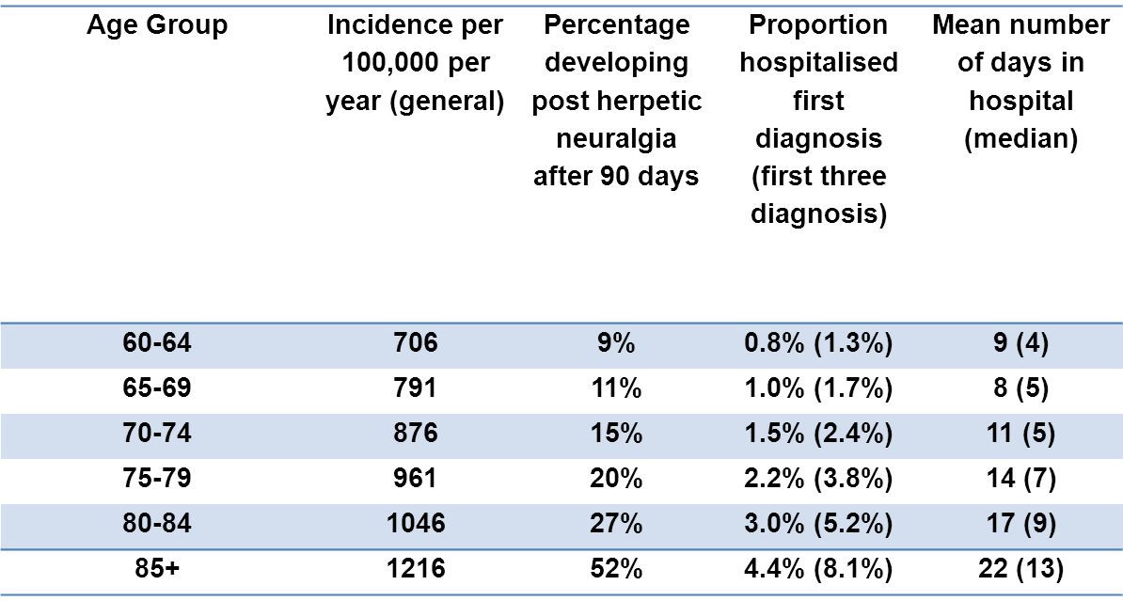
Epidemiology of shingles in England and Wales
Estimated annual age-specific incidence, hospitalisation rate, length of inpatient stay, Burden of disease in the immunocompetent population England and Wales. (Data taken from van Hoek and others, 2009)
Notes:
This table again shows the estimated annual age specific incidence per 100,000 with the associated burden of disease for each of the age quinquennia.
The burden of disease is measured in this table as the percentage developing post herpetic neuralgia (PHN) after 90 days, proportion of those hospitalised after the first diagnosis and the mean number of days spent in hospital.
The table shows the association between the incidence of age related shingles and the burden of disease. In particular, those individuals above 75 years of age account for a higher percentage of those developing PHN after 90 days. They are more likely to be hospitalised as a result of the disease and stay the longest when admitted to hospital.
As shown in the table, the burden of disease is closely related to age with those in the older age groups experiencing severe forms of the illness.
The severity of the disease burden is markedly increased in those individuals aged 75 to 85+ years. Individuals aged 85 years and over account for 4.4% of hospital admissions after the first diagnosis and 8.1% of hospital admissions within the first 3 diagnoses. They account for 52% of individuals developing PHN after 90 days and as a result of the disease, require a minimum of 22 days in hospital. This highlights the severity and impact of the disease in this age group and emphasises the importance of offering vaccination to older individuals.
These estimates are from 2007 prior to the vaccination programme being established.

Slide 17
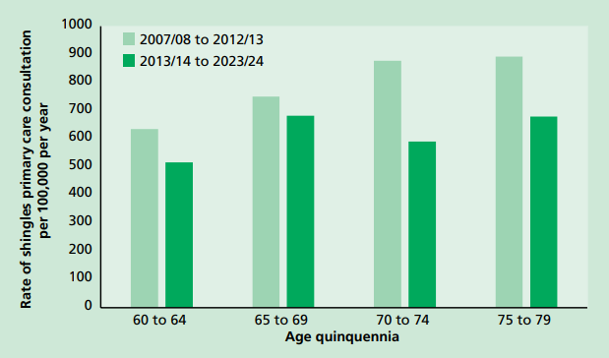
Epidemiology of shingles in England
Source: Green Book of immunisation - Shingles (publishing.service.gov.uk)
Notes:
Average annual age-specific rates of shingles primary care consultation per 100,000 in England, 2007/08 to 2023/24 (epidemiological year between October and September). Zostavax vaccination programme started in September 2013. Data from Andrews et al., 2020 and Royal College of General Practitioners (RCGP) Research and Surveillance Centre (RSC).
NB. This data is in relation to England only

Slide 18
Vaccine coverage
Since the introduction of the Shingles vaccination programme in 2013 there has been a year on year decline in timely vaccine uptake
Coverage increases over time as people have been eligible for longer but remains suboptimal
Efforts to identify and vaccinate all eligible individuals are needed to achieve a continuing reduction in the number of cases of this debilitating and painful condition
All those advising on or administering the shingles vaccine should take every opportunity to offer vaccination to eligible patients as soon as they become eligible to help to protect them from this serious illness

Slide 19
Shingles vaccine coverage data: Wales
Shingles vaccination was successfully introduced in Wales during September 2013.
Since then, there has been an overall decline in vaccine uptake.
(Information in Table above relates to year from April – March)
*Age 70 as at previous September
** Age 70 as at extract date (end March)
 | Year 4* (2016/17) | Year 5* (2017/18) | Year 6* (2018/19) | Year 7** (2019/20) | Year 8** (2020/21) | Year 9** (2021/22) | Year 10** (2022/23)
70y | 42.6% | 40.5% | 35.0% | 39.7% | 33.1% | 31.1% | 36.2%
 | Year 11*** (2023/24)
65y**** | 27.4%
70y**** | 36.8%
(Information in Table above relates to year from September – August)
***Age as at end August
****Uptake of at least one dose of any shingles vaccine
Data to monitor shingles immunisation in Wales are provided to Public Health Wales (PHW) by General Practices through Audit+
Notes:
It is important that general practices consider how they can optimise the uptake of shingles vaccine in eligible patients in order to reduce the significant burden of disease associated with shingles among older adults.
Coverage of at least one dose of any vaccine in the immunosuppressed group aged 50+ years, as at end August 2024 was 49.2%. Some of these older adults would have been eligible for the previous routine shingles vaccination.
Uptake dipped during the pandemic.

Slide 20
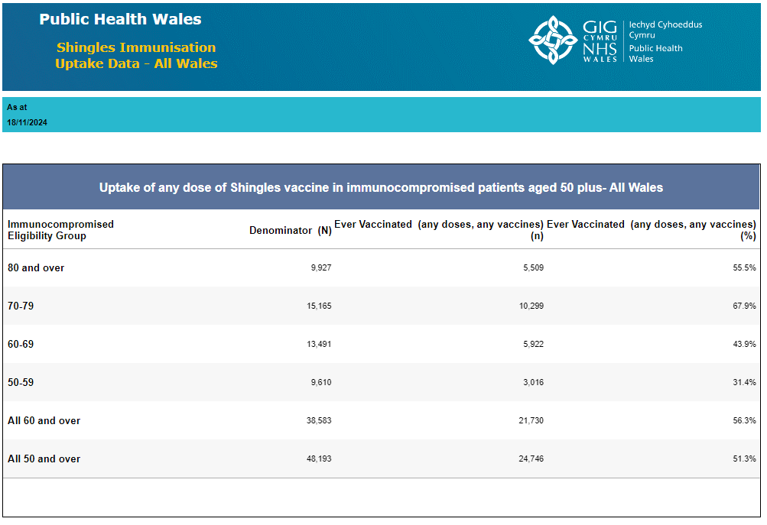
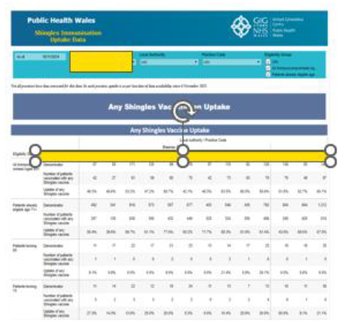
Example of shingles vaccine uptake data on PHW website
National and HB level Shingles dashboard - ENGLISH | Tableau Public
GP_Shingles: GP Shingles - Tableau Server (cymru.nhs.uk)
Vaccination against shingles (Herpes Zoster)
Notes:
Shingles vaccine uptake by HB can be viewed here: https://public.tableau.com/app/profile/public.health.wales.health.protection/viz/ShinglesVaccination-LocalHealthBoard/Dashboard
Shingle vaccine uptake by GP and cluster is available here (NHS only): https://phw-tableau.cymru.nhs.uk/#/views/ShinglesVaccination-GPLevel/Dashboard?:iid=2

Slide 21
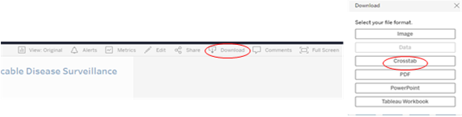
Cluster and GP level data
A GP and cluster level shingles immunisation summary can be found on the VPDP SharePoint Surveillance Page.
The interactive dashboard summarises shingles immunisation uptake data for those aged 50+
The data on which the report is based are submitted from general practices through Audit+ and the dashboard will be updated on a monthly basis.
The dashboard data can be exported to Excel by clicking on the Download button at the top right of the dashboard and selecting Crosstab – see screenshots below:
Notes:
Shingle vaccine uptake by GP and cluster is available here: GP_Shingles: GP Shingles - Tableau Server (cymru.nhs.uk)

Slide 22
Evaluation of the shingles vaccination programme
In 2020 an England population based study¹ estimated that the impact of herpes zoster vaccination in the 5 years after the introduction for 70-79 yr. olds in England in September 2013 was:
40,500 fewer herpes zoster GP consultations.
1,840 fewer herpes zoster hospitalisations (including 540 PHN consultations).
These reductions were consistent with a vaccine effectiveness of:
between 50 to 60% (herpes zoster) GP consultations and 66 to 75% (PHN) GP consultations
between 37% to 50% (herpes zoster) hospitalisations
between 49% to 50% PHN) hospitalisations
Public Health Wales are working on a study which will be shared when available, however the data from England highlights the effectiveness of the shingles vaccine programme.
Notes:
¹https://bmjopen.bmj.com/content/bmjopen/10/7/e037458.full.pdf
Impact of the herpes zoster vaccination programme on hospitalised and general practice consulted herpes zoster in the 5 years after its introduction in England: a population-based study
Andrews N, Stowe J, Kuyumdzhieva G, Sile B, Yonova I, de Lusignan S, Ramsay M, Amirthalingam G
Izurieta H S et al (2021) Recombinant Zoster Vaccine (Shingrix®): Real-World Effectiveness in the First 2 Years Post-Licensure Recombinant Zoster Vaccine (Shingrix): Real-World Effectiveness in the First 2 Years Post-Licensure | Clinical Infectious Diseases | Oxford Academic (oup.com)

Slide 23
What is shingles?
Vaccination against shingles?

Slide 24
Pre-requisites to administering shingles vaccine
Before administering shingles vaccine, it is recommended that:
*Those new to immunisation should receive comprehensive foundation immunisation training. Both knowledge and clinical competence should be assessed before new immunisers start to give and/or advise the shingles vaccine National Minimum Standards and Core Curriculum for Vaccination Training
Training in the management of anaphylaxis and Basic Life Support is undertaken, as specified by policy for your local area and are familiar with Resuscitation Council UK (RCUK) guidance on Management of Anaphylaxis in the Vaccination Setting
Any additional statutory and mandatory training as required by your employer is completed
An appropriate legal framework to supply and administer shingles vaccine is in place e.g. written prescription, Patient Specific Direction (PSD), Patient Group Direction (PGD). Visit here for Wales PGD template
Those involved in immunisation and vaccination understand the process of consent and how this applies when giving vaccines. Information on consent can be viewed here: Consent: the green book, chapter 2 - GOV.UK
Immunisers and those giving immunisation advice access and familiarise themselves with the following key documents: Shingles, Green Book Chapter : Information for healthcare practitioners: Vaccination against shingles(publishing.service.gov.uk) The vaccine product information in the Summary of Product Characteristics (Electronic Medicines Compendium website)
Notes:
*This should be either through a face to face taught course or a blended approach of both e-learning and a face to face taught course. New immunisers should also have a period of supervised practice and support with a registered healthcare practitioner who is experienced, up to date and competent in immunisation.
Practitioners should always ensure they are accessing the most up to date information and guidance.

Slide 25
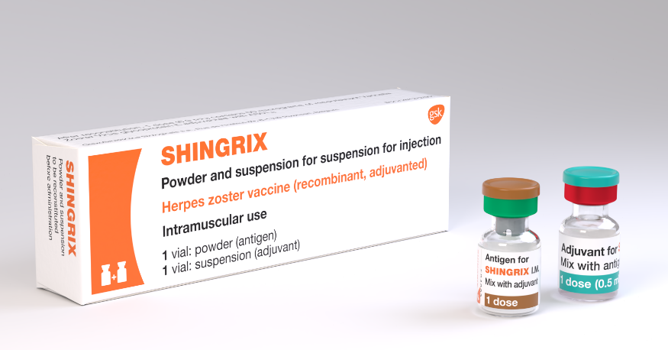
Shingrix®
Full product name: Shingrix®
Herpes zoster vaccine
Marketed by: GlaxoSmithKline UK
Type of vaccine: Recombinant adjuvanted subunit shingles vaccine
Does not contain live varicella-zoster virus, latex, thiomersal or gelatine
Contains a single protein glycoprotein E found in the outer shell of the herpes zoster virus, and an adjuvant to enhance the body's immune response to an antigen.
Contains Polysorbate 80
By combining the VZV specific antigen (gE) with an adjuvant system (AS01B), Shingrix® is designed to induce antigen-specific cellular and humoral immune responses in individuals with pre-existing immunity against VZV.
The vial rubber stopper is composed of butyl rubber which does not contain natural rubber latex
Image source: www.nhs.uk/conditions/shingles
Refer to SmPC for vaccine contents and excipients

Slide 26
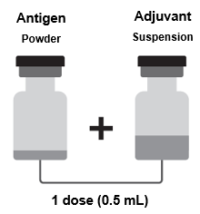
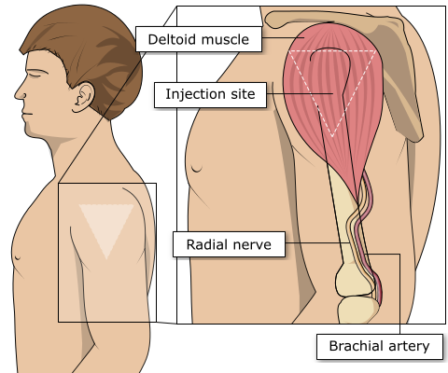
Preparation and administration of Shingrix®
Shingrix ® requires reconstitution of two vials prior to administration:
  One vial contains the powder
  One vial contains the suspension (adjuvant)
For reconstitution instructions refer to SmPC
Discard the vaccine if foreign particulate matter and/or variation of appearance is observed in the vials
Select the appropriate needle length to ensure an intramuscular (IM) administration depending on the patient's size and weight (refer to Green Book -Chapter 4 – immunisation procedures)
Administer the entire 0.5ml dose as per standard protocol, preferably into the deltoid muscle of the arm
The vaccine must not be given intravascularly
Image source:SmPC
Image source: The Australian Immunisation Handbook (health.gov.au)
Notes:
Healthcare professionals are encouraged to read the Summary of Product Characteristics (SmPC) to ensure accurate reconstitution and delivery of the product.
Shingles vaccine should preferably be injected into the deltoid muscle in the upper arm (or anterolateral aspect of thigh if not possible to use the deltoid muscle).
Injecting too high into the upper arm might result in the vaccine being deposited in the shoulder capsule rather than the deltoid muscle.
This can cause inflammation that can lead to a shoulder injury or a frozen shoulder leading to pain, weakness and a limited range of motion that can last for months.
Injecting too far to the side of the arm or too low on the arm risks injecting into the axillary nerve or the radial nerve.
This can cause a burning or shooting pain during the procedure and can lead to nerve damage (neuropathy/paralysis).
To avoid shoulder injury, the limb should be assessed before administering the vaccine to identify the correct site for injection.
Shingrix vaccine can be given at same time as other vaccines (refer to slide 30 and relevant Green Book chapters). The vaccines should be given at a separate site, preferably in a different limb. The sites at which each vaccine was given should be noted in the individual’s health records.
Shingrix powder and suspension for suspension for injection, Herpes zoster vaccine (recombinant, adjuvanted) - Summary of Product Characteristics (SmPC) - (emc) (medicines.org.uk)

Slide 27
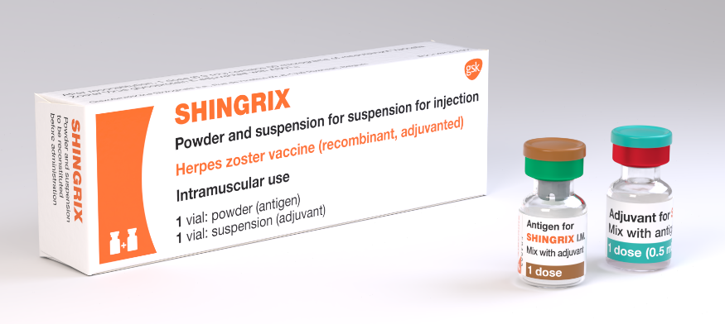
Shingrix® dosage and schedule
After reconstitution Shingrix® should be administered as a 0.5ml dose
The schedule consists of 2 doses of vaccine with the following interval between doses:
  For severely immunosuppressed individuals 8 weeks to 6 months
  For immunocompetent individuals 6 months to 12 months (it may be offered from 8 weeks after the first dose. For operational reasons a longer dose interval is being used between 6-12 months in England, Wales and Northern Ireland)
There is no current recommendation for a booster dose (the need for booster doses following 2 primary doses has not yet been determined)
Image source: www.nhs.uk/conditions/shingles
Notes:
The second dose can be given 6 months after the first dose but as Shingrix® vaccine is being offered to severely immunosuppressed individuals, they should be protected with a full course as soon as possible so the recommendation is to give the 2nd dose of vaccine at 8 weeks to 6 months.
The need for, and the timing of a booster dose, for Shingrix® has not yet been determined therefore no booster is currently recommended.

Slide 28
Contraindications and precautions
Contraindications:
Shingrix® should not be administered to those who have had:
  A confirmed anaphylaxis to a previous dose of the vaccine
  A confirmed anaphylaxis to any constituent or excipient of the vaccine
Precautions:
Individuals with bleeding disorders (e.g. coagulation or thrombocytopenia) may be vaccinated intramuscularly if, in the opinion of a doctor familiar with the individual’s bleeding risk, vaccines or similar small volume intramuscular injections can be administered with reasonable safety by this route
If an individual is acutely unwell, immunisation may be postponed until they have fully recovered to avoid confusing the differential diagnosis of any acute illness by wrongly attributing any signs or symptoms to any possible adverse effects of the vaccine
Notes:
https://www.medicines.org.uk/emc/product/12054
With a confirmed allergic reaction to a previous dose of the same vaccine, this contraindicates further vaccination with the same vaccine or a component of that vaccine, unless otherwise advised by an expert who has been able to investigate the reaction further.
Green Book: Chapter 8 Vaccine safety and adverse events following immunisation: the green book, chapter 8 - GOV.UK
UKHSA PGD Shingrix Template (2024) https://www.wmic.wales.nhs.uk/pgds-templates-advice/
Refer to PGD on Patient Group Directions (PGD) - Welsh Medicines Advice Service

Slide 29
Co-administration
Shingrix® can be given at the same time as inactivated or live vaccines including but not limited to adjuvanted flu vaccine (aTIV), pneumococcal polysaccharide vaccine (PPV23), pneumococcal conjugate vaccines (PCV), respiratory syncytial virus (RSV), COVID-19.
When Shingrix® is given at the same time as the 23-valent pneumococcal polysaccharide vaccine (PPV23), individuals should be advised about possible side effects of fever and shivering
Shingrix ® may also be offered at the same appointment to individuals aged 75 years and above who attend, year-round, for their RSV vaccination
Individuals should be informed about the likely timing of potential adverse events relating to each vaccine.
For more information on co-administration please refer to the relevant chapters in the Green Book
Vaccination against shingles (Herpes Zoster)
Notes:
Shingrix® can also be given with the 23-valent pneumococcal polysaccharide vaccine, PPV23 and with COVID-19 vaccines. In studies, when adults aged 50 years and older received PPV23 or COVID-19 vaccine with their first dose of Shingrix®, the immune response to both vaccines was unaffected but fever and shivering were more commonly reported when Shingrix was co-administered with PPV23.
Any co-administered vaccines should be given at a separate site, preferably in a different limb. The sites at which each vaccine was given should be noted in the individual’s health records.

Slide 30
Possible adverse reactions
Most commonly reported (1:10 of people vaccinated)
Pain, redness, swelling at the injection site; headache; gastrointestinal symptoms, (nausea, vomiting and/ or abdominal pain), myalgia, fatigue, chills, fever.
Generally lower in those 70 years of age and above.
Less commonly reported (≥1/100 to <1/10)
Injection site pruritus, malaise.
Uncommon (≥1/1,000 to <1/100)
Lymphadenopathy, arthralgia.
Rare (≥1/10,000 to <1/1,000)
Hypersensitivity reactions including rash, urticaria, angioedema (from spontaneous reporting).
Driving and using machines
Shingrix® may have a minor influence on the ability to drive and use machines in the 2- 3 days following vaccination. Fatigue and malaise may occur following administration.
Individuals should be advised that they should not drive or use machines if they are feeling unwell.
Notes:
A full list of side effects can be found in the Shingrix® summary of product characteristics:
https://www.medicines.org.uk/emc/product/12054

Slide 31
Common vaccine product-induced Adverse Event Following Immunisation (AEFI)
Common vaccine-induced AEFIs include:
pain, swelling or redness at the site of injection. These are common after immunisation and should be anticipated
local adverse reactions that generally start within a few hours of administration and are usually mild and self-limiting*.
systemic adverse reactions which include fever, malaise, myalgia, irritability, headache and loss of appetite**.
The occurrence or severity of such local reactions does not contraindicate further doses of immunisation with the same vaccine or vaccines containing the same antigens.
Timing of systemic reactions will vary according to the characteristics of the vaccine received, the age of the recipient and the biological response to that vaccine.
Vaccination against shingles (Herpes Zoster)
Notes:
*Although these are often referred to as ‘hypersensitivity reactions’, they are not allergic in origin, but may be either due to high titres of antibody or a direct effect of the vaccine product. The occurrence or severity of such local reactions does not contraindicate further doses of immunisation with the same vaccine or vaccines containing the same antigens.
**The timing of systemic reactions will vary according to the characteristics of the vaccine received, the age of the recipient and the biological response to that vaccine. For example, fever may start within a few hours of tetanus-containing vaccines, but occurs seven to ten days after measles- containing vaccine. The occurrence of such systemic reactions does not contraindicate further doses of the same vaccine or vaccines containing the same .

Slide 32
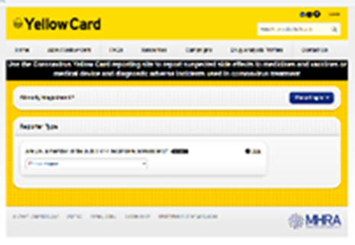
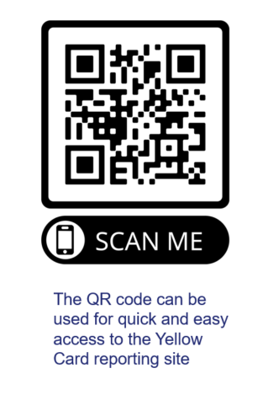
Reporting suspected adverse reactions
Vaccinees should be advised that they can report any adverse reactions or suspected side effects to the MHRA through the online yellow card scheme website or the Yellow Card app
Any suspected side effects following vaccine administration should be reported to the MHRA Yellow Card Scheme.
Anyone can report even if uncertain about whether vaccine caused condition:
  www.mhra.gov.uk/yellowcard or call 0800 731 6789 (9am to 5pm Monday to Friday)
  Green Book Chapter 9 for detailed guidance on reporting vaccine reactions
Vaccination against shingles (Herpes Zoster)
Notes:
Healthcare professionals and patients are encouraged to report suspected adverse reactions to the Medicines and Healthcare Products Regulatory Agency (MHRA) using the yellow card reporting scheme
Green Book chapter 9: https://www.gov.uk/government/publications/surveillance-and-monitoring-for-vaccine-safety-the-green-book-chapter-9

Slide 33
Shingrix® storage and supply
Storage:
Shingrix® should be stored in a refrigerator +2ºC to +8ºC.
Keep in original packaging
Protect from light
Use as soon as possible after removing from fridge
Effectiveness cannot be guaranteed for vaccines unless the cold chain has been maintained, and vaccine has been monitored as per national recommendations
Refer to local policy on vaccine storage and handling, Shingrix® SmPC , and Green Book: Chapter 3
Supply:
Supply of Shingrix ® is available for general practice to order online via the ImmForm website for delivery to those eligible as part of the routine shingles programme
To obtain supplies of Shingrix® for use outside of the national immunisation programme contact GlaxoSmithKline UK, direct on Tel: 0800 221 441
Notes:
Supplies for the routine programme should be ordered from ImmForm
Vaccines for private prescriptions, occupational health or travel are NOT provided free of charge and should be ordered directly from the manufacturer

Slide 34
Shingrix® efficacy
From September 2023, Shingrix® replaced Zostavax® in the routine immunisation programme.
In the phase 3 randomised placebo controlled clinical trials of 15,411 participants, vaccine efficacy in the 7,695 immunocompetent adults ≥ 50 years and 6,950 ≥70 years, vaccinated with two doses of Shingrix® 2 months apart was estimated at 97.2% and 91.2% respectively (reference: Lal et al (2015)). A long-term follow-up of the initial clinical trials showed the vaccine efficacy against zoster were 71.7% to 83.9% 6 to 11 years after vaccination (reference: Strezova et al (2025) in Green Book Shingles Chapter)
One- and two-dose real-world vaccine effectiveness of Shingrix® was estimated at 56.9% and 70.1% respectively in another US study of both immunocompetent and immunosuppressed adults aged >over 65 years (Izurieta et al, 2021). Sub-group analyses showed that VE for immunosuppressed individuals was lower (37.0% for 1 dose and 64.1% for 2 dose) than those who were not immunosuppressed (58.4% for 1 dose and 70.5% for 2 dose). One- and two- dose vaccine effectiveness against post-herpetic neuralgia was 51.4% and 76.0%. The two-dose vaccine effectiveness was not significantly lower for adults aged 80+ years and over, for second doses received at ≥180 days, or for individuals with autoimmune conditions.
Green Book: Shingles
Notes:
Strezova A, Diez Domingo J, Cunningham AL et al. (2025), Final analysis of the ZOE-LTFU trial to 11 years post-vaccination: efficacy of the adjuvanted recombinant zoster vaccine against herpes zoster and related complications. eClinicalMedicine 2025 May 9;83:103241.
Izurieta H S et al (2021) Recombinant Zoster Vaccine (Shingrix®): Real-World Effectiveness in the First 2 Years Post-Licensure Recombinant Zoster Vaccine (Shingrix): Real-World Effectiveness in the First 2 Years Post-Licensure | Clinical Infectious Diseases | Oxford Academic (oup.com)
Lal et al (2015) https://pubmed.ncbi.nlm.nih.gov/25916341/
Dagnew et al (2019) https://pubmed.ncbi.nlm.nih.gov/31399377/

Slide 35
Individuals with a recent history of shingles and post herpetic neuralgia (PHN)
Shingles vaccine is not recommended for treatment of shingles or PHN.
Eligible individuals who have shingles should wait until symptoms have ceased before being considered for shingles vaccination.
Individuals who have two or more episodes of shingles in one year should have immunological investigation prior to vaccination. Clinicians may wish to discuss such cases with local specialist teams.
As PHN can persist for many months or years, if the patient is eligible for shingles vaccine by age and they have no other symptoms, then the recommendation would be to offer the shingles vaccine without any specific interval before offering vaccine.
Natural boosting that occurs following an episode of shingles makes the benefit of offering shingles vaccine immediately following recovery unclear.
Notes:
Immunisation of individuals who are acutely unwell should be postponed until they have recovered fully. This is to avoid confusing the diagnosis of any acute illness by wrongly attributing any sign or symptoms to the adverse effects of the vaccine.
Shingrix vaccine can be given as long as the individual has recovered from acute infection and they have no active vesicles

Slide 36
Prescription only medication (POM)
Shingrix® should only be administered using a:
Prescription written manually or electronically by a registered medical practitioner or other authorised prescriber.
Patient specific direction (PSD).
Patient group direction (PGD).
There is a Welsh National PGD for Shingrix which will is available here
Health Boards will need to review, authorise and sign off locally according to their policies and governance procedures before use.

Slide 37
What is shingles?
Shingles vaccination programme

Slide 38
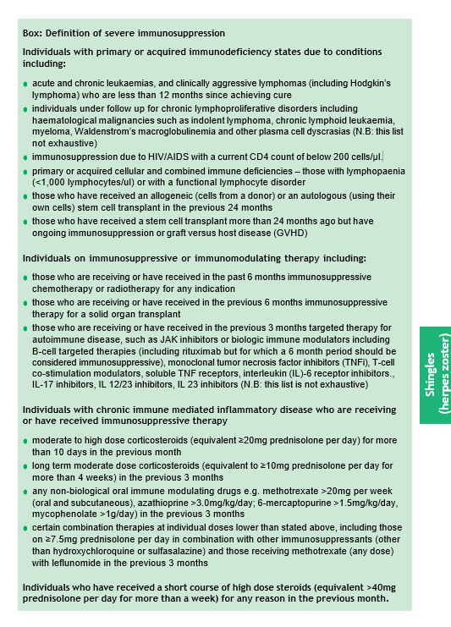
Shingrix® vaccine eligibility
Refer to updated Welsh Health Circular: Change of vaccine and cohort expansion for shingles vaccination programme (from September 2023) (WHC/2023/024) [02 January 2025] and Expansion of shingles immunisation for severely immunosuppressed people aged 18 to 49 (WHC/2025/028) [10 July 2025]
Overview:
Immunocompetent individuals from 60 years of age in a phased implementation over a 10 - year period starting with those turning ’65’ and ’70’ years of age
Immunocompetent individuals 70 to 79 years of age already eligible for the routine immunisation schedule
Severely immunosuppressed (immunocompromised) individuals aged 18years and over who have not received shingles vaccine before (eligibility as defined in the Box: Green Book Shingles Chapter)
Box: Green Book Shingles Chapter
Notes:
From 1 September 2023
For the first 5 years, those turning ‘65’ and ‘70’ years of age each year from 1 September until the following 31 August (inclusive) will become eligible for Shingrix® vaccine on their birthday and will remain so until they are 80 years of age.
For the following 5 years, from 1 September 2028, the eligible age will then reduce and those becoming ‘60’ and ‘65’ years of age from 1 September to 31 August (inclusive) each year, will become eligible on their birthday, so that in 10 years’ time, Shingrix® will be offered routinely to all immunocompetent individuals from 60 years of age.
Immunocompetent individuals who reach their 80th birthday are no longer eligible for a shingles vaccination.
From August 2025:
The programme has been expanded for severely immunosuppressed individuals from aged 18 years (with no upper age limit). Refer to (WHC/2025/028 Expansion of shingles immunisation for severely immunosuppressed people aged 18 to 49 (WHC/2025/028) | GOV.WALES).

Slide 39
Summary of changes to the shingles vaccination programme from 1 September 2023 for immunocompetent individuals
Implementation phases | Delivery period | Eligible for first dose
Phase 1 (five year duration) | 1 Sept 2023 to 31 Aug 2028 | Those who reach age 65 or 70 years during this period should be called in on/after their 65th or 70th birthday*
Phase 2 (five year duration) | 1 Sept 2028 to 31 Aug 2033 | Those who reach age 60 or 65 years during this period should be called in on/after their 60th or 65th birthday*
Ongoing routine offer | 1 Sept 2033 onwards | Those turning 60 years of age should be called in on/after their 60th birthday*
*Those that became eligible and missed out remain eligible until their 80th birthday.
Notes:
In relation to those who were eligible prior to September 2023 changes (70-79 years) they remain eligible until age 80. Where an individual has turned 80 years of age following their first dose of Shingrix®, a second dose should be provided before the individual’s 81st birthday to complete the course.

Slide 40
Summary of changes to the shingles vaccination programme from August 2025 for severely immunosuppressed individuals
Eligibility:
All severely immunosuppressed adults, as defined in the Greenbook chapter, aged 18 years and over (no upper age limit)
Eligible individuals should be offered two doses of Shingrix. ®. For this cohort the second dose should be given 8 weeks to 6 months after the first dose.
Severely immunosuppressed adults represent the highest priority for vaccination given their risk of severe disease. Individuals who should be offered Shingrix® are summarised in the Green Book: Shingles Chapter: Box. If there is any doubt, individual patients should be discussed with their specialist.
Severely immunosuppressed adults who have already received 2 doses of Shingrix® do not need re-vaccination.
Notes:
Refer to WHC/2025/028 Expansion of shingles immunisation for severely immunosuppressed people aged 18 to 49 | GOV.WALES

Slide 41
Individuals aged 18 years and older anticipating immunosuppressive therapy
The risk and severity of shingles is considerably higher amongst severely immunosuppressed adults, therefore eligible individuals anticipating immunosuppressive therapy should ideally be assessed for vaccine eligibility before starting treatment. This would be a clinical judgement and would need a legal framework to administer*
Eligible individuals who have not previously been vaccinated should commence a course of Shingrix® at the earliest opportunity preferably one month before starting immunosuppressive therapy (but at least 14 days if one month is not possible) with a dose interval of 8 weeks.
If immunosuppressive treatment is subsequently commenced after the first dose of Shingrix® is given, the second dose may be given 8 weeks to 6 months later.
Green Book: Shingles
Notes:
*Practitioners will need to check with their local health board if the vaccine needs to be purchased directly from the manufacturer (not ordered through ImmForm). Another legal framework to administer would be required e.g. PSD.
The risk and severity of shingles is considerably higher amongst immunosuppressed individuals
Individuals who have received a stem cell transplant have an increased risk of developing herpes zoster which may have severe and debilitating effects
Discussion should take place with the individual patient’s clinical consultant

Slide 42
Shingrix® vaccine eligibility for those who received Zostavax routinely but have since become severely immunosuppressed
If an individual has had Zostavax® vaccination and then becomes severely immunosuppressed, they should be offered 2 doses of Shingrix®. If an individual has had 2 doses of Shingrix® and then becomes severely immunosuppressed there is no need to repeat the course. The need for routine booster doses following either 2 doses of Shingrix® or a single dose of Zostavax® has not yet been determined.
In Wales the Vaccine Clinical Advisory Group (VCAG) and Welsh Government have agreed that if following a clinical assessment, a severely immunosuppressed* individual would benefit from revaccination then they can be offered a course of Shingrix (2 doses of Shingrix® vaccine at a minimum interval of 8 weeks apart) on a permissive approach based on opportunistic clinical identification. There is no reason to leave any interval after previous Zostavax vaccine for these individuals.
The Welsh Health Circular: Change of vaccine and cohort expansion for shingles vaccination programme (from September 2023) (WHC/2023/024) was updated to reflect this on 02 January 2025.
The use of stock from ImmForm is permitted in these cases as the individuals being offered would be severely immunosuppressed. A Patient Group Directive (PGD) cannot be used in these cases and an alternate legal framework for administration will be required e.g. Patient Specific Directive (PSD) or prescription. The practice would be reimbursed for administering the course of Shingrix under the Statement of Financial Entitlements (SFE).
The UKHSA Shingles vaccination: guidance for healthcare practitioners and Green Book: Shingles Chapter resources provide further information
*For definition of severely immunosuppressed refer to Box Green Book: Shingles Chapter
Vaccination against shingles (Herpes Zoster)

Slide 43
Vaccination of patients outside of the national immunisation programme recommendations
Shingrix®
Following assessment by a suitably qualified clinician, the shingles vaccine may be offered to those who are not currently eligible for the national programme but who benefit medically, for example those with underlying conditions which increase their risk of shingles.
Vaccine for this purpose cannot be used from central supplies (Immform) and must be sourced separately. A PGD cannot be used.
Refer to UKHSA Shingles immunisation programme: information for healthcare practitioners
For administration of shingles to those outside of the national programme an individual clinical assessment is required and a legal framework to administer the vaccination.

Slide 44
Opportunistic vaccination
The ability to provide opportunistic shingles vaccination* has been instrumental in the shingles programme. The WHC/2023/024 encourages this practice to continue:
General practices can accommodate opportunistic vaccination (if operationally possible) in instances where an individual has already attained or passed the age of:
  65 but not yet 80 for phase one and
  60 but not yet 80 in phase two
The opportunistic offer is available to enhance the robust call/recall
Notes:
* The WHC/2023/024 allows for opportunistic vaccination of this group as it has been instrumental in the shingles programme to date and maintaining this practice going forwards is encouraged. In instances where an individual has already attained or passed the age of 65 but not yet 80 for phase one, or 60 but not yet 80 in stage two, then general practices can accommodate opportunistic vaccination if operationally possible. The SFE will be clear on the parameters for this reimbursement route for opportunistic vaccination. This opportunistic offer is available to enhance the robust call/recall.

Slide 45
Call and recall
An effective call/ recall system must be in place (WHC/2023/024 and WHC/2025/028) which should continue after the initial stages of the roll-out:
Expectation that eligible individuals will receive an invitation to be vaccinated, with reminders for those who do not decline but fail to respond to the initial invitation
Requirement to make up to three attempts to contact eligible individuals within 12 weeks of reaching their invitation age
  Can be calls, emails, text messages or written invitations, however at least one must be a written invitation
The first year catch up for severely immunosuppressed individuals concluded on 01 September 2024. Since August 2025:
Severely immunosuppressed (immunocompromised) individuals who turn 18 years old should be offered vaccination within 12 weeks of reaching their invitation age (WHC/2025/028)
Newly diagnosed unvaccinated severely immunosuppressed (immunocompromised) individuals already over 18 years old should be vaccinated within 12 weeks of immunocompromised diagnosis
Notes:
When implementing call/recall, it is a requirement to make up to three attempts to contact eligible individuals within 12 weeks of reaching their invitation age. This is applicable for immunocompetent and immunocompromised individuals at all stages of the programme.
The WHC/2023/024 and WHC/2025/028 provide further detail on call/recall.

Slide 46
What is shingles?
Optimising vaccine uptake

Slide 47
How to maximise vaccine uptake
Maximising vaccine uptake supports the aims of the National Immunisation Framework for Wales which aligns to the Well-being of Future Generations (Wales) Act and contributes to A Healthier Wales.
This section is based upon NICE Vaccine uptake in the general population guideline [NG218] recommendations. It is considered good practice to offer the shingles vaccination on a call and recall basis^{1.} The WHC/2023/24 and WHC/2025/028 stipulates a requirement for call/recall.
Invitations
Invite eligible individuals for vaccination to book an appointment or attend an open access clinic. It is expected that individuals turning 65 and 70 on/after 01/09/2023 are actively called and recalled²
Where possible, use the persons preferred method of communication for invitations (e.g., letter, text, phone call, email)
Consider sending the vaccination invitation and any subsequent reminders from a healthcare practitioner or service that is known to the individual
Consider including a shingles leaflet with your invitation available free (inc. delivery) from: Health Information Resources
Ensure individuals (or their family or carers, as appropriate) who live in care homes or residential settings or are house bound know how to get home visits for vaccination if they are unable to attend the vaccination clinic or other settings where the vaccination is available
Ensure all eligible patients are flagged on the system to promote opportunistic vaccination
Notes:
NICE Vaccine uptake in the general population [NG218] guideline: https://www.nice.org.uk/guidance/ng218
1. Cochrane Database Syst Rev. 2018: Patient reminder and recall interventions to improve immunization rates: https://www.ncbi.nlm.nih.gov/pmc/articles/PMC6491344/
2. WHC/2023/24 https://www.gov.wales/changes-shingles-vaccinations-september-2023-whc2023024

Slide 48
How to maximise vaccine uptake
Reasonable adjustments are a legal requirement under the Equality Act 2010 to make sure health services are accessible to all disabled people. These are small changes made by services that can make a big difference to people's experience and access to healthcare, including vaccinations. The duty is anticipatory. Some examples are offering a longer appointment time, offering the first or last appointment of the day, or a quiet waiting area away from noise and bright lights.
Reminders:
Identify people who do not respond to invitations or attend clinics or vaccination appointments and send a reminder. Confirm receipt of the reminder
Escalation:
If there is no response from reminders. Consider more direct contact such as a phone call. Explore with them the reasons for their lack of response and try to address any issues they raise.
Consider a multidisciplinary approach to address any issues raised, involving other relevant health and social care practitioners
Access is often identified as a barrier to uptake of vaccination, and includes factors such as language barrier, literacy skills, digital literacy, sensory loss, additional health condition, difficulties accessing the venue, or lack of social support to attend appointments away from other responsibilities such as caring
Addressing individual barriers can make a difference to individuals being able to access their vaccine appointment

Slide 49
Additional measures to increase vaccination uptake may include:
Raising awareness within your team about shingles including discussions around potential complications, benefits, eligibility and impact on people’s lives
Raising awareness in your patients about the benefits of the vaccine and eligible groups
Consider the use of resources such as posters and leaflets in waiting rooms, community groups such as local lunch clubs or the library to promote the vaccine. Shingles resources are available to order here: Health Information Resources
Utilise online resources such as your practice webpage or official social media sites to highlight why the vaccine is important, and who is eligible
Consider how patients who do not have access to the internet or digital literacy skills can access the information to support informed vaccination choices

Slide 50
Accessible information and supported decision making
Try to provide the information, invitation and any subsequent reminders in a format and language appropriate for the person and their family members or carers (as appropriate) Click here for accessible resources for shingles
Ensure the vaccination information, invitation and reminders meet the persons communication needs
If someone declines the offer of a vaccination, record this with the reason why if given, and ensure they know how to get a vaccination at a later date if they change their mind
For additional support with decision making, please refer to Recommendations on supporting decision making in the NICE guideline on decision making and mental capacity
More information is available from the PHW Shingles – information for health professionals' page
Further information on increasing vaccination uptake is available in the NICE guidance for vaccine uptake in the general population and Vaccinations for young children and older people: invites, reminders and escalation of contact
There is an eLearning module available which aims to support staff with having positive conversations about immunisations, the module is called ‘Optimising Vaccine Uptake: Using motivational interviewing for better conversations’ and is available here: eLearning - Public Health Wales (nhs.wales)

Slide 51
What is shingles?
Resources

Slide 52


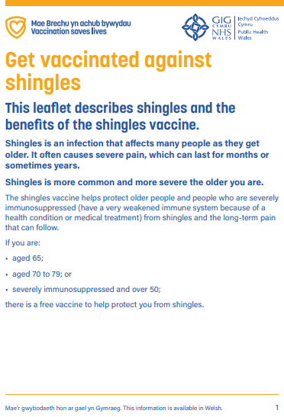


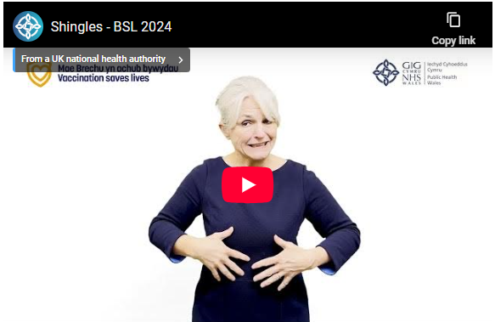
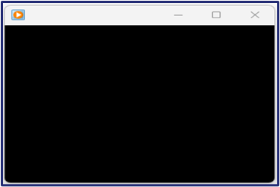
Resources
Resources are available free to order with free delivery on Health Information Resources website
Or download from the Shingles HCP webpage
Accessible resources are available online here
Currently being updated
Currently being updated
Currently being updated
Bilingual shingles leaflet for adults ​
Large print booklet CYM/ENG
Bilingual shingles poster
Currently being updated
Currently being updated
Currently being updated
BSL
Audio file CYM/ENG
Easy read booklet CYM/ENG

Slide 53
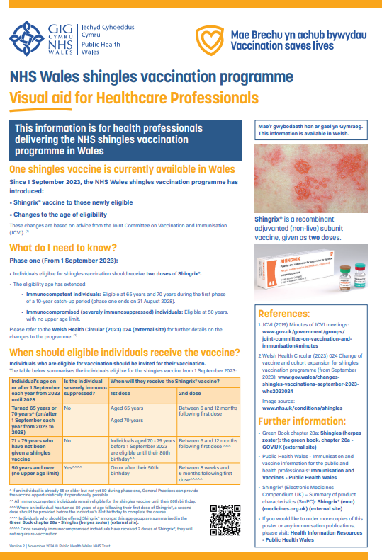

Resources
Shingles ’Frequently Asked Questions’ are available here
An updated shingles healthcare professional visual aid will be available to download in ENG/CYM here
An updated shingles immunisation programme toolkit for Healthcare Practitioners will be available to download in ENG/CYM here
Currently being updated

Slide 54
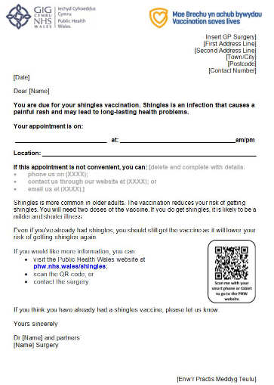
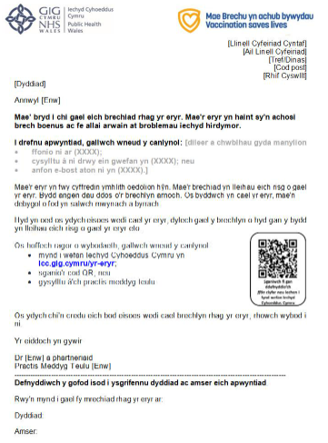
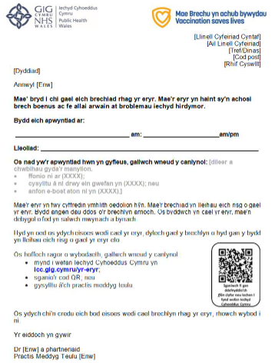
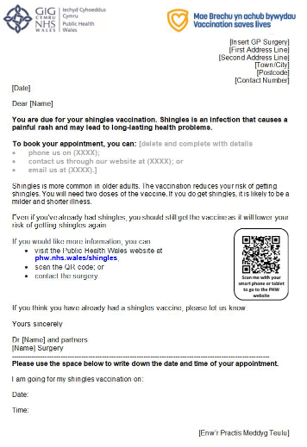
Resources
A template invitation letter is available to download here in English and Welsh
A template invitation letter for severely immunosuppressed individuals will be available to download here in English and Welsh
Template with date for appointment
Template with no date for appointment
Invitation for severely immunosuppressed individuals coming soon

Slide 55
Resources
Template PGDs and Advisory Document for Wales available here: Patient Group Directions (PGDs) and Protocols Landing Page - Public Health Wales (nhs.wales) and Patient Group Directions (PGD) - Welsh Medicines Advice Service (wales.nhs.uk)
Welsh Government Shingles immunisation programme policy (WHC/2023/024): Changes to shingles vaccinations (WHC/2023/024) | GOV.WALES
Welsh Government Shingles immunisation programme policy (WHC/2025/028): Expansion of shingles immunisation for severely immunosuppressed people aged 18 to 49 | GOV.WALES
Shingles vaccination programme website page is available here: Shingles - Information for health professionals - Public Health Wales (nhs.wales)
Shingles (Herpes Zoster): the green book chapter: https://www.gov.uk/government/publications/shingles-herpes-zoster-the-green-book-chapter-28a
Shingles vaccination: guidance for healthcare practitioners: Shingles vaccination: guidance for healthcare practitioners - GOV.UK (www.gov.uk)

