Slide 1
Vaccination against chickenpox (varicella)
and other changes to the routine childhood immunisation schedule in January 2026
These slides are version controlled and subject to revision
Version 2
Date: 12 December 2025
Vaccine Preventable Disease Programme
Public Health Wales
Notes:
Material contained in this document may be reproduced without prior permission provided it is done so accurately and is not used in a misleading context.
Acknowledgement to Public Health Wales NHS Trust to be stated. © 2025 Public Health Wales NHS Trust.
These training slides will be version controlled.
Version 2 changes:
Slide 2: added MMRV programme: information for healthcare practitioners - GOV.UK
Slide 9: added MMRV programme: information for healthcare practitioners - GOV.UK
Slide 41: Updated information from the Varicella green book chapter on the vaccine effectiveness of MMRV
Slide 47 updated links to the SmPC for ProQuad®
Slide 48: previous error in 3rd bullet, which stated Priorix-Tetra® instead of ProQuad®
Slide 49: Updated description of the reconstituted vaccine: a clear pale yellow to light pink liquid ProQuad powder and solvent for suspension for injection in a pre-filled syringe - Patient Information Leaflet (PIL) - (emc) | 101444
Slide 57: new slide added on the Red book
Slides 61-64: reviewed against the published Varicella: the green book - GOV.UK
Slide 67: new slide: MHRA and measles Green Book chapter reaffirms safety of childhood vaccinations
Slides 76/77: additional slides
Updated slides added to the resources section

Slide 2
Green Book
The following Green Book chapters have been updated:
Varicella: the green book - GOV.UK
Measles: the green book - GOV.UK
The following Green Book chapters are still being finalised:
Mumps: the green book - GOV.UK
Rubella: the green book - GOV.UK
This slide set is version 2 and has been reviewed against the Varicella: the green book - GOV.UK and Measles: the green book - GOV.UK green book chapters.
Version changes can be viewed in the notes section of slide 1

Slide 3
Vaccination against varicella (chickenpox), and other changes to the routine childhood immunisation schedule on 1 January 2026.
The information contained within this slide set is up to date as of 12 December 2025
It is important that all immunisers delivering the varicella vaccination programme and/or those who are providing immunisation advice familiarise themselves with the most up to date clinical evidence and guidance. This can be found in the following key documents:
The green book: Varicella: the green book - GOV.UK, Measles: the green book - GOV.UK, chapters have been updated The Mumps: the green book - GOV.UK, and Rubella: the green book - GOV.UK are currently being updated
UKHSA Guidance for Healthcare Professionals: MMRV programme: information for healthcare practitioners - GOV.UK
Welsh Government / policy: Written Statement: Introduction of a routine varicella (chicken pox) vaccination programme (29 August 2025) | GOV.WALES, Changes to routine childhood and selective neonatal hepatitis B vaccinations (WHC/2025/019) GOV.WALES, Routine varicella (chickenpox) vaccination for young children from 1 January 2026 (WHC/2025/046) [HTML] | GOV.WALES
Joint Committee on Vaccination and Immunisation: JCVI statement on a childhood varicella (chickenpox) vaccination programme - GOV.UK, Changes to the childhood immunisation schedule: JCVI statement (Nov 2022) - GOV.UK
VPDP webpage is available here: Immunisation and Vaccines - Public Health Wales
The content of this training slide set is subject to review. This resource will be version controlled. This is version 2 12 December 2025

Slide 4
Acknowledgements
Vaccine Preventable Disease Programme (VPDP), Public Health Wales: Immunisation and Vaccines - Public Health Wales
Vaccine Programme Wales (VPW)
Welsh Government
UK Health Security Agency: www.gov.uk/government/topics/public-health
UKHSA have granted permission for PHW to use the following slides to develop this training resource: Measles, mumps, rubella and varicella (MMRV) vaccination programme - GOV.UK

Slide 5
Notes to users
this slide set contains a collection of core slides for both individual use and for use or adaptation during the delivery of MMRV vaccination training
trainers should select the slides required depending on the background and experience of the healthcare practitioners they are training and according to the role they will have in delivering the MMRV vaccine programme
the information in this slide set (version 2) was correct at time of publication
updates to the slide set may be required in the future, for example in response to changing epidemiology or vaccination recommendations - please check online to ensure you are using the latest version of these slides Immunisation training resources and events - Public Health Wales

Slide 6
Contents
Section | Slide number
Aims | 7
Objectives | 8
Policy and overview of the changes | 10
Rationale for the introduction of a varicella (chickenpox) vaccination programme | 15
Measles | 24
Mumps | 27
Rubella | 30
Varicella (chicken pox) | 33
MMRV vaccination programme | 39
MMRV vaccines | 46
Contraindications and possible adverse reactions | 58
Epidemiology | 68
Engagement insights | 75
Resources | 80

Slide 7
Aims
to provide information for healthcare practitioners involved in advising on and delivering the routine childhood vaccination programme
to raise awareness of the current epidemiology of diseases, including varicella, measles mumps and rubella
to describe the vaccination programme details including administration of the varicella vaccine, eligibility, recommended dosage and schedule, contraindications, precautions and potential adverse reactions
to raise awareness of the impact of the routine childhood vaccination programme, including varicella
to highlight resources that support the routine childhood vaccination programme

Slide 8
Objectives
After completing this resource immunisers will be able to:
describe the aetiology and epidemiology of varicella
understand the rationale and evidence base for the changes to the routine childhood vaccination programme
discuss the benefits of vaccination against varicella
gain essential knowledge to administer the MMRV (measles, mumps, rubella and varicella) vaccine safely
identify relevant resources and additional information in relation to the changes to the routine childhood vaccination programme

Slide 9
Pre-requisites to administering the MMRV (measles, mumps, rubella, varicella vaccine)
Before administering a varicella vaccine, it is recommended that:
those new to immunisation should receive comprehensive foundation immunisation training. Both knowledge and clinical competence should be assessed before new immunisers start to give and/or advise about the MMRV vaccine Immunisation training standards for healthcare practitioner UK Health Security Agency - UKHSA)
immunisers have received MMRV vaccine training through attending a taught session
immunisers have received practical training in MMRV vaccine preparation and administration (if required)
​training in the management of anaphylaxis and Basic Life Support is undertaken, as specified by policy for your local area and are familiar with Resuscitation Council UK (RCUK) guidance on Management of Anaphylaxis in the Vaccination Setting
any additional statutory and mandatory training as required by your employer is completed
an appropriate legal framework to supply and administer the MMRV vaccine is in place e.g. Written prescription, Patient Specific Direction (PSD), or Patient Group Direction (PGD). Visit here for Wales PGD template
those involved in immunisation and vaccination understand the process of consent and how this applies when giving vaccines. Information on consent can be viewed here: Consent: the green book, chapter 2 - GOV.UK
immunisers and those giving immunisation advice access and familiarise themselves with the following key documents: Specific green book chapters on vaccination against measles, mumps, rubella and varicella: Information for healthcare practitioners: MMRV programme: information for healthcare practitioners - GOV.UK The vaccine product information in the Summary of Product Characteristics (Home - electronic medicines compendium (emc)
Notes:
For new immunisers this should be either through a face-to-face taught course or a blended approach of both e-learning and a face-to-face taught course. New immunisers should also have a period of supervised practice and support with a registered healthcare practitioner who is experienced, up to date and competent in immunisation.
Practitioners should always ensure they are accessing the most up to date information and guidance.

Slide 10
Policy and overview of the changes to the routine childhood immunisation schedule on 1 January 2026

Slide 11
Background: publications
November 2022: Joint Committee on Vaccination and Immunisation (JCVI) statement on changes to the routine childhood immunisation schedule Joint Committee on Vaccination and Immunisation (JCVI) statement on changes to the childhood immunisation schedule - GOV.UK
November 2023: JCVI statement on a childhood varicella (chickenpox) vaccination programme JCVI statement on a childhood varicella (chickenpox) vaccination programme - GOV.UK
May 2025: Welsh Government letter to professionals Changes to routine childhood and selective neonatal hepatitis B vaccinations (WHC/2025/019) [HTML] | GOV.WALES
29 August 2025: Welsh Government written statement Written Statement: Introduction of a routine varicella (chicken pox) vaccination programme (29 August 2025) | GOV.WALES
3 November 2025: Welsh Health Circular (WHC/2025/046)
Routine varicella (chickenpox) vaccination for young children from 1 January 2026
Routine varicella (chickenpox) vaccination for young children from 1 January 2026 (WHC/2025/046) | GOV.WALES

Slide 12
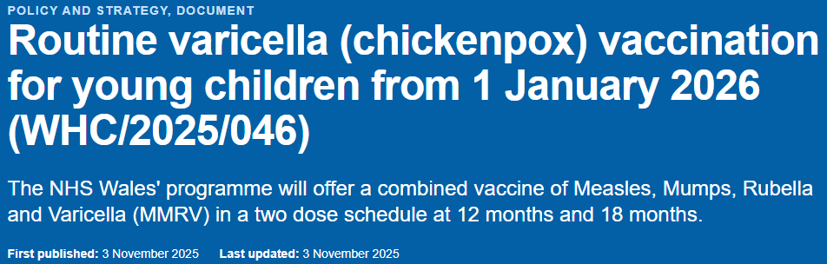
3 November 2025: Welsh Health Circular
Confirmation of the introduction of a new varicella (chickenpox) vaccine to the routine childhood immunisation schedule, following JCVI recommendations.
From 1 January 2026 a varicella (chickenpox) vaccination will be introduced to the routine childhood immunisation schedule.
using the combined measles, mumps, rubella and varicella (MMRV) vaccine
this means that children due their 1st or 2nd MMR vaccine from 1 January 2026 should be offered the combined MMRV vaccine, instead of MMR
there will also be a selective catch-up programme with MMRV for older children without a history of chickenpox or existing varicella vaccination, to help accelerate control and to further reduce transmission in the population
The one-dose MMRV selective catch-up programme will be delivered between 1 November 2026 and 31 March 2028
Routine varicella (chickenpox) vaccination for young children from 1 January 2026 (WHC/2025/046) | GOV.WALES

Slide 13
Summary of changes to the routine childhood immunisation schedule on 1 January 2026
From 1 January 2026:
introduction of an additional (4th dose) of 6-in-1 (DTaP/IPV/Hib/HepB) vaccine at a new routine appointment at 18 months
movement of the second MMR dose from 3 years 4 months to the new routine 18-month appointment
Welsh Government policy: https://www.gov.wales/changes-routine-childhood-and-selective-neonatal-hepatitis-b-vaccinations-whc2025019
From 1 January 2026 a varicella (chickenpox) vaccination will be introduced to the routine childhood immunisation schedule.
using the combined measles, mumps, rubella and varicella (MMRV) vaccine
this means that children due their 1st or 2nd MMR vaccine from 1 January 2026 should be offered the combined MMRV vaccine, instead of MMR
older children (born from 1 January 2020) without a history of chickenpox or previous 2 varicella vaccinations will be offered a dose of MMRV in a catch-up programme to help accelerate control and to further reduce transmission in the population
the one-dose MMRV selective catch-up programme will be delivered between 1 November 2026 and 31 March 2028
This is a new vaccine in the routine childhood vaccination schedule.
Welsh government policy: Routine varicella (chickenpox) vaccination for young children from 1 January 2026 (WHC/2025/046) | GOV.WALES
For more information see: Immunisation and Vaccines - Public Health Wales

Slide 14
Routine schedule from 1 January 2026
8-week appointment
6-in-1
MenB
12-week appointment
6-in-1
MenB
Rotavirus
6-in-1
16-week appointment
Rotavirus
PCV
12-month appointment
PCV
MMRV
MenB
18-month appointment
6-in-1
MMRV
3-yrs and 4-month appointment
4-in-1
NEW
Routine immunisation schedules for Wales - Public Health Wales

Slide 15
Rationale for introduction of varicella (chickenpox) vaccination programme

Slide 16
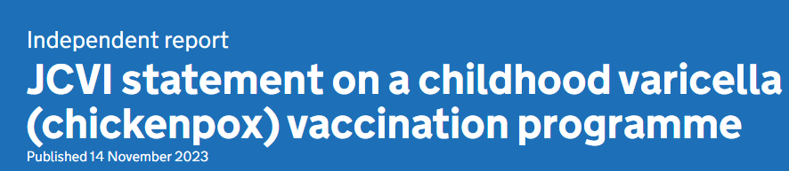
JCVI rationale for considering the introduction of a universal varicella (chickenpox) programme:
The aim of the programme is to prevent severe cases and other serious complications of varicella.
The JCVI sub-committee met many times in 2022 and 2023 to review the updated evidence, including:
varicella disease burden
potential impact on exogenous boosting
updated seroprevalence data
modelling cost-effectiveness and real-world data from countries who have already implemented a programme
JCVI statement on a childhood varicella (chickenpox) vaccination programme - GOV.UK
Notes:
The exogenous boosting (EB) hypothesis proposes that cell-mediated immunity is boosted for individuals re-exposed to varicella-zoster virus (VZV).

Slide 17
JCVI statement: catch-up vaccination programme
International practice
  most countries with routine varicella vaccination have offered catch-up
Rationale
  real world data from other countries has shown that implementation of a universal routine varicella vaccination programme leads to a dramatic drop in varicella cases
  due to the larger pool of varicella-susceptible children following the pandemic restrictions, and as vaccination is predicted to decrease circulation of varicella, there is a risk of susceptible children continuing to be vulnerable to catching varicella as they head into adulthood
  therefore, the committee considered it beneficial for a catchup programme to prevent a gap in immunity
Cost-effectiveness (early findings)
  universal single-dose catch-up vaccination programme using a single dose of vaccine (up to and including 5 years) is likely cost-effective.

Slide 18
JCVI considerations for the introduction of a universal varicella vaccination programme
Disease burden (University of Bristol study)*
Hospital impact
  the true burden of hospitalisations caused by varicella is underestimated through routine data sources due to errors in coding
  varicella is often not recorded as underlying cause (coded instead as secondary infection e.g. cellulitis, iGas, childhood stroke
  it was thought that there may be other secondary complications from varicella which are currently not well understood or captured
  severe complications are common, costly and a burden to the NHS
  uncomplicated varicella can still lead to hospitalisations in the young and those with underlying medical conditions
Community impact
  mild cases not captured in medical datasets
  Quality Adjusted Life Years (QALY) loss was estimated for mild varicella
  caregiver work absences & nursery days lost were measured
Overall findings
  both mild and severe varicella carry significant health, social & economic costs
  findings informed JCVI varicella vaccination modelling
Notes:
* Currently unpublished data. refer to: https://www.gov.uk/government/publications/childhood-varicella-vaccination-programme-jcvi-advice-14-november-2023/jcvi-statement-on-a-childhood-varicella-chickenpox-vaccination-programme for further information

Slide 19
Real-world Experience with Varicella Vaccination
Adopted internationally
  varicella vaccination is included in routine schedules of several countries, either as a 2-dose or single-dose strategy (USA, Canada, Australia, Germany)
  these countries have observed significant impact on cases of varicella and resulting hospitalisations
  countries introducing a 2-dose schedules show indirect protection in younger, unvaccinated children
  there is no evidence of infection rebound in rates of infection among those missing out on vaccination post-introduction
USA experience
  introduced 1995 (1 dose), 2007 (2 doses)
  25-year Centres for Disease Control and Prevention (CDC) data showed major reductions in varicella & hospitalisations
  CDC concluded that data does not support predictions that varicella programme would increase herpes zoster (shingles) incidence
UK modelling relevance
  JCVI sub-committee reviewed USA data
  findings incorporated into modelling to assess potential effect of vaccination on exogenous boosting
Notes:
The exogenous boosting hypothesis postulates that those who have previously had varicella have their immunity boosted by exposure to circulating varicella zoster virus, thereby inhibiting reactivation of the varicella virus and the development of herpes zoster.

Slide 20
Cost-effectiveness Modelling
Model development
  University of Cambridge, with JCVI input (unpublished) JCVI statement on a childhood varicella (chickenpox) vaccination programme - GOV.UK
  applied US real-world data, then refitted to UK data (seroprevalence, Quality of Life, data on primary care consultations for chicken pox)
Exogenous boosting assumptions (assumptions on duration of protection from herpes zoster)
  previous assumption on the duration of protection from herpes zoster through exogenous boosting (20 years) was too long
  it was agreed that the duration was likely to be around 3 years (sensitivity analysis 1–5 years)
Model outcomes
  the updated modelling did not show a rebound in varicella cases after introduction (consistent with international data)
  sharp initial decline maintained with 2-dose schedule
Cost-effectiveness analysis showed that a routine programme would be
  cost effective
  may be cost saving depending on vaccine price
  key drivers: vaccine cost & QALY loss estimates

Slide 21
JCVI recommendation after reviewing the evidence:
Recommendation that a universal varicella vaccination programme should be introduced as part of the routine childhood vaccination programme.
This should be a:
  2 dose programme
  at 12 and 18 months (in the new 18-month appointment)
  using the combined MMRV (measles, mumps, rubella and varicella) vaccine.
  With a catchup programme to prevent a gap in immunity.
As shown in other countries which include varicella in their routine vaccination programme:
A 2-dose schedule is predicted to decrease the number of cases of chickenpox in children rapidly and dramatically.
The programme will prevent severe cases of chickenpox and other serious complications. These are rare but can result in hospitalisation or other serious outcomes.
JCVI statement on a childhood varicella (chickenpox) vaccination programme - GOV.UK

Slide 22
JCVI statement: Varicella vaccine schedule and product choice
Vaccine timing
  proposed schedule at 12 & 18 months (aligns with MMR timing)
Safety considerations
  MMRV 1st dose slightly increased rate of febrile seizures vs using separate MMR and varicella vaccines at the same visit
  risk not seen with MMRV 2nd dose
  absolute risk very low
  febrile seizures are generally benign & self-limiting
Benefits of MMRV
  fewer injections at each visit
  parental preference for combined vaccine (UK attitudinal study*)
  JCVI considered that the small increased risk of febrile seizures was not of clinical concern and that there was a considerable benefit from giving fewer injections across all eligible children
“It is the view of the committee that both doses given in the varicella programme should be as the combined MMRV vaccine”
JCVI statement on a childhood varicella (chickenpox) vaccination programme - GOV.UK
Notes:
*Study available at: https://www.sciencedirect.com/science/article/pii/S0264410X23000488

Slide 23
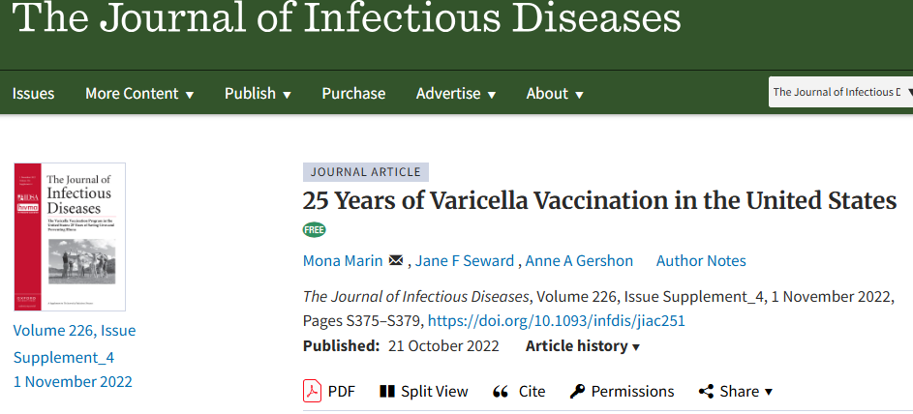
Impact of Varicella vaccination in the USA
The United States were the first country to include varicella vaccination as part of the routine childhood schedule, in 1995.
Before introduction of the varicella vaccine, in the early 1990s:
  4 million cases of chickenpox every year
  10,500 – 13,500 hospitalisations
  100 – 150 deaths.
Mostly affected children.
25 Years of Varicella Vaccination in the United States | The Journal of Infectious Diseases | Oxford Academic
Since 1995:
  97% ↓ cases Estimated 91 million cases of chickenpox prevented
Fewer than: US$23.4 billion net societal savings
  150,000 cases
  1,400 hospitalisations
  30 deaths

Slide 24
Measles

Slide 25
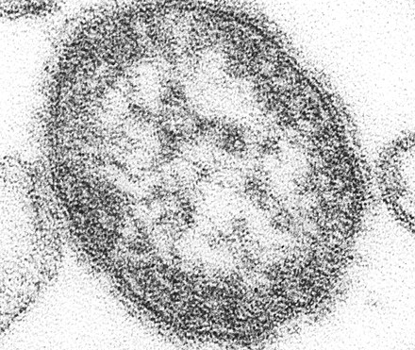
Measles infection
measles is an acute, highly infectious disease caused by a morbillivirus of the paramyoxovirus
measles is one of the most infectious diseases in the world. One person with measles can infect 9 out of 10 people around them, if they are not immune
transmission: respiratory droplets, which may be in the air for many hours
incubation: about 10 days (ranging between 7 and 18 days). With a further 2 – 4 days before the rash appears
infectious period: from when the first symptom appears to 4 days after the rash appears.
household secondary infection rate: approximately 71%
This Photo by Unknown Author is licensed under CC BY-SA

Slide 26
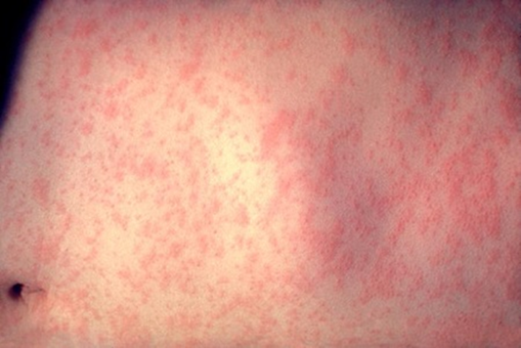
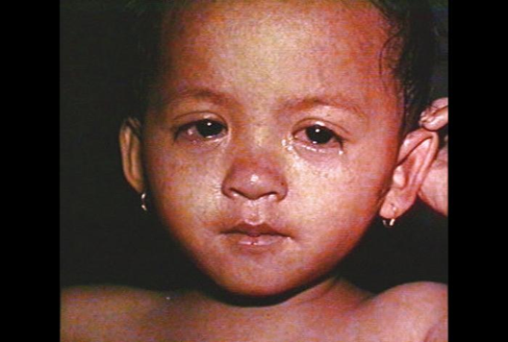
Measles complications
complications more common and more severe in:
  young infants and adults
  immunosuppressed individuals
  and during pregnancy
since the measles vaccine was introduced in the UK in 1968, 20 million cases of measles and 4,500 deaths have been prevented in the UK
outbreaks and cases of measles are mainly in unvaccinated children under the age of 10
complications include pneumonia (1- 6 in 100), otitis media (7-9 in 100), convulsions (1 in 200) and encephalitis (1 in 1000), Sub-acute sclerosing panencephalitis (SSPE) (1 in 25,000), death (1in 1,000-5,000)
there can also be a temporary reduction in the immune response for a few weeks following measles infection; this can increase the risk of severe secondary bacterial and viral infections
Measles rash. Courtesy of CDC
Measles rash and conjunctivitis. Courtesy of CDC
Notes:
A very rare but fatal neurological complication, called sub-acute sclerosing panencephalitis (SSPE), is caused when measles virus establishes chronic infection in the brain. It happens in about one in every 25,000 cases (1 in 8,000 if aged under 2 years). This is a progressive illness with neuro-cognitive symptoms and in most cases leads to coma and death.
The Oxford vaccine group have the following patient's story: https://vaccineknowledge.ox.ac.uk/files/sspe-serious-complication-measles (external site)

Slide 27
Mumps

Slide 28
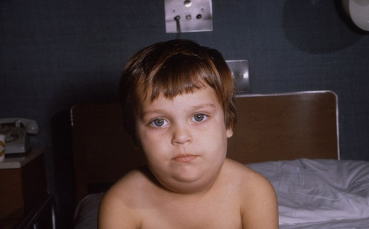
Mumps infection
before the MMR vaccine was introduced in 1988, about 80% of the population developed mumps infection
from this time, mumps cases have dropped dramatically in all age groups, although there have been several large outbreaks since. Most of the cases have been in individuals who missed the MMR vaccine when they were young
mumps is an acute, systemic viral illness that is moderately infectious. It is caused by the paramyxovirus
Courtesy of CDC
transmission: through respiratory droplets and close contact​
incubation: around 16 – 18 days (range: 14 to 25 days)​
infectious period: from about a week before the parotid swelling appears, to several days after ​
mumps is vaccine preventable. Around 88% of people who have 2 doses of the MMR vaccine will be protected against mumps. People who are vaccinated against mumps, but still catch it, are less likely to have serious complications or be admitted to hospital​
most cases of mumps now occur in young adults between the ages of 16 and 30​
prolonged close contact in schools and universities provides ideal conditions for the infection to spread​

Slide 29
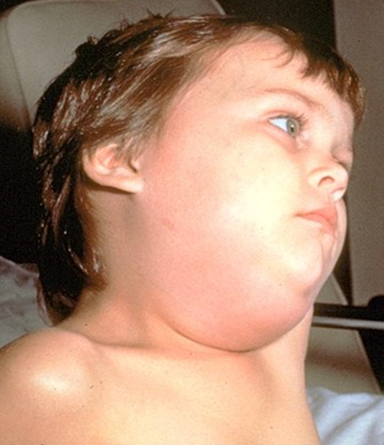
Mumps complications
prior to the introduction of the MMR vaccine in 1988, measles was the most common cause of viral meningitis and acquired deafness in children
asymptomatic mumps does occur in 20 to 40 % of cases
symptoms of mumps include swelling of the parotid gland/s, fever, headache, malaise, myalgia and anorexia
complications include:
  Meningitis: 5 in 100
  Encephalitis: 1 in 1000
  Pancreatitis: 4 in 100
  Oophoritis: 5 in 100 of post-pubertal women
  Orchitis: 25 in 100 of post-pubertal men
  Transient hearing loss: 4 in 100
Photo courtesy of CDC

Slide 30
Rubella

Slide 31
Rubella infection
rubella is a disease caused by a togavirus
transmission: direct contact or droplet
incubation: 14 to 21 days. Most people develop a rash 14 to 17 days after exposure
infectious period: a week before to a week after the onset of the rash
before the introduction of rubella immunisation, more than 80% of adults had evidence of previous rubella infection
in 1970 rubella immunisation was introduced in the UK for pre-pubertal girls and non-immune women of child-bearing age, to prevent rubella infection in pregnancy and congenital rubella syndrome (CRS) in their babies
in 1988 the MMR vaccine was introduced. Following this, there was a considerable decline in rubella in young children, and a fall in rubella infections in pregnant women
    antenatal testing for rubella antibodies (immunity) stopped in 2016 due to women of childbearing age being mostly immune through vaccination. As part of antenatal care, MMR vaccination status should be checked for all pregnant women. Those who are not up to date with their MMR vaccines should be referred to their GP to catch-up postnatally to protect future pregnancies

Slide 32
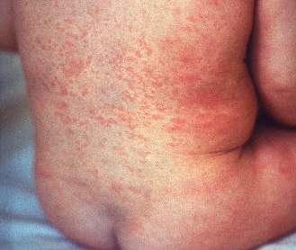
Rubella complications
rubella infection is often asymptomatic. If symptomatic, symptoms can include a mild fever, an erythematous rash (mainly on face and neck), cold like symptoms, feeling generally unwell, and conjunctivitis
transient arthralgia or arthritis can occur in adolescents and adults, especially in women and girls
rare complications: idiopathic thrombocytopenic purpura and encephalitis
rubella in pregnancy can result in severe damage to the foetus. Congenital rubella syndrome (CRS) can present with the following:
  Cataracts and other eye defects
  Deafness
  Cardiac abnormalities
  Microcephaly
  Retardation of intra-uterine growth
  Inflammatory lesions of the brain, liver, lungs and bone marrow
if an infections occurs in the first 8 – 10 weeks of pregnancy, 90% of surviving infants will result in damage, and multiple defects are common
Photo courtesy of CDC

Slide 33
Varicella (chickenpox)

Slide 34
Varicella (chickenpox) disease
chickenpox is an acute, highly infectious disease caused by varicella zoster virus
most common in young children below the age of 10, although it can be caught for the first time at any age
transmission: direct contact with fluid-filled vesicles or inhalation of aerosols from vesicular fluid
incubation: 14 to 16 days (range 10 – 21 days)
infectious period: 1-2 days before rash until the spots have scabbed over (longer if immunosuppressed)
household secondary infection rate: approximately 71%
chickenpox infection is usually mild and self-limiting, though some children do develop complications and be hospitalised. Very rarely people die from chickenpox
90% of people raised in the UK are immune by 15 years old*
Notes:
*Due to the larger pool of varicella-susceptible children following the pandemic restrictions, and as vaccination is predicted to decrease circulation of varicella, there is a risk of susceptible children continuing to be vulnerable to catching varicella as they head into adulthood. Therefore the JCVI considered it beneficial for a catchup programme to prevent a gap in immunity.

Slide 35
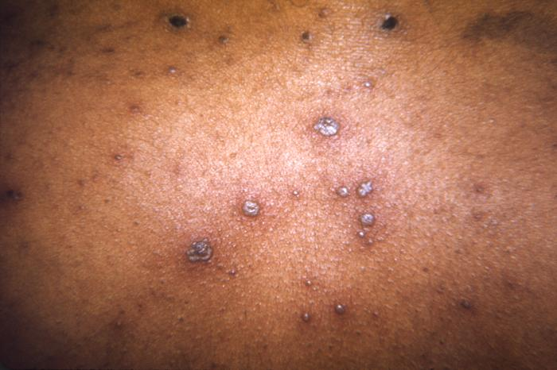
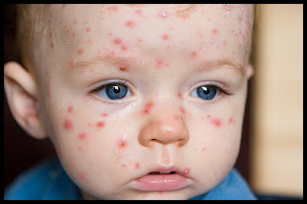
Clinical Features of Chickenpox
mild prodrome:
  1-2 days of fever
  malaise may proceed the rash, though it may be absent (particularly in young children, where the rash may be the first symptom)
rash:
  vesicles start on face/scalp and spread to the trunk and abdomen. Sparce on limbs
  after 3-4 days the vesicles dry with a granular scab, followed by further crops
  severity varies from a few lesions to a widespread confluent rash
early treatment with acyclovir can reduce duration/severity
This Photo by Unknown Author is licensed under CC BY-SA
This Photo by Unknown Author is licensed under CC BY-SA-NC

Slide 36
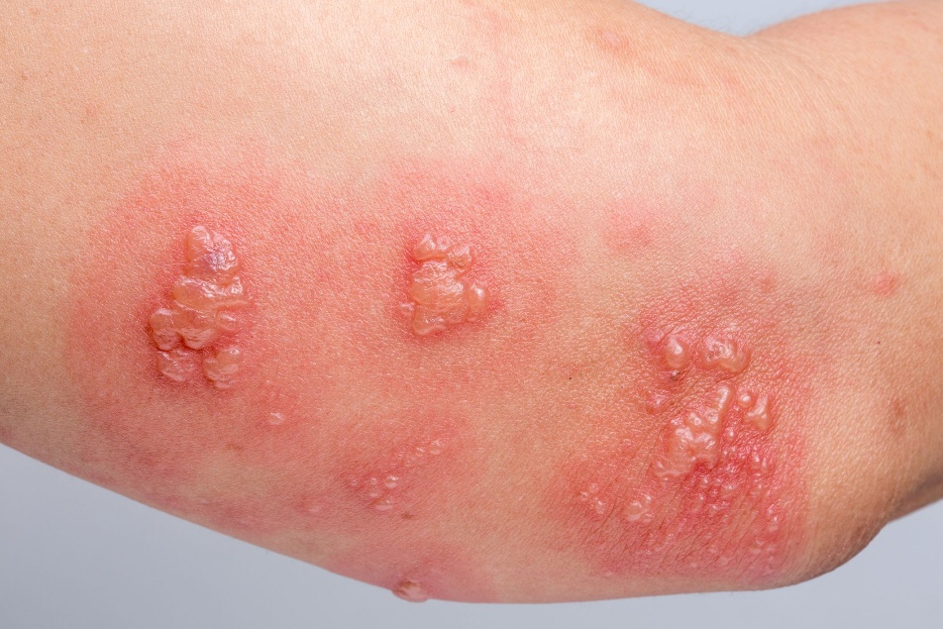
Herpes Zoster (Shingles)
caused by reactivation of dormant varicella zoster virus (VZV)
more commonly in elderly but can occur in children and especially common in immunosuppressed individuals of any age
vesicles in dermatomal distribution
often painful with associated parasthesia
transmission: VZV from shingles lesions can cause chickenpox in susceptible contacts
This Photo by Unknown Author is licensed under CC BY-NC-ND

Slide 37

Risk groups and complications
complications of varicella infection include:
  pneumonia
  secondary bacterial infection of the skin with Group A Streptococcus or Staphylococcus aureus. These can lead to septicaemia
  encephalitis and ataxia
the disease can be more serious in adults, particularly pregnant women and those who smoke. At more risk of fulminating varicella pneumonia
immunosuppressed and neonates: the risk of disseminated or haemorrhagic varicella is greatly increased
the risk to the foetus and neonate from maternal chickenpox are related to the time of infection of the mother
Stock image

Slide 38
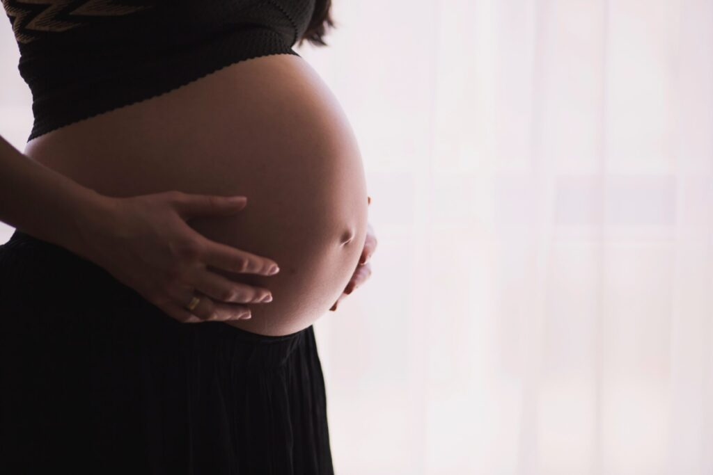
Chickenpox in pregnancy
The risks to the foetus and neonate from maternal chickenpox are related to the time of infection in the mother:
0 - 20 weeks: congenital varicella Syndrome (CRS). Incidence is rare (< 1% in 1st trimester, about 2% weeks 13-20). CRS includes limb hypoplasia, microcephaly, cataracts, growth restriction, skin scarring. The mortality rate is high
20-28 weeks: rare foetal damage (e.g. eye, brain, skin) reported, but risk is low
-7 to+7 days around delivery: severe and even fatal disease in the neonate. Historically high mortality (reduced by varicella zoster immunoglobulin in the UK)
This Photo by Unknown Author is licensed under CC BY-NC-ND

Slide 39
MMRV vaccination programme

Slide 40
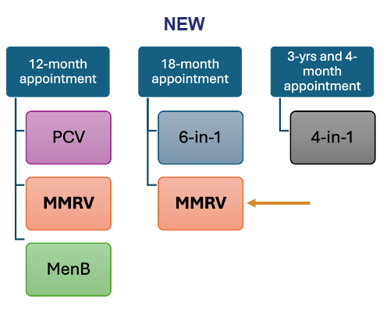
Summary:
On the 1 January 2026:
introduction of additional (4th dose) of 6-in-1 vaccine at a new 18-month appointment
children routinely offered MMRV instead of MMR at 12 and 18 months
at 3 years and 4 months children will routinely only receive the 4-in-1

Slide 41
Vaccine effectiveness
MMRV seroconversion rate is high:
after 1 dose:
  approx. 87% of children develop antibodies against varicella
  more than 90% develop antibodies against measles, mumps and rubella
after 2 doses:
  seroconversion reaches approximately 99% in measles, mumps, rubella and varicella
protection is long-lasting:
  studies show 95% effectiveness for 2 doses (MMRV or MMR+V) in children aged 11-22 months, maintained over 10 years
  25 years of U.S. surveillance confirms no decline in effectiveness over time with a 2-dose schedule*
breakthrough infections can occur, but disease is much milder in vaccinated children (fewer lesions, less fever)
1 dose is extremely effective in protecting against severe disease
MMRV vaccination: information for healthcare professionals - GOV.UK, Green Book chapter 34: Varicella
Notes:
*Effectiveness of Varicella Vaccine: 25 Years of Postlicensure Experience in the United States | The Journal of Infectious Diseases | Oxford Academic

Slide 42
Key information on implementation of routine and catch-up programmes from varicella from 1 January 2026
Date of Birth | Age on 31 December 2025 | New Programme from 01 January 2026 | Child’s full schedule for MMR/MMRV
01.01.2025 or after | Under 1 year | Two doses of MMRV at 12m and 18m | 12m MMRV 18m MMRV
01.07.2024 to 31.12.2024 | 1 year to under 18m | Two doses of MMRV at 18m and 3y4m | 12m MMR 18m MMRV 3y4m MMRV (see notes)
01.09.2022 to 30.06.2024 | 18m to under 3y4m | One dose of MMRV at 3y4m | 12m MMR 3y4m MMRV. (Not eligible for 18-month appointment)
01.01.2020 to 31.08.2022 | 3y4m to under 6y | Selective catch up from 1 Nov-2026 to 31 Mar 2028 for those who have not yet had chickenpox infection. | 12m MMR 3y4m MMR MMRV offered if no history of chickenpox or two varicella vaccines)
31/12/2019 or before | 6y and older | Not eligible | 12m MMR 3y4m MMR
Any child with an incomplete immunisation history for their age should be managed according to the UKHSA uncertain or incomplete immunisation algorithm.
There is no requirement for practices to check the history for those who respond to the offer.
Notes:
The right-hand column shows what a fully vaccinated child (according to both old and current schedules) should have received, or will receive.
It’s fine if some children end up with three MMR-containing doses. If they already have antibodies from a previous dose, these will neutralise the vaccine virus in later doses.

Slide 43

MMRV selective catch-up programme(1)
the one-dose MMRV selective catch-up programme will be delivered between 1 November 2026 and 31 March 2028
the offer is for children over 3y 4m to under 6y on 1 Jan 2026 (DOB 01.01.2020 to 31.08.2022)
1 dose of MMRV vaccine will be offered:
  to those without a history of chickenpox, or
  2 doses of varicella vaccination
children who do present for the selective catch-up do not require the MMRV vaccine if parents volunteer that the child has had previous chickenpox infection or 2 previous varicella-containing vaccines
there is no requirement for practices to check the history for those who do respond to the catch-up offer
there are no safety concerns with giving the vaccine to a child who has already had chickenpox infection or previous varicella vaccination
the vaccine is extremely effective in protecting against severe varicella disease, even if only one dose is administered.
Stock image

Slide 44
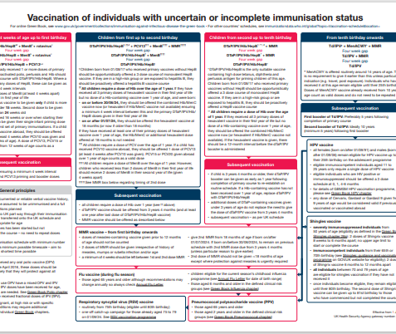
MMRV selective catchup programme (2)
there are no safety concerns with giving MMRV to a child who has already had chickenpox infection or previous varicella vaccination
for children who have missed routine doses of MMR, these children should be caught up using the UKHSA uncertain or incomplete immunisation algorithm

Slide 45

Additional information
a “varicella-only” vaccine will not be offered in the NHS routine or selective programmes
however, pre-existing arrangements remain (outside the routine immunisation schedule) for the provision of the varicella only vaccine for close contacts of those at high risk of complications from varicella infection (e.g. siblings of a child with leukaemia, or a child whose parent or sibling is undergoing chemotherapy), in line with Green Book guidance.
the MMR vaccine will no longer be available for the NHS routine childhood programme from 1 Jan 2026
the MMR vaccine will be available for administration outside the routine childhood programme, e.g. for
  catching up older individuals (DOB on or before 31 Dec 2019) who have not had 2 doses of MMR and are not eligible for MMRV
children > 6y at start of programme (DOB on or before 31 Dec 2019) are not eligible for MMRV vaccination via the routine NHS MMRV programme. If not fully vaccinated, they should be offered MMR vaccine
a small number of children (>1y - < 18m, DOB after 1 July 2024 – 31 Dec 2024) are eligible to receive 3 MMR-containing vaccines. There are no safety concerns with this.
Stock image

Slide 46
MMRV vaccines

Slide 47
The vaccines
the programme will use 2 combined MMRV vaccines:
  Priorix-Tetra® (GSK): (does not contain pork gelatine)
    Patient information leaflet: Priorix Tetra Powder and solvent for solution for injection in pre-filled syringe - Summary of Product Characteristics (SmPC) - (emc) | 101321
    Information for healthcare professionals (SmPC): Priorix Tetra Powder and solvent for solution for injection in pre-filled syringe - Summary of Product Characteristics (SmPC) - (emc) | 101321
  ProQuad® (MSD): (contains pork gelatine)
    Patient information leaflet: ProQuad powder and solvent for suspension for injection in a pre-filled syringe - Patient Information Leaflet (PIL) - (emc) | 101444
    Information for healthcare professionals (SmPC):ProQuad powder and solvent for suspension for injection in a pre-filled syringe - Summary of Product Characteristics (SmPC) - (emc) | 101444
ProQuad® and Priorix-Tetra® are live attenuated vaccines. As the vaccine contains weakened forms of the viruses, it does not cause the diseases
the vaccines are considered clinically equivalent and interchangeable, although Priorix-Tetra® should be offered to children whose parents/ guardians do not wish them to receive a vaccine containing pork gelatine
guidance in the Green Book supersedes the summary of product characteristics (SmPC) Varicella: the green book, chapter 34 - GOV.UK

Slide 48
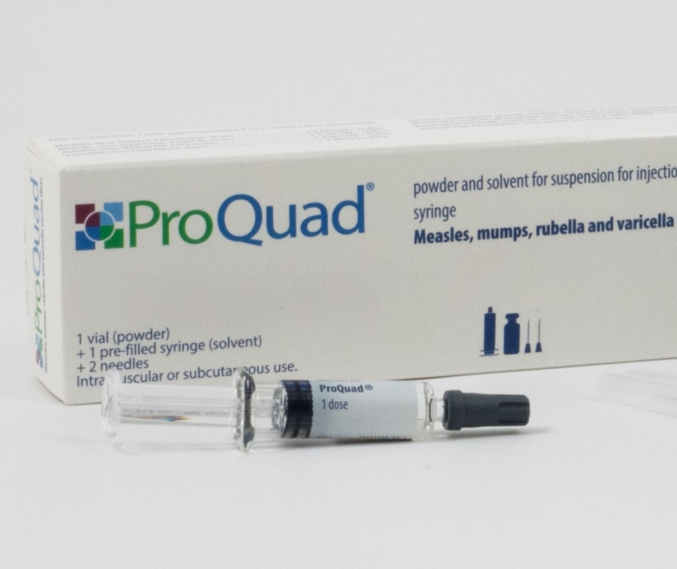
ProQuad®
pack size: Single dose packs. 1 x pre-filled syringe containing solvent + 1 vial of powder + 2 unattached needles. One reconstituted dose is 0.5ml
pack dimension: 150 (H) x 47 (W) x 28 mm (D)
in addition to the live attenuated viruses, ProQuad® contains:
  Sucrose Sodium bicarbonate Neomycin
  Hydrolysed gelatin Potassium phosphate Phenol red
  Sodium chloride Potassium chloride Hydrochloric acid (to adjust pH)
  Sorbitol (E420) Medium 199 with Hanks’ Salts Sodium hydroxide (to adjust pH)
  Monosodium glutamate Minimum Essential Medium, Eagle
  Sodium phosphate
the solvent is water for injections
ProQuad® contains pork gelatine
Priorix-Tetra® should be offered to children whose parents or guardians do not wish them to receive a vaccine containing pork gelatine
Image source: MSD

Slide 49
Preparation and administration of ProQuad®
powder in a vial, with a solvent for solution in a pre-filled syringe
before reconstitution: powder is a before reconstitution the lyophilised powder (or “compact crystalline cake / plug”) is described as white to pale yellow (or “white to pale yellow compact crystalline plug/cake”)
solvent: clear, colourless liquid
reconstitute vaccine:
  by adding entire contents of pre-filled syringe of solvent to the vial containing the powder
  inspect the reconstituted vaccine. Its colour should become a clear pale yellow to light pink liquid
  it may contain translucent product-related particulates, which is normal for this vaccine, but if the vaccine presents with other colouration or contains other particulate matter, do not administer

Slide 50
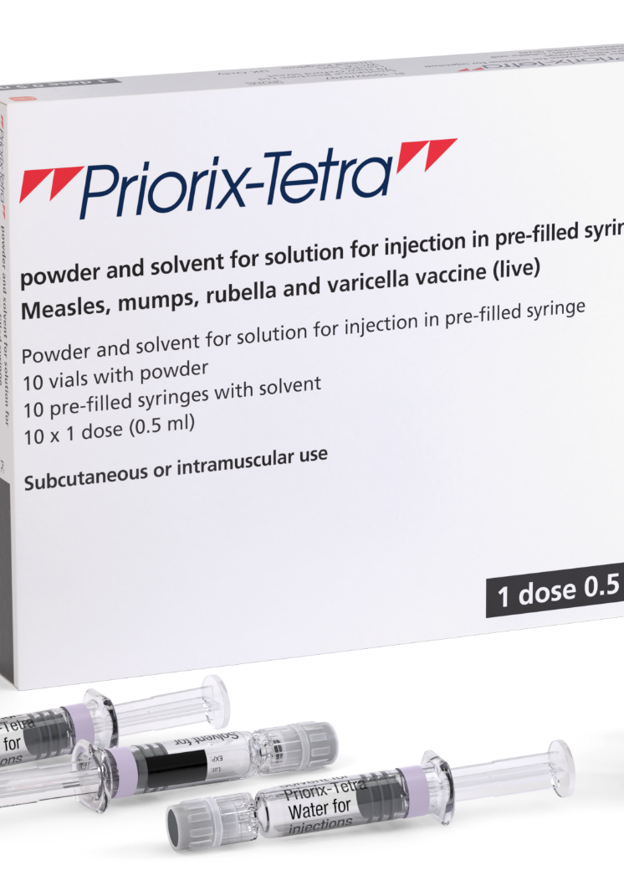
Priorix-Tetra®
pack size: 10 dose pack. 10 x single dose powder in a vial and 10 x single dose diluent (solvent) in a pre-filled syringe. One reconstituted dose = 0.5ml
pack dimension: 142 (H) x 178 (W) x 29 mm (D)
in addition to the live attenuated viruses, Priorix-Tetra® contains:
  Amino acids (containing phenylalanine)
  Lactose anhydrous
  Mannitol (E 421)
  Sorbitol (E420)
  Medium 199 (containing phenylalanine, para-aminobenzoic acid, sodium and potassium)
  Contains a trace amount of neomycin
the solvent is water for injections
Priorix-Tetra® does not contain pork gelatine
this MMRV vaccine should be offered to children whose parents or carers do not wish them to receive a vaccine containing pork gelatine
Image source: GSK

Slide 51
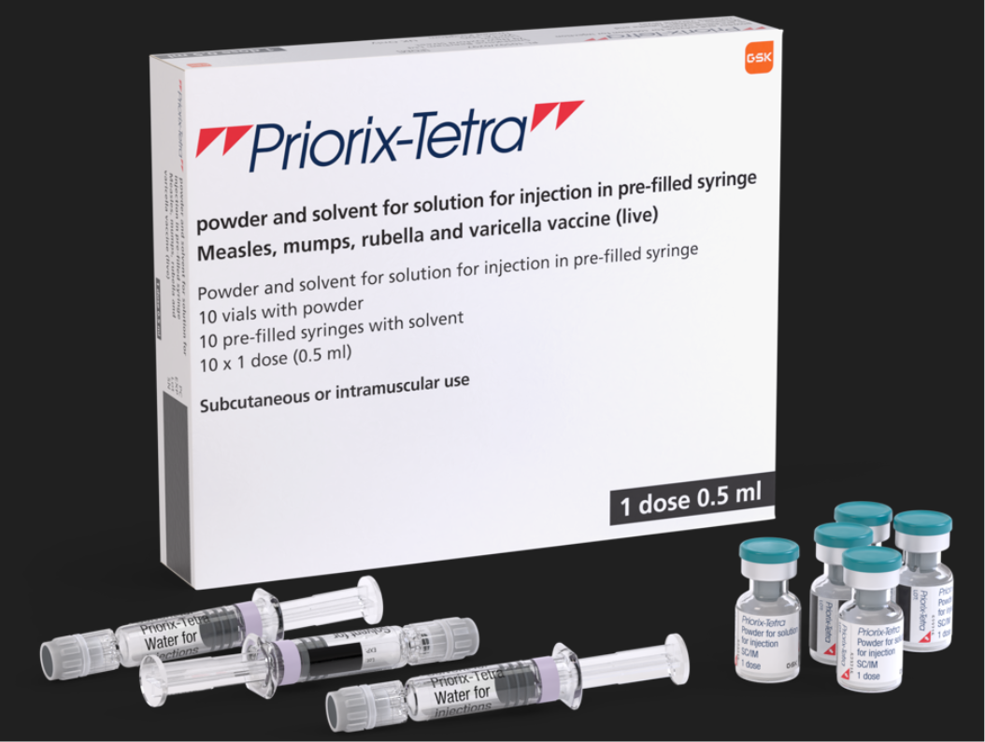
Priorix-Tetra®
Please note that whilst it states: ‘1 dose 0.5ml’ in the bottom right corner of the box and on the side of the box, this refers to the volume of vaccine (0.5ml) which should be given per dose.
The box itself contains10 doses of MMRV vaccine

Slide 52
Preparation and administration of Priorix-Tetra®
powder in a vial, with a solvent for solution in a pre-filled syringe
before reconstitution: powder is a whitish to slightly pink coloured cake, a portion of which may be yellowish
solvent: clear, colourless liquid
reconstitute vaccine:
  by adding entire contents of pre-filled syringe of solvent to the vial containing the powder
  inspect the reconstituted vaccine. Its colour may vary from clear peach to fuchsia pink due to minor variations of its pH
  it may contain translucent product-related particulates, which is normal for this vaccine, but if the vaccine presents with other colouration or contains other particulate matter, do not administer
one reconstituted dose is 0.5ml

Slide 53
MMRV vaccine administration and storage
both vaccines should be stored in a vaccine refrigerator between +2ºC and +8ºC
store them in their original packaging. This is important to ensure that they are protected from light, that their component parts are kept together and for retention of the batch numbers and expiry dates for the entire product, which is printed on the vaccine cartons
once reconstituted, the vaccines should be administered immediately
for the national programme it is recommended that ProQuad® and Priorix-Tetra® be administered intramuscularly
they can be administered into the deltoid area of the upper arm, or the anterolateral aspect of the thigh

Slide 54
MMRV scheduling
the routine schedule is 2 doses (children in the selective catch-up programme will receive 1 dose)
doses should be given as per the new schedule, but where they are given to catch-up a child behind schedule, they can be given a minimum of 4 weeks apart
some children will be eligible to receive 3 MMR-containing vaccines. There are no safety concerns with this
MMRV can be given at the same time as, or at any interval before or after other live vaccines, except for Yellow Fever, where a 4-week interval is required
you will find the new routine immunisation schedule from 1 January 2026 here (currently being updated): Routine immunisation schedules for Wales - Public Health Wales
an eligibility tool to support healthcare professionals when implementing the routine and catch-up programmes for MMR vaccination from 1 January 2026 is available here: Changes to the childhood immunisation schedule - Information for health professionals - Public Health Wales under sub-heading “Which vaccines will be given and when?”

Slide 55
Schedule up to 5 years old from 1 January 2026
Age due | Vaccine
8 weeks old | DTaP/IPV/Hib/HepB (6 in 1) MenB Rotavirus
12 weeks old | 6 in 1 MenB Rotavirus
16 weeks old | 6 in 1 Pneumococcal (PCV)
12 months old | PCV MMRV MenB
18 months old | 6 in 1 MMRV
2- and 3-year-olds, and all school aged children | Live attenuated influenza vaccine (LAIV)
3 years and 4 months | dTaP/IPV (4 in 1)
Routine immunisation schedules for Wales - Public Health Wales

Slide 56
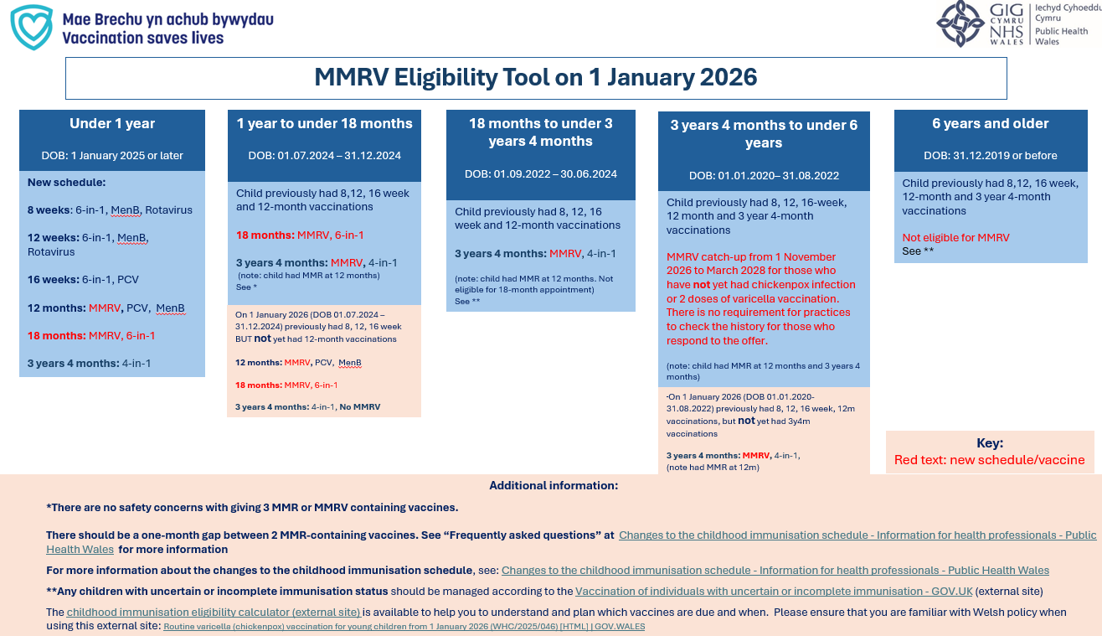
Implementing the routine and catch-up programmes for MMR vaccination from 1 January 2026: eligibility tool for Wales
The MMRV eligibility tool is available here: icc.gig.cymru/OfferynCymhwyseddMMRV

Slide 57
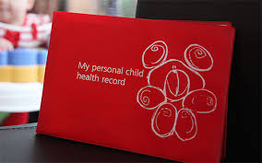
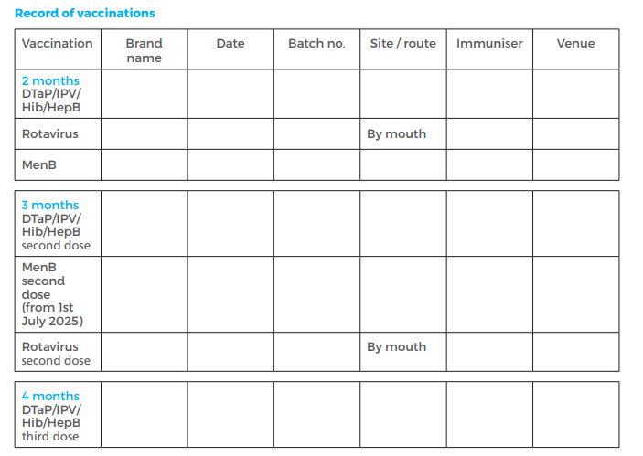
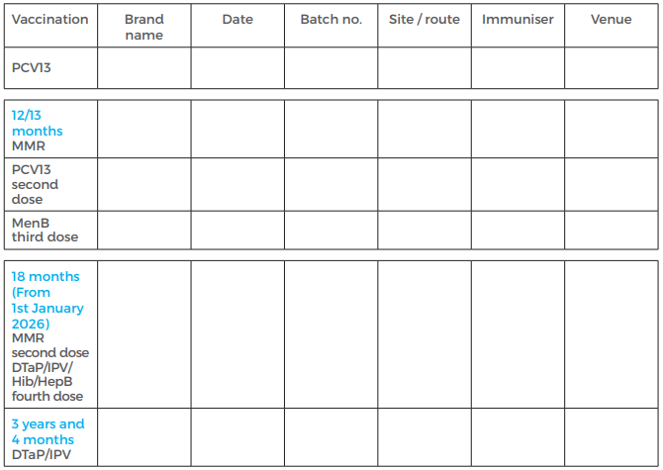
Red Book
a new Red Book was issued in July 2025 and will be updated again in July 2026
Red Books will need to be manually updated to reflect MMRV
57

Slide 58
Contraindications and possible adverse reactions

Slide 59
Contraindications and precautions
The MMRV vaccine should not be given to:
pregnant women. Pregnancy should be avoided for 1 month after the last dose of a varicella containing vaccine
those who are immunosuppressed. See Contraindications and special considerations: the green book, chapter 6 - GOV.UK and Varicella: the green book, chapter 34 - GOV.UK for more detail
anyone who has had:
  a confirmed anaphylactic reaction to a previous dose of the same vaccine
  a confirmed anaphylactic reaction to any ingredient in the vaccine ( including neomycin or gelatine)
varicella vaccines are not recommended for infants under 9 months of age
vaccination should be postponed if a child is acutely unwell with a high fever, and they should wait until they have fully recovered
this avoids confusing symptoms of an illness with adverse effects of the vaccine.
a cold or a minor illness is not a reason to delay the vaccine
very few people are contraindicated for MMRV. If unsure, obtain guidance from the child’s specialist rather than withholding the vaccine

Slide 60
Possible adverse reactions
Global studies have found that varicella-containing vaccines are well tolerated and rarely linked to serious adverse events
adverse events after MMRV vaccination (excluding allergic reactions) are usually due to effective replication of the vaccine viruses, which can cause mild illness. These events typically occur:
  6-11 days post vaccination (measles component)
  2-3 weeks post-vaccination (measles and mumps component (mumps and rubella components)
  3-4 weeks post-vaccination (varicella component)
overall, adverse reaction rates are similar or lower for second and subsequent MMR-containing vaccine doses compared to the first dose
common reactions to the MMRV vaccine include:
  injection site reactions (pain, tenderness, redness, swelling
  fever
  irritability
  rash (including measles-like or varicella-like rash)

Slide 61
Post-vaccination rash
some children may develop a varicella vaccine-associated rash at the injection site
they can attend childcare or school, but any vesicles should be kept covered as a precaution
very rarely, a varicella-like rash may appear elsewhere on the body within one month of vaccination (either disseminated or localised)
a widespread rash is more likely due to natural chickenpox than the vaccine virus; these children should be assessed by a clinician and recent exposure considered
Transmission
transmission of the varicella-containing vaccine virus from immunocompetent individuals to susceptible close contacts is possible but very rare
transmission of vaccine virus in absence of a post-vaccination rash has not been documented
if a localised vaccine-related rash appears away from the injection site, cover the lesions to reduce risk
if the rash is widespread, the risk is higher; immunosuppressed contacts with significant exposure should receive post-exposure prophylaxis as per guidance*
pregnant contacts who are otherwise healthy can be reassured that the risk of infection is very low
Notes:
*Post-exposure prophylaxis for chickenpox and shingles - GOV.UK

Slide 62
Febrile convulsions
febrile convulsions are common in children1 in 25 children by the age of 5 have febrile convulsions
  these are generally short lived and are generally considered benign
there is a small increase in the risk of febrile convulsions 5 to 10 days following the first dose of the MMRV vaccine. This is not observed with the second dose
the absolute risk is very low. To put this in context:
  the number of extra children who may have a febrile convulsion per 100,000
    after 1st dose of MMR: 24
    after 1st dose of MMRV: 35
    after measles infection: 2,300
parents should be advised of the low risk, but also advised to seek medical attention if their child does have a febrile convulsion
as fever after the MMRV vaccine can happen anytime within 2 weeks, there is no need to give prophylactic paracetamol before the vaccine. If the child develops symptoms afterwards, paracetamol can be given
MMRV programme: information for healthcare practitioners - GOV.UK UKHSA have published the following guidance: MMRV and febrile convulsions - GOV.UK

Slide 63
Encephalitis and the MMRV vaccine
encephalitis is a known complication of wild-type varicella and measles infections, occurring in about 2–3 cases per 100,000 varicella infections and 100 cases per 100,000 measles infections
post-marketing surveillance of varicella-containing vaccines has reported a small number of encephalitis cases after vaccination, but no clear link has been established
over 15 years of monitoring in the USA, 22 cases of encephalitis were reported following MMRV vaccination—about 0.06 cases per 100,000 doses
varicella zoster virus was detected in one case, but was not strain-typed
the risk of encephalitis from natural varicella or measles infection is far higher than the risk after vaccination

Slide 64
Idiopathic thrombocytopenic purpura (ITP)
ITP is a blood disorder where the immune system destroys platelets, which are needed for blood clotting
ITP can occur after MMRV vaccination, most likely due to the rubella component
it usually happens within six weeks and resolves on its own
the risk is about 1 in 22,300 after the first MMR dose in the second year of life and is likely similar for MMRV.
the risk after vaccination is much lower than the risk after natural measles or rubella infection.
children with a previous ITP diagnosis do not have an increased risk after MMR-containing vaccines.
there is no evidence linking ITP to the second MMR dose, but data are limited for children who had ITP after the first dose
if ITP occurs after the first dose of MMRV, *test for measles antibodies before giving a second dose
if the child is not protected against measles, a second MMRV dose is recommended
serological testing for mumps, rubella or varicella antibodies is not recommended
Notes:
*Speak to the on-call microbiologist who will help to arrange serological testing at either the local microbiology laboratory, or onward transport to the UKHSA Virus Reference Department, which offers free, specialised serological testing for such children

Slide 65
Prescription only medication (POM)
MMRV should only be administered using a:
prescription written manually or electronically by a registered medical practitioner or other authorised prescriber
patient specific direction (PSD)
patient group direction (PGD)
UK Health Security Agency (UKHSA) provide updated PGD templates (Patient Group Directions) which are available here: Welsh Medicines Advice Service (WMAS). These are template PGD’s that can be amended locally by health boards
NB: Local authorisation is required before PGD templates can be used.

Slide 66
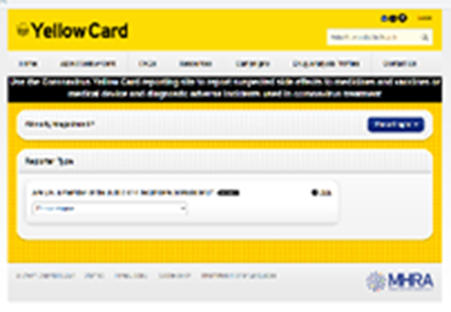

Reporting suspected adverse reactions
vaccinators should be advised that they can report any adverse reactions or suspected side effects to the MHRA through the online yellow card scheme website or the Yellow Card app
any suspected side effects following vaccine administration should be reported to the MHRA Yellow Card Scheme
anyone can report even if uncertain about whether vaccine caused condition:
  www.mhra.gov.uk/yellowcard or call 0800 731 6789 (9am to 5pm Monday to Friday)
  Green Book Chapter 9 for detailed guidance on reporting vaccine reactions
Notes:
Healthcare professionals and patients are encouraged to report suspected adverse reactions to the Medicines and Healthcare Products Regulatory Agency (MHRA) using the yellow card reporting scheme
Green Book chapter 9: https://www.gov.uk/government/publications/surveillance-and-monitoring-for-vaccine-safety-the-green-book-chapter-9

Slide 67
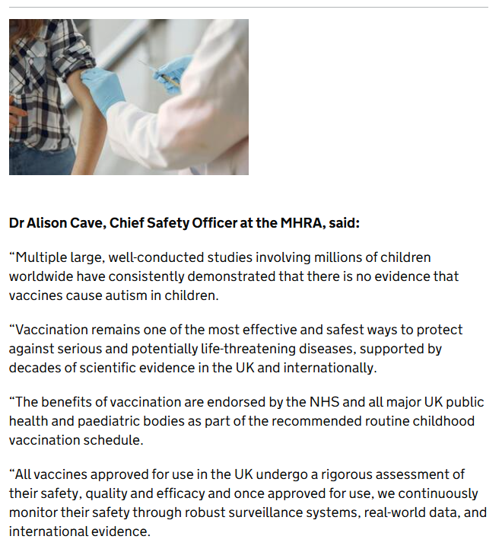
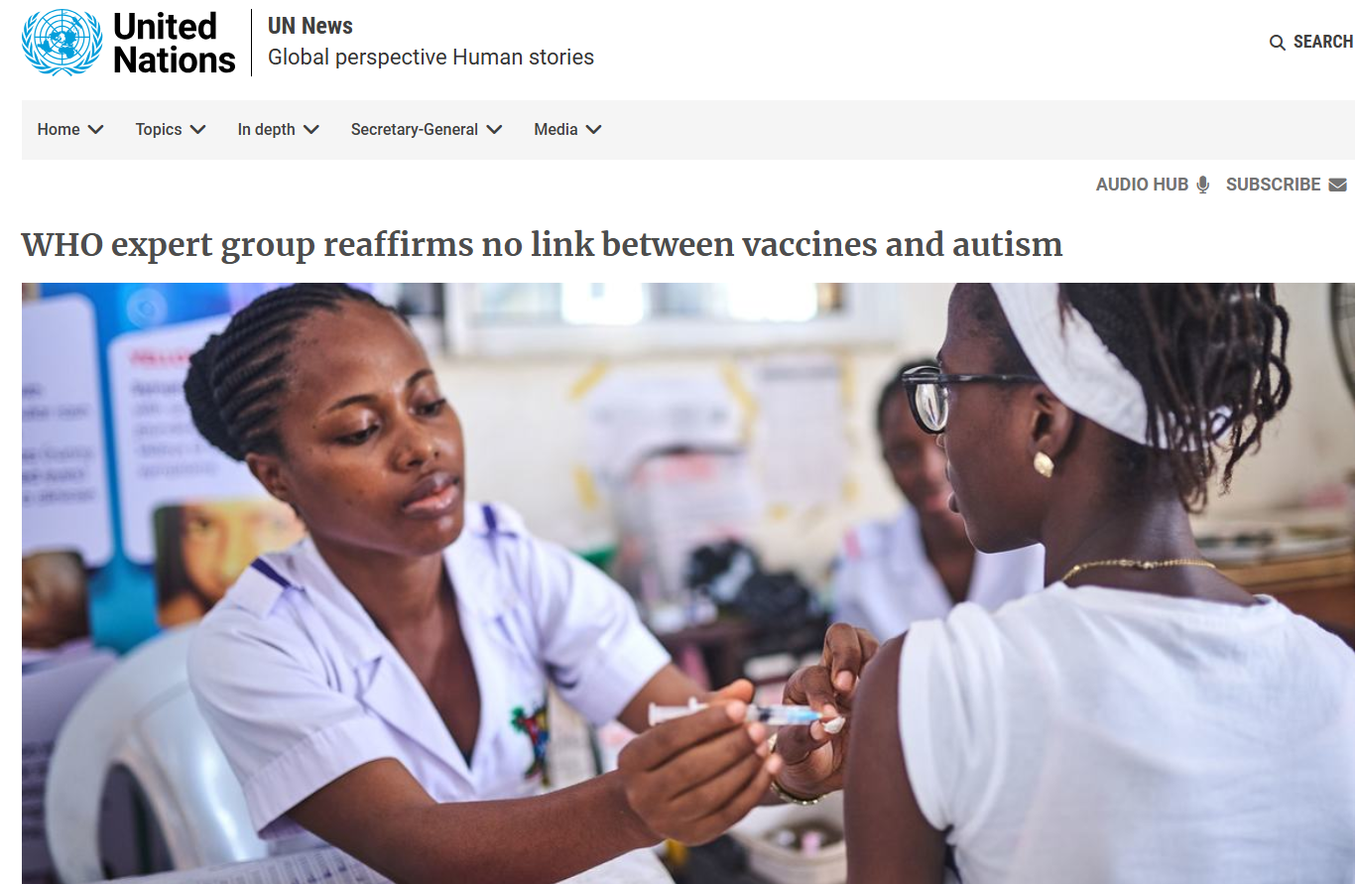
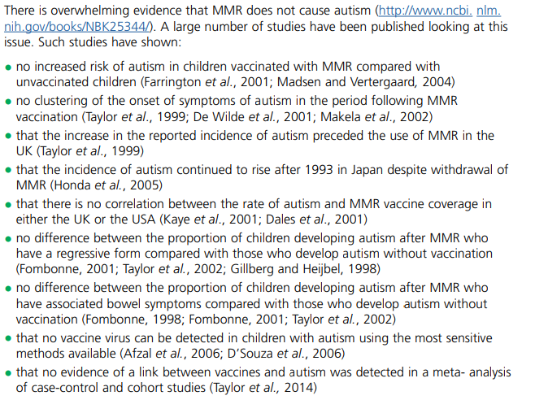
WHO, MHRA and measles green book chapter reaffirms safety of childhood vaccinations
Green Book on Immunisation: Measles: chapter 21
WHO expert group reaffirms no link between vaccines and autism | UN News
MHRA reaffirms safety of childhood vaccination - GOV.UK

Slide 68
Epidemiology
Influenza

Slide 69
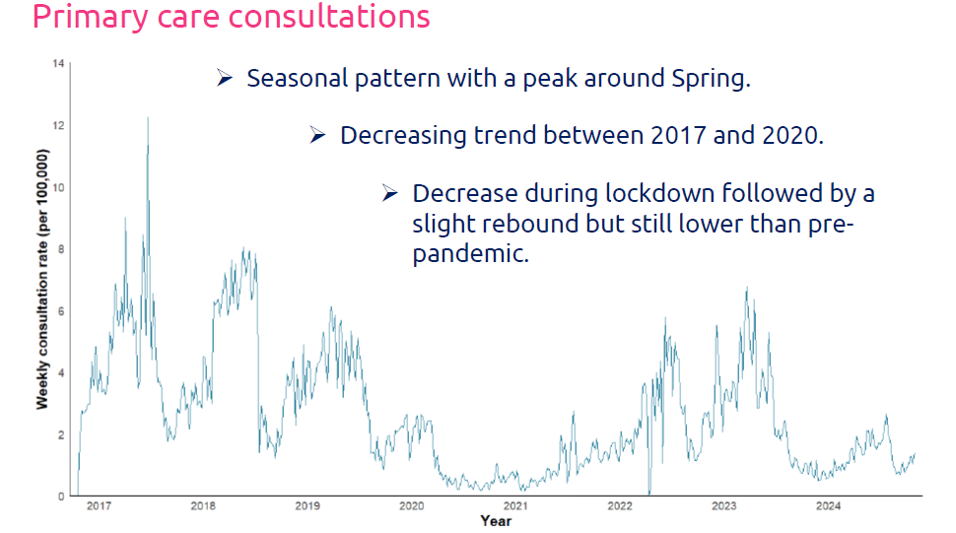
Varicella burden of disease in Wales
MPH Dissertation Project by Louis Whelan
Primary Care Consultations
seasonal pattern with a peak around Spring
decreasing trend between 2017 and 2020
decrease during lockdown followed by a slight rebound but still lower than pre-pandemic
by age-groups:
  the highest rate of consultations in children aged 1-4 years old
  lowest rate of consultations in adults particularly the oldest age groups
  seasonality not visible in cases above 15 years old

Slide 70
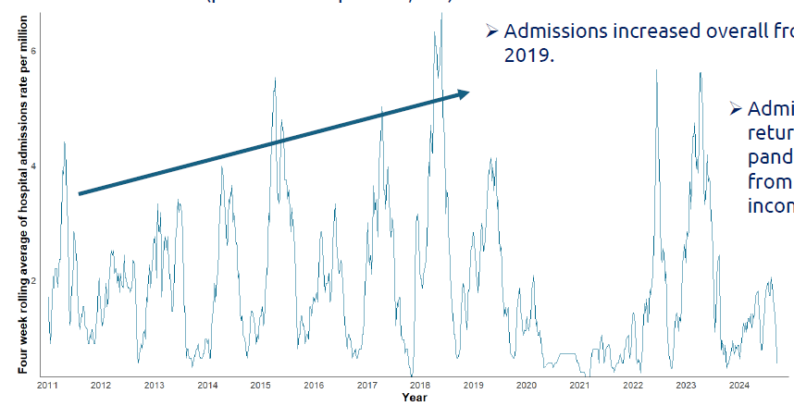
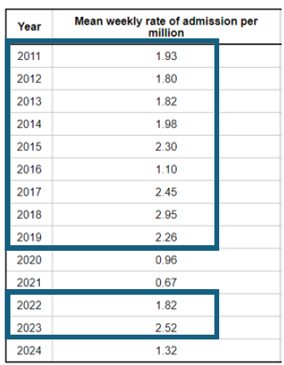
Varicella burden of disease in Wales
MPH Dissertation Project by Louis Whelan
Hospital Admissions
much lower rates of hospital admissions than primary care consultations (per million vs per 100,000)
admissions increased overall from 2011 to 2019
admission rates returned to pre-pandemic levels from 2022 (2024 incomplete)
by age-group:
  highest rate of admission in under 1 year olds by far (almost 3x higher than 1-4 year olds)
  very low rates in adult age groups
  age-specific admission rates for adults aged 50-69 and over 70 are higher than primary care consultation rates

Slide 71
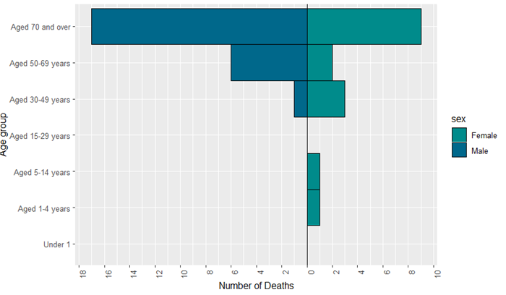
Varicella burden of disease in Wales
MPH Dissertation Project by Louis Whelan
Mortality
Forty deaths related to chickenpox between 2011 and 2024 (average three deaths per year) which corresponds to 0.09 deaths per 100,000 people
overall, 95% of deaths in adults over 30 years old
Chickenpox presents a substantial and measurable burden across Wales with a considerable number of cases resulting in severe disease and complications requiring hospitalisation.
Notes:
Chickenpox presents a substantial and measurable burden across Wales with a considerable number of cases resulting in severe disease and complications requiring hospitalisation.

Slide 72
Varicella burden of disease
Burden of varicella complications in secondary care, England, 2004 to 2017, Burnal et al. 2019
Results
there were over 60,000 admissions with varicella between 2004 and 2017. 38.1% had a recognised varicella complication
the most common complications were bacterial skin infections (11.25%), pneumonia (4.82%), febrile convulsions (3.39%) and encephalitis (2.44%)
in older age groups, complication rates were higher and the complication types were more severe
length of hospital stay for complicated varicella was 3.1 times longer than for uncomplicated varicella
complicated varicella has a substantial health and economic burden.
Burden of varicella complications in secondary care, England, 2004 to 2017 - PMC
Notes:
Chickenpox presents a substantial and measurable burden across Wales with a considerable number of cases resulting in severe disease and complications requiring hospitalisation.

Slide 73
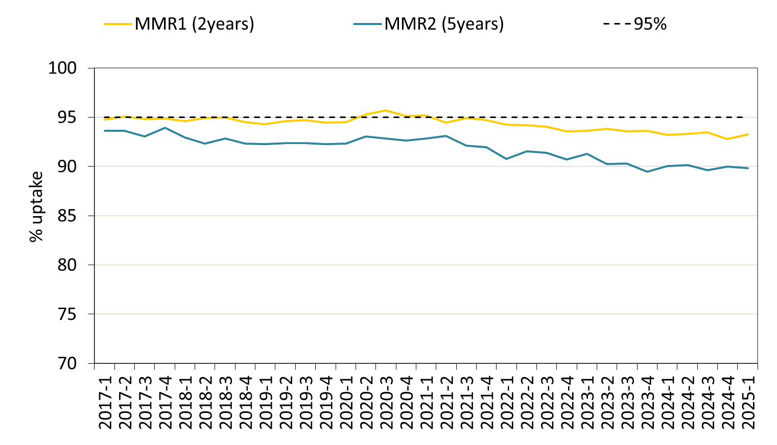
MMR Coverage in Wales
Although there have been some quarterly fluctuations, the long-term trend in coverage of one dose of MMR1 by 2 years and two doses of MMR by five years of age had been gradually decreasing since the first quarter of 2021.
Latest Annual COVER Report
Summarises immunisation uptake in children in Wales reaching key birthdays between 01/04/2024 and 31/03/2025:
MMR uptake of one dose by two years of age was 92.9%
MMR uptake of two doses in children at five years of age was 88.9%. Coverage of one dose of MMR in children at five years of age was 94.9%
Percentage uptake of MMR1 and MMR2 in Wales, quarter 1 2018 to quarter 1 2025
Annual Reports - Public Health Wales

Slide 74
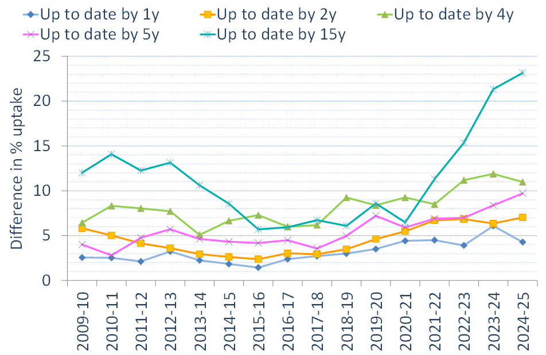
Inequalities in uptake of routine childhood immunisations in Wales 2024-25
Compared to 2023-24, the percentage point gap in uptake of routine immunisations in the most deprived and least deprived areas in Wales have:
Decreased in one-year-olds from 6.1 to 4.3
Increased in two-year-olds from 6.3 to 7.0
Decreased in four-year-olds from 11.9 to 11.0
Increased in five-year-olds from 8.4 to 9.7
Increased in 15-year-olds from 21.3 to 23.2
phw.nhs.wales/topics/immunisation-and-vaccines/cover-national-childhood-immunisation-uptake-data/cover-inequalities-reports/annual-inequalities-report-202425/

Slide 75
Engagement Insights
Influenza

Slide 76
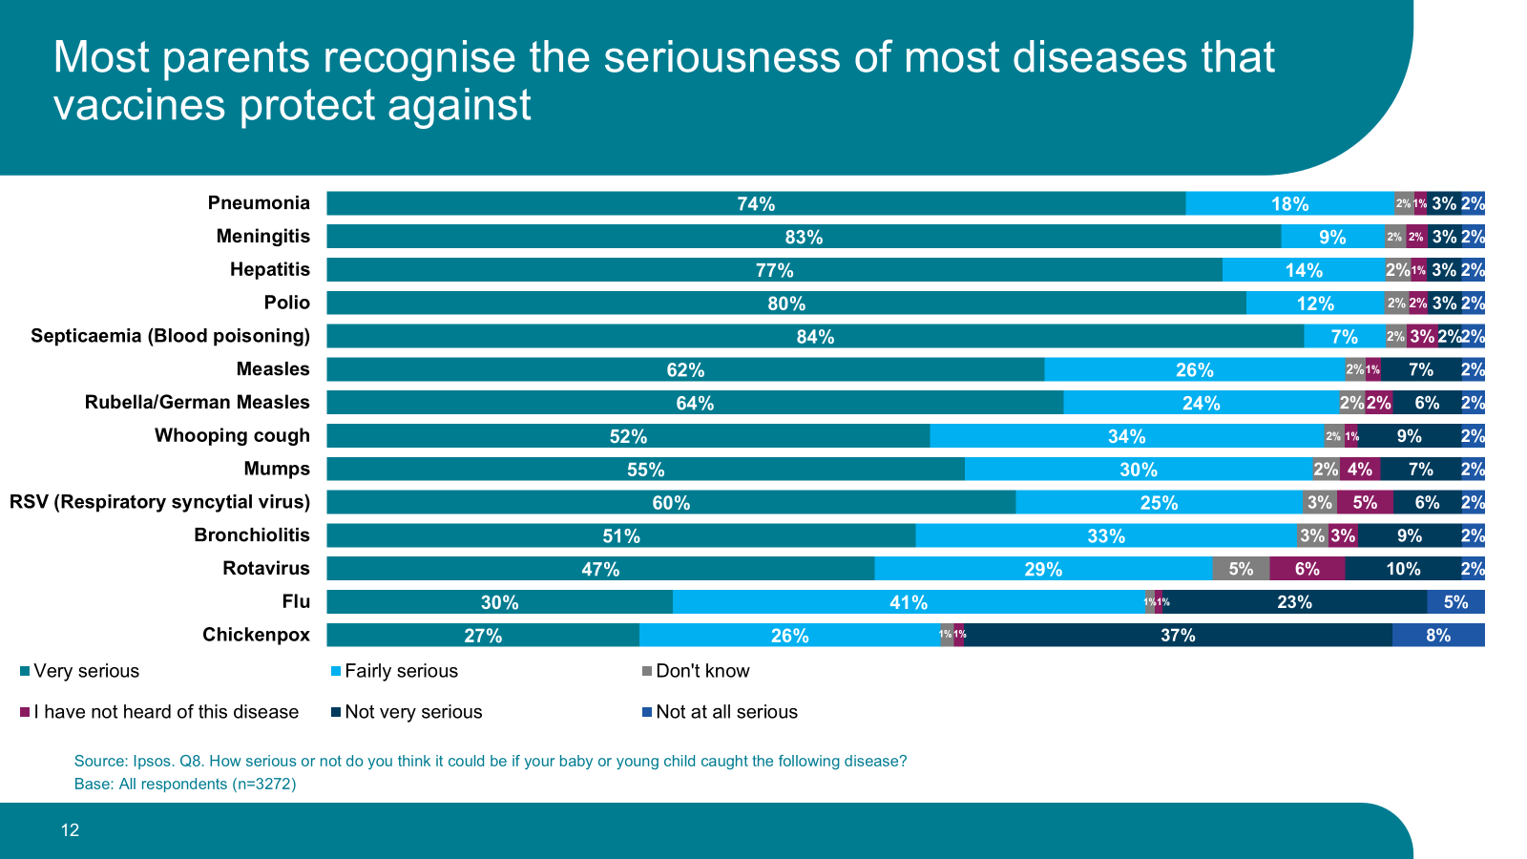
UKHSA parental attitudes to childhood vaccines, 2025
76
Childhood vaccines: parental attitudes survey 2025 findings - GOV.UK
Notes:
UKHSA - An online survey was conducted through the Ipsos Knowledge Panel and Ipsos Interactive Services (IIS) access panel and panel partners between 16 January – 12 February 2025.
A total of 3,272 parents in the UK completed the survey.
To be eligible, parents needed to have at least one child aged between 2 months and less than 5 years.
In total, 325 parents took part in Scotland, 244 in Wales, 227 in Northern Ireland, and 2,476 in England. Parents living in Wales were given the option to complete the survey in English or Welsh.

Slide 77


Health care professional are trusted voices
  Evidence shows that healthcare staff are extremely important and highly trusted as communicators of vaccination information
  Both this trust, and the advice given by healthcare staff, are key factors influencing personal and parental decisions about vaccination
  A high level of knowledge and a positive attitude to vaccination in healthcare staff are widely acknowledged as being important determinants in achieving and maintaining high vaccine uptake
  It is therefore vital that vaccinators are confident, knowledgeable and up to date
National Minimum Standards and Core Curriculum for Vaccination Training - GOV.UK

Slide 78
UKHSA Childhood Vaccines: parental attitudes survey 2025
UKHSA online survey with parents of children aged 2 months to 5 years, focused on what they think about vaccination.
3,272 parents participated between 16 January and 12 February 2025
Findings:
Parents have a high level of confidence in children’s vaccination in UK
    87% agreed vaccines work for children
    85% agreed they are safe
    84% trusted them
Sources of information:
NHS and HCP most trusted sources of information. GP 67% ranked in top 3.
  59% NHS
  15% pharmacists
  7% internet
  3% social media
6% felt they had received enough information to make an informed decision.
89% of parents of children aged 3 years 2 months and under reported that they had an opportunity to discuss vaccines with HCP before child’s first visit. 27% before the child was born.
53% of parents reported feeling more confident about having their baby vaccinated after talking with a HCP.
Seriousness of disease
most parents recognised serious of diseases they protect against.
“very serious” = septicaemia (84%) and meningitis (83%).
chickenpox seen as less serious. 27% rating “very serious” and 26% “fairly serious”.
Childhood vaccines: parental attitudes survey 2025 findings - GOV.UK

Slide 79
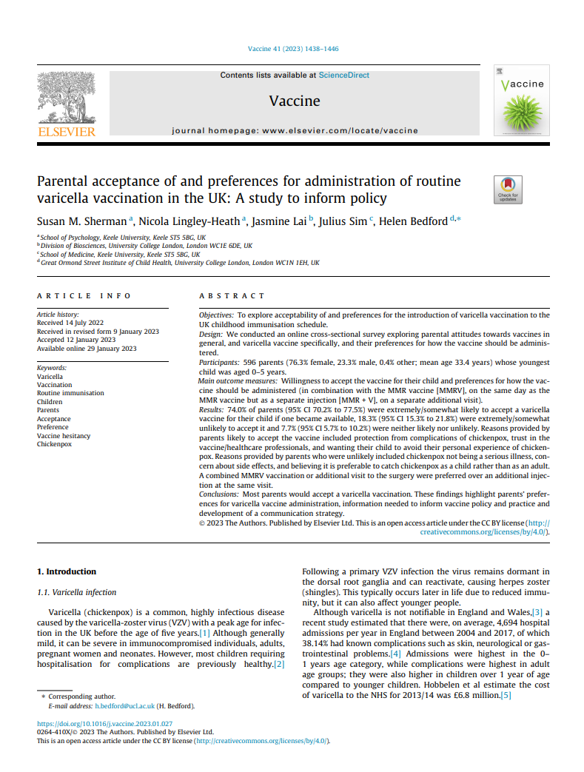
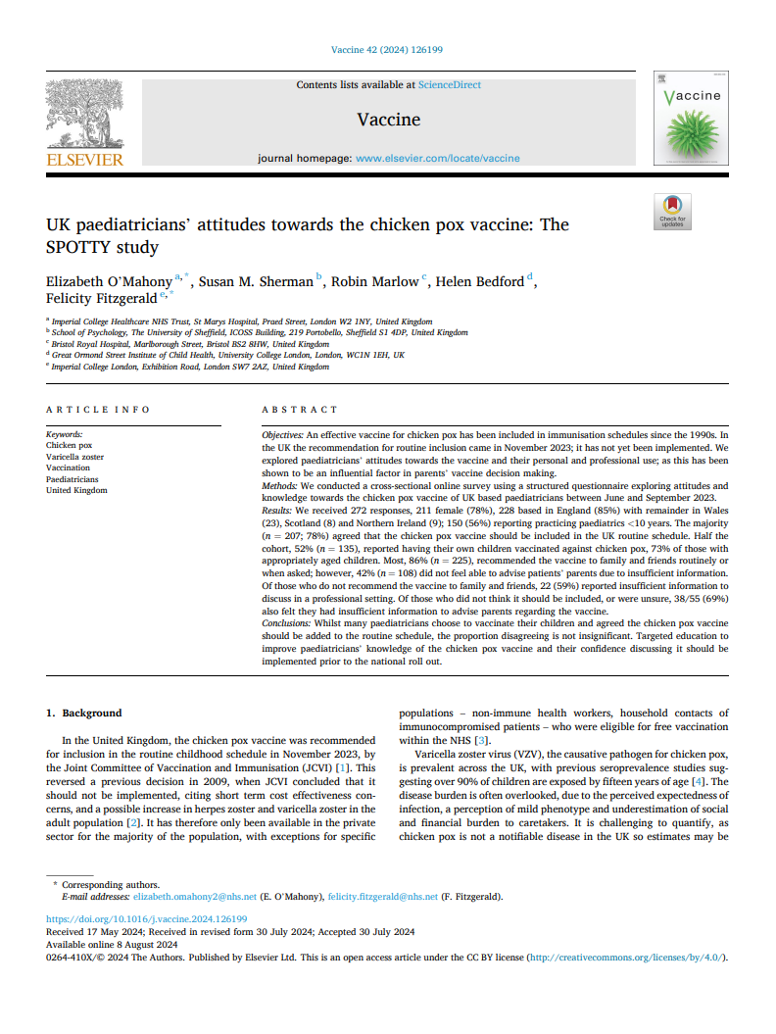
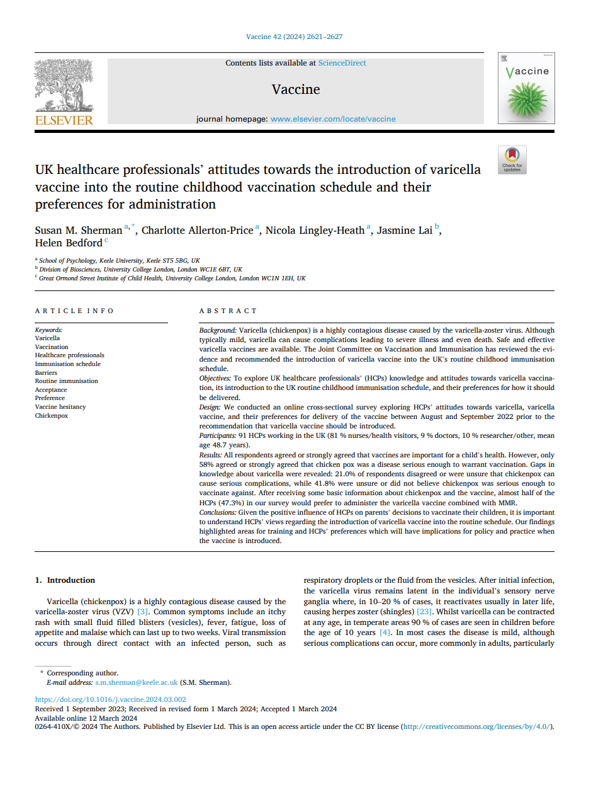
Attitudes towards varicella vaccination in the UK
Healthcare Professionals (HCPs): UK healthcare professionals’ attitudes towards the introduction of varicella vaccine into the routine childhood vaccination schedule and their preferences for administration
surveyed 91 UK HCPs in 2022
while all agreed or strongly agreed that vaccines are important for child health:
  58% believe varicella is serious enough for vaccination
  41.8% were unsure or did not believe varicella was serious enough to vaccinate against.
after receiving basic information, 47.3% preferred a combined MMRV vaccine
highlighted need for training to address knowledge gaps before rollout
Paediatricians: UK paediatricians' attitudes towards the chicken pox vaccine: The SPOTTY study
surveyed 272 UK paediatricians in 2023, 23 from Wales
78% support adding varicella vaccine to routine schedule
86% recommend it to family/friends
however, 42% lack confidence to advise parents due to insufficient information
Parents: Parental acceptance of and preferences for administration of routine varicella vaccination in the UK: A study to inform policy
surveyed 596 UK parents of children aged 0–5, between July and August 2021
74% were extremely/somewhat likely to accept the vaccine
reasons not to vaccinate included perception of seriousness of disease, concerns of side effects, belief that it is preferable to catch chickenpox as a child rather than as an adult
combined MMRV at an additional immunisation visit preferred

Slide 80
Resources
Influenza

Slide 81
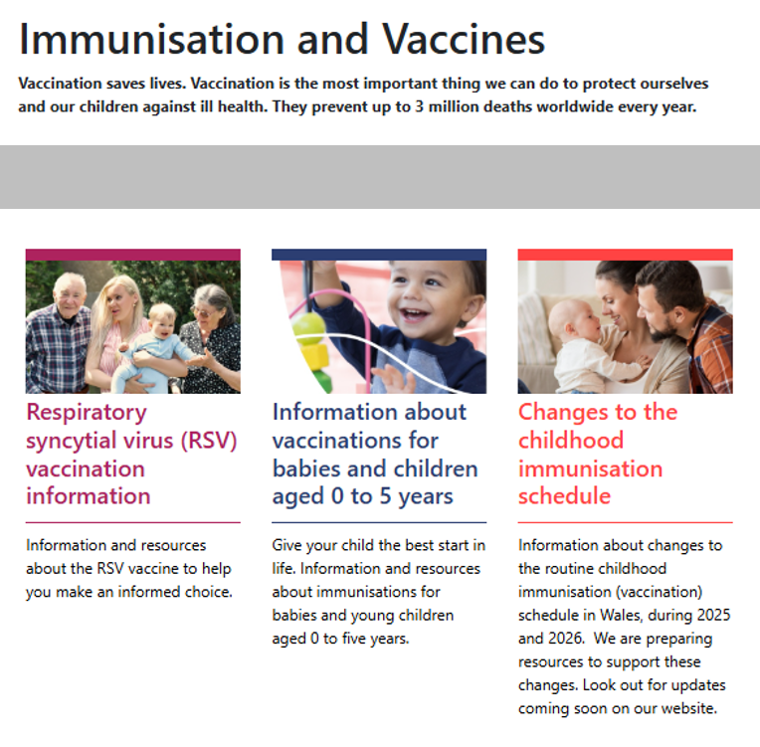
Changes to the routine childhood immunisation schedule: our webpages
Landing page:
Health professionals web page links:
icc.gig.cymru/brechlynnau/ccs-gweithwyr-iechyd-proffesiynol
phw.nhs.wales/vaccines/ccs-information-for-health-professionals
Public web page web links:
icc.gig.cymru/brechlynnau/ccs-gwybodaeth-ir-cyhoedd
phw.nhs.wales/vaccines/ccs-information-for-public
These webpages will be updated as more information becomes available
Immunisation and Vaccines - Public Health Wales

Slide 82
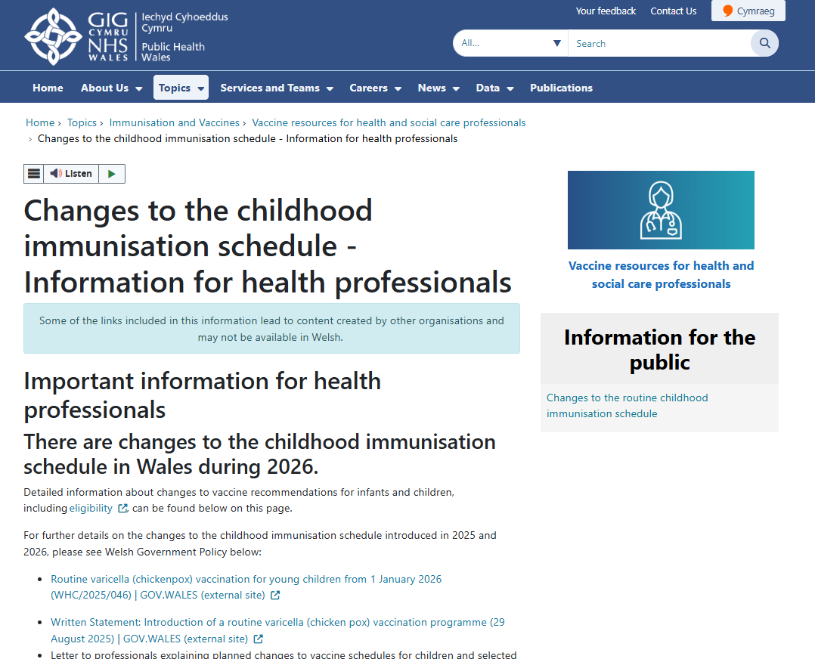
Resources for health professionals and the public
Changes to the childhood schedule webpages
Updates for Stage 2:
  MMRV vaccine
  Additional 6-in-1 vaccination
  18-month appointment
  Vaccination eligibility tool (health professionals web page)
  Vaccination eligibility guide (public web page)
  Unscheduled immunisation record form (health professionals web page)
  Links to resources
  Frequently asked questions
Health professionals web page links:
icc.gig.cymru/brechlynnau/ccs-gweithwyr-iechyd-proffesiynol | phw.nhs.wales/vaccines/ccs-information-for-health-professionals
Public web page web links:
icc.gig.cymru/brechlynnau/ccs-gwybodaeth-ir-cyhoedd | phw.nhs.wales/vaccines/ccs-information-for-public

Slide 83
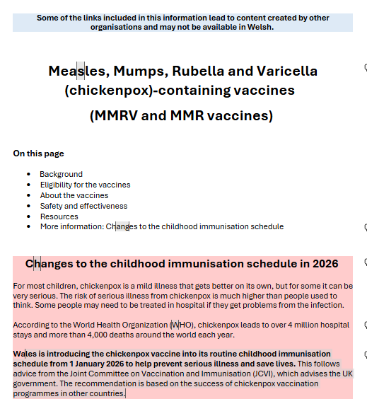
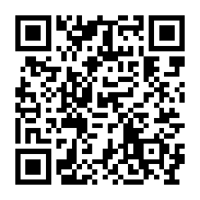
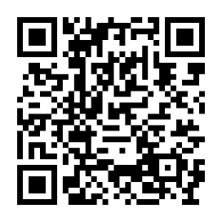
Resources for health professionals and the public
NEW MMRV-MMR vaccines – Public webpage
New slugs (shortened web links)
icc.gig.cymru/MMRV-MMR
phw.nhs.wales/MMRV-MMR
New QR codes
What’s covered?
Information on the diseases: measles, mumps, rubella
and varicella (chickenpox),
Vaccine information covering MMRV and MMR – including
eligibility for each vaccine and target groups
Safety and efficacy
Links to MMRV and MMR-specific resources
Draft
Welsh page
English page

Slide 84
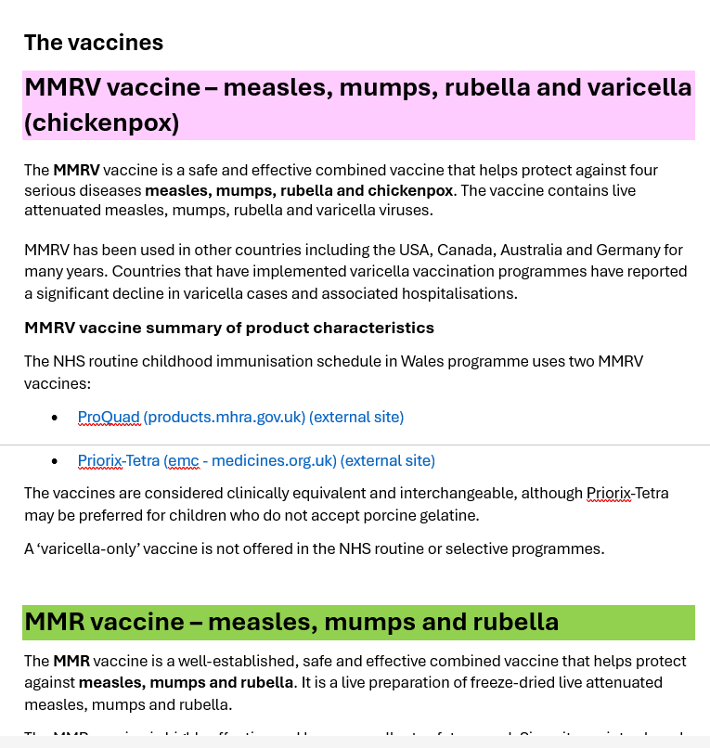
Resources for health professionals and the public
NEW MMRV-MMR vaccines – Health professionals webpage
New slugs (shortened web links)
icc.gig.cymru/MMRV-MMR-proffesiynol | phw.nhs.wales/MMRV-MMR-professionals
icc.gig.cymru/OfferynCymhwyseddMMRV | phw.nhs.wales/MMRVEligibilityTool
What’s covered?
Information on the diseases and vaccines (terms/information aimed at HCPs)
Eligibility Tool for HCPs
Summaries of Product Characteristics (SmPCs)
Safety, efficacy and reporting side effects
Policy and guidance (JCVI, WHCs, scientific articles, letters etc.)
Clinical resources and information e.g. Links to Green Book, PGDs etc.
Links to training resources and events; Data and surveillance
Links to PHW MMRV and MMR-specific health professionals' resources
Draft

Slide 85
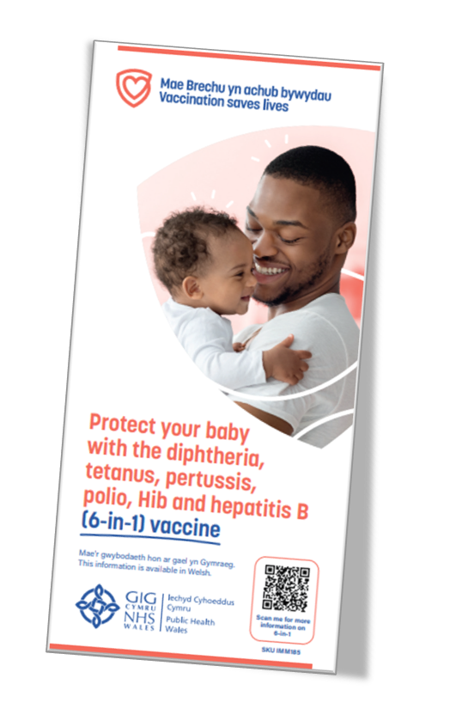

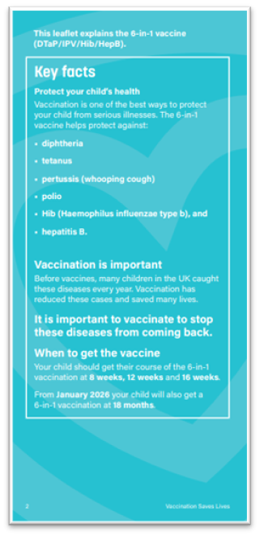
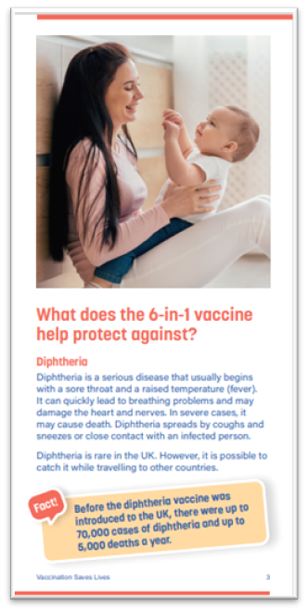

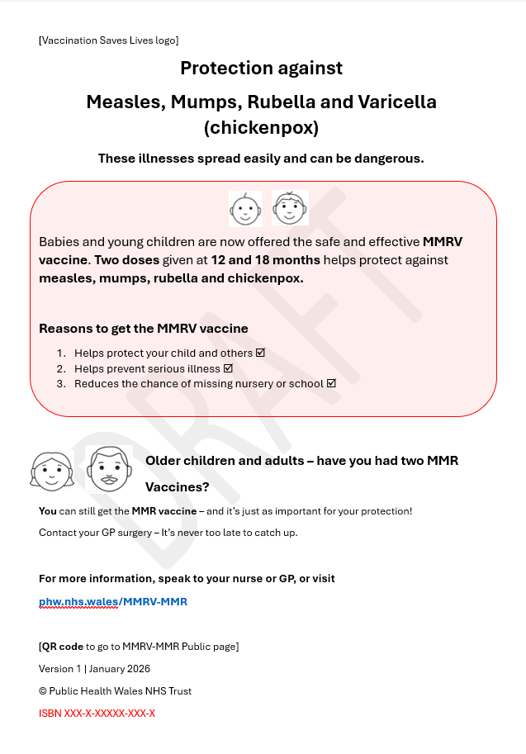
Resources for health professionals and the public
Public resources
MMRV-MMR leaflet and poster
6-in-1 vaccine
4-in-1 vaccine
What to expect after vaccinations
Signposting to Changes to the childhood schedule
and MMRV-MMR Public web pages for further details
and eligibility information.
QR codes
Leaflet content summary (page 2)
Coloured vaccine facts
Coloured vaccines boxes and images - target groups
• Standardised wording e.g.: anaphylaxis, safety reporting
Leaflets - Public Health Wales
Vaccination information in accessible formats - Public Health Wales
Health Information Resources - Public Health Wales

Slide 86

Resources for health professionals and the public
School age resources currently being updated:
MMR briefing document ​for schools
Consent forms
Webpages (public-facing):​
  Vaccination for students - make sure you're protected - Public Health Wales​
  School age children and young people - Public Health Wales​
  icc.gig.cymru/MMRV-MMR-proffesiynol
  phw.nhs.wales/MMRV-MMR-professionals
​

Slide 87


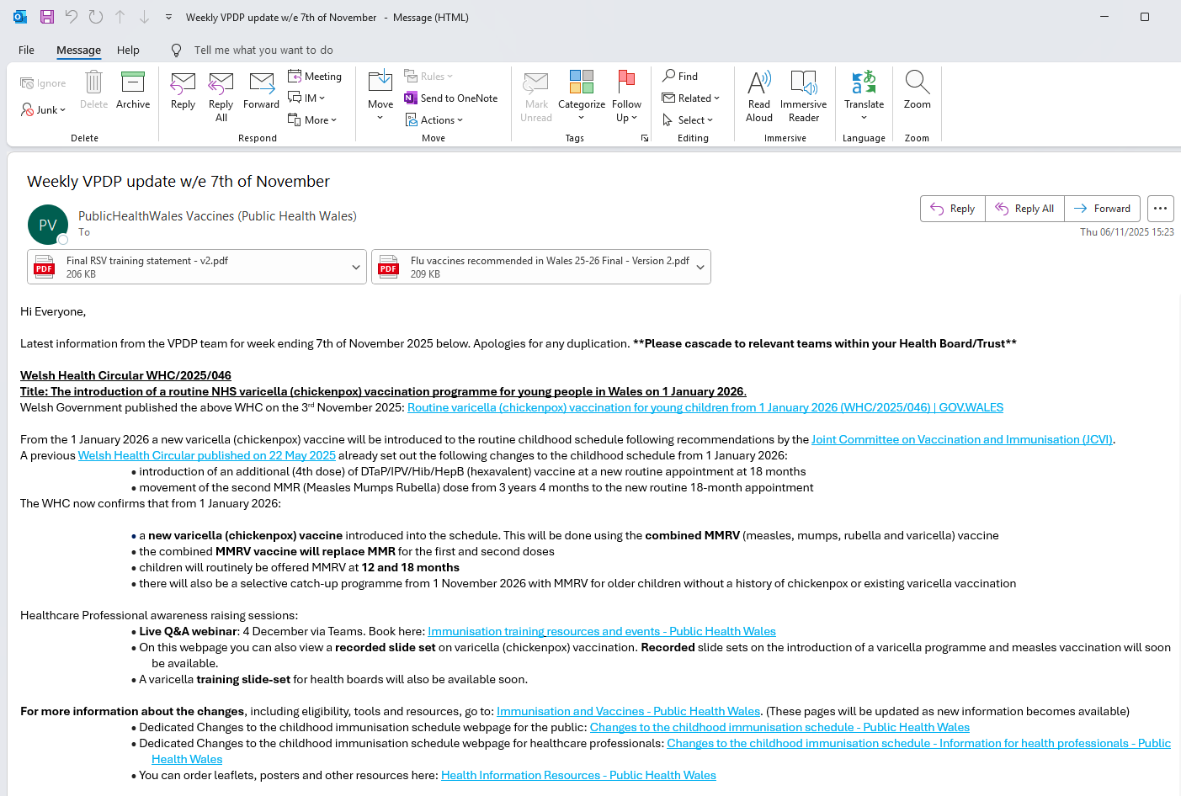
Resources for health professionals and the public
Lots more resources are on the way!
Stay updated with the VPDP weekly emails:
Watch out for the VPDP weekly email updates!
Ensure this information is being shared within your local health board.
Not receiving these updates?
Contact us at the email address below so we can help.
phw.vaccines@wales.nhs.uk

Slide 88
Training resources and events:
To find out about all healthcare professional awareness raising events in relation to the changes, go to: Immunisation training resources and events - Public Health Wales
Here you can:
Book onto events
View recorded slide sets
View webinars
This webpage will be updated as more information becomes available

Slide 89
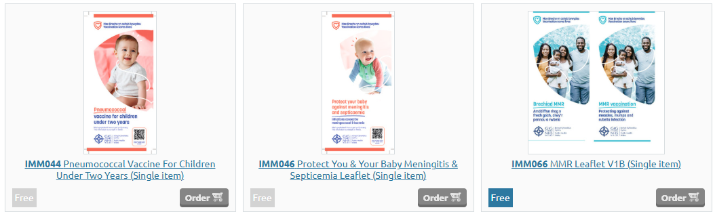
To order leaflets for free:
Go to Health Information Resources - Public Health Wales
To register click the link https://publichealthwales-ws.agility.cloud/ . Enter information. Once completed you are free to browse and order
If you require assistance when ordering, please email Health.Info@wales.nhs.uk. or phw.vaccines@wales.nhs.uk

Slide 90
Resources and web pages
Web page / resource | Link
MMR and MMRV vaccines - A guide to vaccinations for Measles, Mumps, Rubella and Varicella DL leaflet | Leaflets
What to expect after vaccinations – up to 5 years DL leaflet | Leaflets
Changes to the childhood immunisation schedule - Information for health professionals (landing page) | phw.nhs.wales/vaccines/ccs-information-for-health-professionals
Changes to the childhood immunisation schedule - Information for the public (landing page) | phw.nhs.wales/vaccines/ccs-information-for-public
Measles, Mumps, Rubella and Chickenpox (Varicella) containing vaccines (MMRV and MMR vaccines) - Information for health professionals | phw.nhs.wales/MMRV-MMR-professionals
Measles, Mumps, Rubella and Chickenpox (Varicella) containing vaccines (MMRV and MMR vaccines) - Information for the public | phw.nhs.wales/MMRV-MMR
MMRV Eligibility Tool (for health professionals) | phw.nhs.wales/MMRVEligibilityTool | phw.nhs.wales/vaccines/ccs-information-for-health-professionals
Public Vaccination eligibility guide (part of CCS Public page) | phw.nhs.wales/vaccines/ccs-information-for-public
Vaccine resources for health and social care professionals web page | phw.nhs.wales/vaccines-professionals
Unscheduled Immunisations form | phw.nhs.wales/vaccines-professionals
CCS Toolkit for health professionals | phw.nhs.wales/vaccines/ccs-information-for-health-professionals
4 in 1 - for children before they start school DL leaflet | Leaflets
6 in1 - vaccine for babies and children DL leaflet | Leaflets
Public web pages - Frequently Asked Questions (FAQs) for health professionals | Various (CCS landing pages and specific vaccine pages for health professionals)

Slide 91
Resources and web pages
Web page / resource | Link
Public web pages - Frequently Asked Questions (FAQs) for the public | Various (CCS landing pages and specific vaccine pages for the public)
SharePoint Frequently Asked Questions (FAQs) for Health professionals | Frequently Asked Questions (sharepoint.com)
Routine immunisation schedules for Wales | phw.nhs.wales/CompleteSchedule
MMR/MMRV - Protect yourself and those you care about from measles, Mumps, Rubella and Varicella (combined poster) | phw.nhs.wales/MMRV-MMR
Is it measles? poster | phw.nhs.wales/MMRV-MMR-professionals
Measles: Stay safe poster | phw.nhs.wales/MMRV-MMR
MMR toolkit for Primary Care | phw.nhs.wales/MMRV-MMR-professionals
Diphtheria, tetanus, pertussis (whooping cough) and polio (dTaP/IPV or 4-in-1) - Information for health professionals | Diphtheria, tetanus, pertussis (whooping cough) and polio (dTaP/IPV or 4-in-1) - Information for health professionals
Diphtheria, tetanus, pertussis (whooping cough) and polio (dTaP/IPV or 4-in-1) - Information for the public | Diphtheria, tetanus, pertussis (whooping cough) and polio (dTaP/IPV or, '4-in-1' vaccine)
Diphtheria, tetanus, pertussis (whooping cough), polio, Haemophilus influenzae type b (Hib) and hepatitis B (DTaP/IPV/Hib/HepB) (6-in-1) - Information for health professionals | Diphtheria, tetanus, pertussis (whooping cough), polio, Haemophilus influenzae type b (Hib) and hepatitis B (DTaP/IPV/Hib/HepB)(6-in-1) - Information for health professionals
Diphtheria, tetanus, pertussis (whooping cough), polio, Haemophilus influenzae type b (Hib) and hepatitis B (DTaP/IPV/Hib/HepB) (6-in-1) - Information for the public | phw.nhs.wales/6in1vaccine
Preschool Pack | phw.nhs.wales/vaccines-professionals
Accessible resources: Large Print, Easy Read, British Sign Langiuage and Audio | phw.nhs.wales/vaccines/accessible-information

Slide 92
Other important links:
The Green Book: Immunisation against infectious disease - GOV.UK
Green Book chapters: Measles: the green book - GOV.UK, Mumps: the green book - GOV.UK, Rubella: the green book - GOV.UK, Varicella: the green book - GOV.UK
JCVI statement on varicella: JCVI statement on a childhood varicella (chickenpox) vaccination programme - GOV.UK
JCVI statement: Changes to routine childhood and selective neonatal hepatitis B vaccinations (WHC/2025/019) [HTML] | GOV.WALES
UKHSA Guidance for Healthcare Professionals: MMRV programme: information for healthcare practitioners - GOV.UK
Welsh Health Circular: Changes to routine childhood and selective neonatal hepatitis B vaccinations (WHC/2025/019) [HTML] | GOV.WALES
PGDs: Patient Group Directions (PGD) - Welsh Medicines Advice Service

