Slide 1
Routine vaccination against mpox for protection of gay, bisexual and other men who have sex with men (GBMSM) at highest risk of exposure
These slides are version controlled and subject to revision
Version 2 (26 06 2025)
Vaccine Preventable Disease Programme
Public Health Wales
Notes:
Material contained in this document may be reproduced without prior permission provided it is done so accurately and is not used in a misleading context.
Acknowledgement to Public Health Wales NHS Trust to be stated.
Change history
V2.0
Dates and version number updated throughout.
Slide 2: Removed. Included caveats regarding Green Book and Welsh Government publications
Slide 4: Additional resources added.
Slide 9: Updated text in second and last bullet points
Slide 10: Minor tweaks to text
Slide 12: Minor tweaks to text and links in note section updated
Slide 13: Moved incubation text from slide 14 to slide 13 for flow
Slide 14: Moved incubation text from slide 14 to slide 13 for flow
Slide 15: Image added
Slide 16: Removed reference to Clade I no longer a HCID as mentioned numerous times in previous slides.
Slide 20: Bullet points 1 and 3 amended to reflect Green Book Smallpox/Mpox chapter.
Slide 21: Updated in line with most recent published data
Slide 22: Updated in line with most recent published data
Slide 24: Updated bullet 8 and 10, added link to Green Book Chapter
Slide 26: highlighted updated National Minimum Standards and Core Curriculum for Vaccination Training - GOV.UK - published by UKHSA 23 June 2025
Slide 27: Added link to EMA
Slide 28: Updated notes section
Slide 32: Updated text
Slide 33: Reformatted and text updated on slide and in notes
Slide 35: Text updated
Slide 36: Content added to notes section
Slide 38: Text updated
Slide 39: Added links to SmPCs
Slide 40: Added information to notes section
Slide 44: Text updated and amended pack sizes
Slide 45: Amended pack sizes
Slide 52: Text formatted
Slide 54: Amends to slide content
Slide 57: New slide and content added (WHC)
Slide 58: Amends to slide content
Slide 60: Amends to slide content
Slide 62: Amends to slide content
Slide 63: Amends to slide content and table on slide amended
Slide 64: Notes section amended
Slide 65: Amends to slide content
Slide 67: WHC added to resource list
© 2025 Public Health Wales NHS Trust.

Slide 2
Vaccination against mpox
The information contained within this slide set is up to date as of 26 06 2025. ​
It is important that all immunisers delivering the routine mpox vaccination programme and or those who are providing immunisation advice familiarise themselves with the most up to date clinical evidence and guidance, this can be found in the following key documents:
Smallpox and Mpox: the green book, chapter 29: Smallpox and mpox: the green book, chapter 29
Mpox vaccination: Information for healthcare practitioners: Mpox vaccination: information for healthcare practitioners - GOV.UK
Mpox vaccination programme website page is available here: Monkeypox - Information for health professionals - Public Health Wales (nhs.wales).
The content of this training slide set does not contain any information on the use of the intradermal (ID) technique. The ID technique would be covered subject to future service requirements.
**This training slide set is for healthcare practitioners who will be involved in routine administration of MVA-BN vaccine as part of the pre-exposure vaccination strategy for GBMSM at high risk of mpox exposure. There will be a separate training resource for individuals involved in vaccination as an outbreak control measure during an outbreak or incident, or who will be involved in administration of post exposure MVA-BN vaccination which will be available here.**
The content of this training slide set is subject to review, this resource will be version controlled. This is version 2 dated 26 06 2025.
Vaccination against mpox
Notes:
Background
In 2023, the Joint Committee on Vaccination and Immunisation (JCVI) advised that an ongoing routine vaccination strategy for protection against mpox should be developed to prevent future outbreaks and protect those at risk of exposure.
A pre-emptive vaccine strategy could prevent outbreaks occurring and would also allow vaccines to be offered routinely through sexual health services on an ongoing basis, as opposed to an outbreak response which had caused a significant disruption in sexual health services, impacting on their ability to continue with routine work. The public health response costs which were associated with the outbreak were also saved, making a pre-emptive vaccination strategy the preferred approach.
The JCVI keeps all of its advice under review and therefore once further information relating to the duration of protection against mpox from both vaccination and natural infection become available, the modelling work and resulting advice will be reviewed.
JCVI Statement: JCVI statement on mpox vaccination as a routine programme - GOV.UK

Slide 3
Note to trainers
This slide set contains a collection of core slides for both individual use and use or adaptation during the delivery of mpox vaccination training. Trainers should select the slides required depending on the background and experience of those they are training and according to the role they will have in mpox vaccination
Please note that this slide set is for use in relation to the routine mpox vaccination programme for protection of GBMSM at highest risk of exposure
This slide set should not be used for training relating to mpox vaccination in response to an outbreak or incident. The Vaccination in response to an outbreak or incident slide set can be found here when available
Updates to this slide set were made in June 2025 using the following resources:
Smallpox and Mpox: the green book, chapter 29: Smallpox and mpox: the green book, chapter 29
Welsh Government. Introduction of routine vaccinations for mpox and gonorrhoea WHC/2025/021
Infection Prevention and Control (IP&C) Measures for Suspected and Confirmed Cases of Mpox in Healthcare Settings in Wales v3.0
Contact tracing guidance for mpox - GOV.UK
Mpox: guidance on when to suspect a case of mpox - GOV.UK
Biological principles for control of mpox in the UK: 4 nations consensus statement - GOV.UK
CEM/CMO/2025/01 Derogation of mpox
Mpox clade Ib and clade IIb outbreak: epidemiological overview - GOV.UK and
JCVI statement on mpox vaccination as a routine programme - GOV.UK
Notes:
The content of these slides was correct at the time of publishing. Practitioners should always ensure they are accessing the most up to date information and guidance.
This resource is designed to train healthcare practitioners involved in delivering the routine vaccination programme against mpox. Trainers should select the slides they need depending on audience background, role in the programme, length of training session and so on. Some slides may appear repetitive, but this is because trainers are encouraged to use the slides relevant to their audience and should remove any slides which they do not feel are required for their training session.
This resource does not cover the practical aspects of vaccine administration technique. If staff require practical training for this, they should refer to their line manager for additional training.
*Post-exposure vaccination is not covered in this training slide set. Please refer to the Green Book smallpox and mpox chapter, the relevant incident response training slide set and other relevant resources.
*Vaccination as an occupational health measure is not covered in this resource.

Slide 4
Acknowledgements
Vaccine Preventable Disease Programme (VPDP), Public Health Wales Immunisation and Vaccines - Public
UK Health Security Agency (UKHSA) Mpox (monkeypox): guidance - GOV.UK
UKHSA Mpox routine vaccination programme for protection of gay, bisexual and other men who have sex with men (GBMSM) at highest risk of exposure. Information for healthcare practitioners (March 2025) training slide set
Other references included in slides or footer notes
Vaccination against mpox

Slide 5
Contents
Section | Slide number
Aims | 6
Objectives | 7
Mpox timeline Significant background information Mpox | 8 9 10
Epidemiology and surveillance | 18
Vaccination against mpox | 24
MVA-BN vaccine contraindications, precautions, considerations, co-administration, and adverse reactions | 30
MVA-BN Vaccine storage and preparation | 42
MVA-BN Vaccine administration | 45
MVA-BN efficacy | 52
Mpox vaccination programme: recommendations for the use of the MVA-BN vaccine and eligibility | 55
MVA-BN dosage and schedule | 60
Useful resources | 65
Vaccination against mpox

Slide 6
Aims
To provide information for healthcare practitioners involved in advising on and delivering the routine pre-exposure mpox vaccination programme
To raise awareness of the current epidemiology of mpox and the impact on GBMSM
To describe the vaccination programme details including administration of the vaccine, eligibility, recommended dosage and schedule, contraindications, precautions and potential adverse reactions
To raise awareness of the impact of the mpox vaccination programme
To highlight resources that support the mpox vaccination programme
Vaccination against mpox

Slide 7
Objectives
After completing this resource immunisers will be able to:
Describe the aetiology and epidemiology of mpox
Understand the rationale and evidence base for the mpox vaccination programme
Discuss the benefits of vaccination against mpox
Gain essential knowledge to administer the vaccine safely
Recall the legal aspects of vaccine administration
State the storage, handling and safe administration requirements of the MVA-BN vaccine
Identify relevant resources and additional information in relation to the mpox vaccination programme
Vaccination against mpox

Slide 8
Mpox timeline
In the UK in:
  2018 there were 3 cases (Clade II), 2019 there was 1 case (Clade II), 2021 there were 3 cases were (Clade II). All associated with travel to or from countries in west Africa where mpox is endemic
In 2022 a large number of cases (approximately 3,582) of mpox (clade II) were reported in the UK
In June 2022 JCVI endorsed a reactive selective vaccination strategy with an aim to interrupt transmission in individuals at increased risk
In July 2022, the WHO determined that the multi-country outbreak of mpox constituted a Public Health Emergency of International Concern (PHEIC)
In January 2023, the Advisory Committee on Dangerous Pathogens (ACDP) advised that clade II mpox no longer met the criteria for an HCID, based on evidence supporting a low case fatality rate, and mild to moderate severity illness
In November 2023, JCVI recommended that a routine vaccination programme for protection of GBMSM at highest risk of exposure to mpox, offered through sexual health services, should be developed to prevent future outbreaks
In 2023 the Democratic Republic of Congo (DRC) reported a geographical expansion of mpox cases, with the highest ever annual number of Clade I MPXV cases and the first reports of sexual transmission of Clade I MPXV
In 2024 a new strain Clade 1b was identified
During 2024 cases of Clade 1* were reported from several countries surrounding DRC
In August 2024 WHO declared a PHEIC in view of the upsurge of cases in DRC and neighbouring countries and the emergence of the new strain (Clade 1b)
Until October 2024, there were no confirmed cases of mpox clade I in the UK. As of 1 April 2025, 11 cases of Clade Ib have been detected in the UK, with no deaths.
Vaccination against mpox
Notes:
2018: 2 occurred in people who had recently travelled from Nigeria. The third case was in a healthcare worker involved in the care of 1 of the cases and was infected following contact with contaminated bed linen
2019: 1 case following travel to Nigeria
2021: 3 cases in same family where index case had travel history to Nigeria
*For Clade I mpox affected countries see https://www.gov.uk/guidance/clade-i-mpox-affected-countries
Smallpox and mpox: the green book, chapter 29 - GOV.UK

Slide 9
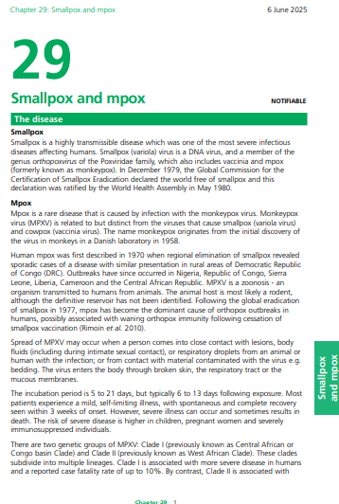
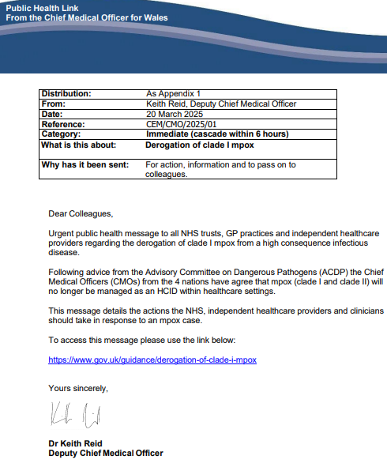
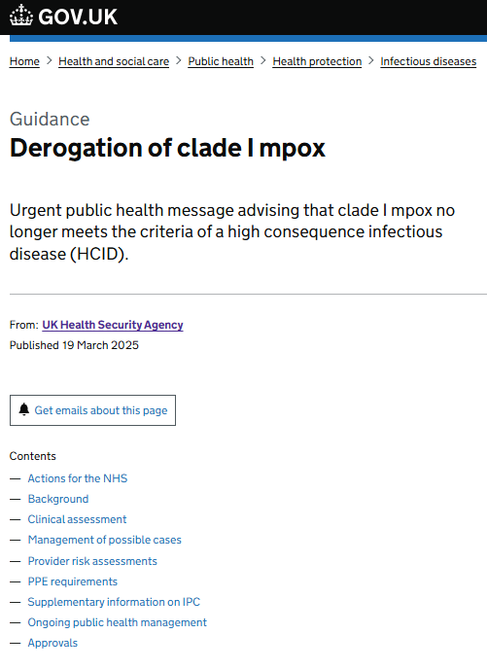
Significant background information
Derogation of mpox clade I
The Advisory Committee on Dangerous Pathogens (ACDP) re-assessed evidence gathered by UKHSA for clade I mpox and advised the UKHSA in February 2025 that it no longer met the criteria of a high consequence infectious disease (HCID). Therefore, the Chief Medical Officers (CMOs) of the 4 nations have agreed that mpox will no longer be managed as an HCID within healthcare settings.
Mpox remains a serious infection for some individuals and remains a World Health Organization (WHO) public health emergency of international concern (PHEIC). The UK’s strategic goal continues to be to eliminate person-to-person transmission of mpox in the UK. Therefore, there will be ongoing public health management of cases and contacts, including vaccination where appropriate.
Further information is available here:
Smallpox and mpox: the green book, chapter 29 - GOV.UK
CEM/CMO/2025/01 Derogation of clade I mpox
UKHSA Derogation of clade I mpox [GOV.UK]
Mpox (clade I and clade II) are no longer classified as HCIDs. Mpox remains a notifiable disease.
Vaccination against mpox
Mpox (clade I and clade II) are no longer classified as HCIDs
Mpox (clade I and clade II) are no longer classified as HCIDs
Mpox (clade I and clade II) are no longer classified as HCIDs
Mpox (clade I and clade II) are no longer classified as HCIDs
Notes:
Additional ref:
Infection Prevention and Control (IP&C) Measures for Suspected and Confirmed Cases of Mpox in Healthcare Settings in Wales [v3.0]

Slide 10
Mpox

Slide 11
Mpox
Rare disease caused by the mpox virus (MPXV), a DNA virus of the orthopoxvirus genus
MPXV is related to, but distinct from, the viruses that cause smallpox (variola virus) and cowpox
There are two genetic groups of MPXV: Clade I (previously known as Central African or Congo Basin Clade) and Clade II (previously known as West African Clade)
  Following a recent review of evidence, the case fatality rate and severity of Clade I was noted to be similar to Clade IIb. In February 2025 the Advisory Committee on Dangerous Pathogens (ACDP) recommended that Clade I should no longer be classified as a High Consequence Infectious Disease (HCID)
  Clade II is associated with milder disease, with a low case fatality rate and since January 2023 was no longer classified as a HCID
Human mpox was first described in 1970 when regional elimination of smallpox revealed sporadic cases of a disease with similar presentation in rural areas of the Democratic Republic of Congo
Outbreaks have since occurred in Nigeria, Republic of Congo, Sierra Leone, Liberia, Cameroon and the Central African Republic
MPVX is a zoonotic disease – an organism transmitted to humans from animals
The animal host is most likely a rodent, although the definitive reservoir has not been identified
Following the global eradication of smallpox in 1977, mpox has become the dominant cause of orthopox outbreaks in humans, possibly associated with waning orthopox immunity following cessation of smallpox vaccination
As MPXV is closely related to the virus that causes smallpox, vaccines designed for smallpox can be used to protect people from getting mpox
MVA-BN vaccine does not contain smallpox virus and cannot cause or spread smallpox
The MVA-BN vaccine is licensed for use against mpox (both Clade I and Clade II)
Mpox is a notifiable disease
Vaccination against mpox
Notes:
The name monkeypox originated from the initial discover of the virus in monkeys in a Danish laboratory in 1958. In November 2022 the World Health Organisation recommended a new preferred name ‘mpox’. WHO reference: WHO recommends new name for monkeypox disease (https://www.who.int/news/item/28-11-2022-who-recommends-new-name-for-monkeypox-disease)
MPXV disease was classified as a high consequence infectious disease (HCID) in 2018 meaning that all cases were managed via HCID pathways in healthcare settings. Evidence supporting low case fatality rate, and a mild to moderate severity illness accumulated for Clade IIb, and in January 2023, and the Advisory Committee on Dangerous Pathogens (ACDP) advised that clade II mpox no longer met the criteria for a HCID. In March 2025, it was announced that the ACDP had recently assessed evidence gathered by UKHSA for Clade I mpox and advised that it also no longer met the criteria of a HCID. It remains a serious infection for some individuals.
There is further information on the HCID status of mpox available here: Derogation of clade I mpox - GOV.UK (https://www.gov.uk/guidance/derogation-of-clade-i-mpox) and Biological principles for control of mpox in the UK: 4 nations consensus statement - GOV.UK (https://www.gov.uk/guidance/biological-principles-for-control-of-mpox-in-the-uk-4-nations-consensus-statement)

Slide 12
Transmission
Mpox does not spread easily between people without very close contact
The virus is transmitted through:
  skin-to-skin contact
  inhalation of the virus through respiratory droplets
  contact with mucous membranes (eyes, nose, mouth, genitals)
Person-to-person spread may occur through:
  direct contact with skin lesions or scabs (including during sexual contact, kissing, cuddling or other skin-to-skin contact)
  close exposure to someone with mpox while they are coughing or sneezing
  contact with clothing or linens (such as bedding or towels) used by an infected person
Spread of mpox may also occur when a person comes into close contact with an infected animal, human or materials contaminated with the virus.
Incubation period:
5 to 21 days (typically 6 to 13 days post exposure)
Vaccination against mpox

Slide 13
Clinical presentation
Signs and symptoms can include:
    Fever
    Headache
    Muscle aches
    Backache
1 to 5 days post initial symptoms onset - rash, often beginning on the face, spreading to other parts, including soles of feet, palms of hands, mouth, genitals and anus
Rash is not always widespread (genital lesions only in some cases)
Lesions may be blisters/vesicles, scabs or ulcers
NB. Not all people who have mpox experience all of these symptoms
    Swollen lymph nodes
    Chills
    Exhaustion
    Joint pain
Vaccination against mpox

Slide 14
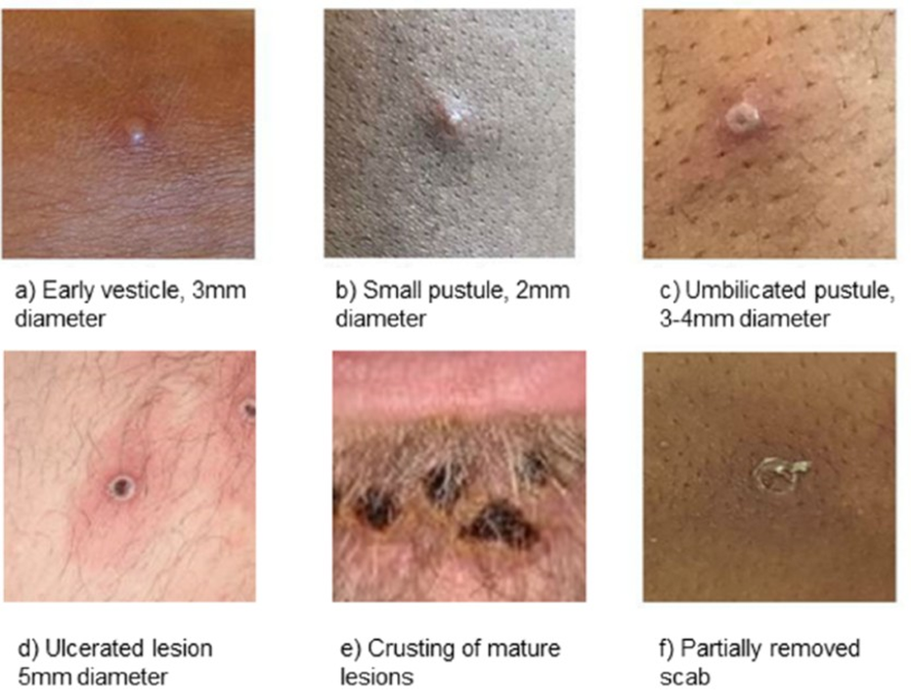
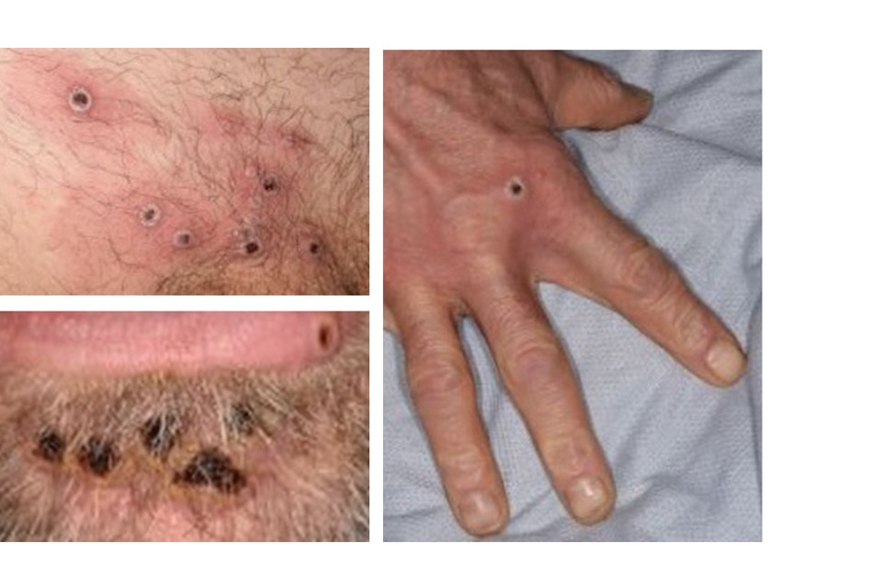
Clinical presentation
Lesions:
go through several different stages
can vary in size
of different appearances and stages may be seen at the same point in time
in discrete areas often present with areas of erythema and/or hyperpigmentation around them
heal by crusting over and scabbing
resolve within 2 to 4 weeks
Infectious period:
Individuals are contagious until all scabs have fallen off leaving intact skin
Scabs may also contain infectious virus material
Image source: Mpox: background information - GOV.UK
Reference: Mpox: background information - GOV.UK
Vaccination against mpox
Notes:
For further information visit: Mpox: background information - GOV.UK

Slide 15
Complications
Mpox is mostly a mild, self-limiting illness, usually with spontaneous and complete recovery within 3 weeks of onset.
Possible complications:
  multi-organ involvement, with bronchopneumonia, encephalitis and sepsis
  death
The risk of severe disease is higher in young children, pregnant women and severely immunosuppressed individuals
Clade Ia has been reported to cause more severe disease with a higher case fatality in affected counties*. Evidence from case management in the UK suggests that there is low severity of disease from Clade Ib.
Vaccination against mpox
Notes:
*ACDP recognises the available data on severity is not translatable to healthcare systems in the UK.
Infection Prevention and Control (IP&C) Measures for Suspected and Confirmed Cases of Mpox in Healthcare Settings in Wales: A4 Branded Word (https://phw.nhs.wales/services-and-teams/antibiotics-and-infections/infection-prevention-control/resources-for-healthcare-professionals/mpox/20-03-2025-ipc-measures-for-suspected-and-confirmed-mpox-harp-phw-v3-0w/)

Slide 16
Diagnosis
Clinical diagnosis of mpox can be difficult as it is often confused with other infections such as chickenpox.
Case definitions for possible, probable, highly probable and confirmed cases have been developed, along with guidance on infection control*
A definite diagnosis of mpox required assessment by health professional and specific testing in a specialist laboratory
Samples from individuals testing positive for MPXV must be sent for clade differentiation as part of ongoing surveillance and management of risk to the UK from mpox. In the UK, testing is provided by many NHS laboratories and is also available at the Rare and Imported Pathogens Laboratory (RIPL) at UKHSA Porton Down
Suspected mpox cases should be discussed with local infection specialists and as necessary with the Imported Fever Service via microbiology as soon as possible*
Vaccination against mpox
Notes:
*Infection specialists may wish to discuss possible mpox cases with the UKHSA Imported Fever Services (IFS) on 0844 778 8990 for clinical advice, for example in a patient who is severely immunocompromised, paediatric, pregnant or from a high risk setting such as shared accommodation.
*For further guidance on Infection Prevention and Control (IP&C) Measures for Suspected and Confirmed Cases of Mpox in Healthcare Settings in Wales refer to: https://phw.nhs.wales/services-and-teams/antibiotics-and-infections/infection-prevention-control/resources-for-healthcare-professionals/mpox/20-03-2025-ipc-measures-for-suspected-and-confirmed-mpox-harp-phw-v3-0w/
PHW Mpox IP&C Resources for healthcare professionals: https://phw.nhs.wales/services-and-teams/antibiotics-and-infections/infection-prevention-control/resources-for-healthcare-professionals/mpox/
More information is available on the mpox guidance pages (https://www.gov.uk/guidance/monkeypox) and the mpox collection page (https://www.gov.uk/government/collections/monkeypox-guidance) NB. This is the UKHSA website so may have nuances to Wales
Mpox: guidance on when to suspect a case of mpox - GOV.UK
For further guidance on Infection Prevention and Control (IP&C) Measures for Suspected and Confirmed Cases of Mpox in Healthcare Settings in Wales refer to: https://phw.nhs.wales/services-and-teams/antibiotics-and-infections/infection-prevention-control//resources-for-healthcare-professionals/mpox/20-03-2025-ipc-measures-for-suspected-and-confirmed-mpox-harp-phw-v3-0w/

Slide 17
Treatment
Treatment for mpox is mainly supportive
Mpox is usually mild and most of those infected will recover within a few weeks without treatment
Mpox remains a serious infection for some individuals
Antivirals (such as cidofovir and tecovirimat) can be used to treat severe disease (or those at risk of severe disease)
People vaccinated against smallpox in childhood may experience a milder disease
Vaccination against mpox

Slide 18
Epidemiology and surveillance

Slide 19
Mpox epidemiology in the UK: clade II
between 2018 and 2022, the UK experienced a small number of imported Clade II mpox cases, associated with travel to or from countries in West Africa where mpox is endemic
rapid diagnosis, isolation, care of cases in HCID centres and quarantine/surveillance of close contacts limited further spread
vaccination of HCID staff and post-exposure vaccination of contacts was advised, and no serious consequences of disease occurred
prior to 2022, no documented community transmission of mpox had been observed in the UK
in May 2022, domestically acquired mpox cases, largely affecting gay, bisexual and other men who have sex with men (GBMSM) led to declaration of a national incident
in June 2022 an outbreak response pre-exposure vaccination programme targeting GBMSM at higher risk was introduced through sexual health services
by 31 December 2022, 3,732 confirmed and highly probable cases had been detected in the UK, mainly in males under 45 years of age in London – all clade II
no reported deaths in the UK but significant morbidity in the majority of those admitted to hospital for clinical care, including severe pain and complications due to secondary bacterial infection
following behaviour modification and vaccination, the outbreak declined by September 2022, with low levels of cases continuing, both domestic and travel associated (286 cases between 1 January 2023 and 31 July 2024)
Vaccination against mpox
Notes:
Source: Mpox epidemiological overview: https://www.gov.uk/government/publications/monkeypox-outbreak-epidemiological-overview

Slide 20
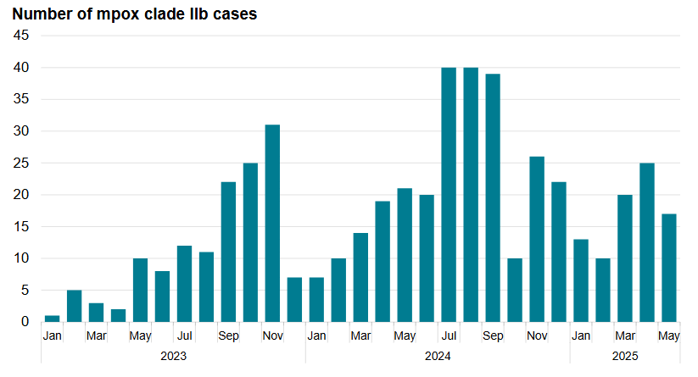
Mpox epidemiology in the UK: clade IIb
graph shows the monthly number of mpox clade IIb cases in England during the period 2023 to 2025, where there were between one and 41 cases per month, (compared to the monthly high of 1,339 cases in July 2022)
updated data is published regularly and available on the mpox outbreak: epidemiological overview webpage
Number of confirmed and highly probable mpox clade IIb cases in England by month in 2023 to May 2025
Vaccination against mpox
Notes:
Source: Mpox epidemiological overview: https://www.gov.uk/government/publications/monkeypox-outbreak-epidemiological-overview

Slide 21
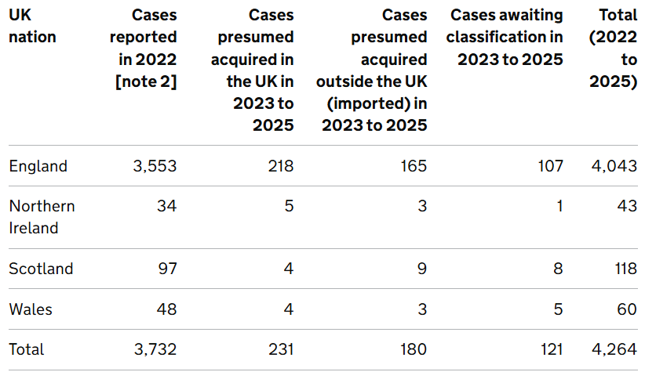
Mpox in UK nations: Clade IIb
Number of confirmed and highly probable mpox clade IIb cases by UK nation of residence, 6 May 2022 to 31 May 2025 [note 1]
For recent data see: Mpox clade Ib and clade IIb outbreak: epidemiological overview
Note 1: Based on data extracted on 2 June 2025.
Note 2: Figures for 2022 start from 6 May 2022 and combine UK acquired and imported cases.
Vaccination against mpox
Notes:
Reference: Mpox outbreak: epidemiological overview, 5 June 2025 - GOV.UK

Slide 22
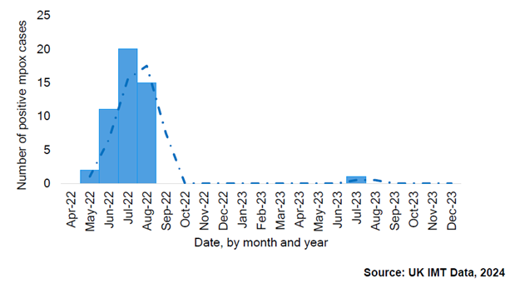
Mpox in Wales : Clade IIb
As of February 2025 for Wales:
  58 laboratory-confirmed cases of mpox in Wales
  Seven notifications so far in 2025
Epidemiological curve showing cases of Mpox diagnosed per month
since the beginning of the Mpox outbreak in 2022-2023, Wales
Vaccination against mpox
Notes:
Reference: phw.nhs.wales/publications/publications1/sexual-health-trends-in-wales-annual-report-2024/

Slide 23
Mpox epidemiology: clade I outbreak
2023: DRC reported geographical expansion of mpox cases, the highest annual number of MPXV clade I cases yet and the first report of sexually transmitted MPXV clade I.
2024: case rates in DRC increased further, including cases in female sex workers.
New MPXV clade Ib variant identified.
MPXV clade I cases reported in East Africa (previously only seen in Central Africa), including in children and heterosexual individuals.
13 Aug 24: mpox public health emergency of international concern declared.
15 Aug 24: first case of MPXV clade Ib in Europe reported in an individual in Sweden who had recently returned from an area of Africa experiencing large numbers of cases.
23 Aug 24: first case of MPXV clade Ib in Asia reported in an individual in Thailand who had recently returned from an affected African country.
Sept 24: first confirmed MPXV clade Ib case in India (following recent travel to UAE but not to the affected countries in Africa). Travel-associated cases of Clade Ib and since been reported in other countries including Germany, India, Kenya, Zimbabwe, Canada and the USA.
Oct 2024: first confirmed MPXV Clade Ib case in the UK in a person returning from affected countries in Africa.
Up to 31 May 2025, 12 cases of mpox clade Ib have been reported in England, most of these cases have reported direct or indirect links to travel to countries where mpox clade Ib is circulating.
Smallpox and mpox: the green book, chapter 29
Vaccination against mpox
Notes:
DRC: Democratic Republic of Congo
Mpox outbreak: epidemiological overview, 5 June 2025 - GOV.UK
Clade I treatment, management and response includes all clade I variants, including clade Ib.

Slide 24
Vaccination against mpox

Slide 25
Pre-requisites to administering mpox vaccine
Before administering mpox vaccine, it is recommended that:
*Those new to immunisation should receive comprehensive foundation immunisation training. Both knowledge and clinical competence should be assessed before new immunisers start to give and/or advise about the mpox vaccine. **Updated National Minimum Standards and Core Curriculum for Vaccination Training - GOV.UK have been published by UKHSA
Immunisers have received mpox vaccine training through attending a taught session, and practical training in mpox vaccine preparation and administration (if required)
Training in the management of anaphylaxis and Basic Life Support is undertaken, as specified by policy for your local area and are familiar with Resuscitation Council UK (RCUK) guidance on Management of Anaphylaxis in the Vaccination Setting
Any additional statutory and mandatory training as required by your employer is completed
An appropriate legal framework to supply and administer mpox vaccine is in place e.g. written prescription, patient specific prescription (PSD), Patient Group Direction (PGD). Visit here for Wales PGD template
Those involved in immunisation and vaccination understand the process of consent and how this applies when giving vaccines. Information on consent can be viewed here: Consent: Consent: the green book, chapter 2 - GOV.UK
Immunisers and those giving immunisation advice access and familiarise themselves with the following key documents: Smallpox and mpox: the green book, chapter 29
Vaccination against mpox
Notes:
* New immunisers should also have a period of supervised practice and support with a registered healthcare practitioner who is experienced, up to date and competent in immunisation.
**This guidance was updated in June 2025 and replaces the previous training standards for registered healthcare practitioners and healthcare support workers in a single document that describes the training that should be provided for all healthcare staff with a role in delivering vaccination programmes.
Practitioners should always ensure they are accessing the most up to date information and guidance.

Slide 26
Smallpox vaccines
Historically, first and second generation live smallpox vaccines have been used for population-level and targeted occupational health-related immunisation programmes for smallpox in the UK
These vaccines are no longer available in the UK and have been replaced by newer, third generation smallpox vaccines, including the modified vaccinia Ankara (MVA-BN) which have a much-improved safety profile.
MVA-BN vaccine licensed in Europe (as Imvanex®) by the European Medicines Agency EMA for the prevention of smallpox in 2013.
September 2019: the US Food and Drug Administration (FDA) approved MVA-BN vaccine (known in US as Jynneos®) for the prevention of mpox as well as smallpox.
September 2022: MVA-BN vaccine approved by the Medicines and Healthcare products Regulatory Agency (MHRA) for immunisation against mpox (regardless of MPXV clade).
September 2024: MVA-BN license extended by EMA* in Europe to include vaccination against mpox and for adolescents from 12 years of age.
MVA-BN vaccine has been used in the UK in response to previous mpox incidents.
Vaccination against mpox
Notes:
*https://www.ema.europa.eu/en/news/ema-recommends-extending-indication-mpox-vaccine-adolescents

Slide 27
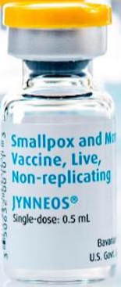
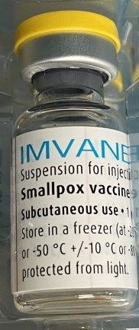
MVA-BN vaccine
Product name: Imvanex® (European brand name) or Jynneos® (US brand name)
Vaccine type: live modified vaccinia Ankara (MVA) vaccine
Manufacturer: Bavarian Nordic (BN)
Pharmaceutical form: suspension for injection (light yellow to pale white, milky suspension)
Route and volume: 0.5ml intramuscular (IM) or subcutaneous (SC).
Presentation: 0.5ml vial
Storage: after thawing, store for up to 8 weeks at +2°C to +8°C in the original package to protect from light
Image source: UKHSA
Vaccination against mpox
Notes:
Most vaccines are given by intramuscular (IM) injection (see chapter 4), but the MVA-BN Summary of Product Characteristics (SmPC) advises that the vaccine should be administered by the deep sub-cutaneous (SC) route. As there is published evidence suggesting an adequate immunological response (Vollmar et al, 2006) and extensive experience of using MVA containing vaccines given by the IM route, UKHSA advised that intra-muscular administration is an acceptable alternative. For adults, the preferred sites for both IM and SC immunisation is the deltoid area of the upper arm; for small children the anterolateral aspect of the thigh is preferred.
Storage: MVA-BN is supplied frozen in packs of 10 or 20 single dose vials. The remaining shelf life at clinic level will depend on previous storage temperature, please refer to documentation on the product.
Frozen vials should be transferred to +2°C to +8°C to thaw or may be thawed for 15 minutes at room temperatures for immediate use. After thawing, vaccine can be stored for up to 8 weeks at +2°C to +8°C. Store in the original package in order to protect from light.
Where fractional doses are being used (see GB Chapter for more information), the contents of the vial can remain at room temperature for up to one hour whilst the 5 doses are used. Each dose should be drawn up and given immediately.
During the 2022 mpox incident, both Imvanex and Jynneos were supplied for use in the UK depending on availability
Smallpox and mpox: the green book, chapter 29 - GOV.UK

Slide 28
MVA-BN vaccine
The virus used in the vaccine is attenuated (weakened) through multiple passages (repeated growth cycles of the cells on a culture) in chicken embryo fibroblast cells
This leads to a substantial loss of its genome (genetic information) and many of the known immune evasion (ability to avoid detection by the immune system) and virulence (ability of the virus to cause damage in the body) factors are not encoded
In human and animal studies, it demonstrates very limited replication capability and low neuropathogenicity, while retaining immunogenic properties, including protective immune responses against a variety of orthopoxviruses
As MVA-BN cannot replicate in mammalian cells, it does not produce a lesion at the site of vaccination
The vaccine virus has been modified so that it does not replicate in humans and it should be considered as an inactivated vaccine.
Vaccination against mpox

Slide 29
MVA-BN vaccine product excipients
Active ingredient:
Modified Vaccinia Ankara – Bavarian Nordic Live virus
Other ingredients:
trometamol
sodium chloride
water for injections
Trace residues of chicken protein, benzonase, gentamicin and ciprofloxacin may also be present from the manufacturing process
To find out more:
  Imvanex
  Visit the MHRA Products | Home website. Type Imvanex into the search box to find information and view the SmPC online.
  Jynneos
  Visit JYNNEOS | FDA to view the package insert online.
Vaccination against mpox
Notes:
Although the vaccine contains live modified vaccinia Ankara virus, the vaccine virus has been modified so that it does not replicate in humans so it should be considered as an inactivated vaccine.

Slide 30
MVA-BN vaccine contraindications, precautions, considerations, co-administration, and adverse reactions

Slide 31
Contraindications
The vaccine should not be routinely given to individuals who have had a sudden life-threatening allergic reaction to:
  a previous dose of MVA-BN vaccine or
  to any component of the vaccine (including trace residues from the manufacturing process such as chicken protein, benzonase, gentamicin and ciprofloxacin)
Please refer to Smallpox and mpox: the green book, chapter 29 for further information
Vaccination against mpox

Slide 32
Precautions
Minor illnesses without fever or systemic upset are not valid reasons to postpone immunisation
If an individual is acutely unwell, immunisation may be postponed until they have fully recovered
  This is to avoid confusing the differential diagnosis of any acute illness by wrongly attributing any signs or symptoms to the adverse effects of the vaccine
Individuals with atopic dermatitis need to be risk assessed by the immuniser prior to vaccination
MVA-BN vaccine is not contraindicated in pregnancy or breastfeeding but individuals who are pregnant or breastfeeding should discuss benefits and risks prior the vaccination.
Please refer to Smallpox and mpox: the green book, chapter 29 and for further information
Vaccination against mpox
Notes:
Please refer to the disease specific chapter (chapter 29) Green Book for information on contraindications and special precautions.

Slide 33
Current or previous mpox infection
If an individual is acutely unwell with symptoms or signs of possible mpox infection, immunisation should be postponed until they have fully recovered - to reduce the risks of exposing others and to avoid wrongly attributing any signs or symptoms to the adverse effects of the vaccine
Whether prior mpox infection protects against future infection is unclear, but based on analogy from smallpox infection and from live smallpox vaccine, it is likely that re-infection will be unusual, particularly in the short term
Vaccination against mpox
Notes:
A very small number of possible reinfections have been reported globally (Hasra et al, 2024, Li et al, 2024).
Hazra A, Zucker J, Bell E, et al. Mpox in people with past infection or a complete vaccination course: a global case series. Lancet Infect Dis. 2024 Jan;24(1):57-64. doi.org/10.1016/S1473-3099(23)00492-9
Li T, Li Z, Xia Y, Long J, Qi L. Mpox reinfection: A rapid systematic review of case reports. Infect Med (Beijing). 2024 Feb 25;3(1):100096. doi: 10.1016/j.imj.2024.100096. PMID: 38586545; PMCID: PMC10998266.

Slide 34
Considerations
Children and young people
In the UK, Imvanex® is licensed for use in adults aged 18 years and older by the MHRA. In Europe, the EMA* have approved its use in adults and adolescents aged 12 years and older. Jynneos® is licensed by the FDA for use in people aged 18 years and over.
Mpox is known to be more serious in young children so the JCVI recommend the use of the MVA-BN vaccine (either Imvanex® or Jynneos®) in all individuals who are eligible, regardless of age. This means MVA-BN vaccine should be given off-label to adolescents, children and babies considered to be at risk when indicated as per the Green Book chapter 29
Vaccination against mpox
Notes:
*EMA recommends extending indication of mpox vaccine to adolescents | European Medicines Agency (EMA) (https://www.ema.europa.eu/en/news/ema-recommends-extending-indication-mpox-vaccine-adolescents)

Slide 35
Underlying medical conditions (1)
Atopic dermatitis
Individuals with atopic dermatitis are known to have developed more site-associated reactions and generalised symptoms following MVA-BN vaccination
Individuals in this group therefore need to have an individual risk assessment before being offered vaccination to assess the risk from exposure, the risk of side effects from vaccination and the potential use of alternative preventive interventions
Individuals with a history of developing keloid scarring should be offered a 0.5ml SC or IM dose of MVA-BN (in preference to a fractional dose intradermally)*
Vaccination against mpox
Notes:
*In Wales it is anticipated that MVA-BN would be administered by SC/IM route, but this could be subject to change based on supply*

Slide 36
Underlying medical conditions (2)
Individuals with immunosuppression, including HIV infection
As MVA-BN vaccine contains a replication-defective virus (does not replicate), it is considered safe in those who are immunosuppressed (although the immune response to the vaccine could be reduced in severely immunosuppressed individuals)
In clinical trials on the use of MVA-BN vaccine in immunosuppressed individuals, no increase in adverse events in this group was seen
MVA-BN vaccine has been demonstrated to be safe in people with HIV infection
Individuals living with HIV who are virally suppressed and have a CD4 count above 200 cells/mm³ are not considered immunosuppressed for the purposes of this vaccination guidance
Vaccination should proceed in accordance with recommendations as individuals with immunosuppression and HIV are at significant risk of the complications of mpox
Specialist advice on other measures may also be required
Additional doses should be considered for those at ongoing risk of exposure in this group
As there is no data on intradermal administration in this group, vaccination should be given via the SC or IM routes
For further information please refer to: Smallpox and mpox: the green book, chapter 29 - GOV.UK
Vaccination against mpox
Notes:
Pischel L, Martini BA, Yu Y, Cacesse D, Tracy M, Kharbanda K, Ahmed N, Patel K, Grimshaw AA, Malik AA, Goshua G, Omer SB. Vaccine effectiveness of 3rd generation mpox vaccines against mpox infection and disease severity: A systematic review and meta-analysis. Vaccine,
2024 https://doi.org/10.1016/j.vaccine.2024.06.021
Yeganeh N, Yin S, Moir O, Danza P, Kim M, Finn L, Fisher R, Kulkarni S, Perez M, Poortinga K, Garland W, Foo C, Haddix M, Archer R, Frey N, Balter S, Singhal R, Kim A. Effectiveness of JYNNEOS vaccine against symptomatic mpox disease in adult men in Los Angeles County, August 29, 2022 to January 1, 2023. Vaccine. 2024 Aug 13;42(20):125987. Doi.org/10.1016/j.vaccine.2024.05.035.
Dalton AF, Diallo AO, Chard AN, Moulia DLet al. Estimated Effectiveness of Jynneos Vaccine in Preventing Mpox: A Multijurisdictional Case-Control Study — United States, August 19, 2022-March 31, 2023. MMWR Morb Mortal Wkly Rep. 2023 May 19;72(20):553-558. Doi.org/10.15585/mmwr.mm7220a3. www.cdc.gov/mmwr/volumes/72/wr/pdfs/mm7220a3-H.pdf

Slide 37
Co-administration with other vaccines
Although no data for co-administration of MVA-BN vaccine with other vaccines exists, it is thought that any interference between this vaccine and others (live or inactivated) is likely to be limited (see Green Book, Chapter 11).
Based on experience with other vaccines, any potential interference is most likely to result in a slightly attenuated (weakened) immune response to one of the vaccines.
There is no evidence of any safety concerns from giving other vaccines at the same time as the MVA-BN vaccine, although it may make the attribution of any adverse events more difficult.
Where vaccines are given at the same time, these should be given in different limbs where possible* (Green Book, Chapter 4)
Where individuals in an eligible cohort present having recently received one or more inactivated or another live vaccine, MVA-BN vaccination should still be given**.
The same applies where MVA-BN vaccination has been received first or where a patient presents requiring 2 or more vaccines***
It is generally better for vaccination with any required vaccines (including MVA-BN, hepatitis A, hepatitis B and HPV) to proceed to avoid any further delay in protection and to reduce the risk of the individual not returning for a later appointment
Vaccination against mpox
Notes:
Currently, there are no data on administering MVA-BN at the same time as other vaccines. However, it can be co-administered with other vaccines in accordance with Chapter 29.
*further guidance on vaccination sites is available in the green book chapter 4
**further guidance on co-administration and intervals between vaccines is available in the green book chapter 11
***hepatitis A and hepatitis B combination vaccine may also be an option if required as this reduces the number of injections

Slide 38
Potential adverse reactions (1)
Data from multiple trials shows that MVA-BN vaccine causes less adverse events than the first- and second-generation smallpox vaccines.
Most common adverse reactions reported in clinical trials (≥1/10):
  headache
  nausea
  myalgia (muscle pain)
  fatigue
  injection site reactions (pain, redness, swelling, hardening and/or itching)
Reactions were mild to moderate in intensity, resolving within 7 days without intervention
Although adverse events such as injection site reactions and influenza-like symptoms are common, serious adverse events are rare.
For further information refer to:
Imvanex SmPC here
Jynneos package insert here
Vaccination against mpox
Notes:
WHO 2013, Frey et al, 2007, Vollmar et al, 2006, von Krempelhuber et al, 2010, Greenberg et al, 2013
World Health Organisation (WHO) (2013) Summary report on first, second and third generation smallpox vaccines. Geneva
Frey SE, Newman FK, Kennedy JS et al. (2007) Clinical and immunologic responses to multiple doses of IMVAMUNE(R) (Modified Vaccinia Ankara) followed by Dryvax(R) challenge. Vaccine. 25: 8562-73
Vollmar J, Arndtz N, Eckl KM et al. (2006) Safety and immunogenicity of Imvamune, a promising candidate as a third generation smallpox vaccine. Vaccine. 24: 2065-70
Von Krempelhuber A, Vollmar J, Prokorny R et al. (2010) A randomized, double-blind, dose-finding Phase II study to evaluate immunogenicity and safety of the third generation smallpox vaccine candidate IMVAMUNE. Vaccine. 28: 1209-16
Greenberg RN, Overton ET, Haas DW et al. (2013) Safety, immunogenicity, and surrogate markers of clinical efficacy for modified vaccinia Ankara as a smallpox vaccine in HIV-infected subjects. J. Infect. Dis. 207: 749-58

Slide 39
Potential adverse reactions (2)
Very common (may affect more than 1 in 10 people) | Common (may affect up to 1 in 10 people) | Uncommon (may affect up to 1 in 100 people) | Rare (may affect up to 1 in 1000 people)
Headache | Chills | nose and throat infection, upper respiratory tract infection | Sinus infection
Aching muscles | Fever | swollen lymph nodes underarm swelling, pain in the armpit | Influenza-like illness
Feeling sick | Joint pain, pain in extremities | dizziness, abnormal skin sensations | Hives (nettle rash)
Tiredness | Loss of appetite | muscle stiffness | Skin discoloration, bruising, lump
Pain, redness, swelling, hardness or itching at the injection site | Discolouration, bruising or warmth at the injection site | sore throat, runny nose, cough | Sweating and night sweats
 | Injection site nodule, injection site haematoma | diarrhoea, vomiting | Muscle cramps, pain and weakness
 |  | rash, itch, skin inflammation, skin discolouration, bruising, flushing, feeling unwell, chest pain | Swelling of the ankles, feet, fingers, face, mouth and throat
 |  | Abnormal sleep Injection site haemorrhage, injection site irritation, Increased: troponin I and hepatic enzyme Decreased: White blood cell count, mean platelet volume | faster heart beat back, neck, abdominal pain, musculoskeletal pain, auxillary pain ear and throat ache dry mouth spinning sensation (vertigo) migraine nerve disorder causing weakness, tingling or numbness, drowsiness Injection site: blisters, parasthesia, rash, inflammation, exfoliation, dryness, movement impairment, contusion weakness, feeling unwell pink eye Increased white blood cell count Somnolence
For further information refer to:
Imvanex SmPC here
Jynneos package insert here
Vaccination against mpox
Notes:
Imvanex: Unknown (cannot be estimated from the available data) adverse reactions include: Acute peripheral facial paralysis (Bell’s palsy)
Jynneos: Serious adverse events. Across all studies, a causal relationship to JYNNEOS could not be excluded for 5 SAEs, all non-fatal, which included Crohn’s disease, sarcoidosis, extraocular muscle paresis, throat tightness, and hemolytic anemia.
Source: EMA Imvanex product information: https://www.ema.europa.eu/en/documents/product-information/imvanex-epar-product-information_en.pdf
Source: Jynneos package insert: Package Insert - JYNNEOS (Refrigerator)

Slide 40
Potential adverse reaction (3)
Rates of adverse events reported after 1st, 2nd or booster dose were similar, but anecdotally the frequency of adverse events, particularly local site reactions, appears to be higher in those who have received previous live smallpox vaccine
As this vaccine is labelled with a black triangle, all adverse reactions occurring in individuals of any age after vaccination should be reported to the MHRA using the Yellow Card Scheme
Any adverse reaction should also be documented in accordance with local procedures
Vaccination against mpox
Notes:
WHO 2013, Frey et al, 2007, Vollmar et al, 2006, von Krempelhuber et al, 2010, Greenberg et al, 2013
World Health Organisation (WHO) (2013) Summary report on first, second and third generation smallpox vaccines. Geneva
Frey SE, Newman FK, Kennedy JS et al. (2007) Clinical and immunologic responses to multiple doses of IMVAMUNE(R) (Modified Vaccinia Ankara) followed by Dryvax(R) challenge. Vaccine. 25: 8562-73
Vollmar J, Arndtz N, Eckl KM et al. (2006) Safety and immunogenicity of Imvamune, a promising candidate as a third generation smallpox vaccine. Vaccine. 24: 2065-70
Von Krempelhuber A, Vollmar J, Prokorny R et al. (2010) A randomized, double-blind, dose-finding Phase II study to evaluate immunogenicity and safety of the third generation smallpox vaccine candidate IMVAMUNE. Vaccine. 28: 1209-16
Greenberg RN, Overton ET, Haas DW et al. (2013) Safety, immunogenicity, and surrogate markers of clinical efficacy for modified vaccinia Ankara as a smallpox vaccine in HIV-infected subjects. J. Infect. Dis. 207: 749-58

Slide 41
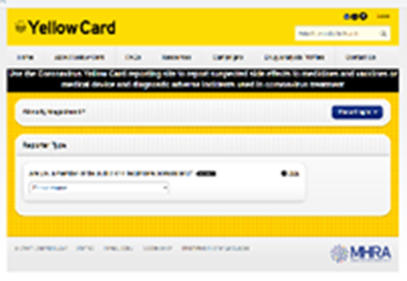

Reporting suspected adverse reactions
Vaccinees should be advised that they can report any adverse reactions or suspected side effects to the MHRA through the online yellow card scheme website or the Yellow Card app
Any suspected side effects following vaccine administration should be reported to the MHRA Yellow Card Scheme.
Anyone can report even if uncertain about whether vaccine caused condition:
  www.mhra.gov.uk/yellowcard or call 0800 731 6789 (9am to 5pm Monday to Friday)
  Green Book Chapter 9 for detailed guidance on reporting vaccine reactions
Vaccination against mpox
Notes:
Healthcare professionals and patients are encouraged to report suspected adverse reactions to the Medicines and Healthcare Products Regulatory Agency (MHRA) using the yellow card reporting scheme
Green Book chapter 9: https://www.gov.uk/government/publications/surveillance-and-monitoring-for-vaccine-safety-the-green-book-chapter-9

Slide 42
MVA-BN vaccine storage and preparation

Slide 43
MVA-BN vaccine storage
MVA-BN vaccine has complex storage requirements, and the expiry date depends upon storage temperature
MVA-BN vaccine is supplied frozen in packs of 10 or 20 vials
MVA-BN vaccine will be shipped from UKHSA storage sites at -20°C
The remaining shelf life at clinic level will depend on previous storage temperature so refer to documentation on the product
It should be stored at -20°C upon receipt to keep the expiry date longer but if -20°C storage is not available, frozen vials should be immediately stored in the fridge at +2°C to +8°C to thaw (or may be thawed for approx. 15 minutes at room temperature for immediate use)
After thawing at +2°C to +8°C, MVA-BN vaccine can be stored at this temperature (+2°C to +8°C ) for up to 8 weeks; add a post-thaw expiry label
Do not re-freeze a vial once it has been thawed
Store in original package to protect from light
Do not use after the expiry date shown on the vial label or after the 8-week post-thaw expiry date (whichever is sooner)
Vaccination against mpox
Notes:
Storage information is also available in the product information as well as the Green Book chapter: https://www.gov.uk/government/publications/smallpox-and-vaccinia-the-green-book-chapter-29
and the PGD: Patient Group Directions (PGD) - Welsh Medicines Advice Service (https://www.wmic.wales.nhs.uk/pgds-templates-advice/)

Slide 44
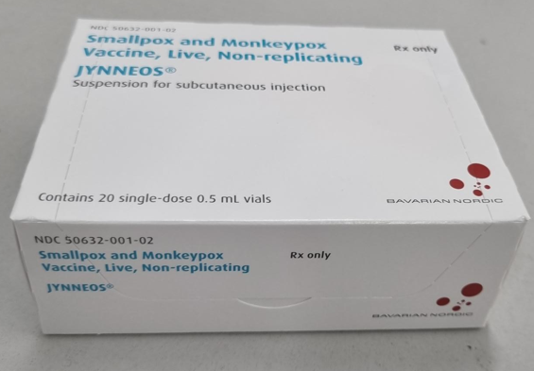
MVA-BN vaccine preparation
MVA-BN vaccine is supplied in packs containing 10 or 20 single dose vials (0.5ml in each)
Once the frozen vaccine has been thawed, it is a light yellow to pale white milky suspension for injection
The vaccine should be allowed to reach room temperature before use
Swirl vial gently before use for at least 30 seconds
Visually inspect the suspension prior to administration
If particles, discolouration and/or abnormal appearance are seen, the vaccine should be discarded
Administration is usually via the subcutaneous or intramuscular route (0.5ml)
Image source: UKHSA
Vaccination against mpox
Notes:
Image of Jynneos packaging (US branded MVA-BN vaccine) supplied by Bavarian Nordic

Slide 45
MVA-BN vaccine administration

Slide 46
Legal framework for administration
Use of MVA-BN for vaccination against mpox may be via a written prescription, Patient Specific Direction (PSD) or a Patient Group Direction (PGD) depending on the vaccine being supplied, and the route of administration
Imvanex® is UK licensed and Jynneos® (US licensed Batch FDP00072) has been approved for use in the UK by the MHRA
Where Jynneos® is the local vaccine available at time of administration, the PGD only enables the use of Jynneos® vaccine: batch number FDP00072 (expiry date 31 July 2025)
Welsh Medicines Advice Service have produced a PGD specifically for the use of the US licensed Batch FDP00072 of Jynneos ▼® vaccine and Imvanex ▼®
If there are any programme changes, these may not be immediately reflected in the PGD; a prescription or PSD should be used in the interim
Vaccination against mpox
Notes:
While Imvanex® is the name of the European product, Jynneos® is the name of the US-licensed version, both of which are developed by Bavarian Nordic.
To ensure sufficient vaccine was available, Jynneos® was urgently procured in the UK to manage the 2022 Clade II mpox outbreak the MHRA granted a ‘batch specific variation’ for the FDP00072 batch (expiry date 31 July 2025) of Jynneos® which enabled importation into the UK for use. This is the only batch of Jynneos® that can be used under the national mpox vaccine PGD. Any batch of Imvanex® can be used under the PGD.

Slide 47
Preparation and administration
Appropriate infection control and aseptic techniques should be used at all times
The following guidance regarding preparation of the vaccination site applies irrespective of the route used for administration:
If the skin is clean, no further cleaning is necessary. Only visibly dirty skin needs to be cleaned. It is not necessary to disinfect the skin (Green Book, Chapter 4)
Routine use of gloves for immunisation is not recommended; follow national IPC guidance
Vaccination against mpox
Notes:
Infection Prevention and Control (IP&C) Measures for Suspected and Confirmed Cases of Mpox in Healthcare Settings in Wales v3.0:
https://phw.nhs.wales/services-and-teams/antibiotics-and-infections/infection-prevention-control/resources-for-healthcare-professionals/mpox/20-03-2025-ipc-measures-for-suspected-and-confirmed-mpox-harp-phw-v3-0w/

Slide 48
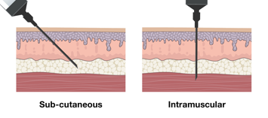

MVA-BN vaccine administration: subcutaneous and intramuscular technique
MVA-BN vaccine administration is usually via the subcutaneous or intramuscular route (0.5ml)
The required needle insertion angle and depth of tissue penetration for each technique is different
Vaccination against mpox
Notes:
A fractional dose may be administered by the intradermal route* (0.1ml), as per the Green Book chapter 29 (e.g. during periods of supply constraint) (https://www.gov.uk/government/publications/smallpox-and-vaccinia-the-green-book-chapter-29)
Additional training is required for intradermal injection.
*In Wales it is anticipated that MVA-BN would be administered by SC/IM route, but this could be subject to change based on supply*

Slide 49
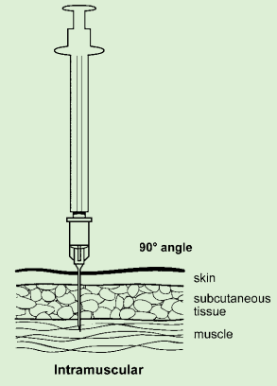
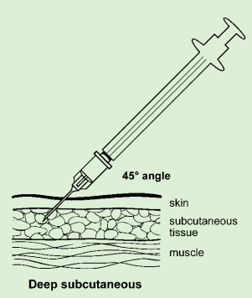
Intramuscular/subcutaneous administration of MVA-BN
The MVA-BN Summary of Product Characteristics (SmPC) advises that the vaccine should be administered by the deep sub-cutaneous (SC) route
However, there is published evidence suggesting an adequate immunological response and extensive experience of using MVA-containing vaccines given by the intra-muscular (IM) route, in August 2022, UKHSA advised that IM administration is an acceptable alternative so the vaccine can be given IM or SC
For adults, the preferred sites for both IM and SC immunisation is the deltoid area of the upper arm
IM injections should be given with the needle at a 90 degree angle to the skin and the skin should be stretched, not bunched
Deep SC injections should be given with the needle at a 45 degree angle to the skin and the skin should be bunched, not stretched
Vaccinators should be familiar with the information about vaccine administration in the Green Book chapter 4
Image source Green Book -Chapter 4 – immunisation procedures
Vaccination against mpox

Slide 50
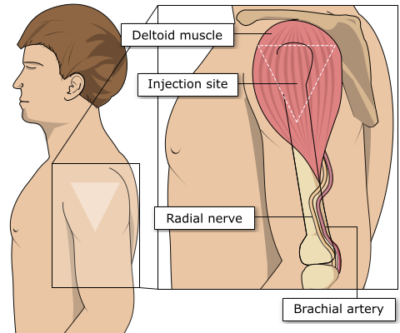
Vaccination intramuscular administration
Giving vaccine into the muscle:
Leads to a better immune response to the vaccine (as the muscle contains the appropriate cells necessary to initiate the immune response)
Is less likely to cause local reactions than if the vaccine is given under the skin (subcutaneously)
For IM and SC injections, the needle needs to be sufficiently long to ensure that the vaccine is injected into the muscle or deep into subcutaneous tissue.
Studies have shown that the use of 25mm needles can reduce local vaccine reactogenicity
The width of the needle (gauge) may also need to be considered. A 23-gauge or 25-gauge needle is recommended for intramuscular administration of most vaccines
In larger adults, a longer length (e.g. 38mm) may be required, and an individual assessment should be made
Image source: The Australian Immunisation Handbook (health.gov.au)
Immunisation procedures: the green book, chapter 4
Vaccination against mpox

Slide 51
Observation following vaccination
  There is no routine requirement for observation post-vaccination
  Observe for any immediate reactions whilst vaccinated individual is receiving any verbal post vaccination information and exiting the clinic/venue
  As fainting can occur following any vaccination, all those vaccinated with MVA-BN should be advised not to drive for 15 minutes after vaccination
  Note: facilities the for management of anaphylaxis should be available at all vaccination sites (see Vaccine safety and adverse events following immunisation: the green book, chapter 8)
Vaccination against mpox

Slide 52
MVA-BN vaccine efficacy

Slide 53
MVA-BN vaccine efficacy and use (1)
Estimates of real-world vaccine effectiveness (VE) in preventing mpox infection have been mainly generated during the 2022 outbreak and reviewed in meta-analyses. In these studies:
Numerous studies* highlight similar vaccine efficacy (VE). This ranges from the lowest being 74% and the highest being 83% respectively for one and two doses of MVA-BN vaccine. Further studies since these reviews have reported similar estimates of VE (Charles et al, 2024).
There is some uncertainty about whether VE may be affected by immune competence: slightly higher VE was estimated in people not living with diagnosed HIV compared to those living with HIV (Yeganeh et al, 2024**) and slightly lower VE was estimated in people with an immunocompromising condition (Dalton et al 2023**).
However, in one review, VE estimates in immunocompromised individuals, people living with HIV or people taking pre-exposure prophylaxis for HIV were similar to overall vaccine estimates, although with wide confidence intervals.
Source and further information: The Green Book chapter 29
Vaccination against mpox
Notes:
Source and further information: The Green Book chapter 29
*Berry MT, Khan SR, Schlub TE, Notaras A, Kunasekaran M, Grulich AE, MacIntyre CR, Davenport MP, Khoury DS. Predicting vaccine effectiveness for mpox. Nat Commun. 2024 May 8;15(1):3856. doi: 10.1038/s41467-024-48180-w
*Mason LMK, Betancur E, Riera-Montes M, Lienert F, Scheele S. MVA-BN Vaccine Effectiveness: A Systematic Review of Real-World Evidence in Outbreak Settings. medRxiv 24306078, 2024 April 26 Doi.org/10.1101/2024.04.25.24306078.
*Pischel L, Martini BA, Yu Y, Cacesse D, Tracy M, Kharbanda K, Ahmed N, Patel K, Grimshaw AA, Malik AA, Goshua G, Omer SB. Vaccine effectiveness of 3rd generation mpox vaccines against mpox infection and disease severity: A systematic review and meta-analysis. Vaccine, 2024 https://doi.org/10.1016/j.vaccine.2024.06.021
Charles H, Thorley K, Turner C, et al. Post-peak mpox in England: epidemiology, reinfection, and vaccine effectiveness – data from 2023. medRxiv 2024 24303362 [accessed 2024 June 18] https://www.medrxiv.org/content/10.1101/2024.02.26.24303362v1
**Yeganeh N, Yin S, Moir O, Danza P, Kim M, Finn L, Fisher R, Kulkarni S, Perez M, Poortinga K, Garland W, Foo C, Haddix M, Archer R, Frey N, Balter S, Singhal R, Kim A. Effectiveness of JYNNEOS vaccine against symptomatic mpox disease in adult men in Los Angeles County, August 29, 2022 to January 1, 2023. Vaccine. 2024 Aug 13;42(20):125987. Doi.org/10.1016/j.vaccine.2024.05.035.
**Dalton AF, Diallo AO, Chard AN, Moulia DLet al. Estimated Effectiveness of Jynneos Vaccine in Preventing Mpox: A Multijurisdictional Case-Control Study — United States, August 19, 2022-March 31, 2023. MMWR Morb Mortal Wkly Rep. 2023 May 19;72(20):553-558. Doi.org/10.15585/mmwr.mm7220a3. www.cdc.gov/mmwr/volumes/72/wr/pdfs/mm7220a3-H.pdf
Guagliardo SA, Kracalik I, Carter RJ, Braden C, Free R, Hamal M, Tuttle A, McCollum AM, Rao AK. Monkeypox Virus Infections After 2 Preexposure Doses of JYNNEOS Vaccine — United States, May 2022–May 2024. MMWR Morb Mortal Wkly Rep 2024;73:460– 466.
Hazra A, Zucker J, Bell E, et al. Mpox in people with past infection or a complete vaccination course: a global case series. Lancet Infect Dis. 2024 Jan;24(1):57-64. doi.org/10.1016/S1473-3099(23)00492-9
Hazra A, Zucker J, Bell E, et al. Mpox in people with past infection or a complete vaccination course: a global case series. Lancet Infect Dis. 2024 Jan;24(1):57-64. doi.org/10.1016/S1473-3099(23)00492-9
Eustaquio PC, Salmon-Trejo LAT, McGuire LC, Ellington SR. Epidemiologic and Clinical Features of Mpox in Adults Aged >50 Years—United States, May 2022-May 2023. MMWR Morb Mortal Wkly Rep. 2023;72:893-6. www.cdc.gov/mmwr/volumes/72/wr/mm7233a3.htm
Kröger ST, Lehmann MC, Treutlein M, Fiethe A, Kossow A, Küfer-Weiß A, Nießen J, Grüne B. Mpox outbreak 2022: an overview of all cases reported to the Cologne Health Department. Infection. 2023 Oct;51(5):1369-1381. doi: 10.1007/s15010-023-01997-x. Epub 2023 Feb 14. PMID: 36787016; PMCID: PMC9926425.
*Post-exposure vaccination is not covered in this training slide set. Please refer to the Green Book smallpox and mpox chapter, the relevant incident response training slide set and other relevant resources.
*Vaccination as an occupational health measure is not covered in this resource.

Slide 54
MVA-BN vaccine efficacy and use (2)
A model has predicted that increasing the interval between the two MVA-BN vaccine doses will lead to higher peak antibody response which remains above the one-dose peak for more than 10 years. This is consistent with modelling used by JCVI, where the observed data in 2023 fitted with a longer duration of protection – at least 5 years for one dose and 10 years for two doses of vaccine.
Source and further information: The Green Book chapter 29
Vaccination against mpox
Notes:
Source and further information: The Green Book chapter 29
Berry MT, Khan SR, Schlub TE, Notaras A, Kunasekaran M, Grulich AE, MacIntyre CR, Davenport MP, Khoury DS. Predicting vaccine effectiveness for mpox. Nat Commun. 2024 May 8;15(1):3856. doi: 10.1038/s41467- 024-48180-w
Zhang X-S, Niyomsri, S, Mandal S, Mohammed H et al. (2024) Cost-effectiveness of vaccinations strategies to control future mpox outbreaks in England. Pre-print. medRxiv 2024.08.20.24312301; doi: https://doi. org/10.1101/2024.08.20.24312301
*Post-exposure vaccination is not covered in this training slide set. Please refer to the Green Book smallpox and mpox chapter, the relevant incident response training slide set and other relevant resources.
*Vaccination as an occupational health measure is not covered in this resource.

Slide 55
Mpox vaccination programme: recommendations for the use of the MVA-BN vaccine and eligibility

Slide 56
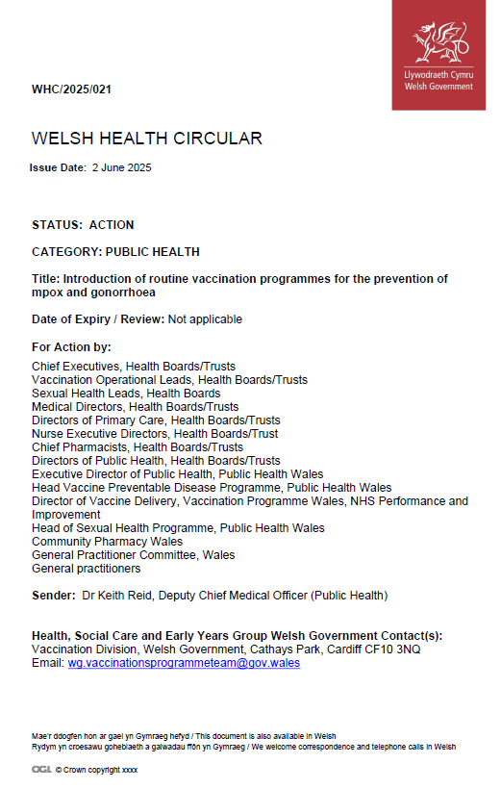
WHC/2025/021 Introduction of routine vaccination programmes for the prevention of mpox and gonorrhoea
Welsh Government has accepted advice from the JCVI to introduce a routine vaccination programme against Mpox for those at highest risk
A global outbreak of the disease began in 2022, linked to infections with clade II and a vaccination outbreak response was developed across the UK, using the smallpox vaccine Modified Vaccinia Ankara - Bavarian Nordic (MVA-BN), with this reactive offer continuing in Wales to present day.
Transmission within Wales has mainly been reported within networks of gay, bisexual, and other men who have sex with men (GBMSM) without a documented history of travel to endemic countries, with limited onward transmission outside of sexual networks.
The programme for mpox will be a pre-exposure vaccination primarily offered to GBMSM who are at highest risk of acquiring mpox. GBMSM at highest risk should be identified amongst those who attend sexual health services, using markers of risk to assess eligibility, as per the guidance in the Green Book.
Sexual health services may also vaccinate other individuals who have frequent, close and intimate contact with the GBMSM network at risk of mpox irrespective of their identified gender.
In Wales there will be a routine vaccination programme for the prevention of mpox for those eligible* through sexual health services (WHC/2025/021). Vaccine Programme Wales will advise Sexual Health Clinics when the programme will become routine, readiness is anticipated to be from July.

Slide 57
Routine programme vaccine recommendations for MVA-BN vaccine (1)
Eligibility for the routine programme will be similar to the 2022 outbreak. GBMSM at highest risk should be identified amongst those who attend sexual health services, using markers of risk to assess eligibility
These risk criteria include:
A recent history of multiple partners
Participating in group sex
Attending sex-on-premises venues
A proxy marker such as a bacterial sexually transmitted infection (STI) within the last year
Refer to Smallpox and mpox: the green book, chapter 29 and JCVI statement on mpox vaccination as a routine programme - GOV.UK
Vaccination against mpox
Notes:
This training slide set is for healthcare practitioners who will be involved in routine administration of MVA-BN vaccine as part of the pre-exposure vaccination strategy for GBMSM at high risk of mpox exposure. There is a separate training resource for individuals involved in vaccination as an outbreak control measure during an outbreak or incident, or who will be involved in administration of post exposure MVA-BN vaccination. They will be available here: Immunisation training resources and events - Public Health Wales (https://phw.nhs.wales/topics/immunisation-and-vaccines/vaccines-professionals/immunisation-training-resources-and-events/)

Slide 58
Routine programme vaccine recommendations for MVA-BN vaccine (2)
Other individuals who have frequent close and intimate contact with the GBMSM network at risk of mpox may be vaccinated irrespective of their identified gender. This would include staff who work in GBMSM sex on premises venues, such as saunas, if they are regularly exposed to items (e.g. linen) or surfaces likely to be contaminated with body fluids or skin cells.
Vaccination against mpox
Notes:
This training slide set is for healthcare practitioners who will be involved in routine administration of MVA-BN vaccine as part of the pre-exposure vaccination strategy for GBMSM at high risk of mpox exposure. There is a separate training resource for individuals involved in vaccination as an outbreak control measure during an outbreak or incident, or who will be involved in administration of post exposure MVA-BN vaccination. They will be available here once published: Immunisation training resources and events - Public Health Wales

Slide 59
Recommendations for the use of MVA-BN vaccine Occupational risk
Given the low incidence of infection in the UK, most health and social care workers are at very low risk of exposure to mpox, and do not require routine pre-exposure vaccination. Unvaccinated (and vaccinated) staff who are required to see suspected cases should wear appropriate personal protective equipment and avoid direct and close contact.
Staff who work in specialist roles where exposure to orthopox viruses is likely to be more frequent and prolonged, should be advised of the possible risk and offered vaccination based on an occupational health risk assessment. This would include:
workers in laboratories where pox viruses (such as MPXV or genetically modified vaccinia) are handled or cultured, and others who work in highly specialist laboratories undertaking procedures with a significantly higher risk of exposure. (Advisory Committee on Dangerous Pathogens and the Advisory Committee on Genetic Modification, 1990)
staff caring for in-patients with mpox in High Consequence Infectious Disease (HCID) units, or Specialised Regional ID Centres (SRIDC), including those who clean areas where mpox patients have been cared for
staff regularly undertaking environmental decontamination around cases of mpox
UK health care and laboratory workers being deployed to respond to a MPXV outbreak or incident overseas
UK humanitarian aid workers who will be living or working in close contact with the local population in areas affected by a MPXV outbreak or incident overseas
Pre-exposure vaccination may also be considered for those about to start providing prolonged or close care for a patient with confirmed mpox, or during wider outbreak response to protect health workers in settings or populations where an outbreak is happening (see GBC section: vaccination during outbreaks and incidents)
For further information contact occupational health and refer to:
Green Book chapter 29
Vaccination against mpox
Notes:
Given the low incidence of infection in the UK, most health and social care workers are at very low risk of exposure to mpox, and do not require routine pre-exposure vaccination. Individuals working in UK diagnostic laboratories, including those undertaking MPXV PCR and/or serology, should be using standard protective equipment and safety cabinets and therefore the risk of exposure, even in high incidence areas, should be minimal.
This training slide set is for healthcare practitioners who will be involved in routine administration of MVA-BN vaccine as part of the pre-exposure vaccination strategy for GBMSM at high risk of mpox exposure. There is a separate training resource for individuals involved in vaccination as an outbreak control measure during an outbreak or incident, or who will be involved in administration of post exposure MVA-BN vaccination. They will be available here: Immunisation training resources and events - Public Health Wales (https://phw.nhs.wales/topics/immunisation-and-vaccines/vaccines-professionals/immunisation-training-resources-and-events/)

Slide 60
MVA-BN dosage and schedule

Slide 61
Mpox vaccination dosage and schedule: routine pre-exposure vaccination
Pre-exposure vaccination of individuals previously not vaccinated against smallpox is a course of 2 doses of MVA-BN with at least a 28-day interval between doses
Pre-exposure vaccination of individuals previously vaccinated against smallpox is a single dose
Smallpox and mpox: the green book, chapter 29
Vaccination against mpox

Slide 62
Recommended schedule for use of MVA-BN
 | Individuals previously not vaccinated against smallpox | Individuals previously vaccinated against smallpox
Immunocompetent individuals (including people with atopic dermatitis)* | 0.5 ml subcutaneous / intramuscular injection AND 0.5 ml subcutaneous / intramuscular injection any time from 28 days | 0.5 ml subcutaneous / intramuscular injection
Individuals who are immunosuppressed adults** and those with a history of keloid scarring | 0.5 ml subcutaneous / intramuscular injection AND 0.5 ml subcutaneous / intramuscular injection at any time from 28 days | 0.5 ml subcutaneous / intramuscular injection
Children under 18 years | 0.5 ml subcutaneous / intramuscular injection AND 0.5 ml subcutaneous / intramuscular injection at any time from 28 days | 0.5 ml subcutaneous / intramuscular injection
Adapted from table in the Green Book chapter 29)
*This includes individuals living with HIV who are virally suppressed and have a CD4 count above 200 cells/mm3
**Immunosuppressed adults as defined in chapter 28a of the Green Book
*In Wales it is anticipated that MVA-BN would be administered by SC/IM route, but this could be subject to change based on supply*
Vaccination against mpox

Slide 63
Mpox vaccination dosage and schedule: reinforcing doses
There is currently insufficient evidence to support routine boosters in immunocompetent individuals so a booster dose may only be considered in limited specific circumstances:
immunocompetent individuals who received their second dose more than two years ago should be offered a further dose of vaccine post-exposure*
immunocompetent eligible health care workers at ongoing risk whose primary course was completed more than 10 years ago**
severely immunosuppressed (as defined in Chapter 28a) individuals eligible for pre-exposure immunisation whose primary course was completed more than 2 years ago. People living with HIV who have a current CD4 count of less than 200 cells/mm³ or who are not virally suppressed, are considered to be severely immunosuppressed
Where boosting is considered necessary:
a single dose should be administered at least two years after the primary course. If boosting is following a significant exposure a single dose of vaccine should be administered within 4 days
if a booster dose is required, administer 0.5ml SC/IM dose or a 0.1ml ID dose of MVA-BN**
Vaccination against mpox
Notes:
*Post-exposure vaccination is not covered in this training slide set. Please refer to the Green Book smallpox and mpox chapter, the relevant incident response training slide set and other relevant resources. They will be available here: Monkeypox - Information for health professionals - Public Health Wales (https://phw.nhs.wales/topics/immunisation-and-vaccines/vaccines-professionals/immunisation-training-resources-and-events/)
**Vaccination as an occupational health measure is not covered in this resource.
****In Wales it is anticipated that MVA-BN would be administered by SC/IM route, but this could be subject to change based on supply*

Slide 64
Previous incomplete vaccination
The UK vaccination schedules incorporate the minimum intervals between subsequent doses of the same vaccine.
This means, for individuals who have been identified as eligible for a two-dose course of vaccine:
if the MVA-BN course is interrupted or delayed, it should be resumed
the first dose does not need to be repeated, or the course restarted
For further information refer to: Smallpox and mpox: the green book, chapter 29 - GOV.UK
Vaccination against mpox

Slide 65
Useful resources

Slide 66
Useful resources (1)
Green Book, Chapter 29: Smallpox and mpox
Welsh Government. Introduction of routine vaccinations for mpox and gonorrhoea WHC/2025/021
Imvanex SmPC available here: https://products.mhra.gov.uk/search/?search=Imvanex&page=1
Jynneos FDA prescribing information package insert: JYNNEOS | FDA
PHW Mpox healthcare professional immunisation and vaccine website: Mpox - Information for health professionals - Public Health Wales
PHW Mpox general immunisation and vaccines website: Mpox (monkeypox) - Public Health Wales
PHW Mpox patient information leaflet: Adults - Public Health Wales
PHW Vaccine record card: Oedolion / Adults
PHW Mpox website: Mpox - Public Health Wales
MVA-BN vaccine for mpox PGD: Patient Group Directions (PGD) - Welsh Medicines Advice Service
MVA-BN consent form will soon be available here: Mpox: Information for health professionals (PHW)
MVA-BN vaccination checklist will soon be available here: Mpox: Information for health professionals (PHW)
Vaccination against mpox

Slide 67
Useful resources (2)
PHW Mpox IP&C Resources for healthcare professionals: Mpox - Public Health Wales
UKHSA Mpox (monkeypox) guidance page: Mpox (monkeypox): guidance - GOV.UK **This collection page should be reviewed regularly to ensure the most up to date guidance is accessed**
CEM/CMO/2025/01 Derogation of clade I mpox: CEM/CMO/2025/01
UKHSA Derogation of clade 1 mpox: Derogation of clade I mpox - GOV.UK
UKHSA Contact tracing guidance: Contact tracing guidance for mpox - GOV.UK
UKHSA Mpox clade Ib and clade IIb outbreak: epidemiological overview: Mpox clade Ib and clade IIb outbreak: epidemiological overview - GOV.UK
UKHSA Vaccination against mpox: information for healthcare practitioners: Vaccination against mpox: information for healthcare practitioners - GOV.UK
JCVI statement on mpox vaccination as a routine programme: JCVI statement on mpox vaccination as a routine programme - GOV.UK
Vaccination against mpox

