Slide 1
Preschool vaccinations resources
Vaccine Preventable Disease Programme
Public Health Wales
January 2026
Version 1
Notes:
Material contained in this document may be reproduced without prior permission provided it is done so accurately and is not used in a misleading context.
Acknowledgement to Public Health Wales NHS Trust to be stated.
© 2025 Public Health Wales NHS Trust.

Slide 2
This slide set has been created to highlight key publications and resources to support healthcare professionals in delivering preschool vaccinations.

Slide 3




Leaflets (1)
Leaflets have been updated to reflect the changes to the routine childhood immunisation schedule in 2025 and 2026
Leaflets are available for the 6-in-1, MenB, rotavirus, pneumococcal, MMRV, 4-in-1, flu and BCG vaccinations. Along with a What to expect after vaccinations leaflet
Bilingual digital versions are available for download on PHW vaccines leaflets page on website:
English website page (English presents first on the leaflet)
Welsh website page (Welsh presents first on the leaflet)
Leaflets are available to order for free on Health Information Resources website

Slide 4





Leaflets (2)
The MMRV/MMR leaflet and What to expect after vaccinations leaflet have been extensively revised to reflect the changes to the routine childhood immunisation schedule
Please use these to assist for you and your patients
Accessible formats are available in BSL, audio, easy read and large print

Slide 5


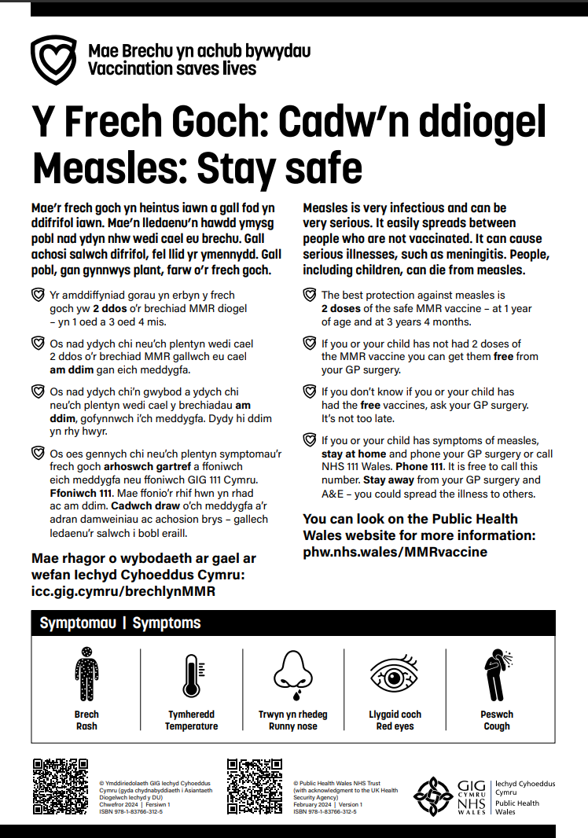
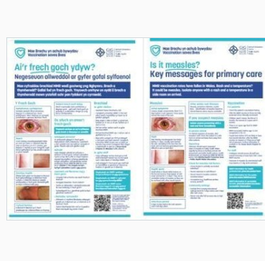
Posters
Posters have been updated to reflect the changes to the routine childhood immunisation schedule in 2025 and 2026
These bilingual resources are available to download from the webshop
Being updated
Being updated

Slide 6
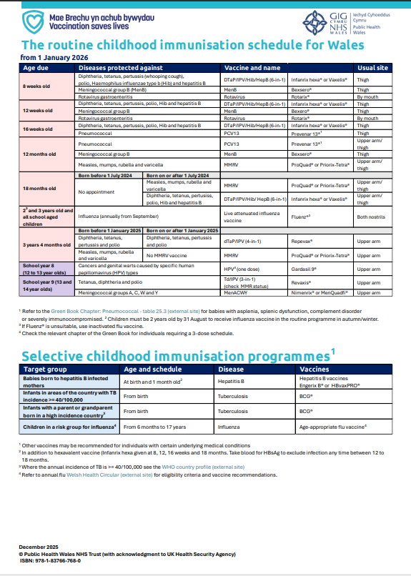
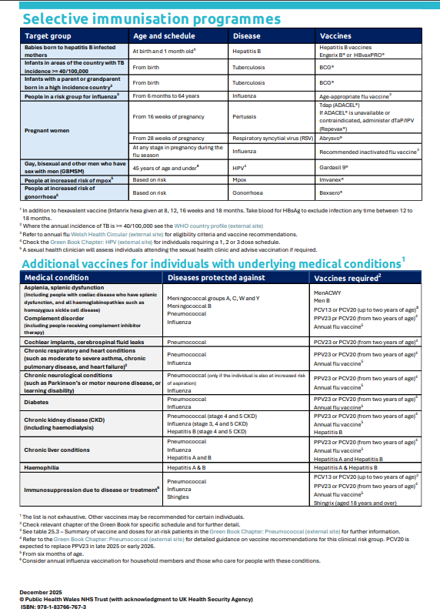
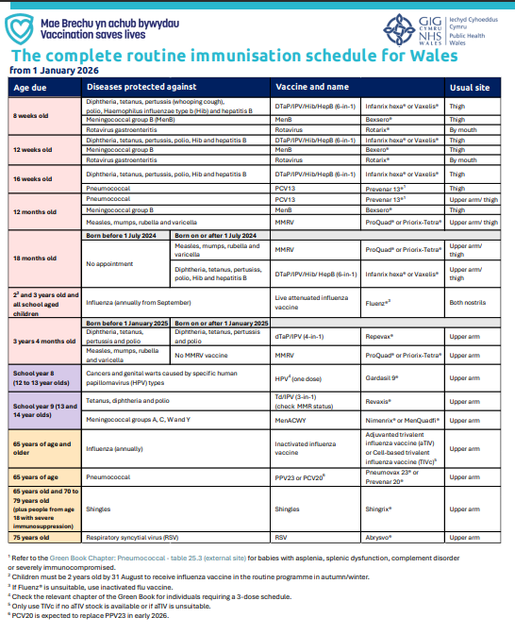
Immunisation schedules
Routine immunisation schedules for Wales - Public Health Wales – available in English and Welsh

Slide 7
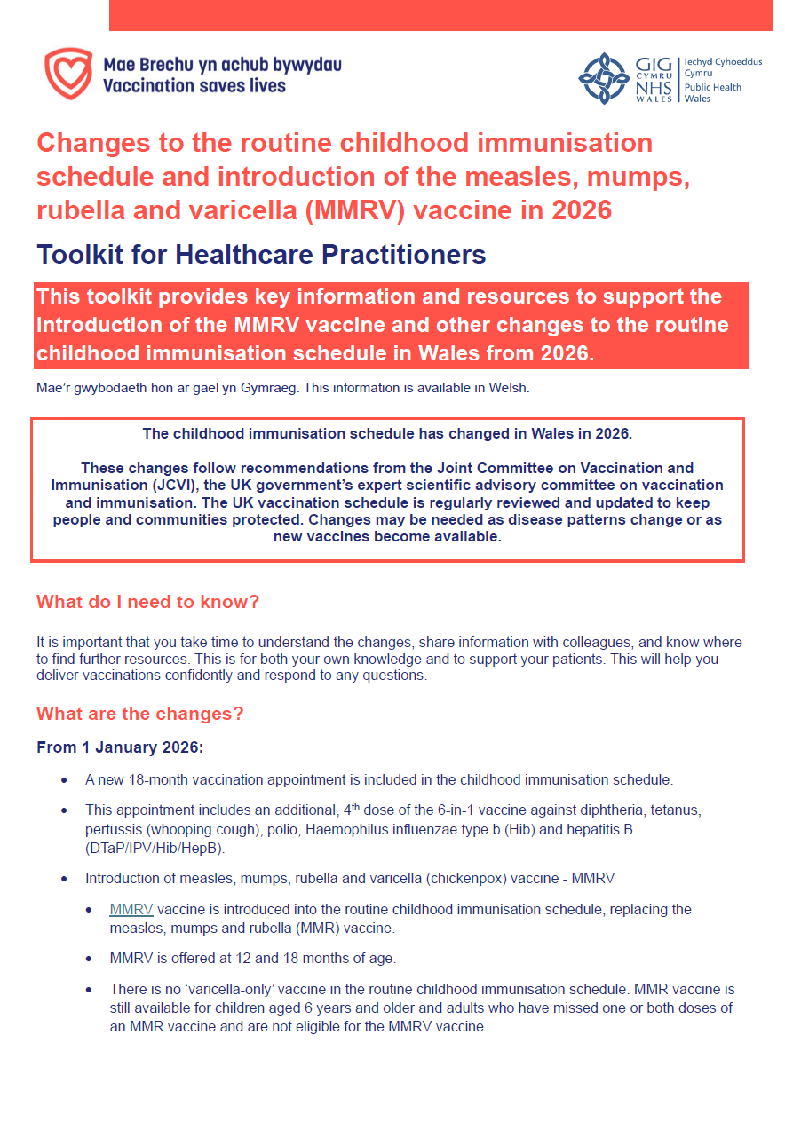
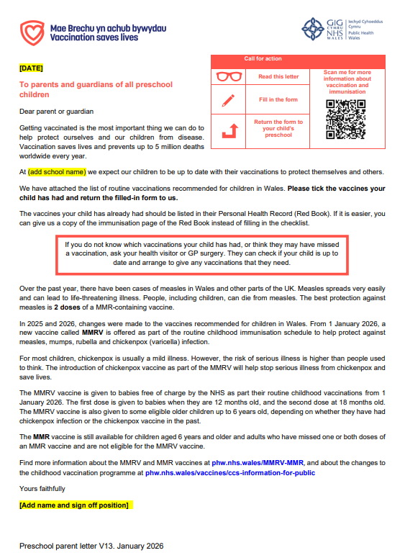
Additional resources (1)
Changes to the routine childhood immunisation schedule in Wales - Toolkit for healthcare practitioners
Preschool Immunisation Resource Pack

Slide 8

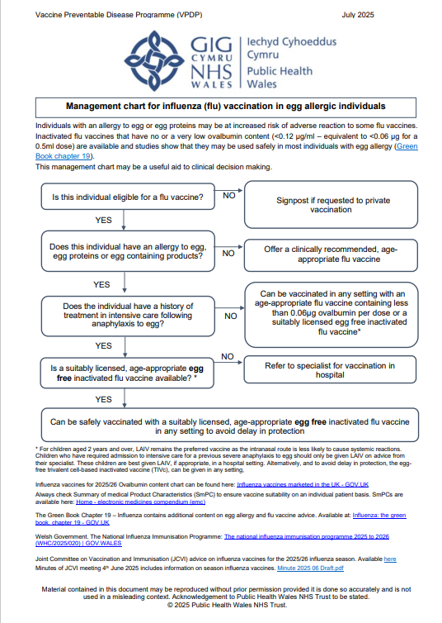
Additional resources (2)
Toolkit for healthcare professionals: measles-containing vaccinations
Egg Allergy Algorithm 25-26
Being updated

Slide 9
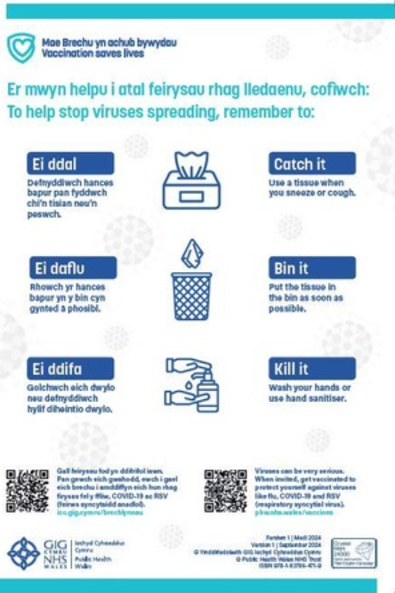

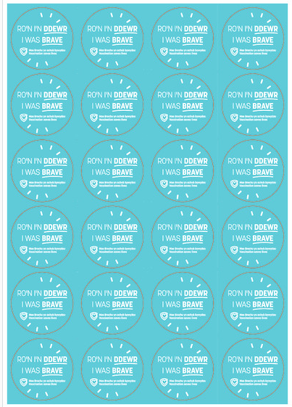
Additional resources (3)
Being updated
Pork gelatine factsheet
Catch it bin it kill it poster
Child flu stickers
Resources are available from the webshop

Slide 10
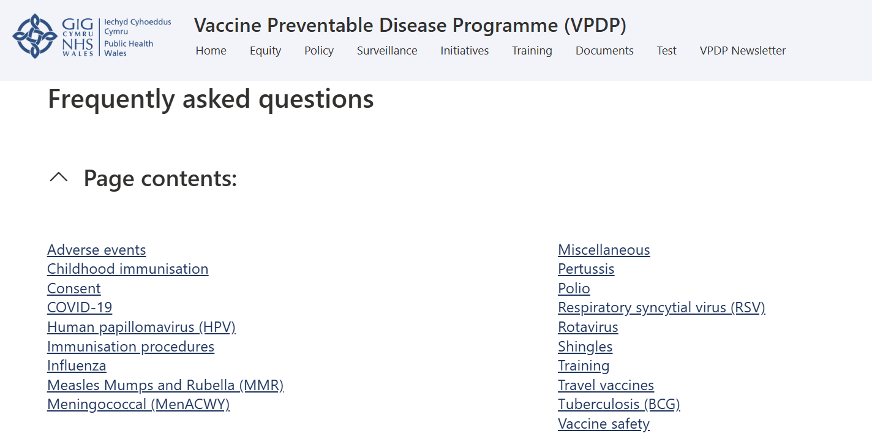
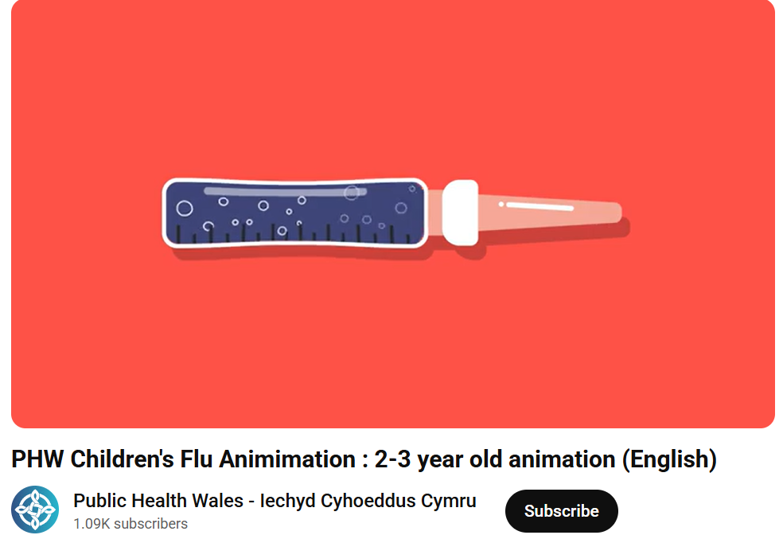
Additional resources (4)
2–3 year old flu animation: English / English Subtitled / Welsh / Welsh subtitled
Frequently asked questions (NHS Wales network connection required)

Slide 11


Training resources
All training resources can be found here: Immunisation training resources and events - Public Health Wales
Vaccination against chickenpox (varicella) and other changes to the routine childhood immunisation schedule in January 2026
Training slide set for health care professionals to assist with delivering the routine childhood schedule and changes to the schedule, including varicella vaccination MMRV.
Changes to the routine childhood immunisation programme in 2025 and 2026 slide set
Training slide set for health care professionals involved in advising on or delivering the routine childhood schedule and changes to the schedule.

Slide 12
Recorded slide sets (1)
A series of recorded slide sets were published to keep healthcare professionals informed about the changes to the routine childhood immunisation schedule these can be viewed here: Immunisation training resources and events - Public Health Wales
The following recorded slides were developed to support the introduction of the MMRV vaccination programme:
Introduction to varicella (chickenpox) the disease, complications and vaccination – 10/09/25
You can view the slide set here
You can view the recorded slide set on SharePoint (NHS employees only)
Introduction of the varicella (chickenpox) vaccines into the routine childhood immunisation schedule – 6/11/25
You can view the slide set here
You can view the recorded slide set on SharePoint (NHS employees)
Measles: the disease, complications and vaccination – 19/11/25
You can view the slide set here
You can view the recorded slide set on SharePoint (NHS employees)

Slide 13
Recorded slide sets (2)
This series of healthcare professional awareness raising sessions included the following recorded slide sets:
An introduction to the proposed changes to the routine childhood immunisation schedule - 20/03/2025
You can view the slide set here
You can view the recorded slide set on SharePoint (NHS employees only)
Pneumococcal conjugate vaccine (PCV) and MenB (Meningococcal B Vaccine) “switch” - 17/04/2025
You can view the slide set here
You can view the recorded slide set on SharePoint (NHS employees only)
Any new recorded slide sets will be published here: Immunisation training resources and events - Public Health Wales

Slide 14


Q&A webinars
An in-depth Q&A webinar on the varicella (chickenpox) vaccination programme in Wales and other changes to the routine childhood immunisation programme in Wales, in 2026.
You can view the slide set here
You can view the recording of the session here (NHS Employees only)
Detailed webinar about the changes to the childhood immunisation programme in 2025, aimed at all healthcare professionals who deliver childhood vaccines or deliver messages about vaccines in Wales.
You can view the slide set here
You can view the recording of the session here (NHS Employees only)

Slide 15
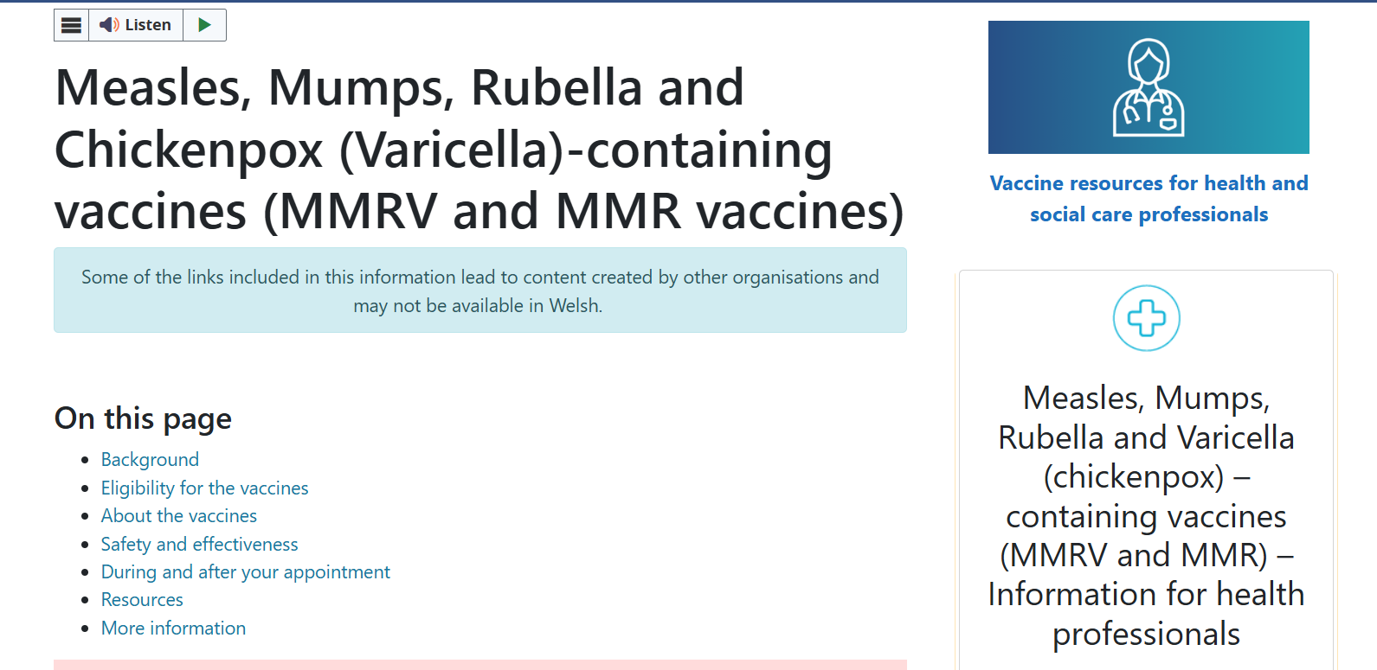
Public Health Wales – vaccine webpages
Public Health Wales have vaccine specific webpages for the public, as well as for health care professionals delivering vaccination programmes
The public webpages can be reached by visiting/typing into your web browser
phw.nhs.wales/vaccines
icc.gig.cymru/brechlynnau
The health care professional pages can also be accessed from the public webpages (see image circled right)
Additional resources on vaccination for health care professionals on vaccination and immunisation in Wales are available at:
phw.nhs.wales/vaccines-professionals and
Vaccine Preventable Disease Programme (VPDP) - Home (sharepoint.com) (NHS Wales access required)

Slide 16
Public Health Wales – preschool vaccine data
Surveillance reports detailing childhood vaccination uptake data can be found here: COVER - National childhood immunisation uptake data - Public Health Wales (Reports are published on a quarterly and annual basis)
Dashboards showing uptake of childhood vaccination can be found here (NHS Wales access required): https://nhswales365.sharepoint.com/sites/PHW_VPDPComms/SitePages/Childhood-Immunisation-(COVER).aspx
The dashboards include Local Authority, MSOA, GP Cluster and Practice and School-Level breakdowns.
They are updated on a quarterly basis and there are separate links for each Health Board.

Slide 17


Communications campaign (1)
A number of communications and assets are available for the preschool programmes including graphics, images, and videos.
These are available at the Brandkit Public Health Wales Asset Library here: Public Health Wales Asset Library (brandkitapp.com).
Resources can be downloaded for free by registering and creating a free account.

Slide 18
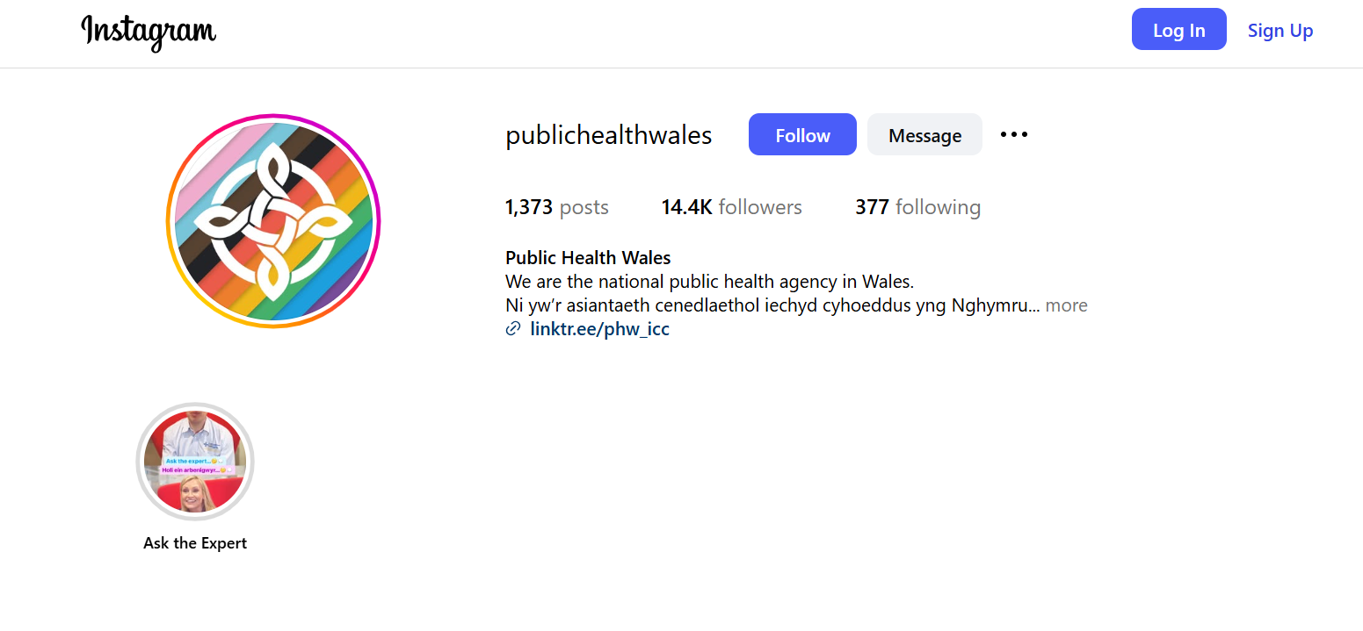
Communications campaign (2)
You can follow Public Health Wales on social media here:
Facebook: Eng | Cym
Instagram: @publichealthwales
LinkedIn: https://www.linkedin.com/company/public-health-wales
TikTok: @publichealthwales

Slide 19
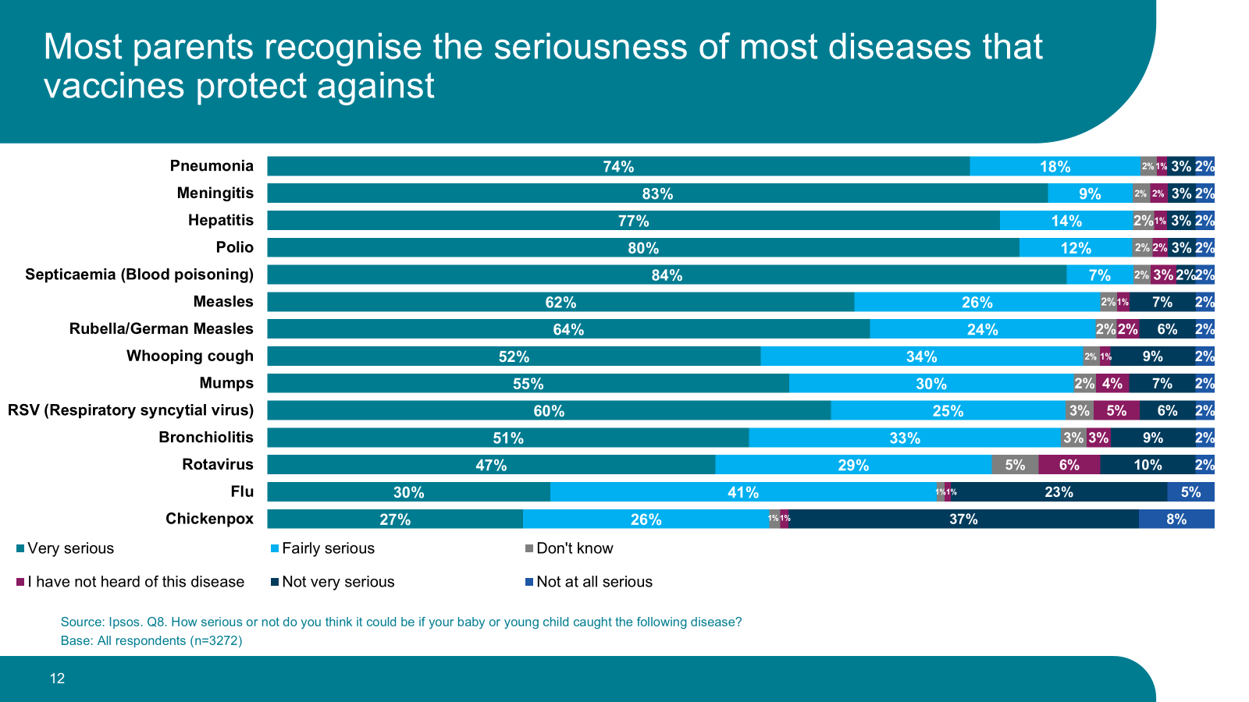
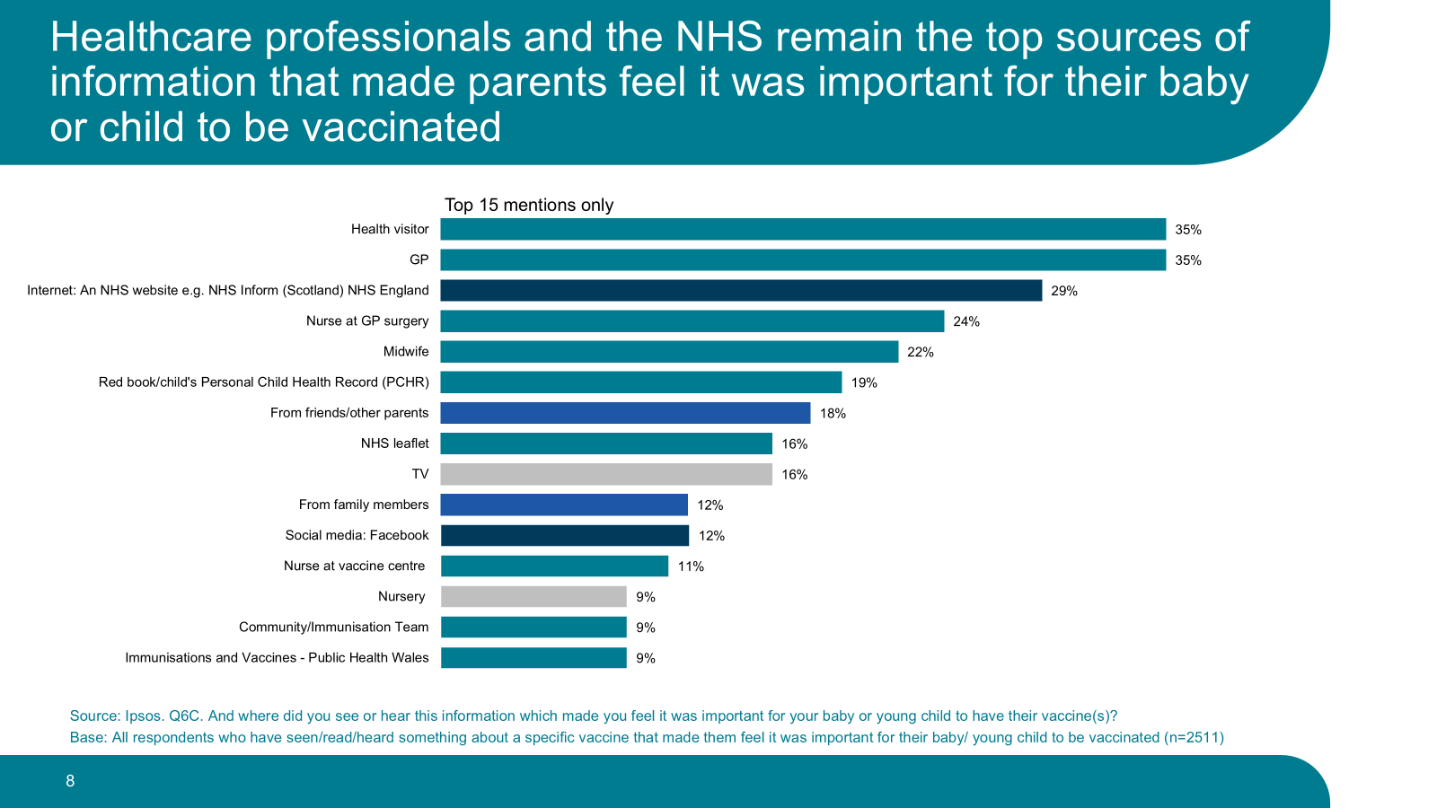
Public engagement (1)
Survey of parental attitudes towards immunisation of preschool children
survey 2025 findings

Slide 20
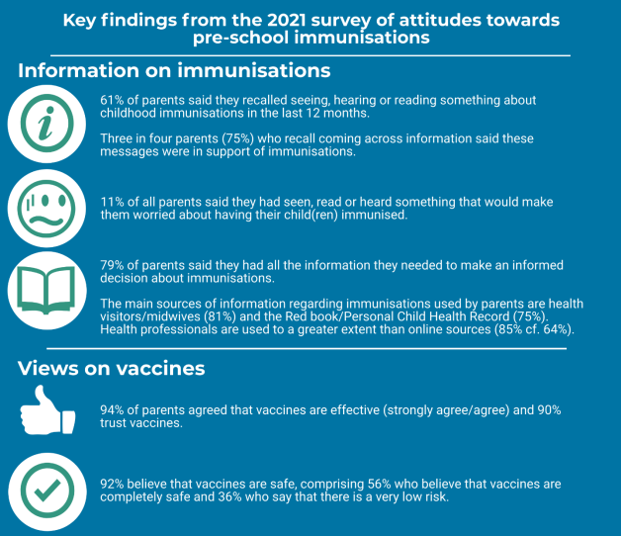
Public engagement (2)
Parental attitudes towards immunisation in Wales, commissioned by Public Health Wales in 2021
Survey of parental attitudes towards immunisation of preschool children

Slide 21
Vaccine Preventable Disease Programme (VPDP) send out a weekly email sharing updates on vaccination resources and other information, if you do not receive these please email us to be added to the distribution list at: phw.vaccines@wales.nhs.uk
If you have any clinical queries, please first contact your Health Board Immunisation Team, with local contacts found at: Vaccine contacts - Public Health Wales
Following this and if still required, VPDP at Public Health Wales, can be contacted at: phw.vaccines@wales.nhs.uk

