Slide 1
Pertussis (whooping cough) vaccination programme for pregnant women
Vaccine Preventable Disease Programme
Public Health Wales
Training for healthcare practitioners
September 2026
Version 3
Notes:
Material contained in this document may be reproduced without prior permission provided it is done so accurately and is not used in a misleading context.
Acknowledgement to Public Health Wales NHS Trust to be stated.
© 2026 Public Health Wales NHS Trust.
Change history:​
​
Version 3:
Minor updates to reflect Pertussis green book chapter, and epidemiological data updated for 2025-2026 period
Version 2:
Updated vaccine uptake Point of Delivery Survey 2024-2025 data included
Information on co-administration of pertussis containing vaccines and other maternal vaccines amended
Slides updated to include information on stock of the dTaP/IPV vaccine Boostrix-IPV®

Slide 2
Pertussis (whooping cough) vaccination programme for pregnant women
The information contained in these slides is accurate at the time of publication, September 2026. These slides are version controlled; this is version 3.
It is important that immunisers and/or those who are providing immunisation advice, should always ensure they are accessing the most up to date information and refer to the relevant chapters of the Green book Immunisation against infectious disease - GOV.UK and other authoritative sources when administering vaccines.
Please note, Boostrix-IPV is no longer being supplied. This slide set will be updated once the relevant green book chapter has been updated to reflect this change.

Slide 3
Acknowledgements
Vaccine Preventable Disease Programme (VPDP), Public Health Wales Immunisation and Vaccines - Public Health Wales
UK Health Security Agency www.gov.uk/government/topics/public-health

Slide 4
Key messages
  vaccination in pregnancy is key to passively protecting babies before they can be directly protected by the infant vaccination programme
  the maternal immunisation programme provides high levels of protection against pertussis disease and death in young infants
  however, the disease continues to circulate, and vaccine uptake needs to improve to protect all infants
  it is very important that healthcare practitioners encourage and enable vaccination of pregnant women against pertussis in every pregnancy, between 16 weeks and 32 weeks.

Slide 5
Aims of resource
  to support staff involved in discussing vaccination against pertussis with pregnant women by providing evidence-based information
  to raise awareness of current pertussis epidemiology and the impact of pertussis on young infants
  to promote uptake of vaccination against pertussis through increasing awareness amongst healthcare practitioners

Slide 6
Learning outcomes
After completing this training resource, immunisers will be able to:
understand the importance of their role in raising the issue of vaccination against pertussis with all women in the antenatal period and provide women with evidence-based information about this vaccination
describe the aetiology and epidemiology of pertussis
understand how pertussis is transmitted and the severity of pertussis infection in young infants
discuss the important role of vaccination against pertussis during pregnancy for young infants
refer pregnant women to sources of additional information

Slide 7
Pre-requisites to administering a pertussis containing vaccine to a pregnant woman
Before administering a pertussis containing vaccine, it is recommended that:
Those new to immunisation should receive comprehensive foundation immunisation training. Both knowledge and clinical competence should be assessed before new immunisers start to give and/or advise about the Influenza vaccine National Minimum Standards and Core Curriculum for Vaccination Training. An advisory document for Wales is available for use alongside this document that addresses specific issues relating to NHS Wales that are not reflected or may differ to England. The advisory document is available from Immunisation training resources and events - Public Health Wales.
Immunisers have received training* through attending a taught session and/or eLearning Immunisation eLearning - Public Health Wales (nhs.wales)​. Immunisers have received practical training in pertussis containing vaccine preparation and administration (if required)
​Training in the management of anaphylaxis and Basic Life Support is undertaken, as specified by policy for your local area and are familiar with Resuscitation Council UK (RCUK) guidance on Management of Anaphylaxis in the Vaccination Setting
Any additional statutory and mandatory training as required by your employer is completed
An appropriate legal framework to supply and administer Influenza vaccine is in place e.g. Written prescription, Patient Specific Direction (PSD), Patient Group Direction (PGD) or Vaccine Group Direction (VGD). Visit here for Wales PGD and VGD templates
Those involved in immunisation and vaccination understand the process of consent and how this applies when giving vaccines. Information on consent can be viewed here: Consent: the green book - GOV.UK
Immunisers and those giving immunisation advice, access and familiarise themselves with the following key documents: Specific Green Book Chapter :Green Book on immunisation pertussis chapterI; Pertussis (whooping cough) vaccination programme for pregnant women: information for healthcare practitioners - GOV.UK: ; The vaccine product information in the Summary of Product Characteristics: Electronic Medicines Compendium website)
Notes:
*This should be either through a face to face taught course or a blended approach of both e-learning and a face to face taught course. New immunisers should also have a period of supervised practice and support with a registered healthcare practitioner who is experienced, up to date and competent in immunisation.
Practitioners should always ensure they are accessing the most up to date information and guidance.

Slide 8
Contents
Section​ | Slide​
1. Pertussis (whooping cough): information about pertussis infection | 9
2. Vaccination of pregnant women: the maternal pertussis vaccination programme ​ | 24
3. Pertussis vaccination in pregnancy – the recommended vaccine: details of the pertussis containing vaccine offered to pregnant women | 33
4. The role of healthcare staff or the immuniser ​ | 49
5. Summary and resources | 58

Slide 9
Pertussis (whooping cough)

Slide 10
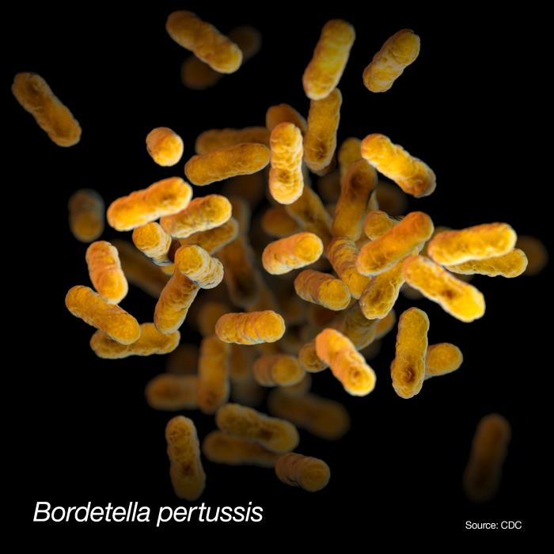
Pertussis
  pertussis is an acute bacterial infection caused by Bordetella pertussis
  it is highly contagious and can be passed from person to person through droplets from the nose and throat of infected individuals when coughing and sneezing
  infants and young children have the highest rates of complications
  infants are the most vulnerable group and almost all deaths from pertussis occur in this age group with most occurring in those younger than 3 months of age
Notes:
Bordetella pertussis is an exclusively human pathogen that can affect people of all ages; however infants are the most vulnerable group with the highest rates of severe complications, hospitalisations and mortality. Adults and older siblings are often the source of infection for younger siblings at home.
Pertussis is a very infectious disease that is passed from one person to another. The bacteria are present in the back of the throat of an infected person and may be spread by coughing or sneezing.

Slide 11
Pertussis
Incubation period:
  the incubation period is on average 6 to 20 days
Infectious period:
  the infectious period is 21 days from cough onset
Source: Pertussis: the green book chapter - GOV.UK

Slide 12
Clinical presentation of pertussis
Initial stage
Early symptoms:
  are similar to those of a cold
  can last for 1 to 2 weeks before becoming more severe
Second or paroxysmal stage
  Characteristic symptoms:
  intense bouts of coughing sometimes referred to as ‘paroxysms’ of coughing
  a ‘whoop’ sound with each sharp intake of breath after coughing (may not occur in infants)
  vomiting after coughing
Convalescent stage
Symptoms:
  slowly become less severe
  generally last 2 to 6 weeks but can persist for months
Notes:
Symptoms caused by pertussis infection tend to develop in stages, with mild symptoms occurring first, followed by a period of more severe symptoms, before improvement begins.
The initial stage or early symptoms of pertussis are often similar to those of a common cold and may include; runny or blocked nose, sneezing, watering eyes, dry irritating cough, sore throat, slightly raised temperature and feeling generally unwell. These early symptoms can last for 1 to 2 weeks before becoming more severe.
The second stage is sometimes called the paroxysmal stage and is characterised by fits of coughing which may be followed by choking and/or vomiting. The cough often comes in short bursts (paroxysms) followed by a desperate gasp for air – when the characteristic whooping noise may be made. Pertussis doesn’t always cause the typical symptoms of the whoop sound or vomiting after coughing, particularly in older children and adults when pertussis may present as a prolonged cough.
Each bout of coughing usually lasts between 1 and 2 minutes, but several bouts may occur in quick succession.
These bouts of coughing may continue for weeks or months. Over time the episodes of coughing become less frequent and full recovery is gradual.

Slide 13
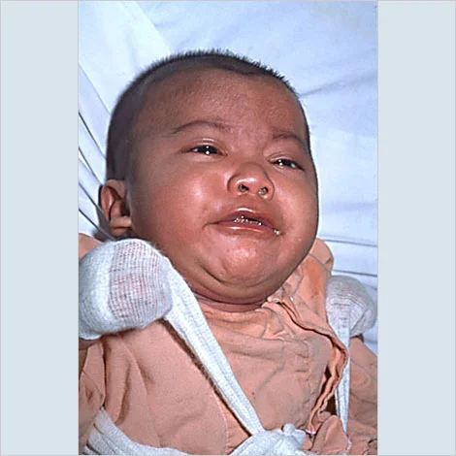
Clinical presentation of pertussis in infants and young children
  infants may not make the ‘whoop’ sound after coughing, but they may start gagging or gasping and may temporarily stop breathing
  young children may also seem to choke or become cyanosed when they have a bout of coughing
  UKHSA audio: What does whooping cough sound like? - YouTube
Photo courtesy of Immunize.org
Notes:
In young infants the typical ‘whoop’ may never develop, and coughing spasms can be followed by difficulty breathing, Apnoea (pauses in breathing) is common in young infants.
Young children may also seem to choke or become blue in the face (cyanosis) when they have a bout of coughing.
The rate of hospitalisation and complications for pertussis is much higher in young infants than it is for older children and adults.

Slide 14
Complications of pertussis in older children and adults
Complications in older children and adults are usually much less serious than those in infants and young children
Intense bouts of coughing can lead to:
  nosebleeds and burst blood vessels in the whites of the eye
  bruised ribs
  hernia
Notes:
Serious complications, such as pneumonia and convulsions, are uncommon in older age groups but can, very occasionally, occur.
Sometimes the cough is severe enough to cause other problems such as fainting, muscle pain in the ribs (and occasionally fractured ribs), a hernia or bleeding in the eye (conjunctival haemorrhage).

Slide 15
Complications in infants and young children
Infants and young children are usually most severely affected and more likely to develop severe potentially life threatening complications such as:
  pneumonia
  temporary pauses in breathing as a result of severe difficulty with breathing
  weight loss due to excessive vomiting
  seizures or brain damage
  encephalitis (an acute inflammation of the brain)
Young infants are much more likely to be admitted to hospital with pertussis than other age groups.
In severe cases pertussis can be fatal in infants.
Notes:
Infants and young children are usually the most severely affected by pertussis and infants are most likely to develop severe potentially life-threatening complications.
Young infants are much more likely to be admitted to hospital with pertussis than other age groups.

Slide 16
Pertussis epidemiology
pertussis is a cyclical disease that peaks every 3 to 5 years
prior to the routine pertussis immunisation programme, annual notifications averaged 120,000 per year in England and Wales
pertussis immunisation, introduced in 1957, reduced these notifications to 2,069 by 1972
currently pertussis containing vaccines are offered to children at 8, 12 and 16 weeks of age, at 18 months, and as a booster at 3 years and 4 months
during an outbreak in 2012, 14 infant deaths were reported in England and Wales, all in unimmunised infants under 3 months of age
this prompted the introduction of a temporary vaccination programme for pregnant women in 2012, this was then made permanent in 2016
Further information on the role out of the maternal pertussis programme can be in the Welsh Health Circular (WHC/2016/020)
Notes:
Pertussis in the very young is a significant cause of illness and death.

Slide 17
Incidence of confirmed pertussis cases at all ages, England and Wales, 1998 to 2012
Notes:
Pertussis tends to have a cyclical nature with a peak in cases every 3 to 5 years. In 2008 (the last peak before the outbreak occurred in 2012) there were 902 laboratory confirmed cases of pertussis. In 2012 there was a dramatic increase to 9,711 laboratory confirmed cases. Cases were 10 times higher than usually seen in peak years. Many more cases occur that are not laboratory confirmed.
All parts of England and Wales, Scotland and Northern Ireland saw a similar dramatic increase in cases in 2012. Increases were also seen in America during 2012 with increased pertussis cases or outbreaks reported in the majority of states. As in the UK, in America the highest rate is in young infants. Similar increases in cases have also been reported in Australia, New Zealand and Canada.
Refs:
America increase: http://www.cdc.gov/pertussis/outbreaks.html
Increase in England and Wales http://www.hpa.org.uk/hpr/archives/2012/news3512.htm#prtsss

Slide 18
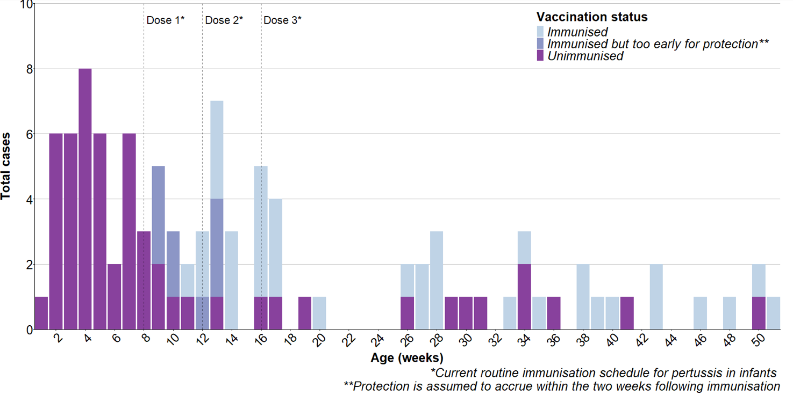
Confirmed cases in infants under one year by week of age at onset (2015 to February 2026)
Notes:
It is clear that a high proportion of infant cases occur before they receive their first dose of vaccine (at 8 weeks). Infants must receive all 3 doses of the vaccine (at 8, 12 and 16 weeks) in a timely manner to gain maximum benefit from the infant programme.
This graph shows the age at onset of pertussis by weeks of age in infants up to a year of age based on laboratory confirmed cases tested between August 2015 and February 2026. We know that young infants in Wales are immunised in a timely manner (Timeliness and equity of infant pertussis vaccination in wales: Analysis of the three dose primary course - ScienceDirect). This graph clearly shows that the majority of infant cases occurred in the first few weeks of life before these babies could be protected by even their first dose of vaccine.
The first dose of the infant programme does offer some protection against disease in infants (a study by Public Health England (PHE), now UK Health Security Agency, calculated protection after first dose to be around 62%) but 3 doses of pertussis-containing vaccine are required to achieve optimal protection (95% in the same study). Cases in fully immunised infants (3 doses) were extremely rare in the period shown considering uptake of three doses is around 95% by one year. Latest COVER reports showing uptake of pertussis containing vaccines can be found here: COVER – National childhood immunisation uptake data - Public Health Wales

Slide 19
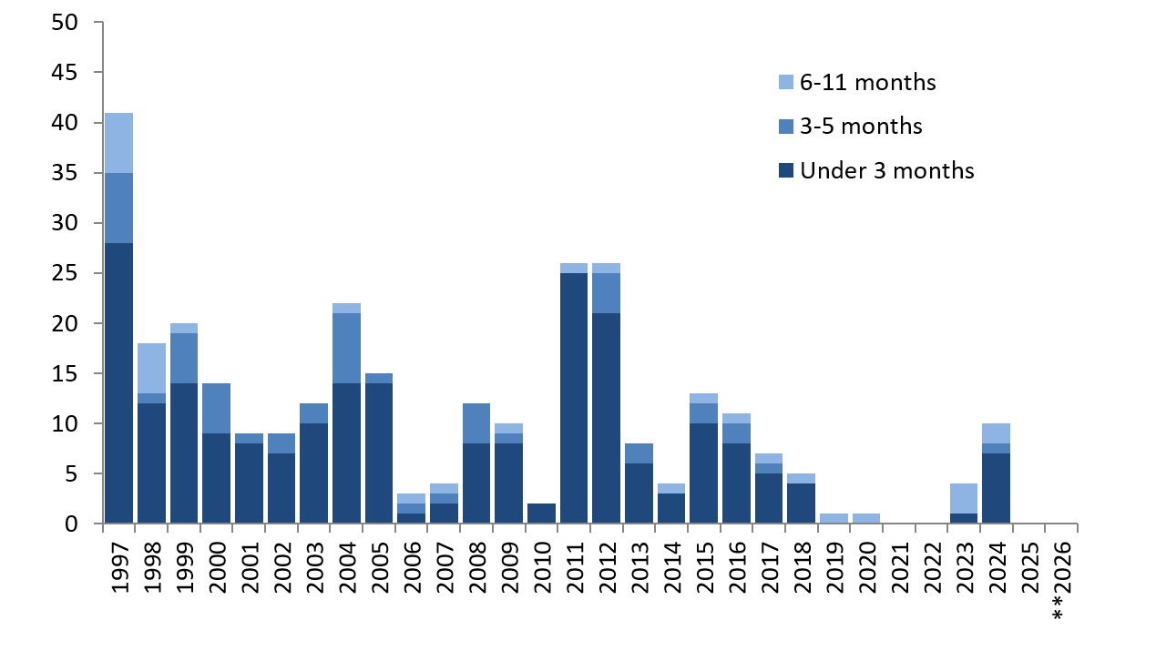
Laboratory confirmations of pertussis in infants aged under one by year, Wales; 1997-2026**
Confirmed pertussis case numbers have remained low since 2023/24.
Incidence in infants is highest in infants under 3 months who can only be protected by maternal vaccination.
*More diagnostic methods have become available over the time period presented with increasing use of serology and oral fluid testing.
**2026 data as at end June.
Notes:
The incidence rate in infants under 3 months of age was estimated at nearly 320 per 100,000 in 2012 in Wales. These young infants are most at risk of severe illness and complications.
As pertussis is very infectious, cases in adults and older children can pass the infection on to young infants. It is known that many cases of pertussis are not diagnosed, tested or confirmed
In addition to the childhood pertussis vaccination programme, a maternal vaccination programme was introduced in 2012, initially as a pilot, with the aim to protect the mother from pertussis (reducing the risk of exposure to the child), but additionally to protect infants in the 8-week period prior to their vaccination programme through maternal antibody transfer. Following the introduction of maternal vaccination in 2012, the incidence of pertussis in children under 3 months fell to pre-outbreak levels whilst disease rates remained higher in older age groups.
Pertussis activity was at exceptionally low levels between 2020 and the middle of 2023 following population measures introduced to control the COVID-19 pandemic. Cases increased from mid 2023, peaking in May 2024. Cases remained low from quarter 4 2024, throughout 2025 and the first half of 2026.
To view pertussis surveillance data in Wales please see the following link: https://phw.nhs.wales/topics/immunisation-and-vaccines/immunisation-surveillance/pertussis-whooping-cough-surveillance-and-epidemiology/

Slide 20
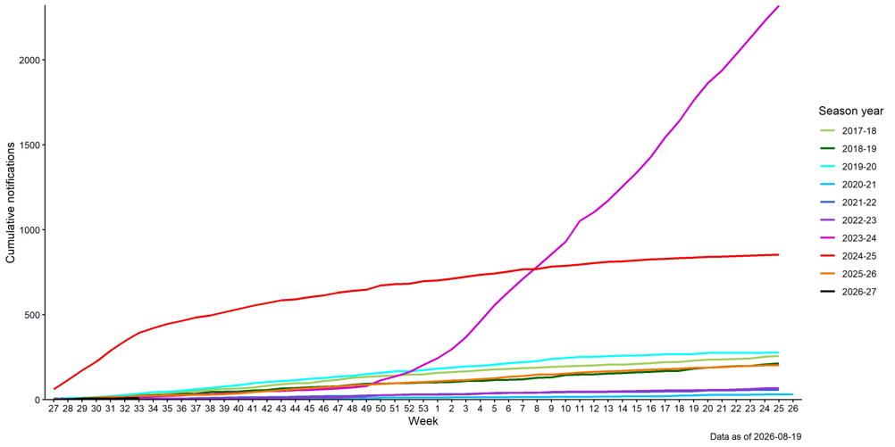
Cumulative number of notifications of whooping cough to Wales Health Protection Teams by week, Wales; 2015-2026
Notes:
Chart indicates the high level of notifications in 2023/24 compared to previous nine years (notifications for all ages). Notifications for 2026-27 remain low (<50 between week 26 and week 39 2026).
Data source: PHW Case and Incident Management System - Tarian

Slide 21
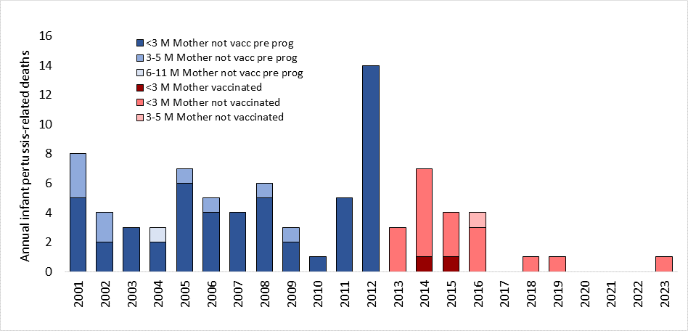
Infant deaths due to pertussis (England)
Maternal vaccination introduced
There were 12 infant deaths in 2024/2025 in England, 8 had mothers who were unvaccinated.
Since 2016, when pertussis vaccination was offered to pregnant women from sixteen weeks there have been no reported deaths from confirmed pertussis cases in Wales.
Notes:
In the 12 years prior to the introduction of maternal pertussis vaccination in October 2012, 63 deaths occurred in babies aged under one year with confirmed pertussis.
The 2012 increase in infant cases resulted in more deaths in babies with pertussis than had been seen in the last 20 years. Fourteen babies with confirmed pertussis died in 2012; these babies were all under 10 weeks old at disease onset and too young to be fully protected by routine immunisation. None had received any vaccine doses.
The high disease incidence and large number of deaths led to Public Health England declaring this to be a national outbreak in April 2012.
Unfortunately, we have continued to see deaths in infants with pertussis since the introduction of pertussis vaccination in pregnancy programme. From 2013 to the end of September 2025, there have been 33 deaths in babies with confirmed pertussis who were all too young to be fully protected by infant vaccination. Of the 33 infants that died, 27 had mothers who were not vaccinated in pregnancy.
This further underlines the importance of ensuring that all pregnant women are given the opportunity to protect their babies from birth against pertussis through timely vaccination in pregnancy.
Fortunately, since 2016, when pertussis vaccination was offered to pregnant women from sixteen weeks there have been no reported deaths from confirmed pertussis cases in Wales as of June 2026.

Slide 22
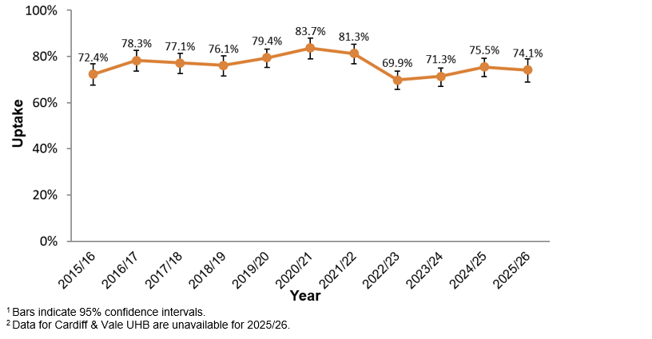
Maternal vaccination uptake in Wales
Uptake of pertussis vaccination in pregnant women participating in the 2015/16 to 2025/26 Point of Delivery (POD) Survey’s
Vaccine uptake in Wales is estimated using an annual five-day survey of women delivering in maternity units across Wales and usually takes place in January.
Notes:
Maternal vaccine uptake is estimated to be significantly lower in recent years. This is of great concern when considered with the data on the previous slides which shows the risk of infant mortality from pertussis infection in children born to unvaccinated mothers.
Immunisation uptake in pregnancy

Slide 23
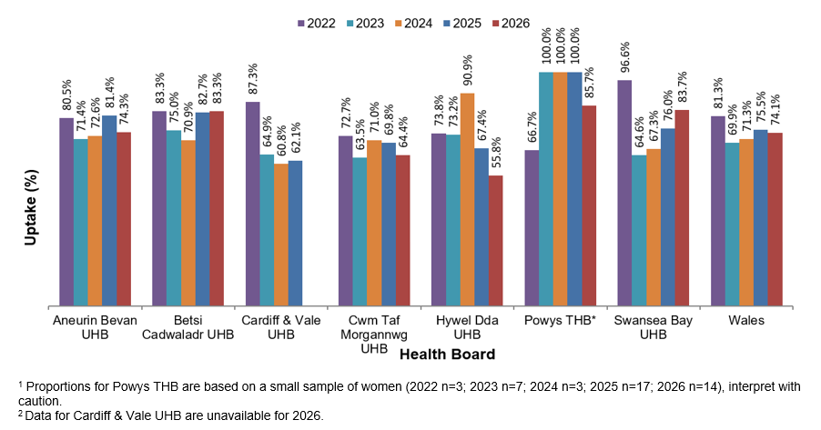
Uptake of pertussis vaccination in pregnant women participating in the 2021/22 to 2025/26 POD surveys, by health board
Notes:
Coverage across Wales varies by health board, although declining uptake has been seen in most areas.

Slide 24
Vaccinating pregnant women

Slide 25
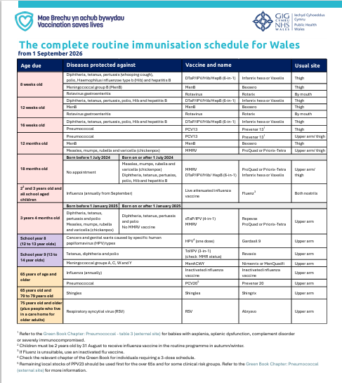
Routine childhood pertussis immunisation
  pertussis containing vaccine is part of the childhood vaccination programme
  a 6-in-1 vaccine (DTaP/IPV/Hib/HepB) which protects against pertussis, diphtheria, tetanus, polio, haemophilus influenzae type b and hepatitis B. The vaccine is offered to infants at 8, 12 and 16 weeks of age, and from January 2026, an additional dose of the 6-in-1 vaccine is offered at 18 months of age as part of the routine childhood immunisation schedule in Wales
  a booster dose of pertussis containing vaccine is given to children from 3 years and 4 months of age (as dTaP/IPV vaccine)
  the primary aim of the childhood vaccination programme is to protect infants who are most at risk of severe disease and in whom case fatality is high
Notes:
Historically, uptake rates for the completed primary course (x3 doses) of childhood pertussis vaccination in England and Wales has been over 95% for children aged 12 and 24 months. Since the pandemic, uptake of routine childhood immunisations have been declining across the UK with uptake of 3 doses of 6in1 by 1year 93.1% during 2025/26 Vaccine uptake in children in Wales: COVER annual report 2025 to 2026 - Public Health Wales. Effectiveness estimates have shown that even the first infant dose offers some protection against pertussis disease and timely administration of all 3 doses is important.
Protection from vaccination against serious pertussis infection is very high for the first few years of life, when the risk of complications is greatest. Protection is extended further by the booster dose given shortly before children go to school (usually given when children are aged about 3 years and 4 months).

Slide 26
Pertussis vaccination – key messages
neither natural disease nor vaccination against pertussis give life-long immunity
individuals who have previously had pertussis disease can become re-infected and spread infection to others
this spread of infection is important, particularly in children too young to be vaccinated
the primary objective of the pertussis vaccination in the pregnancy programme is to protect infants who are most at risk of severe complications and death
vaccination in pregnancy is key to protecting young babies. Maternal pertussis immunisation has been shown to be safe and around 90% effective in protecting infants against disease and hospitalisation until they can have their first vaccinations at 8 weeks of age.
Notes:
Green Book on immunisation pertussis chapter

Slide 27
Pertussis vaccination in pregnancy: protecting those too young to be vaccinated
  maternal pertussis vaccination was introduced in October 2012
  the vaccine should ideally be offered between 16 and 32 weeks of pregnancy to maximise the likelihood that the baby will be protected from birth
  to help provide optimal protection the vaccine should be given before 32 weeks, women who miss vaccination before 32 weeks are still recommended to have the vaccine at any point up until delivery
  the aim of maternal vaccination is to boost antibodies in vaccinated women during pregnancy so that pertussis antibodies are passed from mother to baby
  this is considered the best way to provide passive protection to infants in the first weeks of life and offers women a safe way to protect their baby against this serious disease

Slide 28
Pertussis vaccination in pregnancy
although most women will have been vaccinated or exposed to natural whooping cough in childhood, receiving a pertussis-containing vaccine from week 16 of their pregnancy will temporarily boost their antibody levels
maternal antibodies boosted by vaccination will be passed across the placenta to the unborn baby and should provide protection in the first few weeks of life, when they are most at risk of serious complications if they become infected with pertussis
  maternal vaccination reduces the risk of the mother developing pertussis infection and passing it on to the young infant
  infants born to mothers vaccinated at the recommended time during pregnancy have higher levels of antibodies than those born to unvaccinated mothers, which helps protect the infant until they start receiving their own immunisations
Notes:
Pertussis-containing vaccines are routinely given during pregnancy in vaccination programmes in many other countries, including the US, New Zealand and Australia,
The Green Book states that “Pertussis-containing vaccines may be given to pregnant women when protection is required without delay. There is no evidence of risk from vaccinating pregnant women or those who are breast-feeding with inactivated viral or bacterial vaccines or toxoids”.
An additional benefit of vaccinating a woman during pregnancy is that she will also be protected at the time of delivery and when the infant is very young and will be less likely to transmit pertussis to the infant.
Once a mother has been vaccinated it takes about 2 weeks for the maximum antibody levels to be produced in the mother. The half-life of transferred maternal pertussis antibodies is approximately 6 weeks which makes it important that women are immunised close to the time when transplacental antibody transfer is maximal.
Although it was initially thought that vaccination later in pregnancy would lead to higher levels of maternal antibodies during the period of optimal transplacental transfer that is around or after 34 weeks of gestation, a study by Eberhardt et al (2016) showed that vaccination before 28 weeks actually provides significantly higher levels of antibodies in cord blood. They suggest that although the rate of transfer is higher later in pregnancy, there is more time for antibodies to be transferred for those vaccinated earlier in pregnancy, and therefore the cumulative amount overall is higher in these women and their babies.

Slide 29
Pertussis vaccination in pregnancy: safety
  A large body of evidence supports that vaccination against pertussis in pregnancy is safe for pregnant women, the developing foetuses and infants.
  Inactivated vaccines contain no live organisms, cannot replicate and therefore cannot cause infection in either the mother or the fetus.
  Studies demonstrating that pertussis vaccination in pregnancy is safe include
  Donegan K and others 2014
  20,000 women vaccinated in pregnancy. No increased risk of stillbirth, neonatal death,
  pre-eclampsia or eclampsia, placenta praevia, IUGR/LBW, caesarean section, postpartum haemorrhage or premature labour
  Laverty and others 2021
  exposure to Tdap vaccination in pregnancy was not associated with any increased risk of adverse health outcomes in early childhood
  Other studies have similarly not identified safety concerns (Campbell and others 2018). Pertussis-containing vaccines are routinely given during pregnancy in vaccination programmes in many other countries, including the US, New Zealand and Australia, so there is an increasing body of evidence to support the safety of pertussis immunisation during pregnancy
Notes:
The Medicines and Healthcare Regulatory Agency (MHRA) used a large database of patient records to identify nearly 18,000 vaccinated pregnant women in the UK followed to at least 28 days after vaccination. They compared pre-specified pregnancy outcomes that are reported in the third trimester of pregnancy with background rates of such outcomes before the vaccination in pregnancy programme had been introduced.
Over 6000 of these pregnant women had adequate follow up information and recorded pregnancy outcome. These were compared to background rates and matched to a historical cohort of non-vaccinated women. They found no increased risk of adverse outcomes when compared to historical and unvaccinated controls and no difference in the time to delivery in vaccinated and unvaccinated women.
This large observational cohort study http://www.bmj.com/content/bmj/349/bmj.g4219.full.pdf found no evidence of an increased risk of stillbirth in the 14 days immediately after vaccination or later in pregnancy and found no evidence of an increased risk of any of an extensive predefined list of adverse events related to pregnancy.
Donegan K. ‘Safety of pertussis vaccination in pregnant women in UK: observational study’ British Medical Journal 2014: volume 349, g4219
A review of safety by the Advisory Committee on Immunisation Practices (ACIP) in America, based upon pregnancy registries, and small studies, concluded that “the available data did not suggest any elevated frequency or unusual patterns of adverse events in pregnant women who received dTaP, and that the few adverse events reported were unlikely to have been caused by the vaccine”. Tetanus and diphtheria toxoid vaccines have been used extensively in pregnant women worldwide to prevent neonatal tetanus.
Laverty and others. Health Outcomes in Young Children Following Pertussis Vaccination During Pregnancy - PubMed (nih.gov) Pediatrics 2021, volume 147, issue 5, :e2020042507. doi: 10.1542/peds.2020-042507. Epub 19 April 2021.
Canadian study following up children to 6 years, No significant increased risk of adverse childhood outcomes. In contrast, an inverse association with upper respiratory infections, gastrointestinal infections and urgent or inpatient health service use was noted.
Campbell H, Gupta S, Dolan GP and others. ‘Review of vaccination in pregnancy to prevent pertussis in early infancy’ Journal of Medical Microbiology 2018, volume 67, issue 10, pages 1,426-1,456.

Slide 30
Pertussis vaccination in pregnancy: safety
The Pertussis: the green book chapter - GOV.UK states that:
“Pertussis-containing vaccines should be given to pregnant women to protect their infants from birth. There is no evidence of risk from vaccinating pregnant women or those who are breast-feeding with inactivated viral or bacterial vaccines or toxoids” (Kroger and others 2013)
there is no evidence of risk to pregnancy or the infant from inactivated vaccines such as ADACEL®, Boostrix-IPV®* or REPEVAX® (which are the recommended vaccines for use in the maternal vaccination programme)
*Please note, Boostrix-IPV is no longer being supplied
Notes:
Healthcare practitioners are reminded that in some circumstances the recommendations regarding vaccines given in the Green Book chapters may differ from those in the Summary of Product Characteristics (SPC) for a particular vaccine. When this occurs, the recommendations in the Green Book are based on current expert advice received from the JCVI and should be followed. These Green Book recommendations and/or further advice from the Department of Health should be reflected in PGDs.
Kroger AT, Atkinson WL and Pickering LK. ‘General immunization practices’ In: Plotkin SA, Orenstein WA and Offit PA (eds). Vaccines 6th edition 2013. Philadelphia: Saunders Elsevier, page 88

Slide 31
Protecting each pregnancy
studies have shown a significant decline in antibodies within the first year after maternal vaccination
as the persistence of antibodies after a single dose of pertussis-containing vaccine in pregnancy is short and therefore unlikely to ensure infant protection during consecutive pregnancies, vaccination, ideally between weeks 16 and 32, is currently recommended in every pregnancy
repeated pertussis-containing vaccinations in consecutive pregnancies are well-tolerated

Slide 32
Vaccination after 32 weeks of pregnancy
if a woman reaches 32 weeks of pregnancy and has not received a pertussis-containing vaccine, it should still be offered
if the dose of vaccine is received within 2 weeks of the baby’s birth it may not provide passive protection to the infant; this is because antibody levels in adults peak around 2 weeks after a dose of pertussis vaccine has been given and there would be insufficient time for the mother to make a good response and have antibodies to pass across the placenta
however, offering the vaccine in later pregnancy would potentially protect the mother from pertussis infection and reduce the risk of her becoming a source of infection to her infant

Slide 33
Pertussis vaccination in pregnancy: recommended vaccine

Slide 34
Recommended vaccine
The low dose tetanus, diphtheria and pertussis (Tdap) vaccine (ADACEL®) is supplied and should be used for the maternal pertussis vaccination programme
ADACEL® is the preferred vaccine to offer in the maternal pertussis programme, in line with JCVI advice to offer a non IPV-containing pertussis vaccine. For more information about the vaccine change, see Pertussis (whooping cough) vaccination programme for pregnant women: information for healthcare practitioners - GOV.UK
ADACEL® should not be given to women with a history of severe latex allergy. In these circumstances Boostrix-IPV® or REPEVAX®* should be used
If ADACEL® is not locally available or is clinically contraindicated it is imperative to ensure the individual is offered a suitable and available vaccine containing a pertussis antigen, rather than risk them not being immunised against pertussis
There is no single (monovalent) pertussis vaccine licensed in the UK. Pertussis containing vaccines are only available as combined products.
*Please note, Boostrix-IPV is no longer being supplied ​

Slide 35
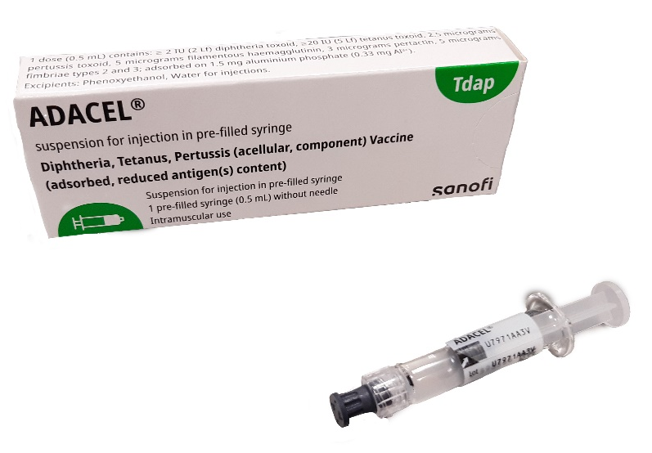
Tdap (ADACEL®) vaccine
Brand name: ADACEL®
Generic name: Tetanus, Diphtheria and Pertussis (acellular, component) vaccine (absorbed, reduced antigen(s) content) (Tdap)
Inactivated vaccine (NB: the vaccine cannot cause pertussis, diphtheria or tetanus)
Immunisers should be familiar with the PGD which is available at:
Patient Group Directions (PGD) - Welsh Medicines Advice Service (wales.nhs.uk)
Summary of Product Characteristics (SmPC) available at:
https://www.medicines.org.uk/emc/product/15553/smpc
Notes:
Monovalent pertussis vaccines are not available. Pregnant women requesting monovalent vaccine should be reassured of the safety and efficacy of Tdap and dTaP/IPV vaccines during pregnancy.
ADACEL® is an inactivated vaccine and contain chemically inactivated and purified antigens – it does not contain live organisms and cannot cause the diseases against which it protects.

Slide 36
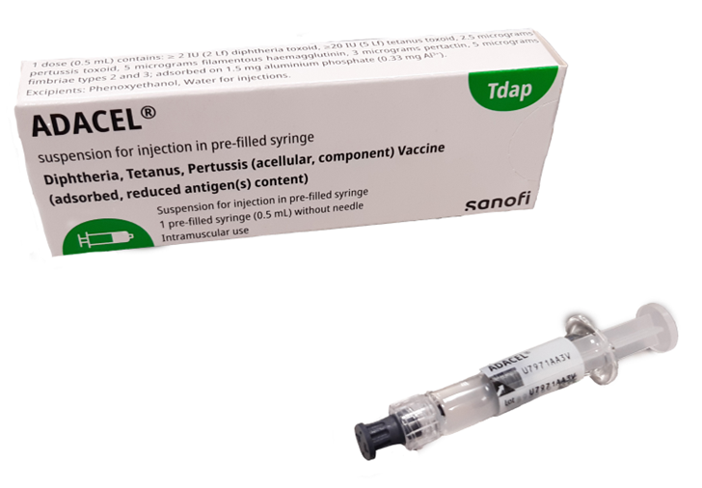
Vaccine administration – Tdap (ADACEL®)
0.5 ml suspension in a pre-filled syringe with a plunger stopper
tip caps contain a natural rubber latex derivative – may cause allergic reactions in latex sensitive individuals
intramuscular injection into the deltoid
single dose for each pregnancy
may be administered at the same time or at any interval before or after RSV¹ seasonal influenza. It may be administered at the same time as seasonal COVID-19 vaccine for eligible pregnant women only².
prescription only medicine so must be administered against a prescription written manually or electronically by a registered medical practitioner or other authorised prescriber, a patient specific direction (PSD), or a patient group direction (PGD)
Notes:
¹There is some evidence that giving the RSV vaccine with pertussis-containing vaccines may slightly reduce the immune response to pertussis. The clinical impact is unclear and likely small. To avoid this potential issue, it is recommended to administer the pertussis vaccine from 16 weeks and the RSV vaccine from 28 weeks. However, if a woman has not received the pertussis vaccine when she is due for the Abrysvo® RSV vaccine, both vaccines can and should be given at the same appointment to ensure timely protection for the infant.
²Please note that from Autumn 2025, COVID-19 vaccination is no longer offered to pregnant women, unless they are immunosuppressed due to disease or treatment. More information about this is available in the JCVI statement on COVID-19 vaccination.

Slide 37
dTaP/IPV vaccine
Brand name: REPEVAX® or Boostrix-IPV®* vaccine
(Note: If ADACEL® is not available or contraindicated, dTaP/IPV) is suitable, safe and effective for use in the prenatal programme and preferable to not vaccinating at all)
Generic name: Diphtheria, Tetanus, Pertussis (acellular, component) and Poliomyelitis (inactivated vaccine) adsorbed (dTaP/IPV)
These are inactivated vaccines and cannot cause pertussis, tetanus, diphtheria or polio
Immunisers should be familiar with the PGD which is available at:
Patient Group Directions (PGD) - Welsh Medicines Advice Service (wales.nhs.uk)
*Please note, Boostrix-IPV is no longer being supplied
Notes:
There is no single (monovalent) pertussis vaccine licensed in the UK. Pertussis containing vaccines are only available as combined products. Pregnant women requesting monovalent vaccine should be reassured of the safety and efficacy of Tdap and dTaP/IPV vaccines during pregnancy.
Both are inactivated vaccines and contain chemically inactivated and purified antigens – they do not contain live organisms and cannot cause the diseases against which they protect.

Slide 38
Vaccine administration – dTaP/IPV
0.5 ml in a pre-filled syringe with a plunger stopper
tip caps contain a synthetic former of rubber (butyl) which does not contain any dry natural rubber (latex)
intramuscular injection into the deltoid
single dose for each pregnancy
may be administered at the same time or at any interval before or after RSV¹ and seasonal influenza. It may be administered at the same time as seasonal COVID-19 vaccine for eligible pregnant women only²
prescription only medicines so must be administered against a prescription written manually or electronically by a registered medical practitioner or other authorised prescriber, against a patient specific direction (PSD), patient group direction (PGD)
Notes:
Healthcare practitioners should read the PGD and the Summary of Product Characteristics (SmPC) prior to administration to familiarise themselves with the vaccines.
¹There is some evidence that giving the RSV vaccine with pertussis-containing vaccines may slightly reduce the immune response to pertussis. The clinical impact is unclear and likely small. To avoid this potential issue, it is recommended to administer the pertussis vaccine from 16 weeks and the RSV vaccine from 28 weeks. However, if a woman has not received the pertussis vaccine when she is due for the Abrysvo® RSV vaccine, both vaccines can and should be given at the same appointment to ensure timely protection for the infant.
²Please note that from Autumn 2025, COVID-19 vaccination is no longer offered to pregnant women, unless they are immunosuppressed due to disease or treatment. More information about this is available in the JCVI statement on COVID-19 vaccination.

Slide 39
Co-administration of pertussis containing vaccines and other maternal vaccines
Vaccines | Can they be co-administered?
Pertussis and RSV (Abrysvo ®) | ✔*
Pertussis and seasonal influenza | ✔
Pertussis and seasonal COVID-19 vaccine² for eligible pregnant women only | ✔
Notes:
Pertussis and RSV (Abrysvo ®)
From September 2024 pregnant women are eligible for the RSV vaccine Abrysvo®. The national programme for infant protection is offered year-round to all pregnant women between 28 and 36 weeks gestation. The vaccine can be offered off label after 36 weeks gestation, however this may not offer as high level of passive protection to the baby.
*There is some evidence that giving the RSV vaccine with pertussis-containing vaccines may slightly reduce the immune response to pertussis. The clinical impact is unclear and likely small. To avoid this potential issue, it is recommended to administer the pertussis vaccine from 16 weeks and the RSV vaccine from 28 weeks. However, if a woman has not received the pertussis vaccine when she is due for the Abrysvo® RSV vaccine, both vaccines can and should be given at the same appointment to ensure timely protection for the infant.
Pertussis and seasonal influenza
The seasonal influenza vaccine should be offered to women at any stage of pregnancy during ‘flu season’ which is usually from September each year. Tdap (or dTaP/IPV where necessary) should be offered to women from 16 weeks of pregnancy regardless of the time of year.
Both vaccines are inactivated vaccines containing different antigens and therefore may be administered at the same time or at any interval before or after each other. No minimum interval needs to be observed between these vaccines.
Both vaccines should be given at the recommended time and vaccination should not be delayed in order to reduce the number of appointments required.
Pertussis and COVID-19
² Please note that from Autumn 2025, COVID-19 vaccination is no longer offered to pregnant women, unless they are immunosuppressed due to disease or treatment. More information about this is available in the JCVI statement on COVID-19 vaccination.
If ADACEL® vaccine is given at same time as other vaccines, the vaccines should be given at a separate site, preferably in a different limb. If more than one vaccine is given in the same limb, they should be given at least 2.5cm apart. The sites at which each vaccine was given should be noted in the individual’s health records.

Slide 40
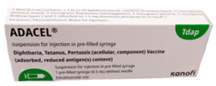

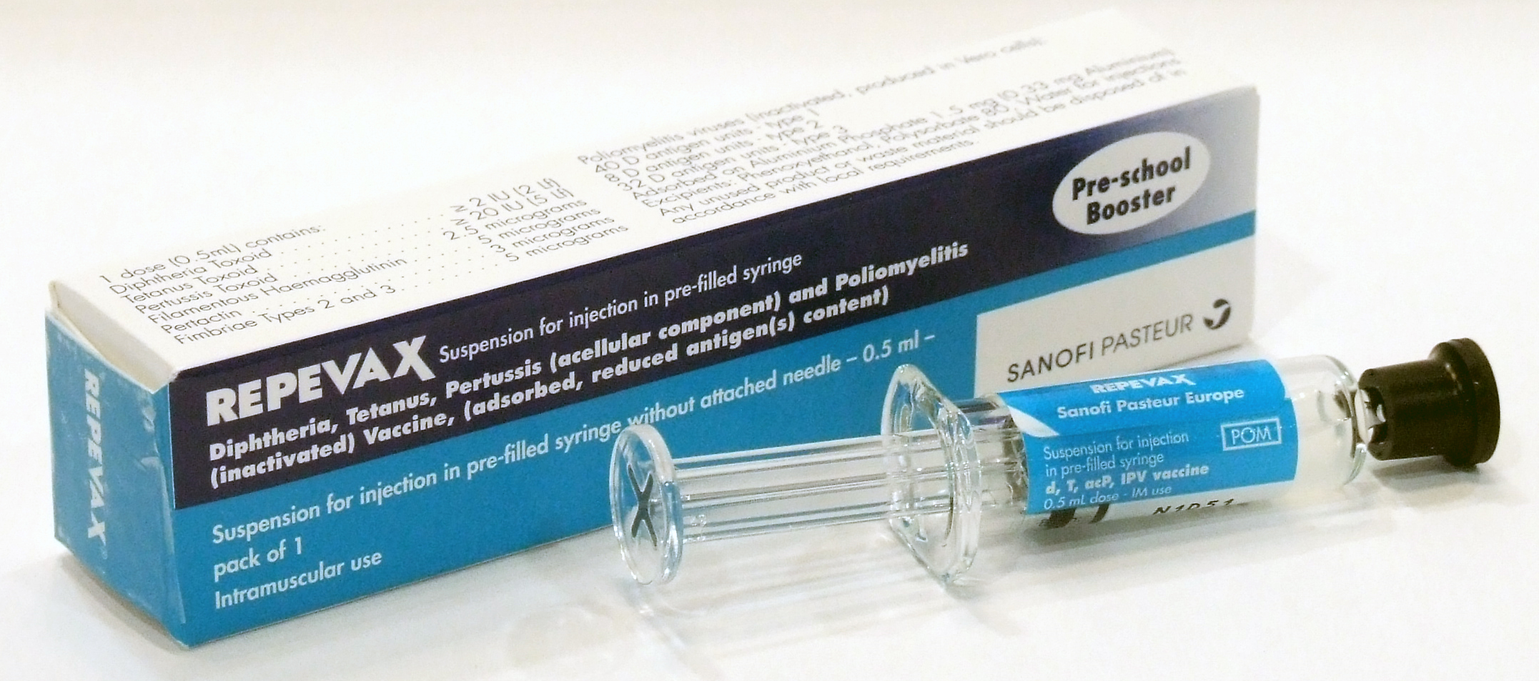
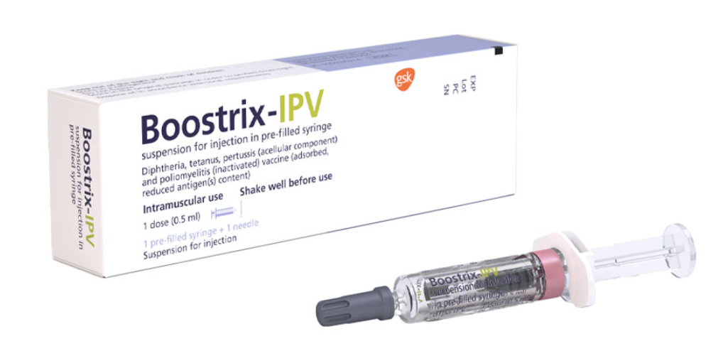
Ensure the right vaccine is given!
ADACEL® (Tdap) is the recommended vaccine for pregnant women from July 2024
REPEVAX® and Boostrix-IPV®* vaccines (dTaP/IPV) should only be given to women who cannot receive ADACEL® (for example severe latex allergy) or if ADACEL® is not available and to obtain it would lead to a delay in the pregnant woman being vaccinated
*Please note that Boostrix-IPV® is no longer being supplied
Notes:
Remember: it is imperative to ensure the individual is offered a suitable and available vaccine containing a pertussis-containing antigen, rather than risk them not being immunised against pertussis.

Slide 41
Contraindications
There are very few individuals who cannot receive pertussis-containing vaccines. When there is doubt, specialist advice should be sought rather than withhold vaccine.
The vaccines should not be given to those who have had:
a confirmed anaphylactic reaction to a previous dose of a pertussis- containing vaccine,
or
a confirmed anaphylactic reaction to neomycin, streptomycin or polymyxin B (which may be present in small amounts).
Pertussis: the green book chapter - GOV.UK
Notes:
There are very few individuals who cannot receive pertussis containing vaccines. When there is doubt specialist advice should be sought on the vaccine and the circumstances under which it could be given. There are very few medical reasons why Tdap or dTaP/IPV should not be given. A confirmed allergic reaction (including anaphylaxis) to a previous dose of a diphtheria, tetanus, pertussis or poliomyelitis containing vaccine contraindicates further vaccination with the same vaccine or a component of that vaccine, which may include neomycin and/or polymyxin.
Anaphylaxis lies along a spectrum of severity in terms of allergic symptoms, generalised urticaria, mucosal angioedema and rhinitis would not be considered to be anaphylaxis because potentially life-threatening features – such as airway problems, respiratory difficulty and hypotension are not present. Other individuals may complain of a sensation of throat tightness, but unless this is severe (e.g. painful swallow, difficulty swallowing saliva) or associated with airway problems, respiratory difficulty and hypotension, is not anaphylaxis. In these cases, affected individuals should be observed to ensure symptoms do not worsen. Vaccine safety and adverse events following immunisation: the green book, chapter 8 - GOV.UK

Slide 42
Precautions
Precautions:
  acute illness with fever – defer until recovered
  current neurological deterioration or encephalopathy of unknown origin within 7 days of previous immunisation with pertussis-containing vaccine – follow advice in the Green Book Pertussis chapter
  severe allergic reaction to latex (applies to ADACEL® vaccine only). Note: If ADACEL® is not available or contraindicated, dTaP/IPV) is suitable, safe and effective for use in the prenatal programme and preferable to not vaccinating at all
Notes:
If the pregnant women is acutely unwell and has a fever, immunisation should be postponed until the patient has recovered. This is to avoid wrongly associating any cause of fever, or its progression, with the vaccine and to avoid increasing any pre-existing fever. Having a minor illness without a fever (for example a cold) is not a reason to delay immunisation.
Pregnant women who have recently received immunisation against diphtheria, tetanus and/or polio should also be offered immunisation with a pertussis-containing vaccine but allow a gap of at least 4 weeks between these immunisations. Although cumulative doses may increase the likelihood of injection site reactions or fever, this is outweighed by the expected benefit to the infant.
In cases of pregnant women who have had encephalopathy of unknown origin within 7 days of previous immunisation with pertussis-containing vaccine, the advice in the Green Book should be followed. For women who have evidence of current neurological deterioration, including poorly controlled epilepsy, immunisation should be deferred and advice in the Green Book should be followed.
A personal or family history of seizures is not a contraindication to immunisation.

Slide 43
ADACEL® and latex allergy
the tip caps of the pre-filled syringes of Tdap (ADACEL ®) vaccine contain a natural rubber latex derivative which may cause allergic reactions in latex sensitive individuals
the Green Book Chapter 6 states the following about severe latex allergy:
  “It is theoretically possible that latex protein from these tip caps, plungers or vial stoppers may cause allergic reactions when the vaccines are administered to latex-sensitive individuals. There is little evidence that such a risk exists, and any such risk would be extremely small.
  As a precaution, if an individual has a history of severe (i.e. anaphylactic) allergy to latex, vaccines supplied in vials or syringes that contain latex should not be administered, unless the benefit of vaccination outweighs the risk of an allergic reaction to the vaccine. Where possible, an alternative latex-free vaccine that covers the same disease should be administered. For latex allergies other than anaphylactic allergies (e.g. a history of contact allergy to latex gloves), vaccines supplied in vials or syringes that contain latex can be administered.”
pregnant women with a known severe latex allergy should be offered one of the dTaP/IPV vaccines (REPEVAX® or Boostrix-IPV®*) as these have a tip cap which does not contain any latex – this may mean that the woman needs to be referred to primary care when the dTaP/IPV vaccine is no longer available in maternity services.
Notes:
*Please note, Boostrix-IPV® is no longer supplied.

Slide 44
Pertussis vaccination and breastfeeding
Both Tdap and dTaP/IPV vaccines can be given to women who plan to breastfeed.
There is evidence that pertussis antibodies in breast milk are increased after immunisation in pregnancy and breastfeeding may therefore help reduce the likelihood of a baby becoming ill with pertussis.
However, whilst there may be some pertussis antibodies transferred to the infant in the breast milk of vaccinated women, this will not be enough to replace the need for the infant to complete the recommended primary immunisation schedule on time.

Slide 45
Adverse reactions following Tdap or dTap/IPV
Reactions reported include:
  pain, redness and swelling at the injection site
  headache
  muscle aches or weakness
  tiredness, malaise
  nausea, vomiting, diarrhoea
  fever and chills
  decreased appetite
  joint pain or swelling
  swelling of vaccinated limb
  rash
Notes:
The full list of adverse reactions associated with ADACEL®, REPEVAX® or Boostrix-IPV®* vaccines are available in the marketing authorisation holder’s Summary of Product Characteristics. *Please note, Boostrix-IPV® is no longer being supplied.
Anaphylaxis is a very rare side effect of most vaccines and facilities for its recognition and management must be available.
SmPCs:
ADACEL suspension for injection in pre-filled syringe - Summary of Product Characteristics (SmPC) - (emc) | 15553
REPEVAX - Summary of Product Characteristics (SmPC) - (emc) | 5580
Boostrix-IPV suspension for injection in pre-filled syringe - Summary of Product Characteristics (SmPC) - (emc) | 5302

Slide 46

Reporting suspected adverse reactions
  healthcare professionals and those vaccinated patients are asked to report suspected adverse reactions to the Medicines and Healthcare Products Regulatory Agency (MHRA) using the Yellow Card reporting scheme
  the Yellow Card scheme is a voluntary reporting system for suspected adverse reaction to medicines and vaccines
  success depends on early, complete and accurate reporting
  report even if uncertain about whether vaccine caused condition
  report suspected adverse reactions through:
    the online Yellow Card scheme (www.mhra.gov.uk/yellowcard)
    downloading the Yellow Card app or
    calling the Yellow Card scheme on 0800 731 6789 9am to 5pm Monday to Friday
  see chapter 9 of Green Book for further details: Surveillance and monitoring for vaccine safety: the green book, chapter 9 - GOV.UK

Slide 47
Vaccine supply
ADACEL® (Tdap) is available to order online via the ImmForm website
it is recommended that practices hold no more than 2 weeks’ worth of stock
Where ADACEL® is contraindicated and dTaP/IPV (REPEVAX® or Boostrix-IPV®*) is required, settings should order via ImmForm.
*Please note that Boostrix-IPV® is no longer being supplied

Slide 48
Vaccine recording
The vaccinator must ensure the following is recorded:
that valid informed consent was given or a decision to vaccinate was made in the individual’s best interests, in accordance with the Mental Capacity Act 2005
name of individual, address, date of birth and GP with whom the individual is registered
name of immuniser
name and brand of vaccine
date of administration
dose, form and route of administration of vaccine
quantity administered
batch number and expiry date
anatomical site of vaccination
advice given, including advice given if the individual is excluded or declines immunisation
details of any adverse reactions and actions taken
This information should be recorded in the individual’s GP record and both the electronic and hand-held maternity records.
Where vaccine is administered outside the GP setting, appropriate health records should be kept and the individual’s GP informed.

Slide 49
The role of healthcare staff

Slide 50
Data management
  health professionals should accurately record the date and the brand and batch number of the vaccine in relevant data systems following vaccine administration
  the delivery date of the baby (or other pregnancy outcome) should also be recorded in the mother’s medical records
  this information is essential to allow an assessment of vaccine uptake, safety and to inform any future public health actions, if required
  vaccination against pertussis should be recorded in the woman’s medical or maternity records and recorded in the relevant data system
  pertussis-containing vaccine uptake for pregnant women is monitored through the Point of Delivery (POD) survey which takes place for 1 week in January each year
Notes:
Staff working in general practices are reminded that in line with their contractual requirements, pertussis vaccination should be offered and provided to eligible patients either opportunistically or on request. Pertussis vaccination should also be correctly coded in the patient’s medical record, regardless of where it was administered.
The completeness of patient data recording in GP records has an impact on our ability to monitor and evaluate vaccination programmes. Wherever possible, the following information should be recorded in GP records for all pregnant women:
the date of delivery
the date of receipt of a pertussis-containing vaccine at or after week 16 of pregnancy, regardless of the setting where the vaccine was administered
where relevant, fields indicating stillbirth or miscarriage

Slide 51
Improving vaccine uptake
the number of women receiving pertussis-containing vaccines has fallen over recent years
a large number of pregnant women are not receiving a vaccine to protect their infant at a time when the number of cases of pertussis is increasing
healthcare practitioners should ensure appropriate measures are in place to optimise uptake of pertussis-containing vaccine for pregnant women including ensuring:
  vaccine is easily accessible
  staff are trained, informed and confident so they can answer any questions
  staff are aware of additional information resources that they can signpost women to for further information if they wish to
  vaccine is offered all year round, not just when the flu vaccine is being offered
Notes:
Improving vaccine uptake
The number of women receiving a pertussis-containing vaccine in Wales for 2025/2026 was 74.1%.
Healthcare practitioners are asked to ensure that appropriate measures are in place to optimise uptake of pertussis-containing vaccine for pregnant women. This includes ensuring vaccine is easily accessible, for example, in the maternity clinic when the woman is already attending for another reason, ensuring that they are informed and confident so they are able to answer any questions the woman may have and providing information resources so that the women are able to access further information if they wish to. Resources are available to order for free from: Health Information Resources - Public Health Wales

Slide 52
Summary of vaccine programme recommendations
  one dose of pertussis-containing vaccine is recommended for women carrying twins or multiple babies
  women who become pregnant again should be offered pertussis containing vaccine during each pregnancy to maximise transplacental transfer of antibody
  ADACEL ® (Tdap) vaccine is supplied for the maternal vaccination programme. If ADACEL ® is not available and to obtain it would result in a delay in vaccinating a pregnant woman, either REPEVAX ® or Boostrix-IPV ®* vaccine can be given instead
* Please note, Boostrix-IPV is no longer being supplied
Notes:
New mothers who have never been vaccinated against pertussis are unlikely to be vaccinated against diphtheria, tetanus and polio and should be assessed as to the need for further immunisations with Td/IPV vaccine. Health professionals should be referred to the ‘Vaccination of individuals with incomplete or uncertain immunisation status’ algorithm: www.gov.uk/government/publications/vaccination-of-individuals-with-uncertain-or-incomplete-immunisation-status

Slide 53
Providing longer term protection against pertussis
  the protection the infant acquires from the mother by the transfer of antibodies across the placenta is short term
  the maternal antibodies passively protect the infant against pertussis from birth until they are due their first dose of primary immunisations at 8 weeks of age and are then naturally broken down by the infant in their first months of life
  it is very important that parents ensure their infants start their immunisation schedule at the recommended 8 weeks of age and receive all the recommended doses for long lasting protection
  those who miss vaccination should be caught up at the earliest opportunity
  parents should ensure older brothers or sisters are also up to date with their immunisations
Notes:
Vaccine uptake levels in pregnant women, babies and young children have fallen in recent years across Wales so it’s really important that those who have missed vaccination are caught up at the earliest opportunity.

Slide 54
Key role for healthcare practitioners
to provide clear, concise and accurate information to every pregnant woman regarding vaccination against pertussis
every effort should be made by nurse, medical practitioners, midwives and other healthcare practitioners to maximise the uptake of pertussis-containing vaccine

Slide 55
Actions for healthcare practitioners
  advise pregnant women it is strongly recommended they are vaccinated against pertussis between 16 and 32 weeks of pregnancy
  explain that if the vaccine is given to pregnant women after 32 weeks of pregnancy, the infant may not receive sufficient maternal antibodies to confer protection
  explain the risks of pertussis in young infants and how vaccination given during pregnancy may provide protection to young infants against pertussis
  explain which vaccine will be used, the contraindications and possible side effects to vaccination and the evidence for this vaccination programme
  advise women how they can arrange for vaccination and, where appropriate, facilitate the arrangements for the vaccination appointment
  follow up at later antenatal appointments to establish whether the woman has had her pertussis vaccination
  encourage women to ensure their babies start their primary immunisations at 8 weeks of age to achieve longer-term protection against pertussis and other vaccine preventable diseases

Slide 56
Pertussis vaccination for healthcare workers (WHC/2024/043)
Since the end of 2023 there has been a large increase in notifications of suspected pertussis, commonly known as whooping cough, in Wales and across the UK
Health Care Workers who come into contact with pregnant women and infants can also be a critical source of infection
In the light of this, and to help protect infants from pertussis, a Welsh Health Circular (WHC) was issued in 2019 setting out an occupational offer of pertussis vaccine for certain healthcare workers in NHS Wales organisations
Following the recent increase of incidents of pertussis and to help protect the most vulnerable, NHS Wales colleagues need to ensure that the occupational offer of pertussis vaccine to HCWs remains an active one.
This was further highlighted in the 2024 Welsh Health Circular reminding NHS Wales colleagues the importance of receiving pertussis vaccination: Pertussis vaccination for healthcare workers (WHC/2024/043) | GOV.WALES

Slide 57
Messages for pregnant women
whooping cough (pertussis) can be serious for babies and may lead to complications resulting in hospitalisation and even death
vaccination during pregnancy boosts your antibodies which are then passed to your baby to help protect them from the day they are born
you will normally receive your whooping cough vaccine from 16 weeks
if you have reached 20 weeks of pregnancy and have not yet been offered the whooping cough vaccine, please ask your midwife and/or GP practice
to give your baby the best protection, you should try and get the vaccine before 32 weeks but if you have missed out you can still have it later. You can even have it after you give birth, to reduce your risk of spreading whooping cough to your baby
vaccination in pregnancy provides very high levels of protection against serious whooping cough disease to your baby at least until they can have their first vaccine at 8 weeks of age
studies from the UK and other countries have shown the whooping cough vaccine is very safe for you and your baby
you need to have the whooping cough vaccine in every pregnancy to boost the antibody you pass on to your baby

Slide 58
Summary and resources

Slide 59
Key messages
  vaccination in pregnancy is key to passively protecting babies before they can be directly protected by the infant vaccine programme
  highest incidence of pertussis infection is in young infants who are most at risk of serious disease and death
  the maternal immunisation programme provides high levels of protection against pertussis disease and death in young infants
  infant cases of pertussis have been dramatically reduced by the introduction of the maternal immunisation programme; the vaccine effectiveness is extremely high at preventing both disease and death in infants
  acceptance of the programme has been good, and no safety concerns have been detected
  however, vaccine uptake needs to improve to protect all infants. In 2024, cases of pertussis peaked in all regions with further infant deaths recorded in England in 2024 and 2025, so it is vital that pregnant women are offered timely vaccination in every pregnancy
  it is vital that healthcare practitioners encourage and enable vaccination of pregnant women against pertussis in every pregnancy, ideally between weeks 16 and 32
  every effort should be made to maximise this life-saving intervention for young infants

Slide 60
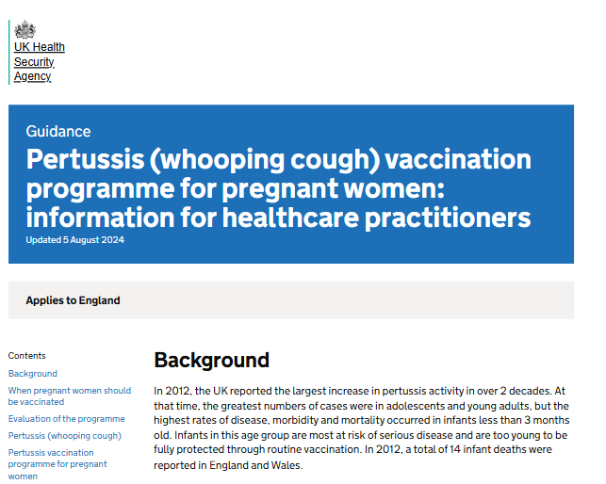
Information for Healthcare Practitioners guidance
The information for healthcare practitioners guidance available on the UKHSA pertussis (whooping cough) immunisation programmes collection is recommended reading for healthcare practitioners administering or providing advice about the prenatal pertussis programme.
It includes the vaccination programme recommendations, contraindications, precautions and examples of scenarios or questions that staff may experience when vaccinating.
Notes:
The information for healthcare practitioner guidance includes additional guidance for breastfeeding, anti-D treatment or other vaccination co-administration, post-natal vaccination and management of pregnant women with incomplete or unknown vaccination histories and inadvertent vaccine administration errors.
The guidance can be found in the UKHSA Pertussis immunisation collection section of the Immunisation collection.

Slide 61

Confident vaccine conversations - Behavioural science and motivational interviewing approach
The approach and style of a vaccine conversation can make a real difference in understanding individual hesitancy, addressing barriers, and influencing vaccine uptake. There is an eLearning module available called: Confident vaccine conversations - Behavioural science and motivational interviewing approach, which aims to support staff with having positive conversations about immunisations.
This eLearning module supports staff to feel more confident starting conversations about vaccination, particularly where there may be hesitancy or concern.
Using practical Motivational Interviewing (MI) techniques, it helps staff navigate sensitive discussions i.e., vaccine misinformation, reduce resistance, and build trust in a respectful, non-judgmental way.
The skills developed are designed for real-world settings and are transferable to a wide range of conversations across healthcare roles.
The eLearning module is available for free on ESR and Learning@Wales. Information and registration support will be available here: Immunisation eLearning - Public Health Wales

Slide 62
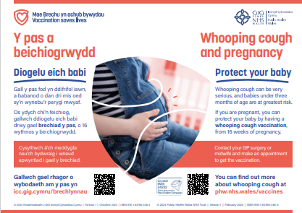
Maternal vaccines resources
All of our resources are FREE to order and have FREE delivery
Pertussis resources:
Whooping cough and pregnancy A4 poster - available here: phw.nhs.wales/topics/immunisation-and-vaccines/vaccines-professionals/pertussis-whooping-cough-vaccination-information-for-health-professionals/whooping-cough-and-pregnancy-a4-poster/

Slide 63


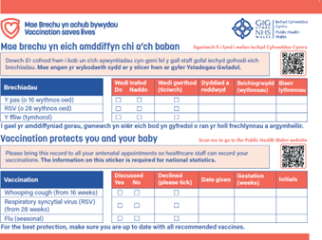
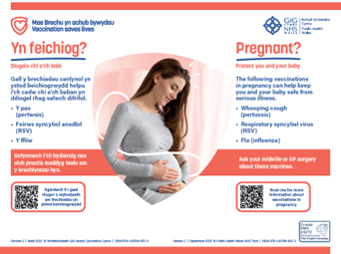
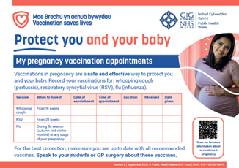
Generic Maternal vaccines resources
Generic maternal vaccines resources can be ordered here: Health information resources - Public Health Wales
How to protect your baby: a booklet with information about all maternal vaccines
A pregnancy vaccines poster: information about all vaccines in pregnancy
Pregnancy sticker: for antenatal records
Pregnancy postcard: a reminder for pregnant women
Accessible resources are available here: Vaccination information in accessible formats

Slide 64
Webpages:
Information about vaccinations in pregnancy phw.nhs.wales/vaccinations-in-pregnancy
Vaccination in pregnancy – information for health and social care professionals phw.nhs.wales/vaccinations-in-pregnancy-professionals
Public pertussis in pregnancy page Whooping cough (pertussis) vaccine in pregnancy: How to protect your baby against whooping cough - Public Health Wales (nhs.wales)
Pertussis vaccination- information for healthcare professionals Pertussis (whooping cough) vaccination – Information for health professionals - Public Health Wales (nhs.wales)
SharePoint pertussis FAQs Frequently asked questions (sharepoint.com)

