Slide 1
COVID-19 Vaccination – Spring 2026
Vaccinations recommended for individuals aged 6 months to 17 years who are immunosuppressed
Pfizer Comirnaty® LP.8.1
3 micrograms/dose for those aged 6 months to 4 years
10 microgram/dose for those aged 5 to 11 years
30 micrograms/dose for those aged 12 to 17 years
​
VPDP update: Respiratory Planning and Delivery Meeting
Hawys Youlden, Lead Nurse Immunisation
Vaccine Preventable Disease Programme
Public Health Wales
Version 2
March 2026
Notes:
Material contained in this document may be reproduced without prior permission provided it is done so accurately and is not used in a misleading context.
Acknowledgement to Public Health Wales NHS Trust to be stated.
© 2026 Public Health Wales NHS Trust.
Version 2:
Previous slide 2: Holding statement on awaited COVID-19 Green Book chapter removed.
Slide 9: Guidance on vaccination for those aged 12-17 years deemed unsuitable for mRNA vaccine added.
Slide 23: Guidance on dilution merged with previous slide 24.
Slide 38: Guidance on vaccination for those aged 12-17 years deemed unsuitable for an mRNA vaccine added.
Slide 42: Guidance on contraindications aligned with COVID-19 Green Book chapter.
Slide 61: Public Health Wales Motivational Interviewing module added

Slide 2
Acknowledgements
Vaccine Preventable Disease Programme
Vaccine Programme Wales
Welsh Medicines Advice Service
Welsh Government
JCVI
UKHSA Green Book

Slide 3
Contents
Section | Slide number
Aims and Objectives | 4
Pre-requisites to administering Pfizer Comirnaty® LP.8.1 COVID-19 mRNA vaccines: training, policy and guidance | 5
COVID-19 vaccination for individuals who are severely immunosuppressed - key principles for all Pfizer Comirnaty® LP.8.1 COVID-19 mRNA vaccines | 12
Pfizer Comirnaty® LP.8.1 - 3 microgram/dose for those aged 6 months to 4 years - 10 microgram/dose for those aged 5 to 11 years | 18
Pfizer Comirnaty LP.8.1 30 microgram/dose 12 to 17 years | 32
Additional slides outlining key principles for all Pfizer Comirnaty® LP.8.1 COVID-19 mRNA vaccines | 37
Summary and resources | 58

Slide 4
Aims
To provide information for healthcare practitioners involved in advising on and delivering the COVID-19 spring 2026 vaccination programme
To describe the vaccination programme details including administration of the COVID-19 Pfizer Comirnaty® LP.8.1 vaccines, eligibility, recommended dosage and schedule, contraindications, precautions and potential adverse reactions
To highlight resources that support the COVID-19 spring 2026 vaccination programme
Objectives
After completing this resource immunisers will be able to:
Understand the rationale and evidence base for the COVID-19 spring 2026 vaccination programme
Gain essential knowledge to administer the COVID-19 Pfizer Comirnaty® LP.8.1 vaccines safely
Identify relevant resources and additional information in relation to the COVID-19 spring 2026 vaccination programme

Slide 5
Pre-requisites to administering Pfizer Comirnaty® LP.8.1 COVID-19 mRNA vaccines: training, policy and guidance and guidance

Slide 6
Notes to users
This slide set contains a collection of core slides for both individual use and for use or adaptation during the delivery of COVID-19 vaccination training
Trainers should select the slides required depending on the background and experience of the healthcare practitioners they are training and according to the role they will have in delivering the COVID-19 vaccine programme
The information contained in these slides is accurate at the time of publication (11 March 2026). These slides are version controlled and subject to revision; this is version 1.
Updates to the slide set may be required in the future, for example in response to changing epidemiology or vaccination recommendations - please check online to ensure you are using the latest version of these slides
It is important that COVID-19 immunisers and/or those who are providing COVID-19 immunisation advice, should always ensure they are accessing the most up to date information and refer to the Green Book COVID-19 chapter and other authoritative sources when administering vaccines.
Only infants and children aged 6 months to 17 years who who are immunosuppressed (as defined in table 4 of COVID-19 chapter of the Green Book) are eligible for a COVID-19 vaccine in the Spring 2026 campaign

Slide 7
Pre-requisites to administering COVID-19 vaccine
Before administering COVID-19 vaccine, it is recommended that:
Those new to immunisation should receive comprehensive foundation immunisation training. Both knowledge and clinical competence should be assessed before new immunisers start to give and/or advise the COVID-19 vaccine Immunisation training standards for healthcare practitioner UK Health Security Agency - UKHSA)
Received COVID-19 vaccine training through attending a taught session and/or eLearning. COVID-19 core eLearning module and vaccine specific modules are available to access here: Immunisation eLearning - Public Health Wales (nhs.wales)
Received practical training in COVID-19 vaccine preparation and administration
Training in the management of anaphylaxis and Basic Life Support is undertaken, as specified by policy for your local area and are familiar with Resuscitation Council UK (RCUK) guidance on Management of Anaphylaxis in the Vaccination Setting
Any additional statutory and mandatory training as required by your employer is completed
An appropriate legal framework to supply and administer COVID-19 vaccine is in place e.g. patient specific prescription (PSD), Patient Specific Direction (PSD), Patient Group Direction (PGD), Vaccine Specific Direction (VGD). Visit here for Wales PGD and VGD template.
Those involved in immunisation and vaccination understand the process of consent and how this applies when giving vaccines. Information on consent can be viewed here: Consent: the green book, chapter 2 - GOV.UK
Immunisers and those giving immunisation advice access and familiarise themselves with the following key documents: Green Book COVID-19 chapter: COVID-19: vaccination programme guidance for healthcare practitioners, The vaccine product information in the Summary of Product Characteristics (Electronic Medicines Compendium website)
Notes:
*This should be either through a face to face taught course or a blended approach of both e-learning and a face to face taught course. New immunisers should also have a period of supervised practice and support with a registered healthcare practitioner who is experienced, up to date and competent in immunisation.
Practitioners should always ensure they are accessing the most up to date information and guidance.

Slide 8
JCVI statement on the COVID-19 vaccination in 2025 and Spring 2026 [published 13 November 2024] (1)
In Spring 2026, JCVI advises that a COVID-19 vaccine should be offered to:
residents in a care home for older adults
adults aged 75 years and over
individuals aged 6 months and over who are immunosuppressed (as defined in ‘immunosuppression’ sections of tables 3 & 4 of the COVID-19 chapter of the Green Book)
Timing of vaccination
The vaccine should usually be offered no earlier than around 6 months after the last vaccine dose, although operational flexibility around the timing of vaccination in relation to the last vaccine dose is considered appropriate (with a minimum interval of 3 months between doses). More information on operational flexibility will be provided in the COVID-19 chapter of the Green Book.
JCVI statement on COVID-19 vaccination in 2025 and spring 2026 - GOV.UK

Slide 9
JCVI statement on the COVID-19 vaccination in 2025 and Spring 2026 [published 13 November 2024] (2)
This JCVI statement outlines the vaccine products for 2025 – Spring 2026:
Children and young people:
For children and young people who are immunosuppressed, JCVI continues to advise the use of the Pfizer-BioNTech COVID-19 mRNA (Comirnaty) vaccine, with the vaccine dose appropriate to the child’s age:
  6 months to 4 years: 3 micrograms
  5 to 11 years: 10 micrograms
  12 to 17 years: 30 micrograms - If not deemed suitable for an mRNA vaccine, then Nuvaxovid JN.1* can be given Green book on Immunisation COVID-19 chapter 14a
Adults:
  JCVI does not have a preference for a specific COVID-19 vaccine product in the adult population. However, JCVI advises a preference for having vaccine products based on more than one vaccine platform in the programme, such as mRNA and protein-based vaccines.
JCVI statement on COVID-19 vaccination in 2025 and spring 2026 - GOV.UK
Notes:
*Nuvaxovid JN.1 dispersion for injection in pre-filled syringe - Summary of Product Characteristics (SmPC) - (emc) | 101554

Slide 10
COVID-19 Spring Vaccination Programme 2026,
Welsh Health Circular (WHC/2025/052) published 15 January 2026 (1)
Groups eligible for a COVID-19 vaccine in spring 2026:
As advised by the JCVI:
residents in a care home for older adults
adults aged 75 years and over
individuals aged 6 months and over who are immunosuppressed (as defined in ‘immunosuppression’ sections of tables 3 & 4 of the COVID-19 chapter of the Green Book)
Programme start and end date:
The COVID-19 spring programme will run between 13 April and 30 June 2026. There will be some limited flexibility into July for those who are unable to receive a vaccination within the main programme window due to illness.
COVID-19 spring vaccination programme 2026 (WHC/2025/052) [HTML] | GOV.WALES
Notes:
This vaccination should be offered around 6 months after the last vaccine dose, although operational flexibility around the timing of the spring dose in relation to the last vaccine dose is considered appropriate (with a minimum interval of three months between doses). More information on operational flexibility will be provided in COVID-19: the green book chapter.

Slide 11
COVID-19 Spring Vaccination Programme 2026,
Welsh Health Circular (WHC/2025/052) published 15 January 2026 (2)
Programme ambitions:
All those eligible for a spring booster to receive a written invite for vaccination;
Health boards should make every effort to maximise uptake across all cohorts ensuring that;
    i. uptake levels are maintained or improved for those over 75 years of age and those resident in a care home for older adults, and that every effort is made to achieve 75% uptake for these cohorts;
    ii. all possible interventions which could improve uptake for the immunosuppressed cohort are explored and acted on, including removing any barriers to vaccination;
    iii. the gap is reduced between uptake rates in the least and most deprived areas of health boards.
COVID-19 spring vaccination programme 2026 (WHC/2025/052) [HTML] | GOV.WALES

Slide 12
COVID-19 vaccination for individuals who are severely immunosuppressed - key principles for all Pfizer Comirnaty® LP.8.1 COVID-19 mRNA vaccines
COVID-19 spring campaign 2026
Notes:
Children who remain eligible should also receive doses of vaccine in a seasonal campaign, at a minimum interval of three months from their previous dose. Operationally, using the same minimum interval and timing for all products and age groups will simplify supply and booking, and will help to ensure longer lasting and optimally timed protection.

Slide 13
Dose recommendation by age and possible additional doses for individuals with severe immunosuppression
Recent UKHSA seroprevalence studies suggest that most children under 5 in the UK have had COVID-19 infection. However, the immunity profile of these children is less certain and may change for future birth cohorts. The JCVI advises that these children aged under 5 should be offered two doses of vaccine.
JCVI has advised that eligible individuals aged 5 years and above only require a single dose of vaccine, irrespective of prior vaccination status.
The only exception to this will be individuals with severe immunosuppression who may require additional doses (see slides below).

Slide 14
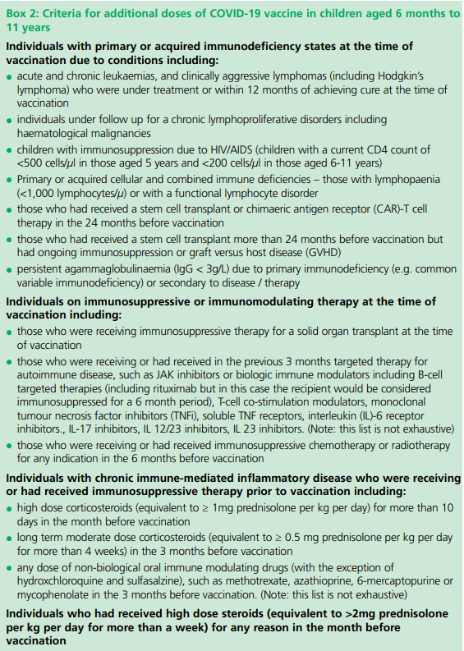
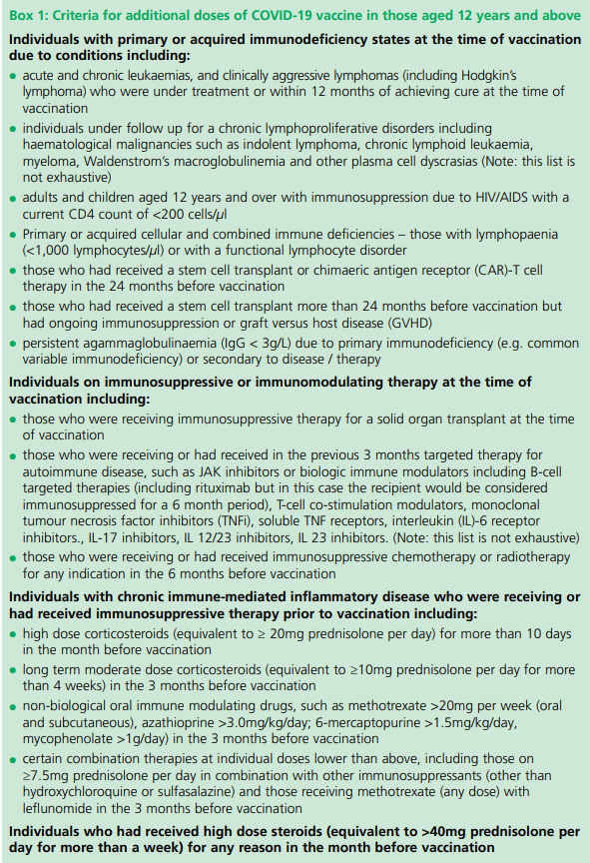
Additional doses for individuals with severe immunosuppression (1)
Some individuals with more severe forms of immunosuppression* make low or no detectable responses, therefore JCVI considers that a small group of more severely immunosuppressed individuals should be offered additional doses of vaccination..
The COVID-19: the green book chapter outlines COVID-19 vaccination eligibility for individuals with severe immunosuppression, this includes: .
  Individuals aged 6 months to 11 years as defined in Box 2
  Individuals aged 12 years and above as defined in Box 1
As per the COVID-19: the green book chapter, a third dose of vaccination in those who are severely immunosuppressed show increased immune responses.
Infants and children who are severely immunosuppressed as defined by Chapter 14a Green Book and/or have been referred for vaccination by a specialist who has designated them as group 01 or 02 as described in WIS (Welsh Immunisation System) are eligible for their COVID-19 vaccine via a PGD: Patient Group Directions (PGD) - Welsh Medicines Advice Service (wales.nhs.uk)
*including individuals who receive bone marrow transplants or CAR-T therapy as they may have lost immunological memory of previous vaccination.

Slide 15
Individuals who receive bone marrow transplant and CAR-T therapy
These individuals may lose immunological memory from vaccination received prior to the treatment and the development of the underlying condition.
After treatment and recovery, these individuals should be considered for a full course of revaccination for all vaccines used in the routine programme (see chapter 7 Green Book) under specialist advice.
Individuals who have recovered from a bone marrow transplant should be considered for a first dose of COVID-19 vaccine, regardless of the time of year.
A subsequent dose should then be offered ideally at an interval of 8 to 12 weeks, to extend the duration of protection. This interval may be reduced to a minimum of three weeks on specialist clinical advice.
Those who remain immunosuppressed will then continue to be eligible for seasonal campaigns.
Notes:
After treatment and recovery, these individuals should be considered for a full course of revaccination for all vaccines used in the routine programme (https://www.gov.uk/government/publications/immunisation-of-individuals-with-underlying-medical-conditions-the-green-book-chapter-7) under specialist advice.

Slide 16
Additional doses for individuals with severe immunosuppression (2)
Previously unvaccinated:
Individuals who are previously unvaccinated and who become or have recently become severely immunosuppressed should be considered for a first dose of vaccination, regardless of the time of year.
Where a primary course is commenced, second doses should ideally be given between 8-12 weeks from the previous dose, to extend protection. This interval may be reduced to three weeks on specialist clinical advice to maximise short term protection. .
Previously vaccinated:
Vaccinated individuals who become or have recently become severely immunosuppressed should be considered for an additional dose of COVID-19 vaccine, regardless of their past vaccination history and the time of year. The additional dose of vaccine should be offered at a minimum interval of three months from any previous doses, to extend protection until the next seasonal campaign.
  Clinical judgement should be used to decide which individuals should be given an additional dose
See, Green book on immunisation COVID-19 chapter

Slide 17
Timing of additional doses
Vaccines administered during periods of minimum immunosuppression are more likely to generate better immune responses. Therefore, any planned additional doses should ideally be given with special attention paid to current or planned immunosuppressive therapies. For example:
For the small number of patients who are about to receive planned immunosuppressive therapy, vaccination may be brought forward to before commencing that therapy (ideally at least two weeks before), when their immune system is better able to make a response
To maximise the benefit, the vaccine should not be given within three weeks of a previous dose
Where possible, additional booster doses should be delayed until two weeks after the period of immunosuppression, in addition to the time period for clearance of the therapeutic agent
Alternatively, consideration should be given to vaccination during a treatment ‘holiday’ or when the degree of immunosuppression is at a minimum
Any decision to defer immunosuppressive therapy or to delay possible benefit from vaccination until after therapy should only be taken with due consideration of the risks of exacerbating their underlying condition, as well as the risks from COVID-19.
Green Book COVID-19 chapter

Slide 18
Pfizer Comirnaty® LP.8.1
3 microgram/dose for those aged 6 months to 4 years
10 microgram/dose for those aged 5 to 11 years
COVID-19 spring campaign 2026

Slide 19
Dosing and schedule
The SmPC Pfizer Comirnaty LP.8.1 3 microgram per dose dispersion for injection COVID-19 mRNA Vaccine recommends a three-dose schedule, however, the JCVI advises that children aged 6 months to 4 years who are immunosuppressed (as defined in table 4 of the COVID-19 Green Book Chapter) should be offered two doses of LP.8.1 3 microgram per dose dispersion for injection COVID-19 mRNA Vaccine
Therefore, Pfizer Comirnaty® COVID-19 mRNA vaccine should be administered under a PGD in accordance with recommendations from the JCVI and COVID-19 Green Book Chapter of the Green Book for the delivery of the COVID-19 vaccination programme. This use would be off-label.
JCVI advised that all second and any subsequent seasonal doses should be given at a minimum interval of three months.
To note:
Individuals aged six months and above with severe immunosuppression (see ‘Box 2’ of the COVID-19 Green Book Chapter) may be considered for additional doses ideally at an interval of 8 to 12 weeks from the previous dose. Where the specialist has advised an exception, then the interval may be reduced to a minimum of three weeks for any of the vaccine products.
Notes:
https://www.sps.nhs.uk/articles/off-label-medicine-use-under-a-patient-group-direction/

Slide 20
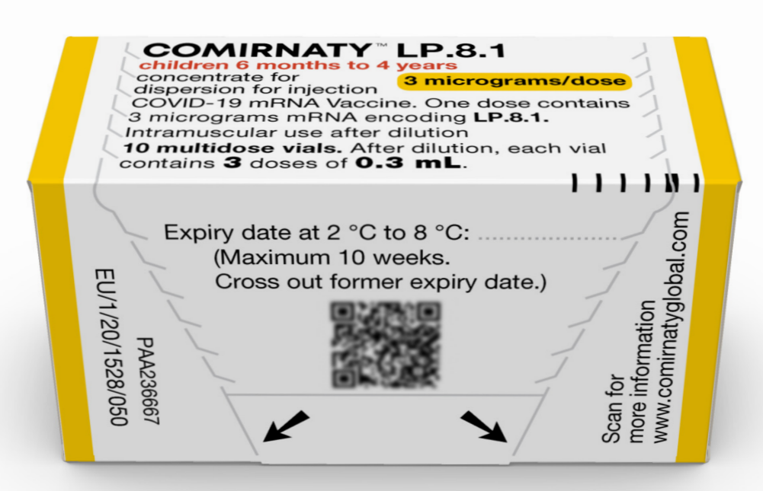
Pfizer Comirnaty® LP.8.1 3 microgram per dose dispersion for injection COVID-19 mRNA Vaccine
SmPC Pfizer Comirnaty® LP.8.1 3 microgram per dose dispersion for injection COVID-19 mRNA Vaccine
20
Notes:
Comirnaty LP.8.1 3 micrograms/dose concentrate for dispersion for injection, 3-dose vial - Summary of Product Characteristics (SmPC) - (emc) | 101152

Slide 21
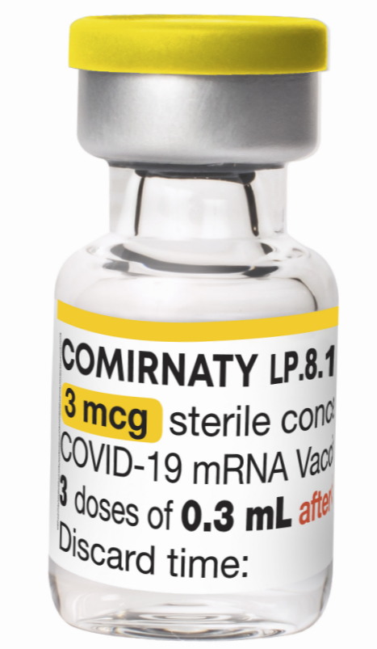
Presentation: Pfizer Comirnaty® LP.8.1
3 microgram per dose dispersion for injection
COVID-19 mRNA Vaccine
Pfizer Comirnaty® LP. 8.1. 3 microgram per dose dispersion for injection COVID-19 mRNA vaccine is a multi-dose vial and must be diluted before use.
After dilution, vials with a yellow cap of Comirnaty LP. 8.1. contain 3 doses of 0.3 mL of vaccine. Standard syringes and needles can be used to extract 3 doses from a single vial.
Each dose must contain 0.3 mL of vaccine.
If the amount of vaccine remaining in the vial cannot provide a full dose of 0.3 mL, discard the vial and any excess volume.
Do not pool excess vaccine from multiple vials.
SmPC Pfizer Comirnaty® LP.8.1 3 microgram per dose dispersion for injection COVID-19 mRNA Vaccine

Slide 22
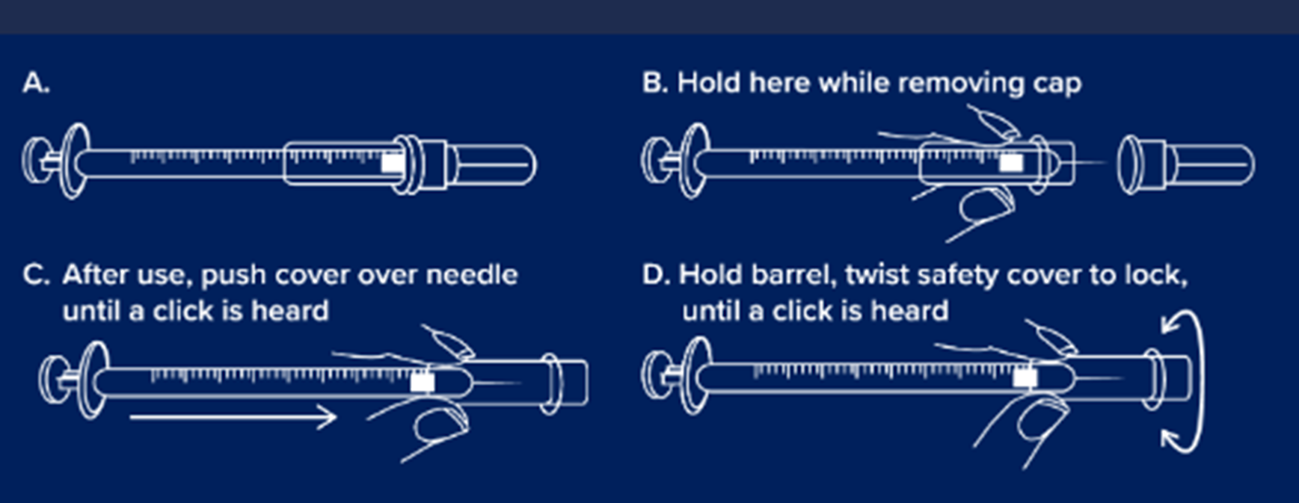
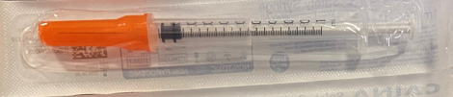
Consumables being supplied for the administration of Pfizer Comirnaty® 3mcg and 10mcg LP.8.1 COVID-19 mRNA Vaccines
GBUK Healthcare Safety combined needle and syringe 1ml 25G x 25mm with needle cover will be supplied for the administration of Pfizer Comirnaty® 3mcg and 10mcg LP.8.1 COVID-19 mRNA Vaccines
GBUK Prosum Prosafe 21g x 38mm, 3ml combined needle and syringe for Pfizer Comirnaty® 3mcg
LP.8.1COVID-19 mRNA vaccine may also be available
GBUK/Caina 25g x 25mm 1ml safety Combined Needle and Syringe may also be available for administration.
Please note: the IPC measures in external resources may not align with the national IPC requirements in Wales. See here for NHS Wales guidance: NIPCM- Public Health Wales

Slide 23

Dilution: Comirnaty® LP.8.1 3 microgram per dose dispersion for injection COVID-19 mRNA Vaccine (1)
Allow the thawed vial to come to room temperature and gently invert it 10 times prior to dilution. Do not shake.
Prior to dilution, the thawed dispersion may contain white to off-white opaque amorphous particles.
The thawed vaccine must be diluted in its original vial with 1.1 mL sodium chloride 9 mg/mL (0.9%) solution for injection, using a 21 gauge or narrower needle and aseptic techniques.
Equalise vial pressure before removing the needle from the vial stopper by withdrawing 1.1 mL air into the empty diluent syringe.
Notes:
Comirnaty LP.8.1 3 micrograms/dose concentrate for dispersion for injection, 3-dose vial - Summary of Product Characteristics (SmPC) - (emc) | 101152

Slide 24
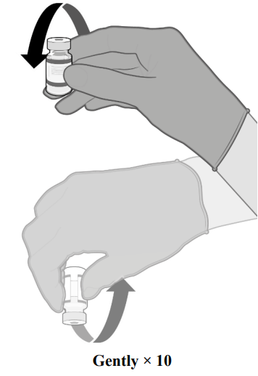
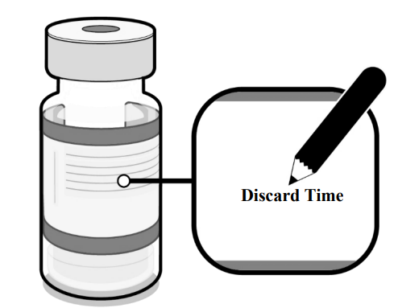
Dilution: Pfizer Comirnaty® LP.8.1 3 microgram per dose dispersion for injection COVID-19 mRNA Vaccine (3)
Gently invert the diluted dispersion 10 times. Do not shake
The diluted vaccine should present as a white to off-white dispersion with no particulates visible. Do not use the diluted vaccine if particulates or discolouration are present
The diluted vials should be marked with the appropriate discard date and time
After dilution store at +2ºC to +30ºC and use within 12 hours
Do not freeze or shake the diluted dispersion. If refrigerated, allow the diluted dispersion to come to room temperature prior to use.
Notes:
Comirnaty LP.8.1 3 micrograms/dose concentrate for dispersion for injection, 3-dose vial - Summary of Product Characteristics (SmPC) - (emc) | 101152

Slide 25
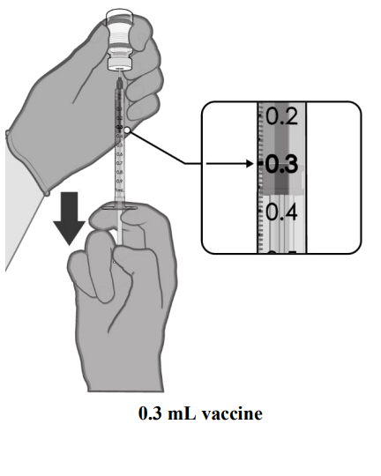
Dose preparation: Pfizer Comirnaty® LP.8.1 3 microgram per dose dispersion for injection COVID-19 mRNA Vaccine
Check product name, batch number and expiry date prior to administration.
After dilution, the vial contains 1.58 mL from which 3 doses of 0.3 mL can be extracted.
Using aseptic technique, cleanse the vial stopper with a single-use antiseptic swab.
Withdraw 0.3 mL of Comirnaty LP.81 for infants and children aged 6 months to 4 years. Standard syringes and/or needles can be used in order to extract 3 doses from a single vial.
Each dose must contain 0.3 mL of vaccine.
If the amount of vaccine remaining in the vial cannot provide a full dose of 0.3 mL, discard the vial and any excess volume.
Discard any unused vaccine within 12 hours after dilution.
Disposal
Any unused medicinal product or waste material should be disposed of in accordance with local requirements.
Notes:
Comirnaty LP.8.1 3 micrograms/dose concentrate for dispersion for injection, 3-dose vial - Summary of Product Characteristics (SmPC) - (emc) | 101152

Slide 26
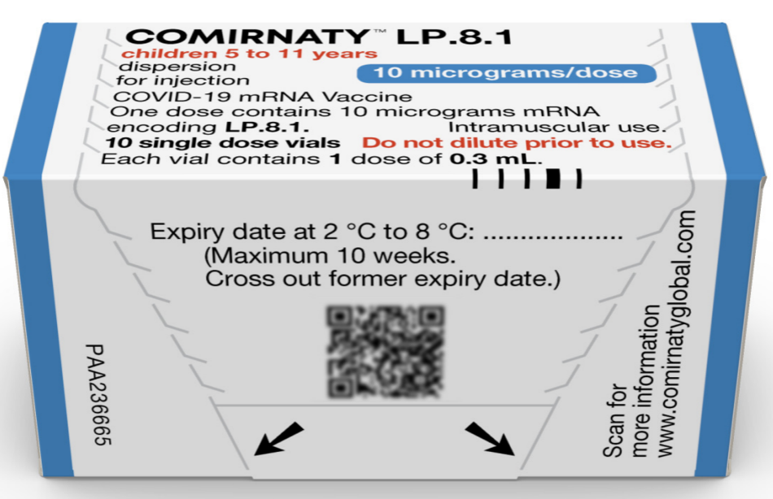
Pfizer Comirnaty® LP. 8.1 10 microgram per dose.
10 single dose vials for injection COVID-19 mRNA Vaccine
SmPC Pfizer Comirnaty® LP. 8.1 10 microgram per dose dispersion for injection
COVID-19 mRNA Vaccine
26
Notes:
Comirnaty LP.8.1 10 micrograms/dose dispersion for injection, single dose vial - Summary of Product Characteristics (SmPC) - (emc) | 101151

Slide 27
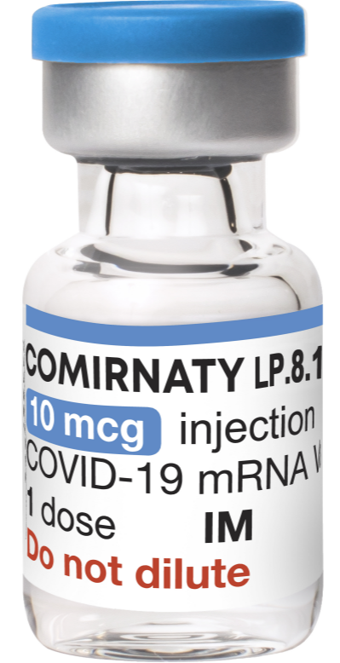
Presentation: Pfizer Comirnaty® LP.8.1
10 microgram per dose dispersion for injection
COVID-19 mRNA Vaccine
Pfizer Comirnaty® LP.8.1 10 microgram per dose dispersion for injection COVID-19 mRNA vaccine is a single dose vial. NO dilution is required.
Vials of Comirnaty LP.8.1 10microgram/dose have a blue cap and a single dose of 0.3 mL of vaccine. Each dose must contain 0.3 mL of vaccine.
Following withdrawal of 0.3 mL, discard the vial and any excess volume.
Do not pool excess vaccine from multiple vials.
SmPC Pfizer Comirnaty® LP.8.1 10 microgram per dose dispersion for injection
COVID-19 mRNA Vaccine
Notes:
Comirnaty LP.8.1 10 micrograms/dose dispersion for injection, single dose vial - Summary of Product Characteristics (SmPC) - (emc) | 101151

Slide 28
Storage: Pfizer Comirnaty® LP. 8.1 COVID-19 mRNA Vaccines
Pfizer Comirnaty® LP. 8.1 COVID-19 mRNA Vaccines will be coming into NHS Wales thawed from UKHSA, it will already have the expiry date and time labelled on the box.
The vaccine may then be delivered to where it is going to be administered thawed but refrigerated between +2ºC to +8ºC.
Thawed vaccine must be transferred immediately to a vaccine fridge on arrival and stored in a carefully monitored temperature range of +2ºC to +8ºC.
Once thawed, the unopened vaccine may be stored refrigerated at +2ºC to +8ºC, protected from light, for up to 10 weeks.
Prior to use, the unopened vial can be stored for up to 12 hours at temperatures between +8°C and +30°C. Thawed vials can be handled in room light conditions.

Slide 29
Patient Group Direction (PGD)
and Vaccine Group Directions (VGD)
Pfizer Comirnaty® LP.8.1 3 microgram per dose dispersion for injection COVID-19 mRNA Vaccine can only be administered under a PGD. Available to view here: Patient Group Directions (PGD) - Welsh Medicines Advice Service (wales.nhs.uk)
Pfizer Comirnaty® LP 8.1 10 microgram per dose dispersion for injection COVID-19 mRNA Vaccine can be administered under a PGD or a VGD
Templates are available to view here: Patient Group Directions (PGD) - Welsh Medicines Advice Service (wales.nhs.uk)
Further information about VGD's is available here: NHS SPS - Specialist Pharmacy Service – The first stop for professional medicines advice
NB: Local authorisation is required before PGD or VGD templates can be used.

Slide 30
Clinical Assessment
The clinical assessment and consent process for infants aged 6 months to 4 years must be carried out by a proficient registered healthcare practitioner only as indicated by the PGD.
Considerations:
  An appropriate risk/benefit conversation with the child, their parent or carer has taken place
  Recognise that children and their family/carer may need more time to process information
  This should be factored in when considering pace of delivery
On the day of vaccination assess if the infant/child:
  Is feeling well
  Is eligible for vaccination
  Has no contraindications to the vaccine as per Green Book Chapter or other authoritative resources
  Is happy to receive the vaccination and address any questions or concerns from child or caregiver

Slide 31
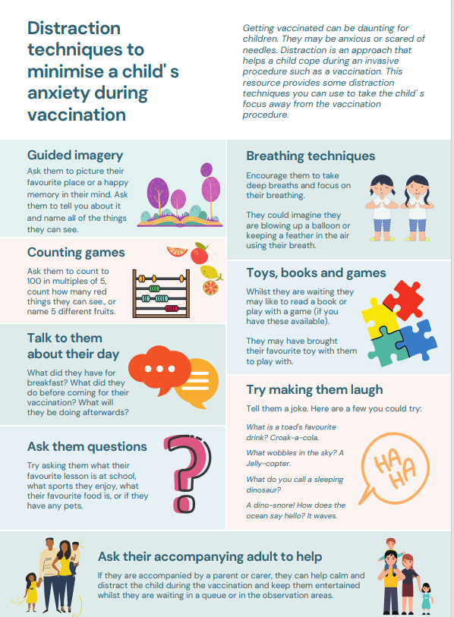
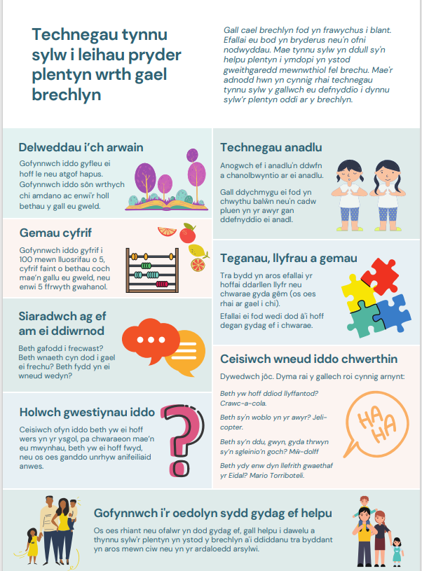
Distraction techniques to minimise a child's anxiety during vaccination
Getting vaccinated can be daunting for some people, particularly children and young people - they may be anxious, scared or needle phobic.
Children may like to bring a favourite toy with them to play with while they wait.
Parents and caregivers play an important role when children receive vaccines, and can hold their child or distract them during vaccinations, which may reduce the child’s stress and help healthcare professionals more easily administer vaccines
Distraction techniques to minimise a child's anxiety during vaccination, available from:
  Distraction techniques to minimise a child' s anxiety during vaccination (nhs.wales)
  WELSH VERSION - Distraction techniques to minimise a child' s anxiety during vaccination (nhs.wales)

Slide 32
Pfizer Comirnaty LP.8.1 30 microgram/dose
12 to 17 years
COVID-19 spring campaign 2026

Slide 33
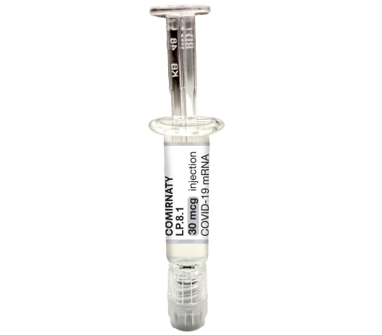
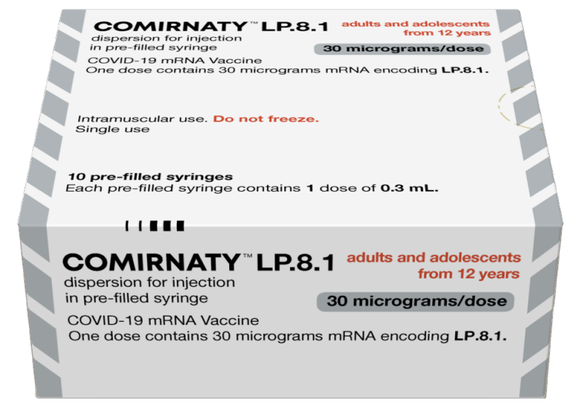
Pfizer Comirnaty® LP.8.1 30 microgram per dose dispersion for injection Pre-filled syringe COVID-19 mRNA Vaccine
SmPC Pfizer Comirnaty® LP.8.1 30 microgram per dose dispersion for injection Pre-filled syringe COVID-19 mRNA Vaccine
33
Notes:
Comirnaty LP.8.1 30 micrograms/dose dispersion for injection in pre-filled syringe - Summary of Product Characteristics (SmPC) - (emc) | 101150

Slide 34

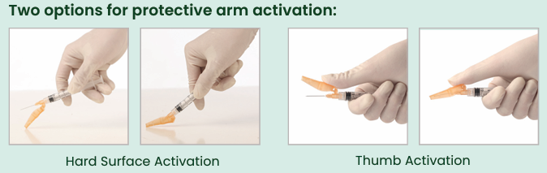
Hypodermic Sol-Care Safety Needle 23G X 1mm for use with Pfizer Comirnaty® LP.8.1 30 microgram per dose dispersion for injection Pre-filled syringe
Sol-Care™ Safety Needle is used in conjunction with a standard syringe.
Features:
•Two options for protective arm activation: hard surface activation and thumb activation
•Simple one-handed safety shield mechanism
•Audible click indicates that the safety mechanism is secured and locked in place
•Hubs, protective shields, and packaging are color-coded for facilitating the identification of needles gauges (ISO 6009)
•Protective arm designed not to obstruct visualization of injection site
•Compatible with all standard Luer Lock and Luer Slip Tip syringes
•Not manufactured with Latex, PVC and DEHP
Please note: the IPC measures in external resources may not align with the national IPC requirements in Wales.
See here for NHS Wales guidance: NIPCM - Public Health Wales: https://phw.nhs.wales/services-and-teams/antibiotics-and-infections/nipcm/)

Slide 35
Storage: Pfizer Comirnaty® 30 mcgs LP.8.1
COVID-19 mRNA Vaccine
Thawed at +2 °C to +8 °C shelf-life 12 months when stored at +2 °C to +8 °C.
NOTE: The vaccine will be received and stored at +2 °C to +8 °C (refrigerated only).
Special precautions for storage:
Store glass pre-filled syringes at +2 °C to +8 °C. DO NOT FREEZE.
Store the vaccine in the original package in order to protect from light
During storage, minimise exposure to room light, and avoid exposure to direct sunlight and ultraviolet light
The Pfizer Comirnaty® 30 mcgs LP.8.1COVID-19 mRNA Vaccine being supplied for the COVID-19 spring 2026 campaign with expire on the 8 September 2026.

Slide 36
Patient Group Direction (PGD) and
Vaccine Group Direction (VGD)
Pfizer Comirnaty® LP.8.1 30 microgram per dose dispersion for injection COVID-19 mRNA Vaccine can be administered under a PGD or a VGD
Templates are available to view here: Patient Group Directions (PGD) - Welsh Medicines Advice Service (wales.nhs.uk)
Further information about VGD's is available here: NHS SPS - Specialist Pharmacy Service – The first stop for professional medicines advice
NB: Local authorisation is required before PGD or VGD templates can be used.

Slide 37
Additional slides outlining key principles for all Pfizer Comirnaty® LP.8.1 COVID-19 mRNA vaccines

Slide 38
 | Pfizer Comirnaty® LP.8.1 3 micrograms/dose | Pfizer Comirnaty® LP.8.1 10 micrograms/dose | Pfizer Comirnaty® LP.8.1 30 micrograms/dose
Doses | 3 doses per vial of 0.3ml after dilution | 1 dose per vial of 0.3ml | 1 dose pre-filled syringe
Age | 6 months – 4 years | 5 – 11 years | 12 – 17 years*
Image
Notes:
For 12-17 year olds who are not deemed suitable for an mRNA vaccine, Nuvaxovid JN.1 can be given Green book on Immunisation COVID-19 chapter 14a. See Nuvaxovid JN.1 dispersion for injection in pre-filled syringe - Summary of Product Characteristics (SmPC) - (emc) | 101554

Slide 39
List of excipients: Pfizer Comirnaty® LP.8.1
COVID-19 mRNA Vaccines
These vaccines contains polyethylene glycol/macrogol (PEG)
2-[(polyethylene glycol - PEG)-2000]-N
N-ditetradecylacetamide (ALC-0159)
(4-hydroxybutyl)azanediyl)bis(hexane-6,1-diyl)bis(2-hexyldecanoate) (ALC-0315)
1,2-Distearoyl-sn-glycero-3-phosphocholine (DSPC)
Cholesterol
Trometamol
Trometamol hydrochloride
Sucrose
Water for injection
For further information about specific excipients in vaccines see:
Comirnaty LP.8.1 30 micrograms/dose dispersion for injection in pre-filled syringe - Summary of Product Characteristics (SmPC) - (emc) | 101150
Comirnaty LP.8.1 10 micrograms/dose dispersion for injection, single dose vial - Summary of Product Characteristics (SmPC) - (emc) | 101151
Comirnaty LP.8.1 3 micrograms/dose concentrate for dispersion for injection, 3-dose vial - Summary of Product Characteristics (SmPC) - (emc) | 101152
Vaccine ingredients | Vaccine Knowledge (ox.ac.uk)

Slide 40
Polyethylene glycol (PEG)
Pfizer Comirnaty® LP.8.1 3 microgram per dose/ 10 microgram per dose/ 30 microgram/per dose dispersion for injection COVID-19 mRNA Vaccine contain polyethylene glycol (PEG)
PEGs (also known as macrogols) are a group of known allergens commonly found in medicines, many household products and cosmetics
Medicines containing PEG include some tablets, laxatives, depot steroid injections, and some bowel preparations used for colonoscopy
Individuals with undiagnosed PEG allergy often have a history of immediate onset-unexplained anaphylaxis or anaphylaxis to multiple classes of drugs. Such individuals should not be vaccinated with COVID-19 vaccine containing polyethylene glycol (PEG) except on the expert advice of a paediatric allergy specialist
Known allergy to PEG is rare but has been implicated in a minority of allergic reactions reported
For further information see: Table 5: Management of patients with a history of allergy in Green Book COVID-19 chapter

Slide 41
Prior to giving Pfizer Comirnaty® LP.8.1COVID-19 mRNA Vaccines
Before giving the vaccine, you need to check if the infant or child:
is eligible to receive the vaccine
has any contraindications or precautions to the Pfizer Comirnaty® mRNA Vaccines
has not received any COVID-19 vaccination in the previous 3 months. The Green Book COVID-19 chapter states, for those eligible for vaccination during seasonal campaigns, a single dose is offered at least 3 months after any previous dose. This interval applies to any vaccine, regardless of the product given for the previous doses. Timing should follow the JCVI advice for that campaign, which aims to provide protection to the most vulnerable at the optimal time
the only exceptions to the 3-month interval would be individuals who are immunosuppressed, these individuals would be recommended a second dose, and in some circumstances, may need to complete vaccinations within a treatment window. In this situation the minimum interval could be reduced to 3 weeks Green Book COVID-19 chapter

Slide 42
Contraindications: Pfizer Comirnaty® LP.8.1
COVID-19 mRNA Vaccines
Vaccination should be postponed in individuals suffering from acute severe febrile illness or acute infection. The presence of a minor infection and/or low-grade fever should not delay vaccination.
The vaccine is contraindicated in those who have had a previous systemic allergic reaction (including immediate-onset anaphylaxis) to:
  a previous dose of a COVID-19 vaccine
  any component (excipient) of a COVID-19 vaccine
People with a history of allergy: A very small number of individuals have experienced anaphylaxis when receiving a COVID-19 vaccine. Anyone with a history of allergic reaction to an excipient in the COVID-19 vaccine should not receive that vaccine (except with expert advice), but those with any other allergies (such as a food allergy) – including those with prior anaphylaxis – can have the vaccine. Guidance about the management of individuals with a history of allergy should be followed (summarised in Table 5) COVID-19: green book chapter.
Notes:
Before administering a COVID-19 vaccine, it is important to check for any relevant medical history including allergies and any previous history of severe reaction to a vaccine. Facilities for management of paediatric anaphylaxis should be available at all vaccination sites. (See Chapter 8 of the Green Book: https://www.gov.uk/government/publications/vaccine-safety-and-adverse-events-following-immunisation-the-green-book-chapter-8 ) and advice issued by the Resuscitation Council (https://www.resus.org.uk/).

Slide 43
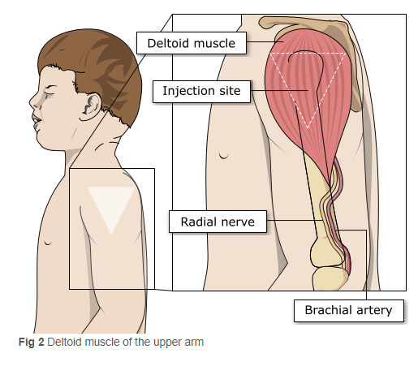
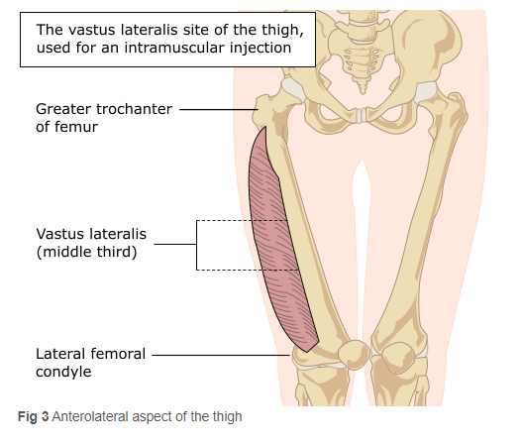
Site of administration:
In infants from 6 to less than 12 months of age, the recommended injection site is the anterolateral aspect of the thigh.
In individuals 1 year of age and older, the recommended injection site is the deltoid muscle, as long as there is adequate muscle mass, if after clinical assessment it is considered there is minimal muscle mass in the deltoid muscle, then the vaccine can be administered in the anterolateral aspect of the thigh. COVID-19: green book chapter.
Image source: The Australian Immunisation Handbook (health.gov.au)

Slide 44
Vaccination site
The vaccine should be administered intramuscularly.
The preferred site is the deltoid muscle of the upper arm in individuals over 12 months of age and the anterolateral aspect of the thigh in those under 12 months of age. The Green book COVID-19 chapter highlights further detail regarding specific age groups receiving the Pfizer BioNTech COVID- vaccines (Comirnaty):
  In infants from 6 months to less than 12 months of age, the recommended injection site is the anterolateral aspect of the thigh
  COVID-19 vaccines can be administered as an intramuscular injection into the deltoid muscle or the anterolateral aspect of the thigh for those ages one to four years of age. In this age group clinical judgment can be applied, if there is minimal muscle mass in the deltoid area of the upper arm, or a particular reason to avoid immunisation in the deltoid muscle, then the vaccine can be given in the anterolateral aspect of the thigh.
  For individuals 5 years of age and older, the preferred site is the deltoid muscle of the upper arm.
The vaccine should not be mixed in the same syringe with any other vaccines or medicinal products.
Giving vaccine into the muscle:
leads to a better immune response to the vaccine (as the muscle contains the appropriate cells necessary to initiate the immune response).
is less likely to cause local reactions than if the vaccine is given into the skin (subcutaneously).
The needle needs to be long enough to ensure vaccine is injected into the muscle. For this reason, a 25mm needle is being provided for administration of the COVID-19 vaccine.

Slide 45
Vaccinating Individuals with bleeding disorders
Individuals with bleeding disorders may be vaccinated intramuscularly if, in the opinion of a doctor familiar with the individual’s bleeding risk, vaccines or similar small volume intramuscular injections can be administered with reasonable safety by this route.
If the individual receives medication/treatment to reduce bleeding, for example treatment for haemophilia, intramuscular vaccination can be scheduled shortly after such medication/ treatment is administered. Individuals on stable anticoagulation therapy, including individuals on warfarin who are up-to-date with their scheduled INR testing and whose latest INR is below the upper level of the therapeutic range, can receive intramuscular vaccination.
A fine needle (23 or 25 gauge) should be used for the vaccination, followed by firm pressure applied to the site without rubbing for at least 2 minutes (Advisory Committee on Immunization Practices 2019). The individual/parent/carer should be informed about the risk of haematoma from the injection Green Book COVID-19 chapter
Notes:
Thrombocytopenia and coagulation disorders
As with other intramuscular injections, the vaccine should be given with caution in individuals receiving anticoagulant therapy or those with thrombocytopenia or any coagulation disorder (such as haemophilia) because bleeding or bruising may occur following an intramuscular administration in these individuals.

Slide 46
Disposal: Pfizer Comirnaty LP.8.1
COVID-19 mRNA Vaccines
Any unused product or waste material should be disposed of in accordance with local policy
Equipment used for immunisation, including used vials, ampoules, or discharged vaccines in a syringe or applicator, should be disposed of at the end of a session by sealing in an UN-approved puncture-resistant ‘sharps’ box, according to local authority regulations and guidance in the Welsh Health Technical Memorandum 07-01 Safe management of healthcare waste

Slide 47
Adverse reactions
Like all vaccines, Comirnaty LP.8.1. can cause side effects, although not everybody gets them
A detailed list of adverse reactions is available in the Summary of Product Characteristics.
The most common reported adverse effects (affecting between 1 in 10 people, and 1 in 100 people) include:
headache, irritability, drowsiness.
diarrhoea, nausea, vomiting and decreased apatite
muscle and or joint pain.
pain in the vaccinated arm.
enlarged lymph nodes.
feeling weak, lethargic, tiredness, chills and fever.
injections site pain, tenderness, redness, itching and swelling.
Irritability, injection site tenderness, sleepiness, rash and reduced appetite more common in individuals aged 6 to 23 months.
Notes:
Comirnaty LP.8.1 3 micrograms/dose concentrate for dispersion for injection, 3-dose vial - Summary of Product Characteristics (SmPC) - (emc) | 101152
Comirnaty LP.8.1 10 micrograms/dose dispersion for injection, single dose vial - Summary of Product Characteristics (SmPC) - (emc) | 101151
Comirnaty LP.8.1 30 micrograms/dose dispersion for injection in pre-filled syringe - Summary of Product Characteristics (SmPC) - (emc) | 101150

Slide 48
Myocarditis and pericarditis
Cases of myocarditis and pericarditis have been reported rarely after COVID-19 vaccination. Cases have been observed more often after the second vaccination, and more often in younger males
Although now licensed from 6 months of age, Moderna Spikevax COVID-19 vaccines are not recommended for use in individuals of less than 18 years of age because of the slightly higher risk of myocarditis/pericarditis compared to Pfizer vaccines Green Book COVID-19 chapter
If an individual develops myocarditis or pericarditis following the first COVID-19 vaccination they should be assessed by an appropriate clinician to determine whether it is likely to be vaccine related
https://www.gov.uk/government/publications/myocarditis-and-pericarditis-after-covid-19-vaccination/myocarditis-and-pericarditis-after-covid-19-vaccination-guidance-for-healthcare-professionals
Healthcare professionals should be alert to the signs and symptoms of myocarditis and pericarditis. Vaccinees (including parents or caregivers) should be instructed to seek immediate medical attention if they develop symptoms indicative of myocarditis or pericarditis such as (acute and persisting) chest pain, shortness of breath, or palpitations following vaccination. Healthcare professionals should consult guidance and/or specialists to diagnose and treat this condition. Green Book COVID-19 chapter
As the mechanism of action and risk of recurrence of myocarditis and pericarditis are being investigated, the current advice is that an individual’s second or subsequent doses should be deferred pending further investigation and careful consideration of the risks and benefits

Slide 49
Guillain-Barré syndrome (GBS)
Very rare reports have been received of GBS following COVID-19 vaccination, so healthcare professionals should be alert to the signs and symptoms of GBS to ensure correct diagnosis and to rule out other causes, in order to initiate adequate supportive care and treatment
Individuals who have a history of GBS should be vaccinated as recommended for their age and underlying risk status. Cases of GBS reported following vaccination may occur by chance (the background rate of GBS is 2 per 100,000 per year in the population) and no causal mechanism with COVID-19 vaccination has been proven
There is evidence to suggest that having had a prior diagnosis of GBS does not predispose an individual to further episodes of GBS when immunised with other vaccines (Baxter et al, 2012) and for the Pfizer BioNTech COVID-19 vaccine (Shapiro Ben David et al, 2021)
In those who are diagnosed with GBS after the first dose of vaccine, the balance of risk benefit is in favour of completing a full COVID-19 vaccination schedule. Green Book COVID-19 chapter

Slide 50
Individuals with a history of immune thrombocytopenia
Individuals with a history of immune thrombocytopenia (ITP) may experience a fall in their platelet count.
Previous ITP is not a contra-indication for vaccination.
Although evidence suggests a raised risk of ITP after the AstraZeneca vaccine (Simpson et al, 2021), ITP has also been reported with other COVID-19 vaccines (Lee et al, 2021).
Given these reports, monitoring of platelets 2-5 days post COVID-19 vaccination in patients with a history of ITP should be considered. Green Book COVID-19 chapter

Slide 51
Erythema multiforme
A number of cases of erythema multiforme (EM) have been reported after Pfizer mRNA vaccinations.
These reports appear to be consistent with EM minor, with no fatalities.
MHRA have consulted dermatology experts who consider EM an uncommon, benign and self-limiting condition which could plausibly be triggered by COVID-19 vaccination; although overreporting due to misdiagnosis was possible.
A past history of EM is not a contraindication for vaccination.
Green Book: COVID-19 chapter

Slide 52
Pregnancy
No data is available yet regarding the use of Pfizer Comirnaty® LP.8.1 COVID-19 vaccine during pregnancy
However, a large amount of observational data from pregnant women vaccinated with the initially approved Comirnaty vaccine during the second and third trimester have not shown any increase in adverse pregnancy outcomes. While data on pregnancy outcomes following vaccination during the first trimester are presently limited, no increased risk for miscarriage has been seen
Animal studies do not indicate direct or indirect harmful effects with respect to pregnancy, embryo/foetal development, parturition (childbirth) or post-natal development.
Based on data available with other vaccine variants, Pfizer Comirnaty® LP.8.1 can be used during pregnancy.
Comirnaty LP.8.1 30 micrograms/dose dispersion for injection in pre-filled syringe - Summary of Product Characteristics (SmPC) - (emc) | 101150

Slide 53
Breastfeeding
No data is available yet regarding the use of Pfizer Comirnaty® LP.8.1 COVID-19 vaccine during breastfeeding.
However, no effects on the breast-fed newborn/infant are anticipated since the systemic exposure of breastfeeding woman to the vaccine is negligible.
Observational data from women who were breastfeeding after vaccination with the initially approved Comirnaty vaccine have not shown a risk for adverse effects in breastfed newborns/infants.
Protective antibodies have been detected in breast milk (Gray et al, 2021). The developmental and health benefits of breastfeeding are clear and should be discussed with the woman, along with her clinical need for immunisation against COVID-19. Green Book COVID-19 chapter.
Pfizer Comirnaty® LP.8.1 COVID-19 vaccine can be used during breastfeeding.
Comirnaty LP.8.1 30 micrograms/dose dispersion for injection in pre-filled syringe - Summary of Product Characteristics (SmPC) - (emc) | 101150

Slide 54
Co-administration with other vaccines
For all vaccines, if they are due at the same time as the COVID-19 vaccine, they can be given.
As COVID-19 vaccines are considered inactivated (including the non-replicating adenovirus vaccine), where individuals in an eligible cohort present having recently received one or more inactivated or another live vaccine, COVID-19 vaccination should still be given.
The same applies for other live and inactivated vaccines where COVID-19 vaccination has been received first or where a patient presents requiring two or more vaccines. It is generally better for vaccination to proceed to avoid any further delay in protection and to avoid the risk of the patient not returning for a later appointment.
For further information, see Green Book COVID-19 chapter

Slide 55
Tips to support clinical assessment and informed consent
Consider the best ways of communicating with the child and parent/carer
Take time to establish a rapport and build trust
Give time to process information and support to explore any questions
Use visuals if appropriate e.g. smiley face or sad face, thumbs up or thumbs down picture, or red/green tick/cross visual to establish understanding and a means of communication
Natural gestures or signs can also help build understanding
Further information on consent can be found at : Greenbook chapter 2 consent (publishing.service.gov.uk)

Slide 56
Informed consent
How much information should you give?
this will be personal to the individual at the time and will depend on their previous knowledge and discussions with others
give people as much information as they need and/or want to make an informed decision
some people will just ‘trust’ what you say while others want lots of information; either is fine
how much each individual needs is up to them, no one is obliged to seek full information
Information to be given includes:
which vaccine is being offered and the disease against which it protects
benefits/risks of immunisation versus risks of the disease​
any possible vaccine reactions and what to do if these occur
Consent is a process, not a one-off discussion and must consider 3 factors:
the person giving consent must be appropriately informed: they must have the necessary information in order to make the decision
consent must be voluntary by the individual without undue pressure or coercion
the person consenting must have the capacity to make the decision
Consent: the green book, chapter 2 - GOV.UK (www.gov.uk)
Mental capacity Act 2005 https://www.legislation.gov.uk/ukpga/2005/9/contents

Slide 57
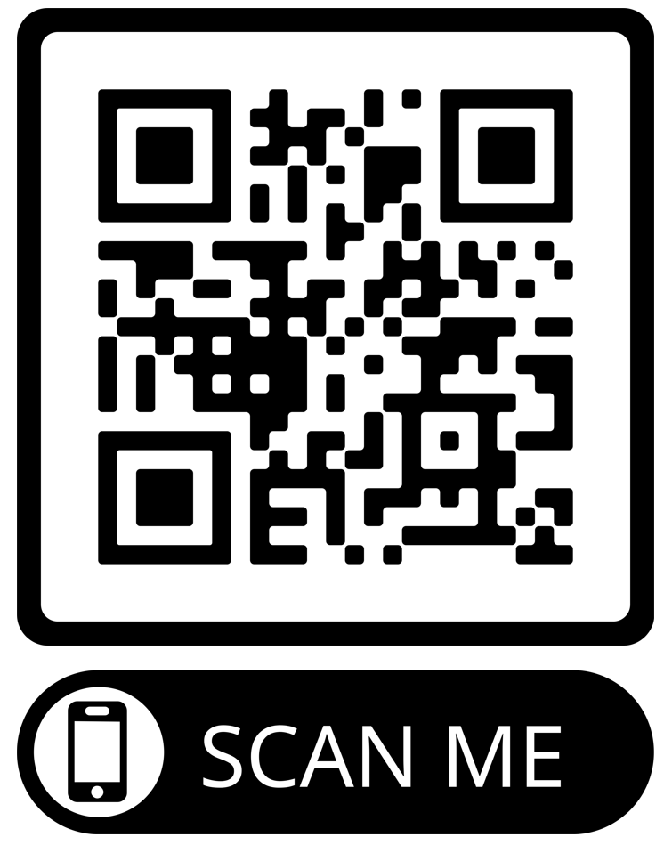
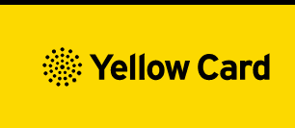
Reporting Adverse Events
Vaccinees should be advised that they can report any adverse reactions or suspected side effects to the MHRA through the online yellow card scheme website or the Yellow Card app
Anyone (patients and HCWs) can make a Yellow Card report, even if they are uncertain as to whether a vaccine caused the condition
▼ This medicinal product is subject to additional monitoring. This will allow quick identification of new safety information. Healthcare professionals are asked to report any suspected adverse reactions.
The QR code can be used for quick and easy access to the Yellow Card reporting site.
www.mhra.gov.uk/yellowcard

Slide 58
Summary and resources

Slide 59
Post vaccination waiting times
Individuals with a personal history of allergy require a period of observation following vaccination (either 15 or 30 minutes depending on their clinical history). These individuals should be managed as described in Table 5 of the Green Book COVID-19 chapter.
Individuals without a personal history of allergy, or with only a family history of allergy, do not need a period of observation.
As fainting can occur following vaccination, all those vaccinated with any of the COVID-19 vaccines should either be driven by someone else or should not drive for 15 minutes after vaccination.
Vaccinated individuals should be informed about how to access immediate healthcare advice in the event of displaying any symptoms. In some settings, for example domiciliary vaccination, this may require a responsible adult to be present for at least 15 minutes after vaccination.
Notes:
The 15 minute observation period following vaccination with COVID-19 mRNA vaccines has been removed for ALL individuals of all ages (except those with a history of non-allergic reaction (see cautions) or a severe allergic reaction (as outlined in COVID-19: the green book chapter advice).

Slide 60
Key messages
COVID-19 is now a relatively mild disease for the vast majority of people. This ongoing increase in population immunity permits the development of a more targeted programme aimed at those at higher risk of developing serious COVID-19 disease.
Individuals aged six months to 4 years who become eligible for COVID-19 vaccination require 2 primary doses as per PGD (off-label).
Individuals aged six months and above with severe immunosuppression may be considered for additional doses ideally at an interval of 8 to 12 weeks from the previous dose.
Exception to this ideal interval may be advised based on specialist clinical judgement, for example for those about to receive or increase the intensity of an immunosuppressive treatment, where a better response would be made if immunised prior to that treatment commencing.
Where the specialist has advised an exception, then the interval may be reduced to a minimum of three weeks for any of the vaccine products.
Previously unvaccinated Individuals who become or have recently become severely immunosuppressed, should be considered for a first dose of vaccination and the second dose given ideally at an interval of 8-12 weeks from the previous dose. Including individuals who receive bone marrow transplants or CAR-T therapy as they may have lost immunological memory of previous vaccination.
For individuals about to receive planned immunosuppressive treatment, a minimum interval of 3 weeks between COVID-19 doses may be followed, to enable the vaccine to be given whilst the individual’s immune system is better able to respond.

Slide 61

Confident vaccine conversations - Behavioural Science Motivational Interviewing approach eLearning module
This eLearning module has been developed as a collaborative project between:​
Public health Wales - Health Protection Division -Training Guidance and Behavioral Science Team ​
Public health Wales - Behavioral Science Unit​
Public health Wales - Health Protection Division - Vaccine Preventable Disease Programme
The module will be available to view here shortly: Immunisation eLearning - Public Health Wales

Slide 62
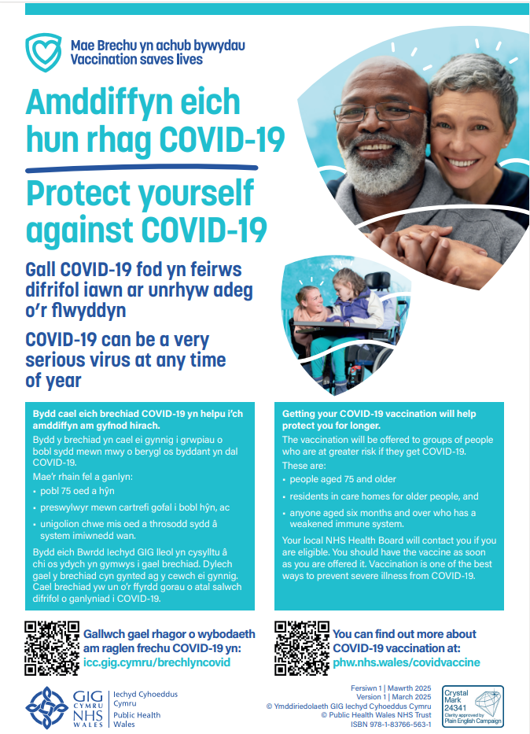


Public resources
Immunisation and Vaccines - Public Health Wales (nhs.wales)
Order for FREE here: https://phw.nhs.wales/services-and-teams/health-information-resources/
COVID-19 Poster
COVID-19 Spring Information Leaflet

Slide 63
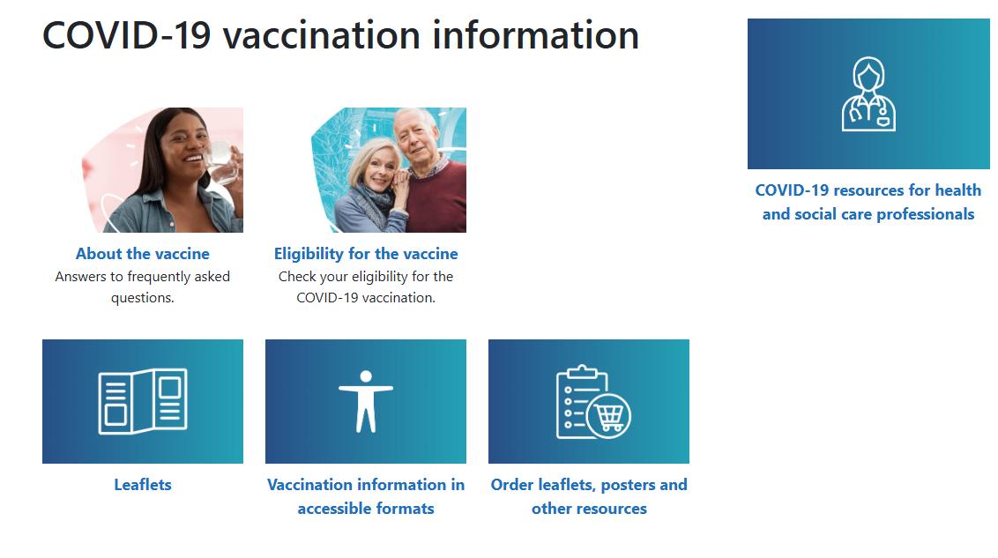
Further information to support the COVID-19 Vaccination Programme
Information for health care professionals here
COVID-19 Information for the public here
Notes:
Resources for health and social care professionals - Public Health Wales (nhs.wales)
About the vaccine - Public Health Wales (nhs.wales)

Slide 64
Further information
Immunisation against infectious disease "Green Book" ​
JCVI statement on COVID-19 vaccination in 2025 and spring 2026 - GOV.UK​
COVID-19 spring vaccination programme 2026 (WHC/2025/052) [HTML] | GOV.WALES
PHW professional information resources:
COVID-19 resources for health and social care professionals - Public Health Wales (nhs.wales)
Vaccine resources for health and social care professionals - Public Health Wales (nhs.wales)
PHW training:
Immunisation training resources and events - Public Health Wales (nhs.wales)
Immunisation eLearning - Public Health Wales (nhs.wales)
UKHSA COVID-19 vaccination resources: ​
COVID-19 vaccination programme - GOV.UK (www.gov.uk)​
UKHSA COVID-19 Immunisation programme Information for healthcare practitioners ​
​This document provides additional information, answers to frequently asked questions and actions to take in the event of inadvertent errors. ​
Oxford Knowledge Project: COVID-19 vaccines​
MHRA: Guidance on coronavirus (COVID-19)

