Slide 1
Accelerated Cluster Development [ACD]
v2.0 (January 2023)

Slide 2

The Journey for the next 15 minutes
We will:
Summarise achievements to date
Outline what the ACD Programme is and it’s purpose
Address the benefits that will be delivered for the public and professionals
Describe what Professional Collaboratives, Clusters and PCPGs will be doing
Consider the further work to be done

Slide 3

Achievements to date
Cluster footprints are well established and aligned to PCPBs and RPBs
Every Cluster area has a current needs assessment and a service development plan
There is a cohort of Cluster Leads with significant experience and skills
Cluster budgets are testing new roles and models of care which are ensuring more sustainable services
Cluster support teams are building expertise in data analysis, project planning, business care development and evaluation
There are excellent examples of patient and public engagement
Cluster initiatives are addressing health inequalities
A number of new delivery models are established

Slide 4

Cluster survey 2020 – What did it tell us?
“Lack of time, funding, each GP practice has different priorities for sustainability “
“lack of communication from the clusters as to the work they are doing and no invitation to attend.”
Increase influence within integrated organisations to ensure that a thorough understanding of front line experience drives strategic discussions
“Not included in discussions around strategic direction. Uninformed of cluster response so unable to influence opportunities to work differently”
Ensure that Clusters are dealing with the most significant local issues ensuring sustainability of all services
“Lack of awareness of AHP roles and capabilities from those developing clusters at strategic levels. Lack of engagement with Therapies in general to develop cluster projects.”
“It is difficult to determine how national policy priorities (for instance the earlier detection of cancer) can influence policy, guidance and activity for clusters”.
“Different working styles of different healthcare providers, as well as referral pathways and management systems often being suited to a single disciplinary rather than incorporating others”
The workforce doesn’t feel engaged in identifying issues and developing workable solutions
Minimise referral delays by increasing MDT working for complex care
Cluster survey 2020
729 responses from across primary care in Wales

Slide 5

What is Accelerated Cluster Development ?
ACD is an organisational change process – it is not an end in itself
Clusters
  serve populations of 25 000-100 000
  bring together professionals from all local services to plan and deliver the best use of all available resources and to
  influence how specialist services are developed and delivered so that they are more responsive to local needs
Why? To improve outcomes and experience for patients, carers and families
What? Speeds progress so that our primary and community care services are better connected, easier to access and navigate and more person-centred
By building capacity to meet the needs of local populations pressures on our workforce are also reduced – which is essential to ensure sustainability of services
Clusters develop local solutions and influence strategic plans

Slide 6

How is the ACD Programme accelerating the development of cluster working ?
Enabling the two purposes of Clusters (Planning & Delivery)
Supporting Clusters to directly influence mainstream Planning and Decision making through Pan Cluster Planning Groups
Bringing Local Authorities and other Stakeholders into the Clusters to support the development of local solutions
Highlighting opportunities to deliver local approaches to HB / RPB strategy
Supporting the development of skills and capacity to support Cluster working
Developing national tools and resources

Slide 7

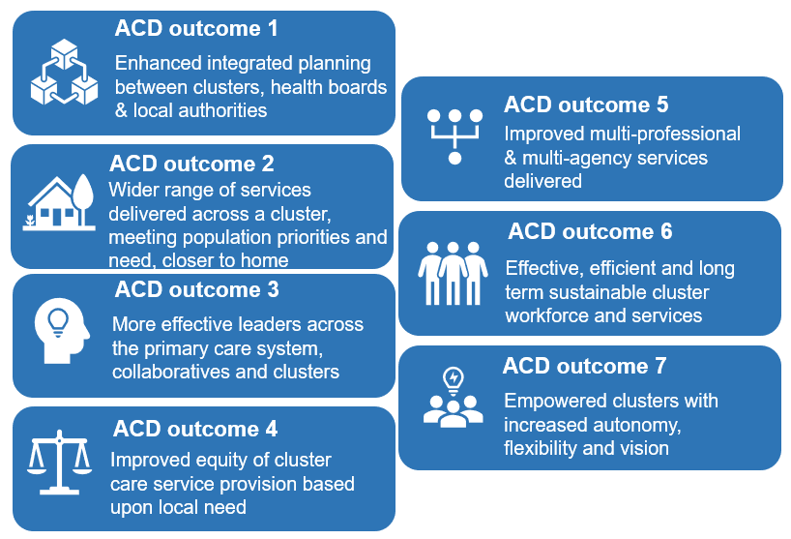
“Working as a cluster ensures care is better co-ordinated to promote the wellbeing of individuals and communities”
Better outcomes and experience for the person
Better working experience for professionals

Slide 8

What will this mean for you as a local service user?
Better outcomes and experience
Your access to services will be improved with a wider range of contact options
Appointments times will be flexible to ensure that care is comprehensive and person centred
Scheduling and record systems will ensure that your records support continuity of care
Your professionals will have more opportunities to discuss your care to ensure that it is co-ordinated
We will keep you informed about your care choices and follow up arrangements
There will be direct access to a wider range of professional skills and expertise in practices and the community
The people who care for you will have greater influence over how services are structured – we will continue to learn from your experience to improve the care we provide

Slide 9
What will this mean for you as a professional?
A strengthened and more connected system to support you to deliver care
You will be better connected with your colleagues
You will have timely access to the advice and support that you need
The capacity of community services will be expanded, guided by the needs of the local population and your experience
There will be new roles and coordination of the team approach
Workload will be distributed to allow you to focus on what only you can do
You will have scheduled time for professional development and peer review

Slide 10
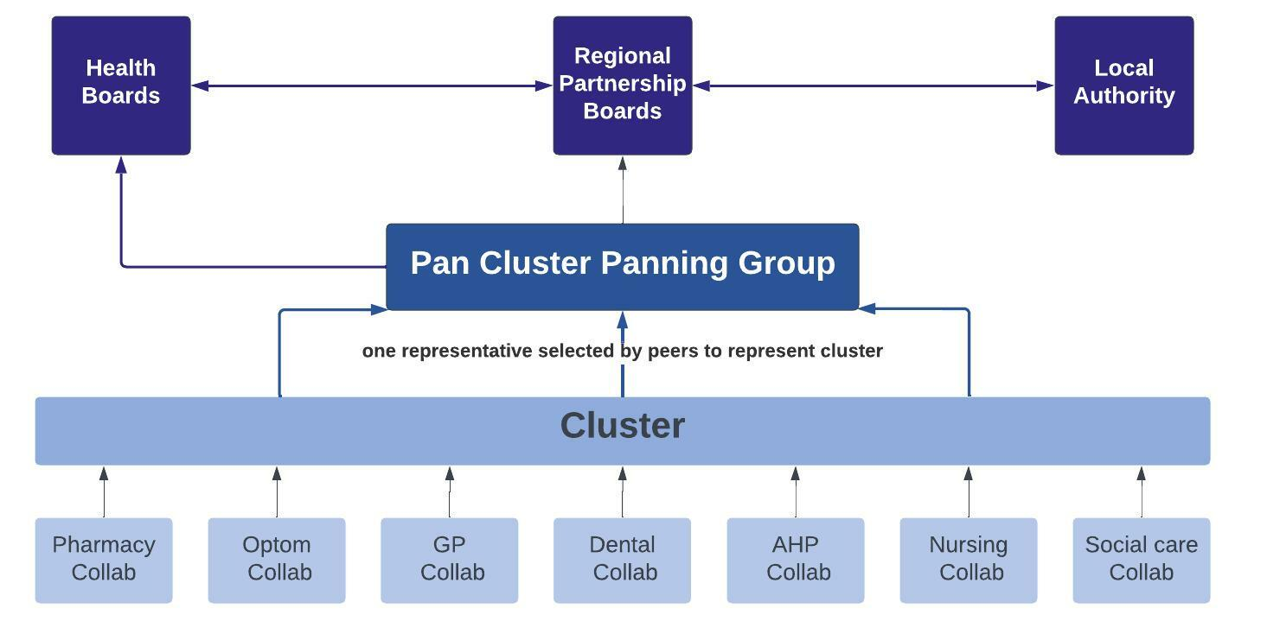
Greater influence from frontline professionals, more informed and innovative plans

Slide 11
Professional Collaboratives
Professional Collaboratives engage groups of professionals, to share experience and good practice, assess and report on the quality and safety of local services and advocate for service improvement
.
Purpose
To identify the specific needs of their population for their area of expertise
To use recognised quality indicators and professional and public experience to Identify service gaps, quality and safety issues to develop and prioritise opportunities to improve services
To advocate for appropriate provision of care for the most vulnerable
To respond to national strategic intent and funding opportunities which are profession specific
To collaborate with each other and with other professions in the planning and delivery of local services, through the Cluster
Professional Collaborative: unique perspective and expertise
Team 2
Team 3
Team 5
Team 1
Team 4
Team 6
Team 7

Slide 12
Clusters : Collaborative networks are stronger working together
.
CLUSTER
Pharmacy Collab
Optom Collab
GP Collab
Social Care Collab
Dental Collab
AHP Collab
Nursing Collab
Clusters bring together all of the professional collaboratives in a local area
Working together to ensure seamless and efficient service provision
Professionals find operational solutions that work in the local context
Clusters include senior leads from Health Board, Local Authority and Third Sector services to ensure that those organisations can inform and support wider system solutions

Slide 13
Cluster working connects to wider organisational support
CLUSTER
Cluster Lead (Chair)
GP Collab Lead
Com Pharmacy Collab Lead
Dental Collab Lead
Optometry Collab Lead
Com Nursing Collab Lead
AHP Collab Lead
3rd Sector Rep
MH Services Rep
Medicines Mgmt. Rep
Primary, Com & Therapies Services Sn mgr.
Cluster Development mgr.
Improve population health & wellbeing | Engage & develop the local workforce
Improve value | Improve quality & safety
Aims: -
How will they achieve this?
  Developing a shared understanding of Cluster population need, agreeing priorities for service development & the allocation of the Cluster budget to progress an agreed Cluster plan
  Sharing relevant data to inform local population service assessment
  Articulating the needs of vulnerable groups & those with special needs
  Collaborating to share good practice & improving person centred care by delivering the agreed Cluster Plan .
  Developing costed proposals for additional service improvements to be considered by the Pan Cluster Planning Group
  Describing workforce needs and priorities and contributing to the development of local solutions

Slide 14
Pan Cluster Planning Groups
PCPGs work at County level to bring together Cluster priorities with the decision makers in HBs and LAs who have statutory responsibility for planning and funding services
Pan Cluster Planning Group – shared understanding of the needs and priorities of the county and an agreed integrations plan which determines resource allocations commissioning etc.
Social Care Lead
PCPG secretariat
Third Sector
Community Health Council
Clinical Pathways Lead
Public Health
Community Nurse
Lead
AHP Lead
Mental Health Lead
Health Board Lead
Cluster Leads
PCPGs will:
Bring together the NHS, Local Authority and key partners in the Third Sector to collaborate across health and social care
Develop an integrated plan which addresses the health, care and wellbeing needs of the County population- taking into account Cluster level analysis and priorities
Commission services to deliver innovative, outcomes - from Clusters, CICs and others

Slide 15

Will delivery of all of the above achieve our aims?
Clusters dealing with the most significant local issues and ensuring sustainability of all services
Increased influence within integrated organisations to ensure that a thorough understanding of front line experience drives strategic discussions
Workforce fully engaged in identifying issues and developing workable solutions
Easier and effective communication and collaboration between teams
Minimised care and treatment delays by increasing multi-professional working for complex care
Reduced duplication of effort by more effectively sharing what each team is doing

Slide 16
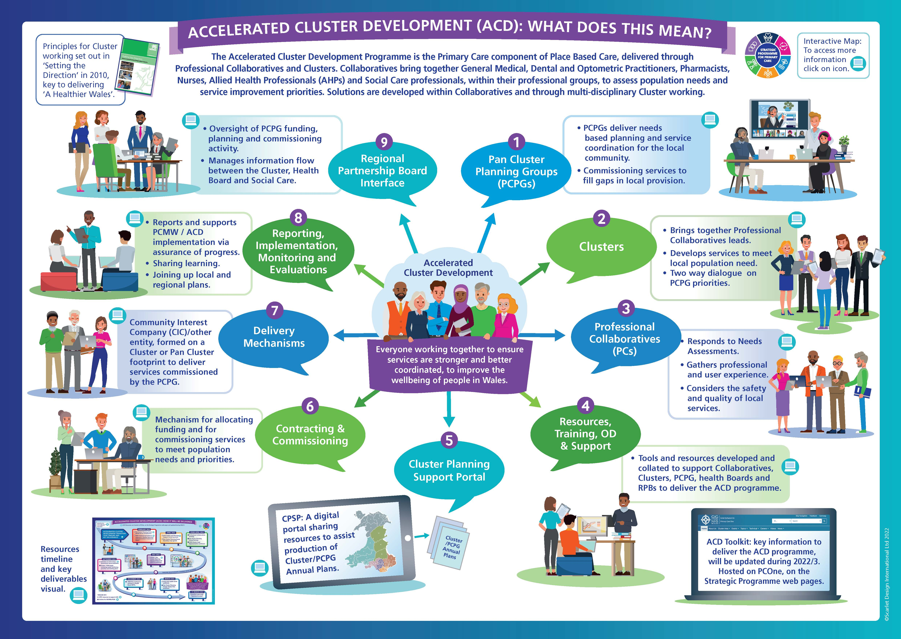

Slide 17





Follow progress and find out more
Email us at : SPPC@wales.nhs.uk
Follow us: @SPPCWales
Keep up to date on our work at : https://primarycareone.nhs.wales/topics1/strategic-programme/
Primary Care One website will host short video talks, programme updates and fact sheets
about the work
Watch videos on our YouTube channel:
https://www.youtube.com/channel/UCdoNfzDbWcnIUVEbxX7XnUg

