Slide 1


Slide 2


What are we going to do?
Discuss and identify the ways that our team has an impact on the environment – positively and negatively
Find ways to ENHANCE positive impacts and REDUCE negative impacts
Write our actions into a planner
Set goals and targets
Monitor and report our progress

Slide 3
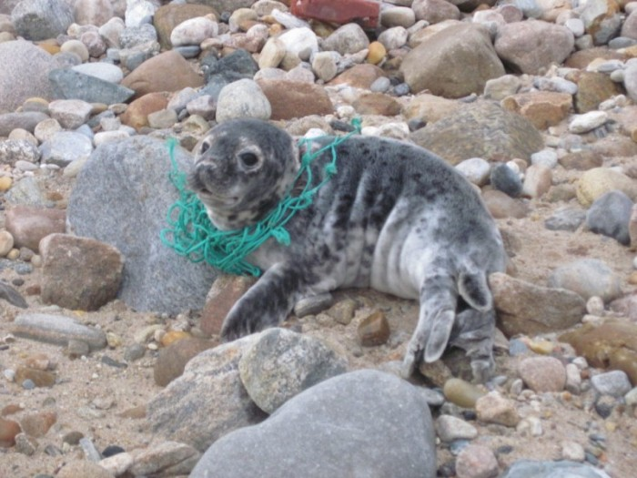
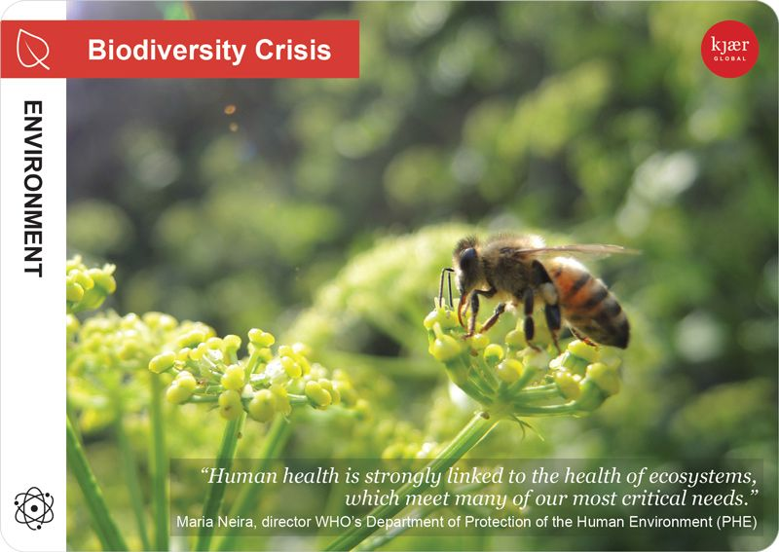
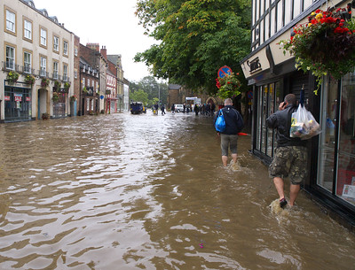


Why are we going to do this?
We have experienced the effects of the COVID-19 pandemic
We have a climate emergency
We have a nature crisis
We have a plastic waste emergency
Our organisation has a legal obligation
We can help ourselves, our families, our employer, our communities, and our planet
What else – why do you think we should do this?

Slide 4
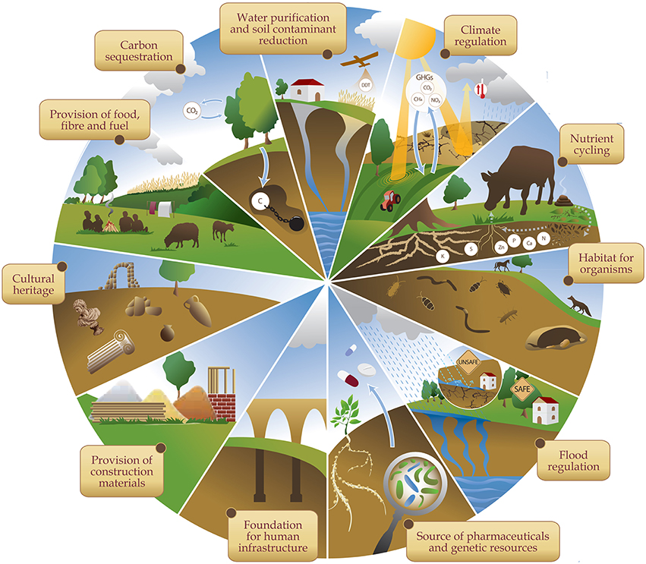
What are our themes?
Our relationship with nature is complex. So, the workshop simplifies things by focusing on three key themes:
Decarbonisation
Biodiversity
Resource Efficiency/ Zero Waste

Slide 5
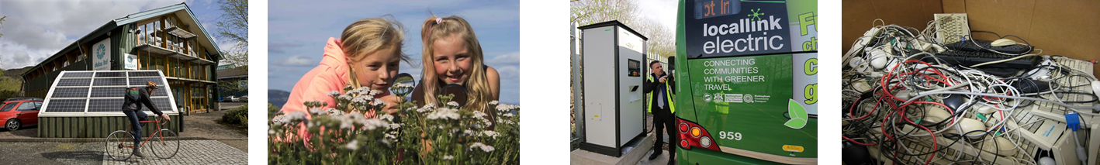
Why these themes?
As a nation and a planet we are facing emergencies in each of the three themes.
These three themes are interlinked
The Welsh, UK, and European Governments, as well as the United Nations have set bold, large-scale targets for each theme
There are legal requirements for the Welsh public sector to address each theme

Slide 6
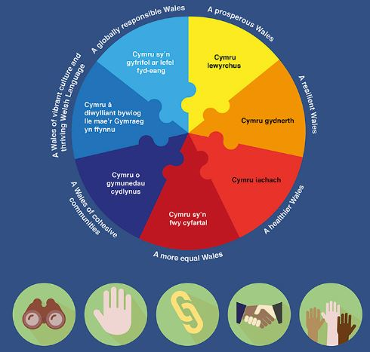
Well-being of Future Generations (Wales) Act 2015
The Act requires 44 public bodies in Wales to deliver seven national well-being goals through five ways of working
Environmental Care and Restoration is a big part of the WFG Act. It recognises that without nature, we cannot thrive.

Slide 7
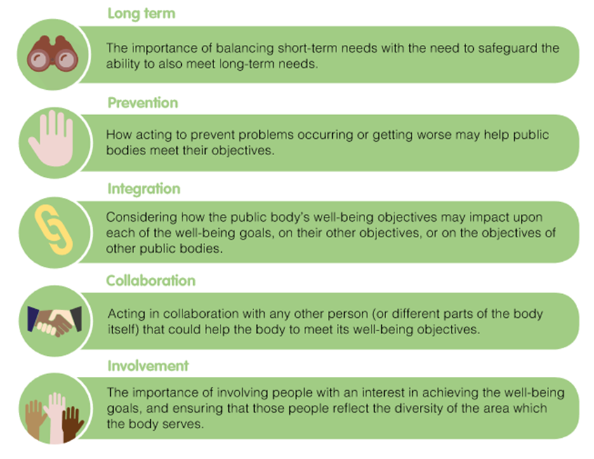
How will we do this?
We will use the five ways of working to think about our impacts on the three key themes – decarbonisation, biodiversity, resource efficiency
Be mindful of how these themes overlap and support each other

Slide 8
Action Planning
We have been provided with a template
Your team will either use or adapt the template, and maintain an ongoing monitoring and reporting system
WORKSHOP GOAL – SET ACTIONS AND FOLLOW THEM UP!

Slide 9

Ground Rules and Advice
• Be present and engaged
• Be honest
• Be empowered to share your ideas
• Listen constructively and be prepared to think differently to usual
• Share all relevant information
• Be timely and concise in your communications
• Understand how to use the meeting technology (and ask if you’re not sure)
• Don’t discount any ideas
• Allow equal space for all participants’ voices to be heard
• Keep jargon to a minimum
We commit to take action as:
Individuals, accepting our personal responsibility
The whole team, providing an example to colleagues
A core component of our organisation’s legal or voluntary compliance practice
Advocates and innovators, seeking the permission from management to go further than the compliance minimum

Slide 10

Let’s start… One World, Three words…
Chose three words to describe how you feel about the natural environment and your relationship with it

Slide 11
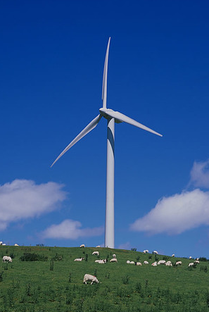
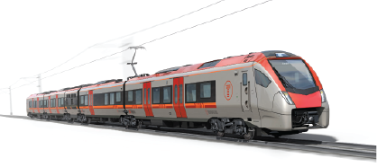
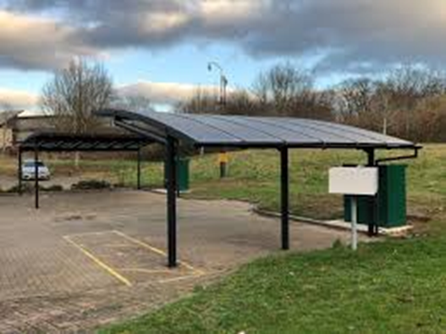
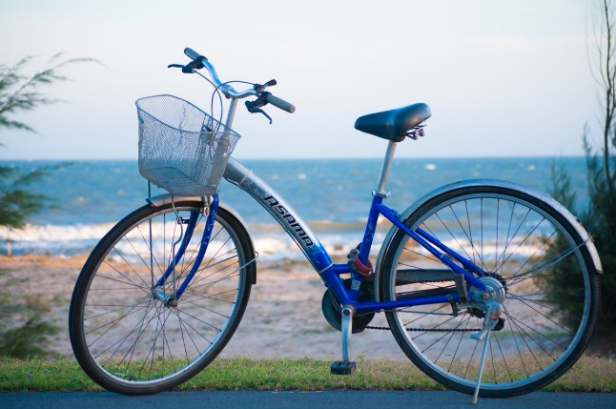
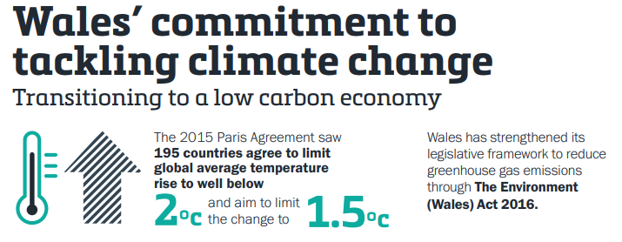
Theme 1 - Decarbonisation (phasing out fossil fuels)

Slide 12
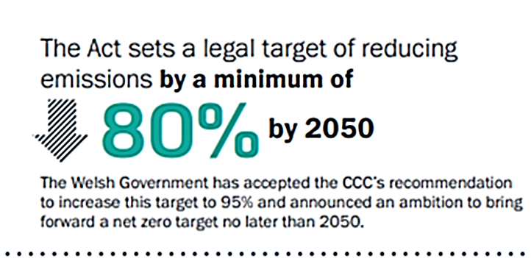
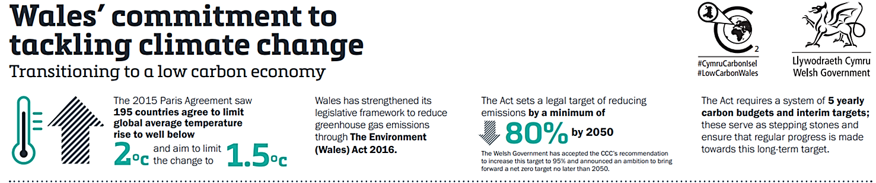
Theme 1 - Decarbonisation (phasing out fossil fuels)
The UK Committee on Climate Change recommended 95% by 2050. Welsh Government has accepted this and committed to achieve a net zero public sector by 2030

Slide 13
Theme 1 - Decarbonisation (phasing out fossil fuels)
Examples to support the discussion:
Travelling to and from work (depending on COVID-19 circumstances): bike, walk, public transport, electric-vehicle, car share: all reduce harmful exhaust emissions
Heating and lighting your home/office: are you doing it efficiently?
Source of electricity: you can choose a green tariff
The food we eat, where and how we purchase it, including packaging
The items we purchase for work: what is their carbon footprint? Are they needed?
The impact of our waste (including during homeworking) on decarbonisation
Impact of carbon emissions on biodiversity, local green spaces, green infrastructure

Slide 14



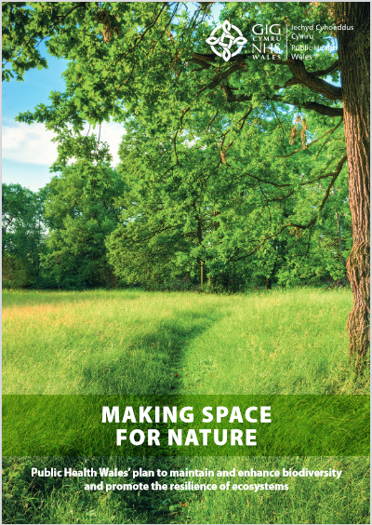

Theme 2. Biodiversity - Reversing the crisis in Nature
Environment (Wales) Act 2016
‘Sustainable management of natural resources’
Section 6 – Biodiversity and resilience of ecosystems duty
‘Seek to maintain and enhance biodiversity and promote the resilience of ecosystems’
‘Embed the consideration of biodiversity and ecosystems into day to day activities, policies, plans, programmes and projects – changing the way we think about acting for biodiversity’
Notes:
http://www.cynnalcymru.com/resource/environmental-volunteering-toolkit/
http://www.cynnalcymru.com/resource/guide-investing-in-nature/
https://phw.nhs.wales/topics/health-and-sustainability/making-space-for-nature-the-public-health-wales-biodiversity-plan/

Slide 15
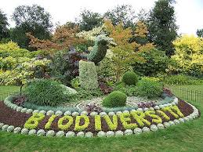
Theme 2. Biodiversity - Reversing the crisis in Nature
Examples to support the discussion:
Site management (home and office) – are we causing the release of harmful substances? Are we providing habitats such as planters, bug hotels, bird boxes/feeders?
Garden management – habitats for hedgehogs, birds, pollinating insects? Are we using chemicals – weed killers, pesticides?
The food we eat – how is it grown, where does it come from, how far has it travelled, how is it packaged?
Paper and office consumables – where do these come from? Are they recycled, or do they have a ‘Forest Stewardship Scheme’ verification mark?
How we travel and the impact on the environment and biodiversity
Volunteering opportunities to improve local green spaces
Engaging with other teams and services

Slide 16

Comfort Break

Slide 17
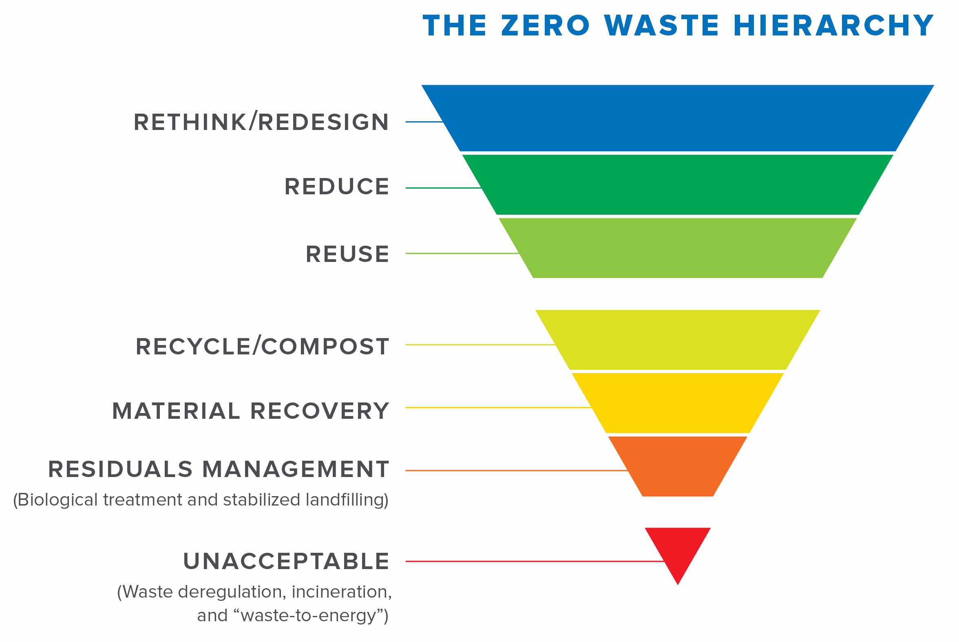
Theme 3: Resource Efficiency / Zero Waste
REFUSE

Slide 18
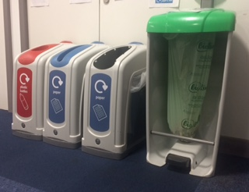
Theme 3: Resource Efficiency / Zero Waste
Examples to support the discussion:
Office consumables: go paperless, no single-use plastics?
Food waste
Procurement practices: minimise waste through terms and conditions of contract
Embed the waste hierarchy (see previous slide)
Think about clothes/uniforms, electrical goods/I.T., cleaning materials, stationery, general waste and recycling
Plastic waste – and how you could make a difference to reduce single-use plastics (or plastic use in general, when there are alternatives)
Garden / land management

Slide 19


Go further…
Are any of our ideas unique and bold?
Could we take things further?
Can we influence others?
How do we make sure that we carry out what we have agreed to do?
Who are we going to tell about all of this?

