Slide 1
School aged HPV resources 2025
Vaccine Preventable Disease Programme
Public Health Wales
July 2025
Notes:
Material contained in this document may be reproduced without prior permission provided it is done so accurately and is not used in a misleading context.
Acknowledgement to Public Health Wales NHS Trust to be stated.
© 2025 Public Health Wales NHS Trust.

Slide 2


Leaflet
Bilingual digital version are available for download on PHW vaccines leaflets page on website:
English website page (English presents first on the leaflet)
Welsh website page (Welsh presents first on the leaflet)
Leaflets are also available to order for free on Health Information Resources website

Slide 3
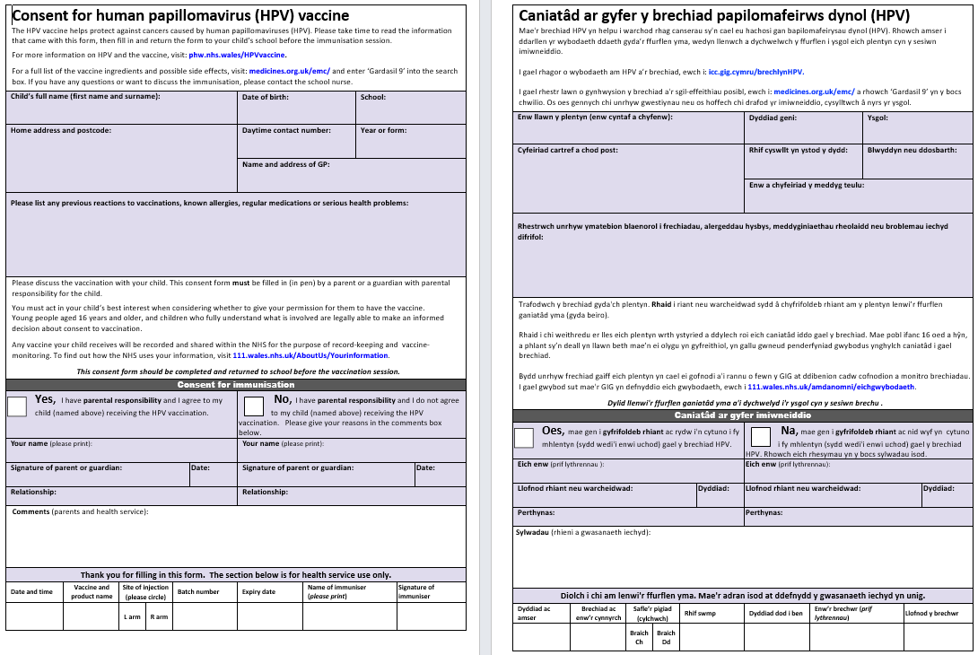
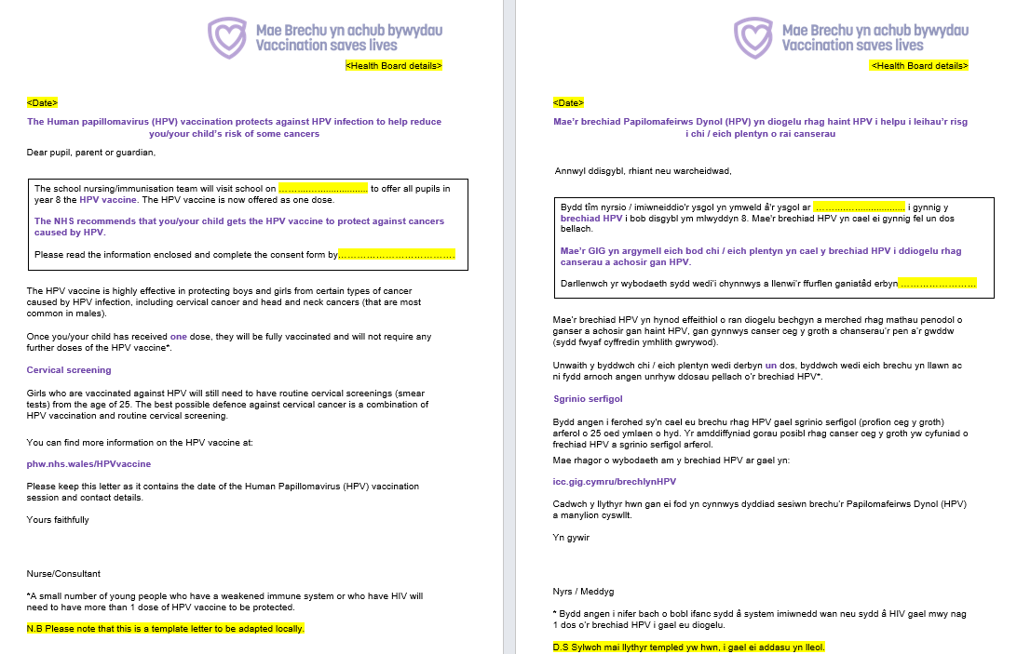
Template letters/consent
The letter and consent form template both include information about self-consent with reference to Gillick competence
Bilingual versions of these templates are available here
Notes:
The consent form directs CYP/parents/guardians to look up ‘Gardasil 9’ for further information about side effects and ingredients.

Slide 4

Briefing document for schools: HPV
This bilingual resource is available here:
English page (English presents first)
Welsh page (Welsh presents first)
It is a digital bilingual document – can be linked to or printed off in health boards
Provides school staff with information about HPV, the HPV programme, why we vaccinate in schools, process, how schools can help, and consent (including Gillick competence)
Feedback from school nurses suggests many are not aware of the suite of briefing documents. Briefing documents are available for all school based programmes and are available from School age children and young people - Public Health Wales.
Please promote Briefing documents as a useful tool for schools

Slide 5

Poster
Stock is still available to order for free on the Health Information Resources website here
Notes:
Available to order here: https://phw.nhs.wales/services-and-teams/health-information-resources/#!/Plant-a-phobl-ifanc-Children-&-young-people/c/161528096

Slide 6
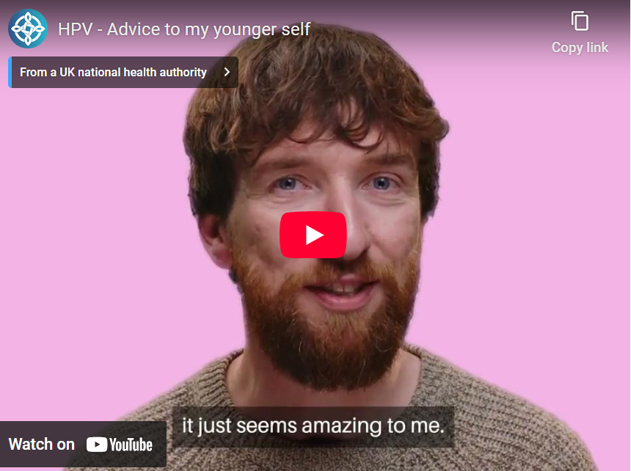
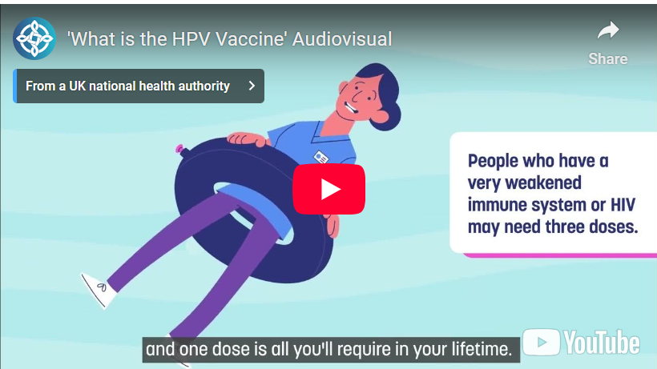
Videos and Animations (1)
Conversations with the public exploring advice to their younger selves regarding the HPV vaccine
An audiovisual explaining ‘What is the HPV vaccine’, available in English and Welsh

Slide 7
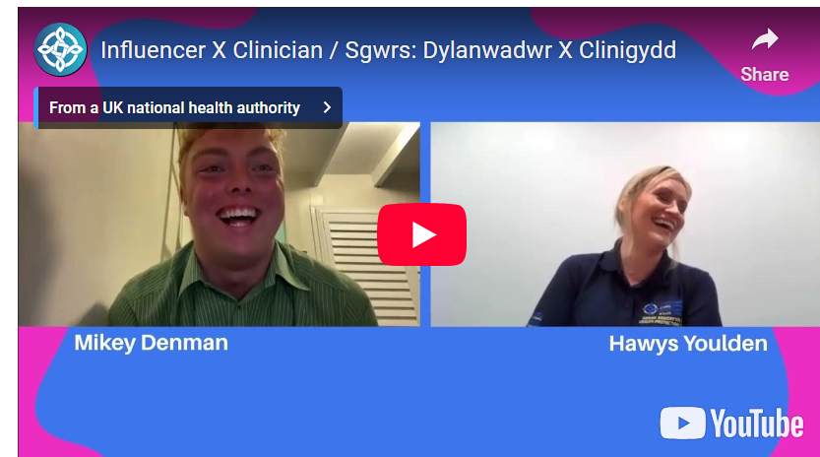
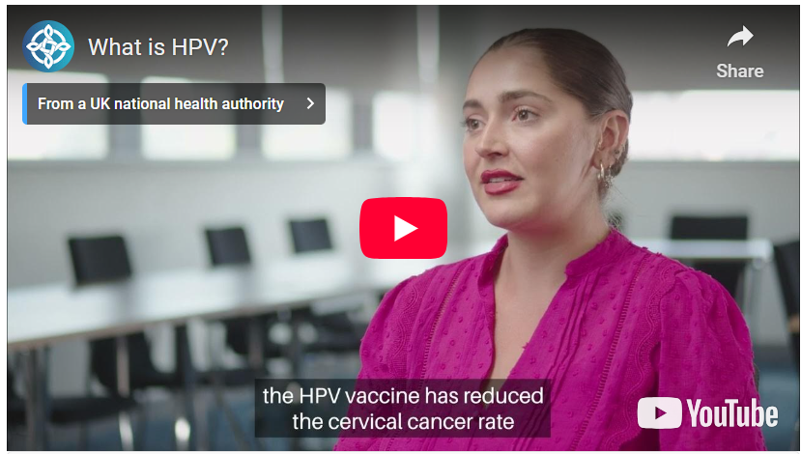
Videos and Animations (2)
Social Media influencer chats with Lead Nurse about HPV and the HPV vaccine
Frequently asked questions about HPV and the HPV vaccine

Slide 8


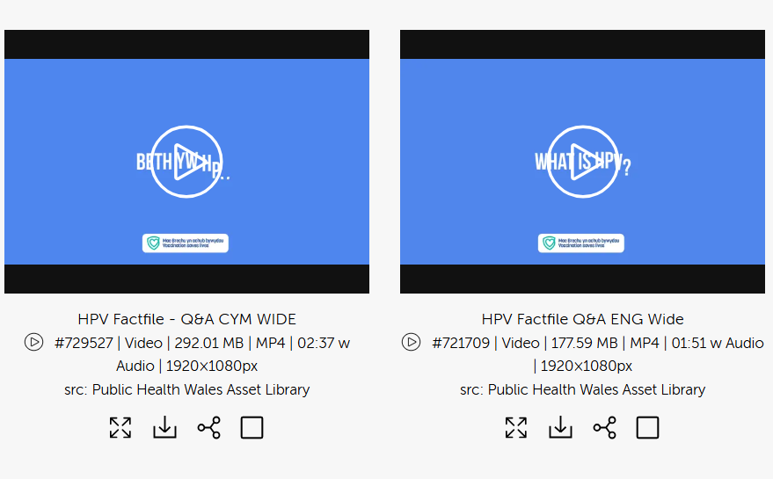
Communications campaign (1)
A number of communications and assets are available for the HPV school aged programme including graphics, images, template social media messages and a toolkit to share with schools that has links to the resources
These are available at the Brandkit Public Health Wales Asset Library here:
Public Health Wales Asset Library (brandkitapp.com) (look for this icon on the right)
Resources can be downloaded for free by registering and creating a free account

Slide 9
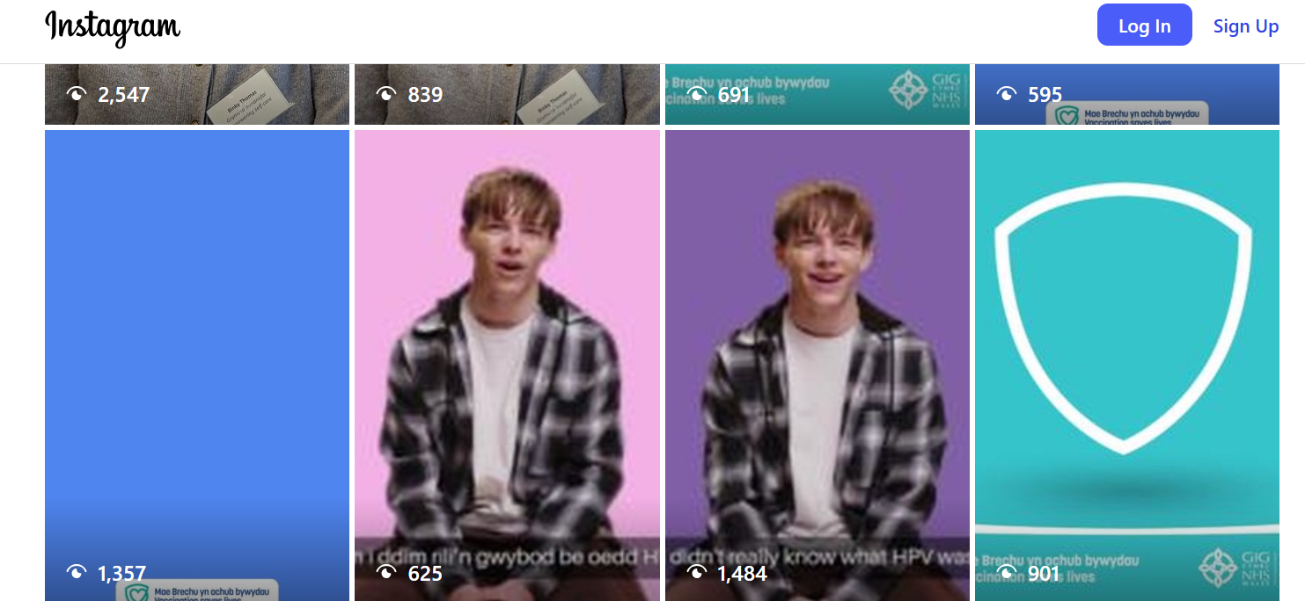
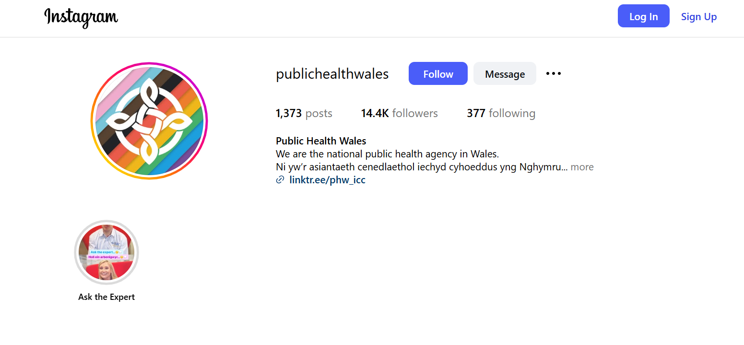
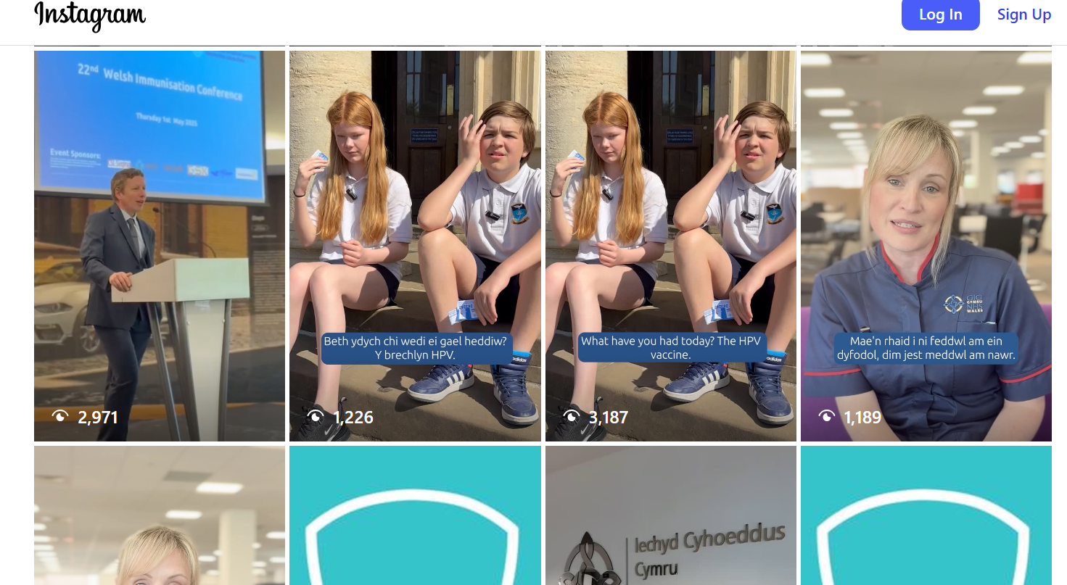
Communications campaign (2)
You can follow Public Health Wales on social media here:
Facebook: Eng | Cym
Instagram: @publichealthwales
LinkedIn: https://www.linkedin.com/company/public-health-wales
TikTok: @publichealthwales

Slide 10
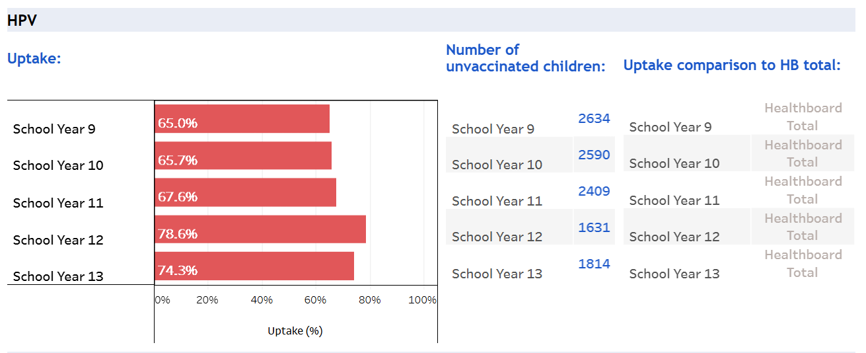
Public Health Wales – School Age Vaccine Data
Dashboard for immunisation data including HPV, MMR, TdIPV and MenACWY uptake is available as school and health board level data
The dashboard is called 'Teenage Immunisation School Level Uptake' and there is a separate link for each HB and then drop down for each school (NHS Wales access required) https://nhswales365.sharepoint.com/sites/PHW_VPDPComms/SitePages/Childhood-Immunisation-(COVER).aspx

Slide 11

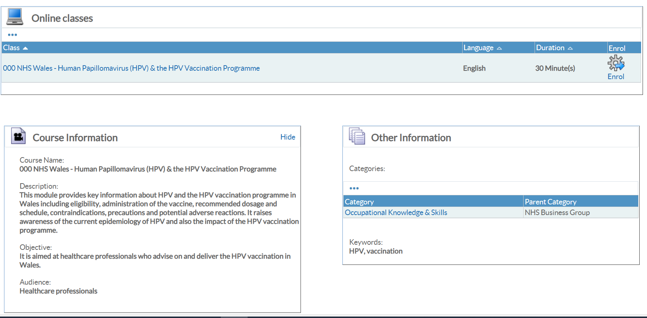
HPV training resources
HPV - Adolescent Vaccination Slideset
E-learning module - HPV and the HPV Vaccination Programme on ESR

Slide 12
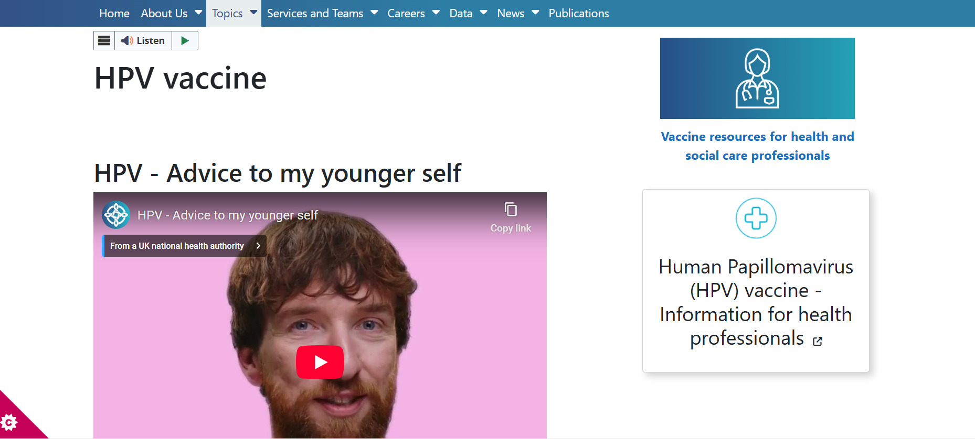
Public Health Wales website
Public Health Wales have HPV specific pages for the public, and for health care professionals delivering the HPV vaccination programme
The public page can be reached by visiting/typing into your web browser
phw.nhs.wales/HPVvaccine
icc.gig.cymru/brechlynHPV
The health care professional page can also be accessed from the public page (see image circled right)
Additional resources on vaccination for health care professionals on vaccination and immunisation in Wales are available at:
phw.nhs.wales/vaccines-professionals and
Vaccine Preventable Disease Programme (VPDP) - Home (sharepoint.com) (NHS Wales access required)

Slide 13

Call to action –Catch-Up programme
Insight gathering
VPDP would like to capture some parental and teenage insights around these planned catch up sessions, to better understand:
Enablers and barriers to attending vaccination appointments
To understand why individuals respond to catch up offers when they missed or delayed routine appointments
To identify barriers and enablers to attending routine school age catch up appointments.
VPDP, PHW evaluation team, PHW Behavioural Science Unit, in collaboration with health board representatives, devised a parental and teenage survey to capture these insights, plus associated resources.
The surveys are intended for parents and teenagers attending for any catch up vaccination not specifically HPV. The anonymous surveys can be accessed via QR codes

Slide 14
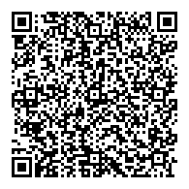
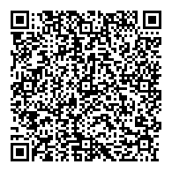
QR codes and Links
Clicwch fi i fynd I’r arolwg Pobl Ifanc:
https://ex.civicamysay.co.uk/EjHdC0xRaHP (Seasneg yn unig)
Click me to go to the Young Person survey:
https://ex.civicamysay.co.uk/EjHdC0xRaHP
Sganiwch fi i fynd i'r arolwg Pobl Ifanc
Scan me to go to the Young Person survey
Clicwch fi i fynd I’r arolwg Rhiant/ Gwarcheidwad:
https://ex.civicamysay.co.uk/BCsDz2h0XY (Seasneg yn unig)
Click me to go to the Parent/ Guardian survey:
https://ex.civicamysay.co.uk/BCsDz2h0XY
Sganiwch fi i fynd i'r arolwg Rhiant/Gwarcheidwad
Scan me to go to the Parent/ Guardian survey

Slide 15

Catch-up programme: Resources
VPDP have also co-designed:
Poster
Postcards to facilitate sharing of the survey QR codes
Both will be circulated as an attachment via email for local printing as soon as they are finalised, and will be made available for ordering from our HIR (Health Information Resources): Health Information Resources - Public Health Wales
Suggested use of the resources
Place posters in waiting areas before vaccination (survey can be completed before vaccine is given)
Print postcards to give to parents/ teenager
Display poster in any post immunisation waiting area.
Immunisation teams may facilitate use of digital equipment / tablets to allow those without IT access to complete form at their appointment.
Immunisation teams may wish to support families to complete survey at the appointment by completing the survey with them.

Slide 16

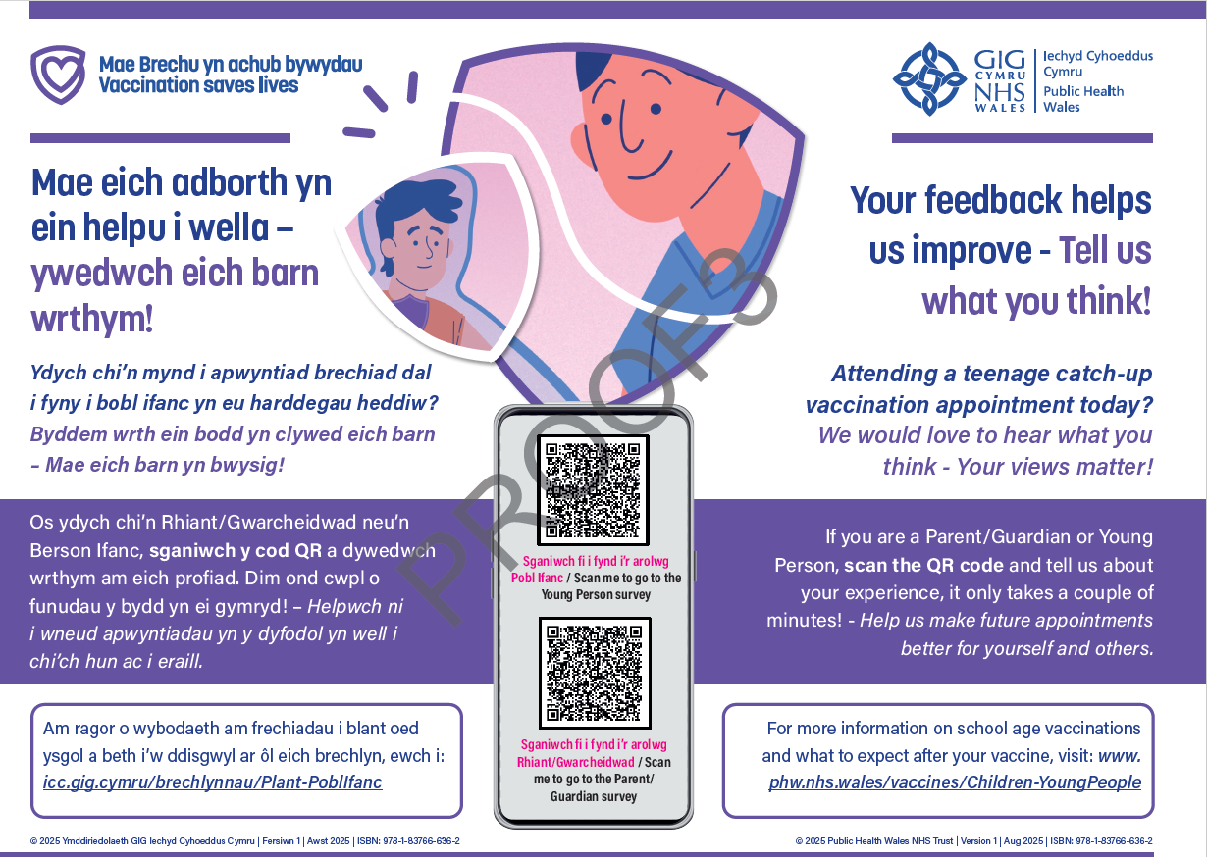
Resource Proofs
Postcard
Poster

