Slide 1
Changes to the Routine Childhood Immunisation Schedule:
Publications and Resources
Vaccine Preventable Disease Programme
Public Health Wales (PHW)
July 2025

Slide 2

This resource has been created to highlight key publications and resources for Healthcare Professionals (HCP's) to support with the changes to the routine childhood immunisation programme
Notes:
Routine immunisationschedulesforWales - Public Health Wales

Slide 3
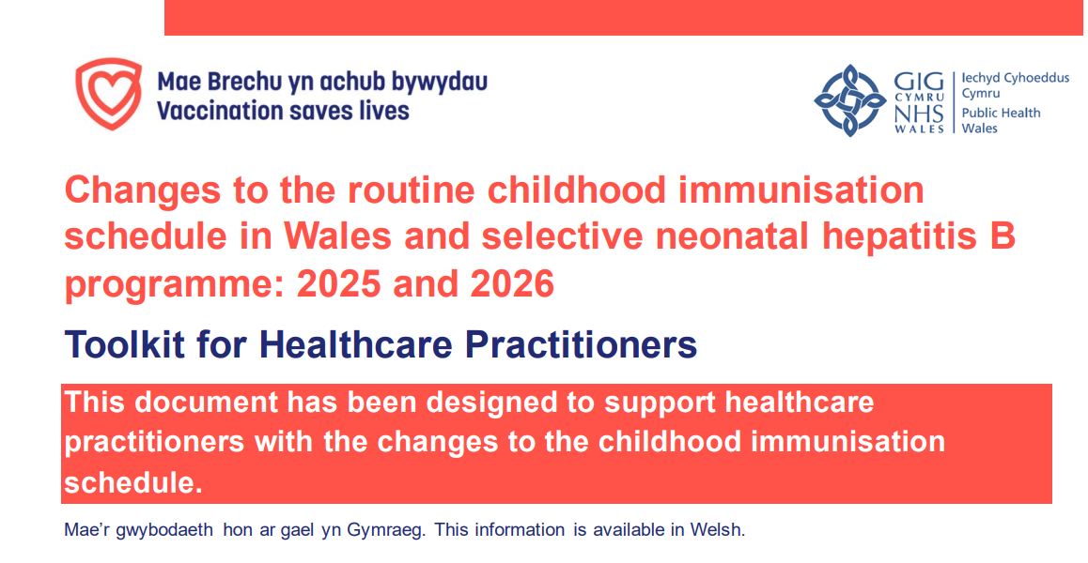
PHW toolkit for the changes to the routine childhood immunisation schedule
The toolkit for the changes to the routine childhood schedule can be found here under 'important information for health professionals'
Designed to briefly outline the changes to the routine childhood immunisation schedule
Contains supporting information on policy, resources and information sessions all on one document
Available in Welsh and English
Notes:
Changes to the childhood immunisation schedule - Information for health professionals - Public Health Wales

Slide 4
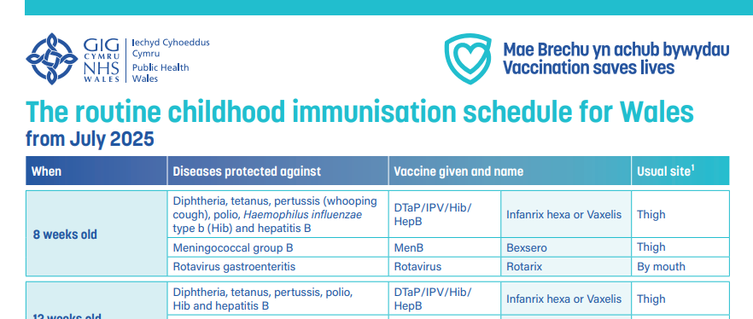
PHW Routine Childhood Immunisation Schedule
The routine childhood immunisation schedule can be found here
Applicable from 1 July 2025
Available in Welsh and English
Notes:
Routine immunisationschedulesforWales - Public Health Wales

Slide 5
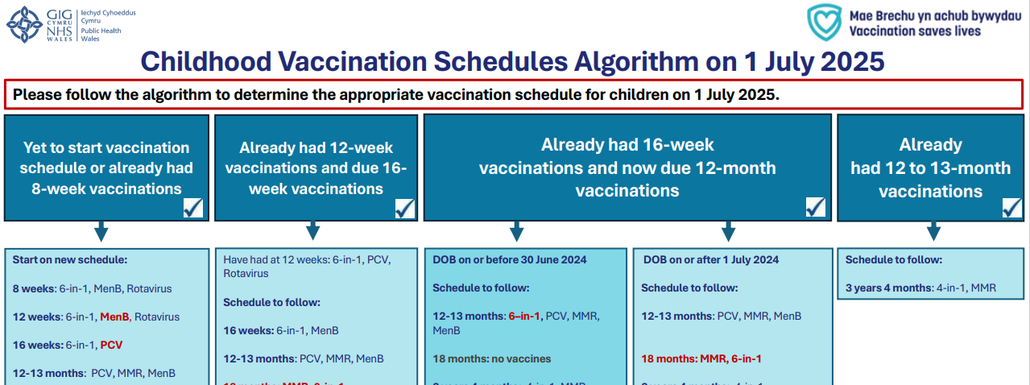
PHW vaccine eligibility tool for healthcare professionals (1)
Assists HCP to determine which vaccines are due and when
Found here under 'which vaccines will be given, and when?'
Downloadable and printable
This tool is applicable to Wales
Notes:
Changes to the childhood immunisation schedule - Information for health professionals - Public Health Wales

Slide 6
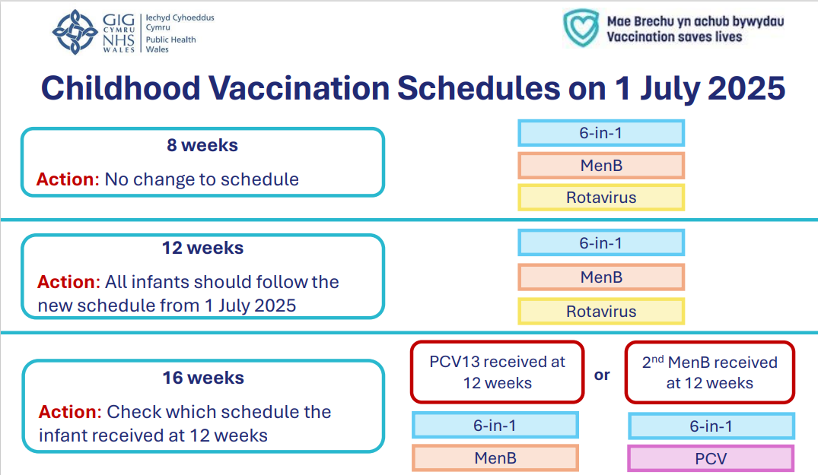
PHW vaccine eligibility tool for healthcare professionals (2)
Assists HCP to determine which vaccines are due and when
Found here under 'which vaccines will be given, and when?'
Downloadable and printable
This tool is applicable to Wales
Notes:
Changes to the childhood immunisation schedule - Information for health professionals - Public Health Wales

Slide 7
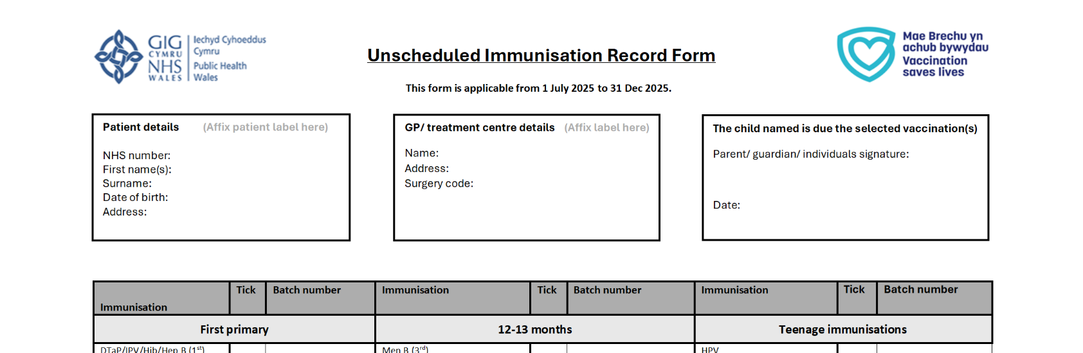
PHW unscheduled immunisation record for General Practice
Applicable from 1 July 2025 to 31 December 2025
The unscheduled forms can be found here, under 'clinical resources and information',
Available in Welsh and English
Downloadable and printable
Notes:
Changes to the childhood immunisation schedule - Information for health professionals - Public Health Wales

Slide 8
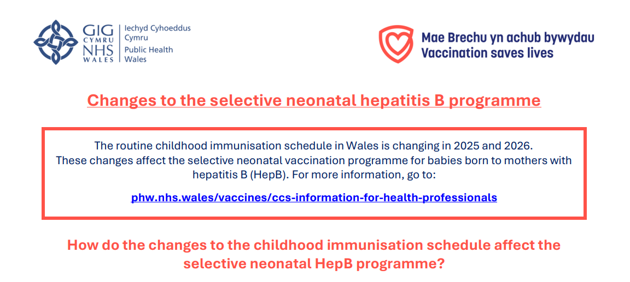
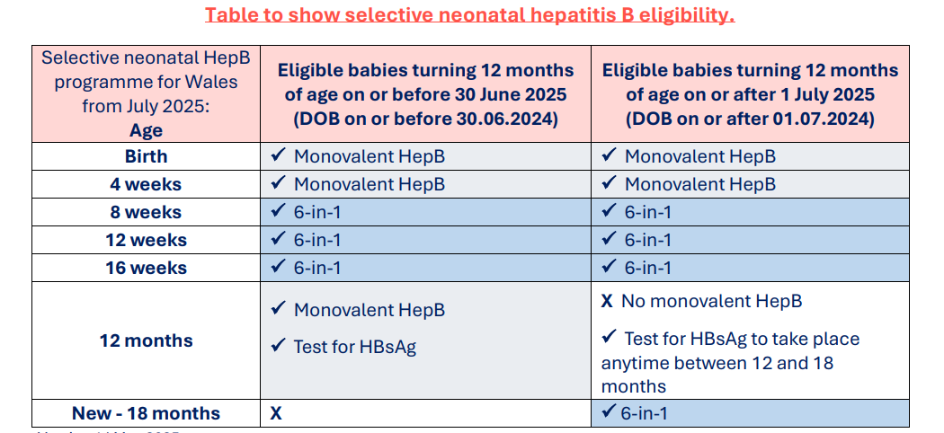
PHW selective neonatal hepatitis B programme information sheet
The information sheet, alongside other information on the selective neonatal hepatitis B programme, can be found here
This information sheet outlines the changes and includes a neonatal hepatitis B vaccine eligibility table
Notes:
Hepatitis B (HepB) - Information for health professionals - Public Health Wales

Slide 9
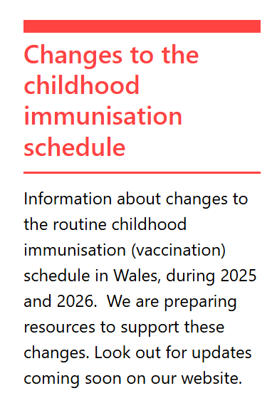
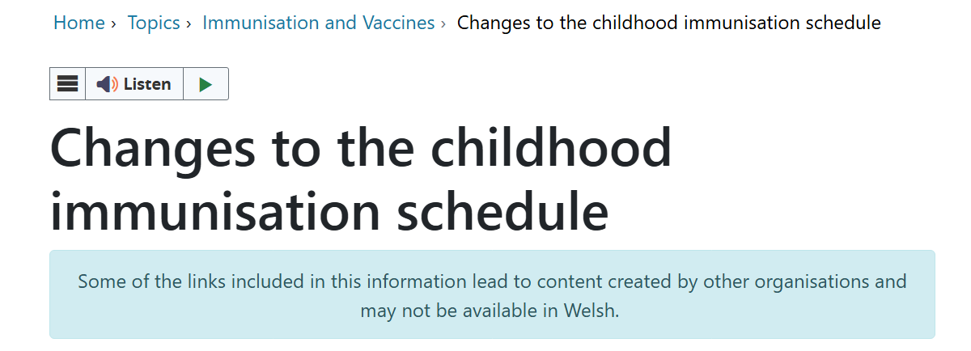
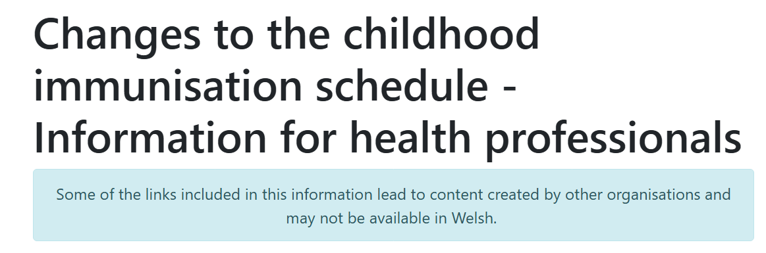
Public and HCP webpages for the changes to the routine childhood immunisation schedule can be found here
PHW public and HCP webpages
Notes:
Health Information Resources - Public Health Wales

Slide 10
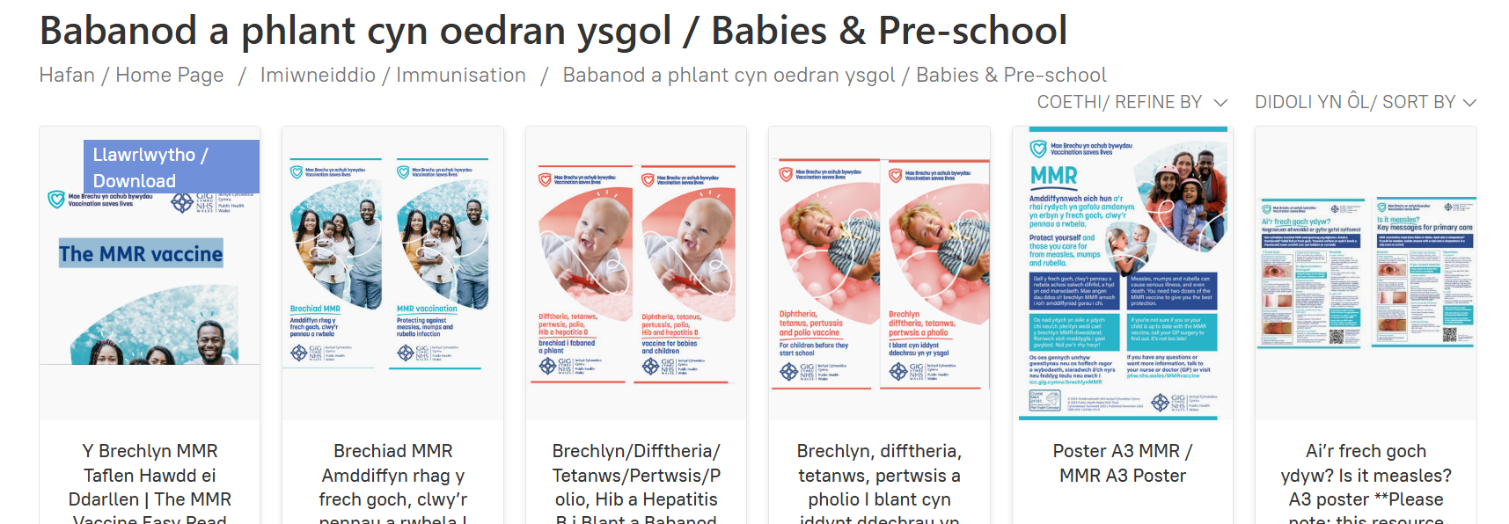
Pre-school leaflets and resources are free to order here
PHW pre-school leaflets and resources
Notes:
Health Information Resources - Public Health Wales

Slide 11
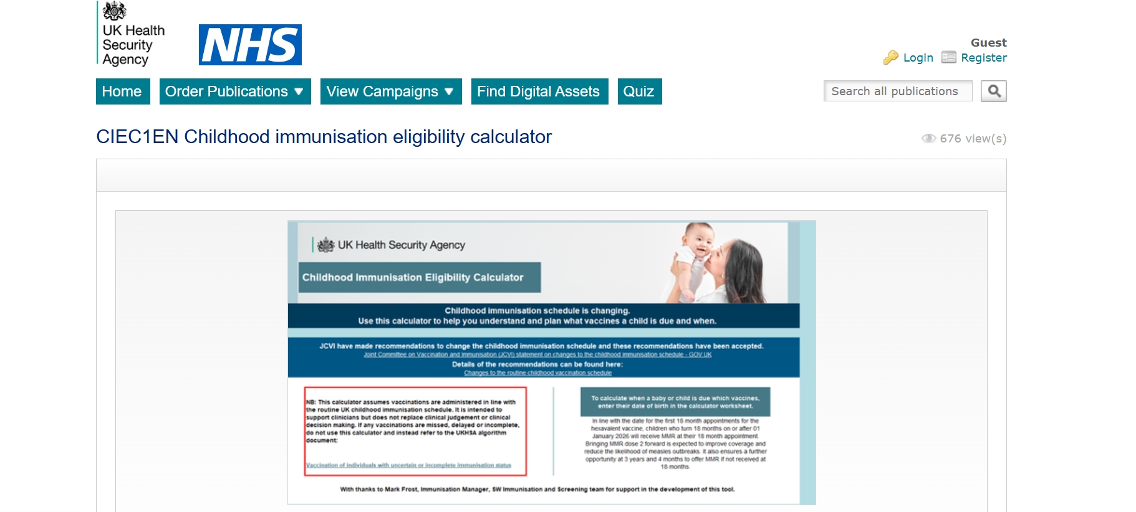
UKHSA Childhood Immunisation Eligibility Calculator
This is a resource produced by the UKHSA, which can be found here (external site)
Please note policy differs between Wales and England, and you are advised to read the Welsh Health Circular before using the calculator
In Wales, since 1 July 2025, the routine Hib/MenC (Menitorix®) offer to those turning 1 year old has stopped; please be aware that England have not issued a hard-stop
Notes:
Childhood schedule changes from 1 July 2025: information for healthcare practitioners - GOV.UK
Changes to routine childhood and selective neonatal hepatitis B vaccinations (WHC/2025/019) [HTML] | GOV.WALES

Slide 12
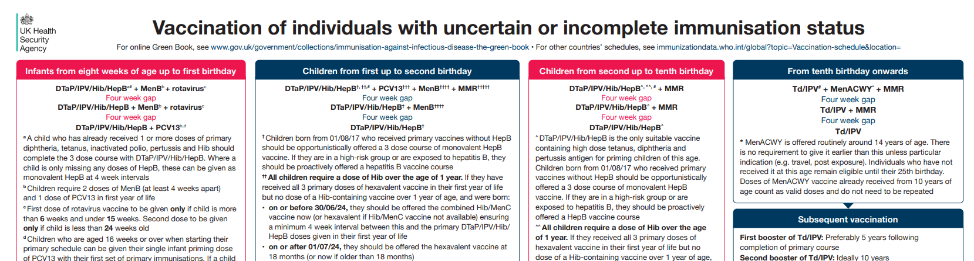
UKHSA uncertain or incomplete immunisation status algorithm
This is a resource produced by the UKHSA, which can be found here (external site)
Please note policy differs between Wales and England, and you are advised to read the Welsh Health Circular before using the calculator
In Wales, since 1 July 2025, the routine Hib/MenC (Menitorix®) offer to those turning 1 year old has stopped; please be aware that England have not issued a hard-stop
Notes:
Vaccination of individuals with uncertain or incomplete immunisation - GOV.UK
Changes to routine childhood and selective neonatal hepatitis B vaccinations (WHC/2025/019) [HTML] | GOV.WALES

Slide 13
Welsh health boards Immunisation & Vaccination contacts can be found here
Vaccine Preventable Disease Programme
phw.vaccines@wales.nhs.uk
Notes:
Vaccine contacts - Public Health Wales

