Slide 1






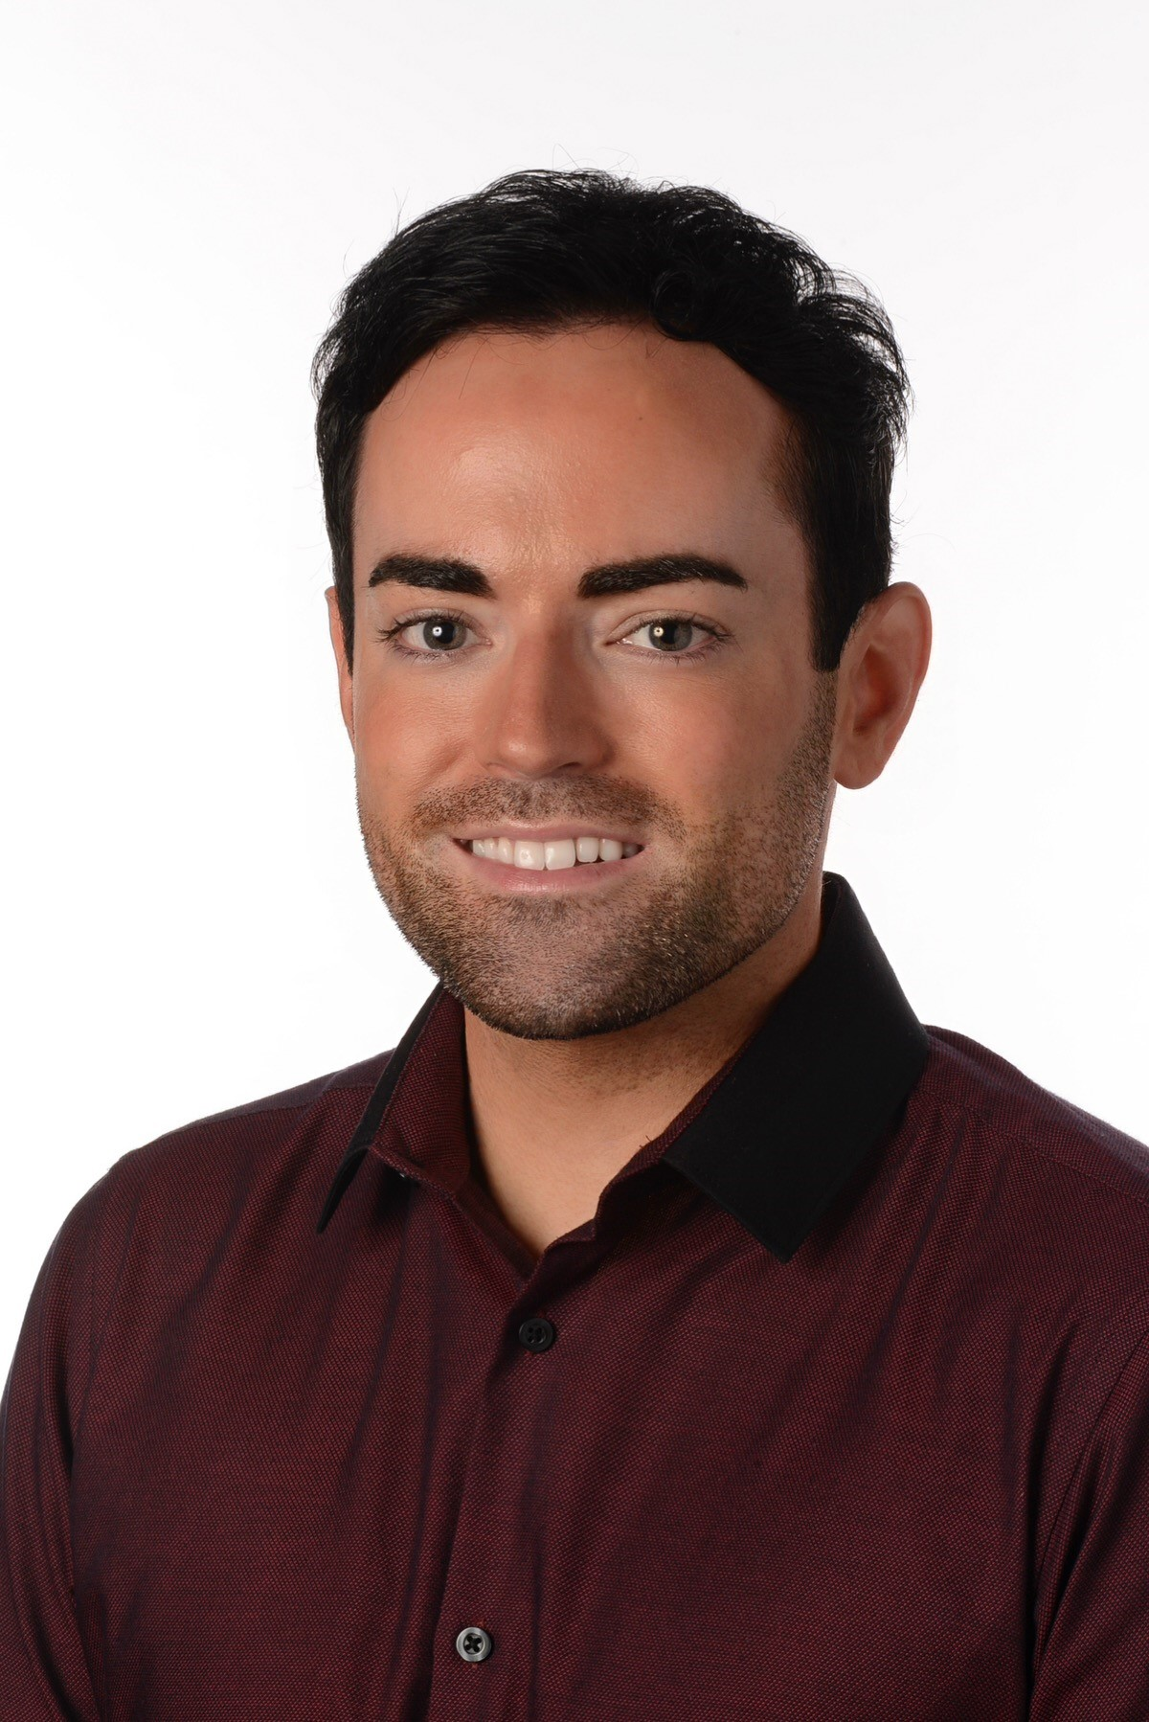
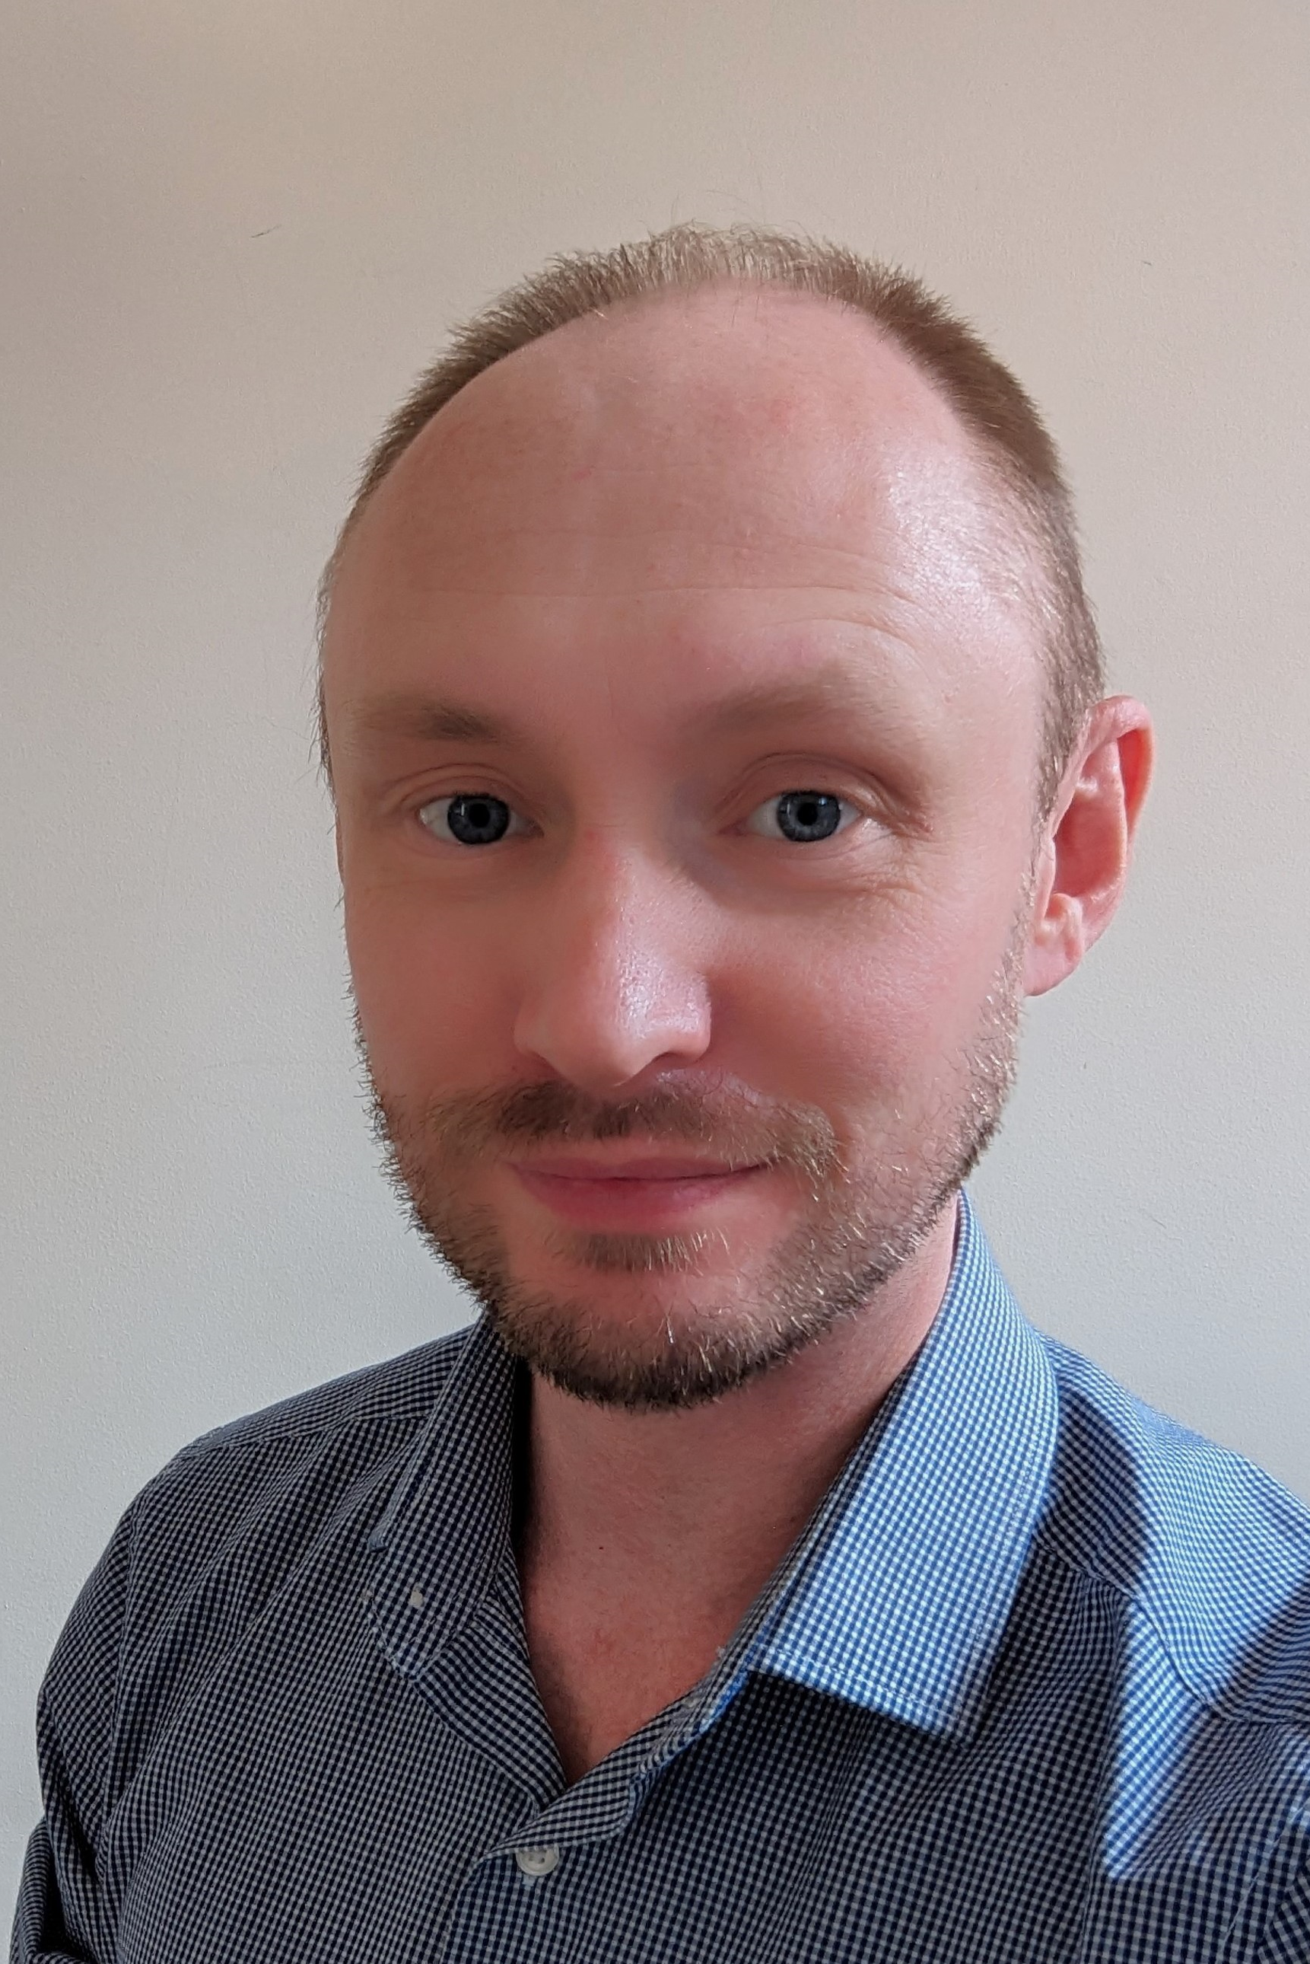
Enfys update
28th September 2023
Enfys co-chair Karl Whitcombe
PMO Manager, Strategy and Planning
Karl.whitcombe3@wales.nhs.uk
Pronouns: He/Him
Enfys co-chair Graham Brown
Consultant in Public Health, Screening
Graham.Brown@wales.nhs.uk
Pronouns: He/Him
Notes:
Introduce ourselves
Karl –Hello my name is Karl The LGBTQ+ community is a fundamental part of my life; I strive for inclusion and awareness. The network is a safe place, where LGBTQ+ staff and allies can connect and support.
Graham – intro and why we are network chairs

Slide 2
Who we are and what we do Enfys’ Purpose & Vision
Public Health Wales’ Enfys LGBTQ+ Network is an inclusive employee network open to Lesbian, Gay, Bi, Trans, Non-Binary, Intersex, Queer and diverse people and their Allies​​​. We strive to provide a supportive, inclusive, safe and confidential space for all LGBTQ+ staff including marginalised and underrepresented LGBTQ+ people, to meet, share and discuss views, experiences or concerns.
Members, regardless of sexual orientation, gender identity and gender expression, should feel empowered to perform to their fullest potential and their contributions valued in Public Health Wales, both within and outside of network activities. We represent our staff to ensure under-represented voices across the organisation are lifted and used as a catalyst for positive change.
At Public Health Wales, we want to ensure it is an organisation that is a safe space for you to be your authentic self at work and that is does not tolerate homophobia, biphobia or transphobia, and every member of the network and all staff champion allyship to ensure people’s lived experiences are valued and respected.
76 Enfys members
Public Health Wales
Enfys Update 2023
Notes:
Graham slide

Slide 3

Aspirations for the Network Co-Chairs aims
Building on excellence
Croeso i pawb / Welcome to all
Safe place – Where LGBTQ+ staff & allies can connect and provide peer to peer support, share lived experiences
Capture improvements & new ideas ‘You said, we did’
Share & raise awareness of LGBTQ+ issues, events/activities
Increase membership with LGBTQ+ staff and allies
Be a critical friend to Public Health Wales
Public Health Wales
Enfys Network
Notes:
Thank previous chairs
As new co chairs our aspiration for the network.
Building on the excellent work of the already established network…
LGBTQ+ and allies feel welcomed and seen, safe place to connect, network and shared lived experience
Capture improvement, new ideas, issues.
Share info on LGBTQ+ activities. events knowledge
Be a friend to PHW, ensuring LGBTQ+ voices are heard.

Slide 4

Looking back 2022/23
Enfys Bear competition, which raised £120 for LBGT+ Cymru Helpline – Oct 22 – Dec 22
Trans awareness raising session with Kate Hutchinson – Nov 22
Asexuality and people of colour awareness raising session with Yasmin Benoit – April 23
International Day Against Homophobia, Transphobia and Biphobia News Story – Published May 23
Pride Events 2023 – Swansea (April), Pride Cymru Cardiff (June), 1st Merthyr Pride (August)
New Co Chairs, ‘Getting to know you survey’ – June & August 23
Non-Binary awareness raising event with Kay Dennis to highlight the experiences of non-binary people – July 23
Updated ToR in line with new chair appointment – July 23
Network work meetings change to every 6 weeks – September 23
Enfys LGBTQ+ Network Quiz – September 23
Public Health Wales
Enfys Update 2023
Notes:
Karl - Talk about speakers
Thank Tracey for attending pride, senior support.
Quiz – Queer Emporium community charity.

Slide 5

Looking forward 2023/24
Launching ‘LGBTe a coffi+’ break sessions in between network meetings – 23 Oct 23
Bi Visibility Day Event - Navigating the asylum system: bisexual forced migrants with Rania Vamvaka – Sep 23
International Pronouns Day – 18th Oct 23
Theatre trip – ‘Social networking event for members to see ‘Everyone’s Talking About Jamie’ - Oct 23
Enfys Bear Competition, in association with the Women’s Network, fundraising for Women’s Aid Cymru, Trans Aid Cymru and Glitter Cymru – 23 Oct-Dec 23
‘Can I call you that?’ In collaboration with REACH network – Nov 23
Trans Day of Remembrance - we will publish a News Story in honour of trans people whose lives were lost to anti-transgender violence – 20th Nov 23
Submit to Stonewall Workplace Equality Index 2024 – Nov 23
LGBT+ History Month - 23 Feb 2024
Pride Month – June 24
Pride Cymru – 22nd June 24
Presence at Pride events an intersectional approach – attend one in North Wales, Glitter Pride (BAME LGBTQ+ people) and Trans Pride Cymru
Public Health Wales
Enfys Update 2023
Notes:
Graham
LGBTe a coffi encourage networking and discussion on lived experience. Build on this to a possible social event.

Slide 6
Enfys next steps Executive 4 ASKS
Reverse mentoring opportunities for exec team
For execs to attend external LGBTQ+ conferences, events and seminars so they understand experiences of the community
Attend internal awareness raising events sessions to understand experiences of the community and demonstrate allyship
We would love a new Executive Sponsor for Enfys!
Public Health Wales
Enfys Update 2023
Notes:
3 asks – notes
Point 1 – we’d love for our new exec sponsor (when we have one) to be part of this mentoring programme. If they ask about how this programme will be developed, say we have a bunch of best practice we can refer to from other orgs but will work with L&D to develop this within PHW and that all networks have the opportunity to be part of this.
Point 3 – opportunity to understand the experiences of diverse people within the community. Also demonstrates to staff that you want to learn about these experiences by seeing you there.
Reverse Mentoring –
Why this -Allows senior executives to better understand issues LGBTQ+ employees face Identify barriers to progression for LGBTQ+ employees Develop actionable solutions for progress Gives LGBTQ+ talent opportunity to influence senior leaders’ thinking
Why now - Progress is not a given; rights can be taken away Vocal media opposition to trans rights Regressive policies being enacted in some countries
Why us - Senior allies are key to improve diversity and inclusion LGBTQ+ employees offer unique insights We are all culture carriers
One in four trans people aren’t open to anyone at work about being trans
More than a third of LGBTQ+ staff have hidden that they are LGBTQ+ at work for fear of discrimination
2. For execs to attend external LGBTQ+ conferences so they understand experiences of the community
= As well as Pride events, insightful events, such as Welsh Gov LGBTQ+ action plan for Wales conference updates. Lived experience.
3. = Come along to Enfys meetings and socials, such as LGBTe a Coffi session.

Slide 7
Gweithio gyda'n gilydd i greu Cymru iachach Working together for a healthier Wales

