Slide 1
Wales Public Health Rapid Overview Dashboard
As at 20th March 2023
This slide deck is not for onward sharing without permission from PHW

Slide 2
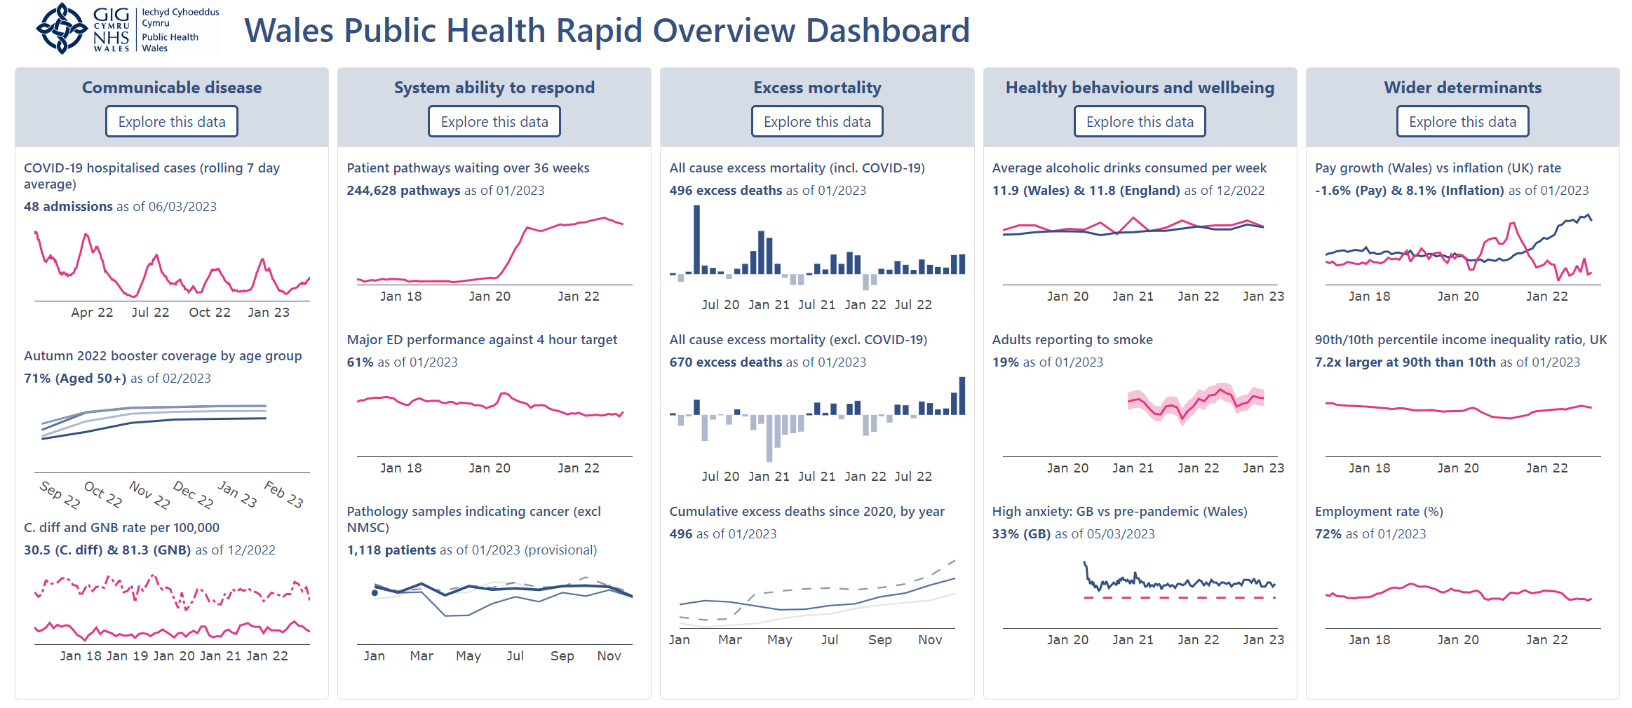
Cockpit view

Slide 3
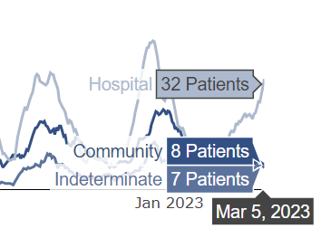

Communicable disease
Latest figures

Slide 4
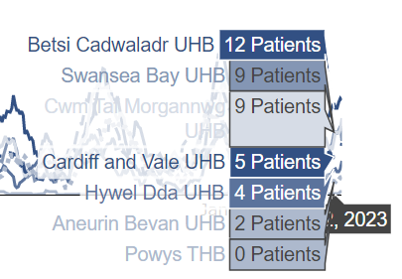
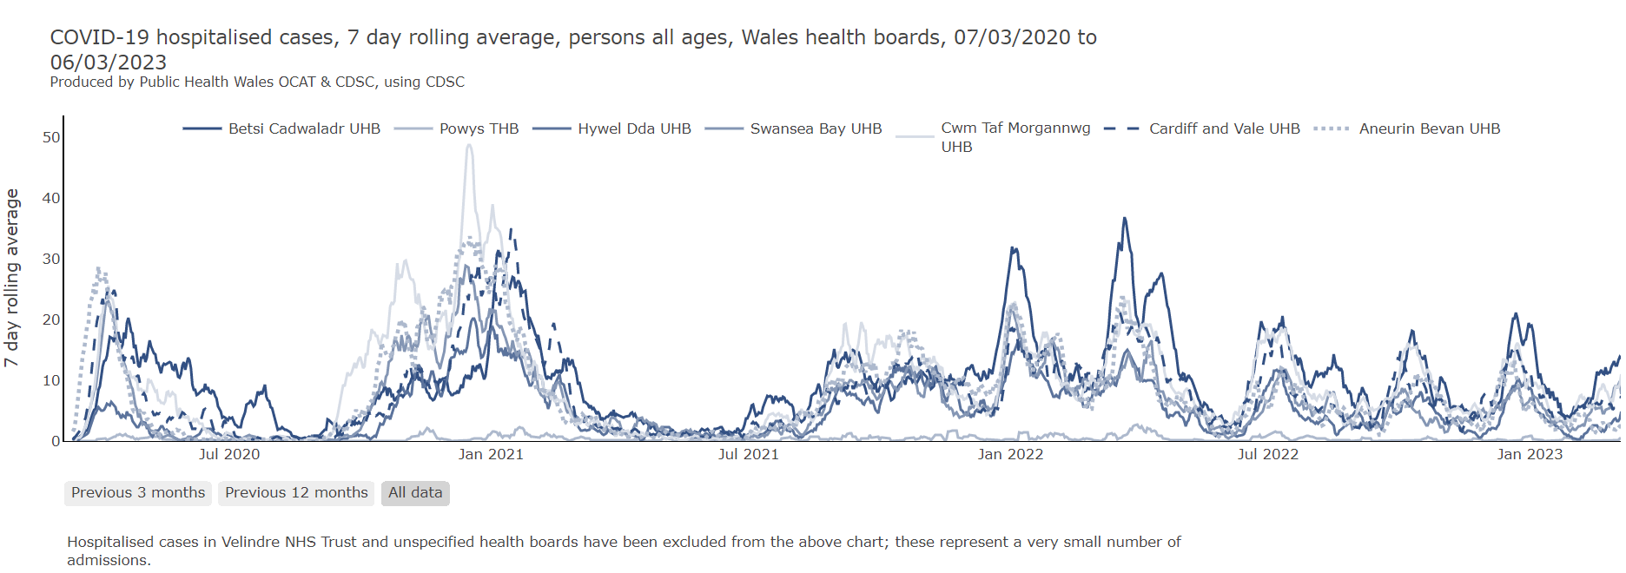
Latest figures
Communicable disease

Slide 5
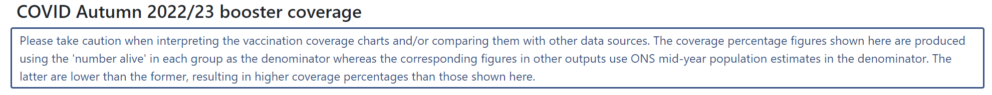
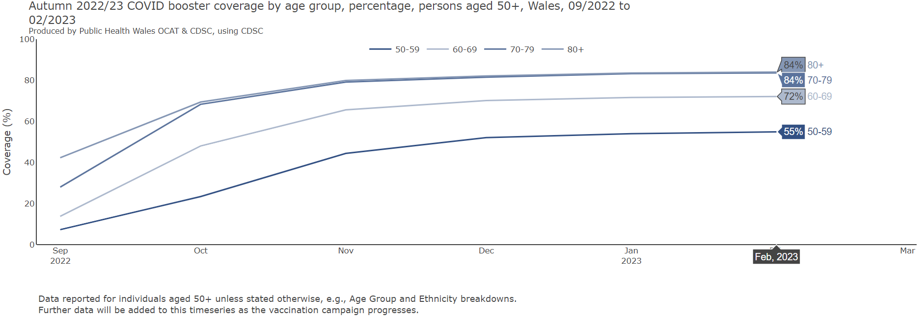
Communicable disease

Slide 6
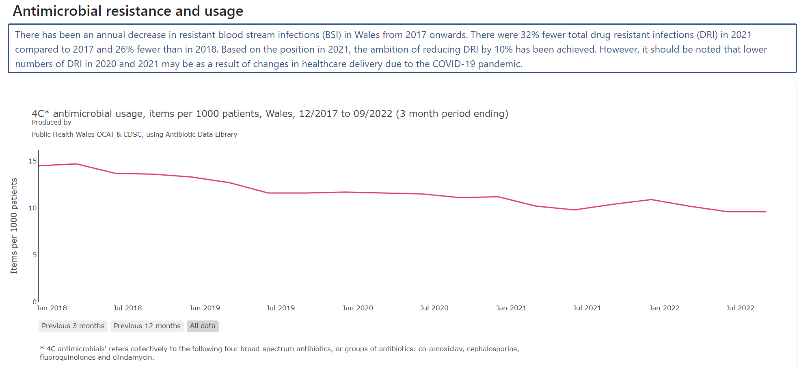
Communicable disease

Slide 7
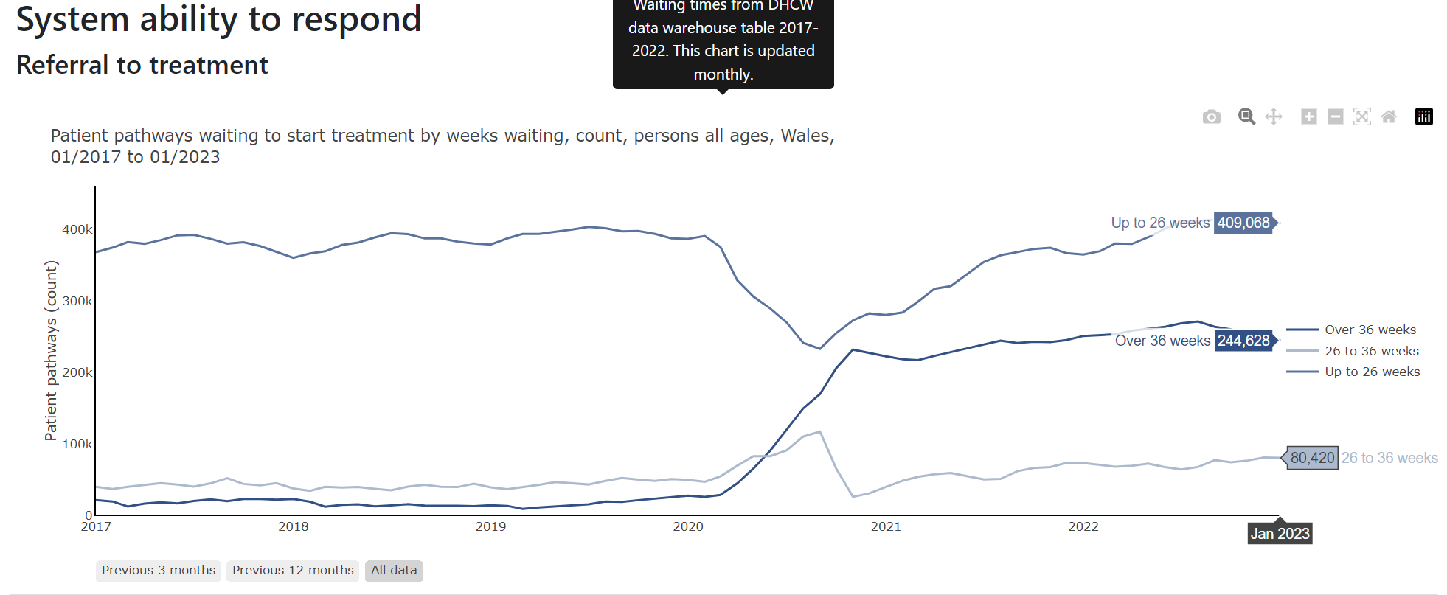
System ability to respond

Slide 8
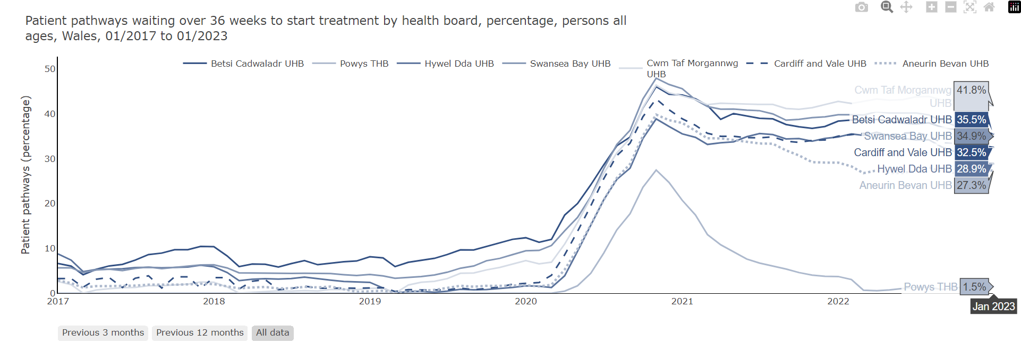
System ability to respond

Slide 9
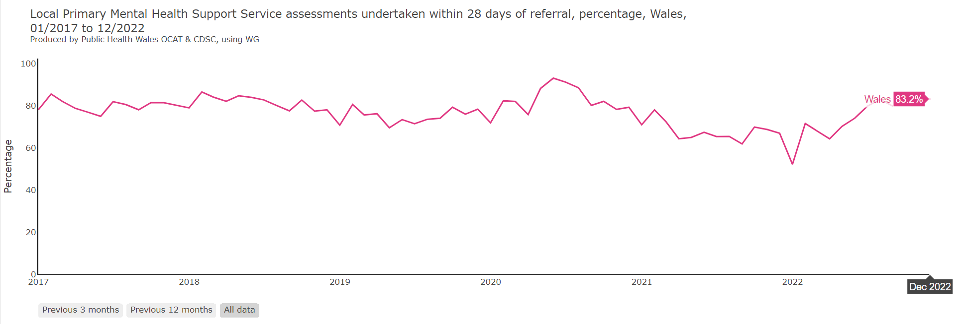
System ability to respond

Slide 10

System ability to respond

Slide 11
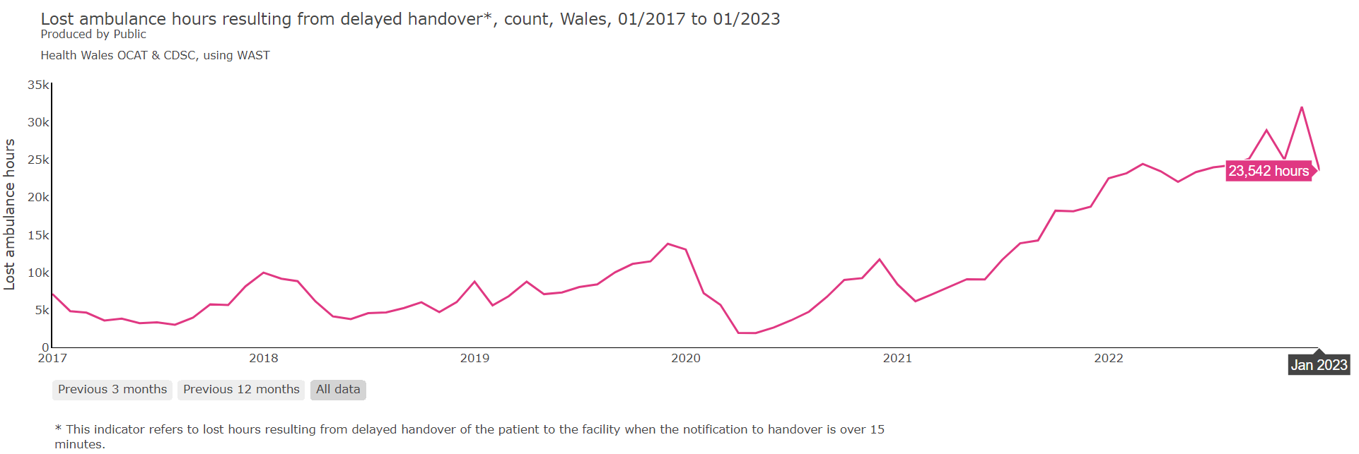
System ability to respond

Slide 12
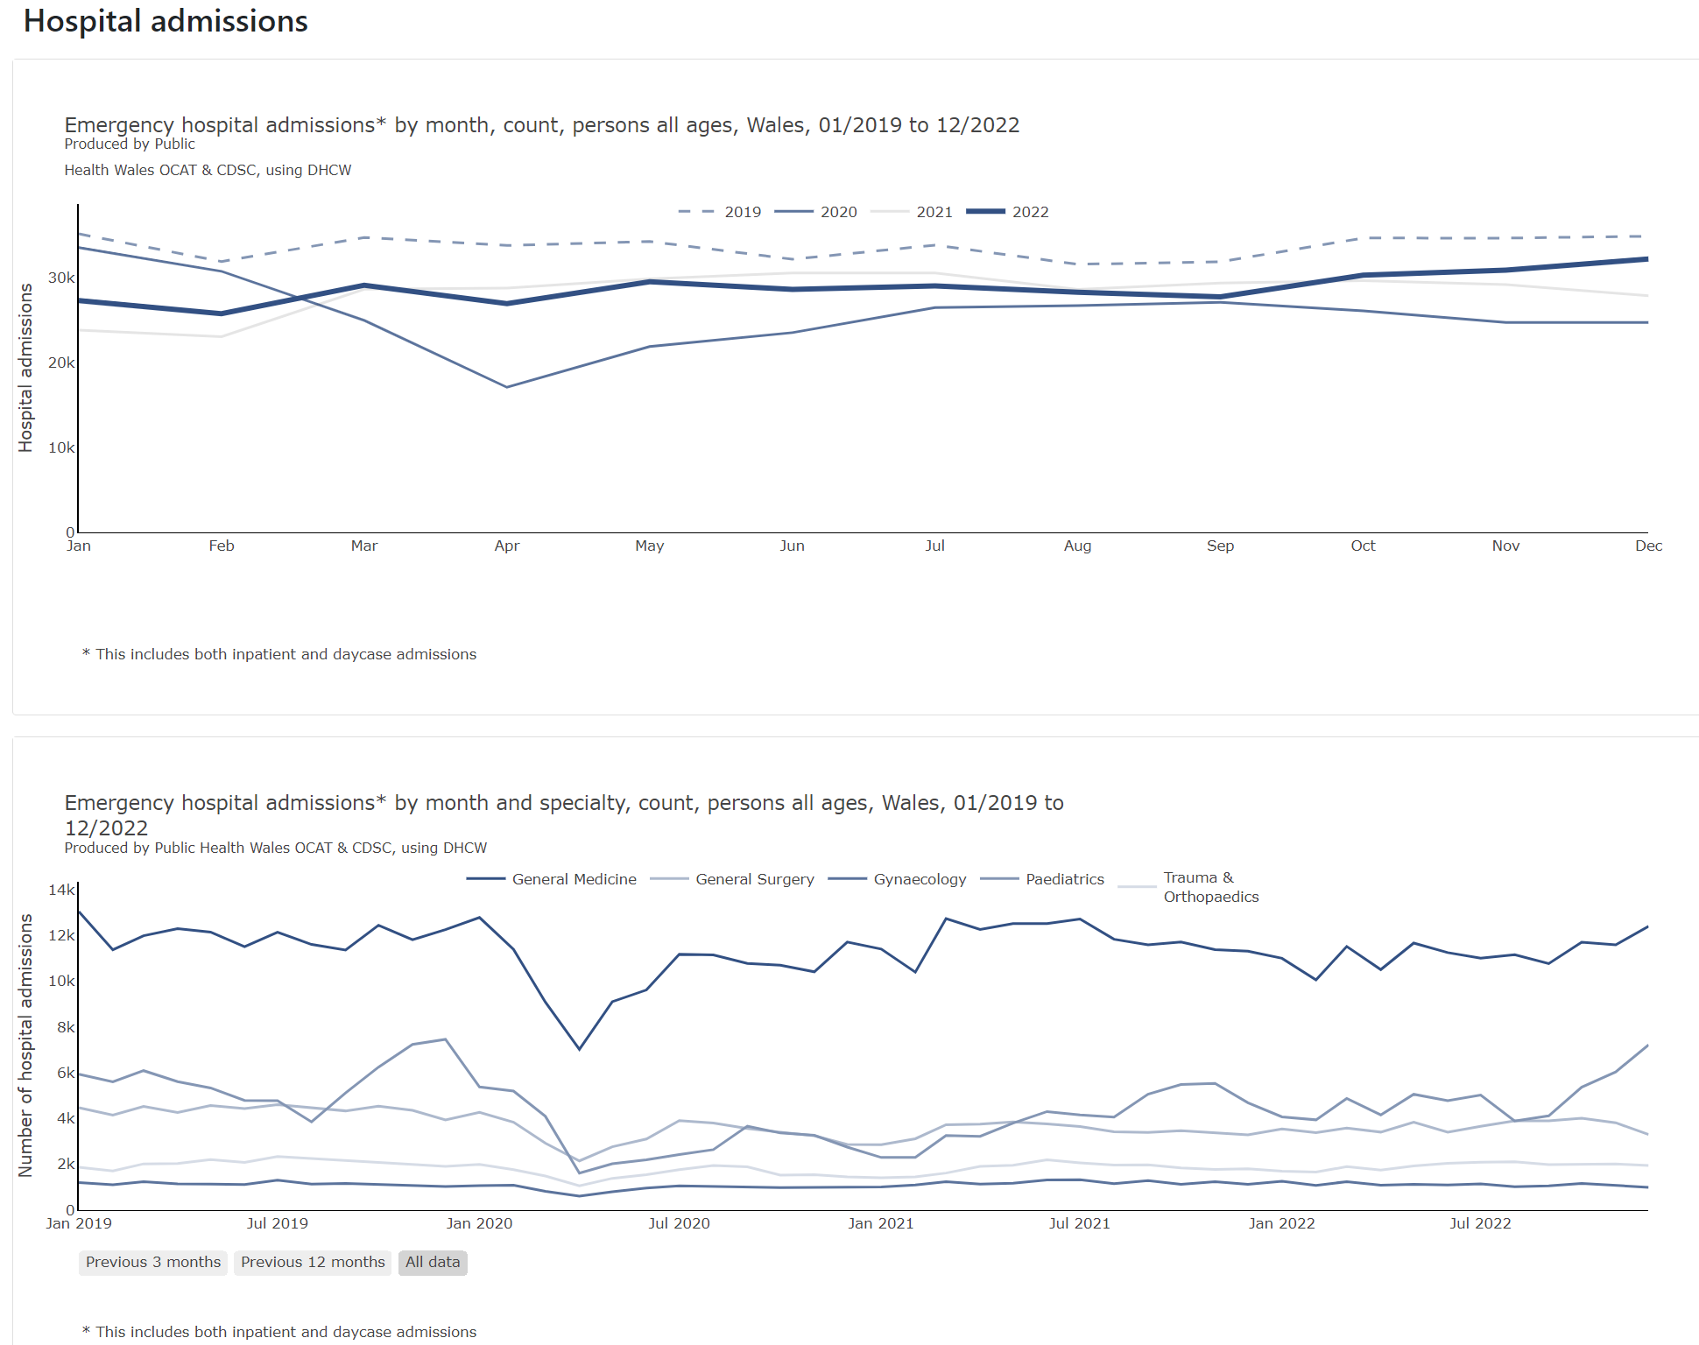
System ability to respond

Slide 13
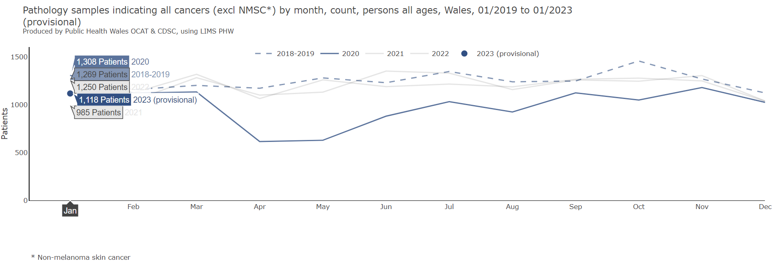
System ability to respond

Slide 14
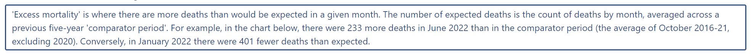
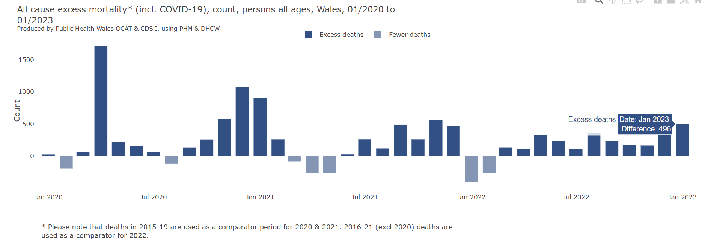
Excess mortality

Slide 15
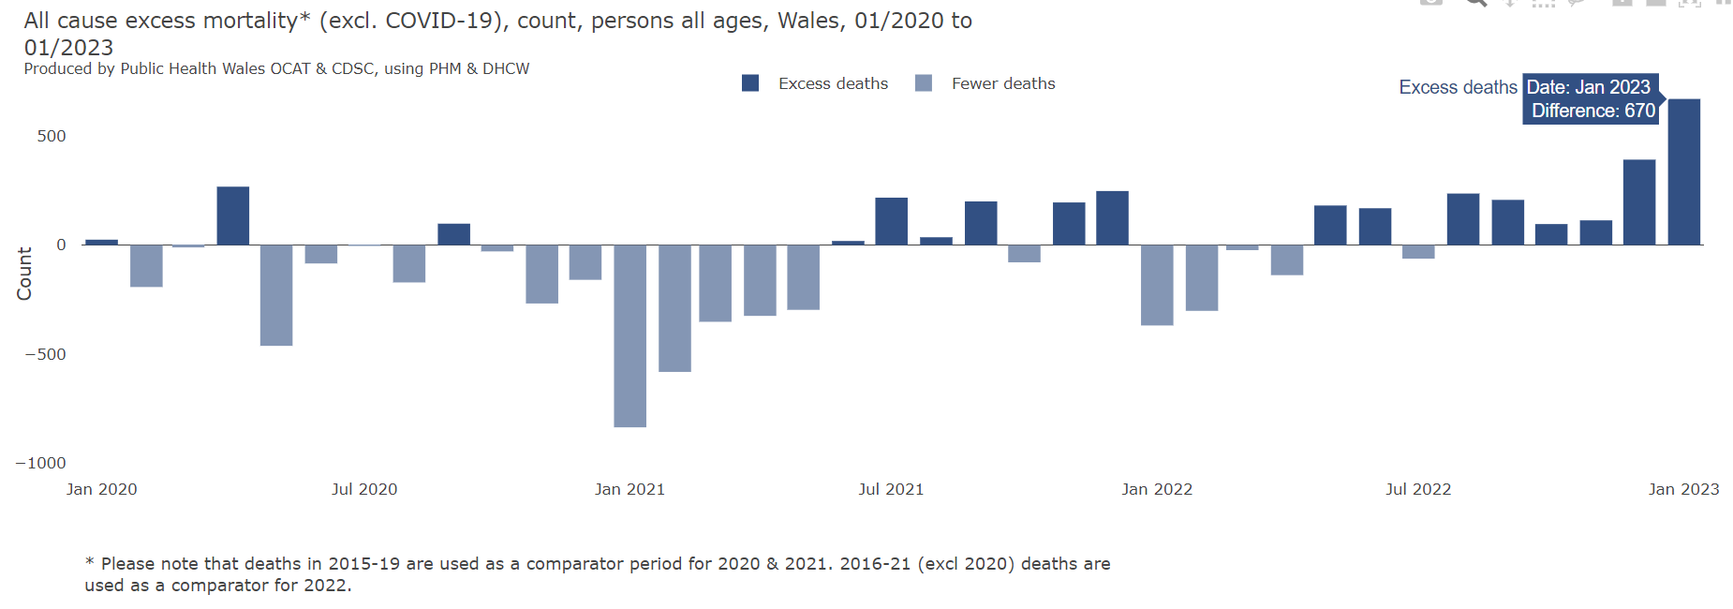
Excess mortality

Slide 16
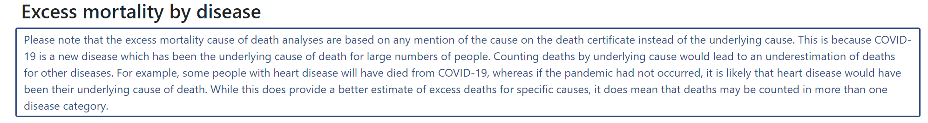
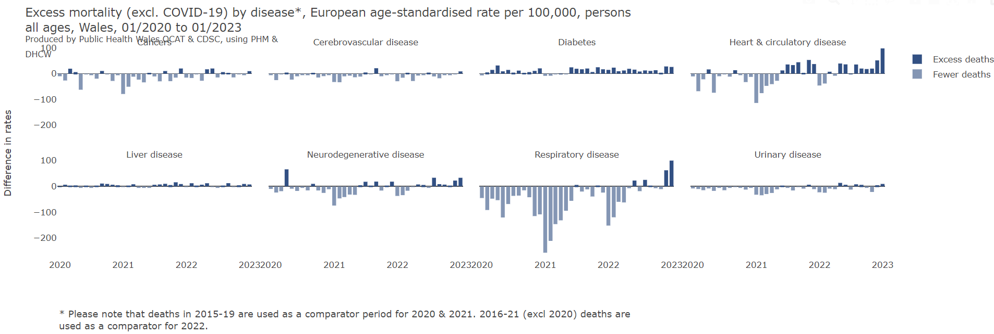
Excess mortality

Slide 17
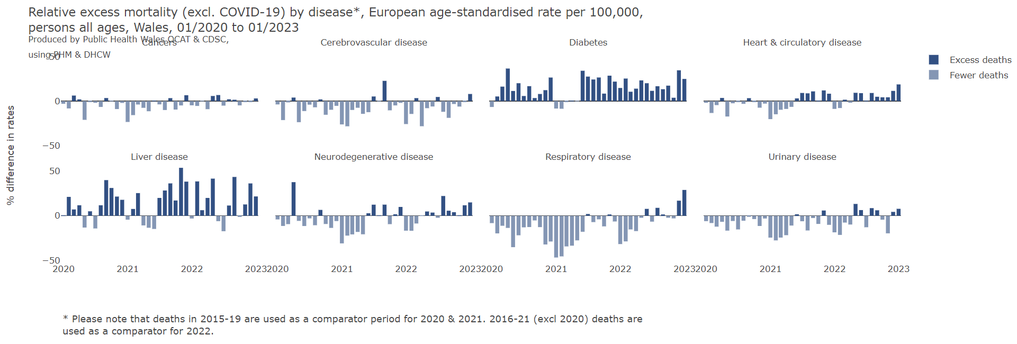
Excess mortality

Slide 18
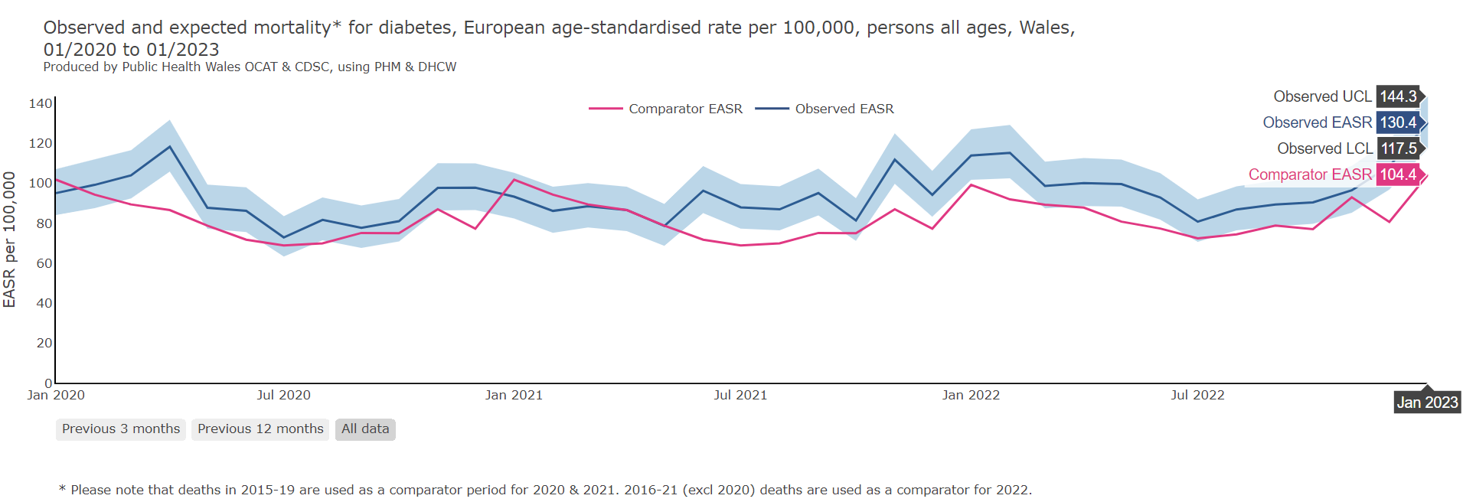

Excess mortality

Slide 19
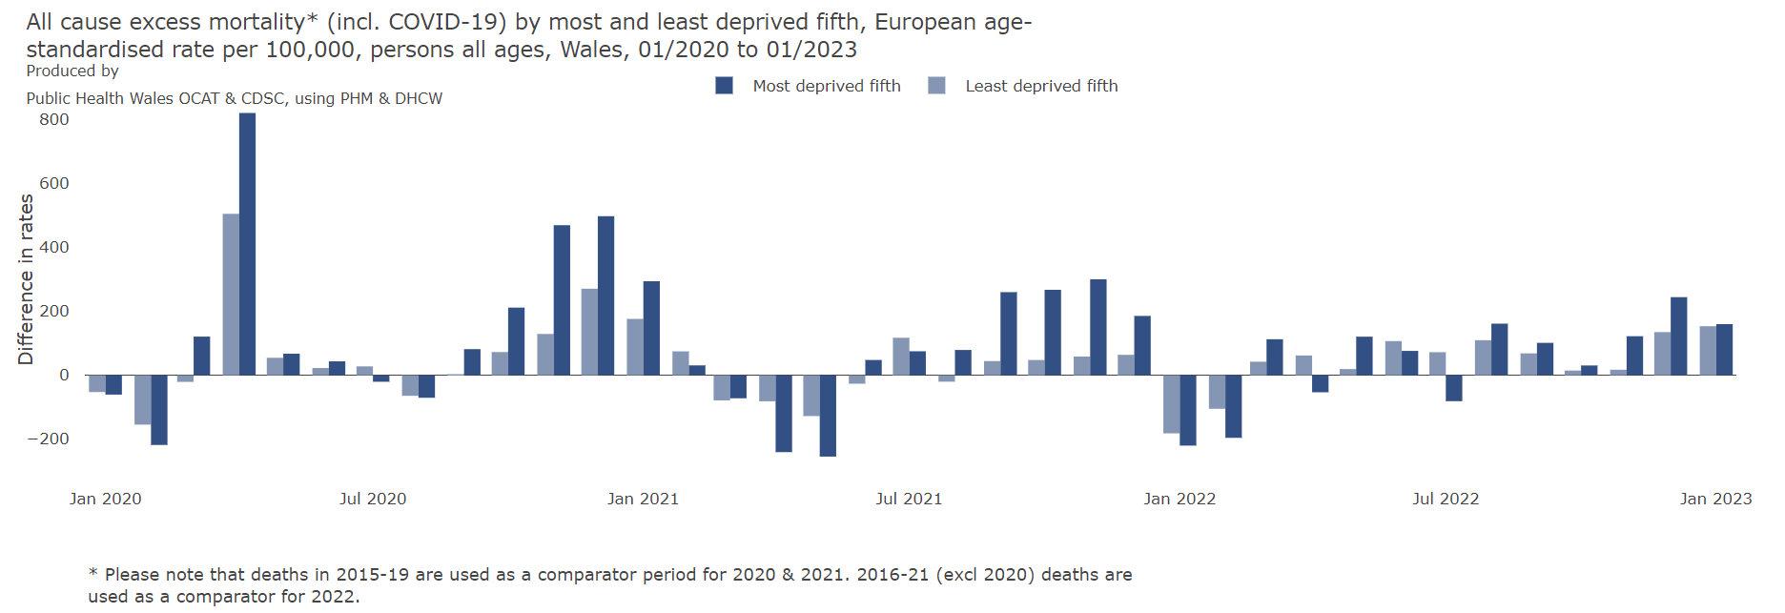
Excess mortality

Slide 20
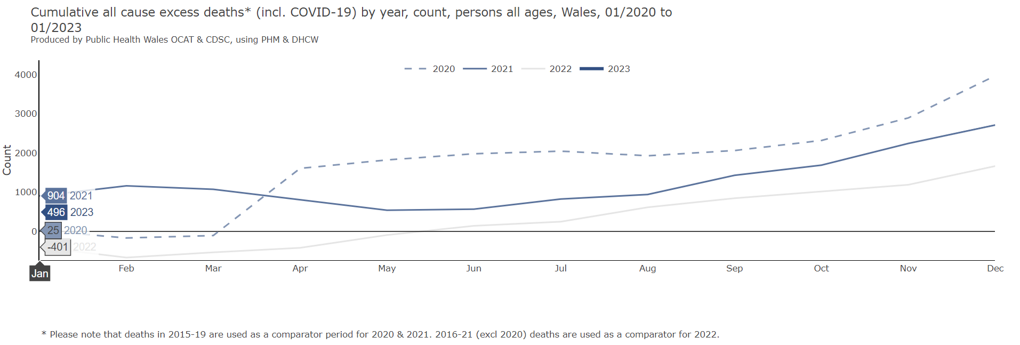
Excess mortality

Slide 21

Health behaviours and wellbeing

Slide 22
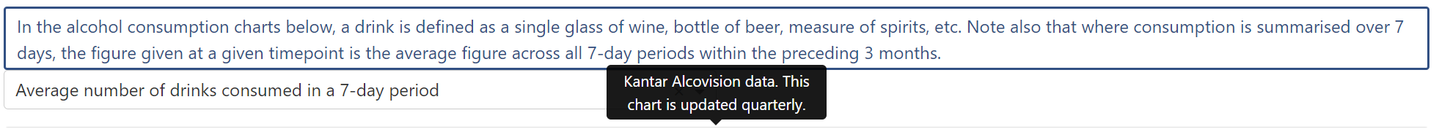
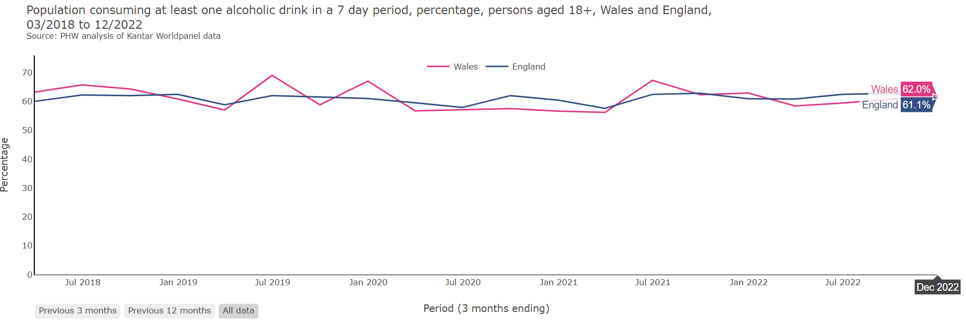
Health behaviours and wellbeing

Slide 23

Health behaviours and wellbeing

Slide 24
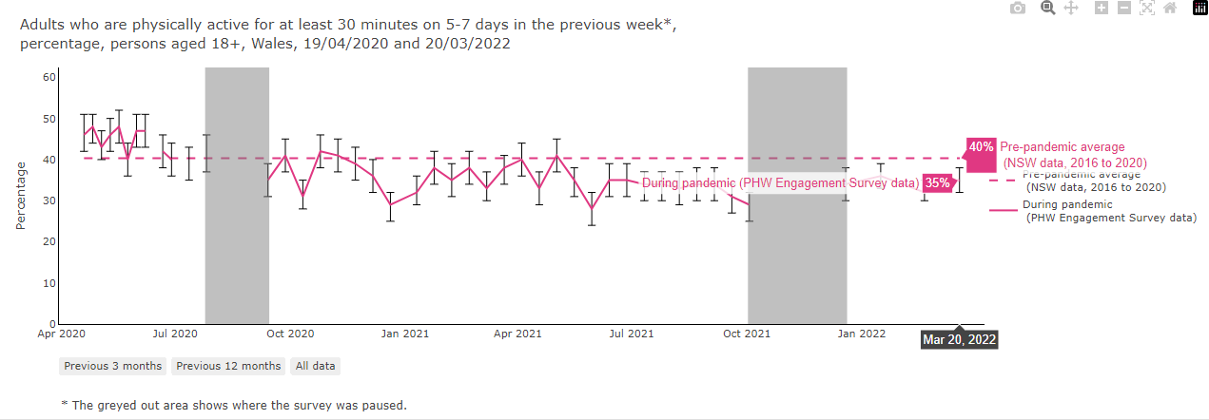
Health behaviours and wellbeing

Slide 25

Health behaviours and wellbeing

Slide 26

Health behaviours and wellbeing

Slide 27
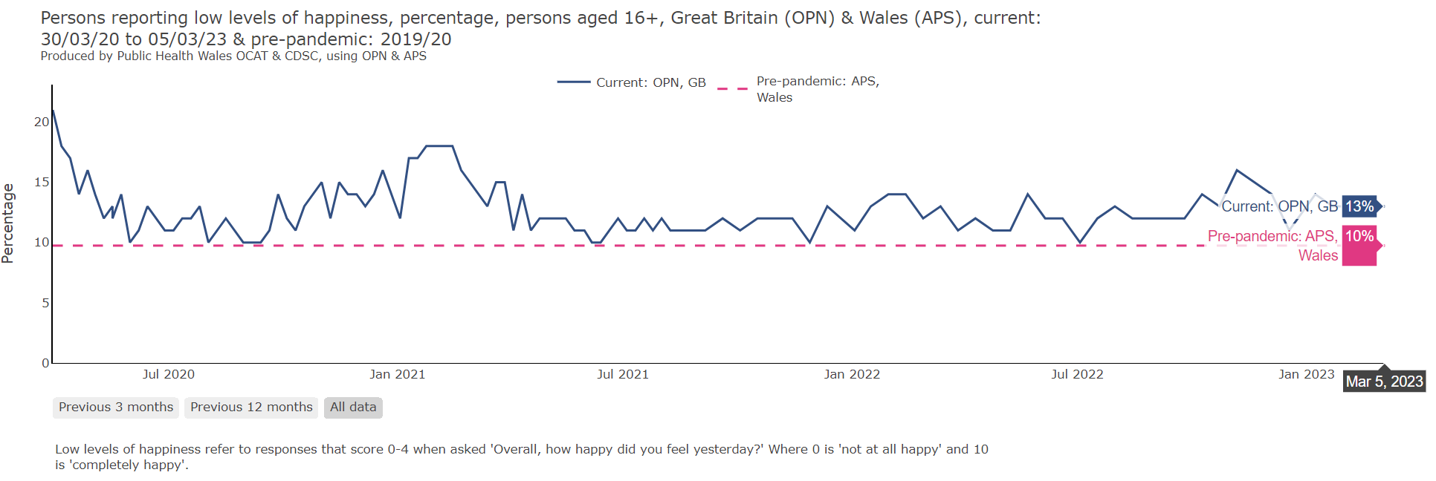
Health behaviours and wellbeing

Slide 28

Health behaviours and wellbeing

Slide 29
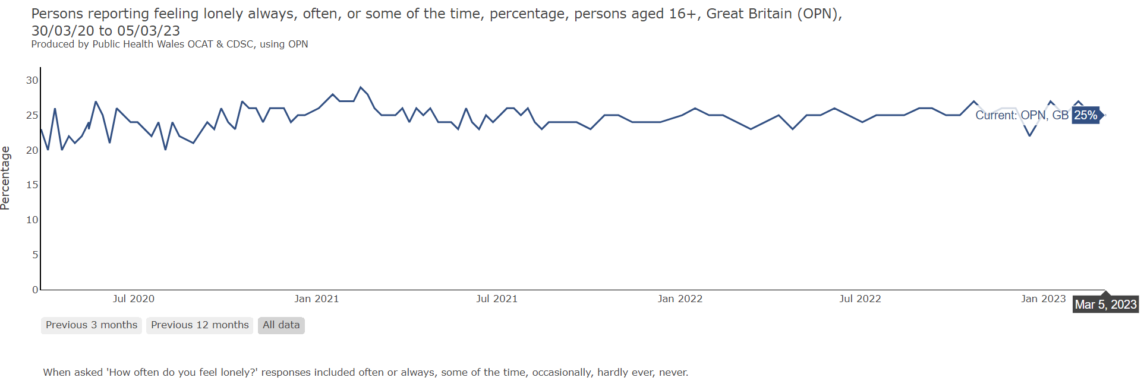
Health behaviours and wellbeing

Slide 30
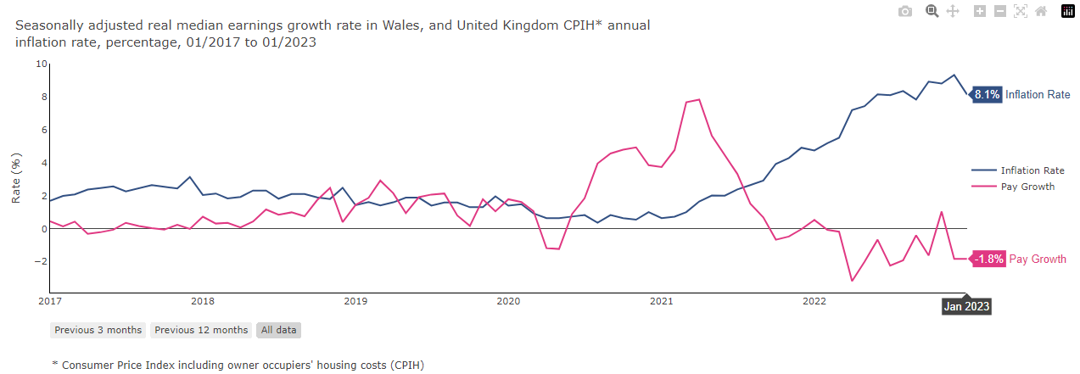
Wider determinants

Slide 31
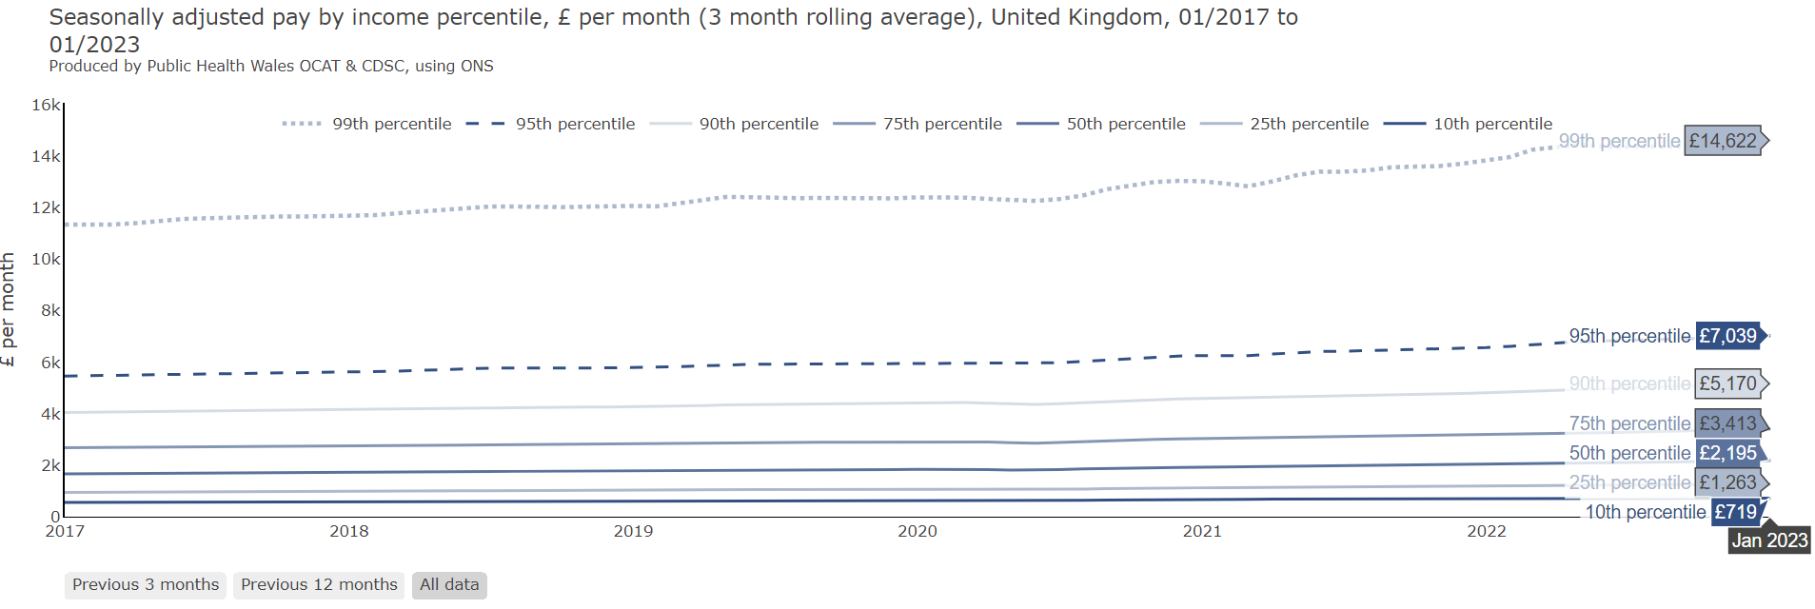
Wider determinants

Slide 32

Wider determinants

Slide 33
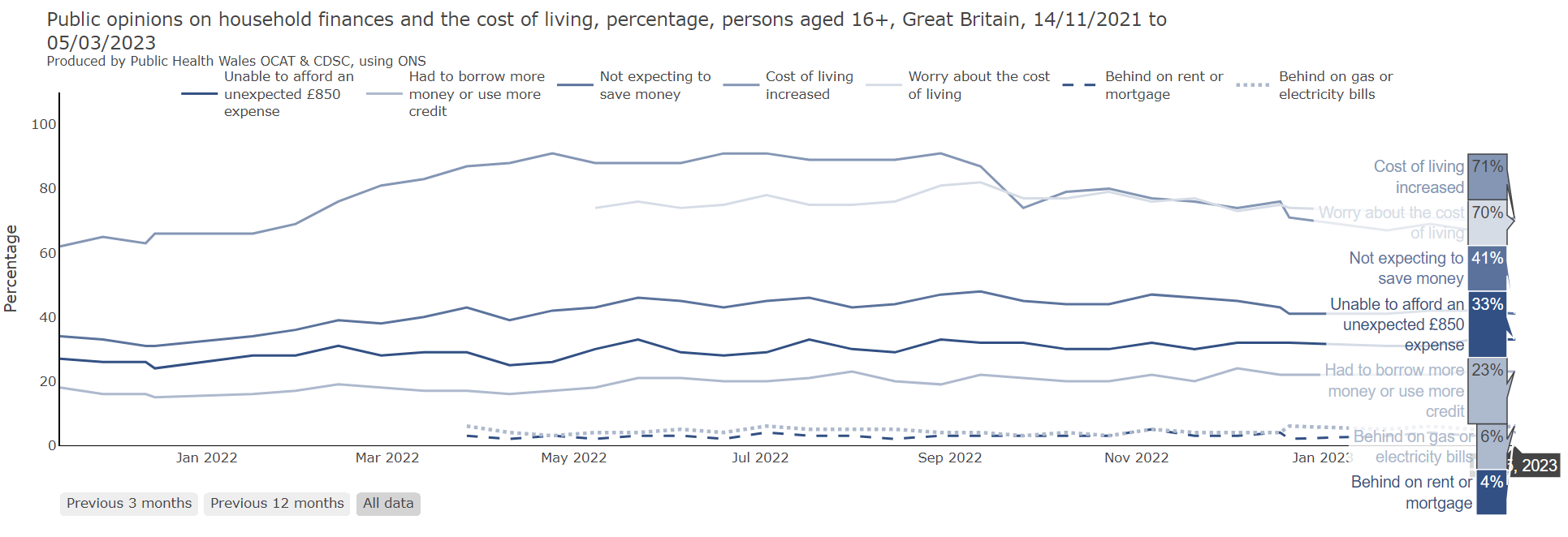
Wider determinants

Slide 34
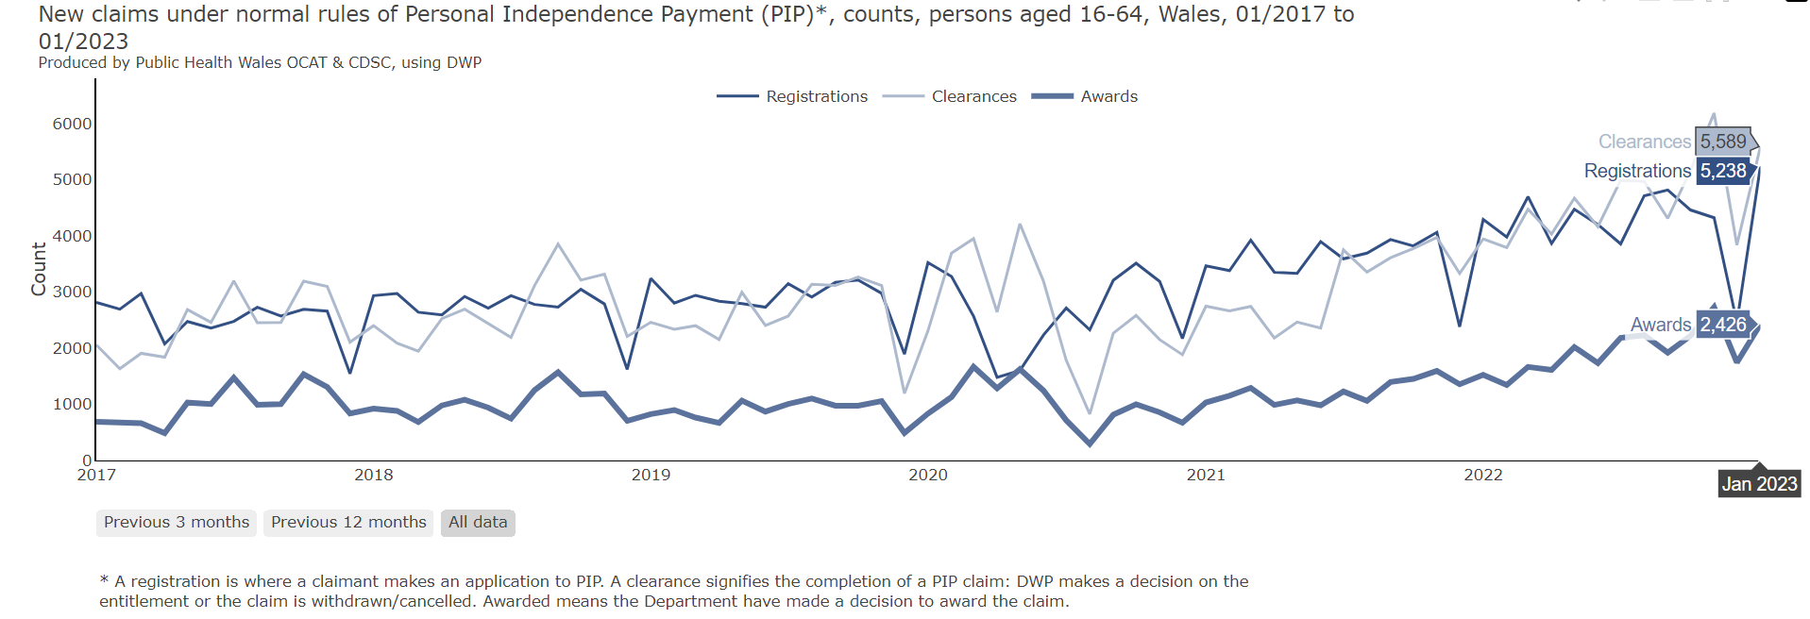
Wider determinants

Slide 35

Wider determinants

Slide 36

Wider determinants

Slide 37
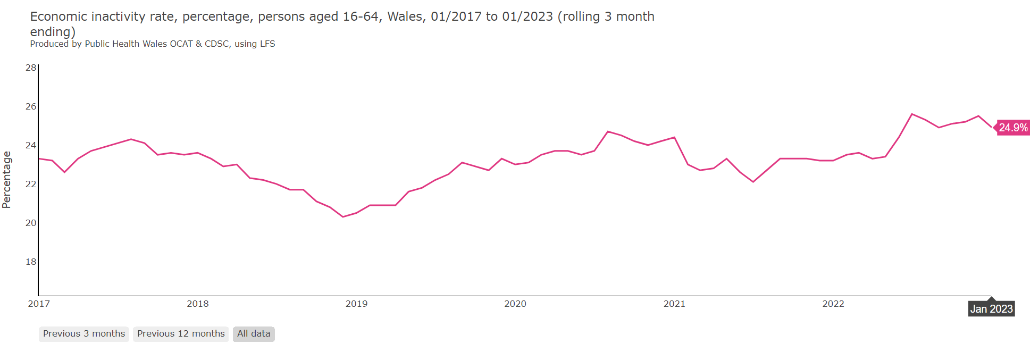
Wider determinants

Slide 38
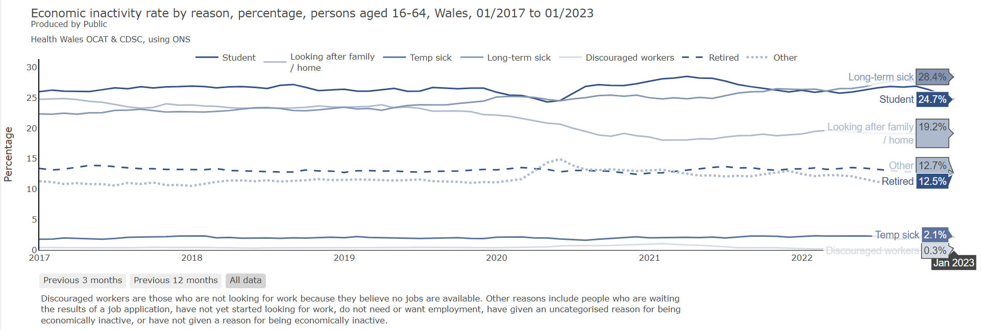
Wider determinants

Slide 39

Wider determinants

