Slide 1
Integrated Performance Report
Monitoring of COVID-19 and non COVID-19 related activity
June 2020

Slide 2
Setting the Scene
Introduction
Introduction
The Integrated Performance Report (May 2020) provides the Board with an update on the latest available position during the COVID-19 outbreak. This summary report brings together key information from a number of existing resources from the following areas which will continue to evolve as additional intelligence is made available.
(select area to the right to navigate):
Section 1 focuses on examples of work being undertaken across the organisation to support our COVID-19 response. This includes high level summary dashboards that are being used to help inform action, including the COVID-19 Surveillance Dashboard.
Section 2 provides an overview of our financial performance for Month 3 2020/21. It includes a high-level summary of revenue and capital financial performance including an overview of costs directly related to the organisation’s COVID-19 response.
Section 3 highlights latest available data on our workforce. Two dashboards are presented including an organisational dashboard of reported sickness absence due to COVID-19 and key metrics related to our people.
Section 4 provides an update for a number of our key services and programmes (where data is available) for those areas continuing to operate during COVID-19. It also includes the latest available information on our mandatory Quality indicators.
COVID-19 Response
Finance
Business as usual
Covid-19
Workforce
Performance Indicators
2

Slide 3
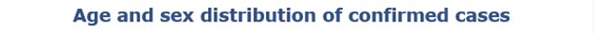
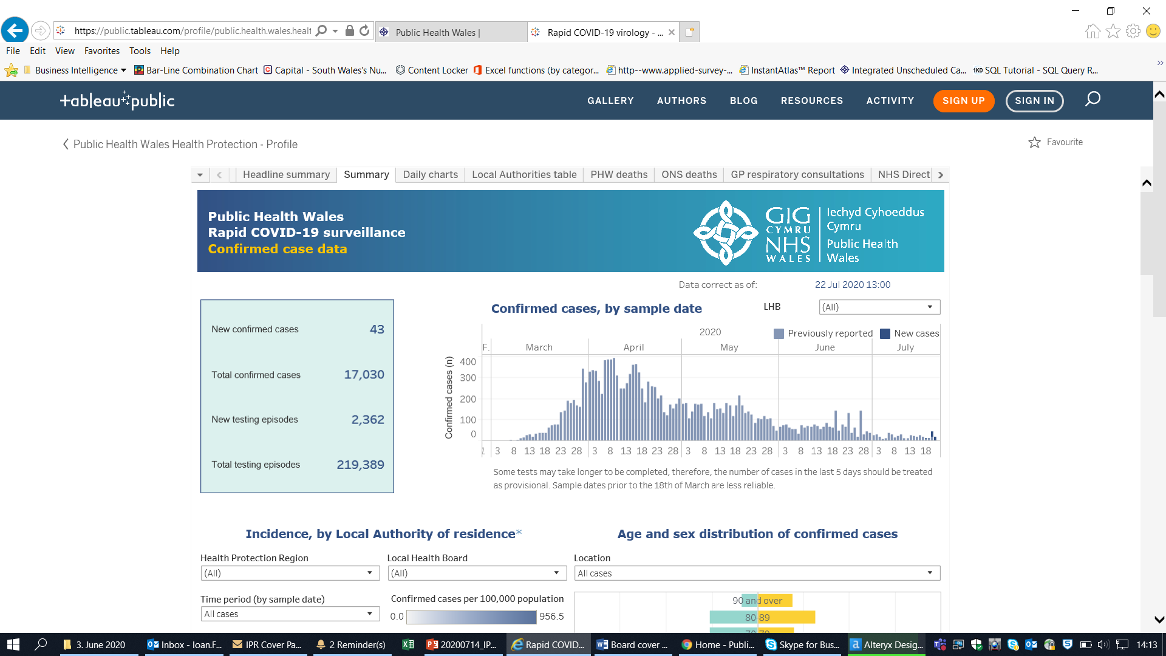
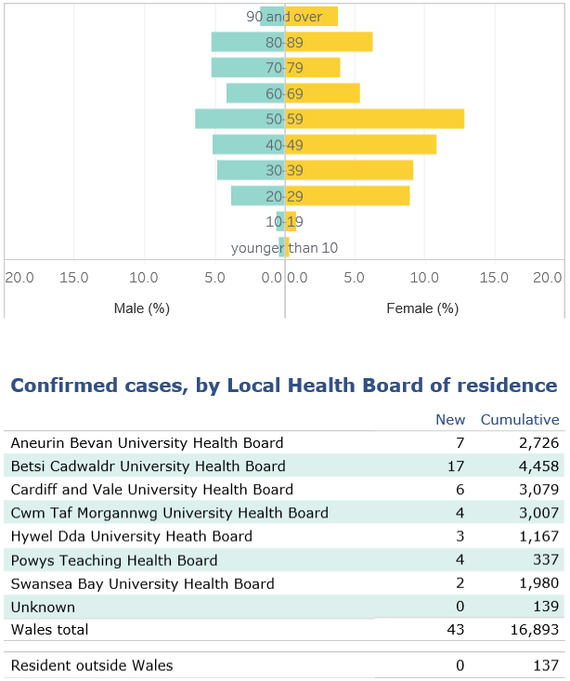
COVID-19 Response
COVID-19
Return to overview
COVID-19 Surveillance: Cases
Data correct as of 22 July 2020
Data extracted from Public Health Wales Rapid COVID-19 surveillance tool, available here (publically available).
3

Slide 4
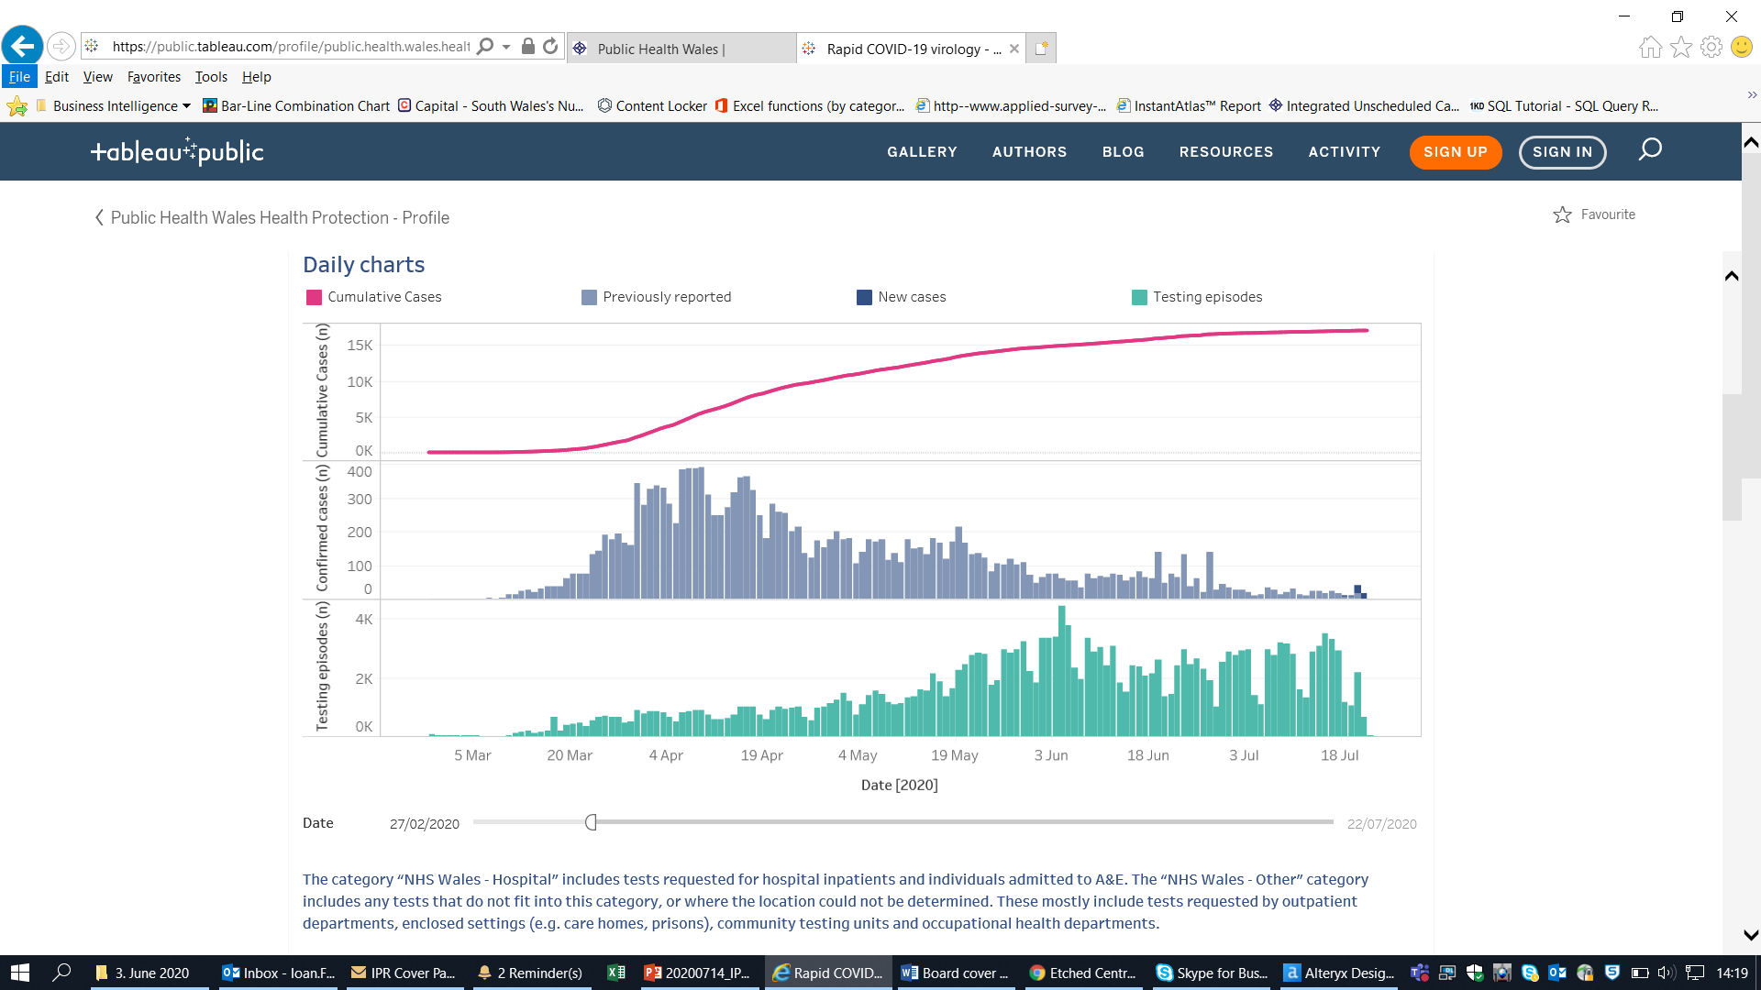
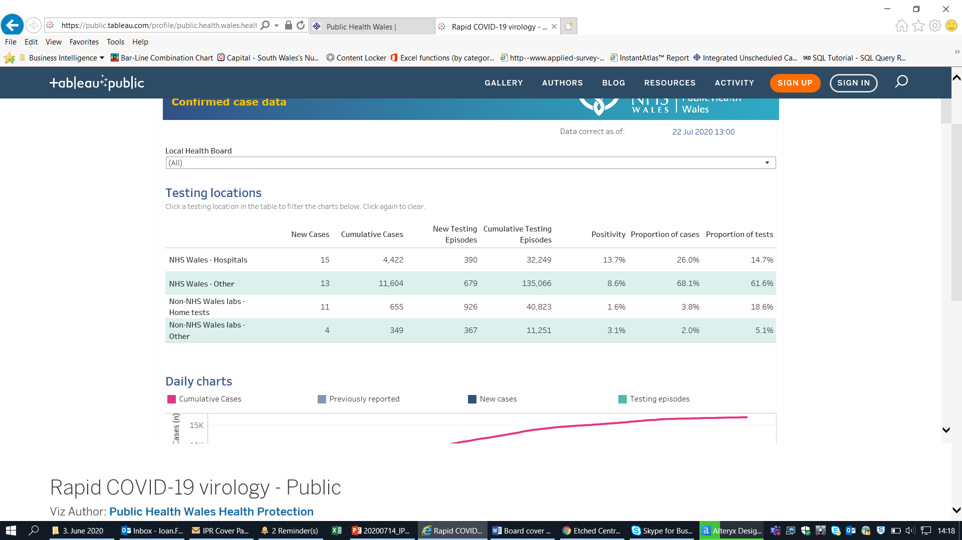
COVID-19 Response
COVID-19
Return to overview
COVID-19 Surveillance: Testing
Data correct as of 22 July 2020
Data extracted from Public Health Wales Rapid COVID-19 surveillance tool, available here (publically available).
4
4

Slide 5
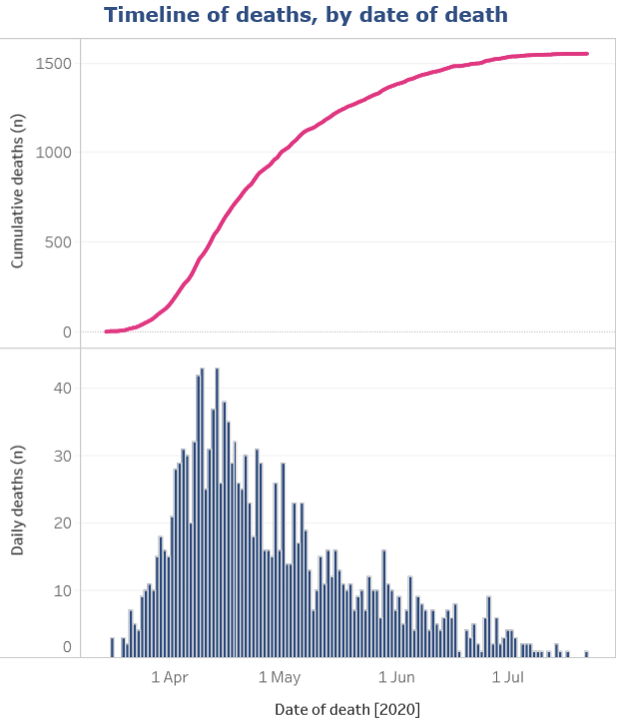
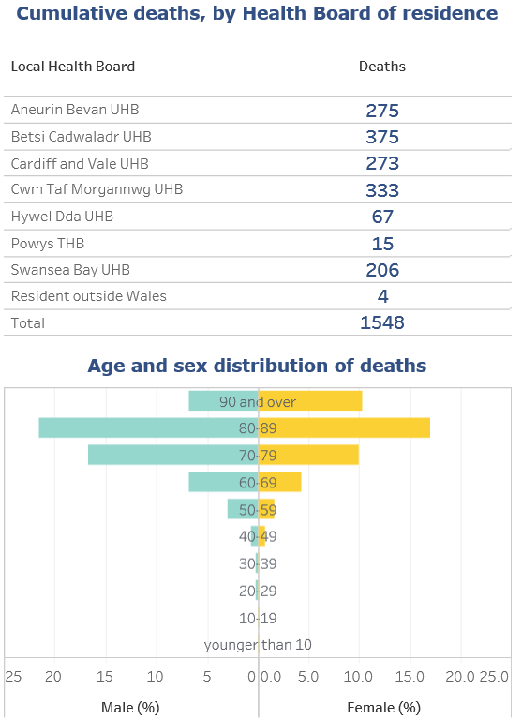
COVID-19 Response
COVID-19
Return to overview
COVID-19 Surveillance: Suspected deaths in lab confirmed cases
Data correct as of 22 July 2020
Data extracted from Public Health Wales Rapid COVID-19 surveillance tool, available here (publically available).
5
5

Slide 6
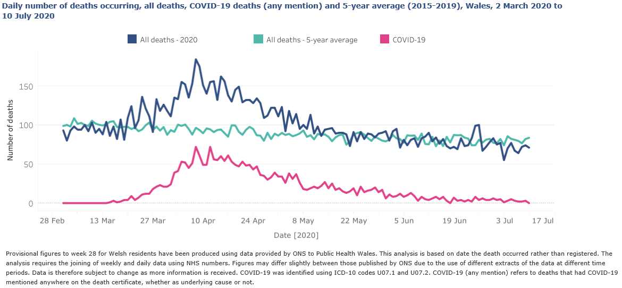
COVID-19 Response
COVID-19
Return to overview
COVID-19 Surveillance: ONS mortality data for Wales
Updated weekly Data correct as of 23 July 2020
Data extracted from Public Health Wales Rapid COVID-19 surveillance tool, available here (publically available).
6
5

Slide 7
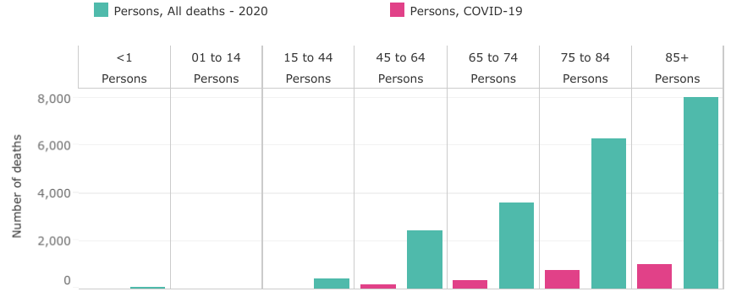
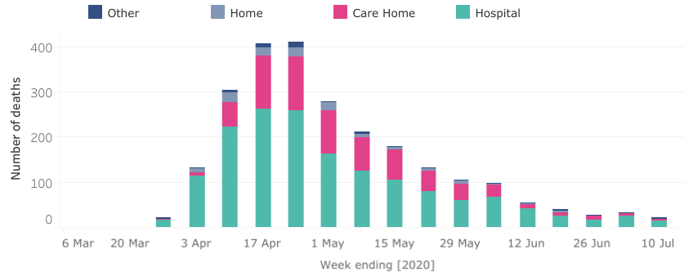
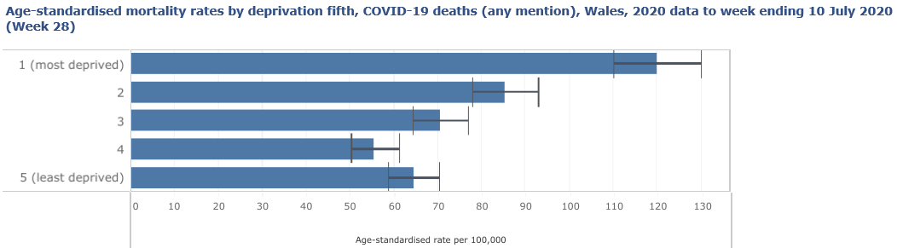
COVID-19 Response
COVID-19
Return to overview
COVID-19 Surveillance: ONS mortality data for Wales
Number of deaths by age group, all deaths and COVID-19 deaths (any mention), Wales, 2020 data to week ending 10 July 2020 (Week 28)
Weekly number of deaths registered by place of occurrence, COVID-19 deaths (any mention), Wales, week ending 13 March (Week 11) to week ending 10 July 2020 (Week 28)
Data updated weekly
Data correct as of 23 July 2020
Data extracted from Public Health Wales Rapid COVID-19 surveillance tool, available here (publically available).
7
5

Slide 8
Finance
Business as usual
COVID-19
Return to overview
Overview of Financial Performance - Month 3 2020/21
Summary
The purpose of this report is to outline to the Executive Team and the Board the revenue and capital position for Public Health Wales as at 30 June 2020 (M3), which is also circulated to the Audit and Corporate Governance Committee. The content of this report is reflected in the Director of Finance commentary that has been submitted to Welsh Government on 13 July 2020 as part of the full financial monitoring return for Month 3.
The following table highlights the performance against the key revenue and capital financial targets.
Target
Current
Year to
Year-end
Traffic
Month
Date
Forecast
Light
Revenue financial target
(1K)
(17K)
Breakeven
Deficit/(Surplus)
Capital financial target
281K
1,070K
Breakeven
Public Sector Payment Policy
96%
95.89%
>95%
The cumulative reported position for Public Health Wales is a net surplus of £17k. This position includes £6.298m of costs directly related to the Trust’s COVID-19 response. This position includes anticipated income from Welsh Government of £236k.
8

Slide 9
Finance
Business as usual
COVID-19
Return to overview
Overview of Financial Performance - Month 3 2020/21
Directorate
9

Slide 10
Finance
Business as usual
COVID-19
Return to overview
Overview of Financial Performance - Month 3 2020/21
The month-end position for Public Health Wales is a net surplus of £17k. This position includes anticipated income from Welsh Government of £236k broken down as follows:
£88k Digital strategy
£148k Healthier Wales (Early years prevention)
As part of our financial plans for 2020/21 it has been agreed that pay underspends, a number of non-pay budgets, and the internal investment fund will be held centrally to contribute to the additional costs incurred as a result of COVID-19. Total spend on COVID-19 to date is £6.298m of which £0.809m has been met from within Public Health Wales centrally held budgets. £406k from pay underspends and £403k from non pay reductions in spend and internal investment slippage, in addition £456k has been met from external funding in respect of Genomics sequencing tests, leaving £5.033m of additional income received from Welsh Government.
Public Health Services Directorate
Microbiology division has overspent in month 3 by £434k, this overspend has been offset by underspends in Screening division of £198k, Health Protection division of £163k, SPR Division of £26k and Public Health Services Corporate division of £48k. Public Health Services Directorate will need to ensure that a break-even plan for the Directorate is maintained for the full year forecast.
Status of LTA/SLA Agreements
As a result of the Covid 19 pandemic, All Wales DoFs agreed a funds flow approach for Q1 that was on the premise of keeping NHS Wales operating through giving stability to providers with the financial risk and significant opportunity costs sitting with commissioners. For PHW this meant that NHS LTAs and SLAs were essentially “block” agreements and would not generate a performance cost variation. Recognising that service activity is likely to be low during the initial phases of Q2 any financial arrangements should recognise the joint provider/commissioner risks, and structured with a view to incentivise delivery whilst fairly managing risks for providers and commissioners. Therefore All Wales DoFs have agreed to extend the approach agreed for Q1 into Q2. Q3 arrangements will be considered by All Wales DoFs during September 2020.
10

Slide 11
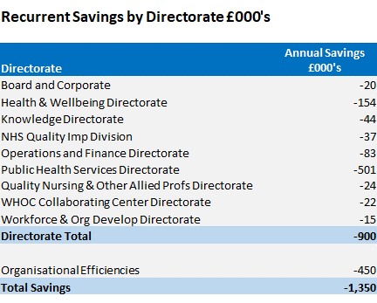
Finance
Business as usual
COVID-19
Return to overview
Overview of Financial Performance - Month 3 2020/21
Savings / Organisational Efficiencies
Public Health Wales savings strategy for 2020/21, as set out in the IMTP, was £1.350m, made up of 1% Directorate savings and 0.5% Organisational Efficiencies.
Of the £900k relating to the 1% savings target assigned to each Directorate. £74k was met by increased vacancy factors. Based on the Month 3 pay position the increased vacancy factors are being achieved and will continue to be monitored on a monthly basis. The remaining element of £826k was met by changes within staffing establishments (£75k) and non-pay efficiencies (£670k).
Of the £450k relating to Organisational efficiencies, £120k related to savings linked to VERs in 19/20 was achieved in month 1. The remaining efficiencies are linked to procurement efficiencies (£105k), Salary Sacrifice Schemes (£40k) and yet to be identified red schemes (£185k). Due to COVID-19 priorities, the remaining efficiencies have been re-classified as red schemes (£330k).
11

Slide 12
Finance
Business as usual
COVID-19
Return to overview
Overview of Financial Performance - Month 3 2020/21
Investments
The current status of the investments for both 2019/20 and 2020/21 are as follows:
There will be slippage against investment within Public Health Wales due to delays in the allocation of internal investment funding as a result of COVID-19.
Due to the inability of our Directorates to pursue investment, £328k of months 1 – 3 investment slippage has been used to form part of Public Health Wales overall financial commitment to supporting the COVID-19 response. There are on-going discussions with Welsh Government on additional funding they may provide to contribute to our COVID-19 costs.
Description
Total £000s
2019/20 Over Commitment of Investments
-300
2019/20 Investments yet to be utilised
687
Net impact of 2019/20 Investments
387
2020/21 Green Savings Schemes
1,020
Month 1 - 3 Investment Slippage use to fund COVID
-328
Overall Investments
1,079
12

Slide 13
Finance
Business as usual
COVID-19
Return to overview
Overview of Financial Performance - Month 3 2020/21
Capital
Public Health Wales capital funding for 2020/21 totals £4.826m, split as follows:
Discretionary £1.687m, £154k of which has been allocated to support COVID-19. The allocation of the remaining £1.206m is currently being finalised.
Strategic £3.139m in respect of COVID-19 is made up as follows:
  Cepheid Systems - £751k
  Perkin Elmer Platforms - £740k
  Eplex - £553k
  MAST Seegene - £666k
  MAST x3 Microlab Starlet - £429k
13

Slide 14
Finance
Business as usual
COVID-19
Return to overview
Overview of Financial Performance - Month 3 2020/21
 | Opening Balance 1/4/2020 £000s | Movement £000s | Closing Balance 30/06/20 £000s
Non-Current Assets
Property, plant and equipment | 11,941 | 2,276 | 14,217
Intangible assets | 1,334 | 0 | 1,334
Trade and other receivables | 0 | 0 | 0
Non-Current Assets sub total | 13,275 | 2,276 | 15,551
Current Assets
Inventories | 866 | 11,654 | 12,519
Trade and other receivables | 14,470 | 12,476 | 26,946
Cash and cash equivalents | 8,819 | (8,337) | 482
Current Assets sub total | 24,155 | 15,792 | 39,947
TOTAL ASSETS | 37,430 | 18,069 | 55,498
Current Liabilities
Trade and other payables | (18,882) | (17,099) | (35,981)
Provisions | (1,313) | (858) | (2,171)
Current Liabilities sub total | (20,195) | (17,958) | (38,152)
NET ASSETS LESS CURRENT LIABILITIES | 17,235 | 111 | 17,346
Non-Current Liabilities
Trade and other payables | (1,381) | (94) | (1,476)
Provisions | (1,291) | 0 | (1,291)
Non-Current Liabilities sub total | (2,672) | (94) | (2,767)
TOTAL ASSETS EMPLOYED | 14,563 | 17 | 14,580
FINANCED BY: Taxpayers' Equity
PDC | 13,444 | 0 | 13,444
Retained earnings | 609 | 17 | 626
Revaluation reserve | 510 | (0) | 510
TOTAL TAXPAYERS' EQUITY | 14,563 | 17 | 14,580
Balance Sheet
The Balance Sheet, or Statement of Financial Position, reports the assets, liabilities and reserves of the organisation at a specific point in time.
Non-Current Assets
Property, plant and equipment has increased by £2.276m. This reflects the net position of our capital purchases to month 3. The majority of this (£2.110m) being on Covid-19 projects.
Current Assets
Stock has increased by £11.654m due to month 3 purchases of Covid-19 consumables for Cardiff laboratories. Current trade and other receivables has increased by £12.476m. This increase is predominantly on Whole of Government Accounts receivables and relates to the Welsh Government core income invoice for July which is raised a month in advance to ensure receipt in time for July (£8.860m).
The cash position has reduced by £8.337m due mainly to large payments to suppliers of Covid-19 consumables. The Trust has received £10m of funding from Welsh Government in early July as a contribution to the Q1 Covid-19 costs incurred.
Current liabilities
Current trade and other payables has increased by £17.099m. This increase is due to the WG income mentioned above which is treated as deferred income (£9.388m) and a further increase for month 3 relates to accruals for the Covid-19 consumables purchased from Perkin Elmer (£6.493m). The increase in provisions of £0.858m is primarily due to 3 new cases in June 20/21. The Trust is only liable for £75k of the increase in provision (the first £25k of payments on each case) with the remainder being reimbursed by the Welsh Risk Pool.
14

Slide 15
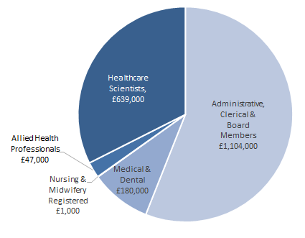
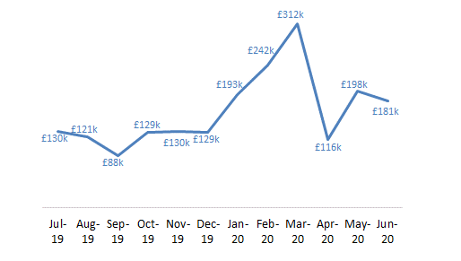
Finance
Business as usual
COVID-19
Return to overview
Overview of Financial Performance - Month 3 2020/21
Agency Spend
Summary Variances are mostly due to last year’s invoices being paid in month 2 which makes the month 3 figures the expected monthly amounts. Health and Wellbeing saw an increase from the HMQ agency staff costs and cover for a vacancy. Reliance on the accuracy of Division’s receipting may result in fluctuations to the monthly amounts. There have also been a number of agency staff’s contracts coming to an end this month, especially in the WHO CC and Knowledge Directorates.
15
14

Slide 16
Finance
Business as usual
COVID-19
Return to overview
Overview of Financial Performance - Month 3 2020/21
Conclusion
The Board is asked to note the following:
financial position reported at month 3
status of the Capital Programme for 2020/21
whilst we always undertake to either seek funding approval from Welsh Government or identify from our own budgets, that the total quantum of funding for addressing COVID-19 across Wales remains fluid and uncertain. There is a risk that the organisation’s operational cost of addressing and recovering from the pandemic cannot be contained within available funding resulting in a potential breach of the planned outturn for 2020-21
16

Slide 17
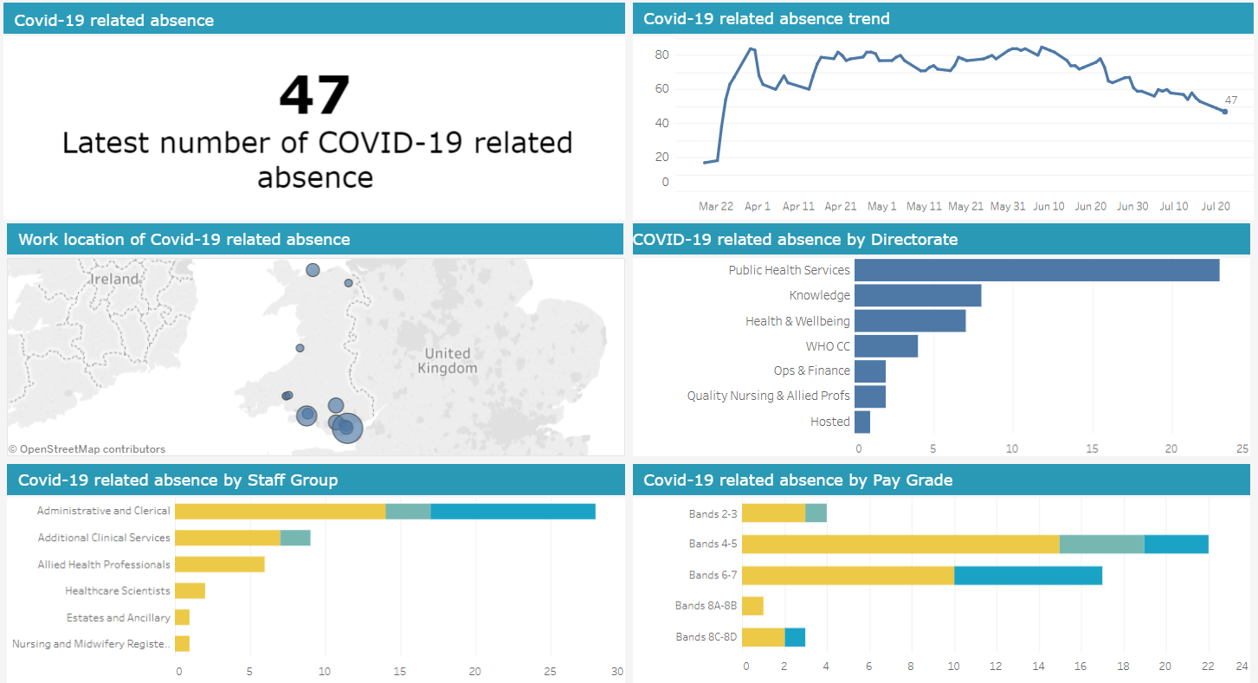
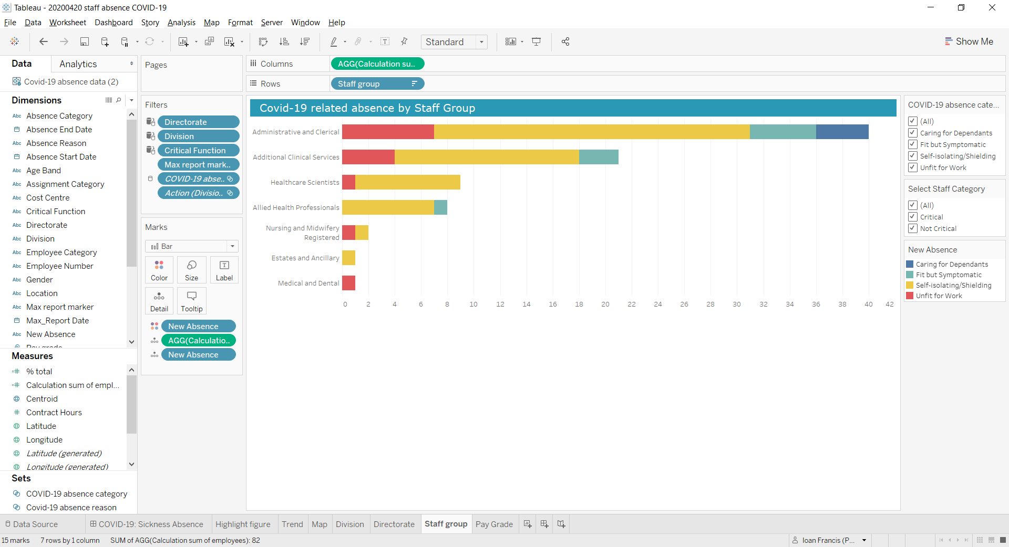
Workforce
Business as usual
COVID-19
Return to overview
COVID-19 Staff Absence Dashboard
Data correct as of 22 June 2020
Dashboard available here (Not publically available)
Business as usual
Covid-19
17

Slide 18
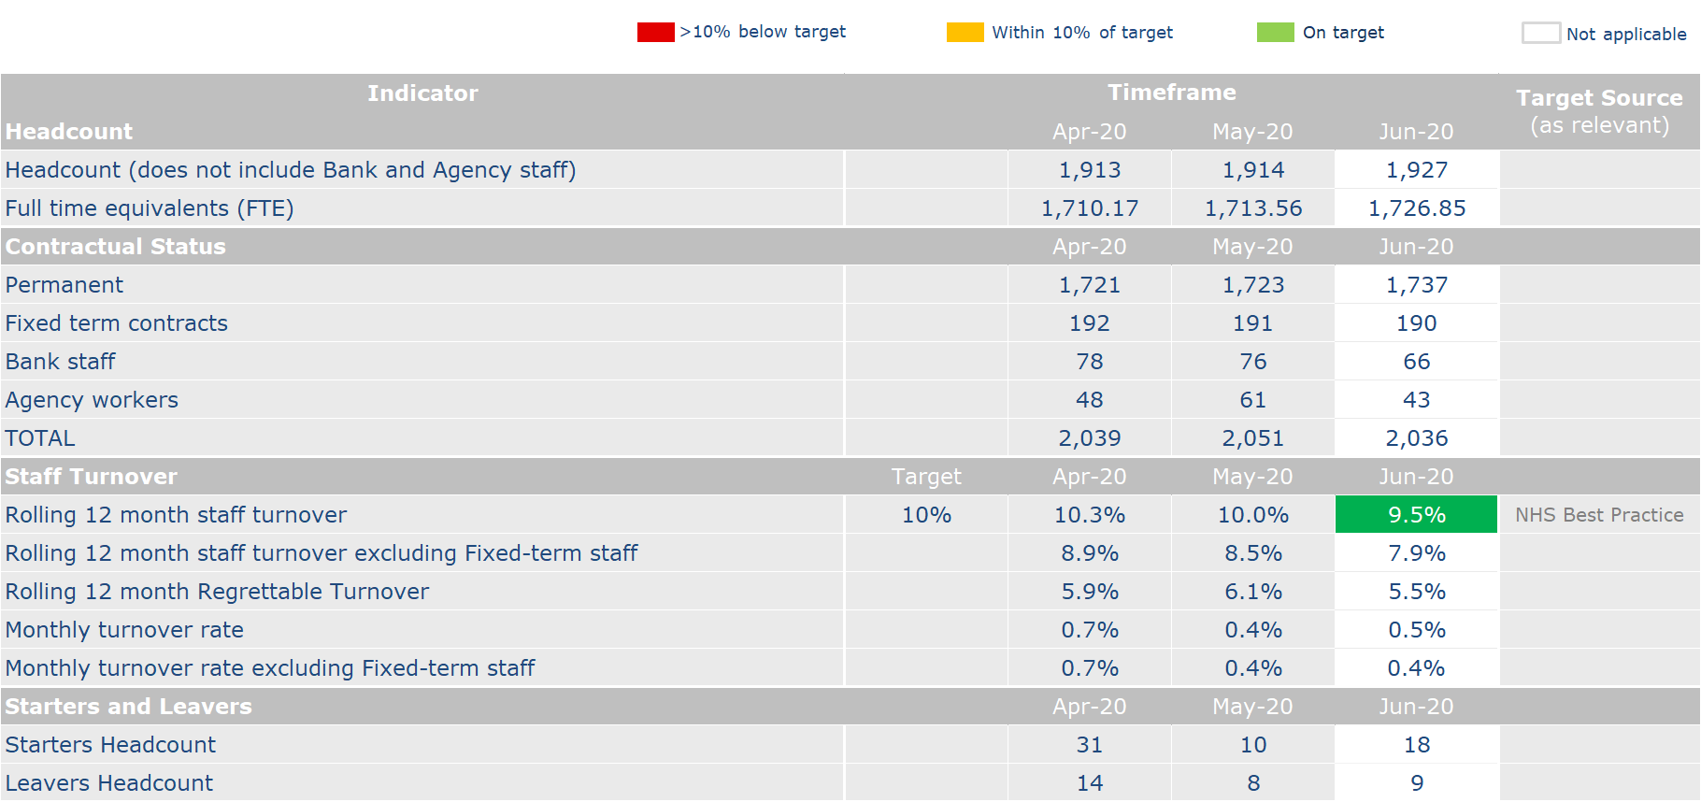
Workforce
Business as usual
COVID-19
Return to overview
Business as usual
Covid-19
18

Slide 19
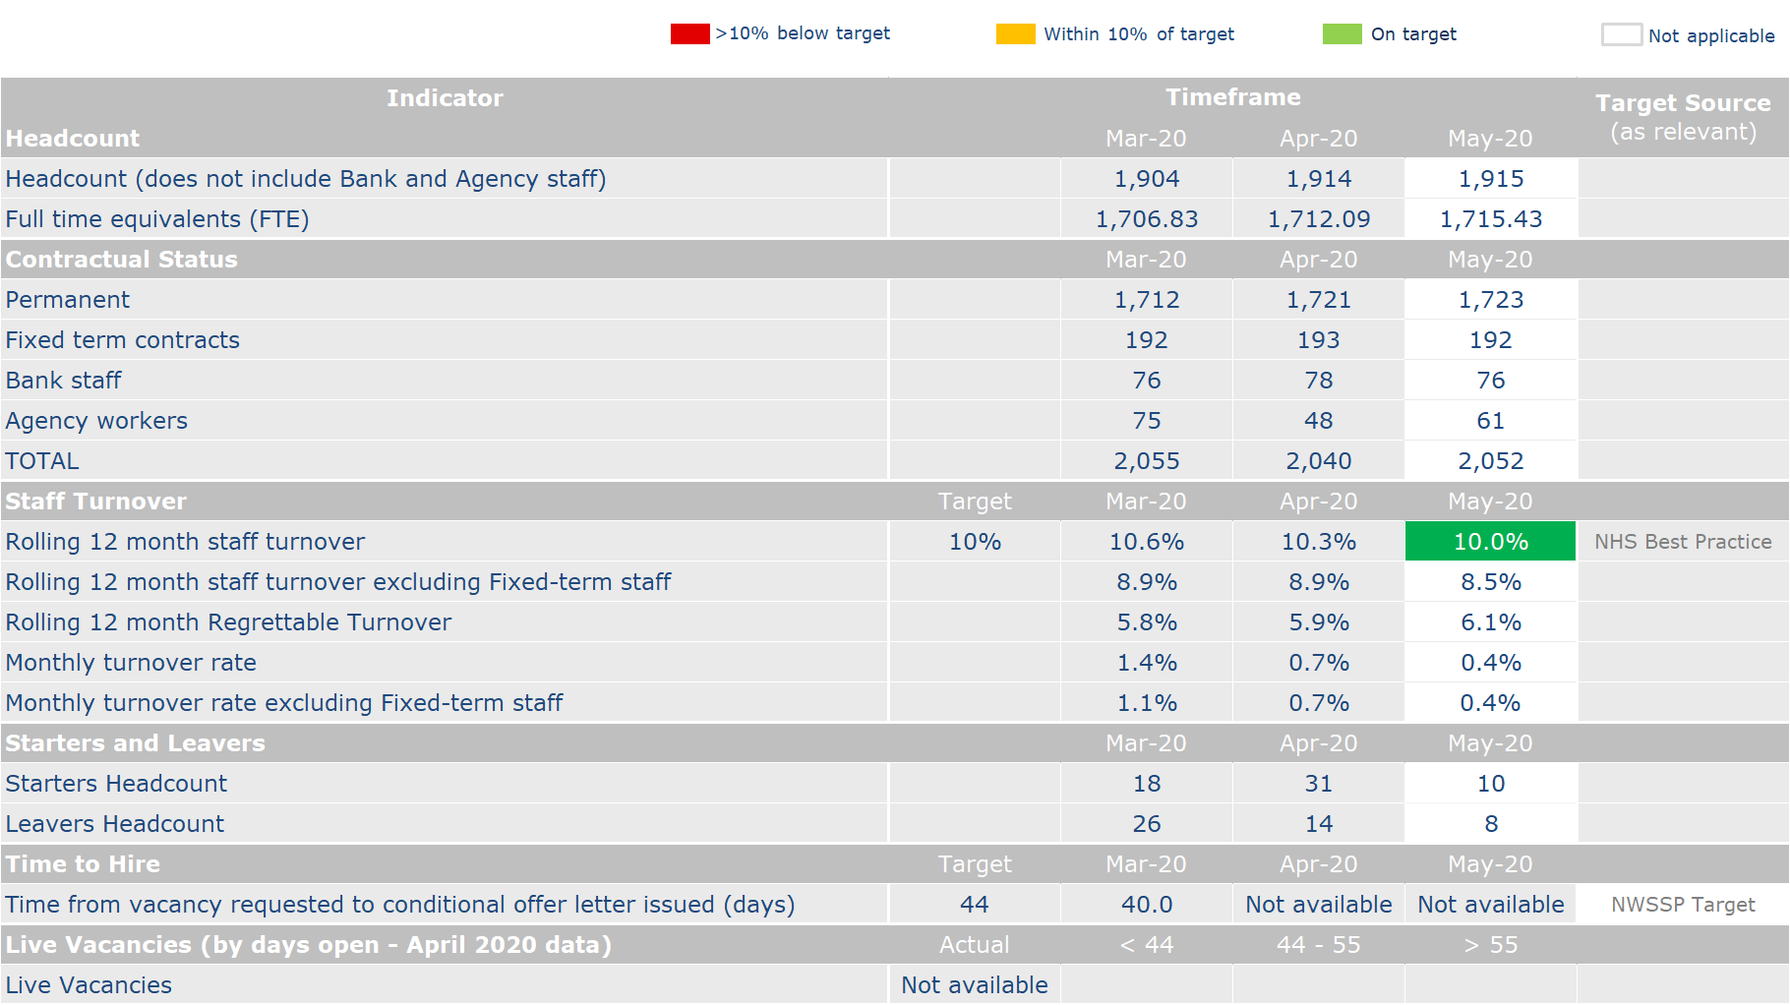
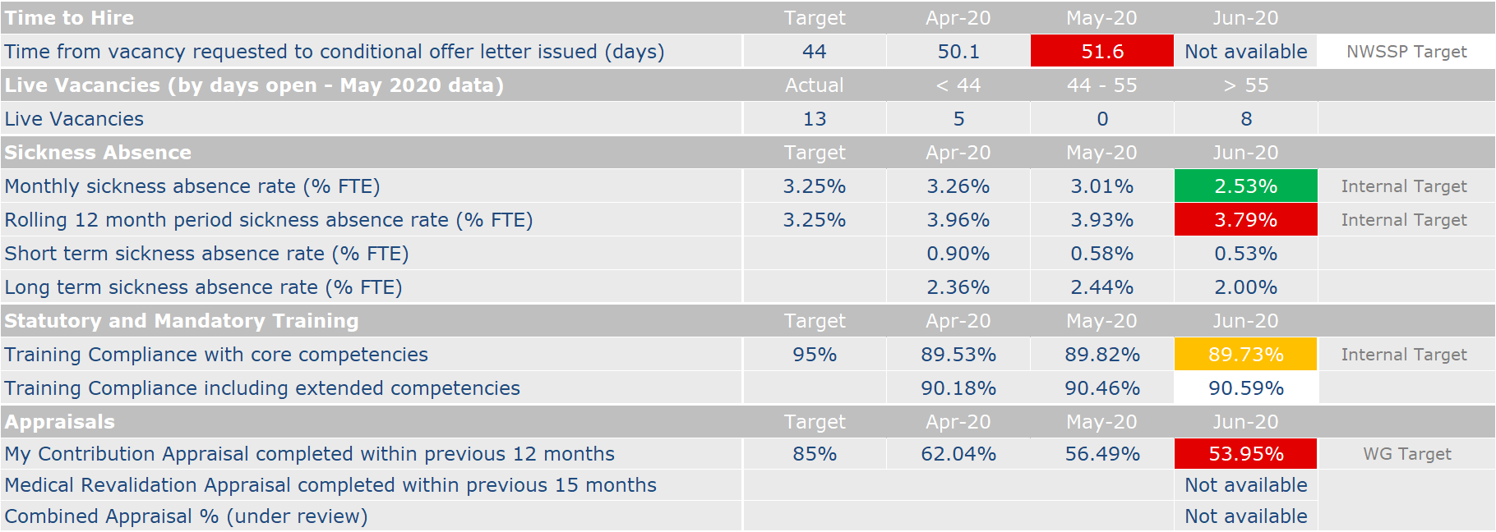
Workforce
Business as usual
COVID-19
Return to overview
1
2
3
1
Business as usual
Covid-19
Notes
¹ Data received from NWSSP for recruitment performance in April and May 2020. Data shows that the target has not been met for the previous two months. Further information has been sought from NWSSP and will be provided when available.
19

Slide 20
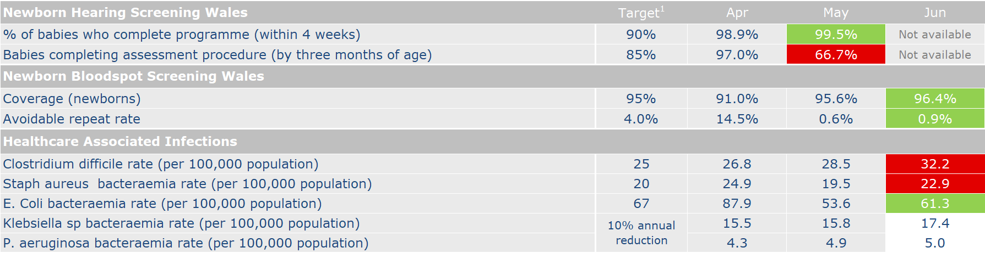
Performance Indicators
Performance Dashboard
Return to overview
¹ Data reported against 2020/21 targets, or where a performance trajectory has been agreed to facilitate reaching the target, the trajectory has been used as defined within our latest IMTP. Targets for Healthcare Associated Infections have not yet been agreed with Welsh Government for 2020/21
20

Slide 21
Performance Indicators
Performance Dashboard
Return to overview
Newborn Hearing Screening
Whilst newborn hearing screening has continued in the hospital setting throughout the pandemic, the decision was taken at the beginning of the pandemic to suspend screening in community settings to reduce bringing women and babies back into a hospital setting and to prioritise our limited staff availability. The screening pathway was also amended to ensure that babies can complete the screening pathway as promptly as possible, with reduced repeats and referrals to audiology required. Babies unable to be screened in hospital are being referred to audiology for TBT (Targeted Behavioural Testing) at 9 months of age.
Throughout this time about 2/3rds of well babies have been screened whilst in hospital. Some have been missed because of quick discharges, staffing shortages and other challenges. This means approximately 150 babies a week are being referred to audiology for TBT, creating a backlog of work waiting to be done in 9 months time.
Following discussion with Audiology Departments across Wales, it was agreed that they would offer newborn hearing screening in the community to babies who had not yet been screened, aiming to see them at 12 weeks or younger. As well as screening the babies as young as possible this will prevent the list of referred babies from building up. Redeployed screeners from the Abdominal Aortic Aneurysm Screening Programme were also trained to enable them to carry out newborn hearing screening which has provided additional capacity to screen babies within the clinics.
Newborn Hearing Screening Wales is now beginning to re-start community clinics across Wales. Initially this will be to screen babies who were missed in hospital and there will be some cross-over with audiology led clinics. Some areas will have been disproportionately affected by the cancellation of community clinics, for example Powys where there are more births in smaller centres where there are no permanent hearing screeners based. The regional coordinators have been working closely with midwifery and audiology colleagues in all areas, with more focus in areas of greatest need.
We would like to thank our colleagues in audiology for working with us to find a solution for the babies that we were unable to screen in hospital. Most recent update is that audiology colleagues have screened 1,710 babies before they are 12 weeks of age and there are a further 500 babies who will be offered screening.
We look forward to continuing to work closely with the departments to consider how to test the babies that have still not been screened and who will start to be called at 9 months after the start of the pandemic. We are clearly working to ensure this number is as low as possible.
21
20

Slide 22
Putting Things Right
Business as usual
Return to overview
Summary During the reporting period, a total of 10 formal complaints were received and 7 were acknowledged within the target time of 2 working days. There has been a delay in formal complaints being acknowledged within the target timelines due to capacity issues, but improvements to working practices within the enclosed settings cell showed improvements in this towards the end of the reporting period. There were 2 compliments received during the reporting period. The ratio of compliments to formal complaints is 5:1 (informal and formal is 2:1). This is a notable shift from the normal ratio in which compliments exceed complaints by a considerable margin. However this is probably caused by the fact that compliments are almost exclusively reported by the Screening programmes and their ability to receive compliments has been impacted due to the suspension of screening programmes. This is anticipated to change over the next year with a complete review of complaints and concerns handling (including compliments) and the rollout of Datix Cloud which will have a dedicated compliments area, and the introduction of a service user feedback system across Wales. One SI was reported during the period from Cervical Screening and a full update is being provided to QSIC on 16 July. There is no longer a requirement from WG to close incidents with them within 60 working days and so this metric has been removed from the report.
Performance against Mandatory Indicators
Complaints | Target | 1 Apr – 30 June
Total number of formal complaints received for the period 1 April – 30 June 2020 | - | 10
Number (%) of complaints acknowledged within 2 working days | 95% (PHW) | 7 (70%)
Number (%) of complaints responded to within 30 working days of receipt | 75% (WG) 95% (PHW) | 4 (40%)
Number of informal complaints (on the spot) received | - | 10
Compliments | Target | 1 Apr – 30 June
Number of compliments received | - | 2
Serious Incidents | Target | 1 Apr – 30 June
Number of serious incidents reported | - | 1
Number of serious incidents not closed within 60 days | No longer reported in line with revised NHS Delivery Framework 2020/21
22
21

Slide 23
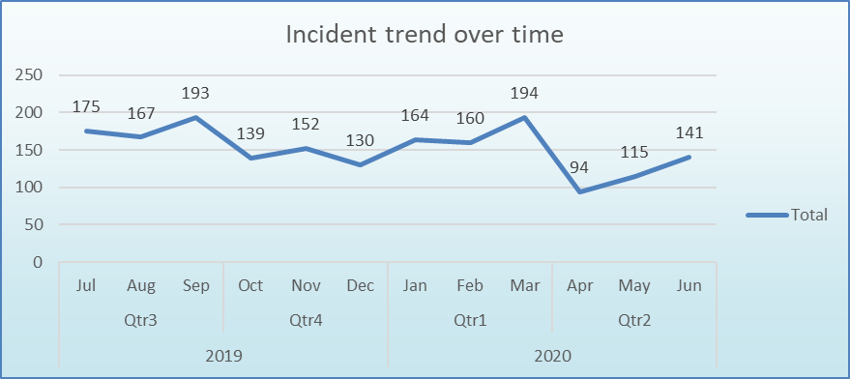
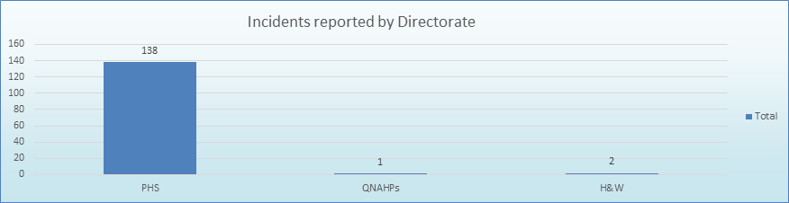
Putting Things Right
Business as usual
Return to overview
Incident Management
Summary During June 2020 there were a total of 141 incidents reported. The first chart shows the incident reporting totals over the previous year with the current reporting period highlighted. The second chart shows the number of incidents reported by Directorates for the current reporting period. The rise in incident reporting continues and is now closer to the average figure pre-Covid19. Out of the 141 incidents reported, 35% (49) were linked in some way to the Covid19 emergency. One area of particular note is the rise of around 215% in Information Governance incidents reported, compared to the same period last year (6 in June 2019; 19 in June 2020) Out of 19 incidents reported, over 75% (15) were Covid19 related, and whilst this is undoubtedly influenced to a degree by changes in working practices, improved reporting procedures which make it easier for staff to identify information governance incidents is also a factor.
23
22

Slide 24
Putting Things Right
Business as usual
Return to overview
Claims
 | June 2020
Current number of confirmed claims | 9
Current number of potential claims | 9
Current number of redress cases | 0
New claims received in month | 0
Number of claims closed in month | 0
New redress cases received in month | 0
Number of redress cases closed in month | 0
Number of Settled Claims in this reporting period | 0
Aggregate value of confirmed claims in progress | £1,637,791.18
Aggregate value of potential claims | £5,725,000.00
Aggregate value of confirmed and potential claims | £7,362,791.18
Anticipated Public Health Wales Liability in respect of confirmed claims | £225,000.00
Summary At the end of June 2020 the total number of confirmed and potential clinical negligence claims is 18. There have been 4 new potential claims received since May against Cervical Screening. The aggregated value of the confirmed claims is £1,637,791.18. The anticipated Public Health Wales liability in respect of confirmed claims is £225,000.00. The significant increase in aggregate value of potential claims is a result of a claim that is anticipated which will have a shared liability with a Health Board. Lessons learnt relating to any settled claims are shared via the Quality, Safety and Improvement Committee via the quarterly claims report.
24

