Slide 1
Public Health Wales: Sampling and Testing
Board Meeting
30 July 2020

Slide 2
Sampling and testing – July 2020
Where are we now?
Referral
Since decision to align with UK.gov testing portal, development of the Welsh portal has ceased.
On-going discussions regarding the need for a portal to support serology – likely UK
Sampling
No further planned involvement in Population Sampling Centres
Mobile Testing Units handover 31st July to commercial provider. PHW support will reduce, providing guidance around deployment in outbreaks
On-going development of Electronic test request system
Population sampling centres and Mobile testing units move over to Lighthouse labs

Slide 3
Testing
Since the start of the pandemic PHW worked to secure testing capacity for Wales
Various platforms
Issues and key challenges
Supply chain vulnerable at times
Competing for finite supply
UK allocations
Imperial Park 5
The Microbiology Division designed and modelled a laboratory space in two weeks.
To provide antigen testing and antibody testing capacity
Now to be utilised as a lighthouse lab for DHSC
Will utilise lab 2 instead for antibody testing

Slide 4
Testing
PHW lab testing capacity

Slide 5
Sampling and testing – July 2020
Where are we now?
Testing
Platform and reagent capacity >16,000 daily tests
Recruitment process on track
Turnaround time significant focus in line with contact tracing requirements for TTP
Population sampling centres and Mobile Testing units move over to Lighthouse labs
Results
On-going process improvement with HB
On-going issues with manual exceptions and administrative burden within PHW and HB

Slide 6
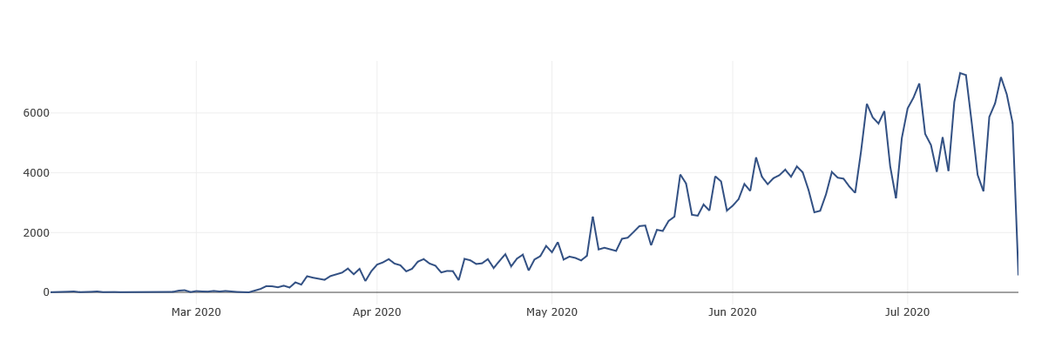
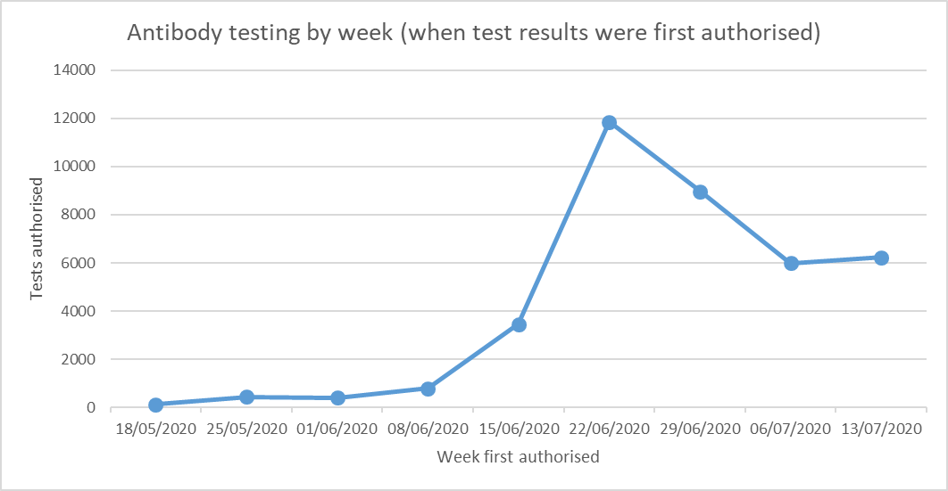
Testing Activity in Wales (Daily)

Slide 7
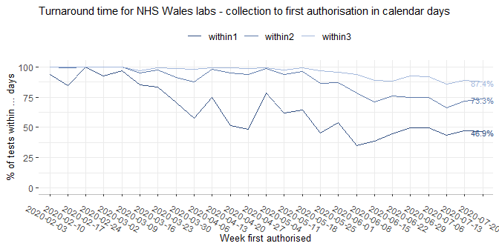
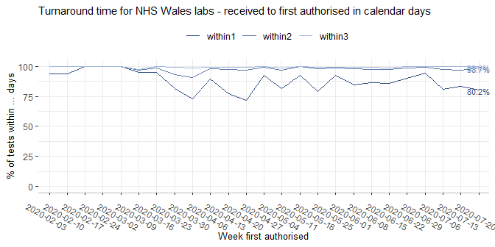
Turnaround times

Slide 8
Sampling and testing
Issues and challenges
Supply chain
Largely resolved
Complexity within the system
Potentially increasing
Clarity around PHW role, responsibilities and expectations
Aligning of UK data with Welsh information systems

Slide 9
Sampling and testing
Forward look
Testing
Capacity – reagent + workforce.
Turnaround times
Nuanced reporting
Results
Improvement in data and analytics
Professional advice and support to Welsh Government
Ability to undertake deep dives and consider improvement efforts
Care home testing

