Slide 1
Integrated Performance Report
Monitoring of COVID-19 and non COVID-19 related activity
March 2020

Slide 2
Setting the Scene
Introduction
Introduction
The Integrated Performance Report (March 2020) provides the Board with an update on the latest available position during the COVID-19 outbreak. This summary report brings together key information from a number of existing resources from the following areas (select area to the right to navigate):
Section 1 focuses on examples of work being undertaken across the organisation to support our COVID-19 response. This includes high level summary dashboards that are being used to help inform action, including the COVID-19 Surveillance Dashboard and Executive Dashboard.
Section 2 provides an overview of our financial performance for 2019/20. It includes a high-level summary of year-end revenue and capital financial performance including an overview of costs directly related to the organisation’s COVID-19 response.
Section 3 highlights latest available data on our workforce. Two dashboards are presented including an organisational dashboard of reported sickness absence due to COVID-19 and key metrics related to our people.
Section 4 provides a year-end picture of performance for a number of our key services and programmes in 2019/20 (where data is available). It also includes the latest available information on our mandatory Quality indicators.
COVID-19 Response
Finance
Business as usual
Covid-19
Workforce
Performance Indicators
2

Slide 3
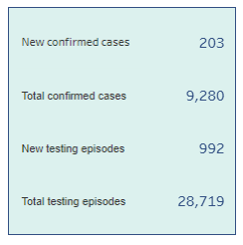
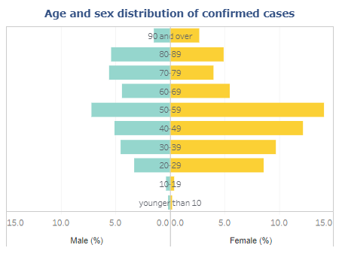
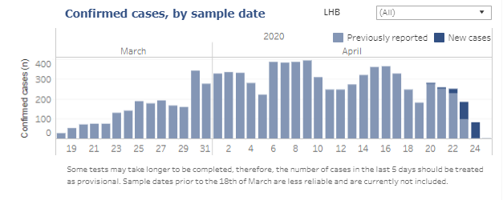
COVID-19 Response
COVID-19
Return to overview
COVID-19 Surveillance: Cases
Data correct as of 26 April 2020
Data extracted from Public Health Wales Rapid COVID-19 surveillance tool, available here (publically available).
3

Slide 4
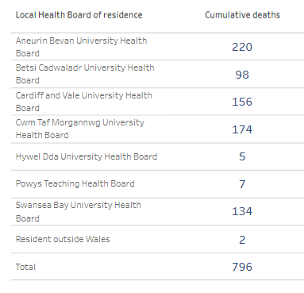
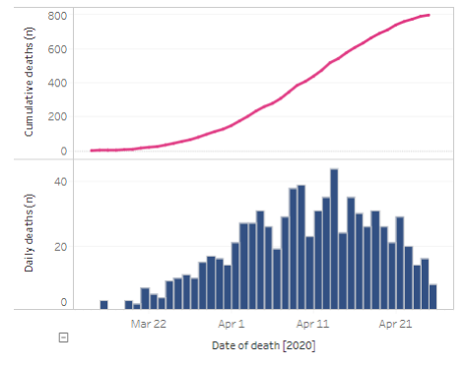
COVID-19 Response
COVID-19
Return to overview
COVID-19 Surveillance: Deaths
Data correct as of 26 April 2020
Data extracted from Public Health Wales Rapid COVID-19 surveillance tool, available here (publically available).
4

Slide 5
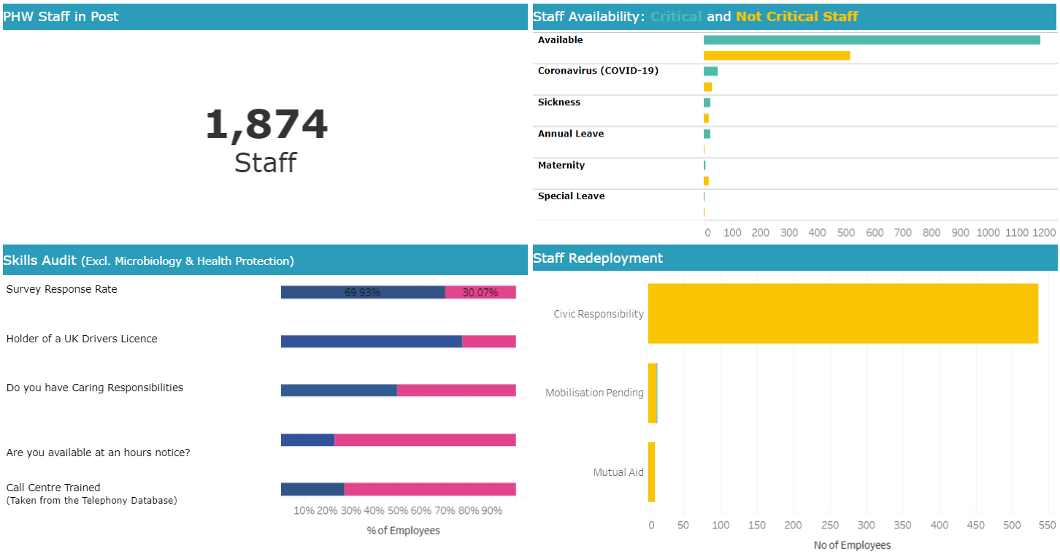
COVID-19 Response
COVID-19
Return to overview
Data reported as at 24 April 2020
Executive Dashboard
Executive Dashboard available here (Not publically available)
5

Slide 6
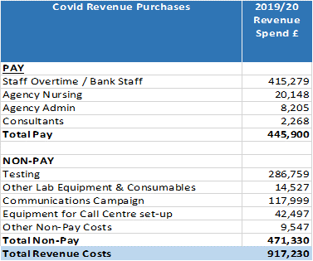
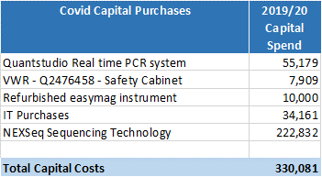
Finance
Business as usual
COVID-19
Return to overview
Overview of Financial Performance - 2019/20
COVID-19 Revenue & Capital
It has been necessary for Public Health Wales to incur additional revenue and capital costs in respect of its national leadership role in the response to COVID-19 in 2019/20. The tables below show the total revenue and capital costs incurred during 2019/20 totalling £917,230 and £330,081 respectively.
Within the 2019/20 revenue outturn position Public Health Wales was able to cover £496k of the total spend on COVID-19 from within current budgets due to slippage in the following areas:
Health and Wellbeing: Primary Care programmes and Health Improvement Strategic Plans
Screening: increased vacancy due to delayed recruitment and cancellation of events
Postponement of investment plans that were due to commence in March
Welsh Government have provided additional funding for the remaining £421k.
6

Slide 7
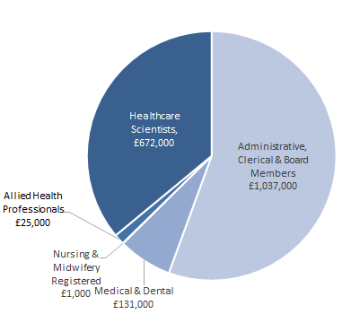
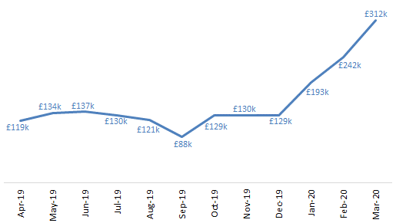
Finance
Business as usual
COVID-19
Return to overview
Overview of Financial Performance - 2019/20
Agency Spend
7

Slide 8
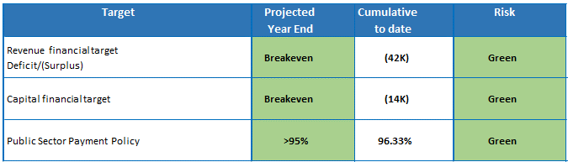
Finance
Business as usual
COVID-19
Return to overview
Overview of Financial Performance - 2019/20
Summary
The purpose of this report is to provide a high-level summary of the 2019/20 revenue and capital financial performance for Public Health Wales to the Executive Team and the Board. The year-end reporting deadline for draft accounts submission is 22 May 2020, followed by final audited accounts submission deadline of 30 June 2020. This means that this position is currently draft and when finalised, a detailed financial performance report will be submitted to Executive Team and the Board.
The following table highlights the performance against the key revenue and capital financial targets.
The year-end position for Public Health Wales is a surplus of £42k. The year-end position includes £0.917m of costs directly related to the Trust’s COVID-19 response. The Public Sector Payment Policy Statutory target has once again been achieved for 2019/20.
8

Slide 9
Finance
Business as usual
COVID-19
Return to overview
Overview of Financial Performance - 2019/20
Financial position by Income, Pay and Non Pay
The cumulative reported position is a net surplus of £42k, and is summarised in the table below:
Type | Annual Budget £000s | Cumulative Budget £000s | Cumulative Actual £000s | Cumulative Variance £000s
Income | -155,340 | -155,340 | -155,347 | -7
Pay | 96,288 | 96,288 | 94,266 | -2,022
Non Pay | 59,052 | 59,052 | 61,040 | 1,987
Grand Total | 0 | 0 | -42 | -42
The pay and non pay variances are due to pay vacancies and recruitment challenges which have been offset by increased spends on non pay to deliver agreed forecasted positions.
9

Slide 10
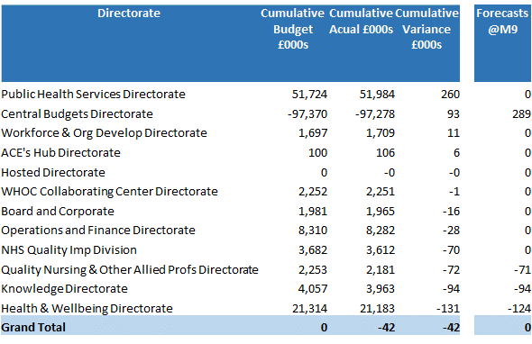
Finance
Business as usual
COVID-19
Return to overview
Overview of Financial Performance - 2019/20
Directorate
Key movements from Forecasts are:
Public Health Services - £260k movement from forecast
The movement in the overall position for Public Health Services was primarily due to increased expenditure within Microbiology. Increased costs were incurred on laboratory consumables, courier costs in North Wales and maintenance charges across the Division.
Central Budgets - £196k movement from forecast
Welsh Risk Pool forecasted expected to be £118k at Month 9, actual figure was £48k, a movement of £70k
HR legal cases and a number of non-pay pressures didn’t materialise as originally expected.
10

Slide 11
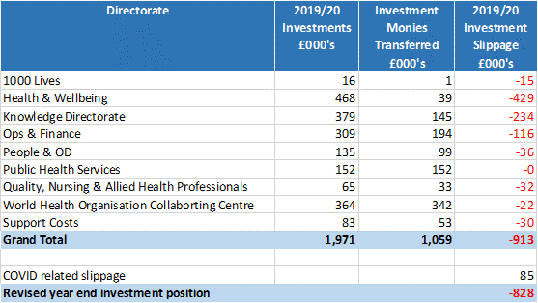
Finance
Business as usual
COVID-19
Return to overview
Overview of Financial Performance - 2019/20
Investments
The following table summarises the year-end position in respect of investment funding.
The revised year end investment position is as per our forecasted plans, as previously reported to Board, and was used to fund:
VER cases - £110k
Changes in the discount factor for personal injury benefit £126k
Climate change research project £58k
Defibrillators for our sites £15k
Creditor write backs - £359k
Reduction in VAT recovery for 2019/20 - £208k
11

Slide 12
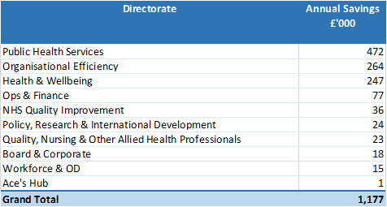
Finance
Business as usual
COVID-19
Return to overview
Overview of Financial Performance - 2019/20
Savings / Organisational Efficiencies
The 2019/20 savings target needed in order to deliver the full investment programme on a recurrent basis is £1.371m. However, due to the profiling of the expenditure plans of the investment bids then the savings achieved for 2019/20 are £1.177m.
Of this, £913k relates to the 1% savings target assigned to each Directorate. £257k of which was met by increased vacancy factors. Based on the year end pay position the increased vacancy factors have been achieved. The remaining element of £656k was met by changes within staffing establishments and non-pay efficiencies. The Trust has met the Organisational Efficiency Target of £165k for 2019/20.
12

Slide 13
Finance
Business as usual
COVID-19
Return to overview
Overview of Financial Performance - 2019/20
Capital
Public Health Wales capital funding for 2019/20 totals £3.980m, split as follows:-
Discretionary £1.041m
Strategic £2.609m, which is in respect of CSIMs year 4, Digital Priorities Investment Fund, WAAASP Equipment Replacement, Screening Mammography Equipment and Laboratory Information Network Cymru.
Strategic - COVID-19 £0.33m
13

Slide 14
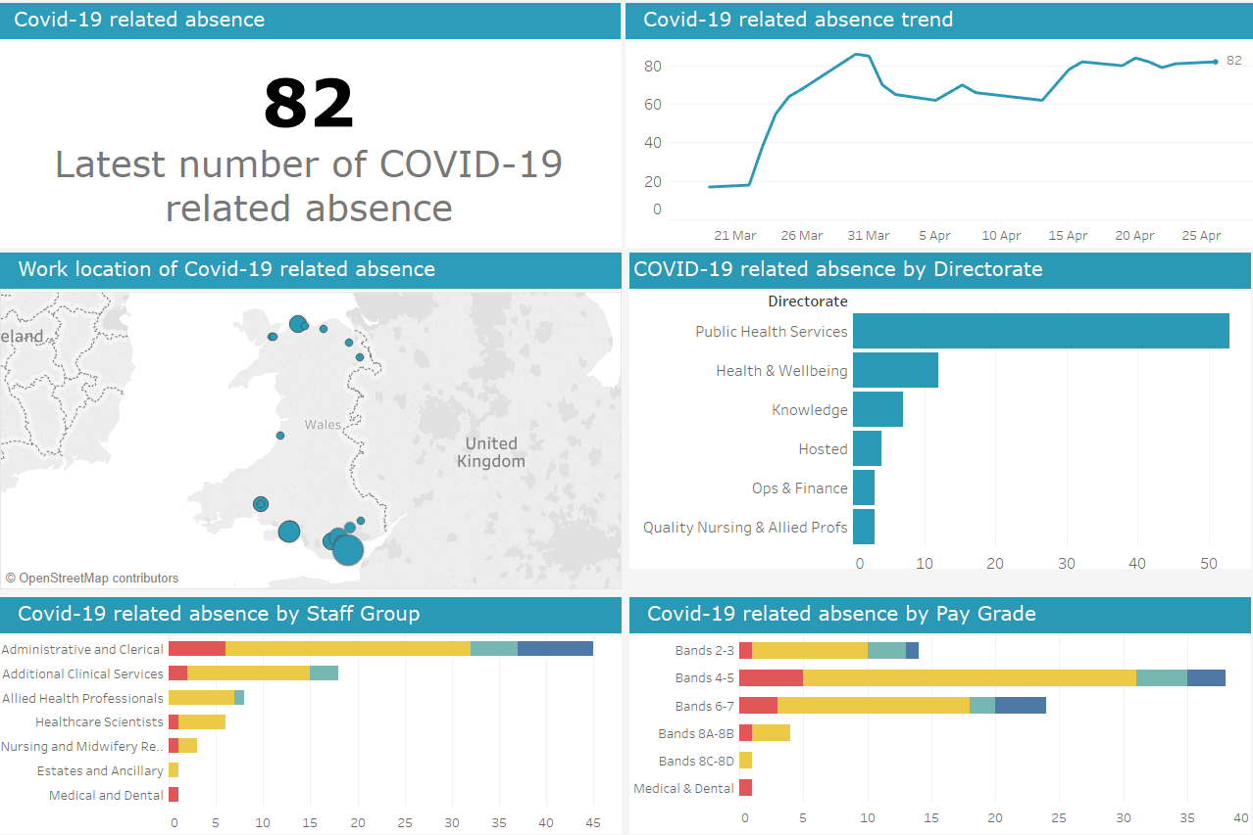
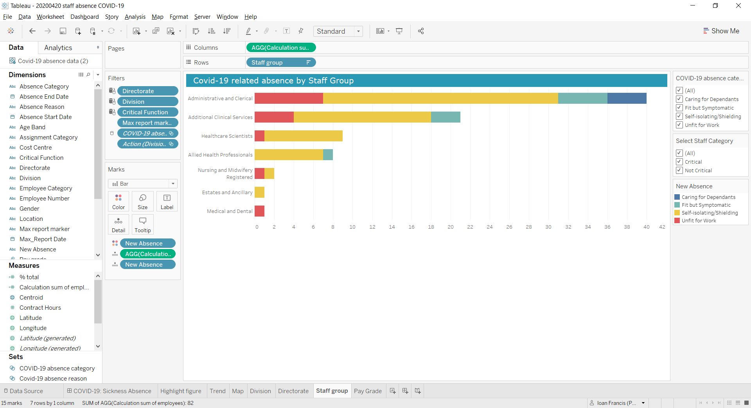
Workforce
Business as usual
COVID-19
Return to overview
COVID-19 Staff Absence Dashboard
Data reported as at 24 April 2020
Dashboard available here (Not publically available)
Business as usual
Covid-19
14

Slide 15
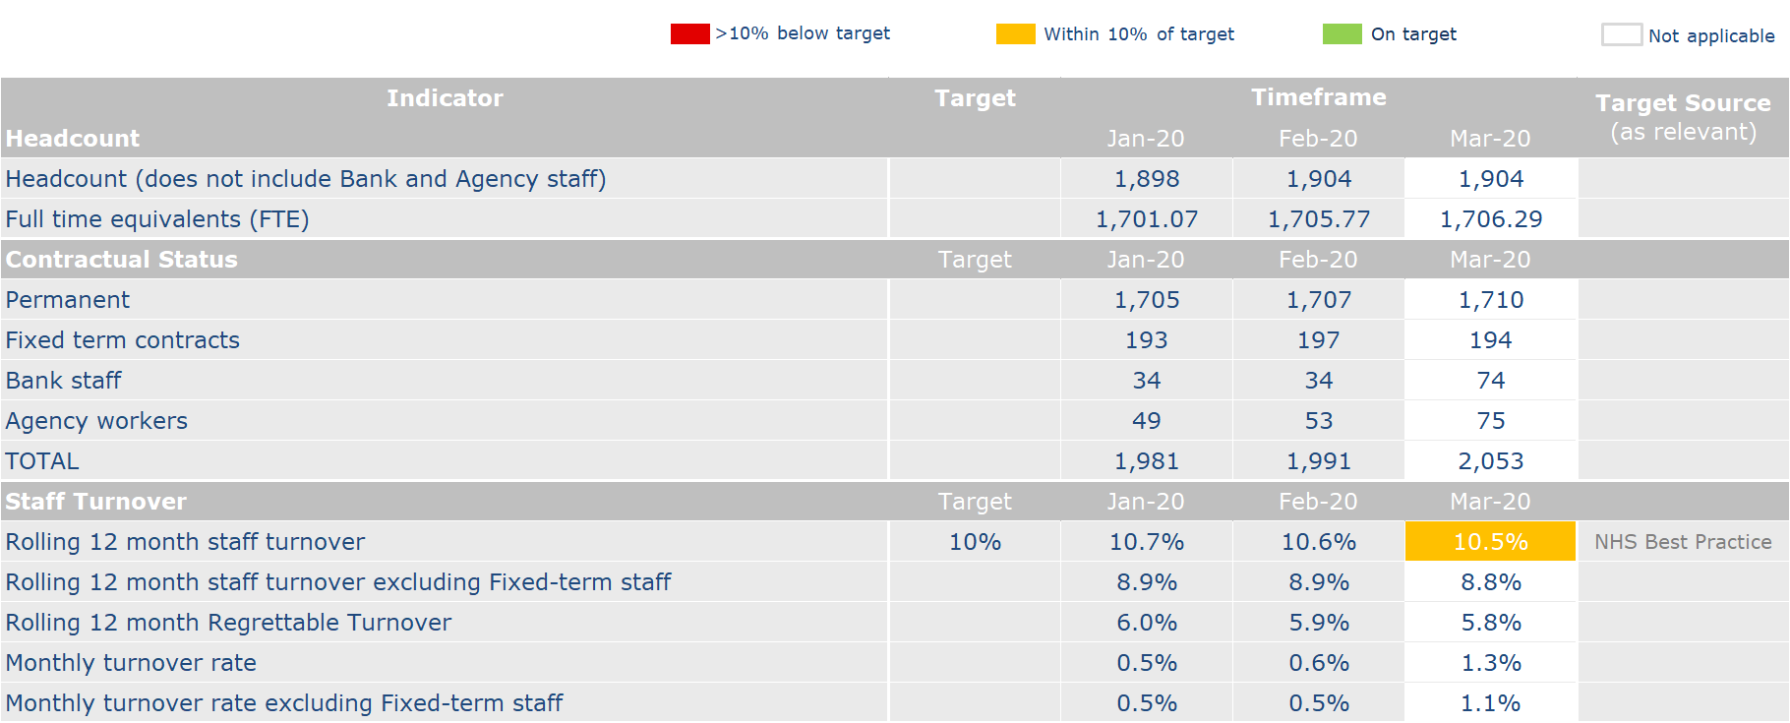
Workforce
Business as usual
COVID-19
Return to overview
Business as usual
Covid-19
15

Slide 16
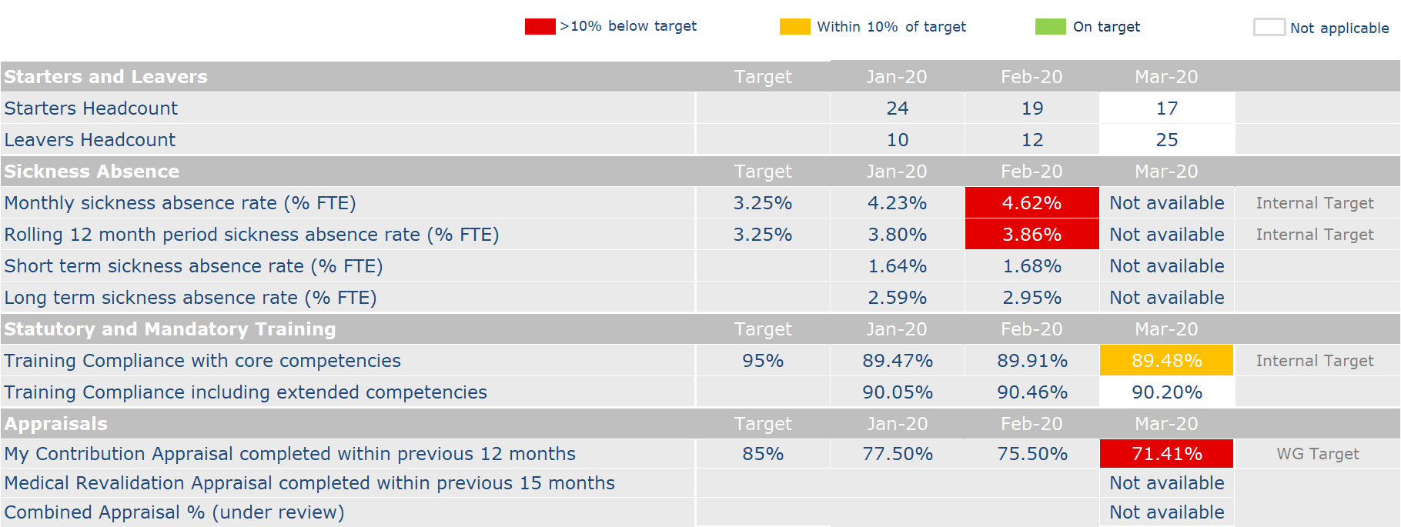
Workforce
Business as usual
COVID-19
Return to overview
Business as usual
Covid-19
16

Slide 17
Performance Indicators
Performance Dashboard
Return to overview
17

Slide 18
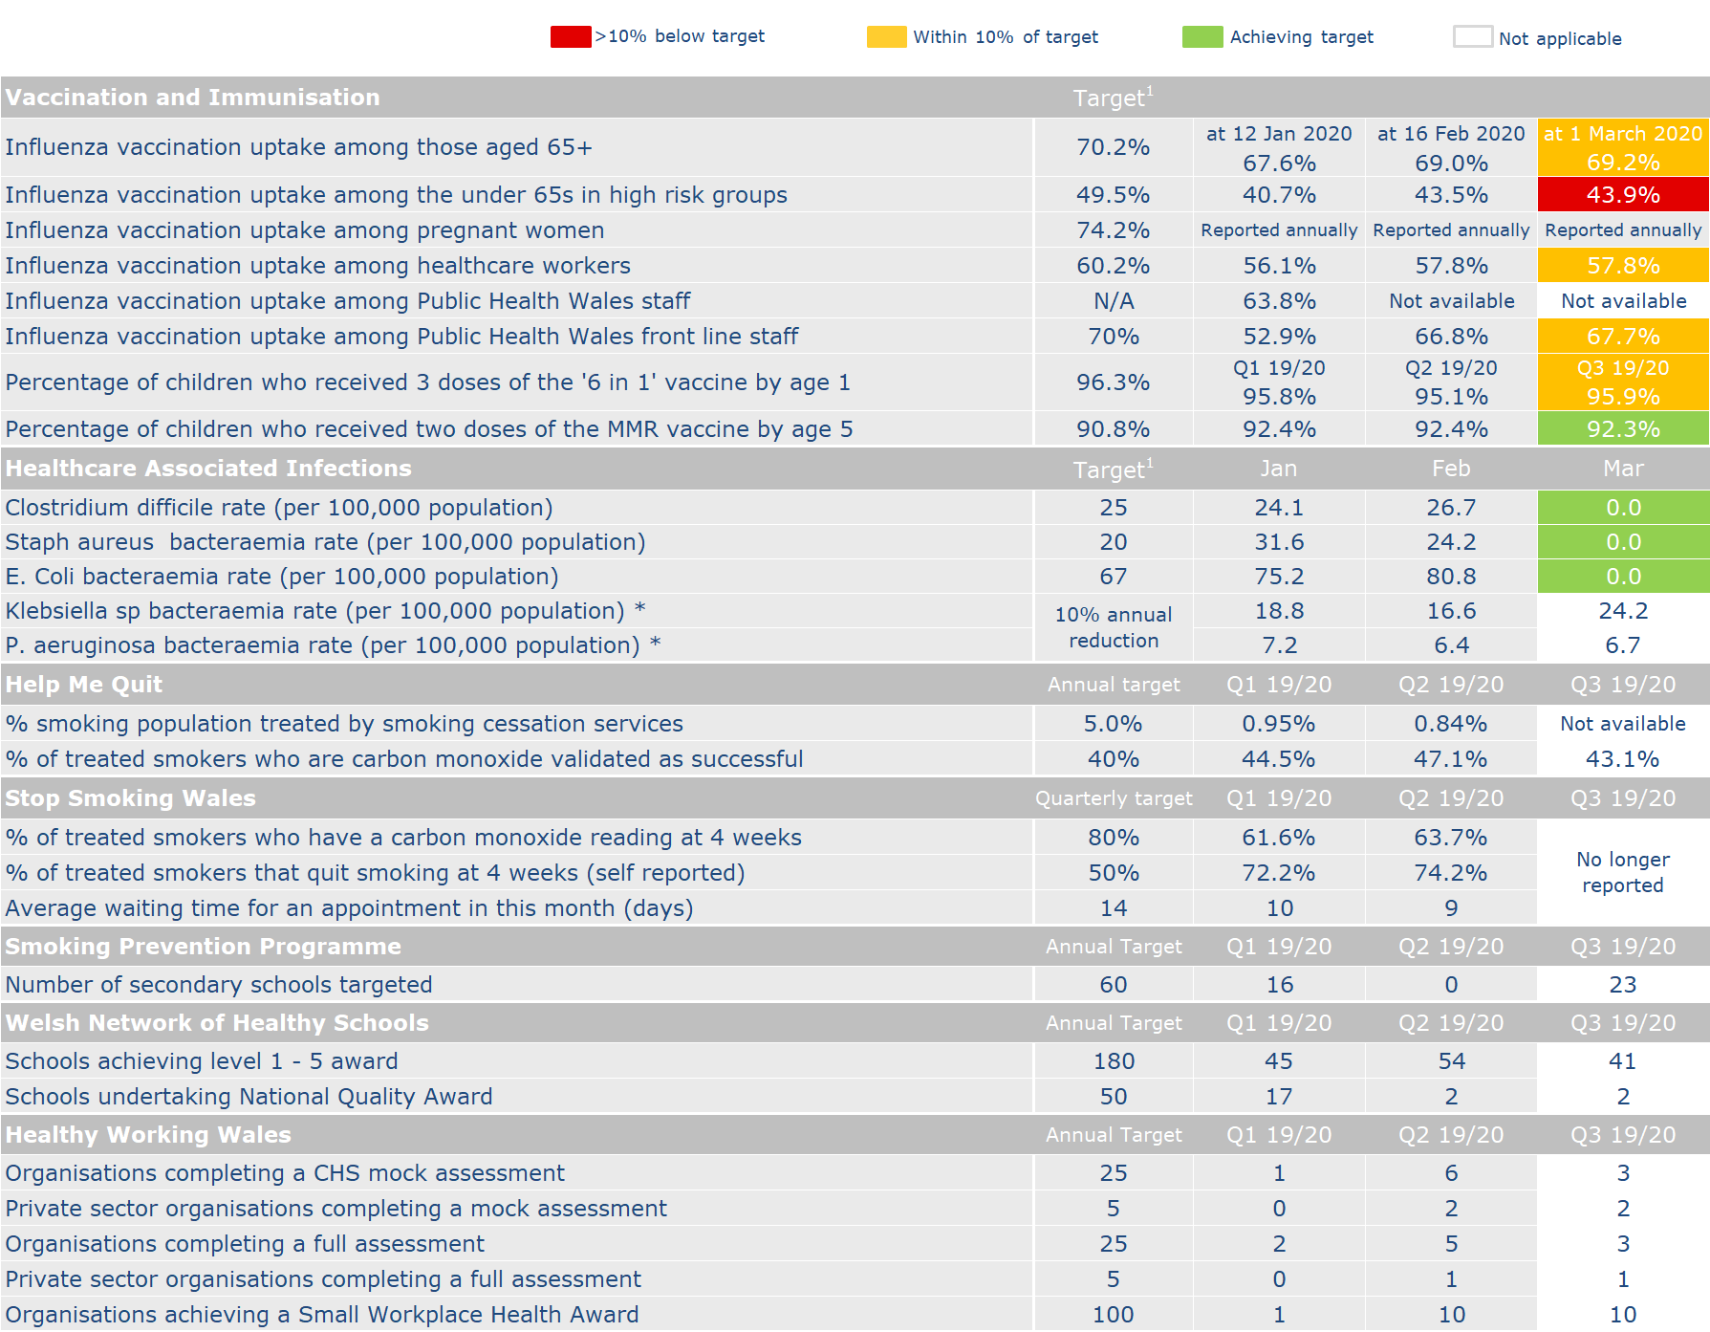
Performance Indicators
Performance Dashboard
Return to overview
18

Slide 19
Performance Indicators
Performance Dashboard
Return to overview
19

Slide 20
Performance Indicators
COVID-19
Return to overview
Screening
Following the announcement from the UK Government on 16 March which advised against non-essential social contact and non-essential travel, the subsequent recommendations were agreed following a risk assessment on ability and safety to deliver screening programmes:
Invitations and screening clinics temporarily paused from 20 March for Diabetic Eye Screening Wales, Wales Abdominal Aortic Aneurysm Screening Programme, Breast Test Wales. Invitations temporarily paused from 20 March for Cervical Screening Wales and Bowel Screening Wales.
Screening pathways completed for those participants who had already been screened and contacted all those who had a screening appointment booked.
Newborn Bloodspot Screening, Newborn Hearing Screening programmes and Antenatal Screening have continued as all have a short window of time that they can be offered and can prevent impactful complications for newborns.
Performance in March was impacted by the changes that have been put in place in response to COVID-19:
Breast Test Wales – completed the screening pathway for women who have been screened and the assessment process was within timeliness standards. The round length indicator will not be met as the programme has been paused.
Cervical Screening Wales – maintained timeliness of completing the screening pathway for cervical screening during March.
Bowel Screening Wales – coverage increased in March but this will now reduce due to the COVID-19 response. Waiting time for colonoscopy was not met and this will further reduce as health boards paused their colonoscopy provision.
Wales Abdominal Aortic Aneurysm Screening – uptake of surveillance maintained in March but will reduce as surveillance has been paused
Newborn Hearing Screening – indicators for February within standard but will reduce going forward due to the challenges of maintaining this service during COVID-19 response. All efforts are being undertaken to offer screening to newborns.
Newborn Bloodspot Screening – Coverage slightly reduced in March as the impact of COVID-19 started and this may further reduce but all efforts are being undertaken to offer screening to newborns. Avoidable repeat rate increased in March and work remains to keep this rate low.
Diabetic Eye Screening Wales – Coverage reduced and this is the start of the impact on COVID-19 as clinics were cancelled. The results letters timeliness reduced due to staff shortages but all results letters have been sent out for those who have been screened.
20

Slide 21
Putting Things Right
Business as usual
Return to overview
Performance against Mandatory Indicators
Complaints | Target | March 2020
Total number of formal complaints received for the period 1 – 31 March 2020 | - | 2
Number (%) of complaints acknowledged within 2 working days | 95% (PHW) | 2 (100%)
Number (%) of complaints responded to within 30 working days of receipt | 75% (WG) 95% (PHW) | 1 (50%)*
Number (%) of complaints responded to within a period exceeding 30 working days but within 6 months | - | 1
Number of informal complaints (on the spot) received | - | 3
Serious Incidents | Target | March 2020
Number of serious incidents reported | - | 0
Number of serious incidents not closed within 60 days | 0% | 0
*One of the formal complaints received during the reporting period exceeded the target response time by 2 days as a result of the current pressures of dealing with COVID-19.
21

Slide 22
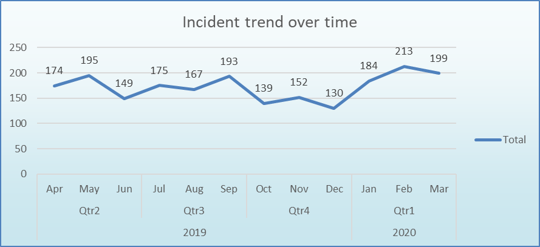
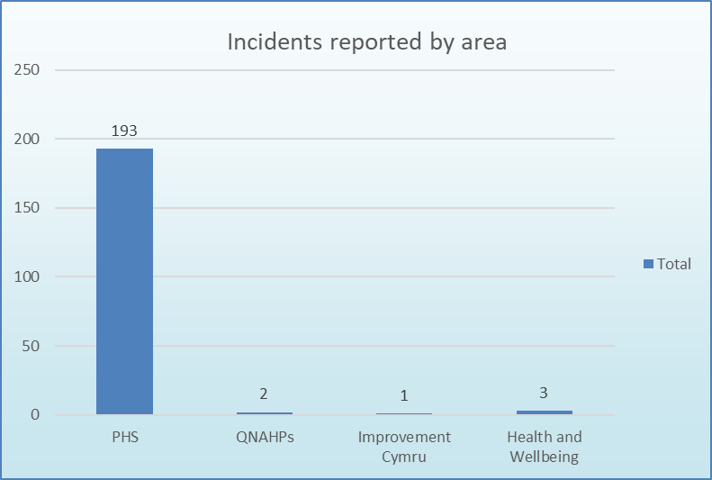
Putting Things Right
Business as usual
Return to overview
Incident Management
Summary There was a slight fall in incidents with 199 being reported during the reporting period. This is likely to be explained by changes in working practices and a reduction in overall incidents due to the COVID-19 outbreak response. Data will be available in the next reporting period on the number of incidents that have been reported as being COVID-19 related.
It should noted that almost all of the incidents occur within Public Health Services, which is to be expected due to the clinical nature of their activities.
22

Slide 23
Putting Things Right
Business as usual
Return to overview
Claims
 | March 2020
Current number of confirmed claims | 10
Current number of potential claims | 5
Current number of redress cases | 0
New claims received in month | 0
Number of claims closed in month | 0
New redress cases received in month | 0
Number of redress cases closed in month | 0
Number of Settled Claims in this reporting period | 0
Aggregate value of confirmed claims in progress | £2,147,491.18
Aggregate value of potential claims | £5,725,000.00
Aggregate value of confirmed and potential claims | £7,872,491.18
Anticipated Public Health Wales Liability in respect of confirmed claims | £250,000.00
Summary At the end of March 2020 the total number of confirmed and potential clinical negligence claims is 15. The aggregated value of the confirmed claims is £2,147,491.18. The anticipated Public Health Wales liability in respect of both confirmed and potential claims is £375,000.00. The significant increase in aggregate value of potential claims is a result of a claim that is anticipated which will have a shared liability with a Health Board.
23

