Slide 1
Integrated Performance Report
Monitoring of COVID-19 and non COVID-19 related activity
April 2020

Slide 2
Setting the Scene
Introduction
Introduction
The Integrated Performance Report (April 2020) provides the Board with an update on the latest available position during the COVID-19 outbreak. This summary report brings together key information from a number of existing resources from the following areas (select area to the right to navigate):
Section 1 focuses on examples of work being undertaken across the organisation to support our COVID-19 response. This includes high level summary dashboards that are being used to help inform action, including the COVID-19 Surveillance Dashboard and Executive Dashboard.
Section 2 provides an overview of our financial performance for Month 1 2020/21. It includes a high-level summary of revenue and capital financial performance including an overview of costs directly related to the organisation’s COVID-19 response.
Section 3 highlights latest available data on our workforce. Two dashboards are presented including an organisational dashboard of reported sickness absence due to COVID-19 and key metrics related to our people.
Section 4 provides an update against year-end performance for a number of our key services and programmes in 2019/20 (where data is available) and those continuing to operate during COVID-19. It also includes the latest available information on our mandatory Quality indicators.
COVID-19 Response
Finance
Business as usual
Covid-19
Workforce
Performance Indicators
2

Slide 3
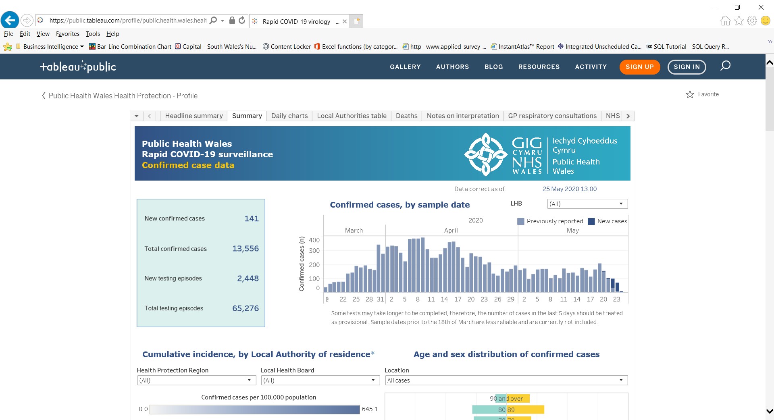
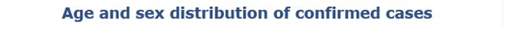
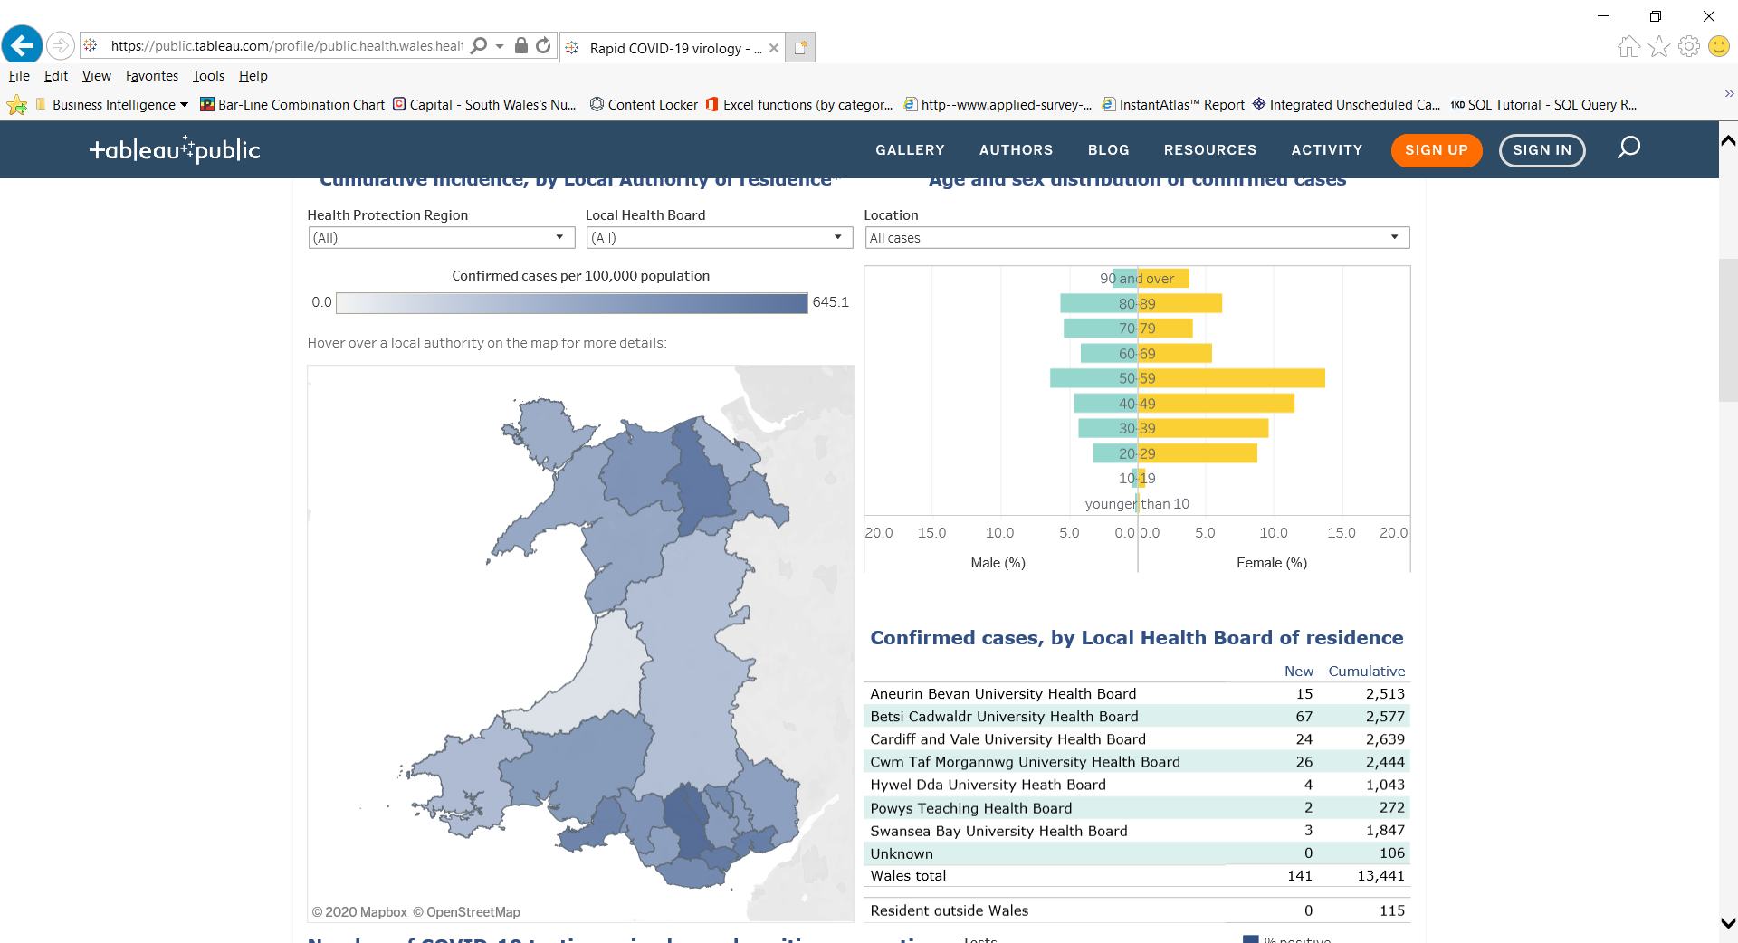
COVID-19 Response
COVID-19
Return to overview
COVID-19 Surveillance: Cases
Data correct as of 25 May 2020
Data extracted from Public Health Wales Rapid COVID-19 surveillance tool, available here (publically available).
3

Slide 4
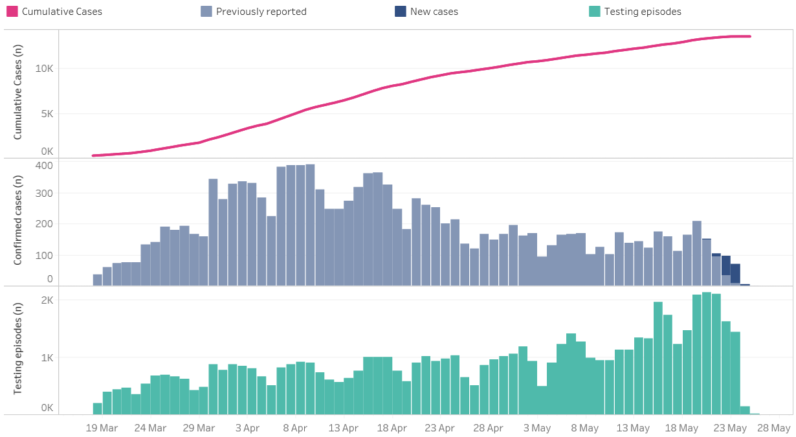
COVID-19 Response
COVID-19
Return to overview
COVID-19 Surveillance: Testing
Data correct as of 25 May 2020
Data extracted from Public Health Wales Rapid COVID-19 surveillance tool, available here (publically available).
4
4

Slide 5
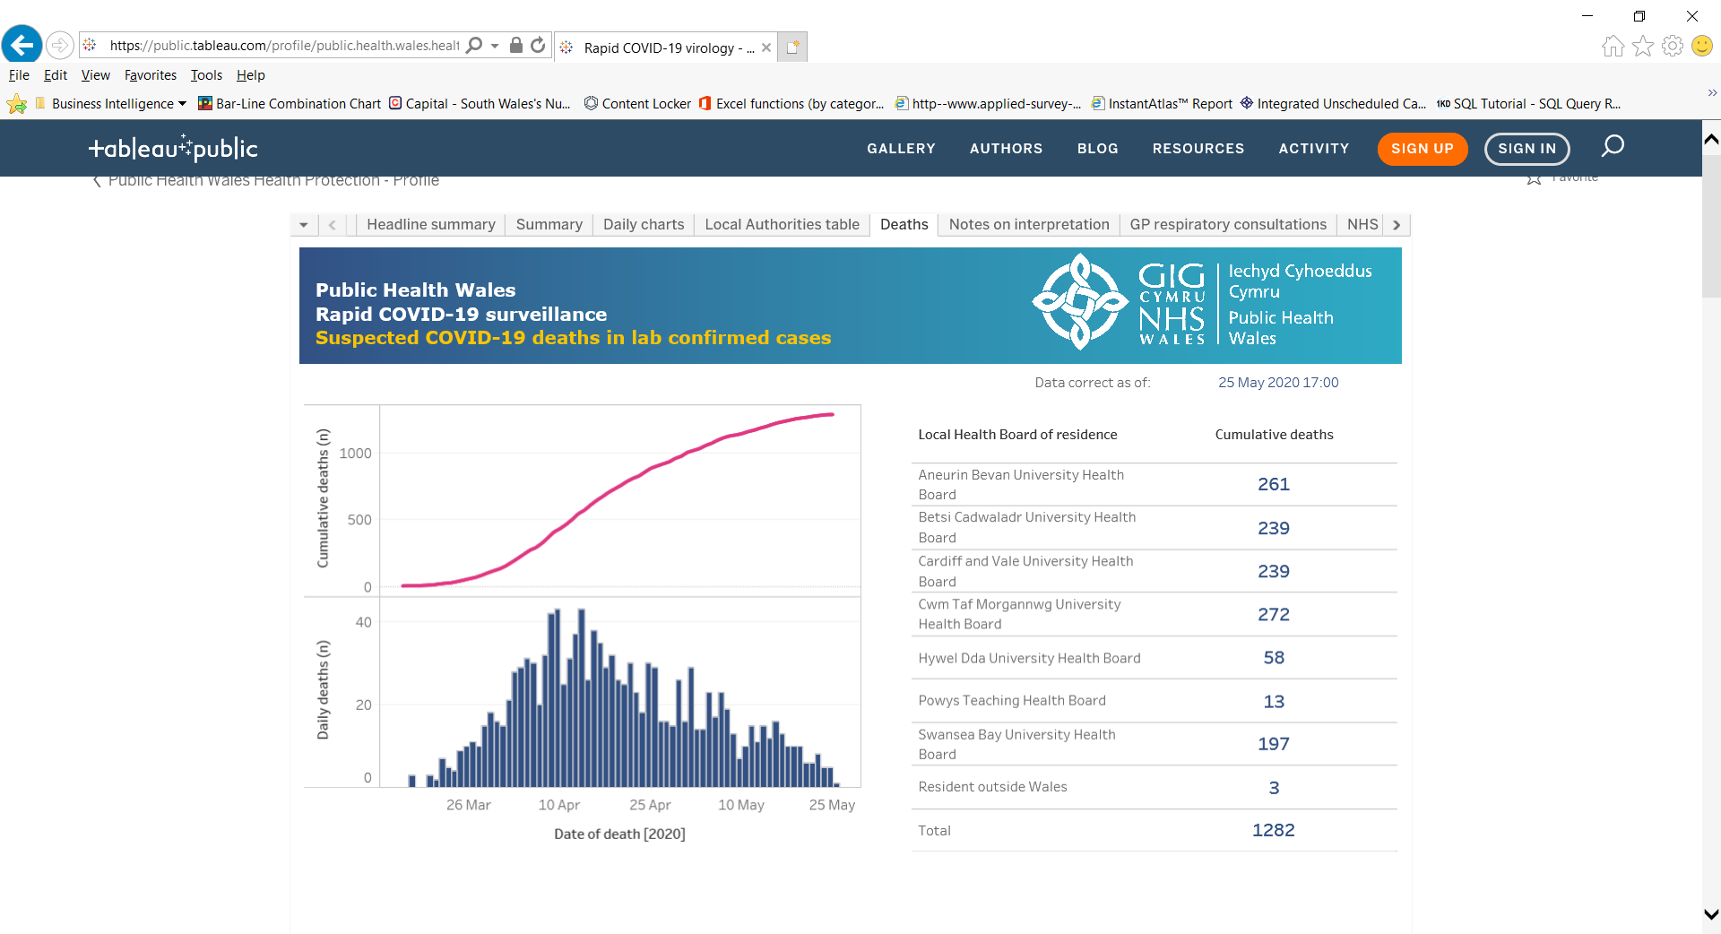
COVID-19 Response
COVID-19
Return to overview
COVID-19 Surveillance: Deaths
Data correct as of 25 May 2020
Data extracted from Public Health Wales Rapid COVID-19 surveillance tool, available here (publically available).
5

Slide 6
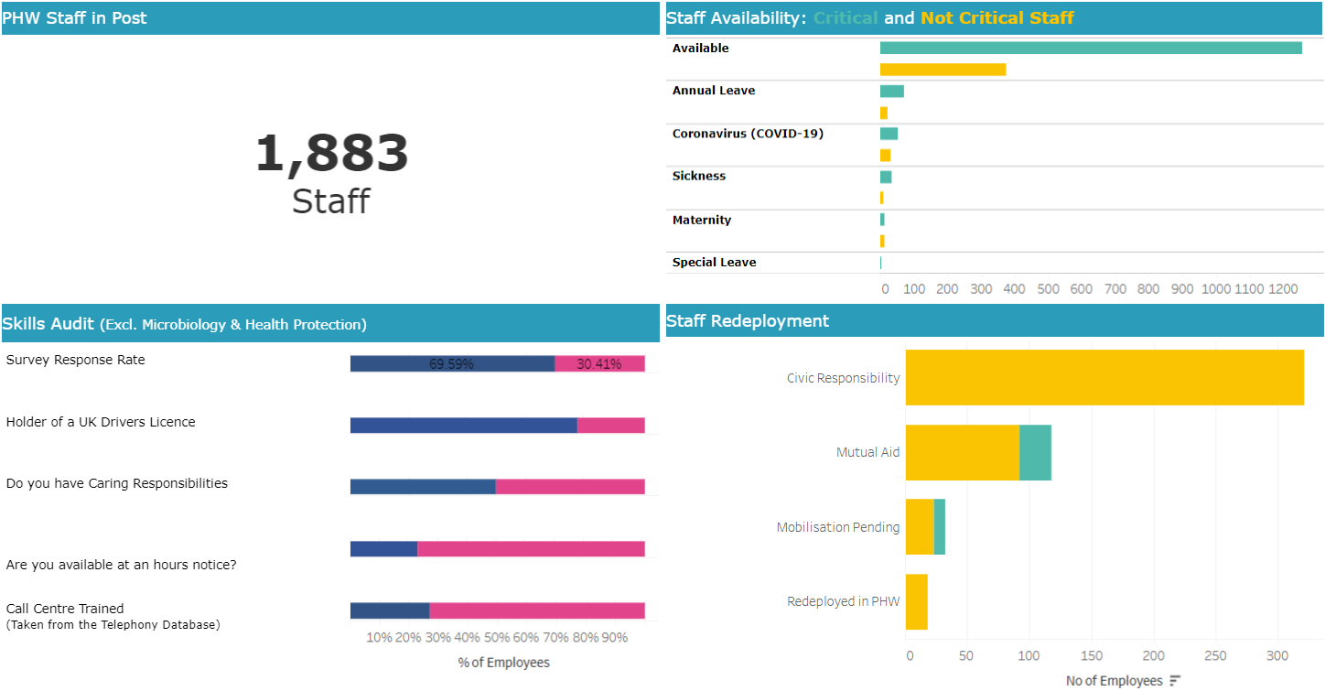
COVID-19 Response
COVID-19
Return to overview
Data correct as of 25 May 2020
Executive Dashboard
Executive Dashboard available here (Not publically available)
Available for redeployment*
* Public Health Wales currently has 321 staff (identified as non-critical) available for deployment, either to support our Covid-19 response or to provide mutual aid to the wider NHS.
6

Slide 7
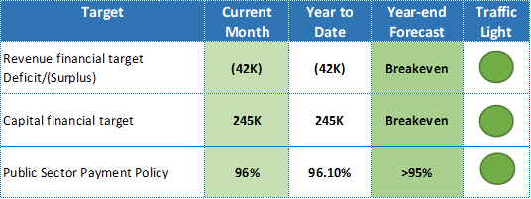
Finance
Business as usual
COVID-19
Return to overview
Overview of Financial Performance - Month 1 2020/21
Summary
The purpose of this report is to outline to the Executive Team and the Board the revenue and capital position for Public Health Wales as at 30 April 2020 (M1), which is also circulated to the Audit and Corporate Governance Committee. The content of this report is reflected in the Director of Finance commentary that has been submitted to Welsh Government on 18 May 2020 as part of the full financial monitoring return for Month 1.
The following table highlights the performance against the key revenue and capital financial targets.
The cumulative reported position for Public Health Wales is a net surplus of £42k. This position includes £1.330m of costs directly related to the Trust’s COVID-19 response. This position includes anticipated income from Welsh Government of £1.067m.
7

Slide 8
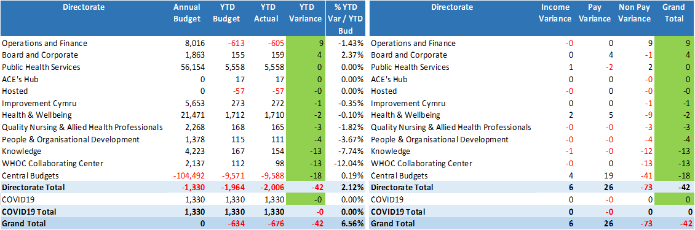
Finance
Business as usual
COVID-19
Return to overview
Overview of Financial Performance - Month 1 2020/21
Directorate
8

Slide 9
Finance
Business as usual
COVID-19
Return to overview
Overview of Financial Performance - Month 1 2020/21
Directorate
The month-end position for Public Health Wales is a net surplus of £42k. This position includes anticipated income from Welsh Government of £1.067m broken down as follows:
£1.010m Covid-19
£0.025m Digital strategy
£0.032m Healthier Wales (Early years prevention)
As part of our financial plans for 2020/21 it has been agreed that pay underspends, a number of non-pay budgets, and the internal investment fund will be held centrally to contribute to the additional costs incurred as a result of COVID-19. Total spend on COVID-19 for month 1 is £1.330m of which £0.320m has been met from within Public Health Wales centrally held budgets. £130k from pay underspends and £190k from non pay reductions in spend (£75k release of budget associated with the Public Health Wales Conference to contribute to the COVID-19 media campaign and £115k of Public Health Wales Investment slippage), leaving £1.010m of additional income required from Welsh Government.
Public Health Services Directorate:
Microbiology division has overspent in month 1 by £186k, this overspend has been offset in by underspends in Screening division of £119k and Health Protection division of £49k. Public Health Services Directorate will need to ensure that a break-even plan for the Directorate is maintained for the full year forecast.
9

Slide 10
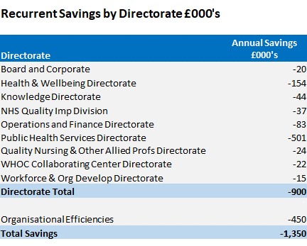
Finance
Business as usual
COVID-19
Return to overview
Overview of Financial Performance - Month 1 2020/21
Savings / Organisational Efficiencies
Public Health Wales savings strategy for 2020/21, as set out in the IMTP, was £1.350m, made up of 1% Directorate savings and 0.5% Organisational Efficiencies.
Of the £900k relating to the 1% savings target assigned to each Directorate. £74k was met by increased vacancy factors. Based on the Month 1 pay position the increased vacancy factors are being achieved and will continue to be monitored on a monthly basis. The remaining element of £826k was met by changes within staffing establishments (£75k) and non-pay efficiencies (£670k).
Of the £450k relating to Organisational efficiencies, £120k related to savings linked to VERs in 19/20 and has been achieved in month 1. The remaining efficiencies are linked to procurement efficiencies (£105k), Salary Sacrifice Schemes (£40k) and yet to be identified red schemes (£185k). Due to COVID -19 priorities, the remaining efficiencies have been re-classified as red schemes (£330k).
10

Slide 11
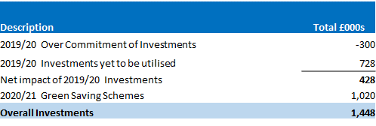
Finance
Business as usual
COVID-19
Return to overview
Overview of Financial Performance - Month 1 2020/21
Investments
The current status of the investments for both 2019/20 and 2020/21 are as follows:
There will be slippage against investment within Public Health Wales due to delays in the allocation of internal investment funding as a result of COVID-19.
Due to the inability of our Directorates to pursue investment, £115k of month 1 investment slippage has been used to form part of Public Health Wales overall financial commitment to supporting the COVID-19 response. There are on-going discussions with Welsh Government on additional funding they may provide to contribute to our COVID-19 costs.
11

Slide 12
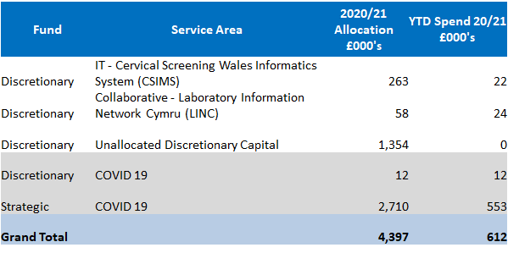
Finance
Business as usual
COVID-19
Return to overview
Overview of Financial Performance - Month 1 2020/21
Capital
Public Health Wales capital funding for 2020/21 totals £4.397m, split as follows:
Discretionary £1.687m, £12k of which has been allocated to support COVID-19
Strategic £2.710m in respect of COVID-19 is made up as follows:
  Cepheid Systems - £751k
  Perkin Elmer Platforms - £740k
  Eplex - £553k
  MAST Seegene - £666k
12

Slide 13
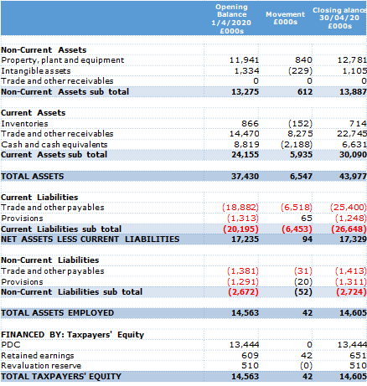
Finance
Business as usual
COVID-19
Return to overview
Overview of Financial Performance - Month 1 2020/21
Balance Sheet
The Balance Sheet, or Statement of Financial Position, reports the assets, liabilities and reserves of the organisation at a specific point in time.
Non-Current Assets
Overall non-current assets has increased by £0.612m. This reflects the net position of our capital purchases in month 1 of 20/21. The majority of this (£0.553m) being on COVID-19 strategic project.
Current Assets
Current trade and other receivables has increased by £8.275m. This increase predominantly relates to the Welsh Government core income advance invoice for June.
Cash and cash equivalents has decreased by £2.188m. This is partly due to the timing of our month 1 tax and NI payments (£1.937m) which remain outstanding.
Current liabilities
Current trade and other payables has decreased by £6.518m. As mentioned above £1.937m of tax and NI payments relating to month 1 remains outstanding. The remainder of the variance is predominantly non-NHS accruals (£3.408m) mostly relating to consumables contracts, £0.120m relating to COVID-19 Wellbeing marketing campaign and £0.261m COVID-19 on-call and overtime owed.
13

Slide 14
Finance
Business as usual
COVID-19
Return to overview
Overview of Financial Performance - Month 1 2020/21
Agency Spend
Summary There has been a decrease in expenditure in the categories ‘Administrative, Clerical & Board Members’ from £231K in March 2020 to £70K in April 2020, in ‘Medical and Dental’ from £32K to £13K, in ‘Nursing & Midwifery Registered’ from £1k to 0, in ‘Allied Health Professionals’ from £14K to 0 and in ‘Healthcare Scientists’ from £35K to £33K. This is due mainly to several agency contracts coming to an end and 3 COVID nurses stood down at the end of March 2020.
14

Slide 15
Finance
Business as usual
COVID-19
Return to overview
Overview of Financial Performance - Month 1 2020/21
Conclusion
The Board is asked to note the following:
financial position reported at month 1
status of the Capital Programme for 2020/21
whilst we always undertake to either seek funding approval from Welsh Government or identify from our own budgets, that the total quantum of funding for addressing COVID-19 across Wales remains fluid and uncertain. There is a risk that the organisation’s operational cost of addressing and recovering from the pandemic cannot be contained within available funding resulting in a potential breach of the planned outturn for 2020-21
15

Slide 16
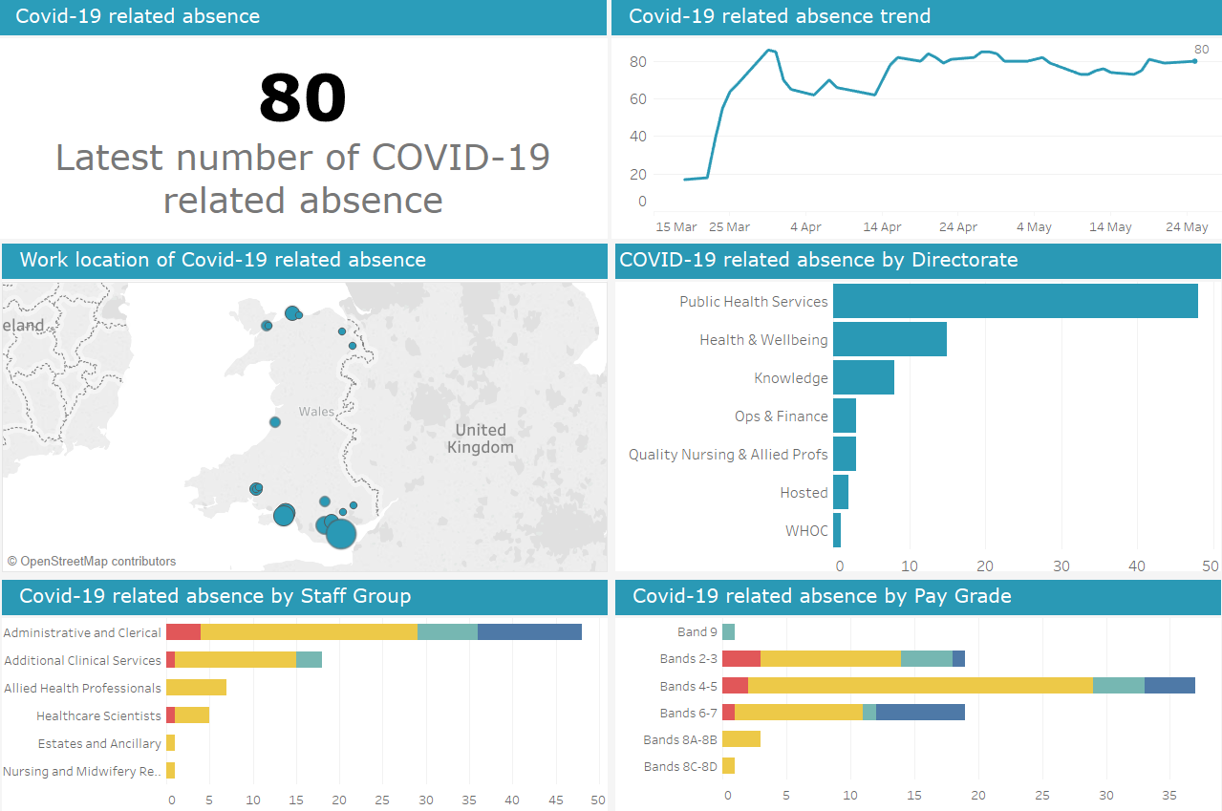
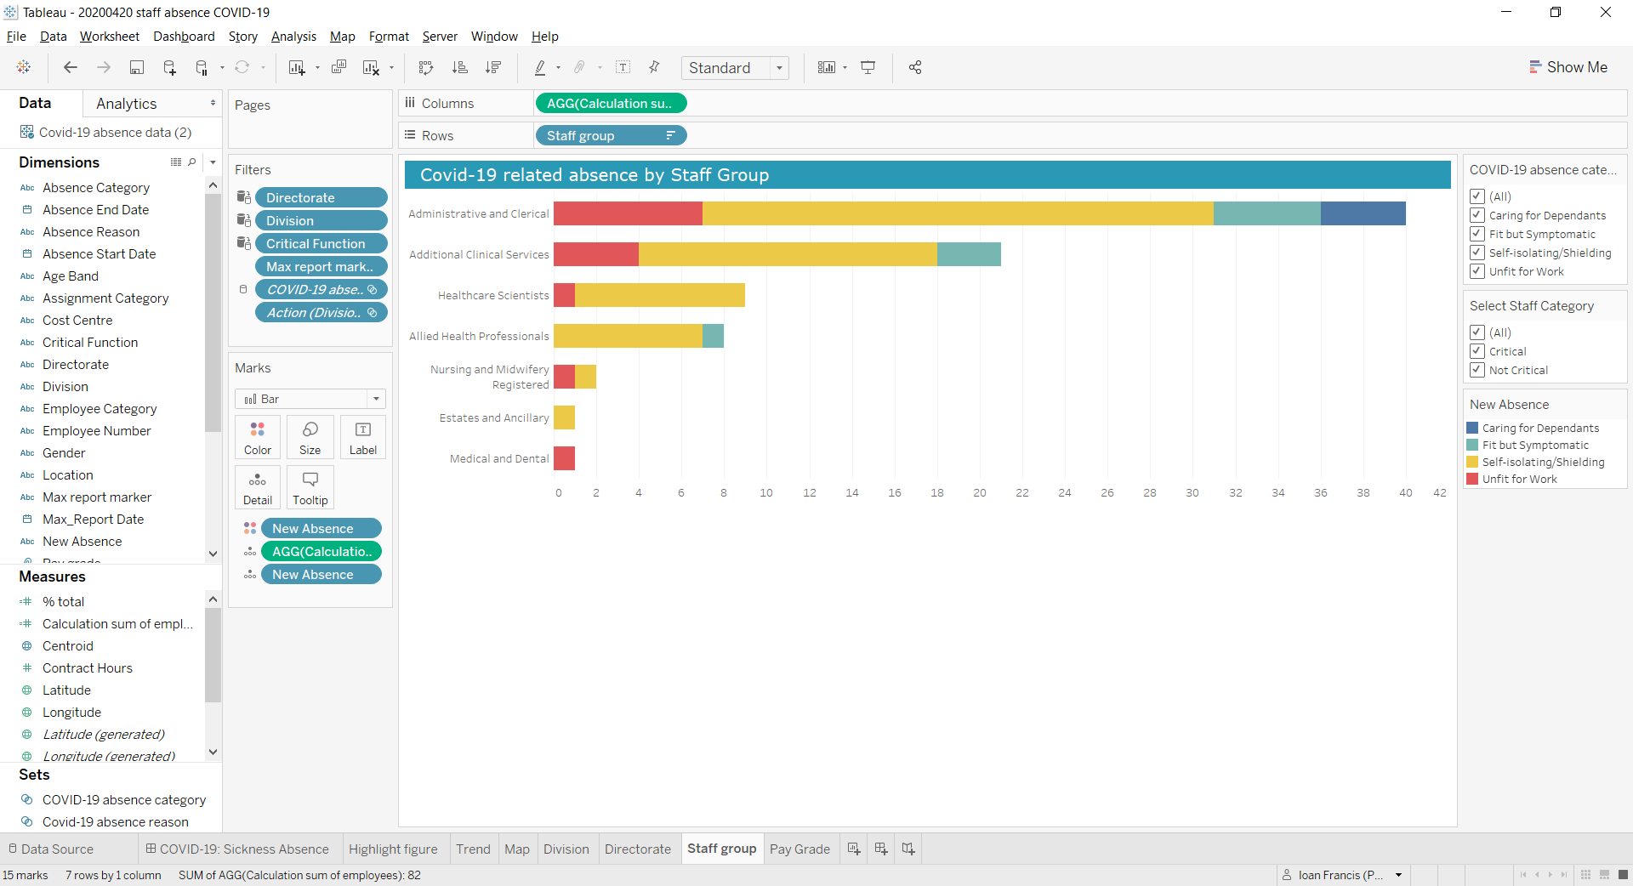
Workforce
Business as usual
COVID-19
Return to overview
COVID-19 Staff Absence Dashboard
Data correct as of 25 May 2020
Dashboard available here (Not publically available)
Business as usual
Covid-19
16

Slide 17
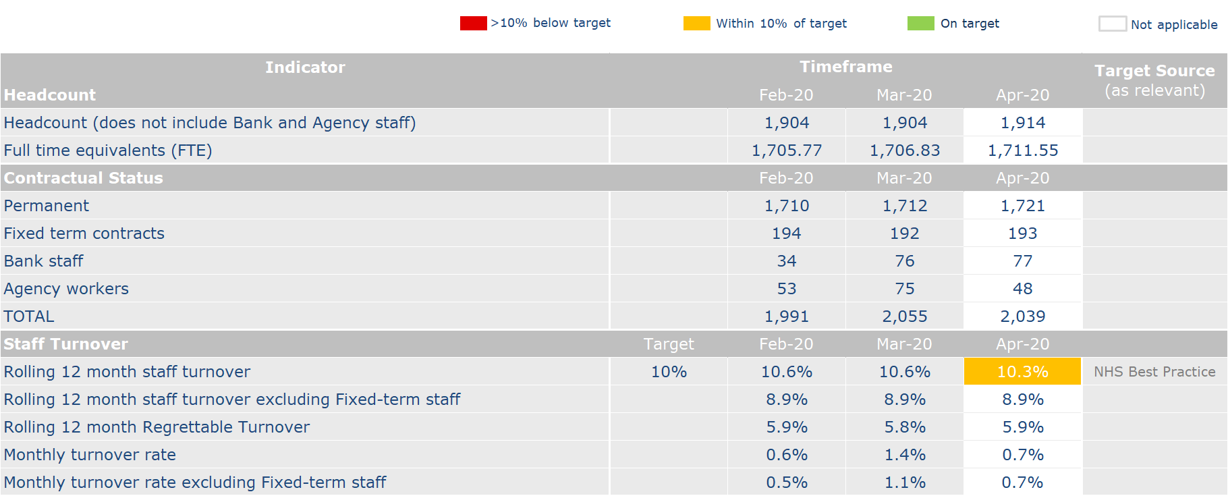
Workforce
Business as usual
COVID-19
Return to overview
Business as usual
Covid-19
17

Slide 18
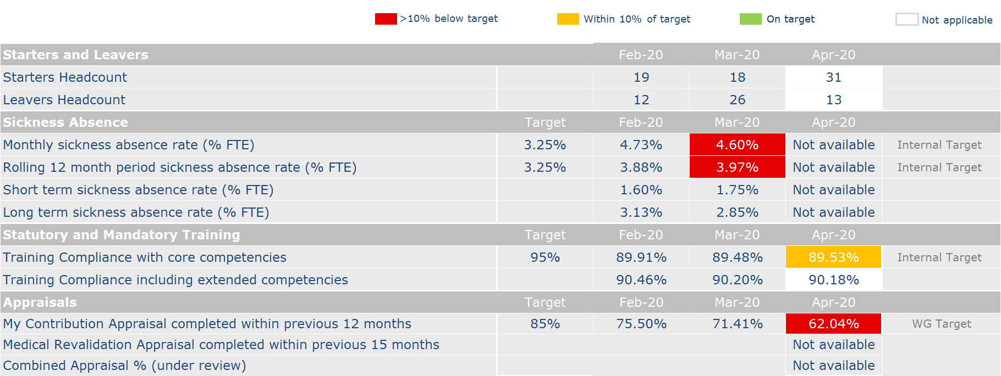
Workforce
Business as usual
COVID-19
Return to overview
Business as usual
Covid-19
**
**While it is understandable that there has been a delay in the completion of the reviews and the input of these reviews onto ESR due to the COVID-19 response, it remains vital that reviews are completed and inputted into ESR. The People and OD team will continue to support this process.
18

Slide 19
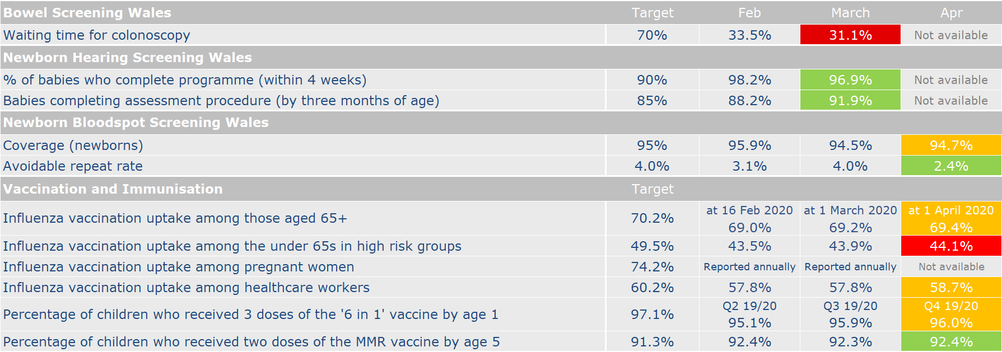
Performance Indicators
Performance Dashboard
Return to overview
**
**
**
**
** Denotes provisional Quarter 4 2019/20 figures
19

Slide 20
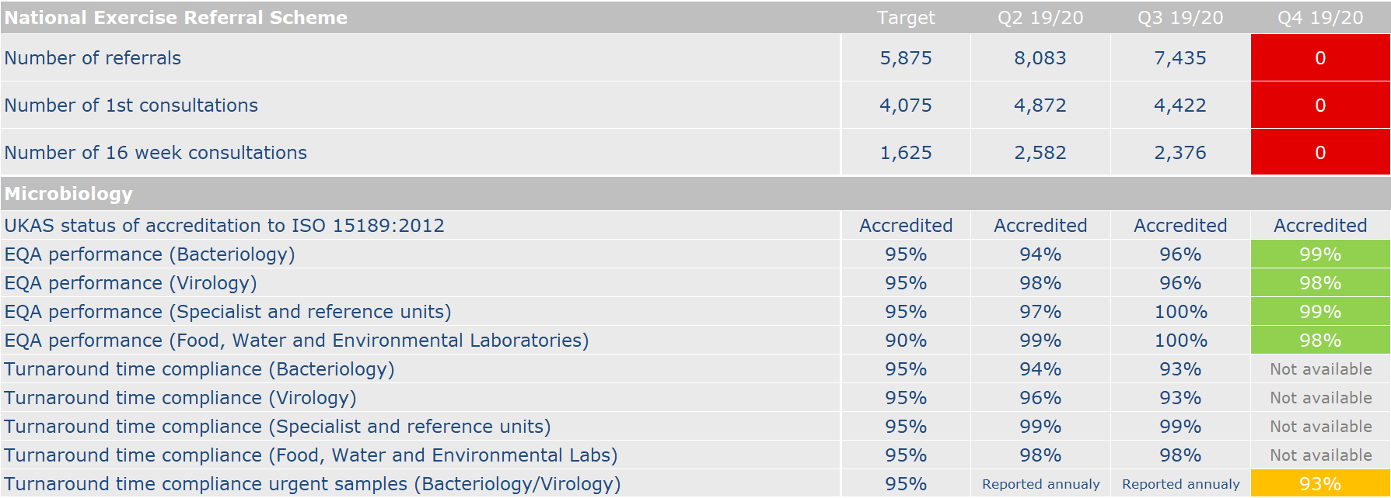
Performance Indicators
Performance Dashboard
Return to overview
Not available
Not available
Not available
**
**
**
**
** Microbiology turnaround time compliance for Quarter 4 2019/20 not available due to issues accessing DeepSee software following system update. Issue has been raised with NWIS and added to risk register for ongoing monitoring.
20

Slide 21
Putting Things Right
Business as usual
Return to overview
Performance against Mandatory Indicators
Complaints | Target | April 2020
Total number of formal complaints received for the period 1 – 30 April 2020 | - | 2
Number (%) of complaints acknowledged within 2 working days | 95% (PHW) | 2 (100%)
Number (%) of complaints responded to within 30 working days of receipt | 75% (WG) 95% (PHW) | 1 (50%)*
Number (%) of complaints responded to within a period exceeding 30 working days but within 6 months | - | 1
Number of informal complaints (on the spot) received | - | 3
Serious Incidents | Target | April 2020
Number of serious incidents reported | - | 0
Number of serious incidents not closed within 60 days | 0% | 0
* One of the formal complaints received during the reporting period exceeded the target response time by 2 days as a result of the current pressures of dealing with COVID-19.
21

Slide 22
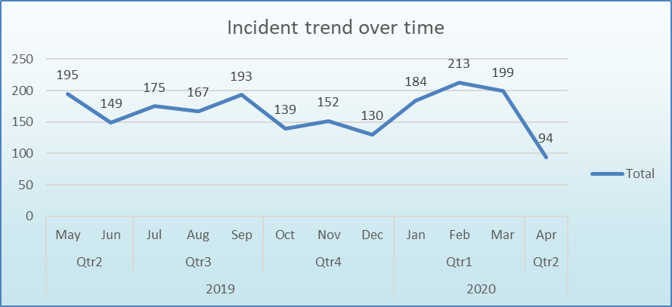
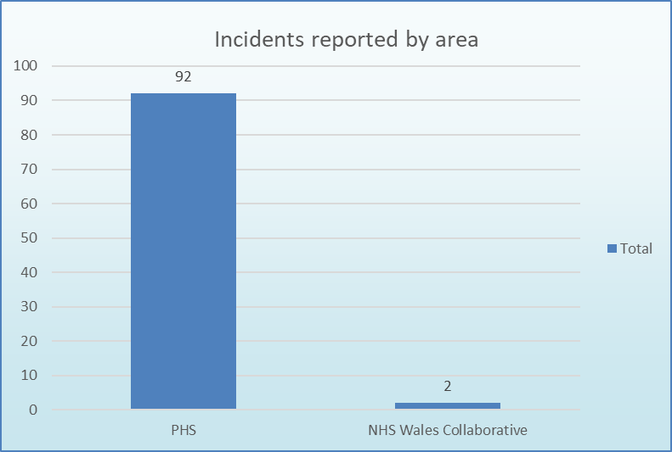
Putting Things Right
Business as usual
Return to overview
Incident Management
Summary There has been a marked drop in reported incidents during this reporting period. Some of this can be attributed to the changes in working practices across the organisation, for example in Screening where there has been a 62% fall in reports on the same period last year. This is to be expected due to the number of screening activities that have been paused. There has also however been a 36% reduction in reported incidents within Microbiology in the same period, where the anticipation was to have either maintained the same levels or even increased. The reasons for this drop are not yet clear although it is likely to be connected with resource. The Chief Risk Officer is investigating the issue to determine whether or not further support is required to ensure incident reporting remains compliant with Policy. Considerable support has been given by the Risk and IG team to the National Contact Centre, the Enclosed Settings Cell and also to Cervical Screening to both reduce the number of incidents that remain open and also to improve incident reporting across all areas. Incidents remain primarily within the Public Health Services directorate. A format is currently under development to agree and report Covid-19 related incidents to Gold on a weekly basis.
22
22

Slide 23
Putting Things Right
Business as usual
Return to overview
Claims
 | April 2020
Current number of confirmed claims | 9
Current number of potential claims | 5
Current number of redress cases | 0
New claims received in month | 0
Number of claims closed in month | 1
New redress cases received in month | 0
Number of redress cases closed in month | 0
Number of Settled Claims in this reporting period | 0
Aggregate value of confirmed claims in progress | £1,637,791.18
Aggregate value of potential claims | £5,725,000.00
Aggregate value of confirmed and potential claims | £7,362,791.18
Anticipated Public Health Wales Liability in respect of confirmed claims | £225,000.00
Summary At the end of April 2020 the total number of confirmed and potential clinical negligence claims is 14. The aggregated value of the confirmed claims is £1,637,791.18. The anticipated Public Health Wales liability in respect of both confirmed and potential claims is £225,000.00. The significant increase in aggregate value of potential claims is a result of a claim that is anticipated which will have a shared liability with a Health Board. Internal Audit provided substantial assurance for the Financial Management of Claims
23

