Slide 1



Dr Tom Connor
Bioinformatics Lead Public Health Wales,
Reader, Cardiff University
Lead Welsh COG-UK Sequencing Hub
COVID-19 genomics in Wales update
Supported by

Slide 2
Acknowledgements
Cardiff University
Dr Anna Price
Joel Southgate
The ARCCA team
PHW Bioinformatics
Dr Matt Bull
Dr Sara Rey
Dr Nicole Pacchiarini
Amy Gaskin
PHW Pathogen Genomics
Dr Sally Corden
Joanne Watkins
Lee Graham
Alec Birchley
Bree Wilcox
Jason Coombes
Lauren Gilbert
PHW Specialist virology centre
CLIMB Collaborators
Professor Nick Loman
Radoslaw Poplawski
Dr Sam Nicholls
The wider COG-UK Consortium (over 450 collaborators) : https://www.cogconsortium.uk/

Slide 3

So, what is Genomics?
Put simply, genomics is the branch of biology that is concerned with studying genomes
But what is a genome?
A genome is effectively the blueprint containing the instructions to build an organism

Slide 4

Pathogen genomics in Wales
PHW delivers multiple pathogen genomics services to the NHS in Wales
Current development areas
  AMR bacterial surveillance and characterisation
  Cystic Fibrosis polymicrobial infection diagnostics
  Enterovirus surveillance
Production systems
  C. difficile surveillance and outbreak support
  Mycobacteria identification and characterisation
  Influenza surveillance
  HIV susceptibility testing
System built as a modular platform
Pandemic planning has been a specific part of the bioinformatics development
There was no specific planning to use genomics for COVID-19 ahead of time
But: within 24 hours of being given approval to switch sequencing on for COVID-19, we had sequenced our first welsh SARS-CoV-2 genome
Accreditation in process
System design/needs assessment in progress
Pilot system development

Slide 5
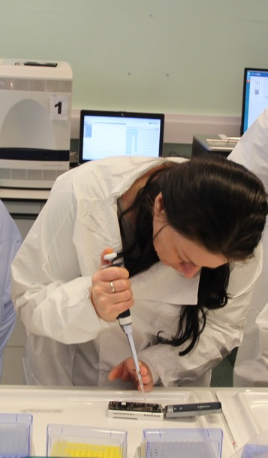
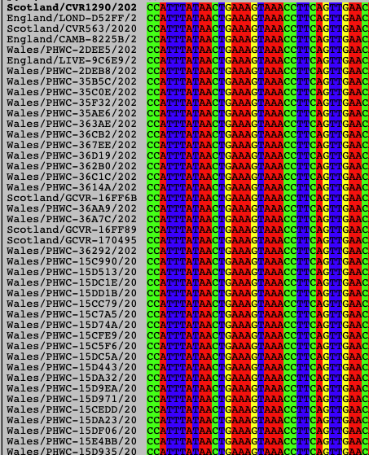
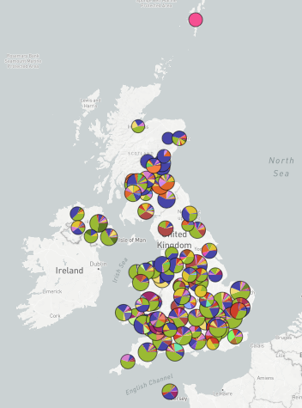
We use genomics to track changes in the virus and then use a range of approaches to analyse these changes
Sequencing instruments generate sequence data
Data is analysed in Wales and on a UK level
We read the virus genome from viruses taken from infected people using a sequencing instrument
Data is collated in Cardiff

Slide 6
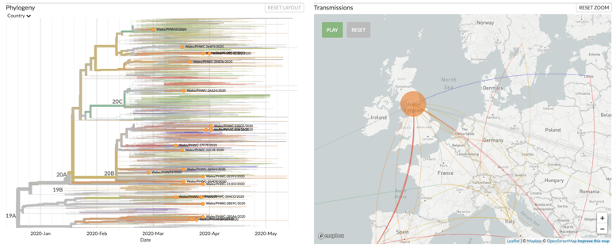
In the case of COVID-19, what does genomics enable?
Study the evolution of the whole virus
Study individual parts that make up the virus
Study the spread of the virus in time and space
(see data at https://nextstrain.org/)
Study changes over time
Image from Alanagreh et al, Pathogens 2020, ; https://doi.org/10.3390/pathogens9050331

Slide 7
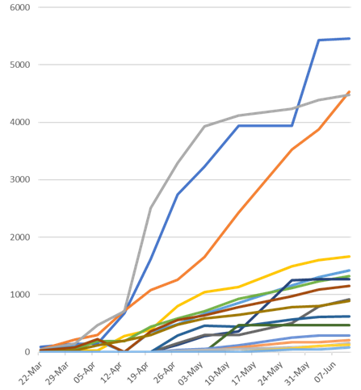
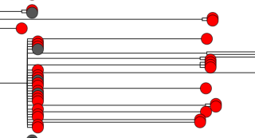
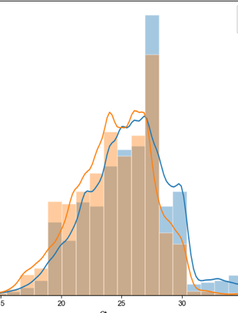
What are we doing here?
Sequencing every available Welsh COVID-19 case
Then we are:
Supporting outbreak analysis
Looking for important virus changes
Tracking the spread and entry of the virus in Wales and the UK

Slide 8
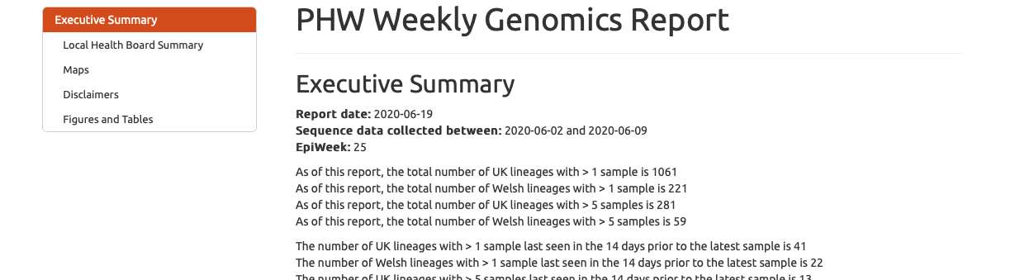
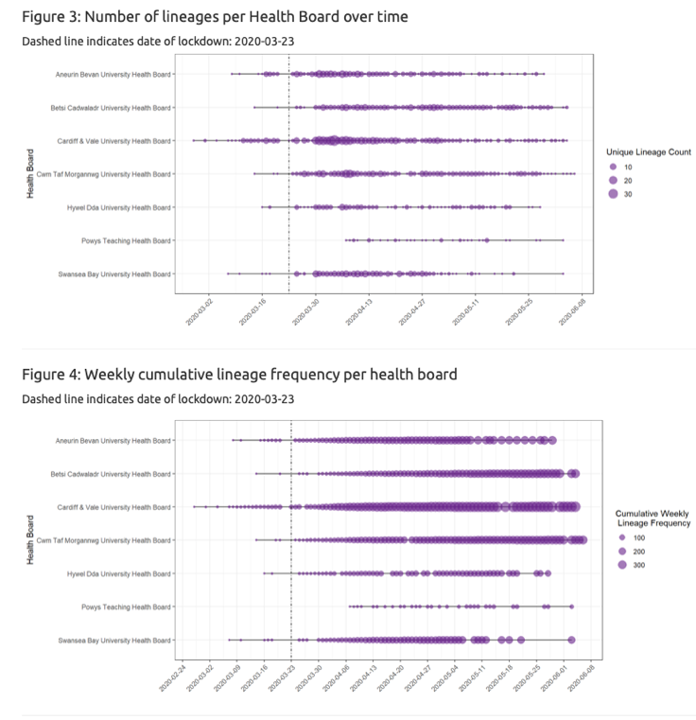
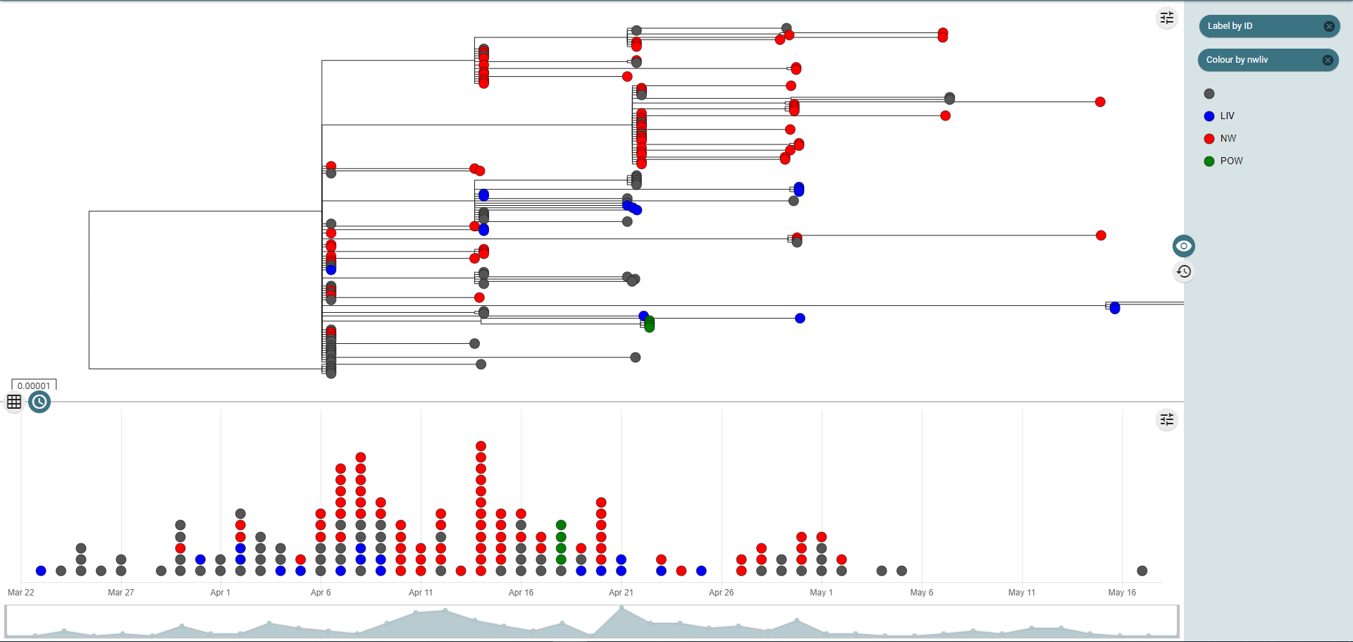
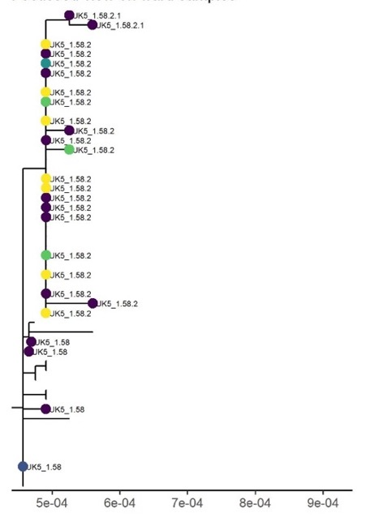
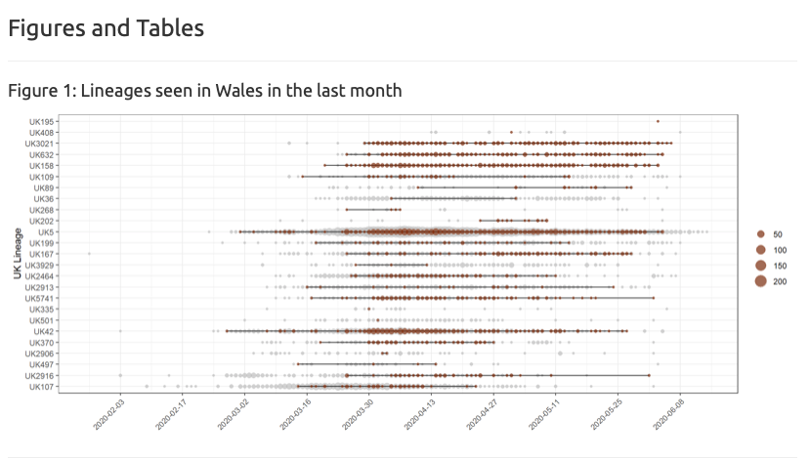
We have built an analysis and reporting system from scratch
Important to note that these have been built so we can apply them to other genomics activities, to further benefit our patients

Slide 9
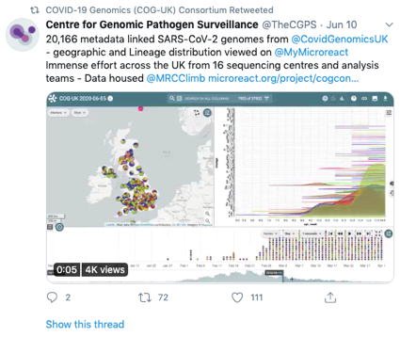
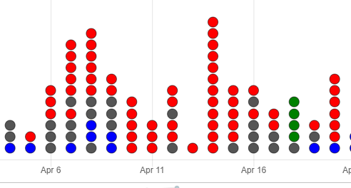
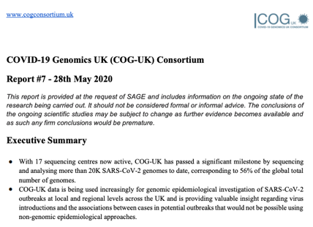
Our analysis is being used at many levels
Our data and analysis go to government (SAGE and TAC in Wales) to help guide policy
Our data is shared with colleagues in the NHS at a local level
We work within PHW at a national level to support pandemic response
We publish our data and analyses to support global pandemic response

Slide 10
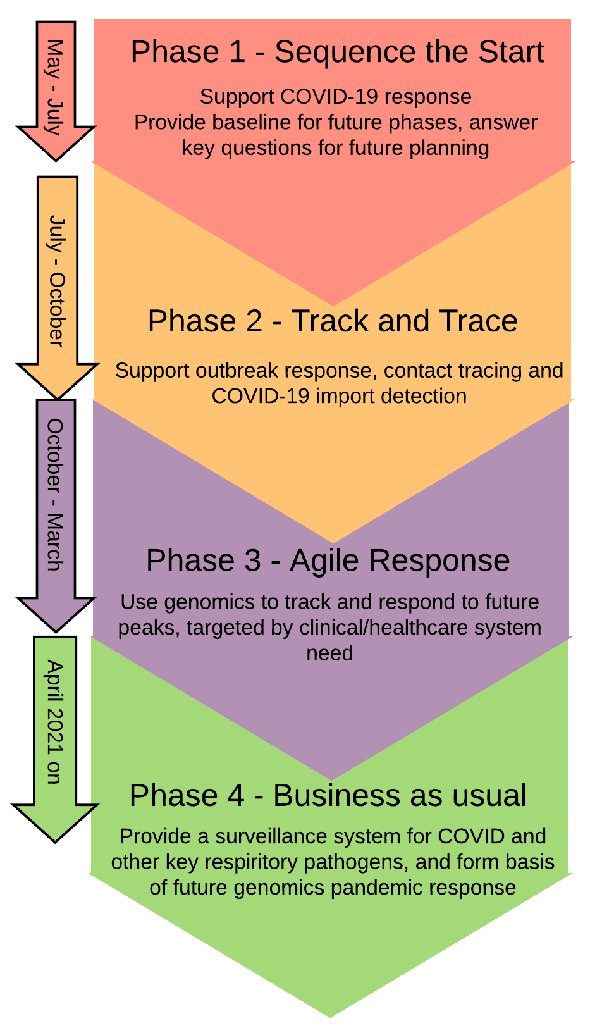
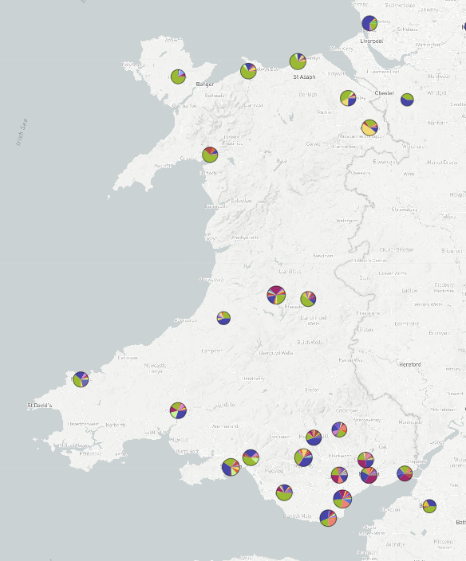
Current areas of impact and future work
We are:
Supporting local outbreak response
Examining viral transmission
Tracking viral mutations
Supporting government by providing analyses to SAGE and TAC, and data to modelling efforts
Supporting TTP by:
  Performing genomic surveillance
  Identifying imports from the UK and abroad
  Estimating outbreak growth rates
  Characterising clusters of cases
  Planned: Supporting the placing of cases into genomic clusters
Supporting future planning and response by analysing the 1st wave

Slide 11
Conclusions
We have built a world-leading COVID-19 sequencing service in Wales
We have sequenced and shared more genomes than every country in the world other than the USA and England
We are sequencing samples in real time, and using this data to support every level of the pandemic response, from hospital outbreaks up to national scientific advice
This is an extension of the world-class work that was already being performed by PenGU
.

Slide 12
Current areas of impact and future work
We are:
Supporting local outbreak response
Examining viral transmission
Tracking viral mutations
Supporting government by providing analyses to SAGE and TAC, and data to modelling efforts
Supporting TTP by:
  Performing genomic surveillance
  Identifying imports from the UK and abroad
  Estimating outbreak growth rates
  Characterising clusters of cases
  Planned: Supporting the placing of cases into genomic clusters
Supporting future planning and response by analysing the 1st wave

