Slide 1
Integrated Performance Report
Monitoring of COVID-19 and non COVID-19 related activity
May 2020

Slide 2
Setting the Scene
Introduction
Introduction
The Integrated Performance Report (May 2020) provides the Board with an update on the latest available position during the COVID-19 outbreak. This summary report brings together key information from a number of existing resources from the following areas which will continue to evolve as additional intelligence is made available.
(select area to the right to navigate):
Section 1 focuses on examples of work being undertaken across the organisation to support our COVID-19 response. This includes high level summary dashboards that are being used to help inform action, including the COVID-19 Surveillance Dashboard.
Section 2 provides an overview of our financial performance for Month 2 2020/21. It includes a high-level summary of revenue and capital financial performance including an overview of costs directly related to the organisation’s COVID-19 response.
Section 3 highlights latest available data on our workforce. Two dashboards are presented including an organisational dashboard of reported sickness absence due to COVID-19 and key metrics related to our people.
Section 4 provides an update for a number of our key services and programmes (where data is available) for those areas continuing to operate during COVID-19. It also includes the latest available information on our mandatory Quality indicators.
COVID-19 Response
Finance
Business as usual
Covid-19
Workforce
Performance Indicators
2

Slide 3
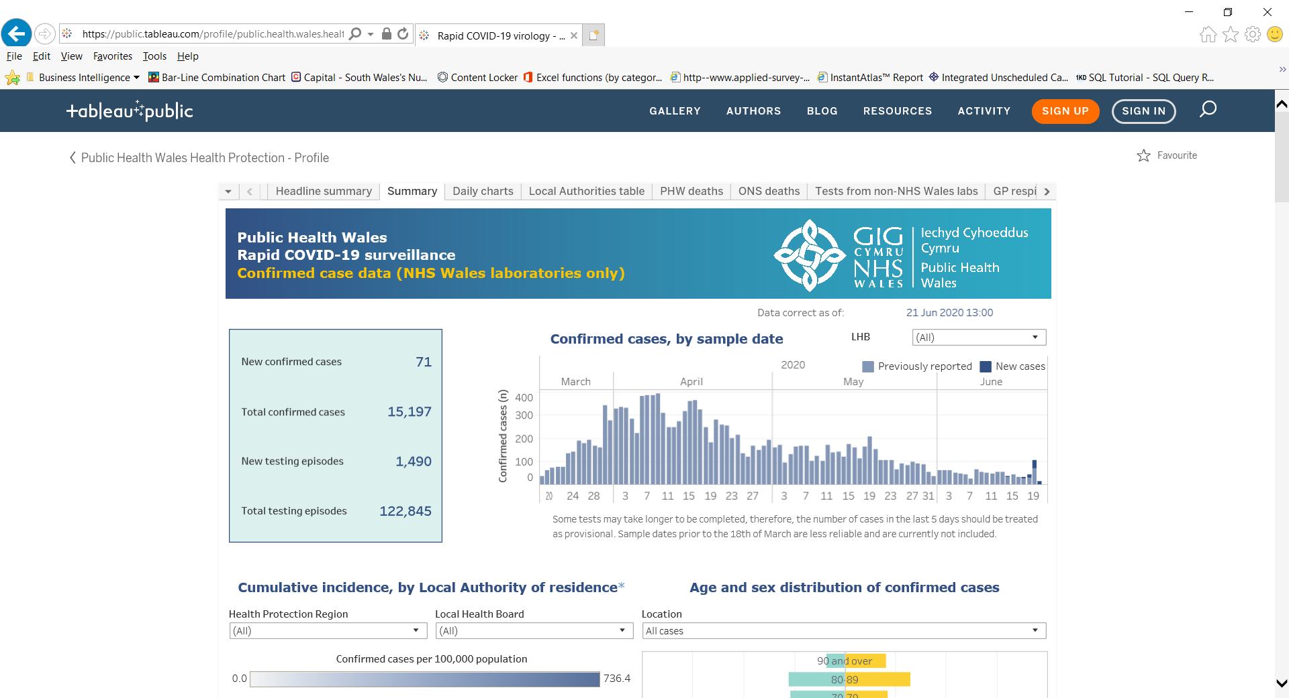
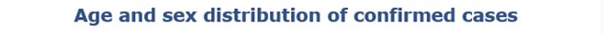
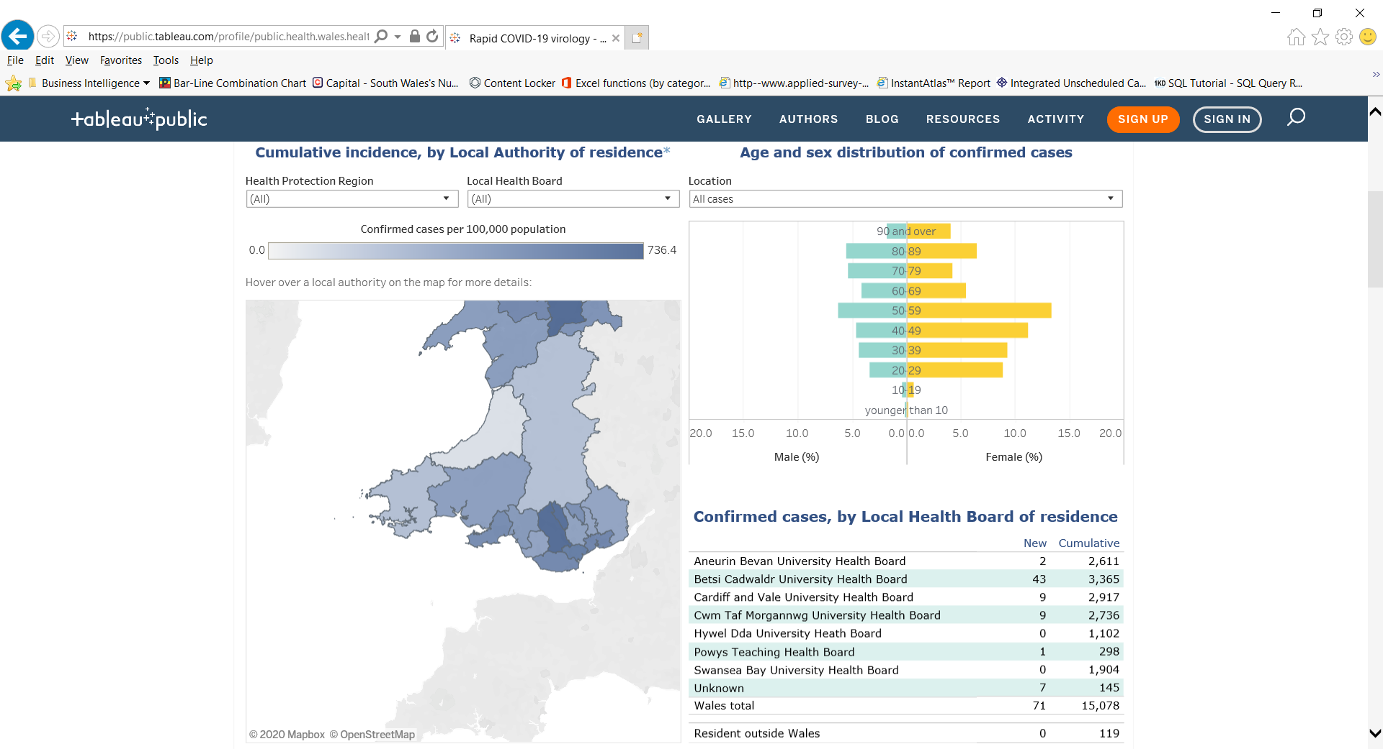
COVID-19 Response
COVID-19
Return to overview
COVID-19 Surveillance: Cases
Data correct as of 21 June 2020
Data extracted from Public Health Wales Rapid COVID-19 surveillance tool, available here (publically available).
3

Slide 4
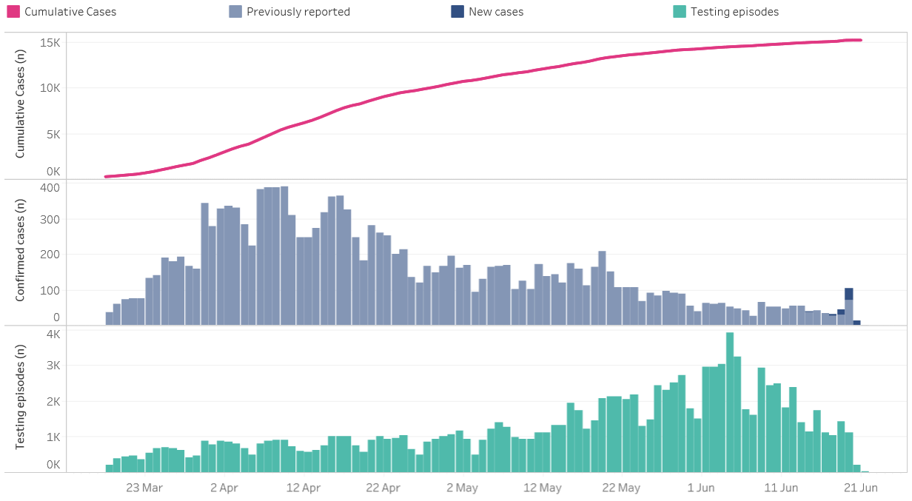
COVID-19 Response
COVID-19
Return to overview
COVID-19 Surveillance: Testing
Data correct as of 21 June 2020
Data extracted from Public Health Wales Rapid COVID-19 surveillance tool, available here (publically available).
4
4

Slide 5
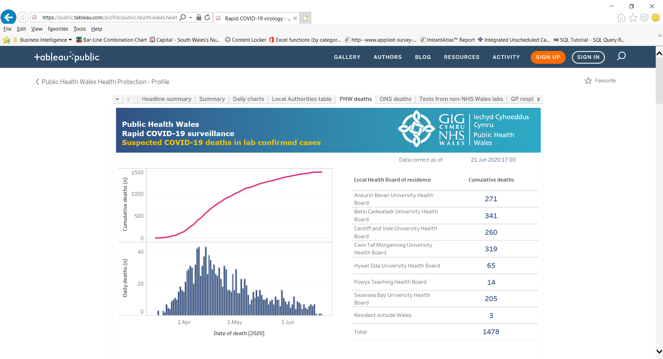
COVID-19 Response
COVID-19
Return to overview
COVID-19 Surveillance: Suspected deaths in lab confirmed cases
Data correct as of 21 June 2020
Data extracted from Public Health Wales Rapid COVID-19 surveillance tool, available here (publically available).
5

Slide 6
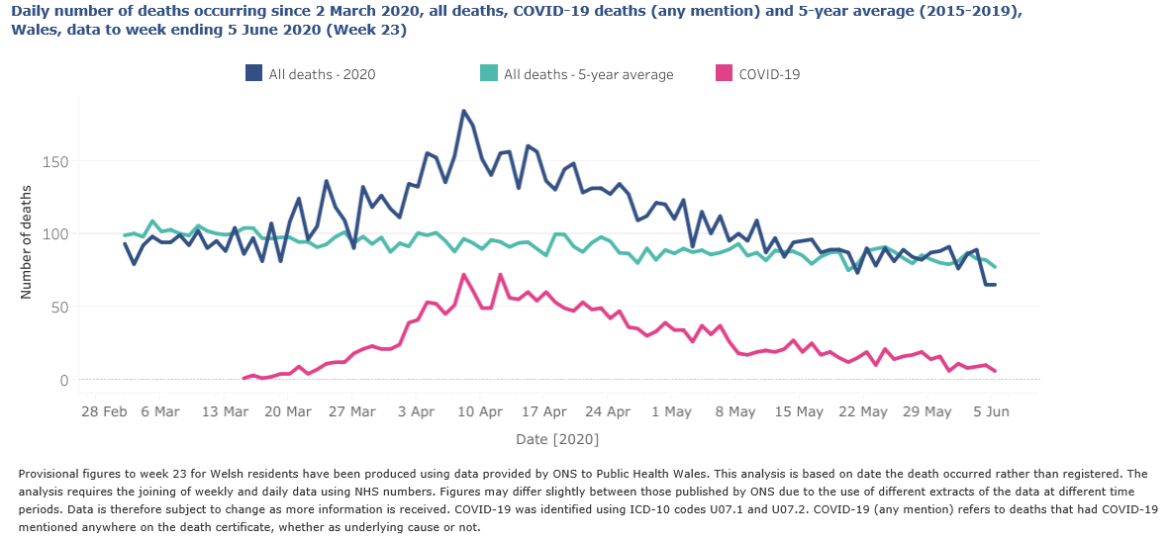
COVID-19 Response
COVID-19
Return to overview
COVID-19 Surveillance: ONS mortality data for Wales
Updated weekly Data correct as of 18 June 2020
Data extracted from Public Health Wales Rapid COVID-19 surveillance tool, available here (publically available).
6
5

Slide 7
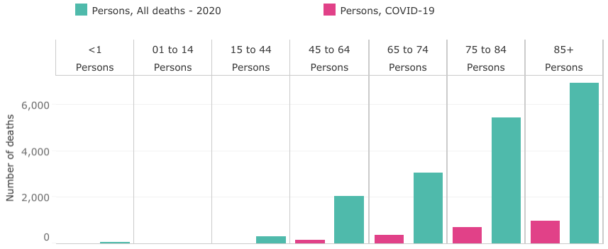
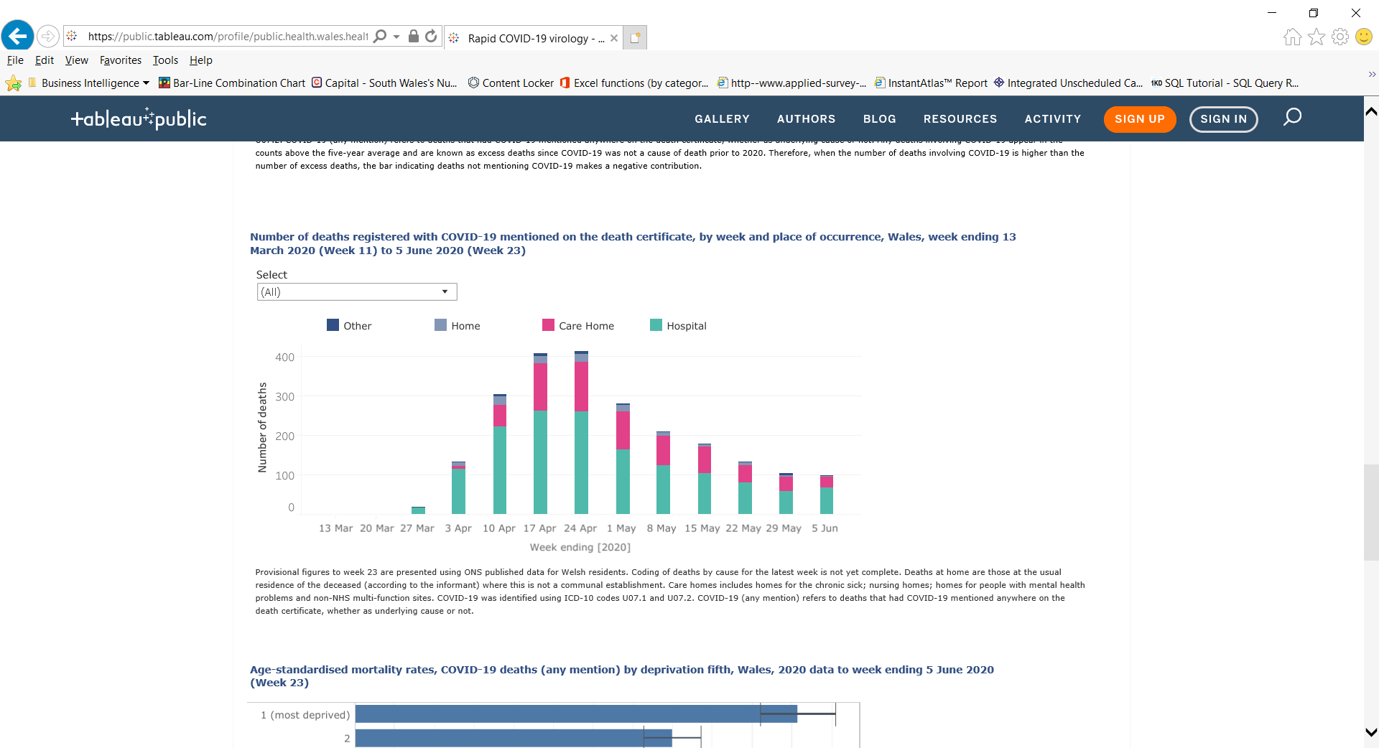
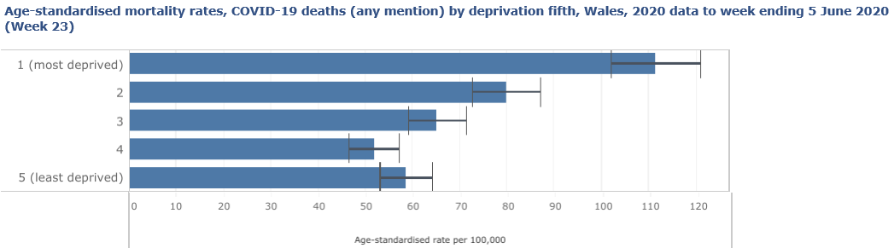
COVID-19 Response
COVID-19
Return to overview
COVID-19 Surveillance: ONS mortality data for Wales
Deaths by age group, all deaths this year and COVID-19 deaths (any mention), Wales, 2020 data to week ending 5 June 2020 (Week 23)
Number of deaths registered with COVID-19 mentioned on the death certificate, by week and place of occurrence, Wales, week ending 13 March (Week 11) to 5 June 2020 (Week 23)
Data updated weekly
Data correct as of 18 June 2020
Data extracted from Public Health Wales Rapid COVID-19 surveillance tool, available here (publically available).
7
5

Slide 8
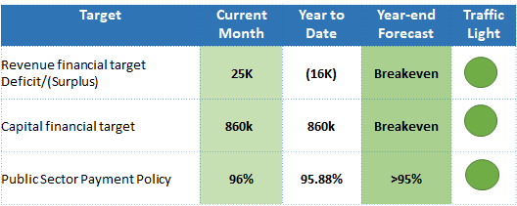
Finance
Business as usual
COVID-19
Return to overview
Overview of Financial Performance - Month 2 2020/21
Summary
The purpose of this report is to outline to the Executive Team and the Board the revenue and capital position for Public Health Wales as at 31 May 2020 (M2), which is also circulated to the Audit and Corporate Governance Committee. The content of this report is reflected in the Director of Finance commentary that has been submitted to Welsh Government on 11 June 2020 as part of the full financial monitoring return for Month 2.
The following table highlights the performance against the key revenue and capital financial targets.
The cumulative reported position for Public Health Wales is a net surplus of £16k. This position includes £3.104m of costs directly related to the Trust’s COVID-19 response. This position includes anticipated income from Welsh Government of £2.330m.
8

Slide 9
Finance
Business as usual
COVID-19
Return to overview
Overview of Financial Performance - Month 2 2020/21
Directorate
9

Slide 10
Finance
Business as usual
COVID-19
Return to overview
Overview of Financial Performance - Month 2 2020/21
Directorate
The month-end position for Public Health Wales is a net surplus of £16k. This position includes anticipated income from Welsh Government of £2.330m broken down as follows:
£2.227m Covid-19
£0.052m Digital strategy
£0.051m Healthier Wales (Early years prevention)
As part of our financial plans for 2020/21 it has been agreed that pay underspends, a number of non-pay budgets, and the internal investment fund will be held centrally to contribute to the additional costs incurred as a result of COVID-19. Total spend on COVID-19 to date is £3.104m of which £0.658m has been met from within Public Health Wales centrally held budgets. £336k from pay underspends and £337k from non pay reductions in spend and internal investment slippage, with the remaining £218k having been met from external funding from Cardiff University in respect of Genomics sequencing tests, leaving £2.227m of additional income required from Welsh Government.
Public Health Services Directorate:
Microbiology division has overspent in month 2 by £214k, this overspend has been offset by underspends in Screening division of £102k, Health Protection division of £54k and Public Health Services Corporate division of £51k. Public Health Services Directorate will need to ensure that a break-even plan for the Directorate is maintained for the full year forecast.
10

Slide 11
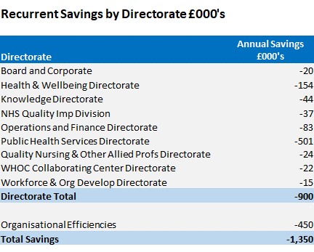
Finance
Business as usual
COVID-19
Return to overview
Overview of Financial Performance - Month 2 2020/21
Savings / Organisational Efficiencies
Public Health Wales savings strategy for 2020/21, as set out in the IMTP, was £1.350m, made up of 1% Directorate savings and 0.5% organisational efficiencies.
Of the £900k relating to the 1% savings target assigned to each Directorate, £74k was met by increased vacancy factors. Based on the Month 2 pay position the increased vacancy factors are being achieved and will continue to be monitored on a monthly basis. The remaining element of £826k was met by changes within staffing establishments (£75k) and non-pay efficiencies (£670k).
Of the £450k relating to organisational efficiencies, £120k related to savings linked to VERs in 19/20 was achieved in month 1. The remaining efficiencies are linked to procurement efficiencies (£105k), salary sacrifice schemes (£40k) and yet to be identified red schemes (£185k). Due to COVID-19 priorities, the remaining efficiencies have been re-classified as red schemes (£330k).
11

Slide 12
Finance
Business as usual
COVID-19
Return to overview
Overview of Financial Performance - Month 2 2020/21
Investments
The current status of the investments for both 2019/20 and 2020/21 are as follows:
There will be slippage against investment within Public Health Wales due to delays in the allocation of internal investment funding as a result of COVID-19.
Due to the inability of our Directorates to pursue investment, £228k of months 1 and 2 investment slippage has been used to form part of Public Health Wales overall financial commitment to supporting the COVID-19 response. There are on-going discussions with Welsh Government on additional funding they may provide to contribute to our COVID-19 costs.
12

Slide 13
Finance
Business as usual
COVID-19
Return to overview
Overview of Financial Performance - Month 2 2020/21
Capital
Public Health Wales capital funding for 2020/21 totals £4.397m, split as follows:
Discretionary £1.687m, £111k of which has been allocated to support COVID-19. The allocation of the remaining £1.255m is currently being finalised.
Strategic £2.710m in respect of COVID-19 is made up as follows:
  Cepheid Systems - £751k
  Perkin Elmer Platforms - £740k
  Eplex - £553k
  MAST Seegene - £666k
13

Slide 14
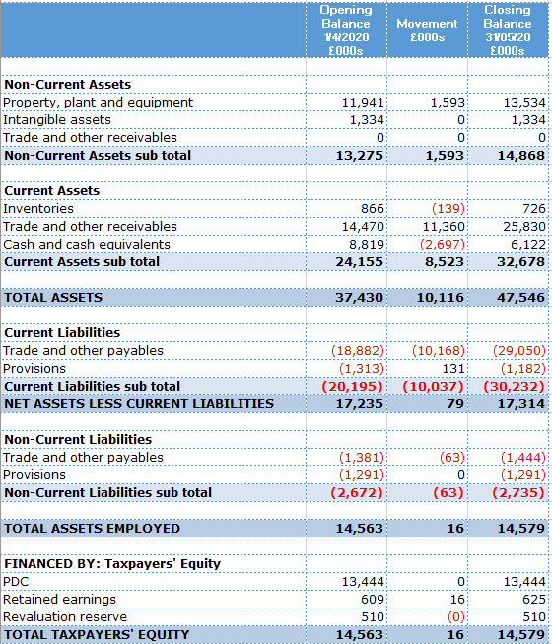
Finance
Business as usual
COVID-19
Return to overview
Overview of Financial Performance - Month 2 2020/21
Balance Sheet
The Balance Sheet, or Statement of Financial Position, reports the assets, liabilities and reserves of the organisation at a specific point in time.
Non-Current Assets
Property, plant and equipment has increased by £1.593m. This reflects the net position of our capital purchases in month 2 of 20/21. The majority of this (£1.256m) being on Covid-19 strategic project.
Current Assets
Current trade and other receivables has increased by £11.360m. This increase is predominantly on Whole of Government Accounts receivables and relates to the Welsh Government core income invoice for June which is raised a month in advance to ensure receipt in time for June (£8.860m). Anticipated Welsh Government funding has been accrued for Covid-19 related activities to date, this income totals £2.227m.
Cash and cash equivalents has reduced by £2.697m. We are monitoring our cash position closely as expenditure increases due to Covid-19 but with no additional funding yet confirmed.
Current liabilities
Current trade and other payables has increased by £10.168m. This increase is predominantly due to the June core income mentioned above which is treated as deferred (£8.860m). In addition, there are accruals for anticipated screening LTA charges from Health Boards which total £1.487m.
14

Slide 15
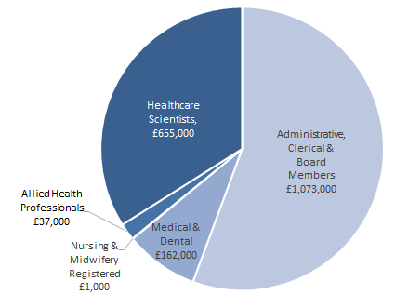
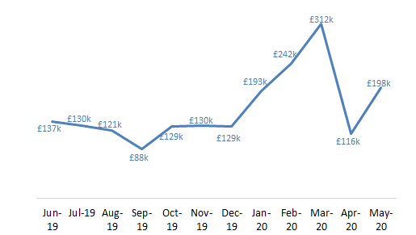
Finance
Business as usual
COVID-19
Return to overview
Overview of Financial Performance - Month 2 2020/21
Agency Spend
Summary For the COVID response, a new COVID directorate has been set up, and the agency usage for this has increased. The large increase has been due to three consultants working increased hours on the response, as well as the adjustments made due to over accruals in month one compared to the actual invoice payments in month 2. A number of key COVID-19 roles are still being resourced using agency staff (e.g. call takers). There are a number of projects that were extended past the end of March, which have led to agency staff being kept on to complete the work, as it was not possible or appropriate to recruit on a fixed term basis for this short period. The Covid-19 response has also led to some vacancies not being recruited to and some gaps have continued to be filled by agency staff, whilst the recovery plan is implemented.
15
14

Slide 16
Finance
Business as usual
COVID-19
Return to overview
Overview of Financial Performance - Month 2 2020/21
Conclusion
The Board is asked to note the following:
financial position reported at month 2
status of the Capital Programme for 2020/21
whilst we always undertake to either seek funding approval from Welsh Government or identify from our own budgets, that the total quantum of funding for addressing COVID-19 across Wales remains fluid and uncertain. There is a risk that the organisation’s operational cost of addressing and recovering from the pandemic cannot be contained within available funding resulting in a potential breach of the planned outturn for 2020-21
16

Slide 17
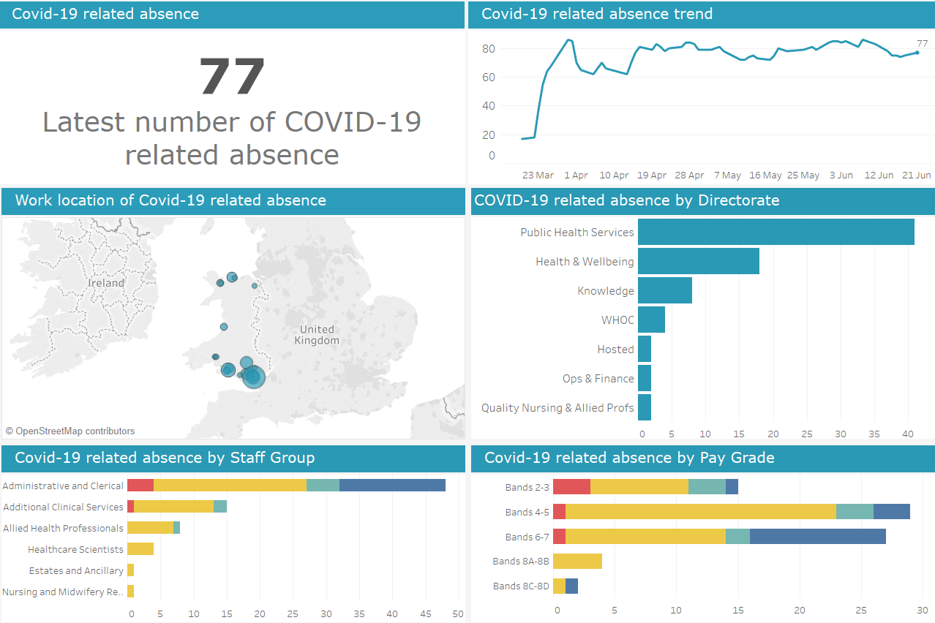
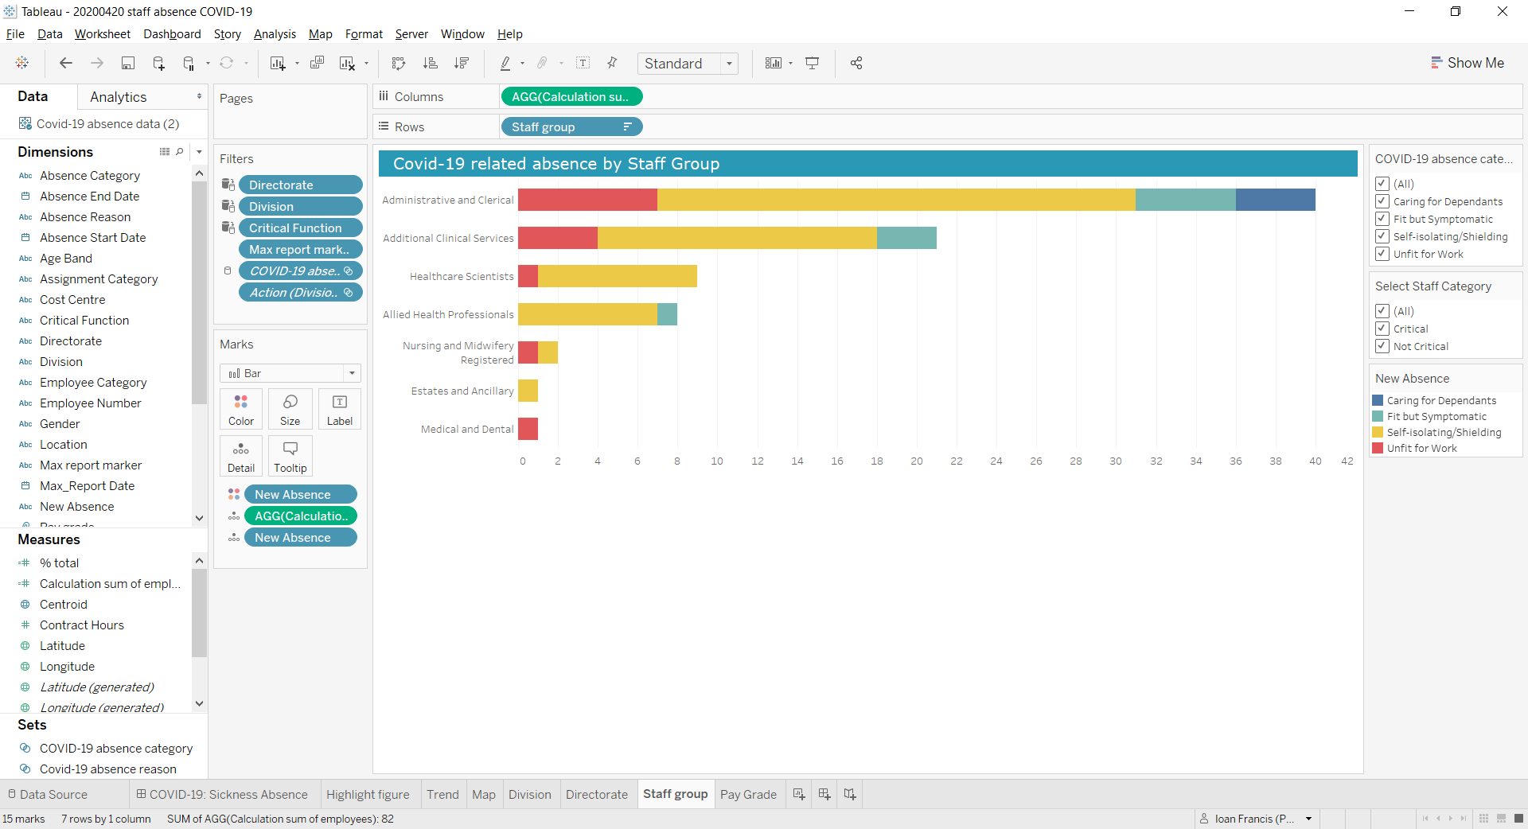
Workforce
Business as usual
COVID-19
Return to overview
COVID-19 Staff Absence Dashboard
Data correct as of 21 June 2020
Dashboard available here (Not publically available)
Business as usual
Covid-19
17

Slide 18
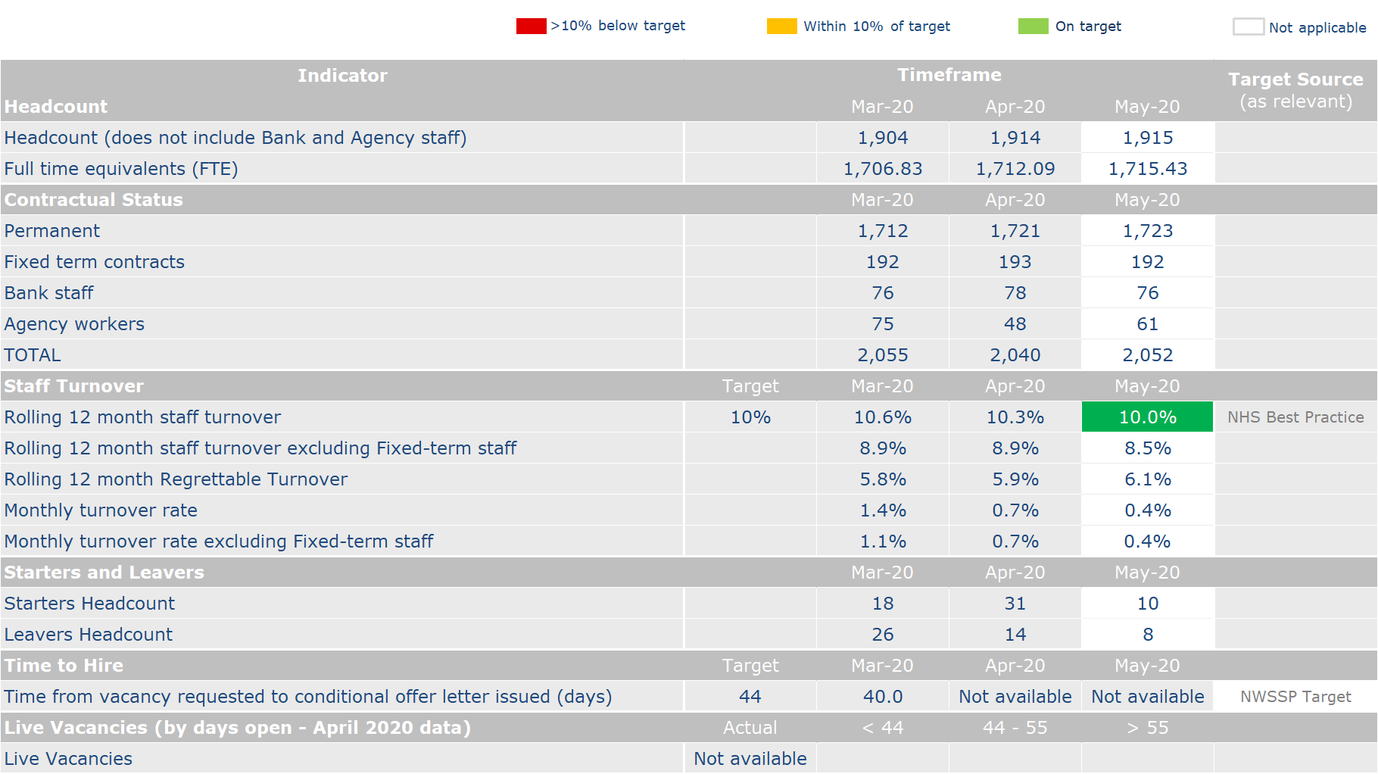
Workforce
Business as usual
COVID-19
Return to overview
Business as usual
Covid-19
18

Slide 19
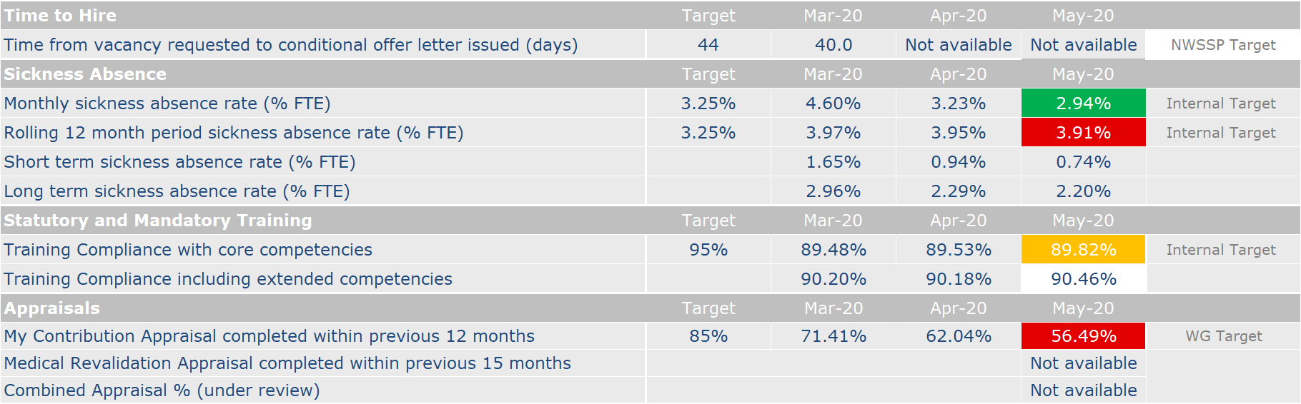
Workforce
Business as usual
COVID-19
Return to overview
1
2
Business as usual
Covid-19
3
Notes
¹ Recruitment figures not updated as the data received from NWSSP on a monthly basis has not been made available.
² There has been a notable improvement in sickness absence figures. This is being explored further by the P&OD Team and we will provide further details at the appropriate time.
³ The reduction in appraisal compliance is being taken forward through an Executive owned action plan.
19

Slide 20
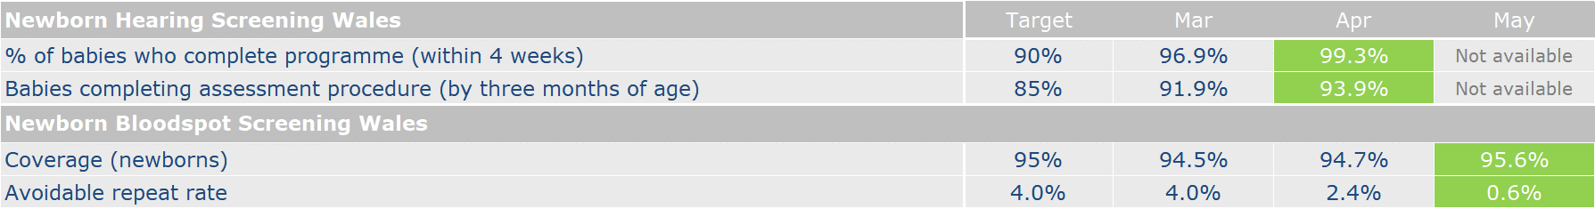
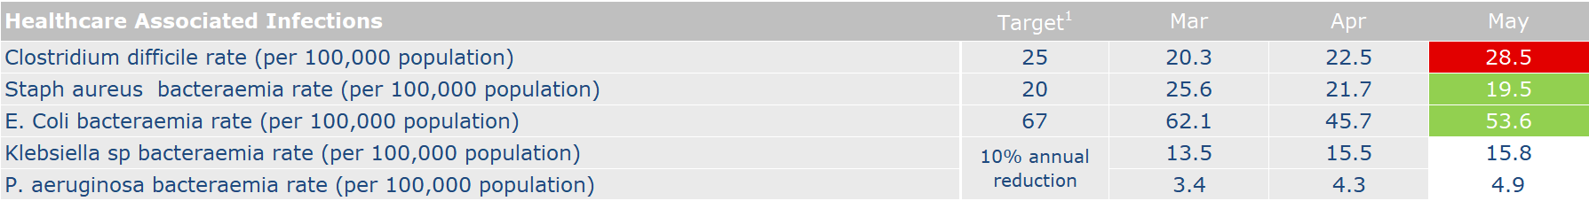
Performance Indicators
Performance Dashboard
Return to overview
Not available
20
19

Slide 21
Putting Things Right
Business as usual
Return to overview
Performance against Mandatory Indicators
Summary During the reporting period, a total of 8 formal complaints were received and 2 were acknowledged within the target time of 2 working days. There has been a delay in formal complaints being acknowledged due to capacity issues within the team and training up a new member of temporary staff who has been redeployed to assist with this area of work. Five of the formal concerns are in relation to closed settings. This has been a complex issue and the team required much support to investigate and properly resolve these complaints which have resulted in them exceeding the target times. Dedicated resource has now been put in place to ensure that complaints are dealt with in a timely manner. One of the formal complaints is linked to a microbiology incident and requires thorough investigation however colleagues in this area are dealing with pressures of Covid-19 therefore this delay is reasonable given the circumstances. Two of the formal complaints did not come via the concerns team immediately therefore, there has been a delay in getting these progressed.
Complaints | Target | May 2020
Total number of formal complaints received for the period 1 – 31 May 2020 | - | 8
Number (%) of complaints acknowledged within 2 working days | 95% (PHW) | 2
Number (%) of complaints responded to within 30 working days of receipt | 75% (WG) 95% (PHW) | 1
Number (%) of complaints not yet responded but likely to be within a period exceeding 30 working days but within 6 months | - | 7
Number of informal complaints (on the spot) received | - | 5
Serious Incidents | Target | May 2020
Number of serious incidents reported | - | 0
Number of serious incidents not closed within 60 days | 0% | 0
21

Slide 22
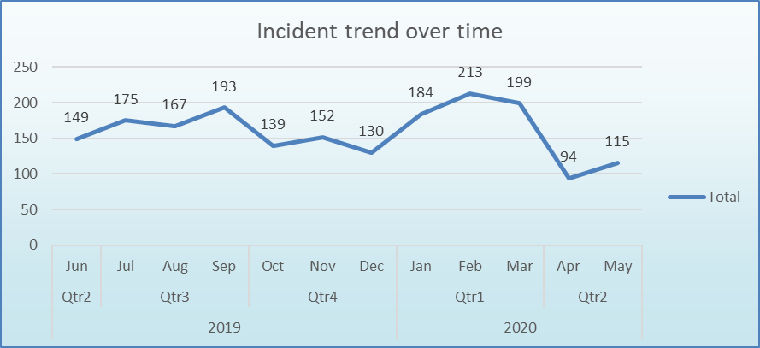
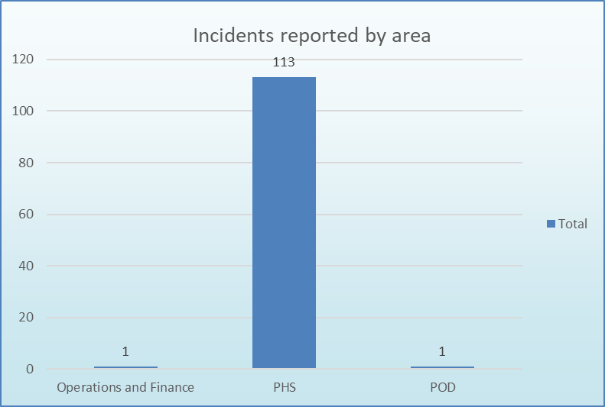
Putting Things Right
Business as usual
Return to overview
Incident Management
Summary During May 2020 there were a total of 115 incidents reported. The first chart shows the incident reporting totals over the previous year with the current reporting period highlighted. The second chart shows the number of incidents reported by Directorates for the current reporting period. This period has seen a slight rise in incidents reported. Considerable support has been given by the Risk and IG team to the National Contact Centre, the Enclosed Settings Cell and also to Cervical Screening to both reduce the number of incidents that remain open and also to improve incident reporting across all areas. Incidents remain primarily within the Public Health Services directorate. A newly formatted report has recently been approved at Gold for the reporting of Covid-19 related incidents on a weekly basis.
22
22

Slide 23
Putting Things Right
Business as usual
Return to overview
Claims
 | May 2020
Current number of confirmed claims | 9
Current number of potential claims | 8
Current number of redress cases | 0
New claims received in month | 0
Number of claims closed in month | 0
New redress cases received in month | 0
Number of redress cases closed in month | 0
Number of Settled Claims in this reporting period | 0
Aggregate value of confirmed claims in progress | £1,637,791.18
Aggregate value of potential claims | £5,725,000.00
Aggregate value of confirmed and potential claims | £7,362,791.18
Anticipated Public Health Wales Liability in respect of confirmed claims | £225,000.00
Summary At the end of May 2020 the total number of confirmed and potential clinical negligence claims is 17. The aggregated value of the confirmed claims is £1,637,791.18. The anticipated Public Health Wales liability in respect of both confirmed and potential claims is £225,000.00. The significant increase in aggregate value of potential claims is a result of a claim that is anticipated which will have a shared liability with a Health Board. Lessons learnt relating to any settled claims are shared via the Quality, Safety and Improvement Committee via the quarterly claims report.
23

