Slide 1
Laboratory Improvement Programme
25th February 2021

Slide 2
Background
Significant investment in NHS Wales laboratories since start of the pandemic:
Establishment of 24/7 working at 3 regional laboratories
Creation of 6 ‘hot’ labs to support rapid testing within secondary care
The establishment of a high volume COVID-19 testing laboratory
Additionally a commitment to significantly improve turnaround times
<4 hours for rapid testing in hospital
<12 hours for all other

Slide 3
Background
Hot labs – End of November
IP-5 lab 2 – 7th December
Train and supervise new staff
Validate new laboratory processes including the validation of IP5
Extensive improvement programme to improve laboratory performance, recognition of the need to improve:
In-laboratory performance
Pre-laboratory performance

Slide 4
Improvement programme
Achieving <12hr in-Lab turnaround time
Application of Lean methodologies to identify bottlenecks and redesign
Visual management
Smoothing the flow of samples to PHW laboratories
Working with health boards to model Coronavirus Testing Units’ (CTU) capacity and predicted demand throughout the day.
Modelling regional and IP5 laboratory capacity based on machine run time capabilities.
Planning logistical transport routes to regulate demand into laboratories
Real-time coordination of sample flow to laboratories

Slide 5
Progress
Comprehensive review of in-lab processes for high-volume platforms in all three regional laboratories and IP-5 Lab 2
Creation of regional laboratory improvement groups to review reports, and drive local improvements to in-lab turnaround times.
Implementation of a new approach to sampling demand and laboratory capacity planning.
Adjustment in courier transport times/routes.
Adjustment in data analytics information monitoring and display.
Adjustment in partnership working with Welsh Health Courier Services, CTUs and the NHPRC to determine processes, constraints and opportunities for improvement

Slide 6
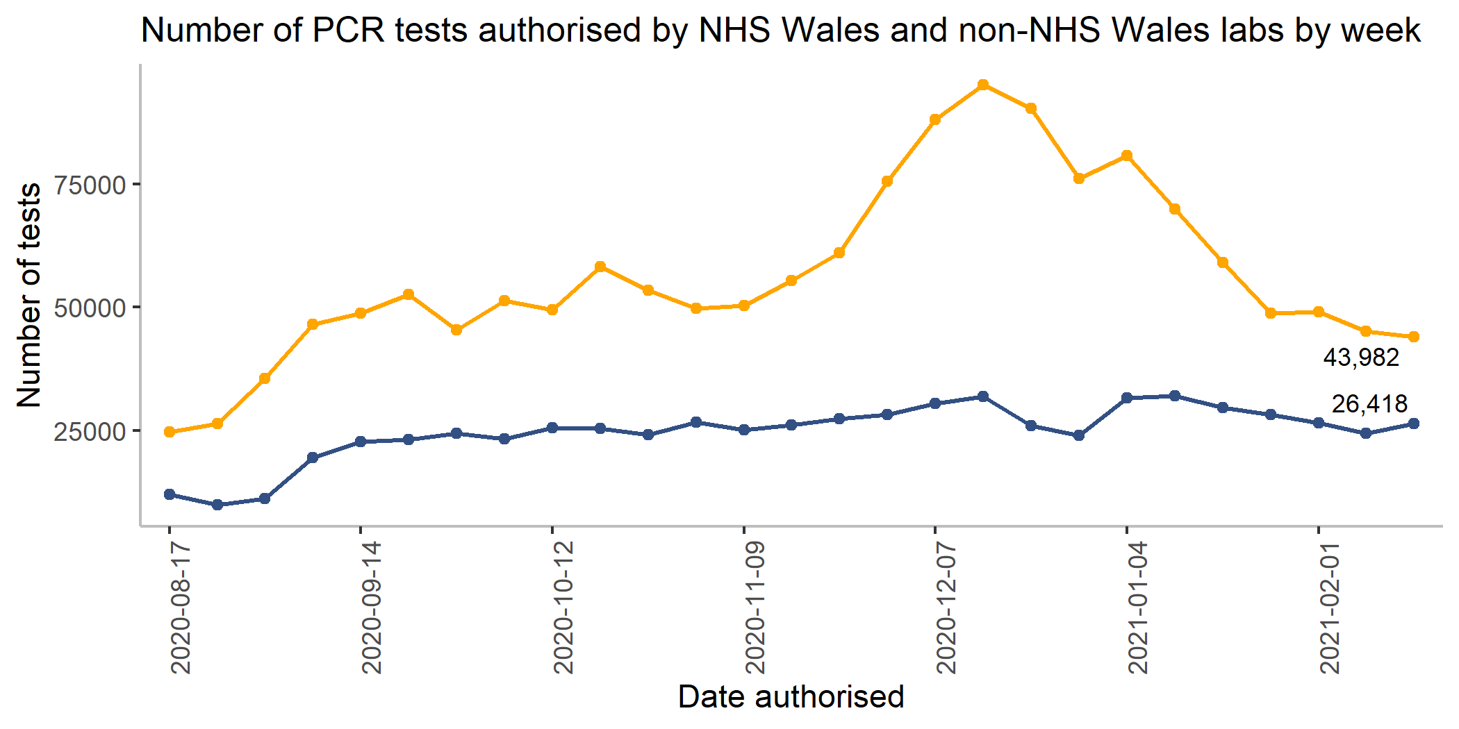

Slide 7
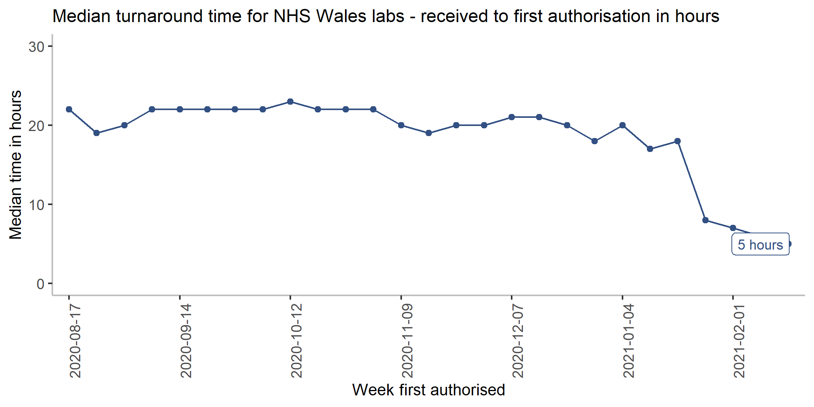

Slide 9
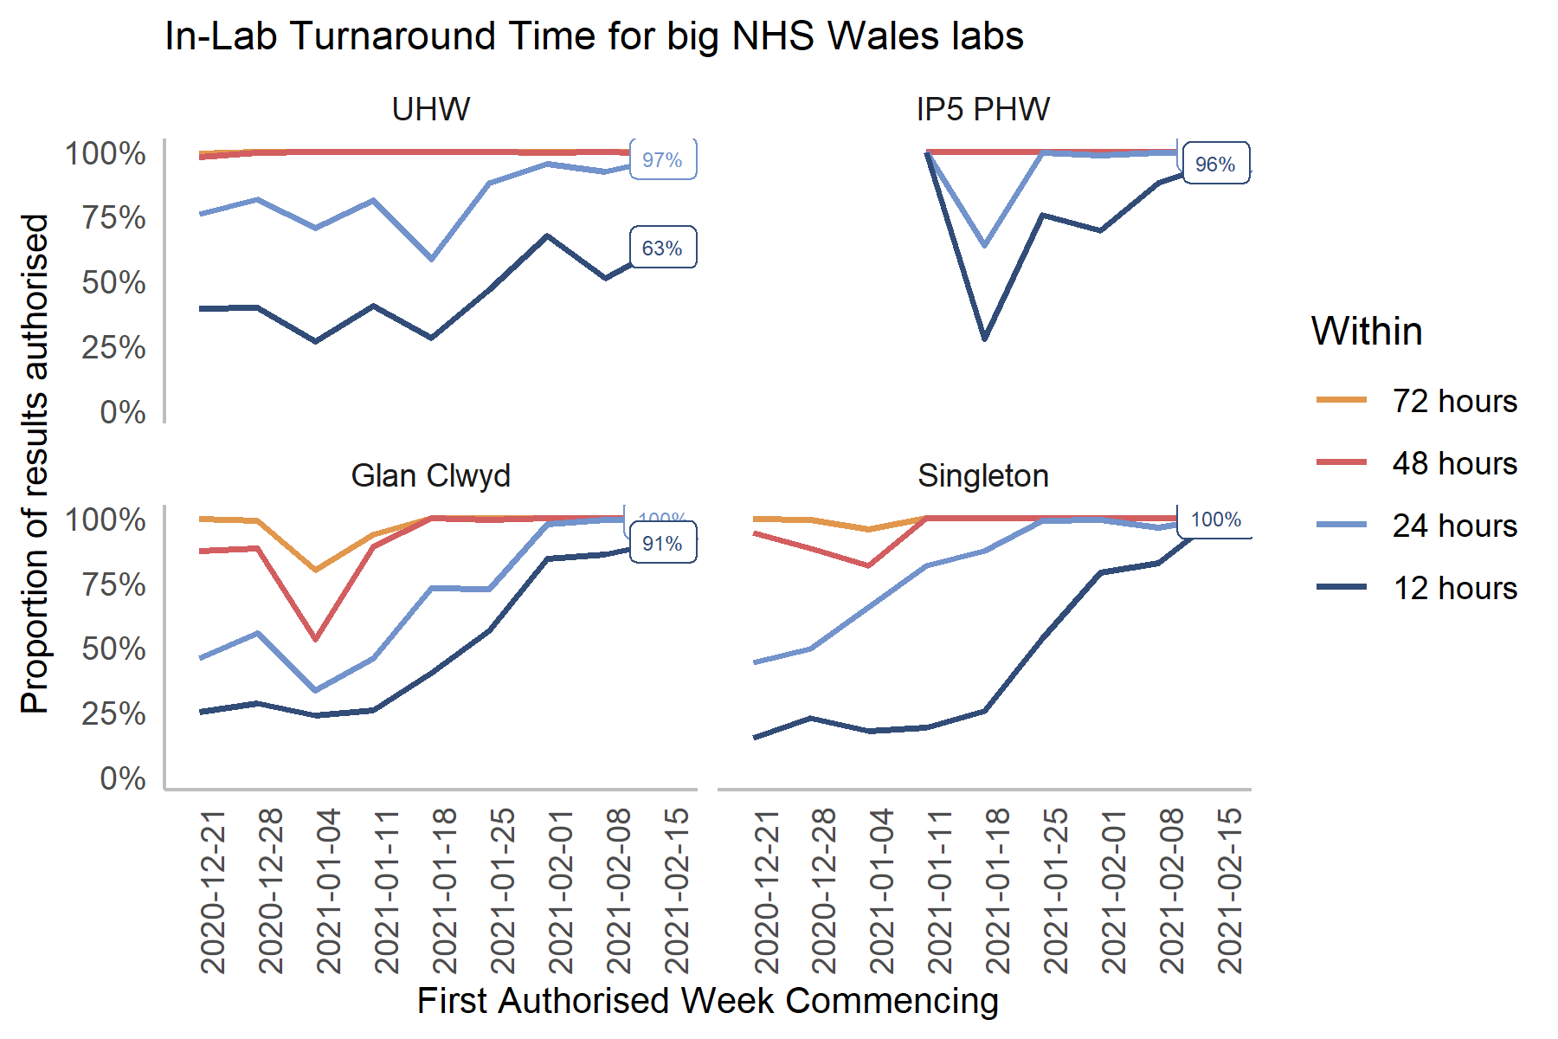
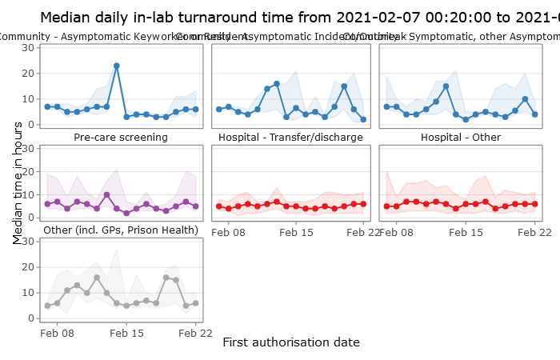

Slide 10
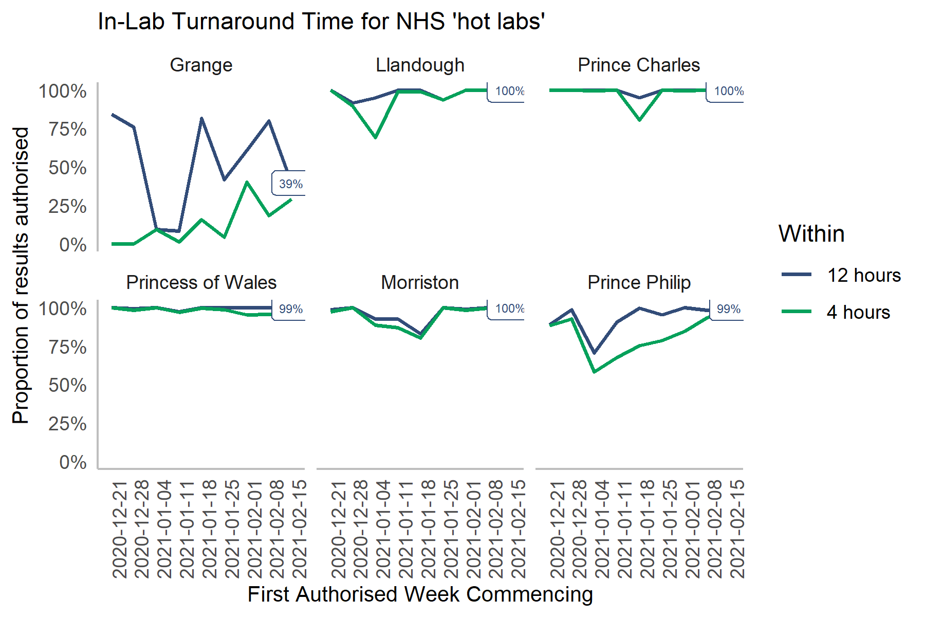

Slide 11
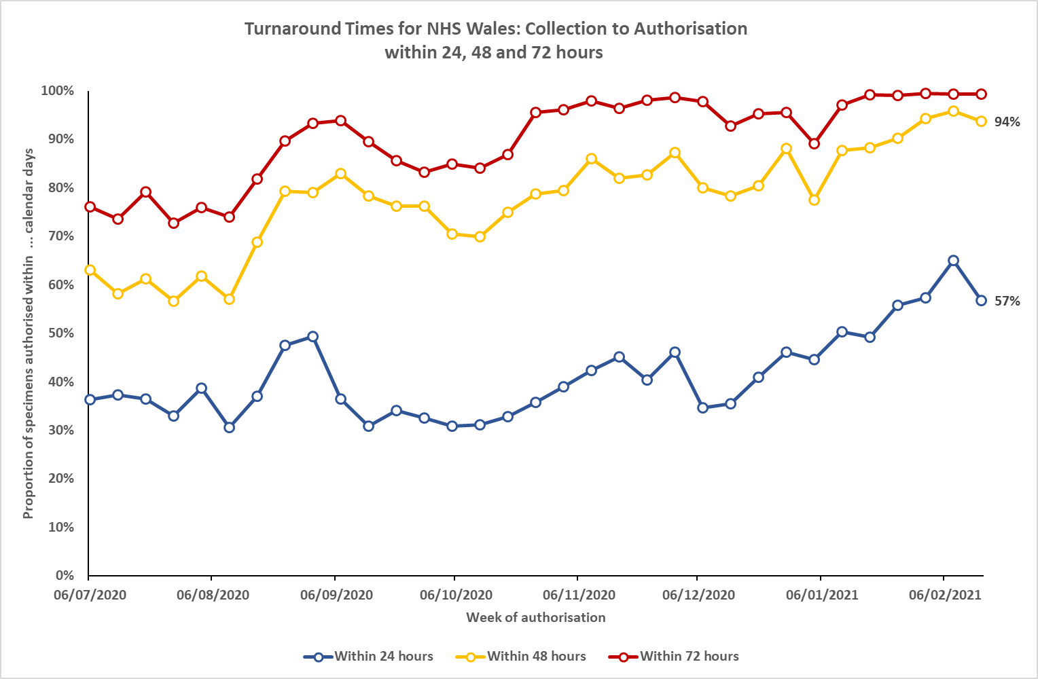

Slide 12
Summary
Significant evidence of improvement across the laboratory system
On-going work to further improve in-lab process
Significant need for focus on pre-lab process
Working with Health Boards
Working with TTP

