Slide 1
Integrated Governance Model
Rhiannon Beaumont-Wood, Executive Director of Quality, Nursing and Allied Health Professionals
Stuart Silcox, Assistant Director, Integrated Governance
Eleanor Higgins, Integrated Governance Manager
Sharon Twine, Integrated Governance Manager
25 February 2021

Slide 2

Integrated Governance – a definition
“Integrated governance is defined as a holistic approach undertaken by a governing body, supported by management and staff, to integrate governance into an organisation’s drivers for sustainable success.”
(Adapted from the Institution for Financial Accountants)
Integrated Governance Model - February 2021 | page 2

Slide 3
Why do we need Integrated Governance?
2018/19 reorganisation and creation of Integrated Governance team
Continuing expansion of Public Health Wales workforce
Strong Board governance - scope to improve integration of governance elements and their understanding across the organisation for the benefit of staff
An Integrated Governance model will help us to improve the following:
Clinical, operational, financial and risk management processes and their inter-relationships
Promote conduct of business in compliance with regulations and strategic objectives of Public Health Wales
Enable staff to relate their role and responsibilities to integrated governance
Help staff answer questions eg. “Why are we doing this?” and “Who do we need to tell about this?”
Develop sustainable governance to help respond to emerging strengths, weaknesses, opportunities and threats
Integrated Governance Model - February 2021 | page 3

Slide 4
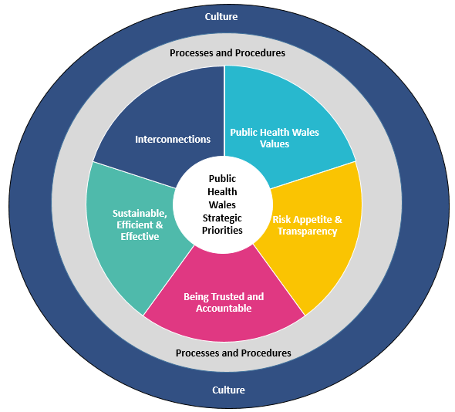
Public Health Wales Integrated Governance Model
PHW is starting from a position of strength, eg financial governance:
Audit Wales Structured Assessment 2020 – assessment of managing financial resources
[WAO] found that the Trust’s arrangements for managing financial resources are working well
[Public Health Wales] continues to meet its financial duties but achieving financial balance in 2020-21 assumes additional funding will be made available to cover the ongoing cost of responding to COVID-19
[Public Health Wales] continues to have strong financial controls and did not need to make significant changes to adapt to COVID-19
Does this link holistically with for example workforce planning or objective setting consistently across the organisation?
Adapted from the ACCA Culture-Governance Tool
Integrated Governance Model - February 2021 | page 4

Slide 5
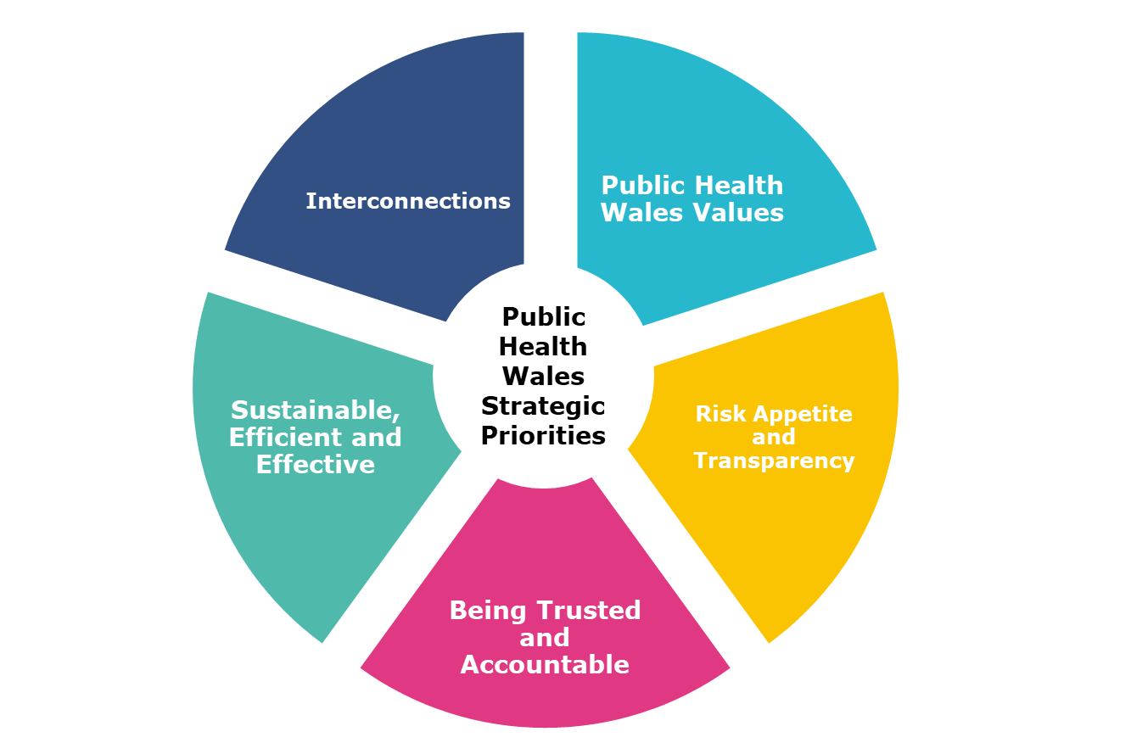
What does good look like - corporate governance
Defined organisation structure; stakeholder engagement eg. Welsh Government, health boards; feedback mechanisms; strategic and operational decision making/reporting groups; Well-being of Future Generations Act; involvement and collaboration
People Strategy; embedded PHW values; performance dashboard; directorate governance arrangements; staff commitment
Internal and external stakeholder engagement; feedback mechanisms eg. Welsh Government JET meeting; performance dashboard; Well-being of Future Generations Act
Decision making structure and delegation of authority; Strategic Risk Register / Corporate Risk Register / Directorate Risk Registers; Board and Committee scrutiny; cascaded reporting; performance dashboard
If we are placing our staff at the core of the model, they all need to understand why and where they contribute.
Board / Committee / Executive team reporting structure; delegation of authority; internal control and relationship with external review agencies; feedback mechanisms; strategic and operational decision making/reporting groups
Integrated Governance Model - February 2021 | page 5

Slide 6
Current Public Health Wales Integrated Governance Infrastructure
Openness and transparency
Organisational values and behaviours
Centre: Elements of integrated governance
Middle ring: Existing architecture (how we do things) (hard)
Outer ring: Culture and relationships between people, teams, directorates and external stakeholders (the way we do things) (soft)
All elements are interdependent and supported by matrix communication across the organisation.
The Integrated Governance Model overarches the existing architecture and provides a consistent reference point.
Leadership and setting the strategic cultural context
External Assurance
Dashboard for performance measurement
Long term strategy/IMTP
Stakeholder communication & engagement
Board & Corporate governance
Research governance
Information governance
Financial governance
Quality & Clinical governance
Integrated Governance in PHW
Infrastructure (environment & IT)
Knowledge, Research & Information Committee
Policies and procedures
(systems and processes)
Board
Knowledge, Research & Information Committee
Values and People Strategy
Quality, Safety & Improvement Committee
Audit & Corporate Governance Committee
People & OD Committee
Quality and Improvement Strategy
Risk appetite/architecture
Culture of quality
Learning and continuous improvement
Integrated Governance Model - February 2021 | page 6

Slide 7
Our approach to implementation
Strengthen and further develop organisational culture
Capitalise on matrix working (COVID response)
Engagement with management and staff throughout the process
Discussion
Workshops
Reporting
Share learning
Owning the learning/improvements/benefits:
More efficient, effective and consistent ways of working
Understanding how roles contribute to operational and strategic objectives
Greater understanding of integrated governance, internal controls and assurance
Integrated Governance Model - February 2021 | page7

Slide 8
Next steps
Three pilot assessments will be undertaken:
Topic-based assessment
Information governance focus
Include organisational learning from the surveillance data breach
Setting-based assessment
Select one screening programme to assess against the model
COVID-19 response
Improvement measures will be developed from each assessment.
Findings from the three pilots will be reported to BET & Board and will inform recommendations for wider organisational application through the Integrated Governance Implementation Plan.
Highlight the practical improvements identified to ways of working in the pilot areas with learning applied across PHW.
A Communications Plan will be developed to raise awareness and gain support for this approach across PHW.
Integrated Governance Model - February 2021 | page 8

